Slide 1

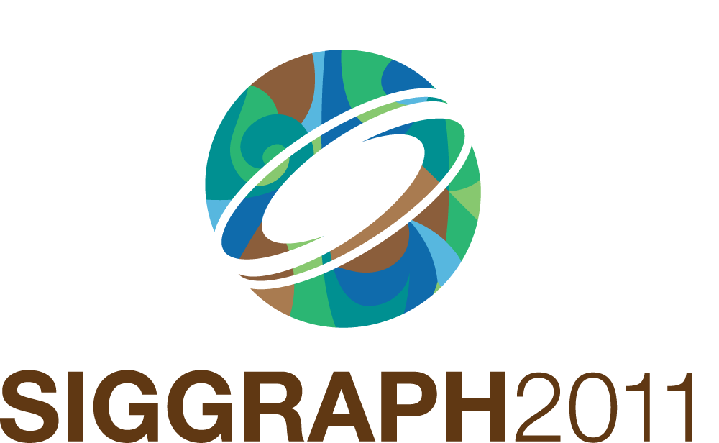

Slide 2


Global Registration of Dynamic Range Scans for Articulated Model Reconstruction
Will Chang Matthias Zwicker
UC San Diego University of Bern

Slide 3
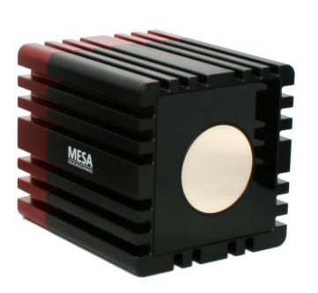
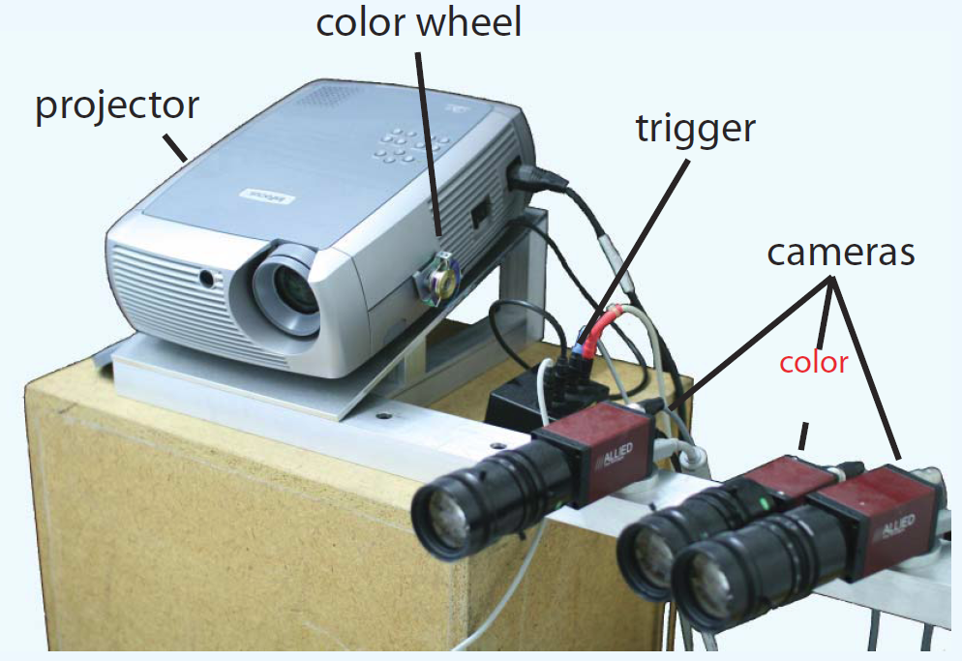
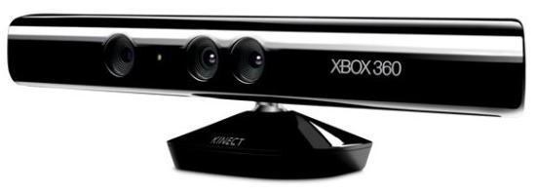
Introduction
Scanning real-world, moving subjects
Reconstruct surface + deformation model → new animations
Recent hardware advances
Microsoft Kinect
Real-time depth camera
Structured light via
random IR dot pattern
SwissRanger SR4000 real-time scanner (2008)
Time-of-flight
Real-time 3D scanner
(Weise et al. 2007)
Structured light
Notes:
The problem that I’ll talk about is scanning a 3d model of a real-world subject
In particular, a moving subject
Using dynamic range scans as input,
Our goal is to both reconstruct a complete 3d surface, and also acquire a model of its motion.
The result could then be used to easily create new animations of the captured subject
This data is now easily acquired by recent advances in hardware
Now a number of things are available
Including TOF, visible structured light, and invisible IR structured light.

Slide 4
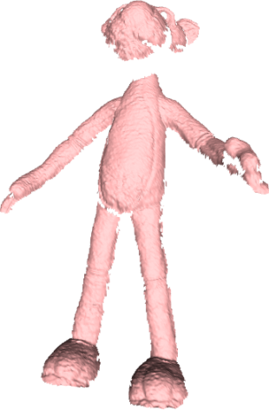
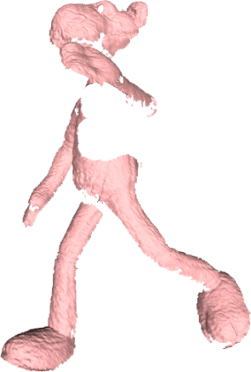
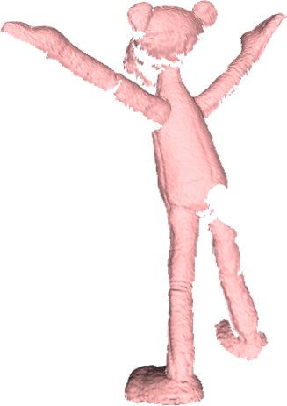
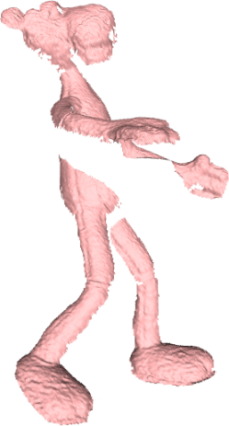
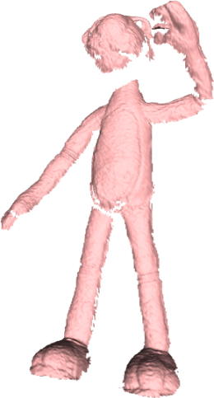
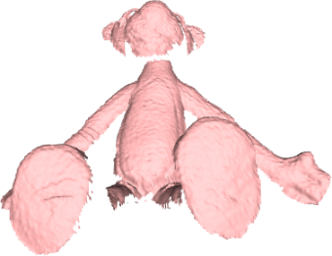
Challenges
Infer correspondence
Moving subject: determine motion
Assume no prior knowledge
Example scan sequence
Notes:
Many challenges to create a 3d model from multiple scans
The fundamental problem is that one camera viewpoint isn’t enough to see the entire surface, so there’s usually a lot of missing data.
So we need to align multiple scans. Camera does not provide correspondence between scans
We need to infer correspondences → Requires determining motion and compensating for it
Many recent work make it more tractable by assuming a there’s template or markers
We focus on a different problem statement: we don’t assume that a template or markers is given. We focus on solving a more general statement of the problem where we don’t assume any prior knowledge.

Slide 5
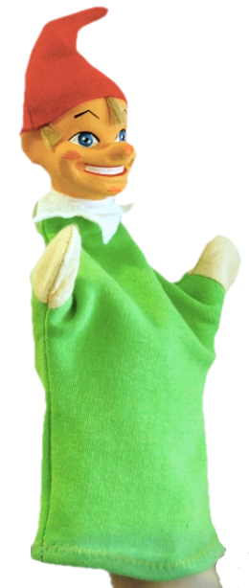
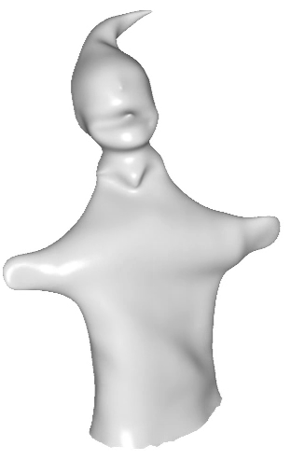
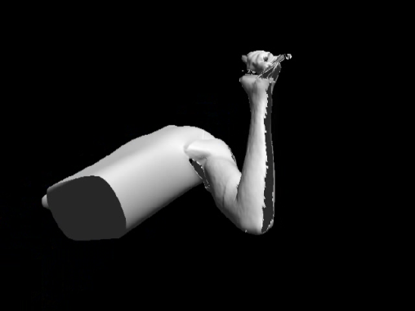
Previous Work
Template-based registration
Rough approx. of scanned surface
Template warping for hole-filling [Allen et al. 2002]
Scanned subject
[Allen et al. 2002]
Template
[Li et al. 2009]
Notes:
The recent work that use a template, means that they use a complete 3d model of the subject similar to what you are scanning
Allen: warping: Template model is very close to scans to begin with, vertex optimization to pull template to scans

Slide 6
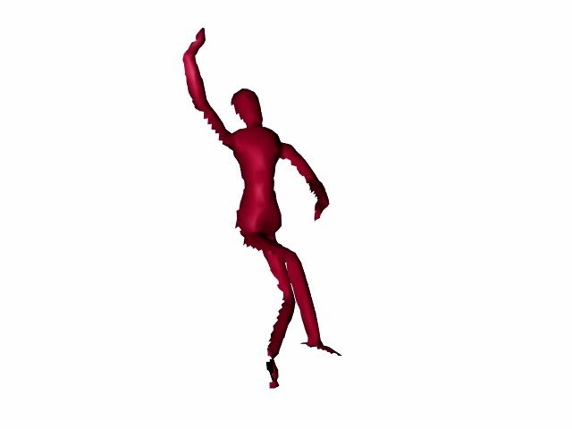
Previous Work
Template-based registration
Rough approx. of scanned surface
Template warping for hole-filling [Allen et al. 2002]
Discrete correspondence optimization [Anguelov et al. 2004]
[Anguelov et al. 2004]
Notes:
Anguelov: discrete optimization: pairwise registration that works with completely different poses

Slide 7
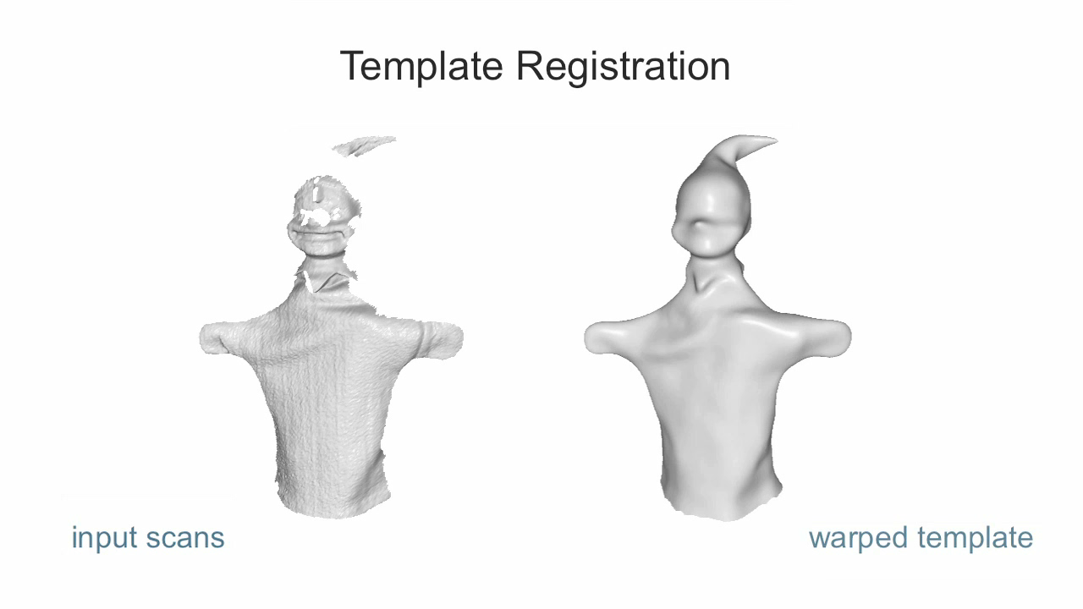
Previous Work
Template-based registration
Rough approx. of scanned surface
Template warping for hole-filling [Allen et al. 2002]
Discrete correspondence optimization [Anguelov et al. 2004]
Coarse template registration [Li et al. 2009]
[Li et al. 2009]
Notes:
Li: start with a coarse template, tracks the scans by a non-rigid fit of the template to each scan
Followed by a detail synthesis to reproduce scan detail

Slide 8
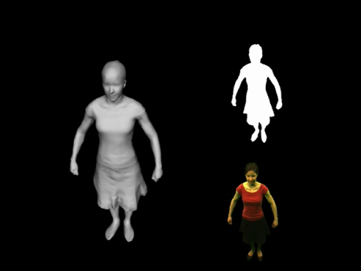
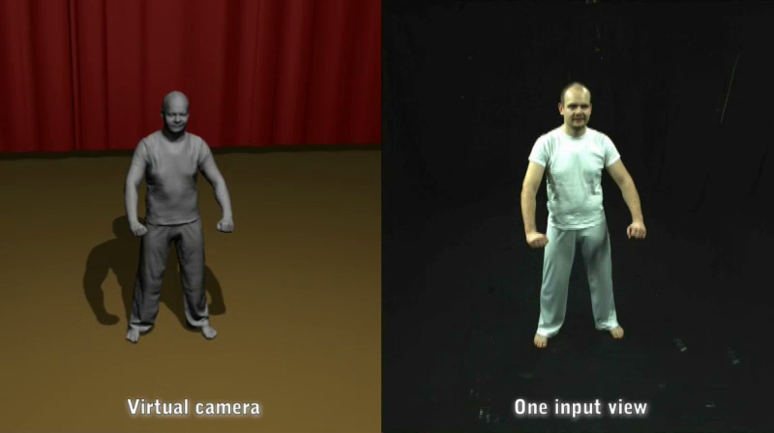
Previous Work
Performance capture using multi-view silhouettes
Fit template w/skeleton to visual hull [Vlasic et al. 2008]
Template fitting to silhouettes [deAguiar et al. 2008]
[Vlasic et al. 2008]
[deAguiar et al. 2008]
Notes:
The work that tracks based on multiview silhouettes give high quality results.
But most of the detail in the shape comes from highly detailed templates created by scanning the subject in advance.
Vlasic et al. fit a template that has a skeleton to the visual hull created by the silhouettes
deAguiar et al. is similar but uses mesh deformation (no skeleton)

Slide 9
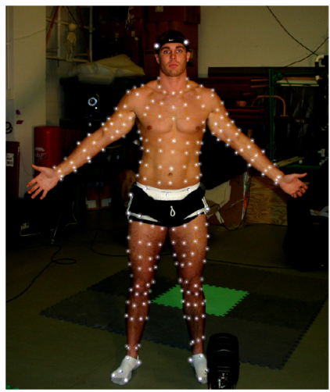
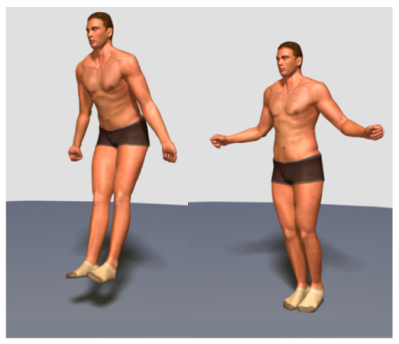
Previous Work
Marker-based capture
Capture human muscle deformation
[Park and Hodgins 2006]
[Park and Hodgins 2008]
Notes:
You can go around the correspondence problem using markers
But this gives high-quality results, such as the work by Park and Hodgins that capture muscle deformation.

Slide 10
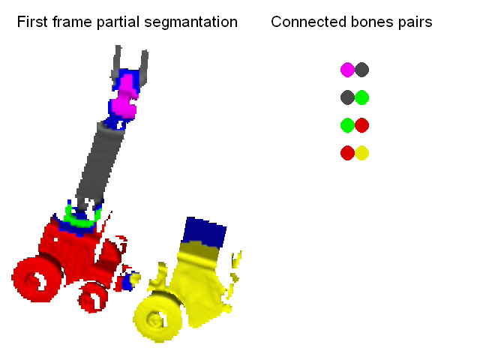
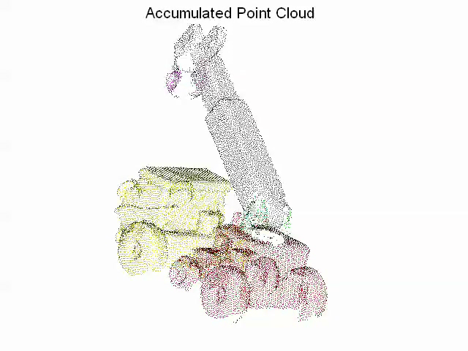
Previous Work
Reconstruction without template
User-specified segmentation [Pekelny and Gotsman 2009]
[Pekelny and Gotsman 2009]
Notes:
There is not much work that does not use a template or markers.
The work by Pekelny and Gostman reconstructs
articulated 3d model without prior knowledge, but the user needs to paint a segmentation for the first frame.

Slide 11
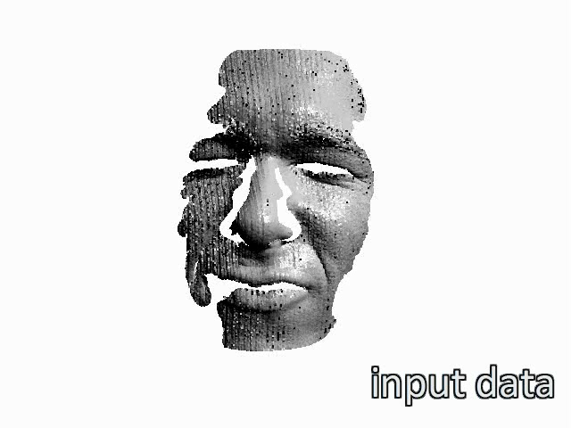
Previous Work
Reconstruction without template
User-specified segmentation [Pekelny and Gostman 2009]
High frame rate / little motion between frames [Wand et al. 2009]
[Wand et al. 2009]
Notes:
Wand et al Non-rigid registration
Successfully captures highly non-rigid deformations with high quality
Requires little motion between frames

Slide 12
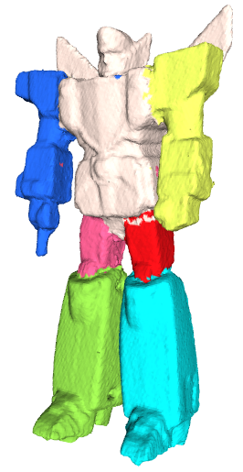
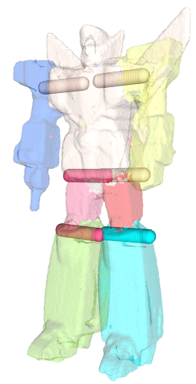
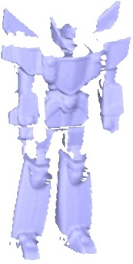
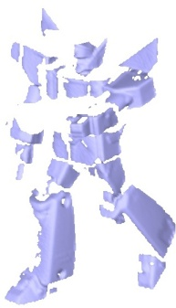
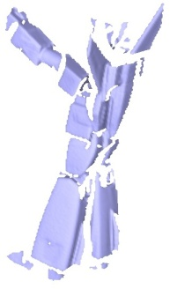
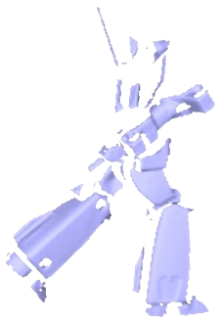
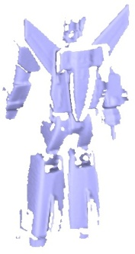
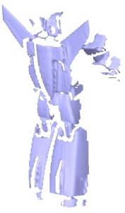
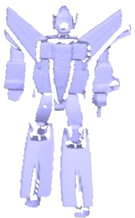
Our approach
Complete models from dynamic range scans
No template, markers, skeleton, segmentation
Articulated models
Use directly to create new animations
Input Range Scans
Reconstructed 3D Model
Notes:
Reconstructs complete models
No template, markers, skeleton, segmentation
But we assume that the movement of the subject is articulated.
Articulated means that we have moving piece-rigid components that are connected by joints

Slide 13
Features
Handles large, fast motion
Incomplete scans (holes, missing data)
Optimization over all scans
1 or 2 simultaneous viewpoints
Input Range Scans
Reconstructed 3D Model

Slide 14
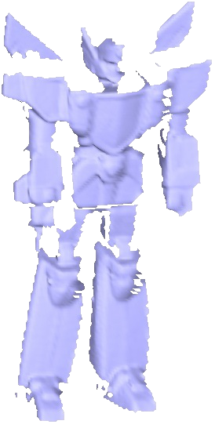
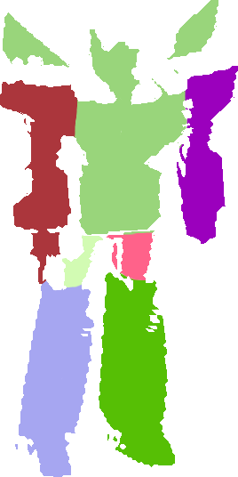
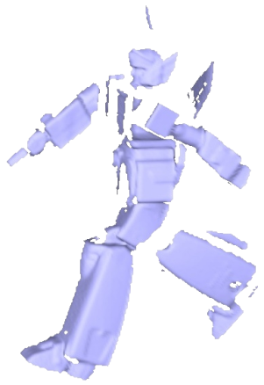
Reconstructing Articulated Models
For every frame, determine
Labeling into constituent parts (per-vertex)
Motion of each part into reference pose (per-label)
Solve simultaneously for labels, motion, joint constraints
Alignment
Unlabeled
Labeled
Labeled
Reference
Notes:
Aligning scans using an articulated model? What does it mean?
Articulated model = parts + movement of each part
Parts: labels per vertex that say which part does this belong to
Motion: Rigid transformation (rotation + translation) for each label
We formulate optimization that solves simultaneously for the labels and the motion and the joints so that the scans align
Note: we will now refer to the “parts” using the term “labels” (the two are interchangeable)

Slide 15
Algorithm Overview

Slide 16
Algorithm Overview
Initialization
Global refinement
Post-process
Initialization
Global Refinement
Post-process
Notes:
3 main steps

Slide 17




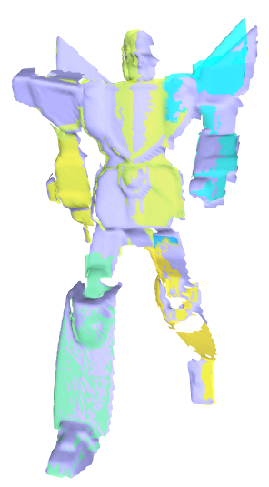
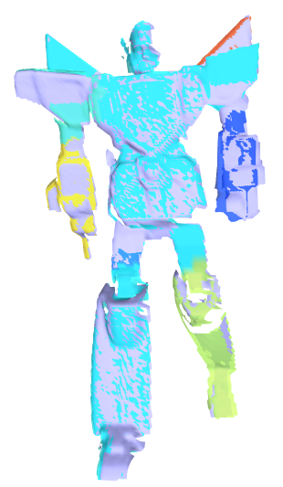
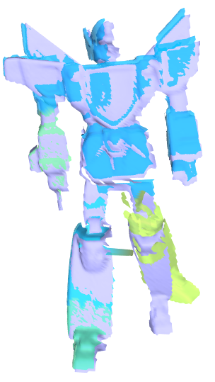
Algorithm Overview
Initialization
Coarse pairwise registration
. . .
Initialization
Labels (per-vertex) and Transformations (per-label) for a coarse registration
Notes:
Pairwise registration
Output: Labels per vertex and transformations per label

Slide 18
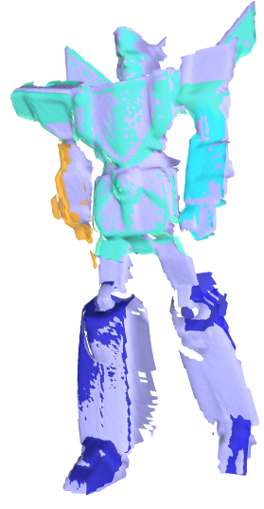
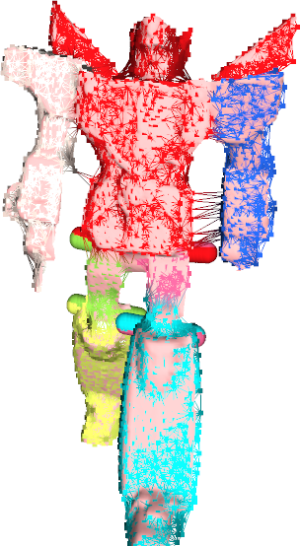
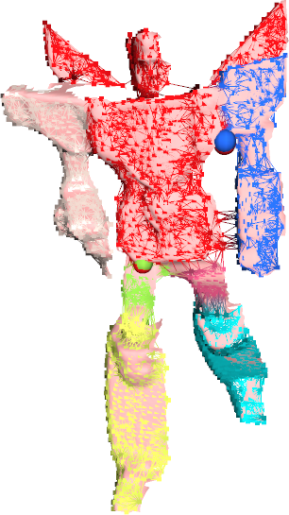
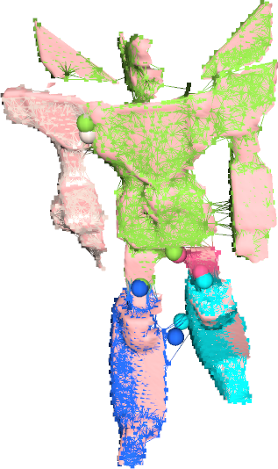
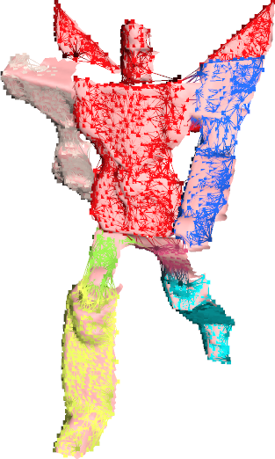
Algorithm Overview
Initialization
Coarse pairwise registration
Global refinement
Solve global model incorporating all frames
Initialized
Frames
Global Refinement
Optimized labels, motion, joints, and geometry
Notes:
Iteratively add each frame
The model is updated globally over all frames

Slide 19
Algorithm Overview
Initialization
Coarse pairwise registration
Global refinement
Solve global model incorporating all frames
Post-process
Gather frames, reconstruct mesh
Initialized
Frames
Global Refinement
Post-process
Notes:
After global alignment is complete, Post-process

Slide 20
Part I: Initialization

Slide 21
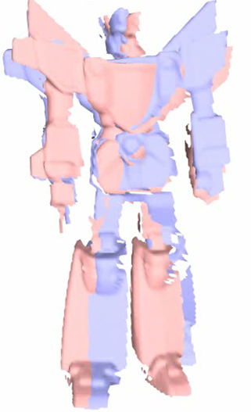
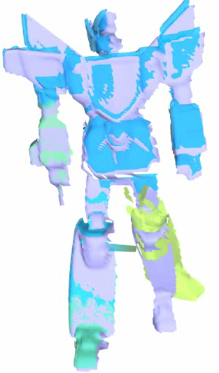
Initialization
Establish initial correspondence of consecutive frames
Frame i and i+1
Registered Result
Notes:
Goal of initialization is to establish initial correspondence between consecutive frames

Slide 22
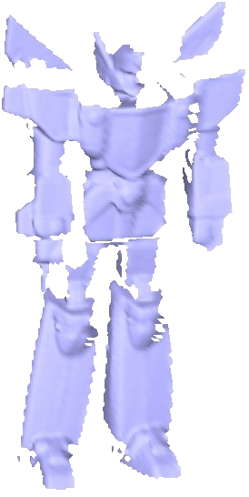
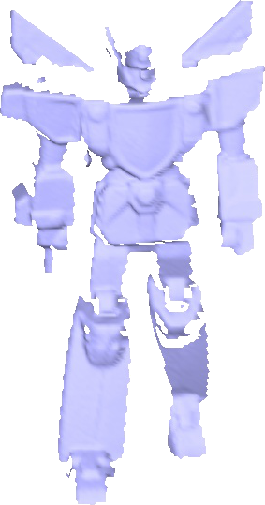
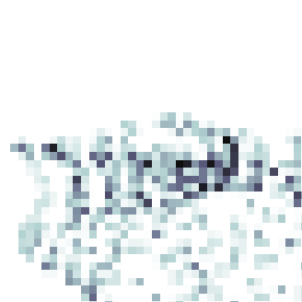

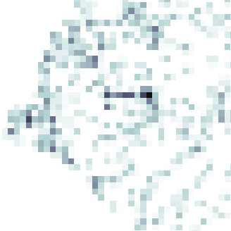



Initialization
Point correspondence using feature descriptors
Spin Image examples
Frame i
Frame i+1
Notes:
First we sample the points in each scan
For each scan we derive a feature descriptor value
The goal of feature descriptors is to find point-wise correspondences
In our work, we use Spin Images as the feature descriptor
Matching is not totally accurate → many-to-many correspondences

Slide 23
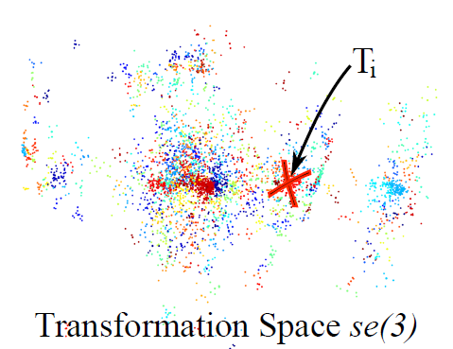
Initialization
Point correspondence using feature descriptors
Transformation (R,t) per correspondence
Cluster (R,t)
(R,t)
(R,t)
(R,t)
(R,t)
(R,t)
(R,t)
(R,t)
(R,t)
(R,t)
(R,t)
(R,t)
Transformation Space se(3)
Frame i
Frame i+1
Notes:
Each cluster forms one rigid part

Slide 24
Initialization
Point correspondence using feature descriptors
Transformation (R,t) per correspondence
Cluster (R,t)
Optimize using “Graph Cuts” [Boykov et al. 2001]
Which (R,t)?
Frame i
Frame i+1
Notes:
Optimization establishes one-to-one correspondences

Slide 25
Initialization
Point correspondence using feature descriptors
Transformation (R,t) per correspondence
Cluster (R,t)
Optimize using “Graph Cuts” [Boykov et al. 2001]
(R,t)₁
(R,t)₂
(R,t)₃
Frame i
Frame i+1
Notes:
Optimization establishes one-to-one correspondences

Slide 26
Initialization Result
Both Frames
Registered Result
Notes:
Color coding
Each color represents a unqiue transformation
Mesh is transformed according to the transformations assigned to its vertices
Registration not perfect
Good enough starting point for subsequent global alignment

Slide 27
Part II: Global Refinement

Slide 28
Global Refinement
Global refinement
Solve global model incorporating all frames
Initialized
Frames
Global Refinement
Optimized labels, motion, joints, and geometry
Notes:
Iteratively add each frame
The model is updated globally over all frames

Slide 29
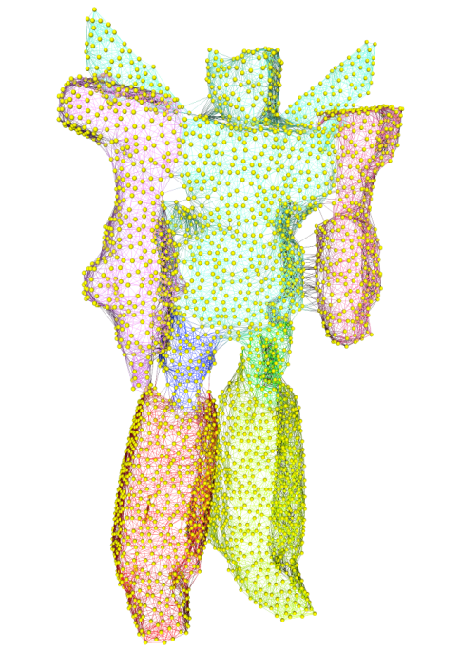

Dynamic Sample Graph (DSG)
Sparse representation
Increases efficiency
Joints: part connectivity
Continuously updating
Update samples from new surface data
Dynamic Sample
Graph (DSG)
Extracted
Joints
Notes:
The key data structure is the DSG
Sparsely represents the geometry and the labels
as we have accumulated over the processed frames
The DSG maximizes the efficiency of the optimization algorithm
→ Also updates the samples so that the entire surface seen so far is uniformly covered

Slide 30
Global Refinement
Fit the DSG to all scans simultaneously (Global Fit)
Alternating Optimization
Optimize Transformations
Optimize Labels
Update joint locations
Repeat until convergence
3-5 iterations per frame
Update samples
Global Fit
Dynamic Sample
Graph (DSG)
Input Scans
Notes:
Global fit: fit the DSG (label samples and deduce transformations for each label) to all frames we have processed so far
Main global refinement optimization proceeds in these steps...
Now we’ll explain further
Optimize Transformations
Optimize Labels

Slide 31


Transformation Optimization
Align DSG as closely as possible to all scans
Labels fixed
Measure alignment using closest point distance
Before
After
Notes:
A key insight is to formulate this to work well for aligning to multiple frames simultaneously.

Slide 32






Transformation Optimization
Multi-part, multi-frame articulated Iterative Closest Point (ICP)
Update closest point
Solve for transformation
Repeat until convergence
Gauss-Newton for non-linear least squares
(Converged)
Notes:
Our key main technical contribution is an algorithm to simultaneously optimize the alignment of multiple frames and multiple parts with joint constraints.
Find the closest point in each scan for each sample in the graph
Solve for the transformations in each part

Slide 33



Joint Constraint
Prevents parts from separating
Two types of joints
Ball Joints (3 DOF)
Hinge Joints (1 DOF)
Derived from part boundaries
Reconstructed Joints
Notes:
The joint constraints in our model are really important for the optimization to converge in the right solution.

Slide 34



Joint Constraint
No Joints
Ball Joints
Only
Ball and
Hinge Joints
Notes:
Leaving out the joint constraint fails to produce an accurate reconstruction

Slide 35


Label Optimization
Change the labels to produce better alignment
Transformations fixed
Measure alignment using closest point distance
Before
After

Slide 36
Label Optimization
Graph Cuts [Boykov et al. 2002]
Data constraint: minimize distance
Smoothness constraint: consolidate labels
Before
After

Slide 37
























Global Refinement: Step Through
Optimizing Transformations
Optimizing Transformations
Optimizing Weights
Optimizing Weights
C?
Update
Samples
Update
Samples
Add
next frame
Add
next frame
(Converged)

Slide 38

Global Refinement: Fast Forward

Slide 39

Post-processing
Gather all frames into reference pose
Resample surface, reconstruct mesh
Notes:
Once we have all scans on the reference frame
→ Resample and reconstruct

Slide 40
Results

Slide 41

Results: Registration
Intel Xeon 2.5 GHz
90 Frames
7 Parts
0.84 million points
5000 DSG samples
Total 165 mins
110 sec/frame
Notes:
Repeat: This is completely automatic
No template, markers, skeleton, segmentation.

Slide 42

Results: Registration
Intel Xeon 2.5 GHz
90 Frames
4 Parts
0.48 million points
2700 DSG samples
Total 66 mins
44 sec/frame

Slide 43

Results: Registration
Intel Xeon 2.5 GHz
40 Frames
10 Parts
2.4 million points
4000 DSG samples
Total 75 mins
113 sec/frame

Slide 44


Ground truth comparison
Red: Ground-truth
Blue: Reconstructed
Notes:
The setup: A rigged character with a walking animation
Obtained depth images from synthetic viewpoints
Goal was to see how well our reconstruction matches the original animation
On the right, we compare the reconstructed data with the original skeletal animation
The structure is automatically recovered, so it doesn’t have the same topology as the input

Slide 45

Results: Inverse Kinematics
Notes:
The main benefit of our method
Result can be used directly to create new animations
Such as this IK system

Slide 46

Limitations
Piecewise rigid approximation
Notes:
Our method identifies reasonable rigid parts
Nonetheless, our method could be used as a preprocess to a further step to model deformable surfaces

Slide 47




Limitations
Needs sufficient overlap
Frame i
Frame i+1
Frame i+2
Frame i+3
Notes:
Consecutive frames need to contain overlapping parts of the geometry, otherwise the initial registration fails
If we take out these two frames this front portion is completely occluded

Slide 48
Limitations
Needs sufficient overlap
Frame i
Frame i+1
Notes:
Consecutive frames need to contain overlapping parts of the geometry, otherwise the initial registration fails
If we take out these two frames this front portion is completely occluded

Slide 49
Conclusions
Articulated Global Registration
Contributions
Automatic registration algorithm for dynamic subjects
No template, markers, skeleton, or segmentation needed
Final result used directly to produce new animations
Input Range Scans
Reconstructed Poseable 3D Model
Notes:
Automatic registration algorithm for dynamic subjects
A key main technical contribution is an algorithm to simultaneously optimize the alignment of multiple frames and multiple parts with joint constraints.
It doesn’t require a template, markers, skeleton, or segmentation
The final result can be used to create new animations

Slide 50
Future Work
Add non-rigid motion
Reduce parameters
Real-time
Input Range Scans
Reconstructed Poseable 3D Model

Slide 51





Acknowledgements
Thank you for listening!
Michael Wand, Sam Buss, UCSD Graphics Lab, TOG Reviewers
Data: Y. Pekelny, C. Gotsman, T. Weise, O. Schall, P. Fong
Input Range Scans
Reconstructed Poseable 3D Model
Novel Poses

Slide 53
Additional Comparisons

Slide 54

Sliding window comparison

Slide 55

Local vs. global comparison

