Slide 1
Developing a Formative Assessment of Instruction for the Foundations of Computing Stream
2013/04/24
Steve Wolfman
UBC CS
Acknowledgments: Help, data, and input from many faculty and students at UBC.
Notes:
Talk notes:
- do people compartmentalize knowledge (a la constructivist learning theory) into "test"/"common sense" belief categories? which will you access? which do you want to access?
Jim Minstrel: first question about concept (i.e., the "answer"); then reason why question. FACETs work from Jim also.
"Threshold concepts" (from Jennifer): concepts where if you don't get that, it's hard to get the ones after.
Techniques for discovering what students (mis)understand, why they all stink individually, and some examples from our Foundations of Computing sequence
ABSTRACT: Pedagogy is changing quickly in CS and apparently for the better, but how do we know how it affects students' understanding of core concepts and skills? Science education assessment in several disciplines has benefitted from simple, broadly usable tools like the Force Concept Inventory. In this talk, I'll discuss my ongoing work identifying and studying core concepts in UBC's "Foundations of Computing" (FoC) sequence--AKA the required undergraduate "theory" courses--and developing from this a short multiple-choice assessment instrument. I will discuss the ideal end product, describe the methodology I am using, and present preliminary results from student and instructor interviews on FoC topics that are broadly accepted as important.

Slide 2
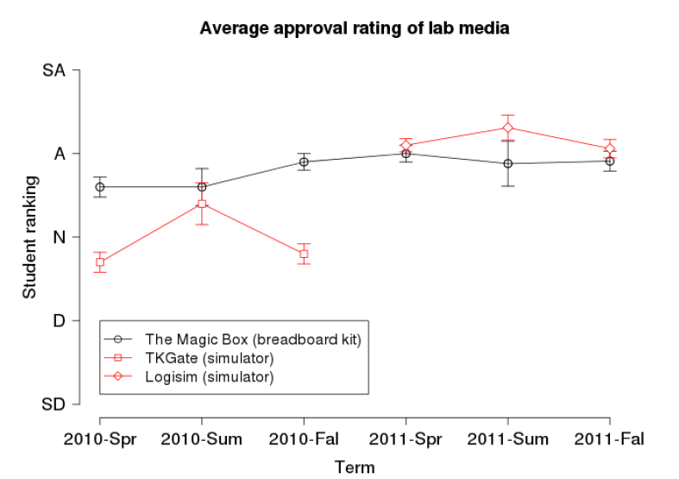
Inspiration
From Patitsas and Wolfman, SIGCSE 2012
From Mazur, Int’l Newsletter on Physics Ed, Apr 1996
Notes:
Mazur: http://www.physics.umd.edu/icpe/newsletters/n32.htm

Slide 3
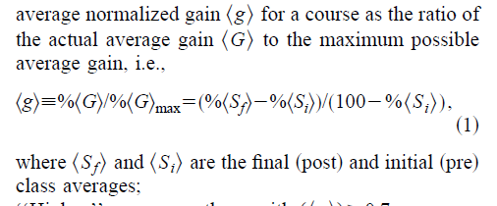
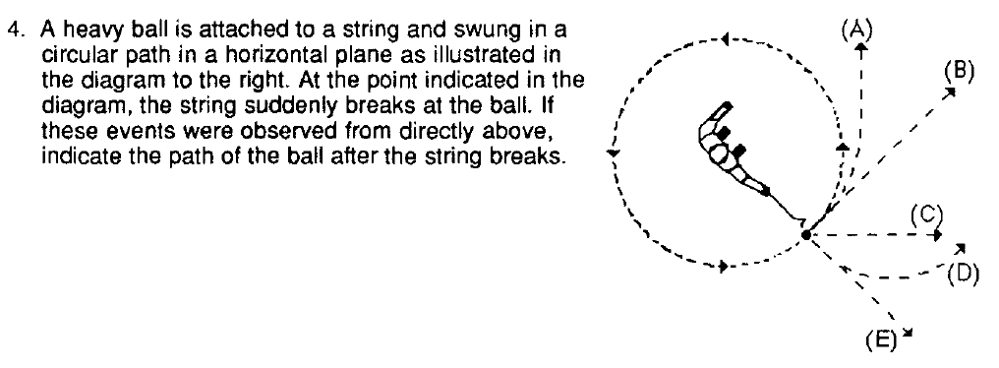
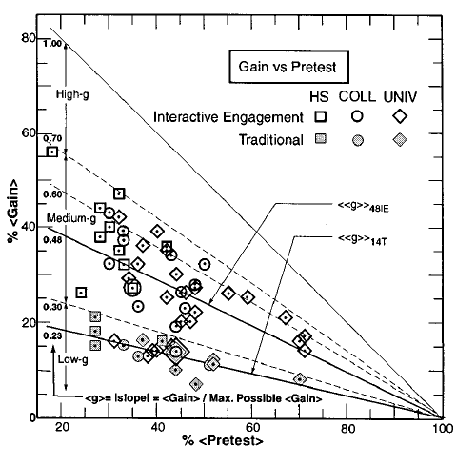
“Role Model”
From Hestenes, Wells, and Swackhamer, Physics Teacher Mar 1992
From Hake, Am. Journal of Physics Jan 1998
Notes:
Hestenes, Wells, and Swackhamer: http://cird.unive.it/dspace/bitstream/123456789/317/2/Forced_concept_inventory.pdf
Hake: http://web.mit.edu/rsi/www/2005/misc/minipaper/papers/Hake.pdf

Slide 4
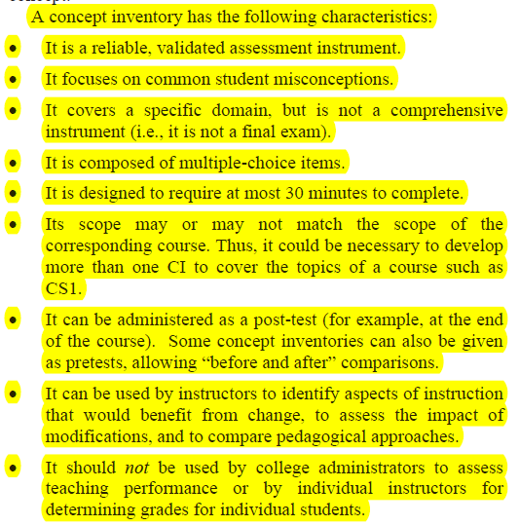
Ideal Goal
A sustainable assessment to serve as a “thermometer” for health of the course sequence.
What makes it sustainable? Let’s look at the FCI:
29 multiple choice Qs and takes 23.3 minutes
Founded on previous and ongoing research on misconceptions in physics
Focuses on a few key topics
Deliverable on paper (if needed!)
From Almstrum et al., ITICSE 2006
Notes:
Cautionary note: Do students have preconceptions, physically-based notions of FoC concepts? Are they clean slates?

Slide 5
Outline
Motivation, Inspiration, Role Model, & Ideal Goal
Idealized Methodology
Practical Methodology
Goals: From Grand to Assessable
Exams: A Lesson in Quality
Post Hoc Analysis: Mystery of the Student Mind
Interviews: Hard-Won Gems + Prior Work: Easy-Won Gems ☺
Discussion
Notes:
Practical Methodology comment: In theory, theory and practice are the same. In practice, they differ.

Slide 6
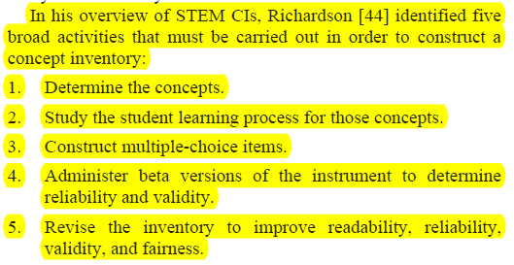
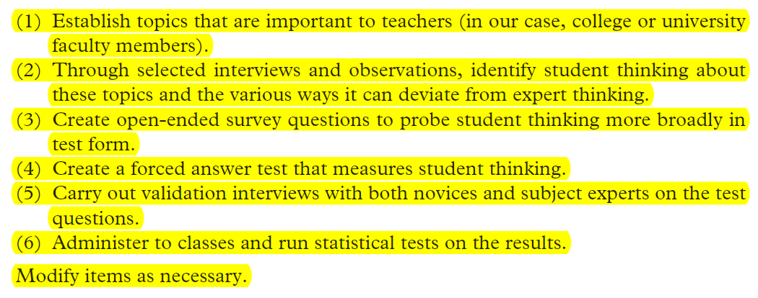
Idealized Methodology
Gather goals by interviewing faculty involved in the stream
Augment & winnow goals by analysis of exam results
Draft questions to assess key goals
Validate expert responses to questions
Collect student misconceptions in think-aloud interviews
Formulate forced-answer versions of Qs based on student responses
Validate forced-answer Qs in think-aloud interviews
Pilot assessment, confirming reliability and validity
General use for assessment of courses, longitudinal analysis, etc.
From Almstrum et al., ITICSE 2006
From Adams and Wieman, Int’l Journal of Science Ed 2010
Notes:
Adams-Wieman_FASI_IJSE2010
iticse-2006-working-group-concept-inventory-why-to-how-to-MUST-READ-p132-almstrum

Slide 7
Outline
Motivation, Inspiration, Role Model, & Ideal Goal
Idealized Methodology
Practical Methodology
Goals: From Grand to Assessable
Exams: A Lesson in Quality
Post Hoc Analysis: Mystery of the Student Mind
Interviews: Hard-Won Gems + Prior Work: Easy-Won Gems ☺
Discussion
Notes:
Practical Methodology comment: In theory, theory and practice are the same. In practice, they differ.

Slide 8
Grand Goals
How do we assess these??
What are the key learning goals for the Foundations of Computing stream?
Recursive/inductive thinking
Analysis of resource (time, space, energy, …) costs of solutions
Formalization/specification of ill-specified problems
Comfort with “dense” formal descriptions
Proposal and explanation of multiple solution approaches to a problem
Meta-cognitive management of the solution process
Generalizing/abstracting problems/sol’n properties
Notes:
Interviews (analysed) w/10 of the 14 faculty who taught the "foundations of computing" stream courses in the past three years.
Ask them how to assess these. Ask them how to assess these in a closed-ended MC format.
Notes on successful/unsuccessful instructor interviews:
The trouble in my least productive interview was that the instructor and I enjoy chewing over big, philosophical issues. That's a fabulous and important pastime, but the point of these interviews was really to get the concrete specifics to form an assessment that can fuel that pastime, not to engage in it.
The best part of the interview was the moment when, looking at an old exam problem, the instructor pointed out a problem students faced with a simple question (determining whether a node is in the left subtree/right subtree of an ancestor or, more likely, determining that it's important and recognizing it). This is a moment fueled by a specific observation of a difficulty students had and a theory as to why in the context of a very concrete problem.
Again, this reinforces the trouble we both had, because we'd often dismiss problems where students did badly by, basically, saying "sure, I'd probably do badly there as well". *BUT*, it's not clear that the students were doing badly for the reasons we imagined. We were too focused on the high level and not sufficiently focused on what the data were telling us.
Conversely, in two of my most productive interviews, the instructors had a broad set of example problems on hand that they could use to fuel discussion in a very concrete way. This led to a laundry list of issues tightly coupled with example problems that might probe these issues.
Moral of the story: Try to get people to look through an old exam or two *before* you see them!
The LiveScribe pen was extremely useful. I didn't actually heavily use my written notes except to orient myself while relistening, but I /did/ love using the high-speed playback. It made it so I could actually finish reviewing my nine interviews in a single day!

Slide 9
Getting Assessable Goals Instead
“Think about times when you cringe inside because your students just don’t get something that seems very important to you, and which you expect any expert to get.”
+
Quick review of low-/mid-/high-scoring exams.
Notes:
Here’s a history of (some of the) prompts used in my second round of instructor interviews.
PB: I think the best way to describe what I'm looking for is places where you sort of feel like you want to cringe because you keep seeing students doing something that feels non-expert, feels naive to you on some important problems.
AH: What are things that students have trouble with that make you cringe? Places where you feel like this is really important, an expert knows how to do this and does it very differently from the way that students are doing it.
EK: What is it that you find cringe-worthy that students have trouble with, where their thinking is very non-expert-like but you'd expect them to get it?
MA: What are the times when you kind of cringe inside because your students just DON'T get something that seems very very important to you, where their thinking is just not expert?
WE: [No opening Q; instead, worked from areas of difficulty on recent exams, which was great.]

Slide 10
Assessable Goals?
Induction (6/2/-1): “should be able to do .. themselves from scratch without requiring additional input”
Divide & Conquer/Recurrences/Dynamic Programming (4/0/-3): “express the solution to a problem in terms of subproblems”
Logarithmic Tree Height (3/0/-0): “How many times can I give away half my apples before being left with just one?”
…
Notes:
Mention how much agreement I had.

Slide 11
Outline
Motivation, Inspiration, Role Model, & Ideal Goal
Idealized Methodology
Practical Methodology
Goals: From Grand to Assessable
Exams: A Lesson in Quality
Post Hoc Analysis: Mystery of the Student Mind
Interviews: Hard-Won Gems + Prior Work: Easy-Won Gems ☺
Discussion
Notes:
Practical Methodology comment: In theory, theory and practice are the same. In practice, they differ.

Slide 12
Exam Analysis (200+ problems, 16 exams)
Mean on problem: 32.3%
Problem value: 12/80
Adjusted problem value: ¹/₁₆
Adjusted exam mean: 70.6%
Adjusted exam stdev: 14.5%
Relative hardness: -2.67 stdevs
Correlation: 37.5%
(note: correlation req’s per-student scores)
Notes:
Example problem analysed.

Slide 13
Outline
Motivation, Inspiration, Role Model, & Ideal Goal
Idealized Methodology
Practical Methodology
Goals: From Grand to Assessable
Exams: A Lesson in Quality
Post Hoc Analysis: Mystery of the Student Mind
Interviews: Hard-Won Gems + Prior Work: Easy-Won Gems ☺
Discussion
Notes:
Practical Methodology comment: In theory, theory and practice are the same. In practice, they differ.

Slide 15
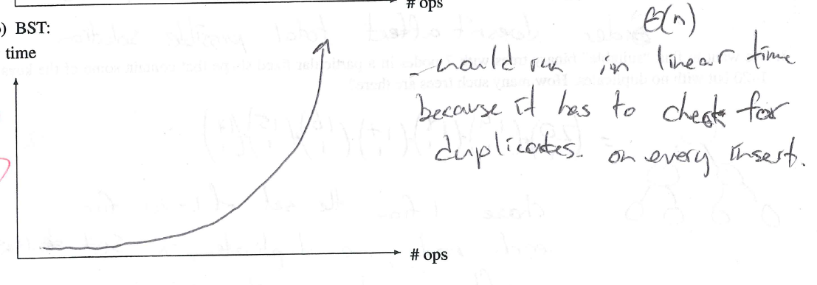
Notes:
What we might like to see in a solution.

Slide 16
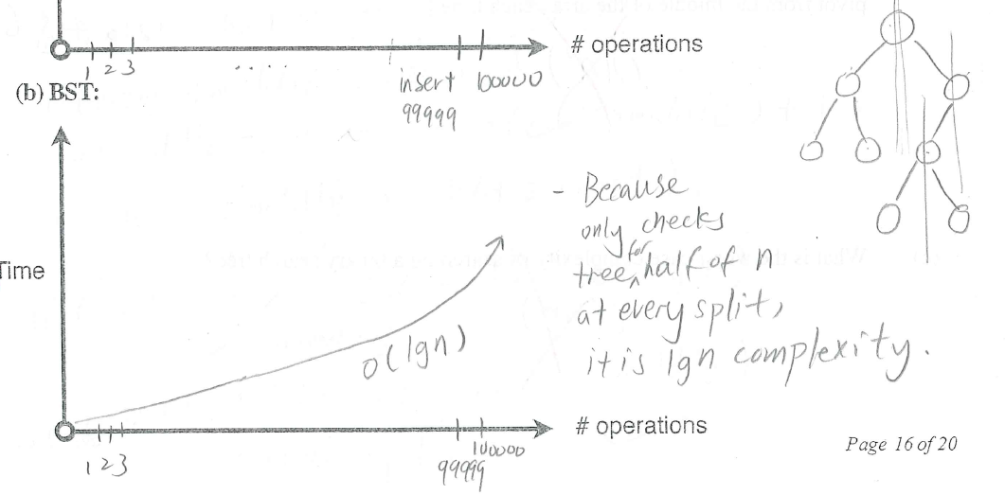

Slide 17
Notes:
“WISHFUL THINKING” (from an assessment design perspective) and then reality:
Wishful thinking: students don’t understand that a structure that is superficially formed like a linked list does not necessarily have the behaviour of a linked list.
Reality: I have no idea if this student instead believed they were working with a Splay Tree, a data structure we didn’t teach but did use as a “learn a bit about a data structure on your own” example in an assignment.

Slide 18
Notes:
Does this student have the misconception that the “n” in our asymptotic analysis is the key value inserted? (Of course, almost none of our students probably have a good understanding that the bottom-line n is the number of bits used to represent the input.)
Or, perhaps they misread “# ops” to mean “operation number”?
What did the rest of this students’ graphs tell us? They were all in “reverse order”. Bizarrely, the unsorted linked list got O(n^2) as its behaviour; the hash table O(n lg n). Does this student just have no idea? Tempting, but the student wrote this down for some reason, and we don’t know what.

Slide 21
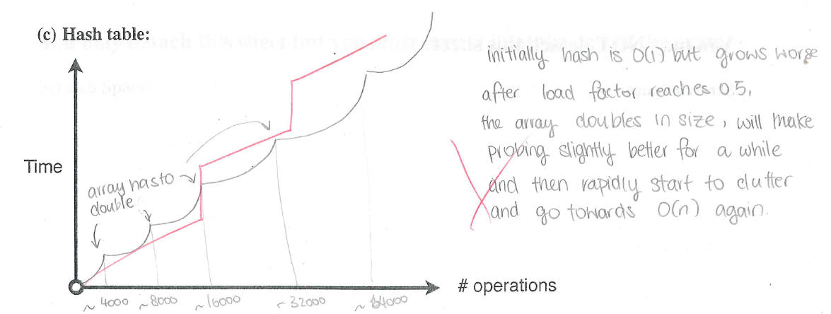
Notes:
This “scallop” is an extremely common pattern for the class that did not spend assignment time viewing graphs of resizing hash table performance.
The obvious interpretation is that students believe the hash table resize is quick, and they both fail to perform the reasoning that tells them that collisions do not occur and overestimate the likely impact of collisions on practical performance of a half-full hash table with linear probing.
Is this really true?
Does this mean they believe the resize takes no (or very little) time? Does it mean they believe that collisions are quite expensive? Do they not understand that this particular case has no collisions? (Ignoring the students who, perhaps, believed they were making general comments due to O(lg n) or O(n lg n) answers on the previous question, we still get 29% of students exaggerating the cost of collisions (and more who believe collisions have at least some cost) compared to 37% of the group as a whole or 45% of the non-logarithmic crowd.)

Slide 22
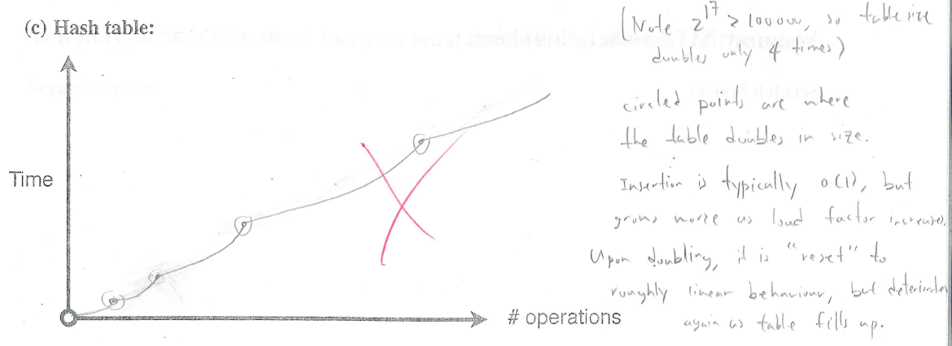
Why “zero cost” resizes? Didn’t count as one of the operations? Just overlooked?

Slide 23
Why “zero cost” resizes? Internally consistent reason for cheap resize?

Slide 24
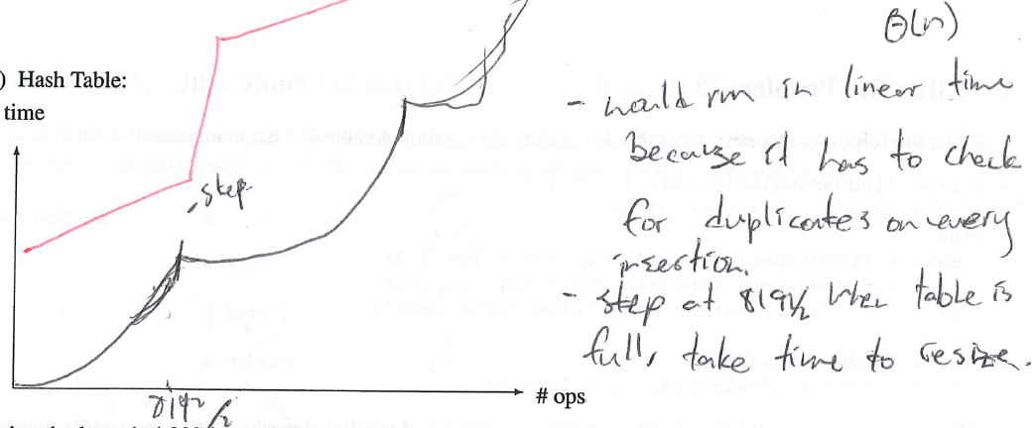
Why “zero cost” resizes? Buried in exaggerated collision cost?

Slide 25
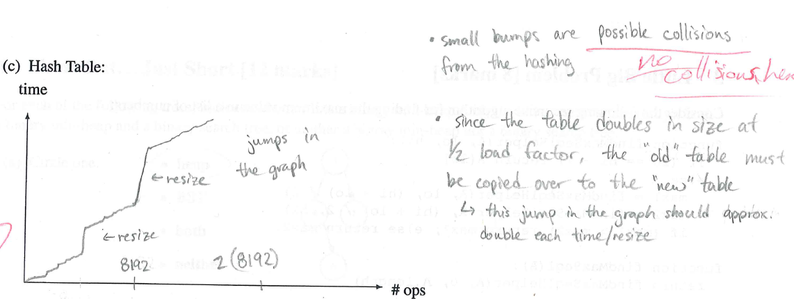
Why exaggerated collision cost? Same sorts of questions…

Slide 26
Outline
Motivation, Inspiration, Role Model, & Ideal Goal
Idealized Methodology
Practical Methodology
Goals: From Grand to Assessable
Exams: A Lesson in Quality
Post Hoc Analysis: Mystery of the Student Mind
Interviews: Hard-Won Gems + Prior Work: Easy-Won Gems ☺
Discussion
Notes:
Practical Methodology comment: In theory, theory and practice are the same. In practice, they differ.

Slide 27
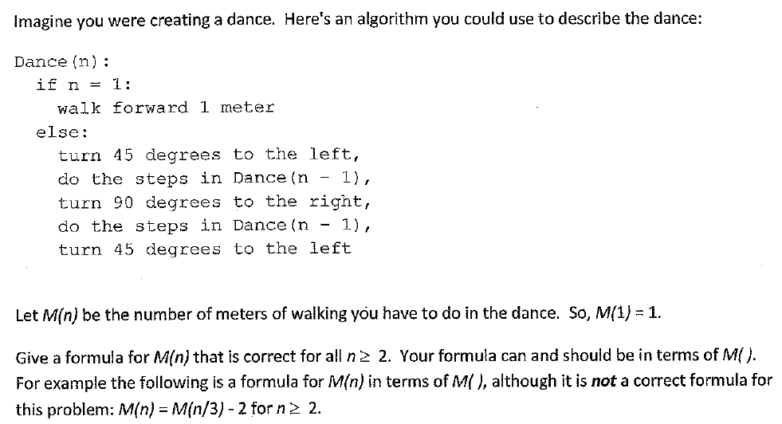

Slide 28
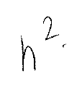
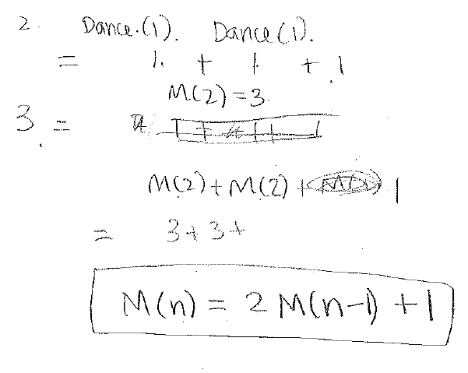
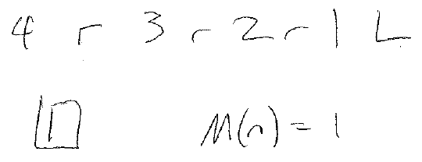
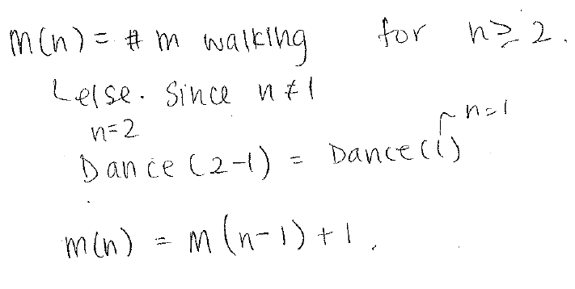
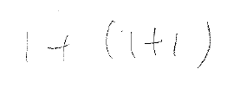
4, 221 CIP
5, 320 CIP
#1: “We first do one step, then M(n-1) steps…”
(320 CIP)
9, completed 121; 221 CIP?? 121 grade?
15, 121 CIP (1/2 way)
7, completed 121; 221 CIP?? 121 grade?
“If I’m correct, it would always be reduced to 1 ultimately. Since it’s just Dance(n-1) and then it’s just turning not really moving… and that wouldn’t affect …. the number of metres that I’ve walked.”
“When it's 3, ... it will be M(2) + M(2) + M(1) ... That would be 3 + 3 + 1?”
19, 121 CIP (1/2 way)
“Starting at 4, you.. Do 4, turn right, do 3, turn right, do 2, turn right, walk forward 1 m, turn left.” “So only at one point will I do 1, that’s when you walk forward. So M(n) = 1.”
Notes:
Note: of first 14, 3 suffer the “+1” misconception with 1 giving final answers reflecting this misconception. (Later interviewees have also demonstrated this misconception, including at least one at the 3rd year level.)
9 complete quotes:
+ So, I'll add plus 1 for the case when it's 1.
+ When it's 2, it's not 1; so, I'll pass. I'll turn 45 degrees, do the step in Dance.. Dance minus 1 so Dance 1. Turn 90 degrees to the left. But.. do I go.. I will go back /here/. Dance 1, Dance 1. So, that will be 1 and 1. Plus 1 when it's 2.
+ When it's 3, ... it will be M(2) + M(2) + M(1) ... That would be 3 + 3 + 1?
+ Oh! OK. So it will be M(n) will be 2 M(n - 1) + 1.

Slide 29
“Starting at 4, you.. Do 4, turn right, do 3, turn right, do 2, turn right, walk forward 1 m, turn left. … So only at one point will I do 1, that’s when you walk forward. So M(n) = 1.”
“If I’m correct, it would always be reduced to 1 ultimately. Since it’s just Dance(n-1) and then it’s just turning not really moving… and that wouldn’t affect …. the number of metres that I’ve walked.”
Notes:
Note: of first 14, 5 suffer the loop misconception with 2 giving final answers reflecting this misconception.
(Later interviewees have also demonstrated this misconception, including at least one at the 2nd year level.)

Slide 30
“kind of looks like n² because you’re getting two recursive calls”

Slide 31
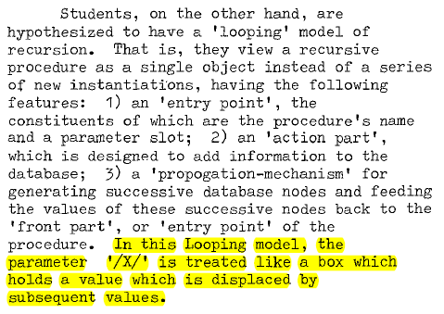
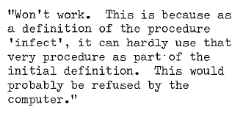
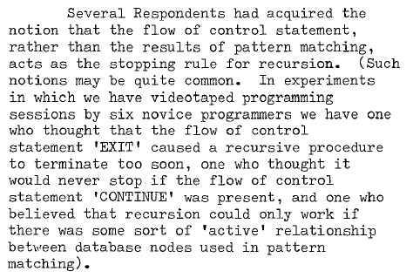
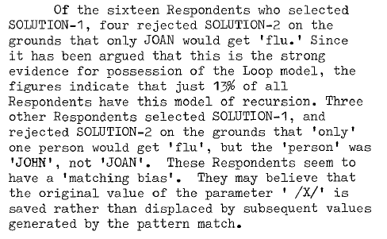
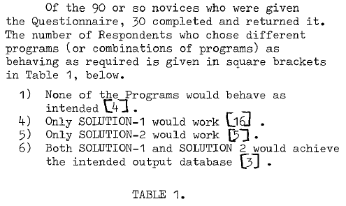
Kahney, CHI 1983
“If I’m correct, it would always be reduced to 1 ultimately. Since it’s just Dance(n-1) and then it’s just turning not really moving… and that wouldn’t affect …. the number of metres that I’ve walked.”
“Starting at 4, you.. Do 4, turn right, do 3, turn right, do 2, turn right, walk forward 1 m, turn left. … So only at one point will I do 1, that’s when you walk forward. So M(n) = 1.”

Slide 32
Götschi, Sanders, and Galpin, SIGCSE 2003
BUT… at 2nd and 3rd year level?
Consider:
When it's 2, it's not 1; so, I'll pass [the if branch]. I'll turn 45 degrees, do the step in … Dance(1). Turn 90 degrees to the left. But … I will go back here.
“When it's 3, ... it will be M(2) + M(2) + M(1) ... That would be 3 + 3 + 1?”
Notes:
Note the value of a FASI that can be used to track student “trajectory” through responses!

Slide 33
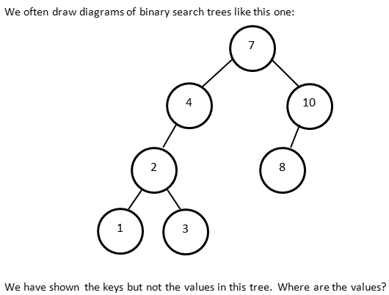
Notes:
Note: where not what.

Slide 34
Exam analysis lesson: communicating clearly is hard.
Notes:
Note: where not what.

Slide 35
“the values are pointed to or stored in the same node object“
"The value [are] stored in these bubbles“
"the values would reside in memory or on disk“
"So the values are.. in the nodes"
Notes:
What students say who have expert-like conceptions.

Slide 36
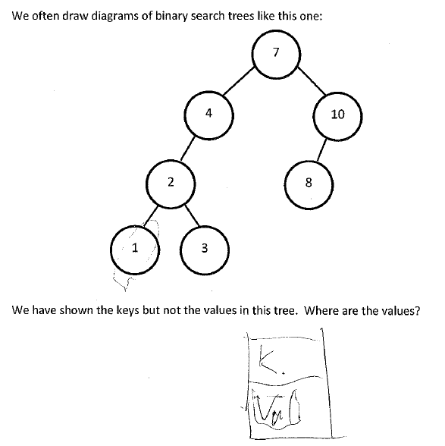
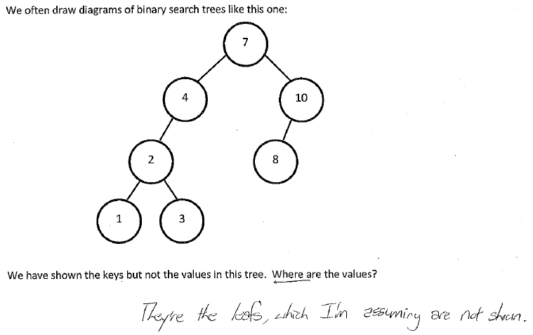
“the values should be 1, 2, 3, 4, 5, so they're index values right.. 6, 7, 8.. um.. there should be index values”
"it could just be an array … and … the keys could just be the indices of a giant array"
"it could just be an array … and … the keys could just be the indices of a giant array"
“[the key is] a lookup for the value”
“the values are being represented in the tree by the keys. So knowing … the key like unlocks … what the value is”
“the values would actually be in the leafs”
that's a weird list of.. numbers. So you're missing.. missing 5 and 6.. and 9
So the values are.. in the nodes I guess is how I'd answer that. Cause they kinda.. it's where you stop searching and that's your value or it's a lookup for the value, and that's what the key is for
Notes:
What students say who have expert-like conceptions.

Slide 37
We often draw Binary Search Trees (BSTs) like this, showing the keys but not the values:
The keys in this BST are numbers; assume that the values are as well.
Where are the values in such a BST? Choose the best answer.
The values are stored in the same node as the keys.
The values are at the leaves.
The values are pointed to from the same node as the keys.
The keys are indices into an array that stores the values.
The keys point to the values.
The values are 1 (for the node labeled 7), 2 (for the node labeled 4), 3 (for the node labeled 10), 4 (for the node labeled 2), and so on.
Not enough information to tell.

Slide 38
We often draw Binary Search Trees (BSTs) like this, showing the keys but not the values:
The keys in this BST are numbers; this time, assume that the values are images.
Where are the values in such a BST? Choose the best answer.
The values are stored in the same node as the keys.
The values are at the leaves.
The values are pointed to from the same node as the keys.
The keys are indices into an array that stores the values.
The keys point to the values.
The values are 1 (for the node labeled 7), 2 (for the node labeled 4), 3 (for the node labeled 10), 4 (for the node labeled 2), and so on.
Not enough information to tell.

Slide 39
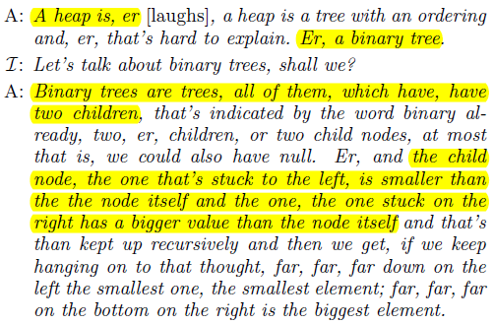
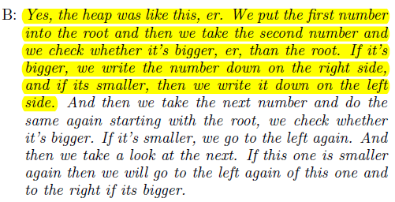
Danielsiek et al. SIGCSE 2012

Slide 40
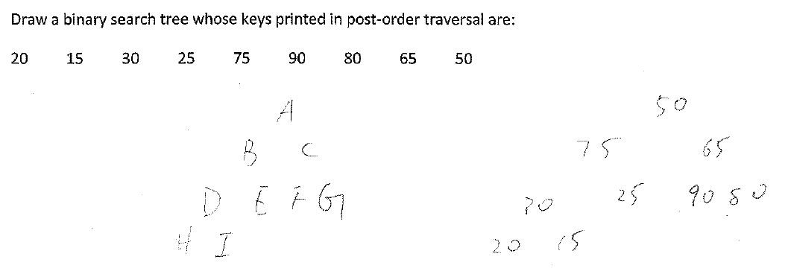
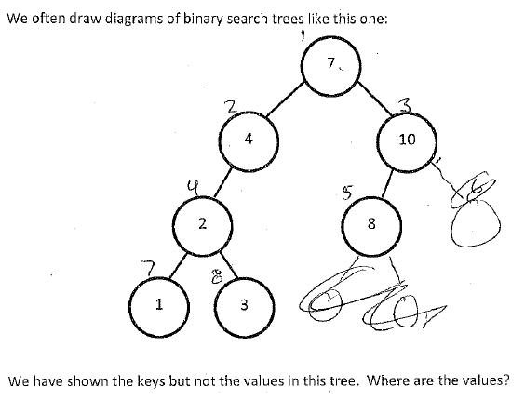
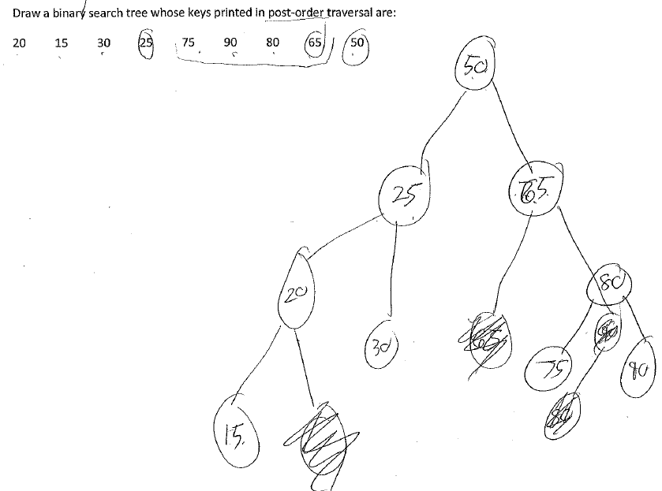
Same student as example: "The smallest, all smallest values should always be at the bottom.. at the top. [pause] Well.. not necessarily, that's for a heap. Um.. hm.. [pause] I'm not sure if that applies for binary trees as well.
Heap/BST Confusion? Never hinted at by my faculty i’views…
In answer to “Why isn’t this a BST?”
“it's because … the right only has depth 1, while the left has depth 3. … BSTs should have both sides equal depth. Is that a heap? It doesn't matter.”
These are the keys; so the values should be 1, 2, 3, 4, 5, so they're index values right.. 6, 7, 8.. um.. there should be index values
Notes:
The post-order traversal responses are (again) different students.
Ref to sigcse-2012-detecting-understanding-ds-algo-miscons-danielsiek, sigcse-2013-algo-ds-miscon-instrument-follow-up

Slide 41
Outline
Motivation, Inspiration, Role Model, & Ideal Goal
Idealized Methodology
Practical Methodology
Goals: From Grand to Assessable
Exams: A Lesson in Quality
Post Hoc Analysis: Mystery of the Student Mind
Interviews: Hard-Won Gems + Prior Work: Easy-Won Gems ☺
Discussion
Notes:
Practical Methodology comment: In theory, theory and practice are the same. In practice, they differ.

Slide 42
Extra Slides

Slide 43
Exam Analysis
For each exam: average and standard deviation if each problem on the exam were worth the same amount
For each question:
average on the question,
correlation to unweighted exam score
“ccontextual hardness” (problem mean in # of exam stddevs away from exam mean)
Notes:
Per-Q exam analysis on 15 final exams (200+ Qs) from 121/221/320 (including precis of each question, correlation to unweighted average, std normal "means" for each Q).
Sample exam analysis on batches of ~10 exams for several crucial questions
Unweighted exam score de-emphasizes problem’s value; better would be correlation to rest of exam, easy to compute but seemed unnecessary.

Slide 44
Notes:
The question asks: "An arc labeled 0 will have to be drawn from the
state labeled "1". Which of these /could/ that arc legitimately lead
to? There may be multiple correct answers. Circle *ALL* that apply.
- A new accepting state.
- A new rejecting state.
- The start state.
- The state labeled "...0".
- The state labeled "garbage".
The correct answers are "a new accepting state" and "the state labeled
"...0"". The answer MUST be accepting, which is enough to eliminate
all but these. To support these, students would need to recognize
that "merging" into "...0" is OK (because starting 00 or 10 will make
no difference to whether a longer string accepts or rejects).
Additionally, they must recognize that it's OK to "duplicate" portions
of a DFA, just in terms of correctness.
On “add arrow”, of the 5 students to whom it’s posed (but note that at least one student mentioned that they seemed not to be allowed to add extra states):
12: adds but retracts -> 0 arc; adds -> …0 arc; states no other arcs possible
11: adds only -> …0 arc
9: adds -> 0 and -> …0 arcs
8: doesn’t really understand Q (but adds -> 0 arc)
7: adds -> 0 and -> …0 arcs
Of 6 students to whom the “# of arrows” question is posed:
7 misunderstands Q (tries to correctly complete DFA), finally sees real Q and responds after that point w/in 30s
8 unfamiliar w/concept (but also tries to correctly complete DFA); never really settles into problem
9 partially misunderstands Q (approaching as if correctly complete DFA), but settles down to 4
10 doesn’t know what DFAs are
11 even after rephrasing to elim stated purpose of DFA, distracted by “correctness”, gives 4 as answer
12 20s after remembering def’n of “legal”, finishes w/4 as answer

Slide 45
This was a bad question!
(Lots of them are, as it turns out!)
Notes:
The question asks: "An arc labeled 0 will have to be drawn from the
state labeled "1". Which of these /could/ that arc legitimately lead
to? There may be multiple correct answers. Circle *ALL* that apply.
- A new accepting state.
- A new rejecting state.
- The start state.
- The state labeled "...0".
- The state labeled "garbage".
The correct answers are "a new accepting state" and "the state labeled
"...0"". The answer MUST be accepting, which is enough to eliminate
all but these. To support these, students would need to recognize
that "merging" into "...0" is OK (because starting 00 or 10 will make
no difference to whether a longer string accepts or rejects).
Additionally, they must recognize that it's OK to "duplicate" portions
of a DFA, just in terms of correctness.
On “add arrow”, of the 5 students to whom it’s posed (but note that at least one student mentioned that they seemed not to be allowed to add extra states):
12: adds but retracts -> 0 arc; adds -> …0 arc; states no other arcs possible
11: adds only -> …0 arc
9: adds -> 0 and -> …0 arcs
8: doesn’t really understand Q (but adds -> 0 arc)
7: adds -> 0 and -> …0 arcs
Of 6 students to whom the “# of arrows” question is posed:
7 misunderstands Q (tries to correctly complete DFA), finally sees real Q and responds after that point w/in 30s
8 unfamiliar w/concept (but also tries to correctly complete DFA); never really settles into problem
9 partially misunderstands Q (approaching as if correctly complete DFA), but settles down to 4
10 doesn’t know what DFAs are
11 even after rephrasing to elim stated purpose of DFA, distracted by “correctness”, gives 4 as answer
12 20s after remembering def’n of “legal”, finishes w/4 as answer

Slide 46
Almost everyone puts the 1 → 0 arc in their solution.
Almost no one understands that they can add states. Bad question design? (At least paired w/the previous problem?)
(Detailed interview analysis is still TODO ☹.)
Notes:
The question asks: "An arc labeled 0 will have to be drawn from the
state labeled "1". Which of these /could/ that arc legitimately lead
to? There may be multiple correct answers. Circle *ALL* that apply.
- A new accepting state.
- A new rejecting state.
- The start state.
- The state labeled "...0".
- The state labeled "garbage".
The correct answers are "a new accepting state" and "the state labeled
"...0"". The answer MUST be accepting, which is enough to eliminate
all but these. To support these, students would need to recognize
that "merging" into "...0" is OK (because starting 00 or 10 will make
no difference to whether a longer string accepts or rejects).
Additionally, they must recognize that it's OK to "duplicate" portions
of a DFA, just in terms of correctness.
On “add arrow”, of the 5 students to whom it’s posed (but note that at least one student mentioned that they seemed not to be allowed to add extra states):
12: adds but retracts -> 0 arc; adds -> …0 arc; states no other arcs possible
11: adds only -> …0 arc
9: adds -> 0 and -> …0 arcs
8: doesn’t really understand Q (but adds -> 0 arc)
7: adds -> 0 and -> …0 arcs
Of 6 students to whom the “# of arrows” question is posed:
7 misunderstands Q (tries to correctly complete DFA), finally sees real Q and responds after that point w/in 30s
8 unfamiliar w/concept (but also tries to correctly complete DFA); never really settles into problem
9 partially misunderstands Q (approaching as if correctly complete DFA), but settles down to 4
10 doesn’t know what DFAs are
11 even after rephrasing to elim stated purpose of DFA, distracted by “correctness”, gives 4 as answer
12 20s after remembering def’n of “legal”, finishes w/4 as answer

Slide 47
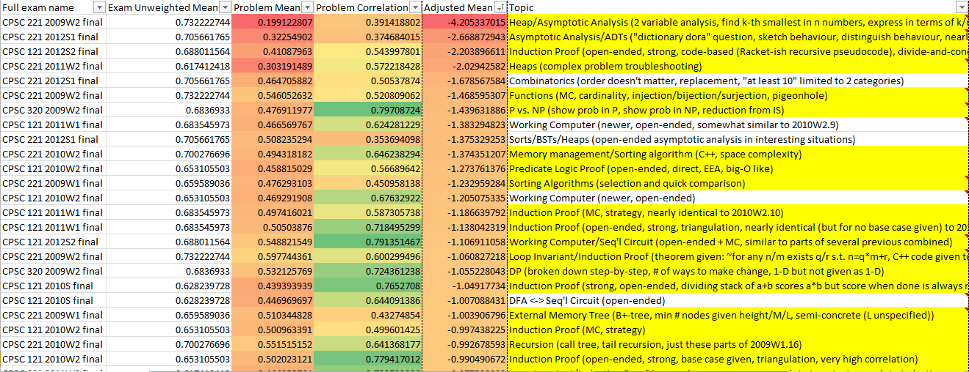
Low Mean Problems
For each question: average and standard deviation on the question,
Strategic snippets of the worst-performing,
Notes:
Students have done terribly
on strong induction but weak induction is sometimes quite bad and
sometimes fairly good. Clearly, both are worth assessing to
understand how changing instructional strategies affect students'
performance.
Besides induction, various topics show up below the mean, such as
Working computer-related problems, predicate logic proof, predicate
logic translation, and DFA <-> sequential circuit problems.
Almost anything concrete shows up well above the mean, e.g., set and
function problems, propositional logic evalution or straightforward
equivalence, number rep, etc.

Slide 48
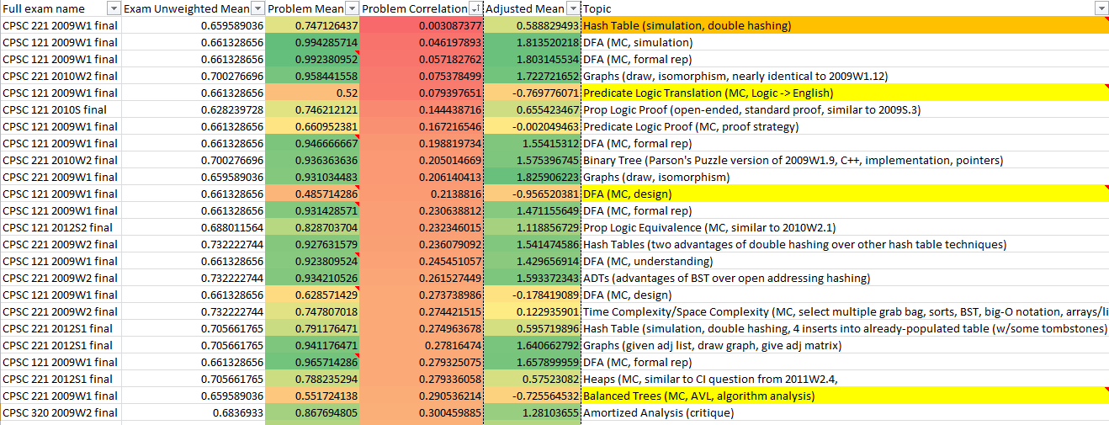
Low Correlation Problems
Notes:
Many problems that are weakly correlated are also those students have done quite well on. Sometimes they're MC questions (guessing?). Concrete problems like number representation and concrete set/function problems also show up often.
Perhaps the most surprising is 2012S2's predicate logic proof problem #10. Students did poorer than average on this problem, yet it is relatively weakly correlated (0.52). Maybe this is high enough anyway to be uninteresting? (As it turns out, it’s the highest-correlated of the MC questions. Bear in mind that these did NOT benefit as much from the equal-weighting process, either.)
Let's refocus on low correlates, but those on which students did
fairly poorly (below mean).
Irritatingly, yet another functions MC problem "tops" this list.
Several MC problems on which it looks like students may have just
guessed rank highly (including the induction strategy planning MC
questions
Perhaps tellingly, of ALL low correlates, the lowest four (0.14 up to
0.35, next is 0.40) are all early-term questions: prop logic
proof/equivalence, number rep, circuit design.

Slide 49
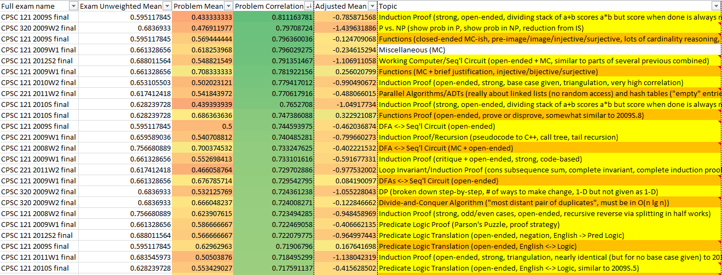
High Correlation Problems
Notes:
Of the high correlation problems, one is unsurprising: the aggregate
of the many MC questions in 2009W1.
Other strong correlates include:
+ some of the strong induction problems
+ the functions problem (perhaps b/c they're end-of-term material??
perhaps b/c they integrate many concepts? surprising!)
Filtering to high correlates on which students did reasonably well
(better than mean on that exam), we get:
+ functions MC
+ functions proof
+ DFAs <-> Seq'l Circuits
+ Predicate logic proof
+ an induction proof (weak)
+ set proof
+ predicate logic translation
Not sure what to say from this. MANY of the high correlates are those
on which students did poorly, not well.

Slide 50
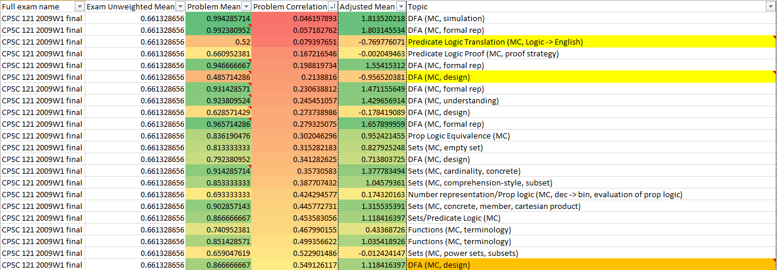
Some MC Questions
Notes:
MC/closed-ended questions from one exam; note the high correlation problems.
The two really interesting ones are the two highlighted “DFA (MC, design)” questions, one of which is the highest correlation problem and the other is the lowest performance problem.
Looking at the small MC questions on which I have lots of detail
(2009W1's problem #1 parts), most are not strongly correlated with
exam results (no surprise!). One DFA design problem is surprisingly
well-correlated (among a handful near or above 0.5)
WHY did some people make different choices? We cannot tell.
The other question with significant correlation is a sets question in
which one correct answer (of two) is trivial (a set is a subset of
itself) and the other is very tricky (because the two sets'
intersection is non-empty, they share an element; so, (a,a) is a
member of P(AxB) for some a in A and so {(a,a)} is a subset of P(AxB).
Perhaps could ask whether and why {(a,a)} is a subset of P(AxB) given
the conditions on A and B?
In terms of the problems people did worst on, they are:
+ Besides the two discussed in the previous problems [referring to the
DFA described above], how many more arcs still need to be drawn from
the existing states in the diagram? (This /should/ be easy! Not
sure if many of the wrong answers are 4s, indicating perhaps that
they didn't understand the question.)
+ Problem 1.2, a rather messy predicate logic question translating
"everybody loves somebody that loves them back". This is really
about negating predicate logic statements and implications from my
perspective.
+ You are building a DFA to recognize the language: "words that end in
a vowel". Should the DFA's start state be accepting or rejecting?
(Again, this /should/ be easy. It boils down to "is an empty string
a word ending in a vowel?".)
+ The set problem from above about P(AxB). This is the only one that
students did poorly on that also had reasonably high correlation
with the overall exam. (But note that the average on this problem
was already up to 66%; indeed, only the first two described were
near or below 50%).
+ A proof strategy problem (#1.4) that I recall feeling was poorly
written during grading.
+ A somewhat messy propositional logic evaluation problem (#1.8, but
this one was the first that was above the mean).

Slide 51
Easy MC: Number Representation

Slide 52
Easy MC: Balanced BST Performance
log(1000) = 100
100 lg 1000
???

Slide 53
Exam analysis lesson: communicating clearly is hard.

Slide 54
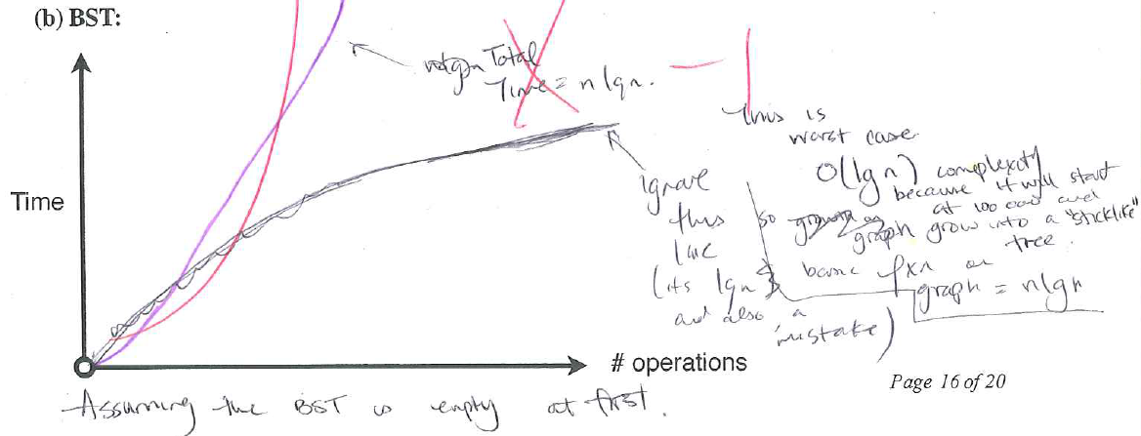
Notes:
“worst case”, “stick-like”, and yet O(lg n). Why?

Slide 55
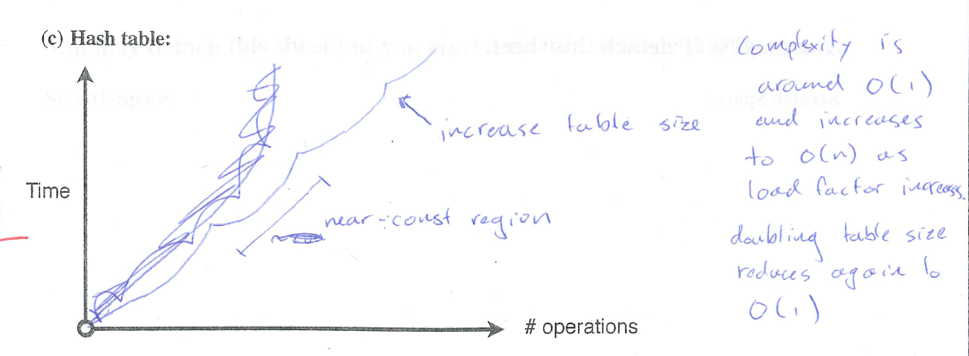

Slide 56
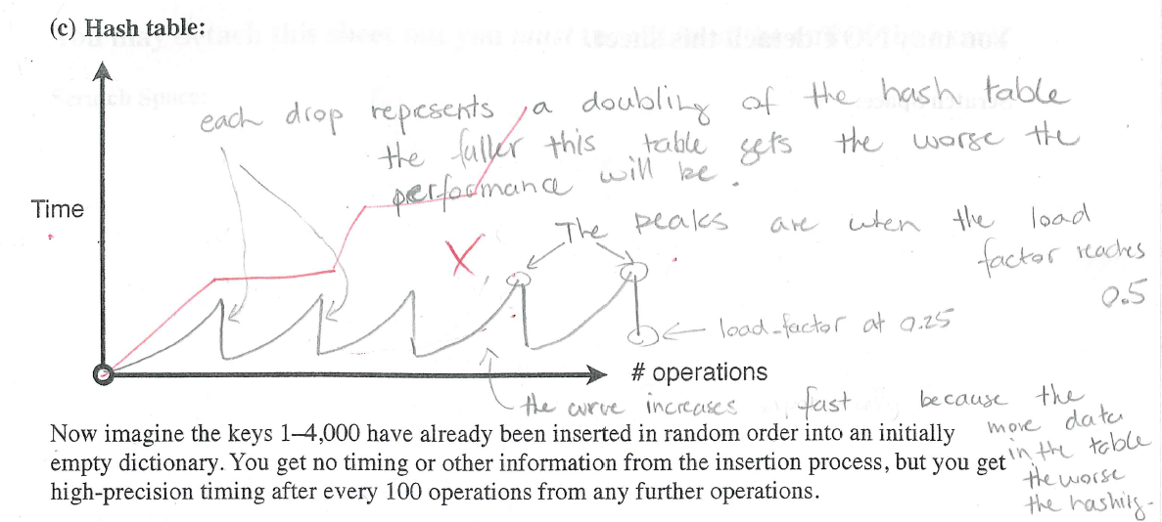

Slide 57
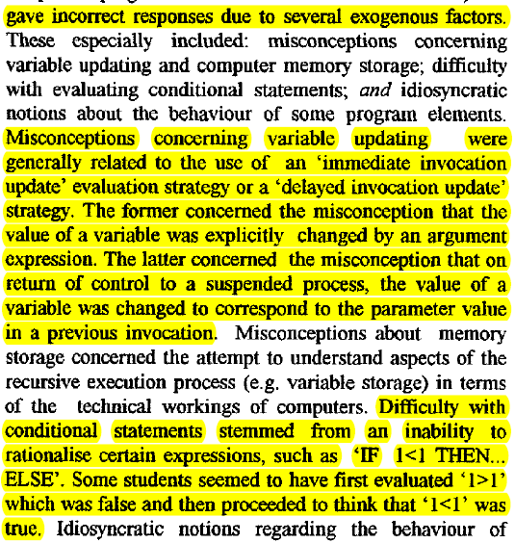
George, SIGCSE 2000

Slide 58
Götschi, Sanders, and Galpin, SIGCSE 2003
Notes:
Note the value of a FASI that can be used to track student “trajectory” through responses!

