Slide 1
The Untold Story of Tech Job Market 😱
Shayan Hosseini, Nov 2023

Slide 3
Why you didn’t go for other things?
work in tech industry really? 😒
Do a PhD 🧑🏻‍🎓
Found a startup 🦄
Make the best Persian restaurant in town 🍚🍖
Notes:
doing a phd and being underpaid for five more years
full of great ideas
quit tech
are legit questions
but they are out of scope of this talk

Slide 4
Who am I?
MSc, Systopia
Distributed systems
5 years of industry experience as a software engineer in Iran
Cloud, Content Delivery Network (CDN)
Notes:
Going back to industry after grad school
My work experience wasn’t in North America
Worked during my undergrad

Slide 5
What I was looking for
Software Engineer
Senior level
Flexible, but I’d prefer to work on distributed systems
Canada 🇨🇦
Flexible, I’d prefer to stay in Vancouver

Slide 6
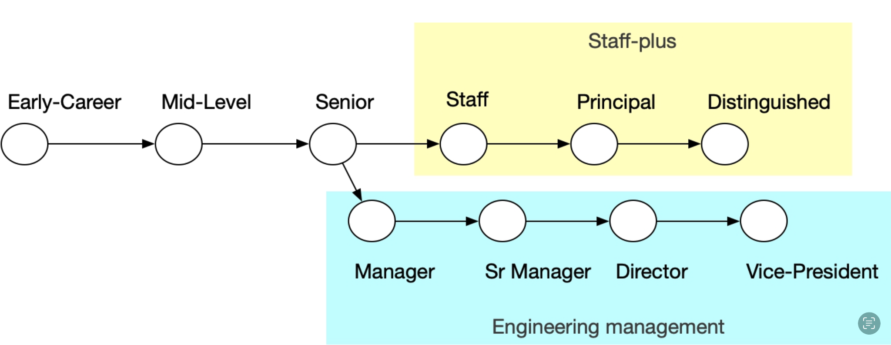
How the engineering career path looks like
Individual Contributor (IC)
Notes:
two tracks

Slide 7
What does it mean to “get a job”?
it’s a market
Employment is a transaction in the labor market.
Bid
👨‍💻
Sell
Labor
Notes:
I’m ready to go and get a job but what does it mean to get a job?
market
“oh, a company wants to give me a job! What a relief!”
get rid of this
farmer examples, growing apples
Employment is a transaction in the labor market.
cause it’s a market it follows the basic rules of supply and demand

Slide 8
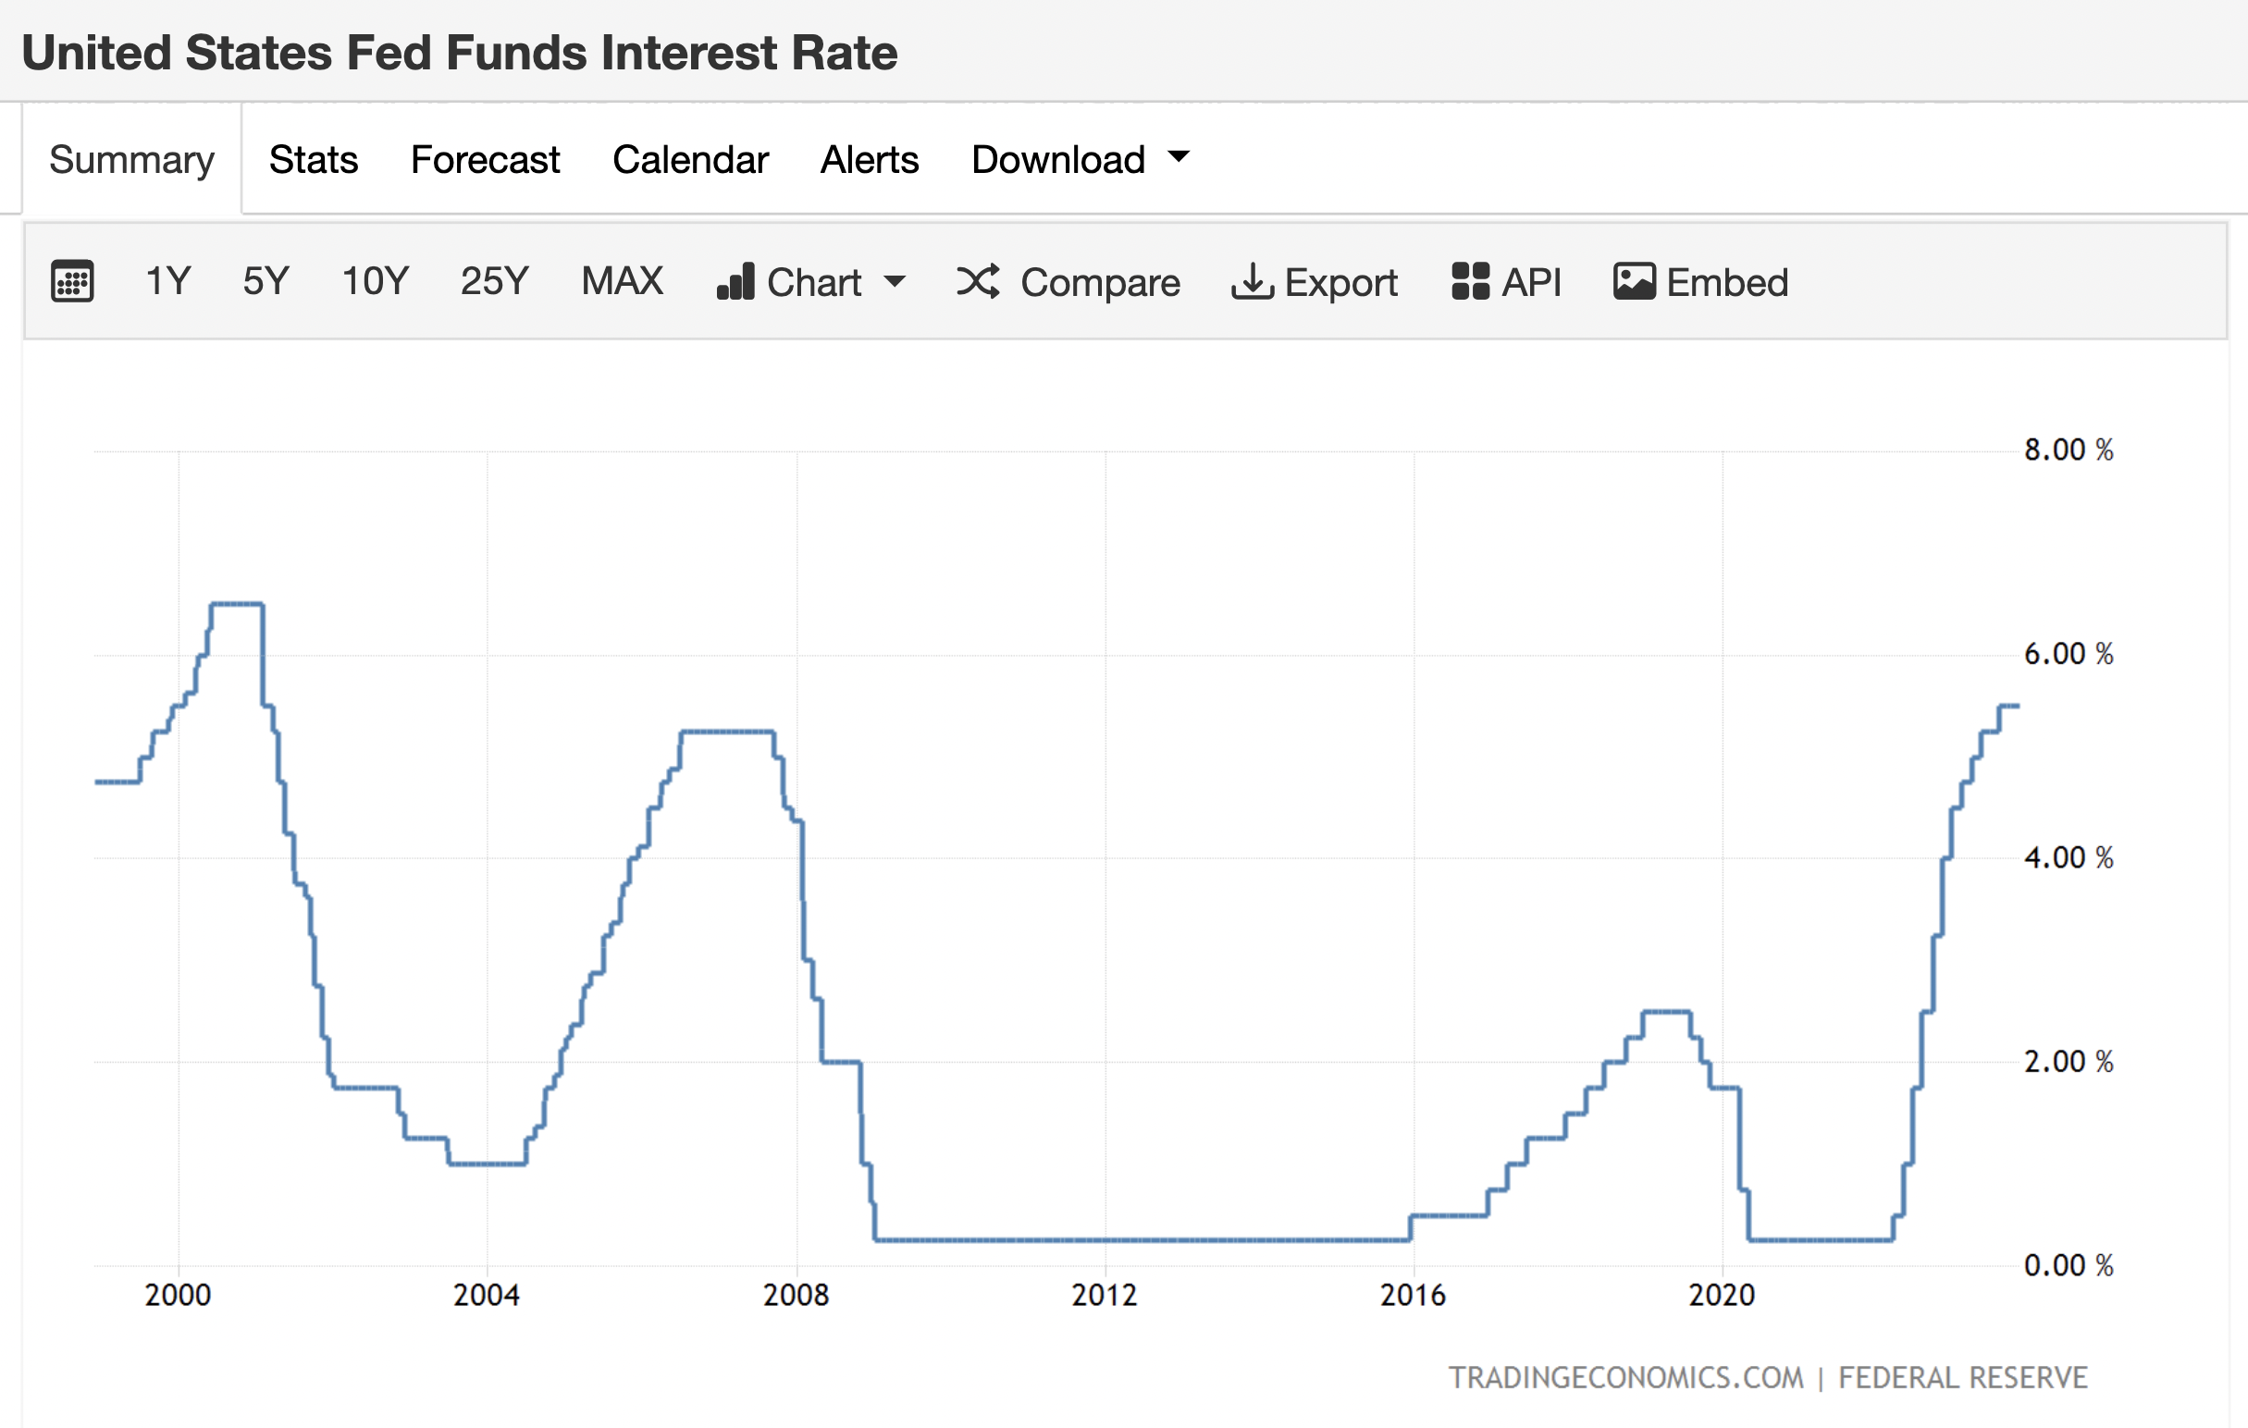
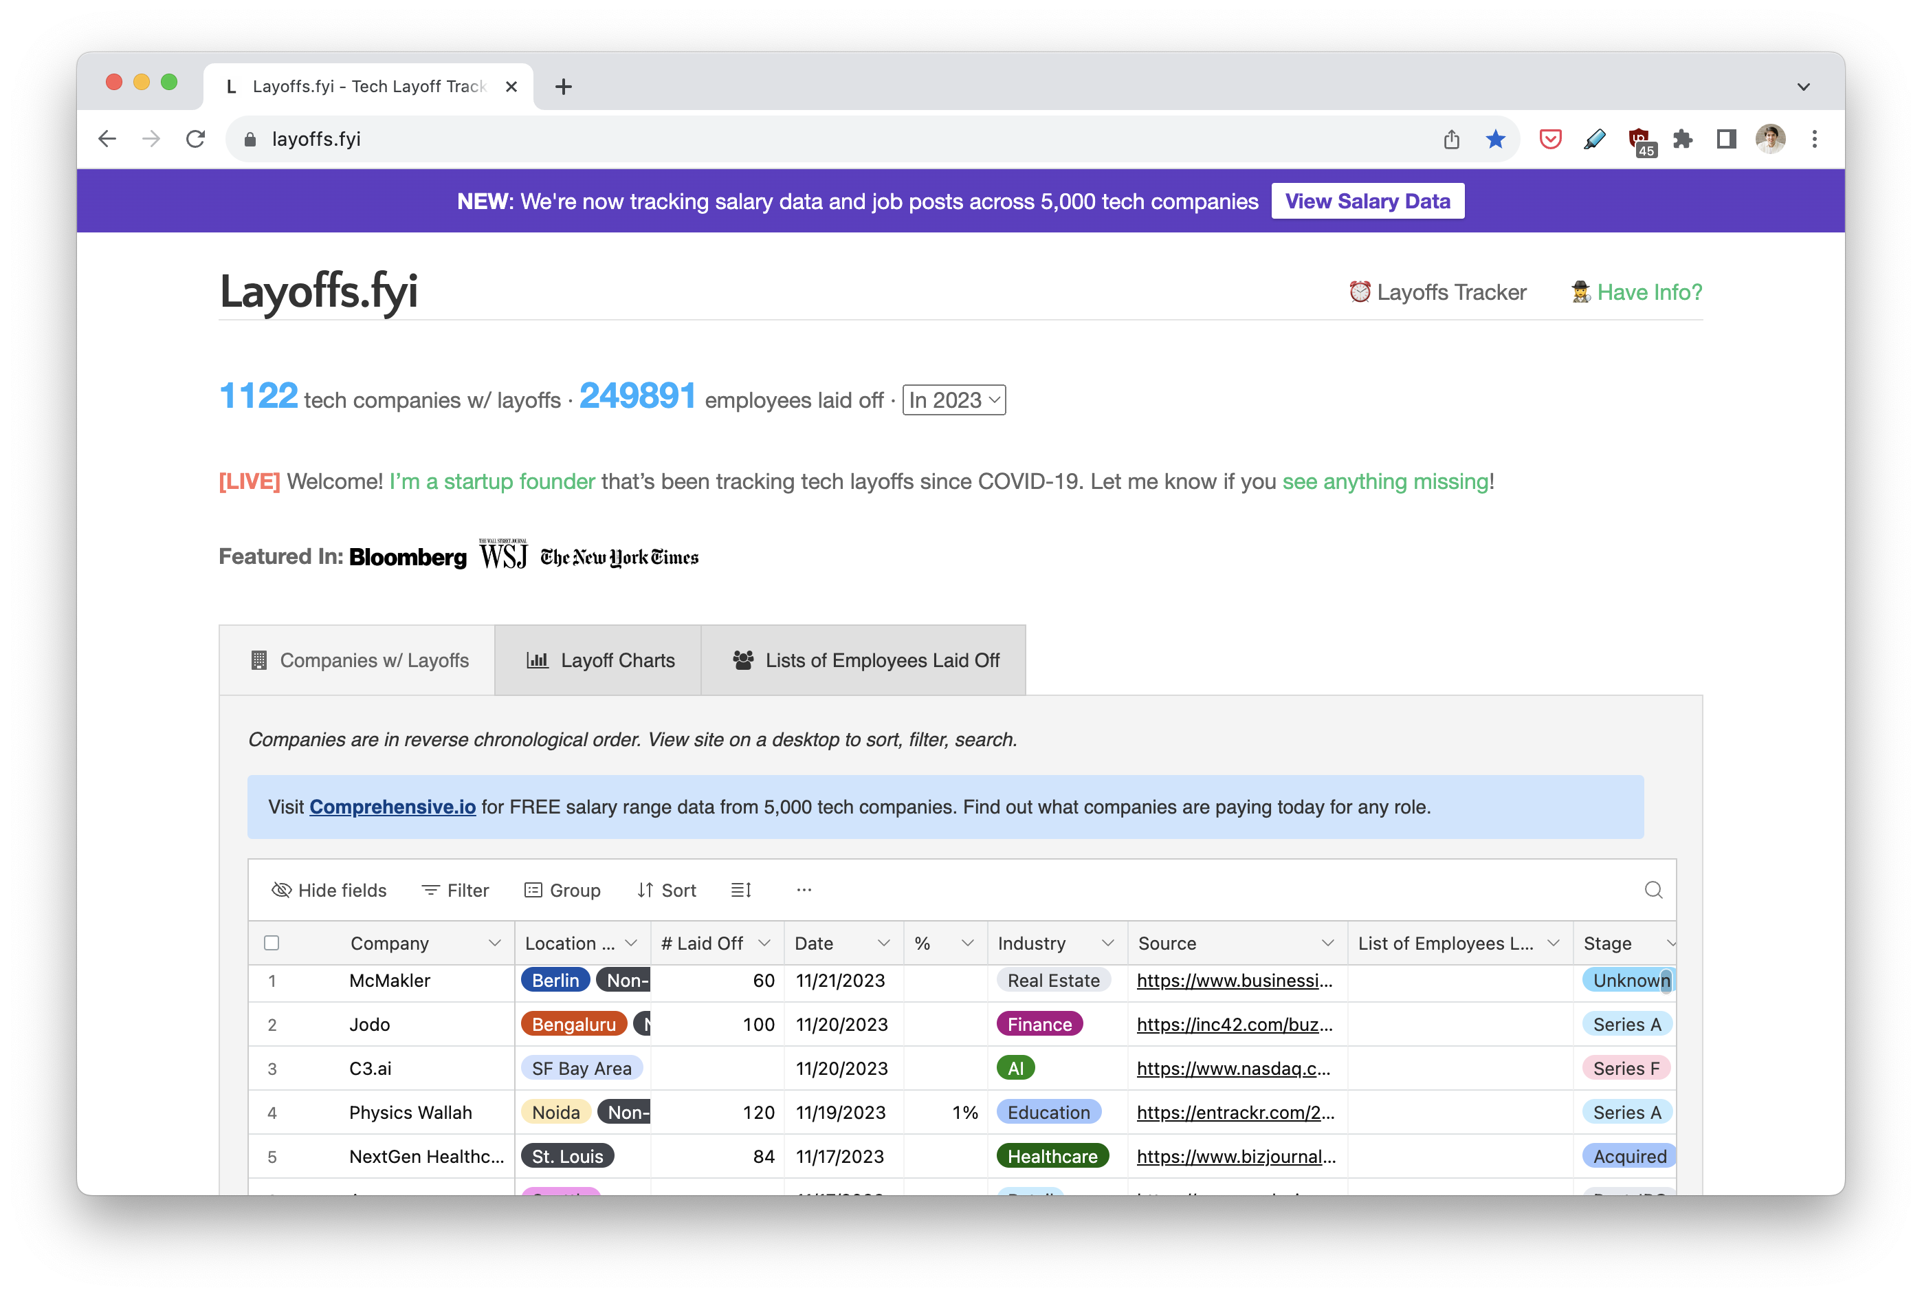
Current Market
Notes:
interest rates are at the highest point since 2008

Slide 9
Current Market
Hiring Freeze 🧊🥶
👨‍💻
Sell
Labor
Notes:
makes the market unbalanced
makes it more competitive for the people who are looking for the jobs

Slide 10
How I started?
Notes:
resume and did some interview prep

Slide 11
Cold Applications
through careers page
70 applications
35 ghosted
33 rejected
2 interviews
Almost a waste of time
Notes:
what does cold application mean?
fill out the form
and submit it
at this this point i was like ok i did some interview prep but i barely can get an interview
main challenge here is getting interviews

Slide 12
Let everyone know you’re on the market
referrals
Friends
Family
Supervisor
Lab alumni
School alumni
Faculty
Old colleagues
Conferences
Social Media
idk, your own thing

Slide 13
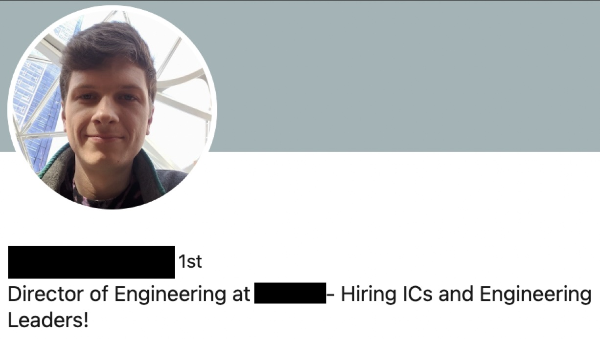
Talk to people with aligned interests
Recruiter
Hiring Manager
Notes:
an important realization
super beneficial
two key actors in the hiring process
recruiters are the people who runs the recruitment process and do the admin work around it
they are not technical people and they’re part of the HR
how to find these ppl? I found them on LinkedIn and messaged them

Slide 14
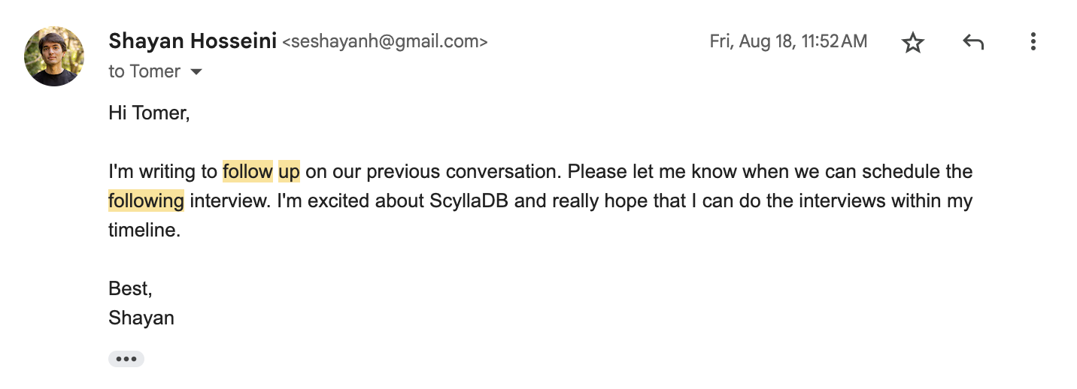
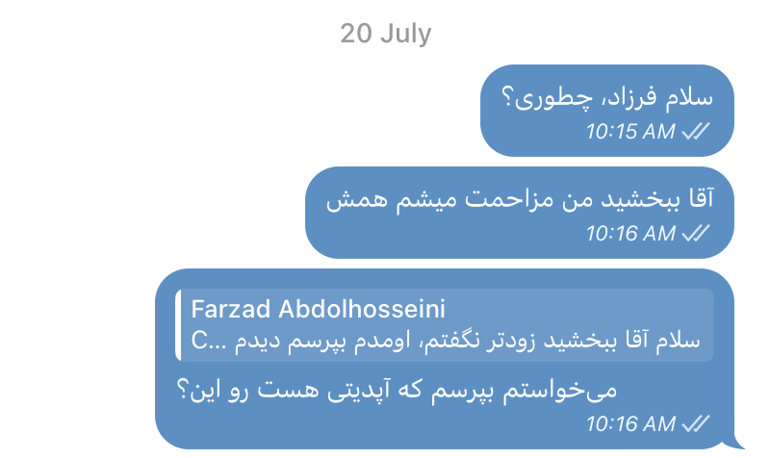
Persistance
Notes:
it’s important to follow up and make sure things get going
but i have prime example that shows the power of persistance

Slide 15
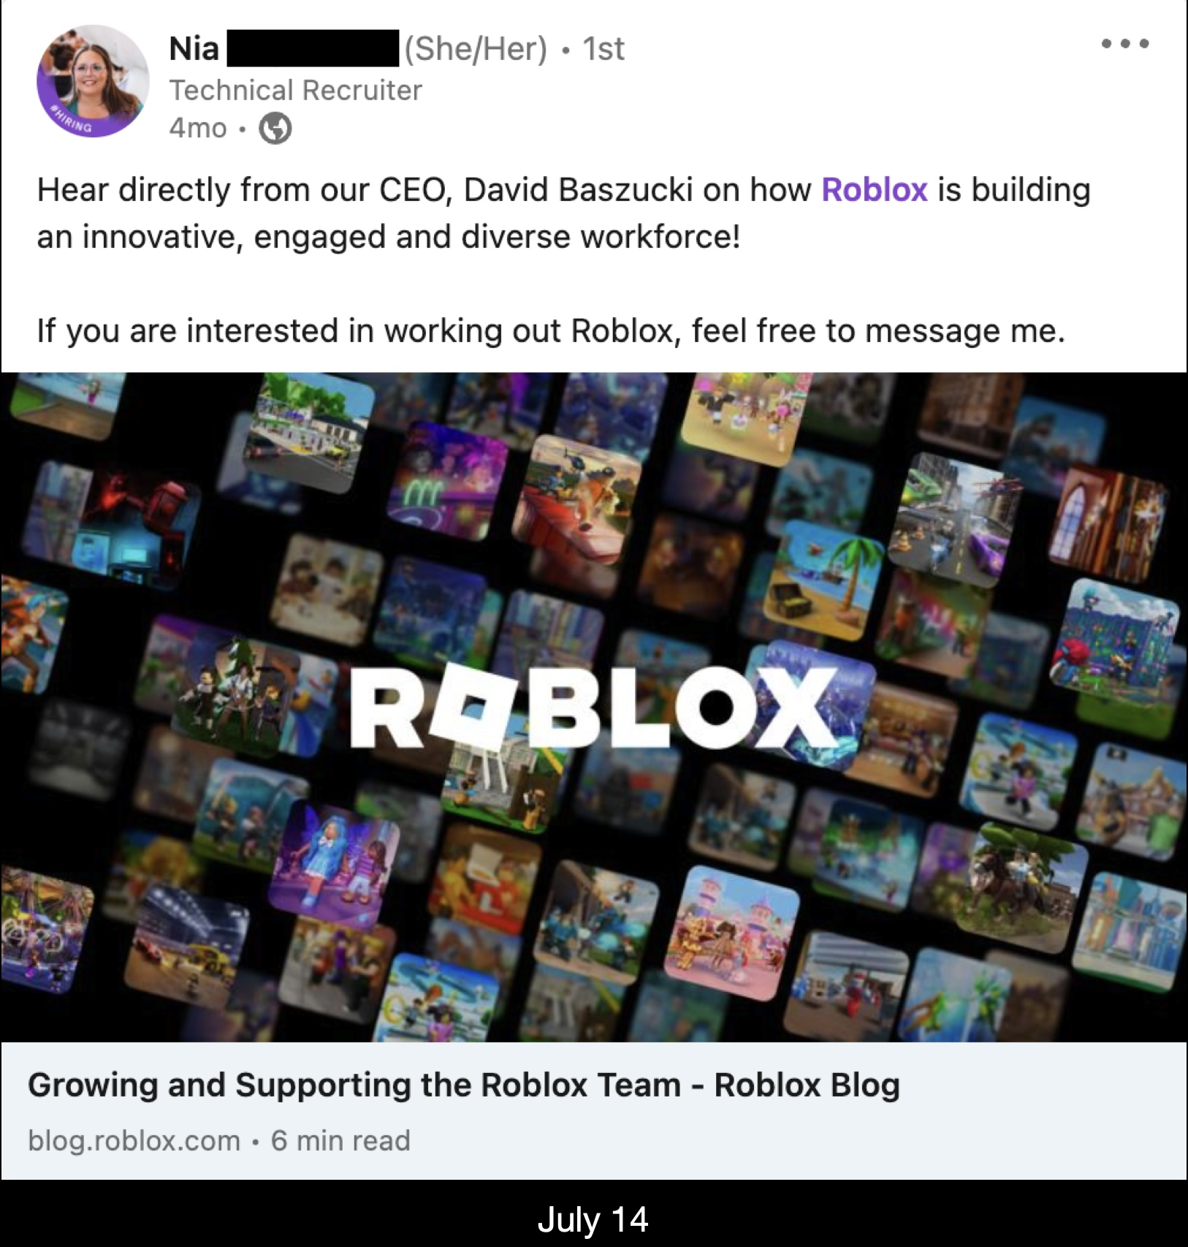
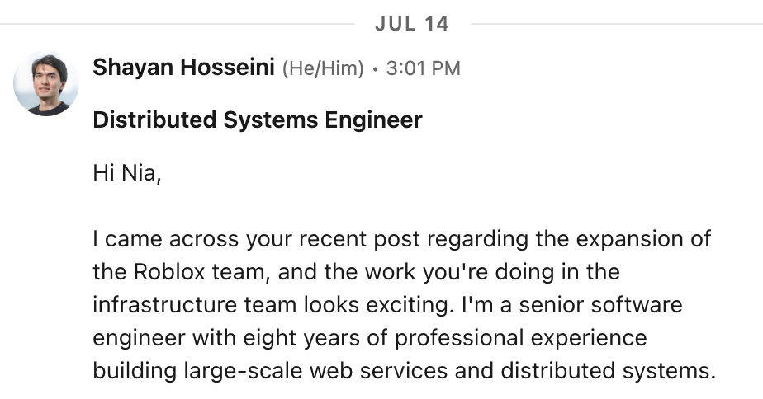
July 14

Slide 16
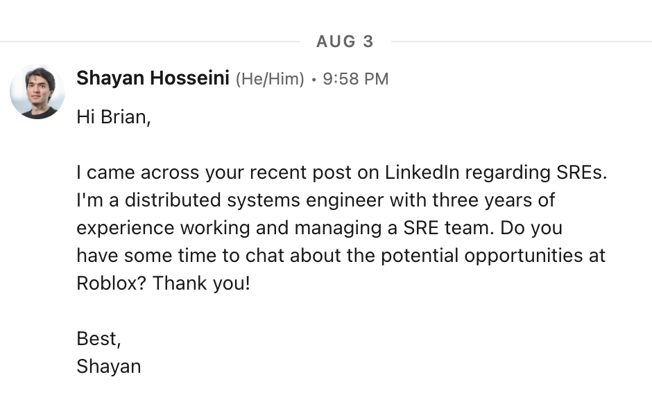
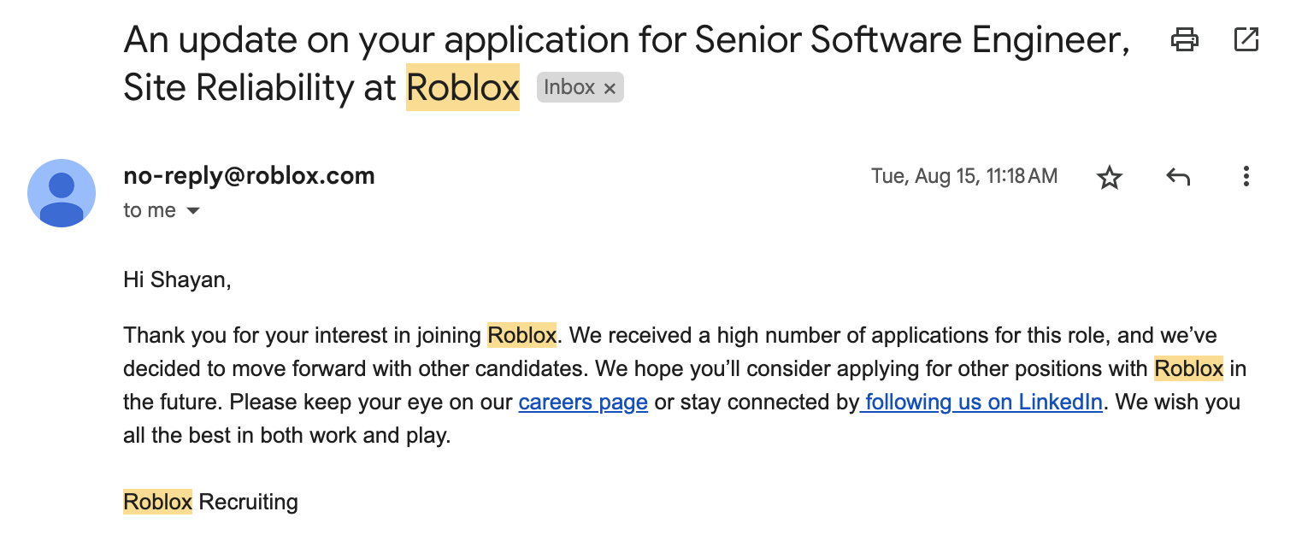
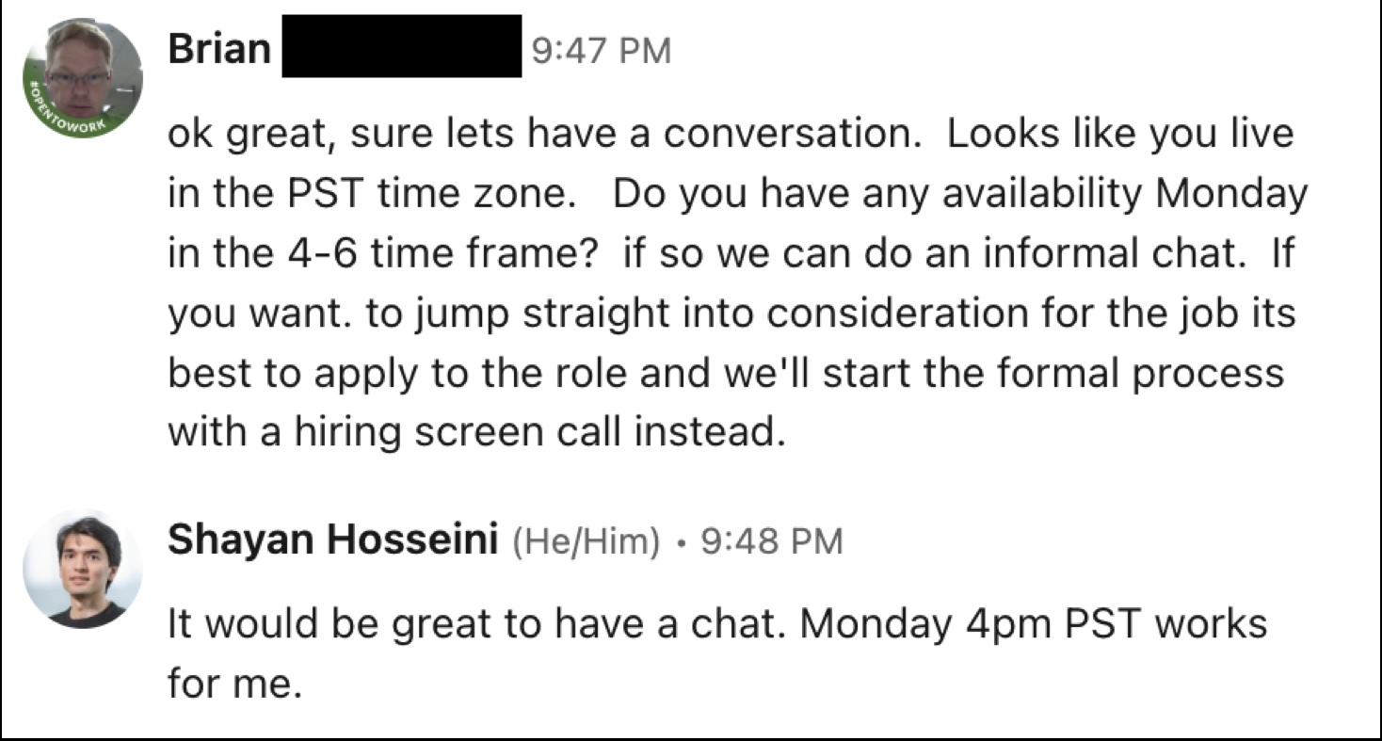
Aug 4
Notes:
he was like send your resume and we’ll start the interview process from there

Slide 17
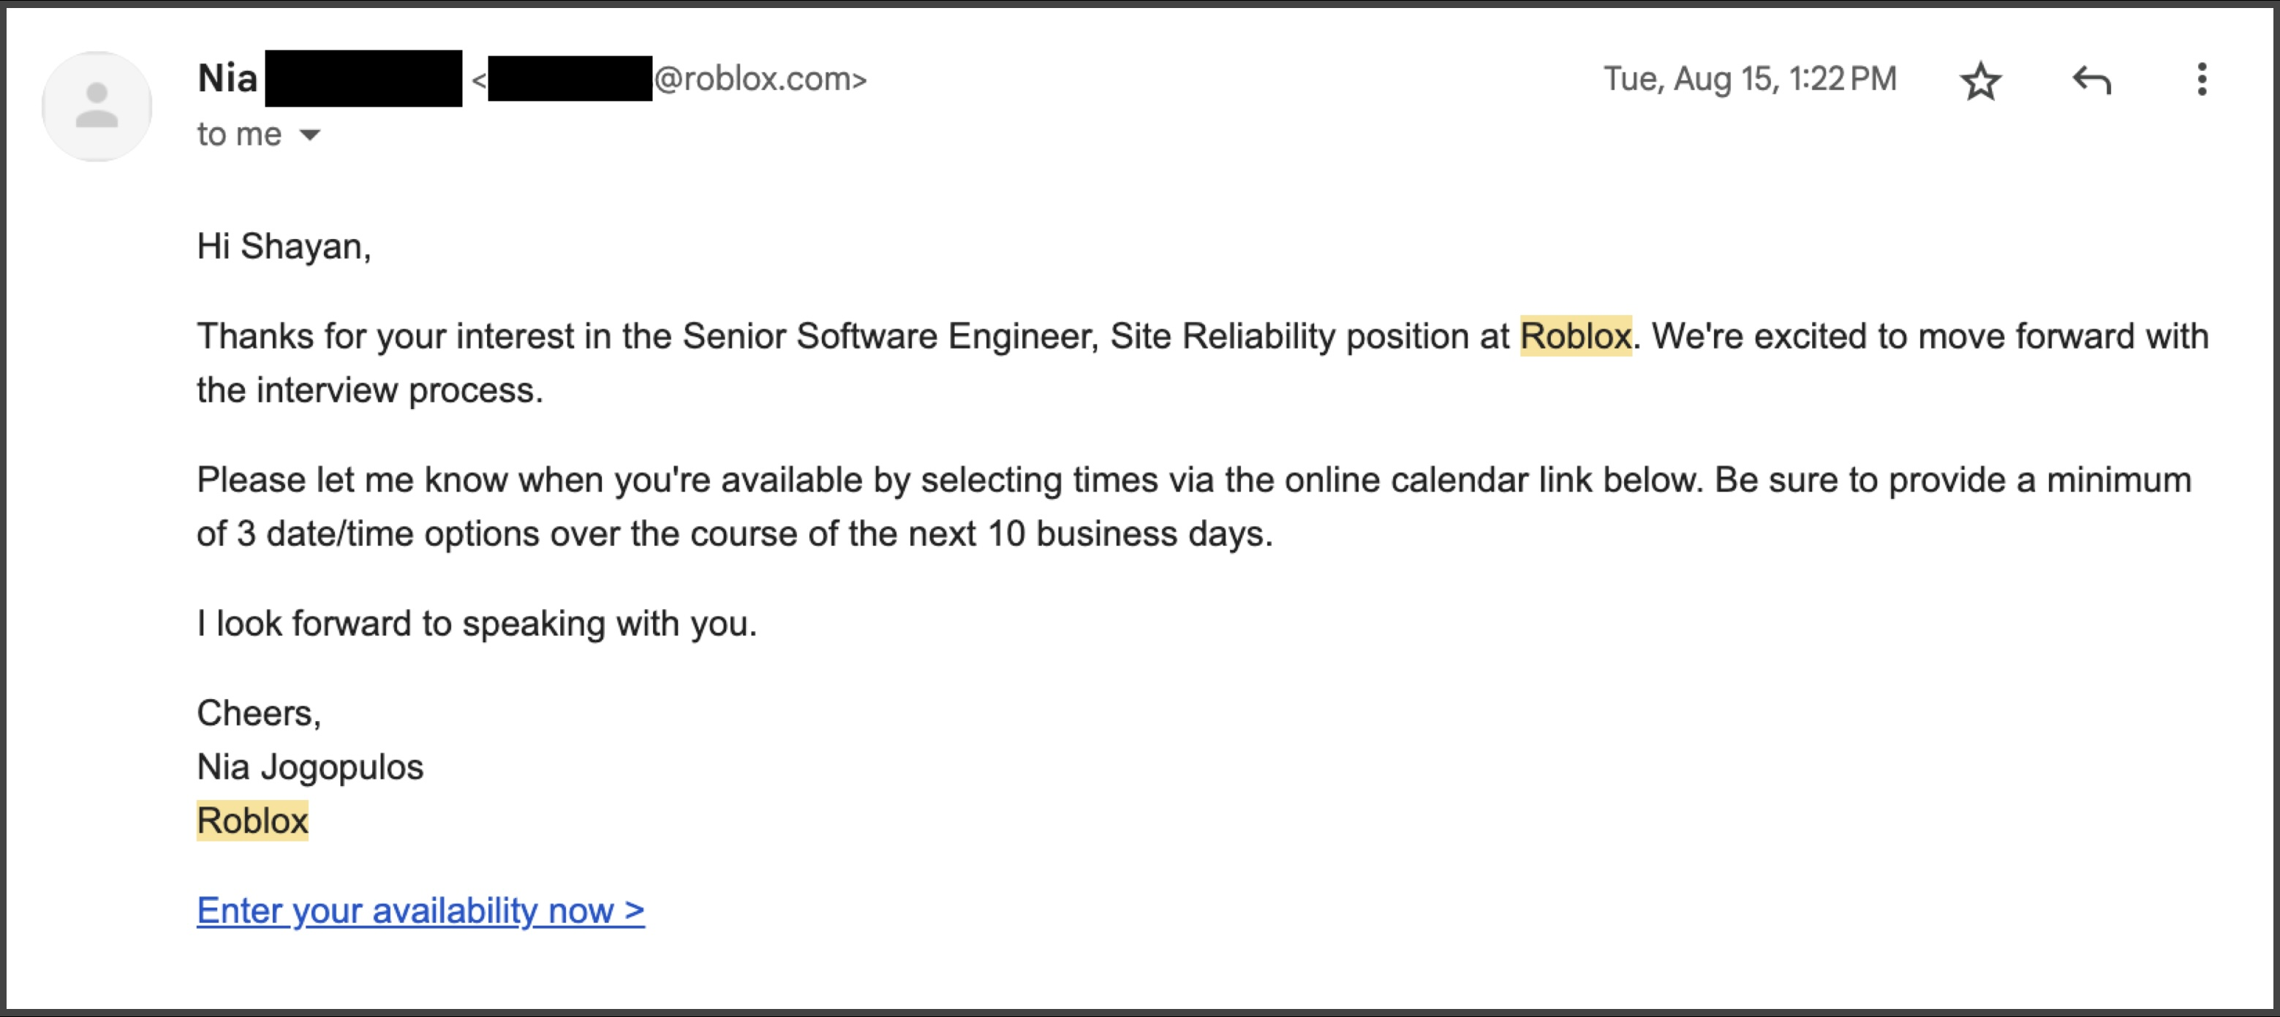
Aug 15
Aug 15

Slide 18
Interviews
28 Company
How I got them?
15 Personal referrals
6 LinkedIn
3 VLDB conference
2 Recruiter reached out
2 Cold application

Slide 19
Tech interviews
brief intro
Phone Screen
Hiring Manager Interview
On-site:
2x Coding interview
2x Design interview

Slide 20
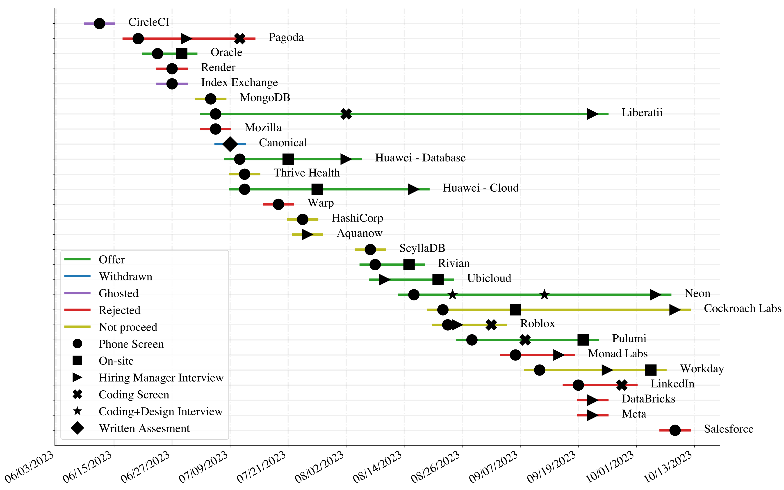
Notes:
my interview timeline
started early June
had my last interview
start with legend
not proceed
screwed up phone interviews in the beginning
strange canonical interview asking about everything, like how i did math and physics in high shcool
i had first round of offers, disappointing offers, passed them and kept going

Slide 21
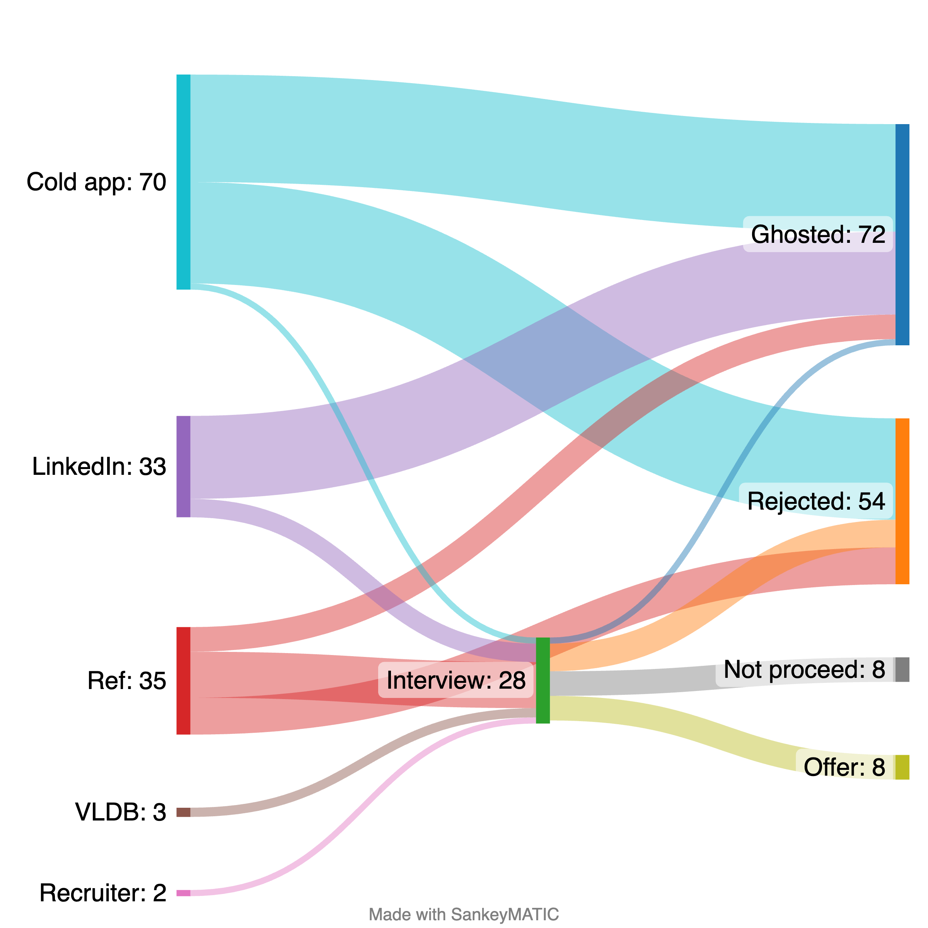

Slide 23
Hey, we’re really excited to have you on the team!
Super cool!
Here is our offer:
Level
Compensation package:
Base salary
Bonus: annual, sign-on
Equity
Benefits

Slide 24
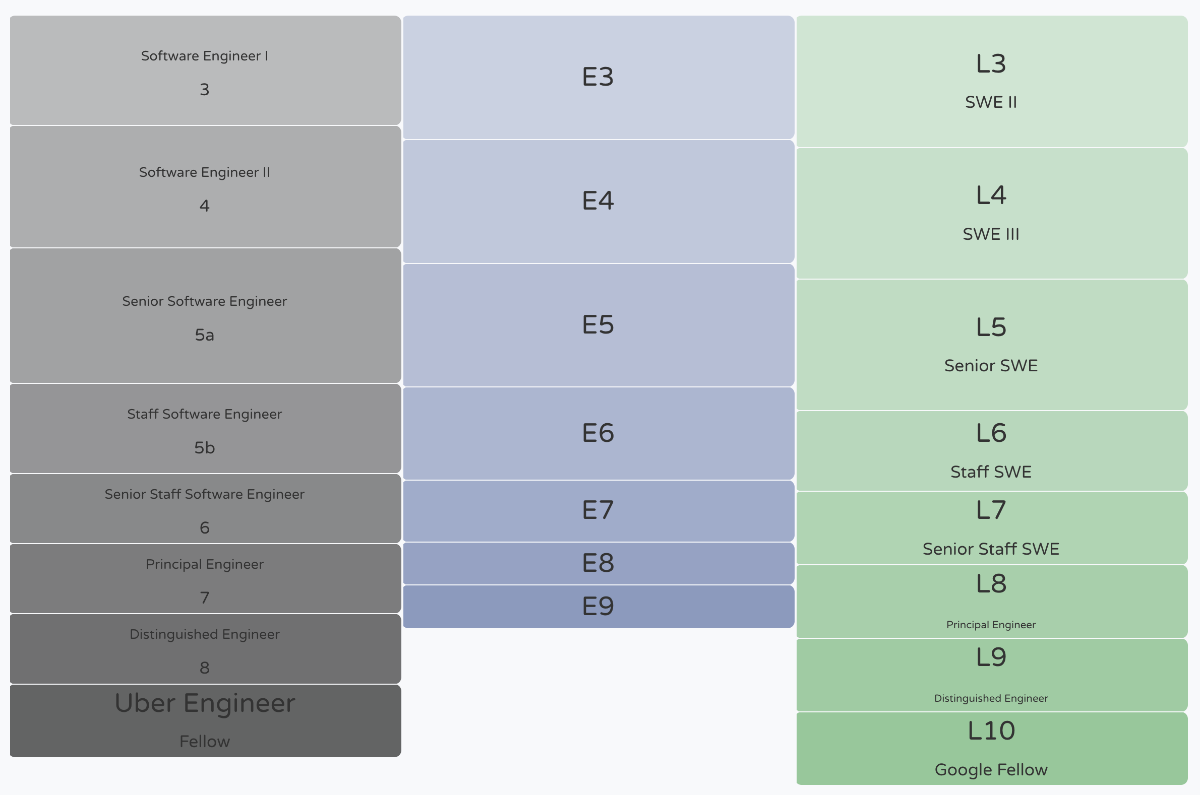
Tech companies’ ladders
Uber
Facebook
Google

Slide 25
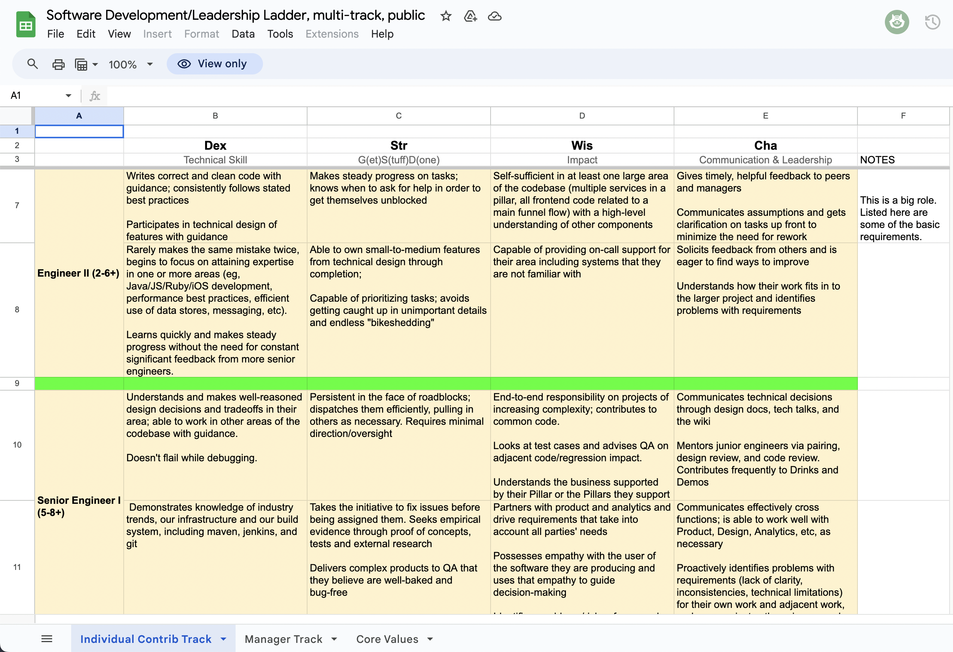
Notes:
how the companies evaluate you that you’re at a certain level?
matrix

Slide 26
Levels.fyi October Newsletter
Notes:
many of senior/principal engineers are taking roles a level lower than they were pre-layoffs.
they made to a certain level before, but now bc the market is unbalance the bar is higher on the companies
my point is that this whole levelling thing is very subjective and it’s driven by the market.

Slide 27
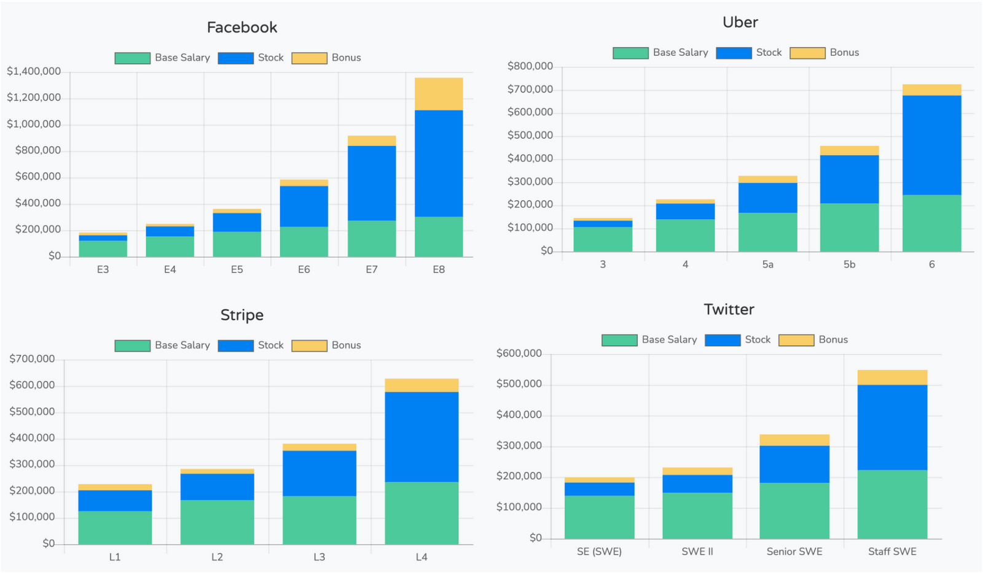
Compensation package
Notes:
the structure of compensation package

Slide 28
On equity
Public Company
Restricted Stock Units (RSU)
Cash 💵
4-year vesting period
1 year cliff
Private Company
Stock options
Cash out only after an exit scenario: IPO or acquisition
Tricky: dilution, taxes, preferred options, ratchet clauses, etc.
Same vesting schedule
Notes:
You will usually be granted RSUs (Restricted Stock Units), which are just shares like you can purchase on the stock market.
you’ll get the offered amount of stocks in 4 years.
The option is an opportunity to buy a share of the company ("exercise") at a given price ("strike price") after the option vests.

Slide 29
$12M in options and stocks gain for DoorDash SWE
Source
$10M in equity gains for 4 years' of equity vested for the first 10 engineers at Amplitude
Source

Slide 30
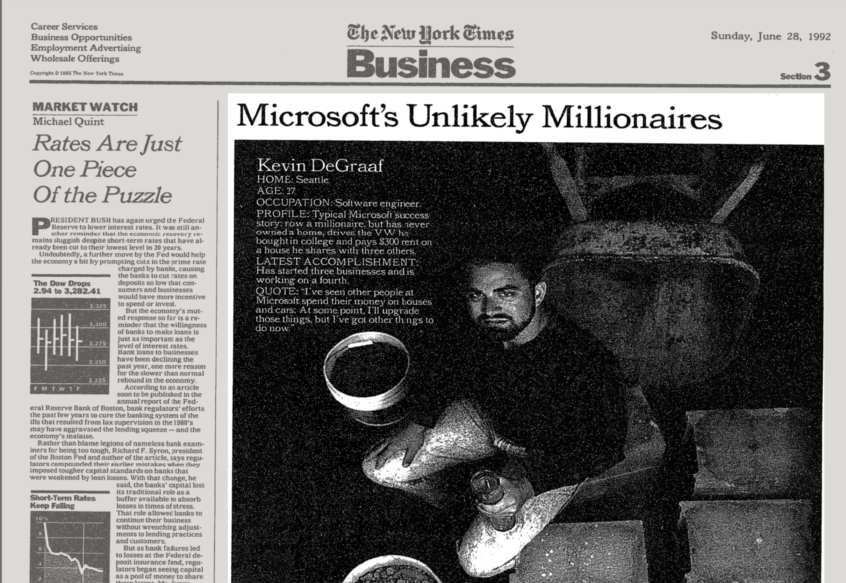
Microsoft is estimated to have created roughly 1,000 millionaires by 1992
TLDR Options
Microsoft's Unlikely Millionaires
Notes:
Famous Microsoft
Will Evans

Slide 32
Hey, we’re really excited to have you on the team!
Super cool!
Here is our offer …
What do you think?
😍
😕
😭
…
omg
meh
#@$%
Notes:
Don’t Negotiate in Real Time
you don’t wanna say “yes, that sounds amazing, when do I start?” bc it close the door on the negotiation
you already implicitly accepted the offer
In negotiations where one side has 10X more experience than you do, it is not in your
benefit to negotiate in real time. Recruiters know this and that’s why they try to negotiate
on the phone.

Slide 33
Hey, we’re really excited to have you on the team!
Super cool!
Here is our offer …
What do you think?
I’ll look over some of these details and discuss it with my family/partner.
I’ll reach out to you if I have any questions. Thanks so much for sharing the good news with me, and I’ll be in touch!
Notes:
don’t be the decision maker
Even if you don’t particularly care what your friends/family/husband/mother thinks, by mentioning them, you’re no longer the only person the recruiter needs to win over. It’s like the “true decision-maker” is beyond their reach.
This is a classic technique in customer support and remediation. It’s never the person on the phone’s fault, they’re just some poor person doing their job. It’s not their decision to make. This helps to defuse tension and give them more control of the situation.

Slide 34
Evaluating an offer
What you’ll be doing?
What you’ll be working on?
Who you’ll be working with
Learning and growth
Work/life balance
Culture and vibe
Compensation package

Slide 35
Know your market value
My strongest offer was 2.5x more than my weakest offer

Slide 36
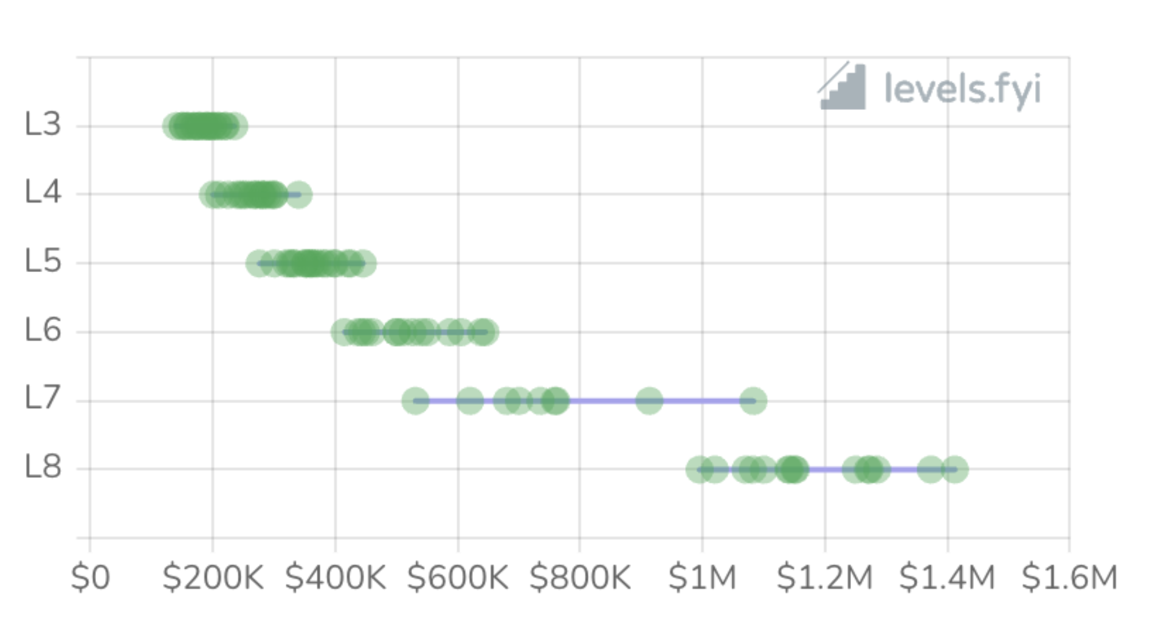
Negotiation
wtf really?
It’s a market and employment is a transaction there
Companies evaluation of you is very subjective
It’s in the favour of company to put you on the lower-end of the things if you’re fine with it
Compensation on a certain level is a range
and it’s a wide range
Notes:
in tech we don’t have demotion
inflating the game

Slide 37
Companies really want you, like they’ve spent so much on you already
Writing and posting a job description on all appropriate channels ($300)
Reviewing ~100 or more resumes ($1250)
About 15% of those resumes need to be phone screened, so roughly 15 phone screens ($2250)
Around 75% of those initial phone screens warrant a technical screen, so roughly 11 technical screens ($9000)
About 30% pass through to an on-site, so roughly 3 onsites. These onsites require the coordination of 6-7 employees ($10800)
Finally, they make one offer. The recruiter (and potentially the executive staff) need to spend time on the phone with the you convincing and negotiating. ($900)
Total ~$24,000
From How Not to Bomb Your Offer Negotiation
Notes:
you’re in a power position
if you walk away it means that they burned 24k and did get nothing
and you can leverage that power

Slide 38
Negotiation
It’s very common in tech
You won’t look greedy
Your manager probably negotiated before accepting their own offer
It’s extremely rare to have an offer rescinded in a negotiation
Worst case, you’ll get no increase on your initial offer

Slide 39
How to negotiate?
Information is power
Managing the timeline
Alternatives
BATNA (Best Alternative To a Negotiated Agreement)
Other offers are powerful
Build a good relationship with your manager and recruiter
Get professional help
Notes:
companies ask you for numbers throughout the process
A company doesn’t give you insight into what it’s thinking. how much it paid the previous candidate with your experience, or anything like that. It intentionally obfuscates those things. But it wants you not to do the same.
This is like a silent auction, and to keep it that way, you must protect information.
BATNA: Basically, it’s what you’d do if you walked away.
Other offers: it’s a strong BATNA + it’s a signal that asserts your value

Slide 40
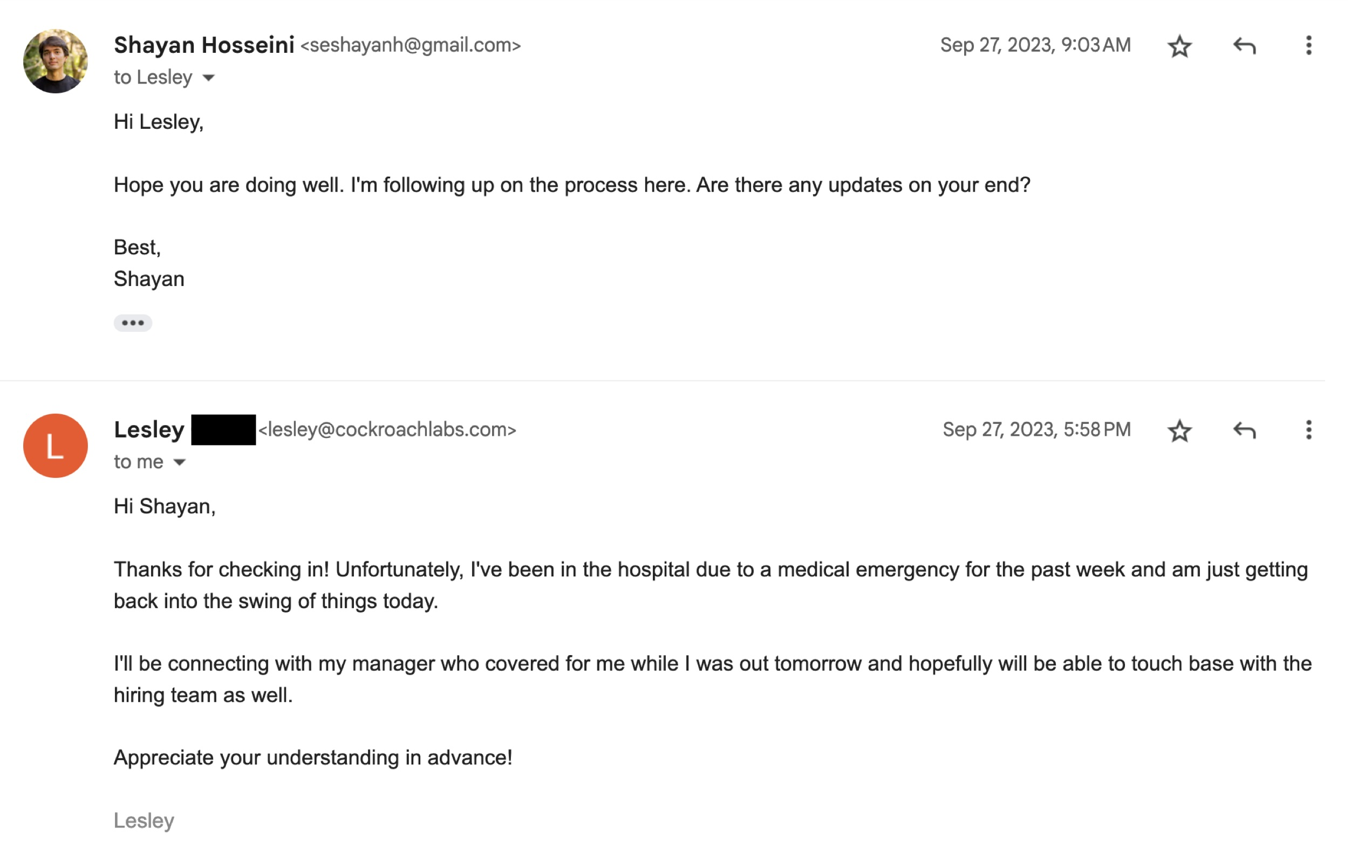
Caveat: be ready for the unexpected

Slide 41
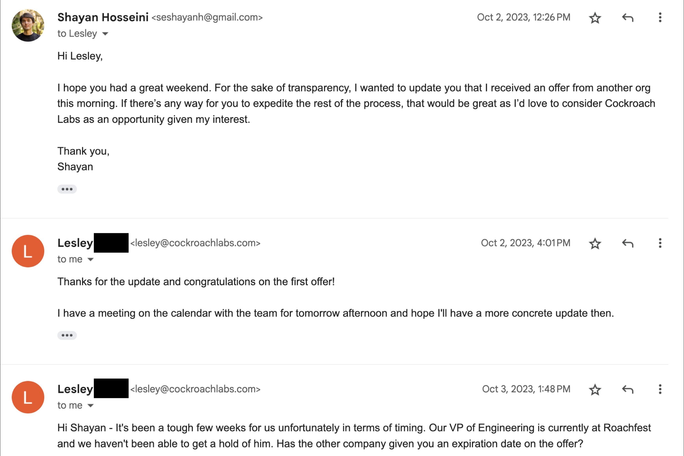

Slide 42
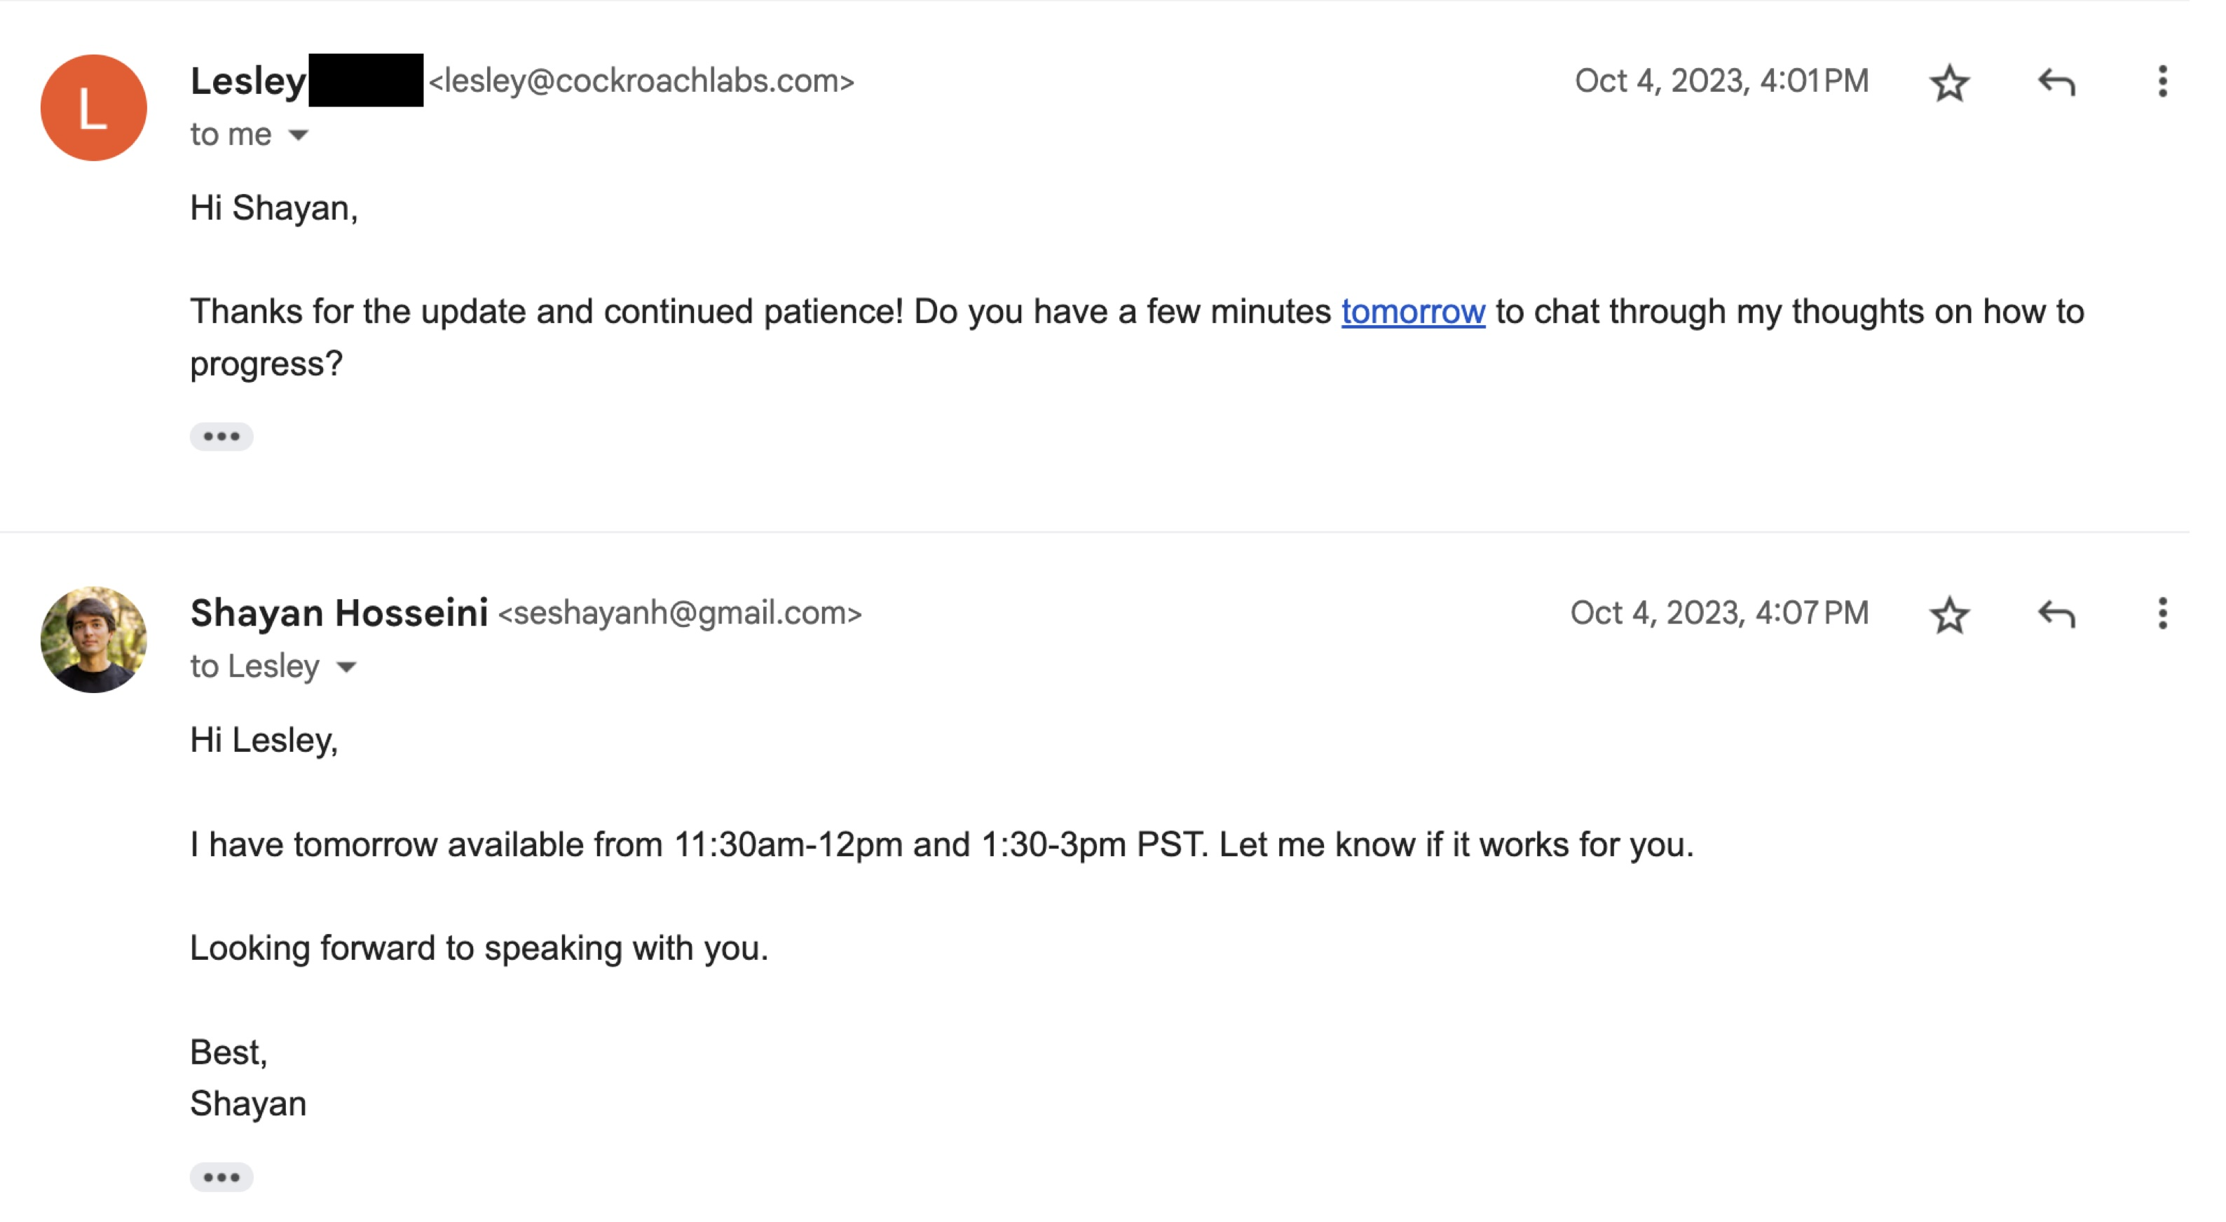

Slide 43
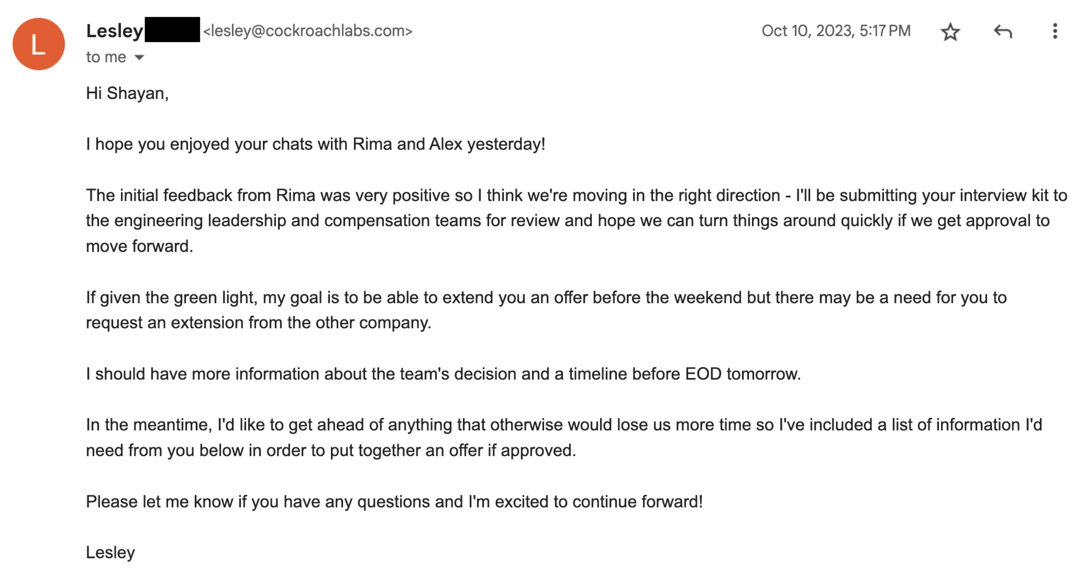

Slide 44
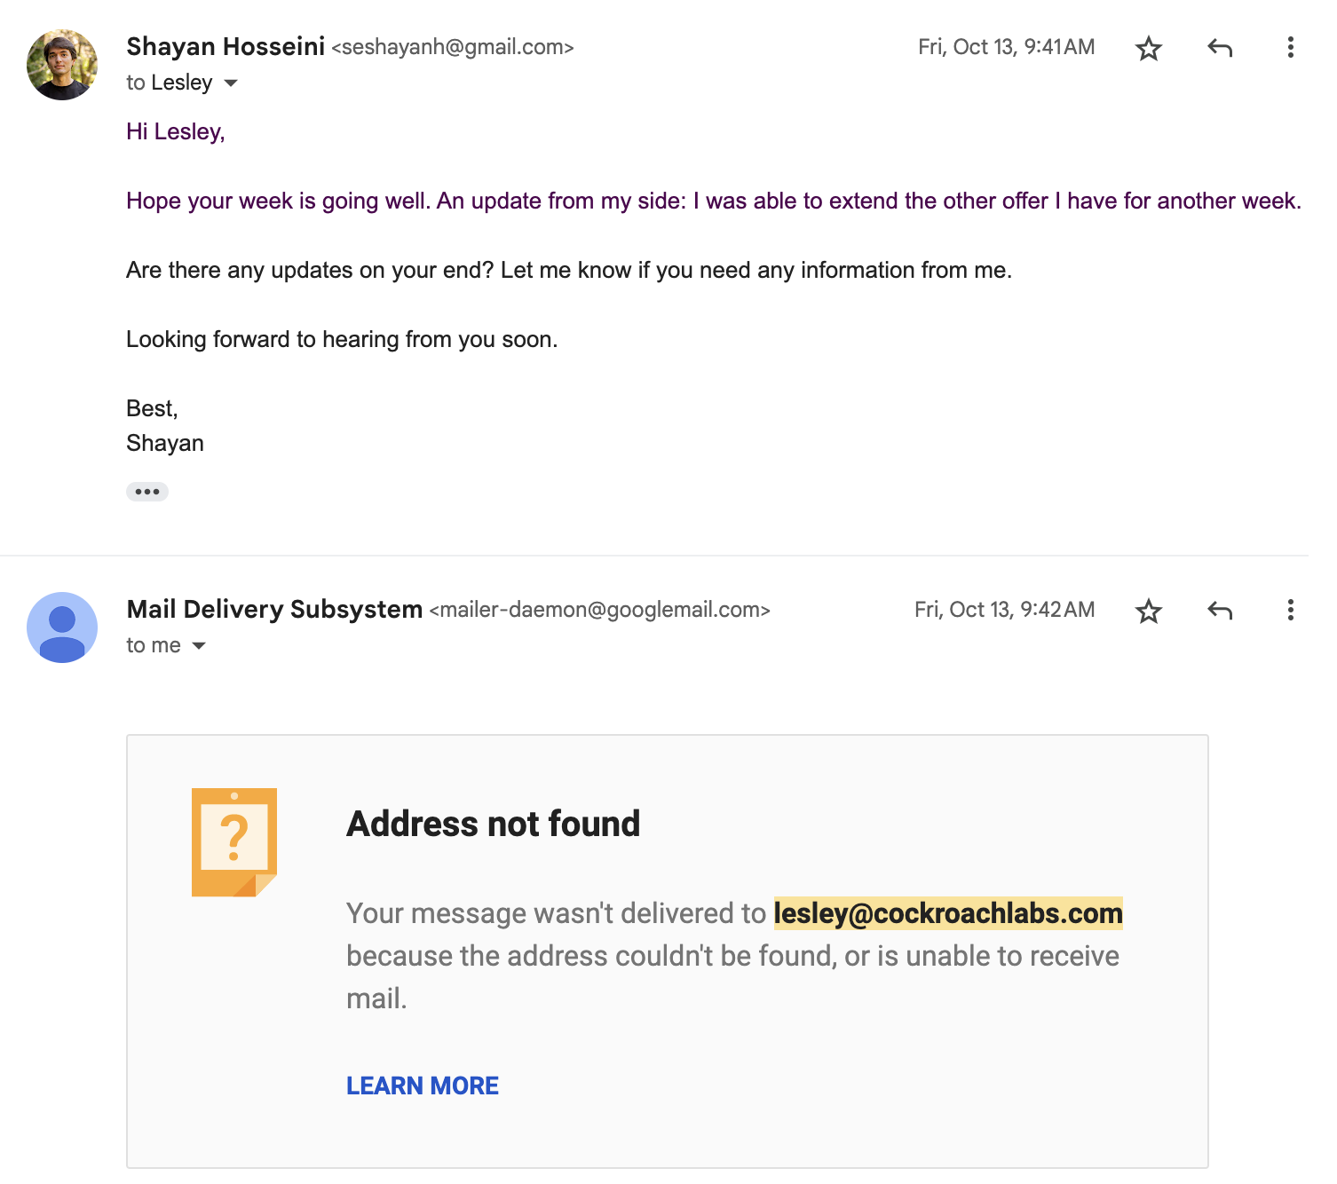

Slide 45
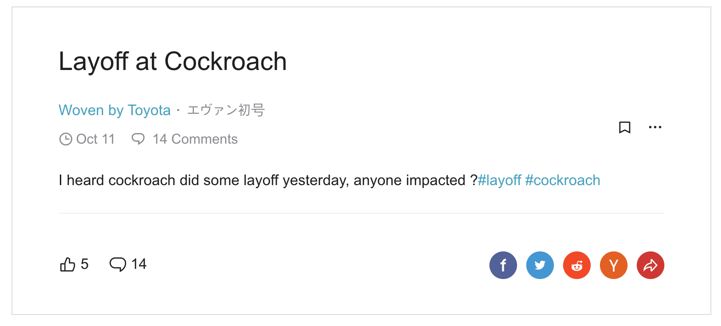

Slide 46
Final thoughts
Thank you all who helped me throughout this process
There a lot of things out of your control
Right place, right time
If you can work in the US, and you fine with it ➡ don’t waste your time here
I’d be more than happy to help about anything related
I joined Neon, a database startup. Check it out: neon.tech

Slide 47
References
Equity 101 for Software Engineers at Big Tech and Startups
Startup options v. cash
Job Hunt as a PhD in AI / ML / RL: How it Actually Happens
Ten Rules for Negotiating a Job Offer
Team Rora
levels.fyi

