Slide 1
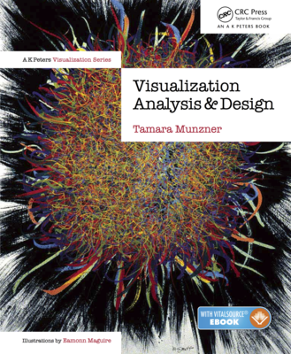
Visualization Analysis & Design
What's Vis, and Why Do It? (Ch 1)
Tamara Munzner
  Department of Computer Science
    University of British Columbia
@tamaramunzner

Slide 2
Defining visualization (vis)
Computer-based visualization systems provide visual representations of datasets designed to help people carry out tasks more effectively.

Slide 3
Defining visualization (vis)
Computer-based visualization systems provide visual representations of datasets designed to help people carry out tasks more effectively.
Why?...

Slide 4


Why have a human in the loop?
Computer-based visualization systems provide visual representations of datasets designed to help people carry out tasks more effectively.

Slide 5
Why have a human in the loop?
Computer-based visualization systems provide visual representations of datasets designed to help people carry out tasks more effectively.
Visualization is suitable when there is a need to augment human capabilities rather than replace people with computational decision-making methods.

Slide 6
Why have a human in the loop?
Computer-based visualization systems provide visual representations of datasets designed to help people carry out tasks more effectively.
Visualization is suitable when there is a need to augment human capabilities rather than replace people with computational decision-making methods.
don’t need vis when fully automatic solution exists and is trusted
many analysis problems ill-specified
  don’t know exactly what questions to ask in advance
possibilities
  long-term use for end users (ex: exploratory analysis of scientific data)
  presentation of known results (ex: New York Times Upshot)
  stepping stone to assess requirements before developing models
  help automatic solution developers refine & determine parameters
  help end users of automatic solutions verify, build trust

Slide 7

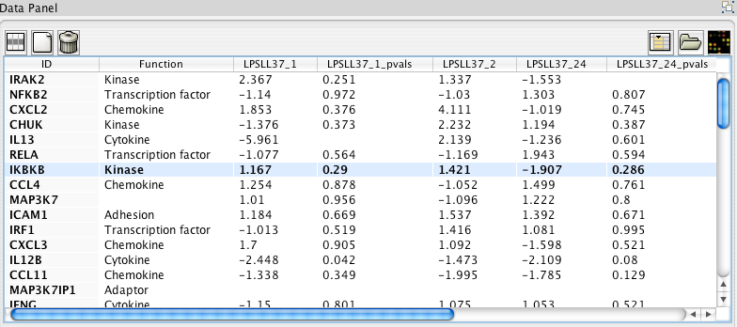
Why use an external representation?
Computer-based visualization systems provide visual representations of datasets designed to help people carry out tasks more effectively.
external representation: replace cognition with perception
[Cerebral: Visualizing Multiple Experimental Conditions on a Graph with Biological Context. Barsky, Munzner, Gardy, and Kincaid. IEEE TVCG (Proc. InfoVis) 14(6):1253-1260, 2008.]

Slide 8
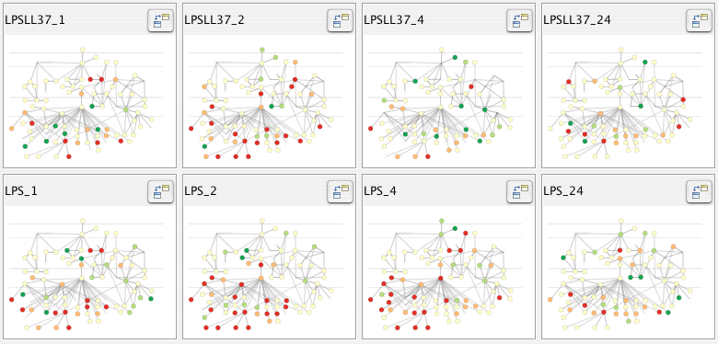

Why use an external representation?
Computer-based visualization systems provide visual representations of datasets designed to help people carry out tasks more effectively.
external representation: replace cognition with perception
[Cerebral: Visualizing Multiple Experimental Conditions on a Graph with Biological Context. Barsky, Munzner, Gardy, and Kincaid. IEEE TVCG (Proc. InfoVis) 14(6):1253-1260, 2008.]

Slide 9

Why depend on vision?
Computer-based visualization systems provide visual representations of datasets designed to help people carry out tasks more effectively.
human visual system is high-bandwidth channel to brain
  overview possible due to background processing
    subjective experience of seeing everything simultaneously
    significant processing occurs in parallel and pre-attentively
sound: lower bandwidth and different semantics
  overview not supported
    subjective experience of sequential stream
touch/haptics: impoverished record/replay capacity
  only very low-bandwidth communication thus far
taste, smell: no viable record/replay devices

Slide 10

Why represent all the data?
Computer-based visualization systems provide visual representations of datasets designed to help people carry out tasks more effectively.
summaries lose information, details matter
  confirm expected and find unexpected patterns
  assess validity of statistical model
    Anscombe’s Quartet
Identical statistics
x mean | 9
x variance | 10
y mean | 7.5
y variance | 3.75
x/y correlation | 0.816

Slide 11
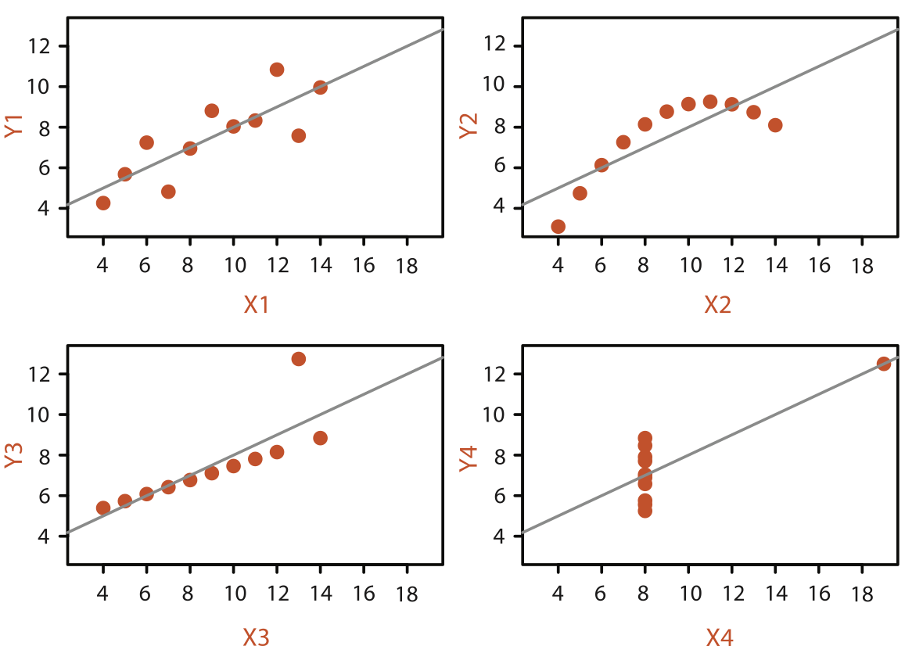
Why represent all the data?
Computer-based visualization systems provide visual representations of datasets designed to help people carry out tasks more effectively.
summaries lose information, details matter
  confirm expected and find unexpected patterns
  assess validity of statistical model
    Anscombe’s Quartet
Identical statistics
x mean | 9
x variance | 10
y mean | 7.5
y variance | 3.75
x/y correlation | 0.816

Slide 12
What resource limitations are we faced with?
Vis designers must take into account three very different kinds of resource limitations: those of computers, of humans, and of displays.
computational limits
  computation time, system memory
display limits
  pixels are precious & most constrained resource
  information density: ratio of space used to encode info vs unused whitespace
    tradeoff between clutter and wasting space
    find sweet spot between dense and sparse
human limits
  human time, human memory, human attention

Slide 13
Why analyze?
imposes structure on
huge design space
  scaffold to help you think systematically about choices
  analyzing existing as stepping stone to designing new
  most possibilities ineffective for particular task/data combination

Slide 14
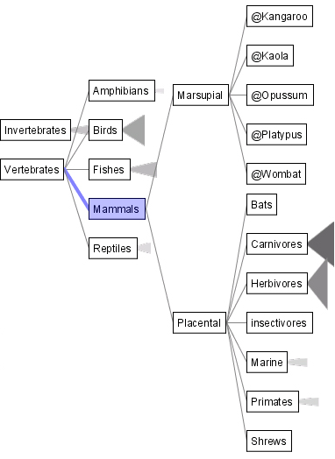
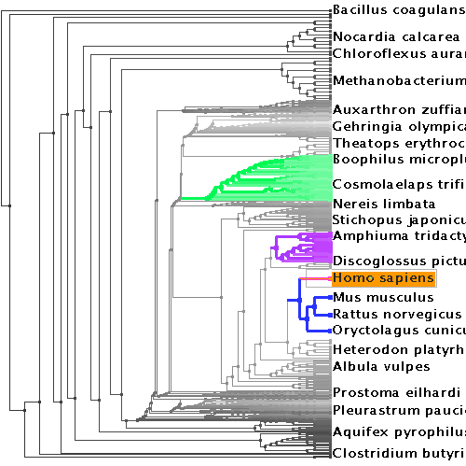
Why analyze?
SpaceTree
TreeJuxtaposer
imposes structure on
huge design space
  scaffold to help you think systematically about choices
  analyzing existing as stepping stone to designing new
  most possibilities ineffective for particular task/data combination
[SpaceTree: Supporting Exploration in Large Node Link Tree, Design Evolution and Empirical Evaluation. Grosjean, Plaisant, and Bederson. Proc. InfoVis 2002, p 57–64.]
[TreeJuxtaposer: Scalable Tree Comparison Using Focus+Context With Guaranteed Visibility. ACM Trans. on Graphics (Proc. SIGGRAPH) 22:453– 462, 2003.]

Slide 15
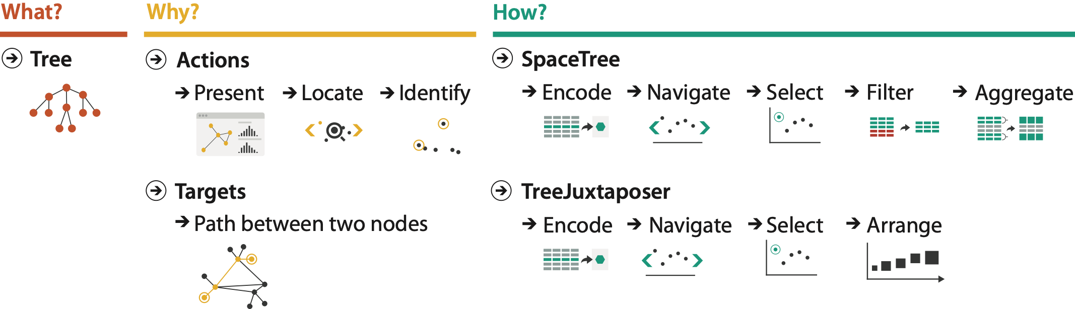
Why analyze?
SpaceTree
TreeJuxtaposer
imposes structure on
huge design space
  scaffold to help you think systematically about choices
  analyzing existing as stepping stone to designing new
  most possibilities ineffective for particular task/data combination
[SpaceTree: Supporting Exploration in Large Node Link Tree, Design Evolution and Empirical Evaluation. Grosjean, Plaisant, and Bederson. Proc. InfoVis 2002, p 57–64.]
[TreeJuxtaposer: Scalable Tree Comparison Using Focus+Context With Guaranteed Visibility. ACM Trans. on Graphics (Proc. SIGGRAPH) 22:453– 462, 2003.]

Slide 16
Visualization Analysis & Design
Analysis: Nested Model (Ch 4)
Tamara Munzner
  Department of Computer Science
    University of British Columbia
@tamaramunzner

Slide 17
Analysis framework: Four levels, three questions
domain situation
  who are the target users?
domain
[A Nested Model of Visualization Design and Validation. Munzner. IEEE TVCG 15(6):921-928, 2009 (Proc. InfoVis 2009). ]

Slide 18
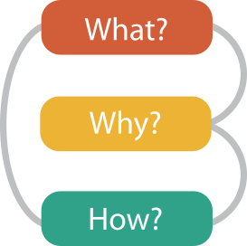
Analysis framework: Four levels, three questions
domain situation
  who are the target users?
abstraction
  translate from specifics of domain to vocabulary of vis
    what is shown? data abstraction
    why is the user looking at it? task abstraction
domain
abstraction
[A Multi-Level Typology of Abstract Visualization Tasks. Brehmer and Munzner. IEEE TVCG 19(12):2376-2385, 2013 (Proc. InfoVis 2013). ]
[A Nested Model of Visualization Design and Validation. Munzner. IEEE TVCG 15(6):921-928, 2009 (Proc. InfoVis 2009). ]

Slide 19
Analysis framework: Four levels, three questions
domain situation
  who are the target users?
abstraction
  translate from specifics of domain to vocabulary of vis
    what is shown? data abstraction
    why is the user looking at it? task abstraction
idiom
  how is it shown?
    visual encoding idiom: how to draw
    interaction idiom: how to manipulate
domain
abstraction
idiom
[A Multi-Level Typology of Abstract Visualization Tasks. Brehmer and Munzner. IEEE TVCG 19(12):2376-2385, 2013 (Proc. InfoVis 2013). ]
[A Nested Model of Visualization Design and Validation. Munzner. IEEE TVCG 15(6):921-928, 2009 (Proc. InfoVis 2009). ]

Slide 20
Analysis framework: Four levels, three questions
domain situation
  who are the target users?
abstraction
  translate from specifics of domain to vocabulary of vis
    what is shown? data abstraction
    why is the user looking at it? task abstraction
idiom
  how is it shown?
    visual encoding idiom: how to draw
    interaction idiom: how to manipulate
algorithm
  efficient computation
domain
abstraction
idiom
algorithm
[A Multi-Level Typology of Abstract Visualization Tasks. Brehmer and Munzner. IEEE TVCG 19(12):2376-2385, 2013 (Proc. InfoVis 2013). ]
[A Nested Model of Visualization Design and Validation. Munzner. IEEE TVCG 15(6):921-928, 2009 (Proc. InfoVis 2009). ]

Slide 21
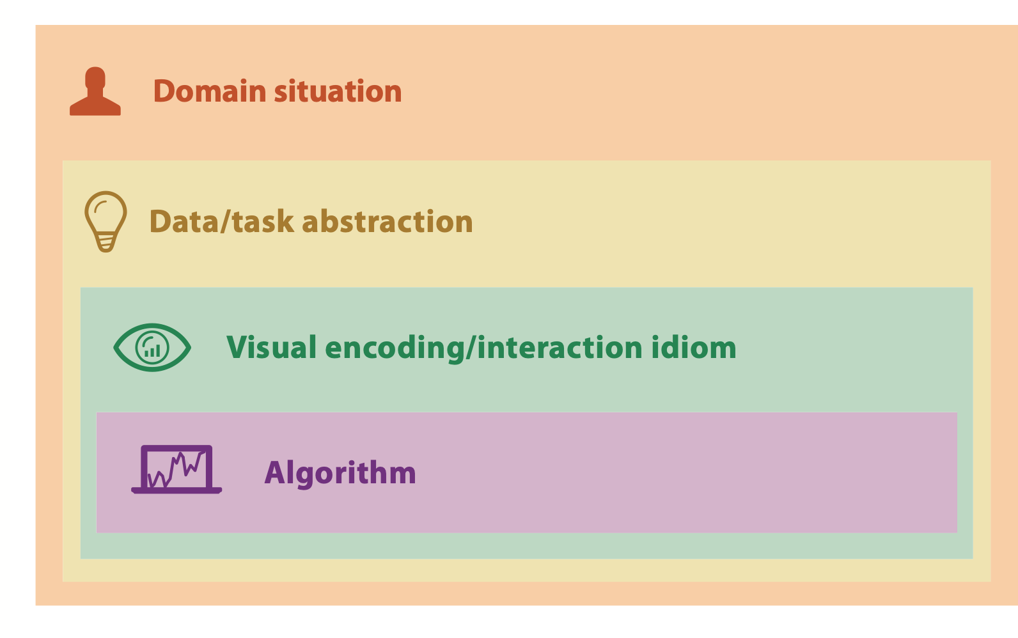

Nested model
downstream: cascading effects
[A Nested Model of Visualization Design and Validation. Munzner. IEEE TVCG 15(6):921-928, 2009 (Proc. InfoVis 2009). ]

Slide 22
Nested model
downstream: cascading effects
upstream: iterative refinement
[A Nested Model of Visualization Design and Validation. Munzner. IEEE TVCG 15(6):921-928, 2009 (Proc. InfoVis 2009). ]

Slide 23
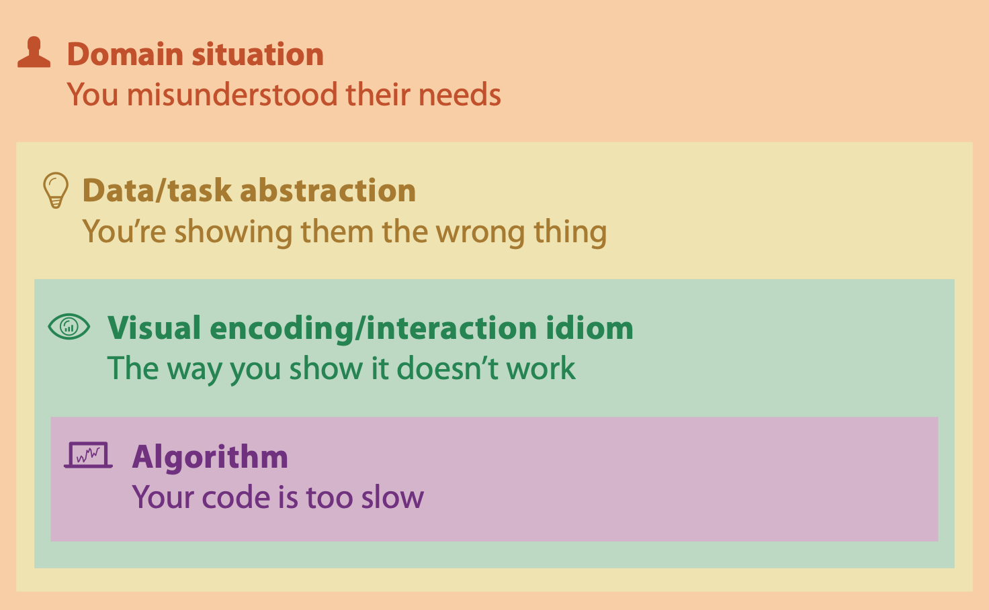
Why is validation difficult?
different ways to get it wrong at each level
[A Nested Model of Visualization Design and Validation. Munzner. IEEE TVCG 15(6):921-928, 2009 (Proc. InfoVis 2009). ]

Slide 24
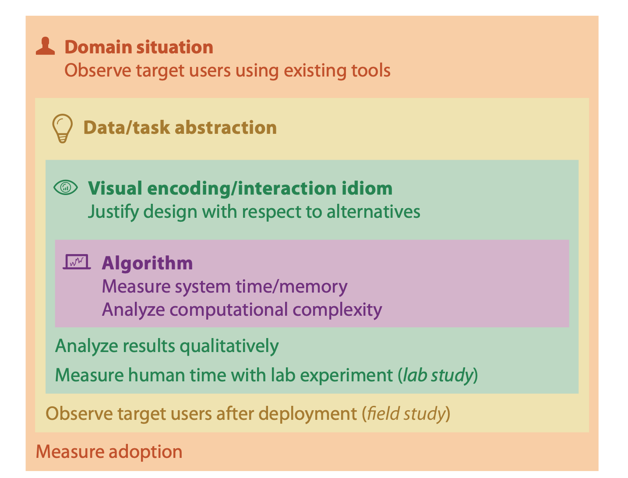
Why is validation difficult?
solution: use methods from different fields at each level
[A Nested Model of Visualization Design and Validation. Munzner. IEEE TVCG 15(6):921-928, 2009 (Proc. InfoVis 2009). ]

Slide 25
Why is validation difficult?
solution: use methods from different fields at each level
  computer science
  technique-driven work
[A Nested Model of Visualization Design and Validation. Munzner. IEEE TVCG 15(6):921-928, 2009 (Proc. InfoVis 2009). ]

Slide 26
Why is validation difficult?
solution: use methods from different fields at each level
  design
  computer science
  technique-driven work
  cognitive psychology
[A Nested Model of Visualization Design and Validation. Munzner. IEEE TVCG 15(6):921-928, 2009 (Proc. InfoVis 2009). ]

Slide 27
Why is validation difficult?
solution: use methods from different fields at each level
  anthropology/
  ethnography
  design
  computer science
  technique-driven work
  cognitive psychology
  anthropology/
  ethnography
[A Nested Model of Visualization Design and Validation. Munzner. IEEE TVCG 15(6):921-928, 2009 (Proc. InfoVis 2009). ]

Slide 28

Why is validation difficult?
solution: use methods from different fields at each level
  problem-driven work (design study)
  anthropology/
  ethnography
  design
  computer science
  technique-driven work
  cognitive psychology
  anthropology/
  ethnography
[A Nested Model of Visualization Design and Validation. Munzner. IEEE TVCG 15(6):921-928, 2009 (Proc. InfoVis 2009). ]

Slide 29

Avoid mismatches
  computational benchmarks do not confirm idiom design
[A Nested Model of Visualization Design and Validation. Munzner. IEEE TVCG 15(6):921-928, 2009 (Proc. InfoVis 2009). ]

Slide 30
Avoid mismatches
  lab studies do not confirm task abstraction
  computational benchmarks do not confirm idiom design
[A Nested Model of Visualization Design and Validation. Munzner. IEEE TVCG 15(6):921-928, 2009 (Proc. InfoVis 2009). ]

Slide 31
Visualization Analysis & Design
Data Abstraction (Ch 2)
Tamara Munzner
  Department of Computer Science
    University of British Columbia
@tamaramunzner

Slide 32
What does data mean?

Slide 33
What does data mean?
14, 2.6, 30, 30, 15, 100001
What does this sequence of six numbers mean?

Slide 34
What does data mean?
14, 2.6, 30, 30, 15, 100001
What does this sequence of six numbers mean?
  two points far from each other in 3D space?

Slide 35
What does data mean?
14, 2.6, 30, 30, 15, 100001
What does this sequence of six numbers mean?
  two points far from each other in 3D space?
  two points close to each other in 2D space, with 15 links between them, and a weight of 100001 for the link?

Slide 36
What does data mean?
14, 2.6, 30, 30, 15, 100001
What does this sequence of six numbers mean?
  two points far from each other in 3D space?
  two points close to each other in 2D space, with 15 links between them, and a weight of 100001 for the link?
  something else??

Slide 37
What does data mean?
14, 2.6, 30, 30, 15, 100001
What does this sequence of six numbers mean?
  two points far from each other in 3D space?
  two points close to each other in 2D space, with 15 links between them, and a weight of 100001 for the link?
  something else??
Basil, 7, S, Pear

Slide 38
What does data mean?
14, 2.6, 30, 30, 15, 100001
What does this sequence of six numbers mean?
  two points far from each other in 3D space?
  two points close to each other in 2D space, with 15 links between them, and a weight of 100001 for the link?
  something else??
Basil, 7, S, Pear
What about this data?

Slide 39
What does data mean?
14, 2.6, 30, 30, 15, 100001
What does this sequence of six numbers mean?
  two points far from each other in 3D space?
  two points close to each other in 2D space, with 15 links between them, and a weight of 100001 for the link?
  something else??
Basil, 7, S, Pear
What about this data?
  food shipment of produce (basil & pear) arrived in satisfactory condition on 7th day of month

Slide 40
What does data mean?
14, 2.6, 30, 30, 15, 100001
What does this sequence of six numbers mean?
  two points far from each other in 3D space?
  two points close to each other in 2D space, with 15 links between them, and a weight of 100001 for the link?
  something else??
Basil, 7, S, Pear
What about this data?
  food shipment of produce (basil & pear) arrived in satisfactory condition on 7th day of month
  Basil Point neighborhood of city had 7 inches of snow cleared by the Pear Creek Limited snow removal service

Slide 41
What does data mean?
14, 2.6, 30, 30, 15, 100001
What does this sequence of six numbers mean?
  two points far from each other in 3D space?
  two points close to each other in 2D space, with 15 links between them, and a weight of 100001 for the link?
  something else??
Basil, 7, S, Pear
What about this data?
  food shipment of produce (basil & pear) arrived in satisfactory condition on 7th day of month
  Basil Point neighborhood of city had 7 inches of snow cleared by the Pear Creek Limited snow removal service
  lab rat Basil made 7 attempts to find way through south section of maze, these trials used pear as reward food

Slide 42
Now what?
semantics: real-world meaning

Slide 43
Now what?
semantics: real-world meaning

Slide 44
Now what?
semantics: real-world meaning
data types: structural or mathematical interpretation of data
  item, link, attribute, position, (grid)
  different from data types in
  programming!

Slide 45
Items & Attributes
item: individual entity, discrete
  eg patient, car, stock, city
  "independent variable"

Slide 46
Items & Attributes
item: individual entity, discrete
  eg patient, car, stock, city
  "independent variable"
  item: person

Slide 47
Items & Attributes
item: individual entity, discrete
  eg patient, car, stock, city
  "independent variable"
attribute: property that is measured, observed, logged...
  eg height, blood pressure for patient
  eg horsepower, make for car
  "dependent variable"
  item: person

Slide 48




Items & Attributes
  attributes: name, age, shirt size, fave fruit
item: individual entity, discrete
  eg patient, car, stock, city
  "independent variable"
attribute: property that is measured, observed, logged...
  eg height, blood pressure for patient
  eg horsepower, make for car
  "dependent variable"
  item: person

Slide 49
Other data types
links
  express relationship between two items
  eg friendship on facebook, interaction between proteins
positions
  spatial data: location in 2D or 3D
  pixels in photo, voxels in MRI scan, latitude/longitude
grids
  sampling strategy for continuous data

Slide 50
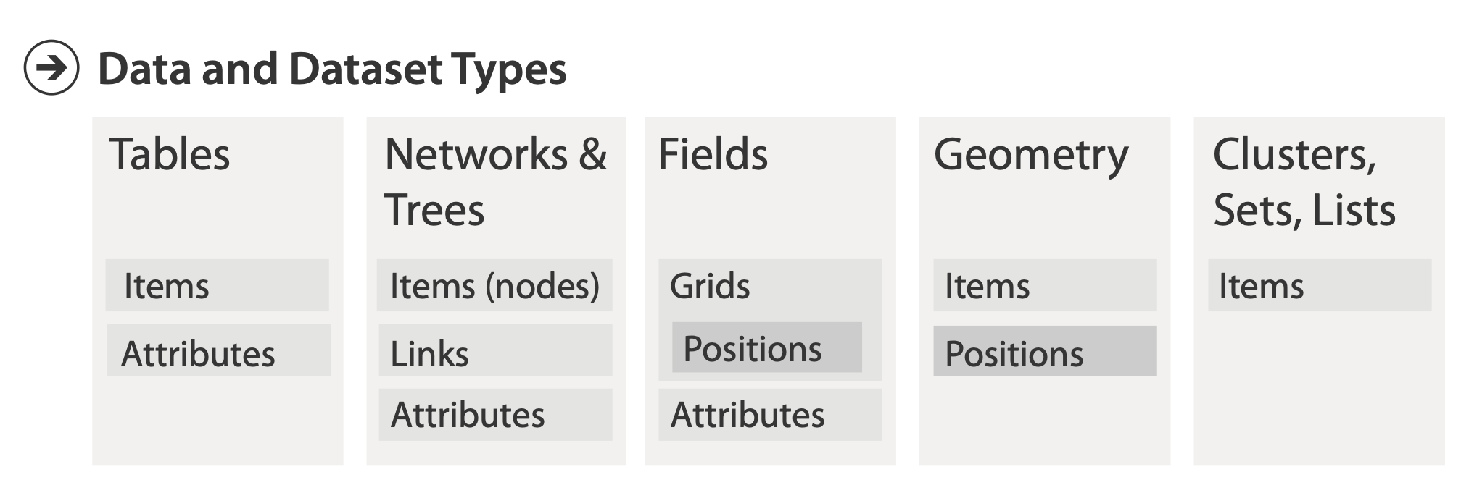
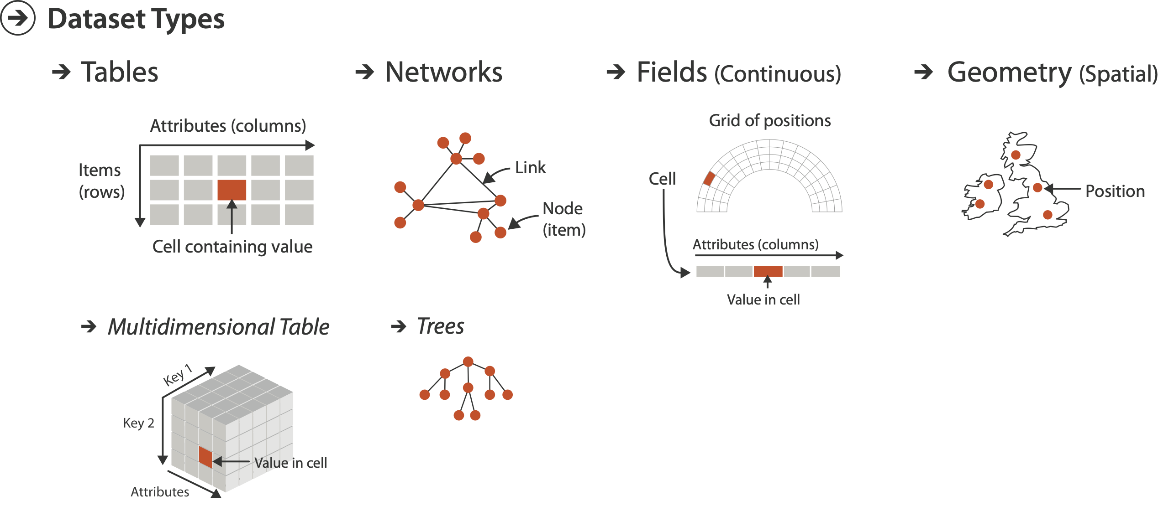
Dataset types
  attributes: name, age, shirt size, fave fruit
flat table
  one item per row
  each column is attribute
  cell holds value for item-attribute pair
  item: person

Slide 51
Dataset types
  attributes: name, age, shirt size, fave fruit
flat table
  one item per row
  each column is attribute
  cell holds value for item-attribute pair
  unique key
  (could be implicit)
  item: person

Slide 52
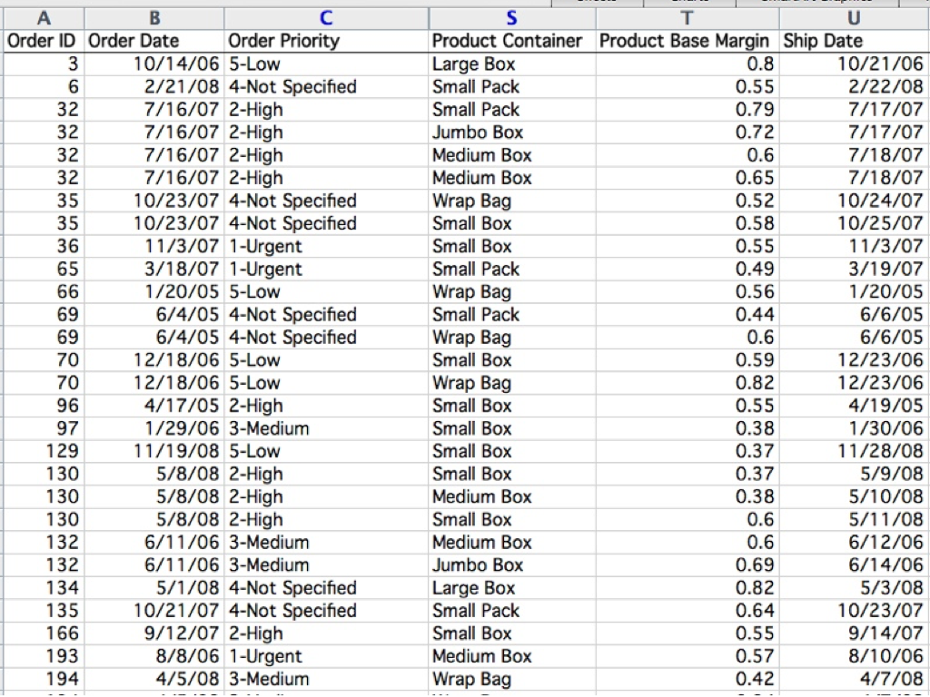
Table

Slide 53

Table
item

Slide 54


Table
item
attribute

Slide 55

Table
item
cell
attribute

Slide 56
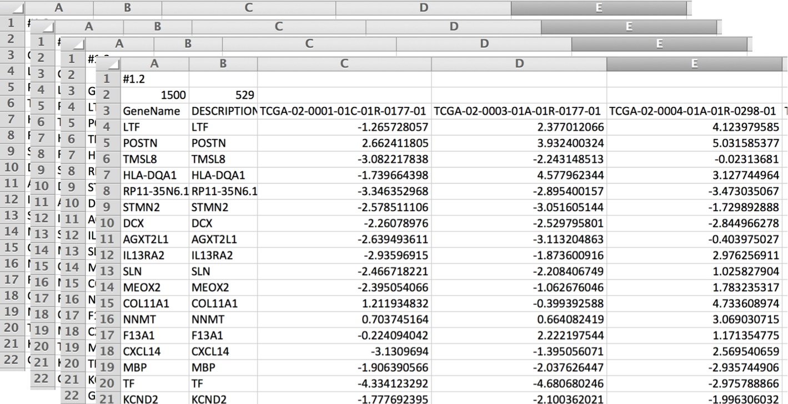
Dataset types
multidimensional tables
  indexing based on multiple keys
    eg genes, patients

Slide 57
Dataset types
network/graph
  nodes (vertices) connected by links (edges)
  tree is special case: no cycles
    often have roots and are directed

Slide 58
Dataset types
Spatial

Slide 59
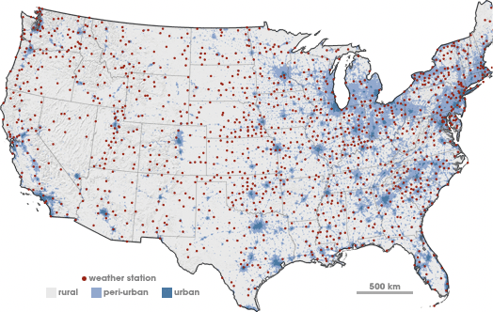
Spatial fields
attribute values associated w/ cells
cell contains value from continuous domain
  eg temperature, pressure, wind velocity
measured or simulated
Spatial

Slide 60
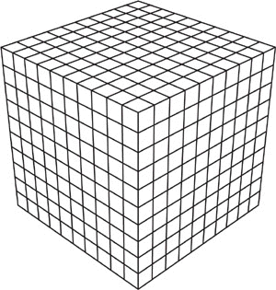


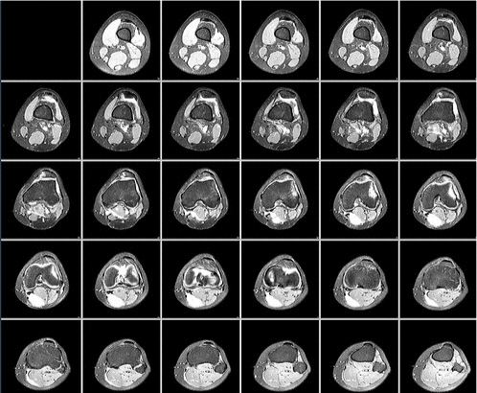
Spatial fields
attribute values associated w/ cells
cell contains value from continuous domain
  eg temperature, pressure, wind velocity
measured or simulated
major concerns
  sampling:
  where attributes are measured
  interpolation:
  how to model attributes elsewhere
  grid types

Slide 61
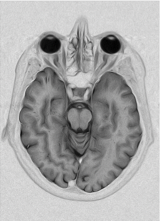

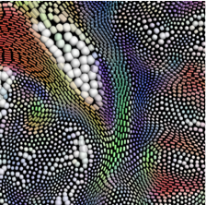
Spatial fields
attribute values associated w/ cells
cell contains value from continuous domain
  eg temperature, pressure, wind velocity
measured or simulated
major concerns
  sampling:
  where attributes are measured
  interpolation:
  how to model attributes elsewhere
  grid types
major divisions
  attributes per cell:
  scalar (1), vector (2), tensor (many)
  scalar
  vector
  tensor

Slide 62
Dataset types
Spatial

Slide 63
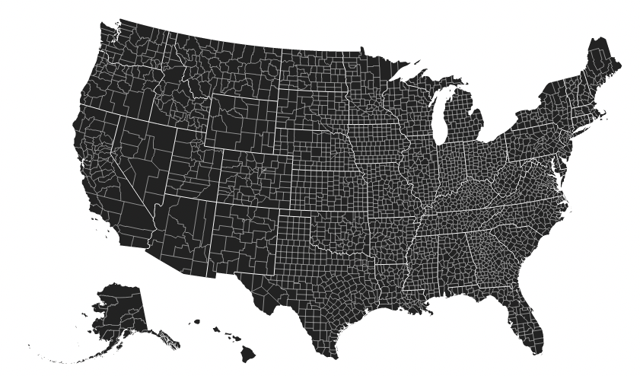
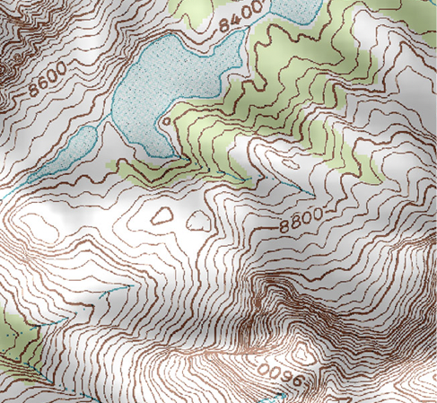
Geometry
shape of items
explicit spatial positions / regions
  points, lines, curves, surfaces, volumes
boundary between computer graphics and visualization
  graphics: geometry taken as given
  vis: geometry is result of a design decision

Slide 64
Dataset types
Spatial

Slide 65
Collections
how we group items

Slide 66
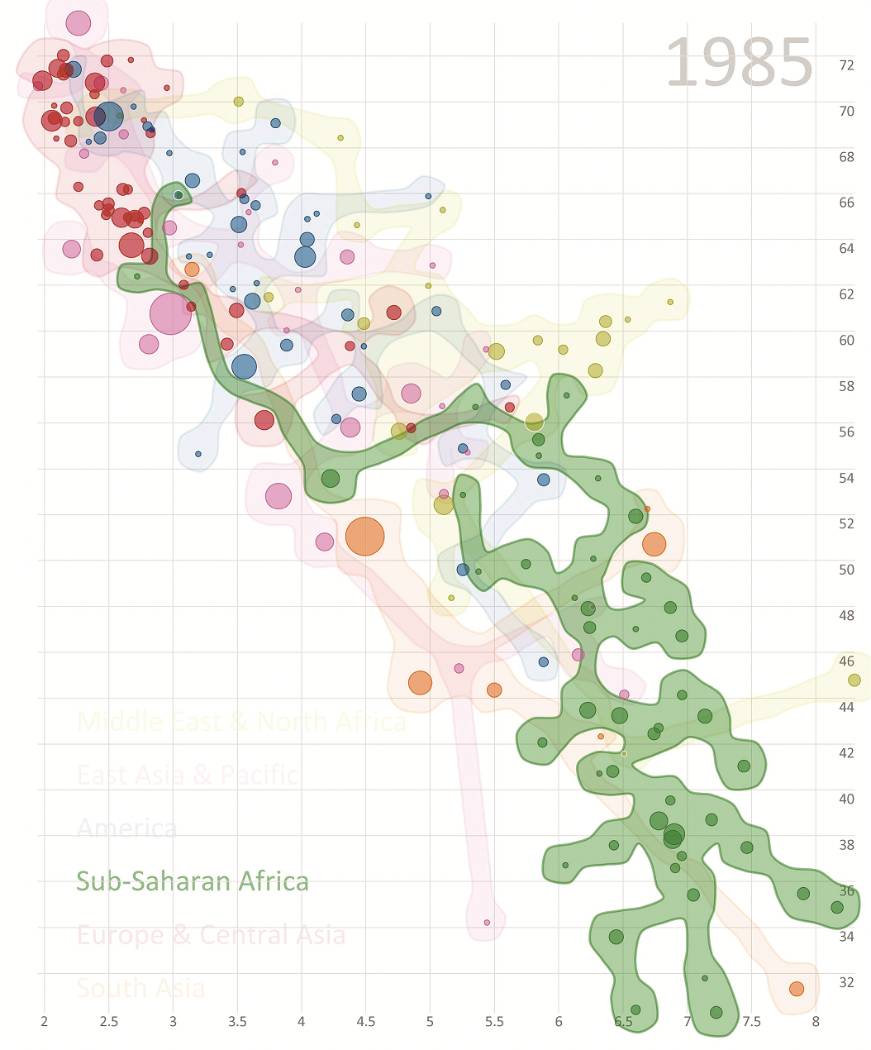
Collections
how we group items
sets
  unique items, unordered

Slide 67
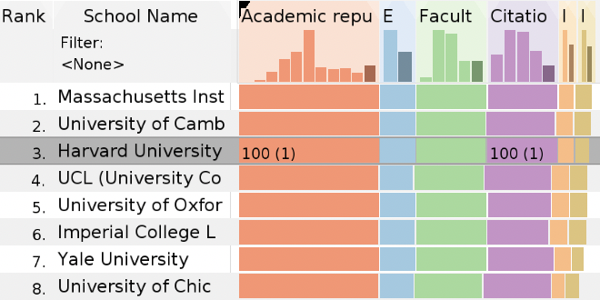
Collections
how we group items
sets
  unique items, unordered
lists
  ordered, duplicates possible

Slide 68
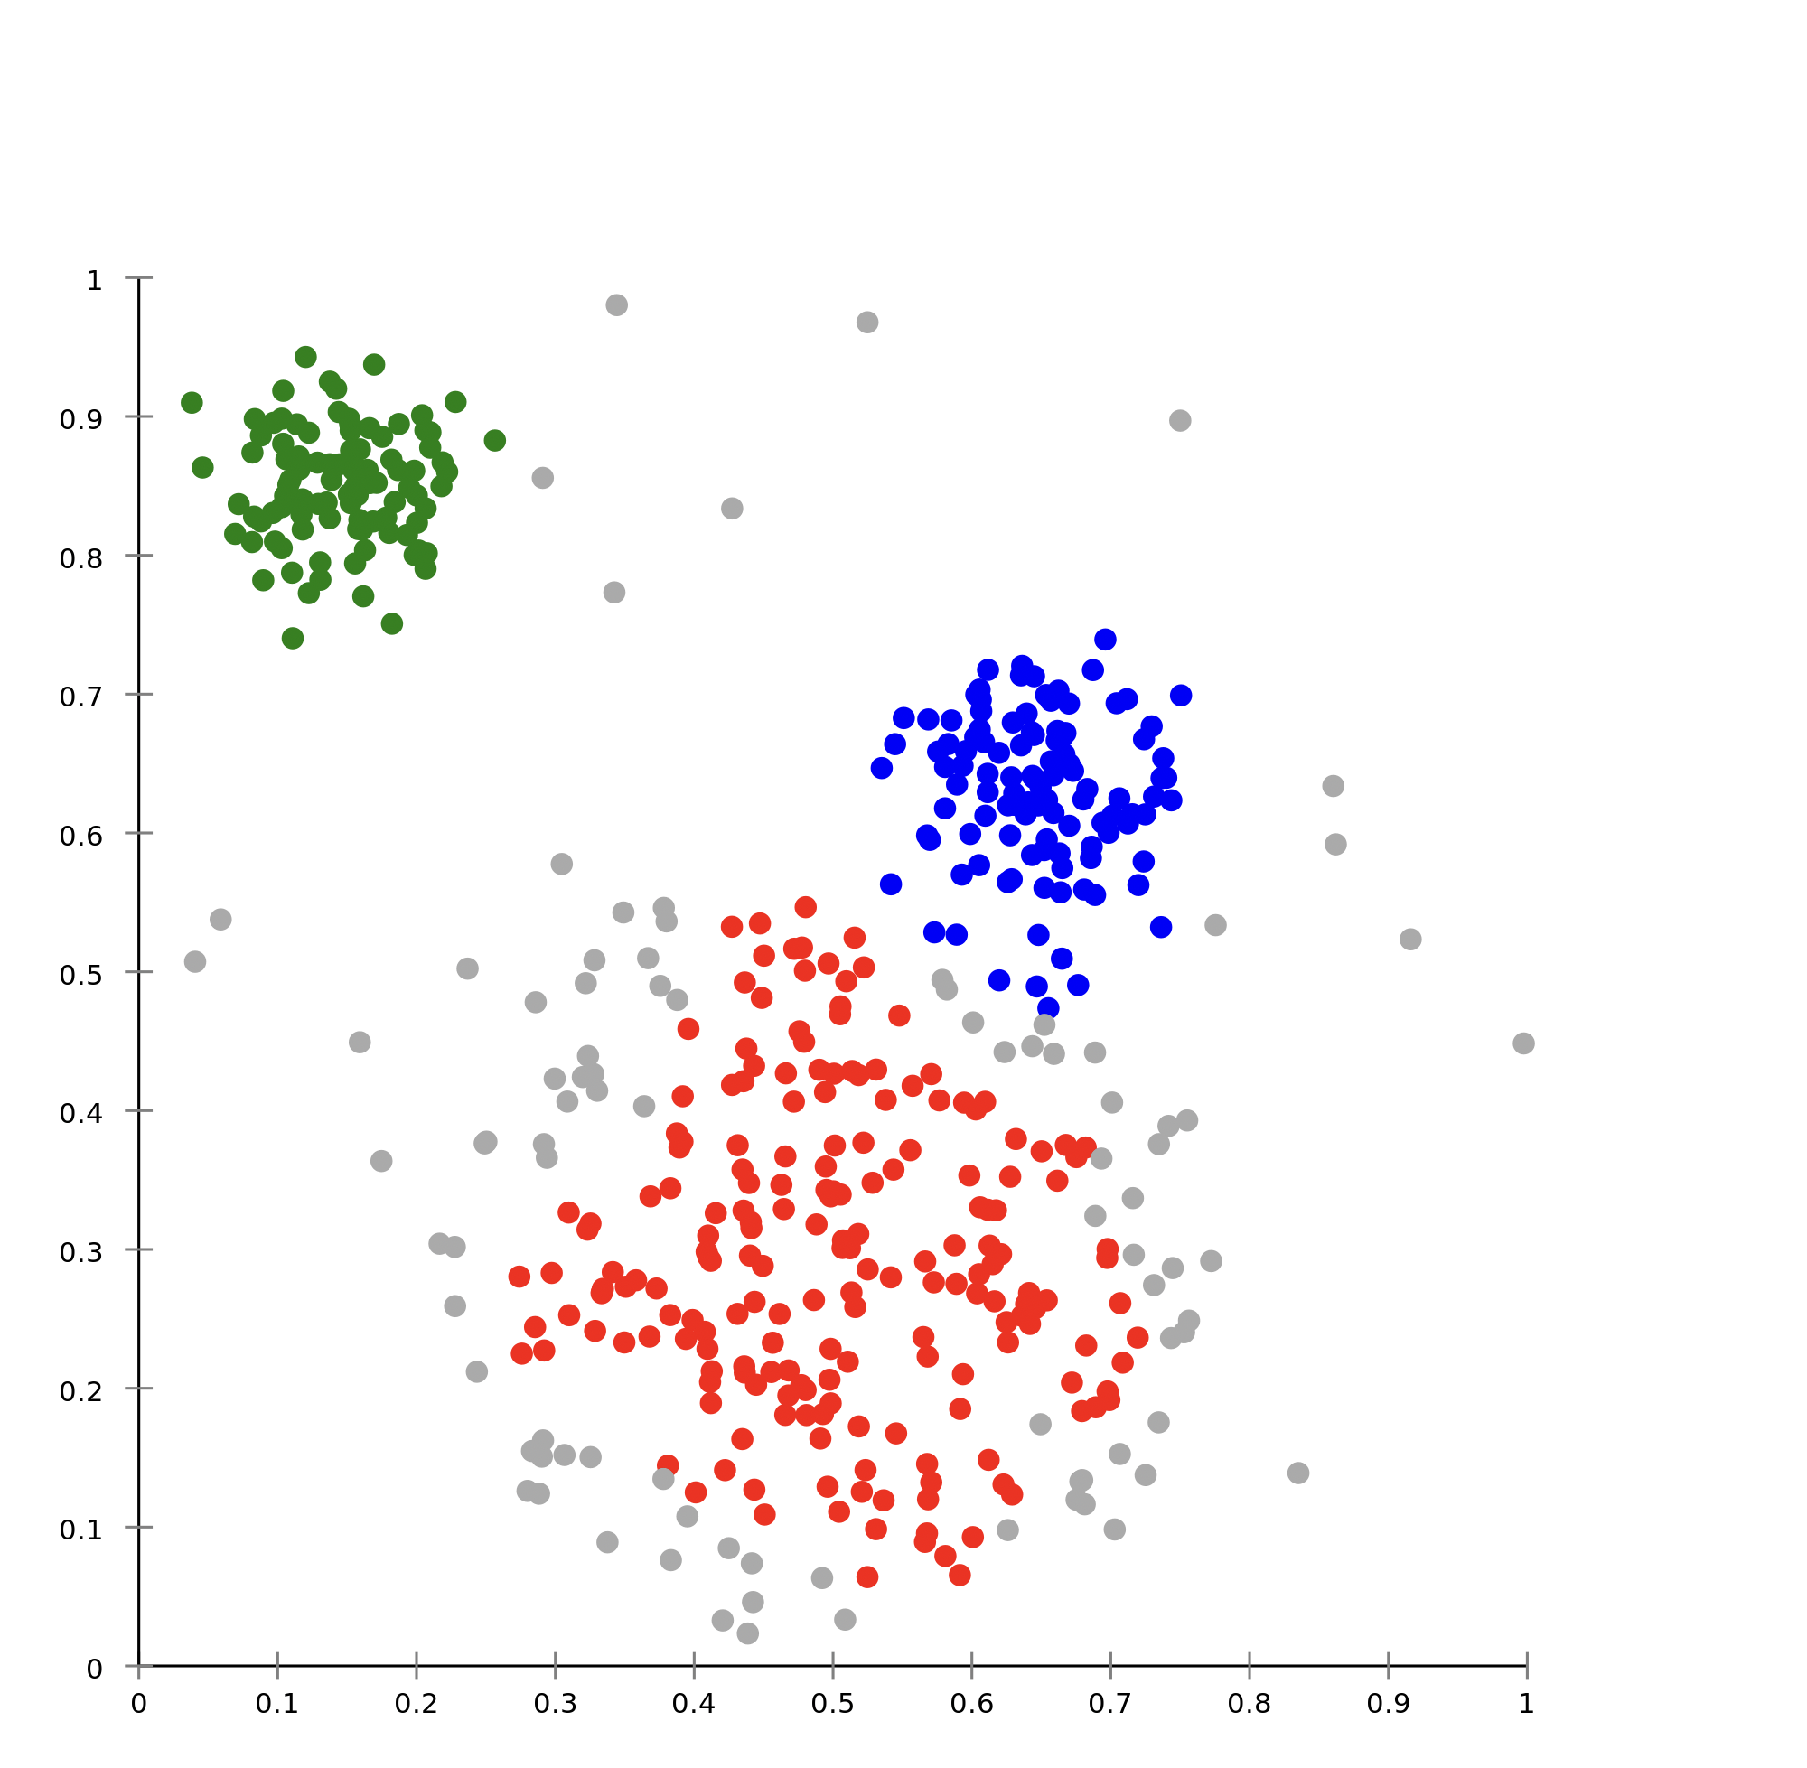
Collections
how we group items
sets
  unique items, unordered
lists
  ordered, duplicates possible
clusters
  groups of similar items

Slide 69
Dataset and data types

Slide 70
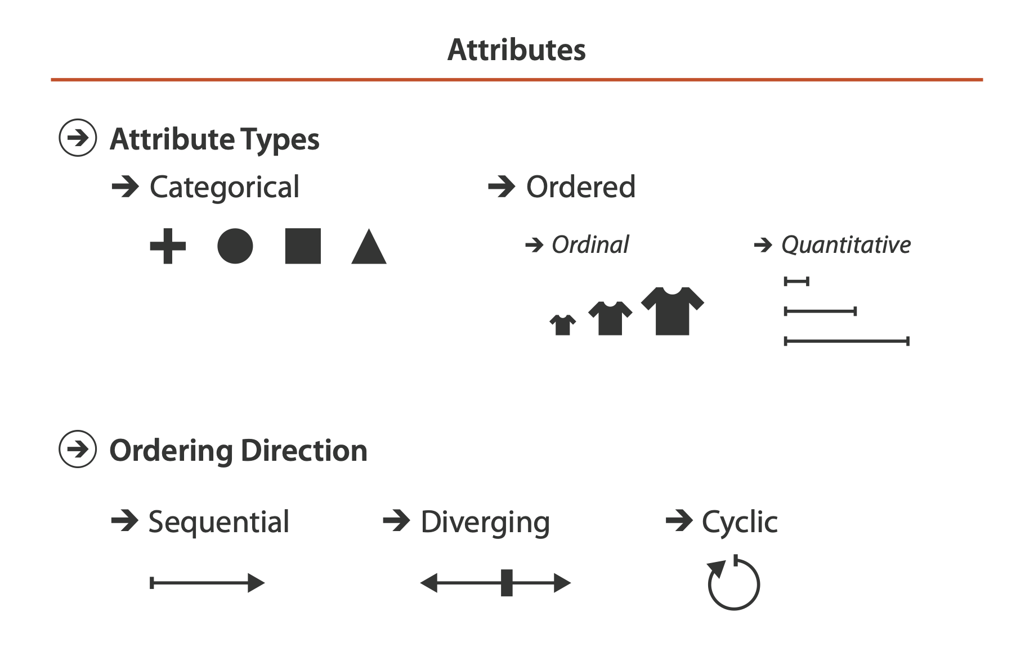
Attribute types
which classes of values & measurements?
categorical (nominal)
  compare equality
  no implicit ordering
ordered
  ordinal
    less/greater than defined
  quantitative
    meaningful magnitude
    arithmetic possible

Slide 71
Table

Slide 72
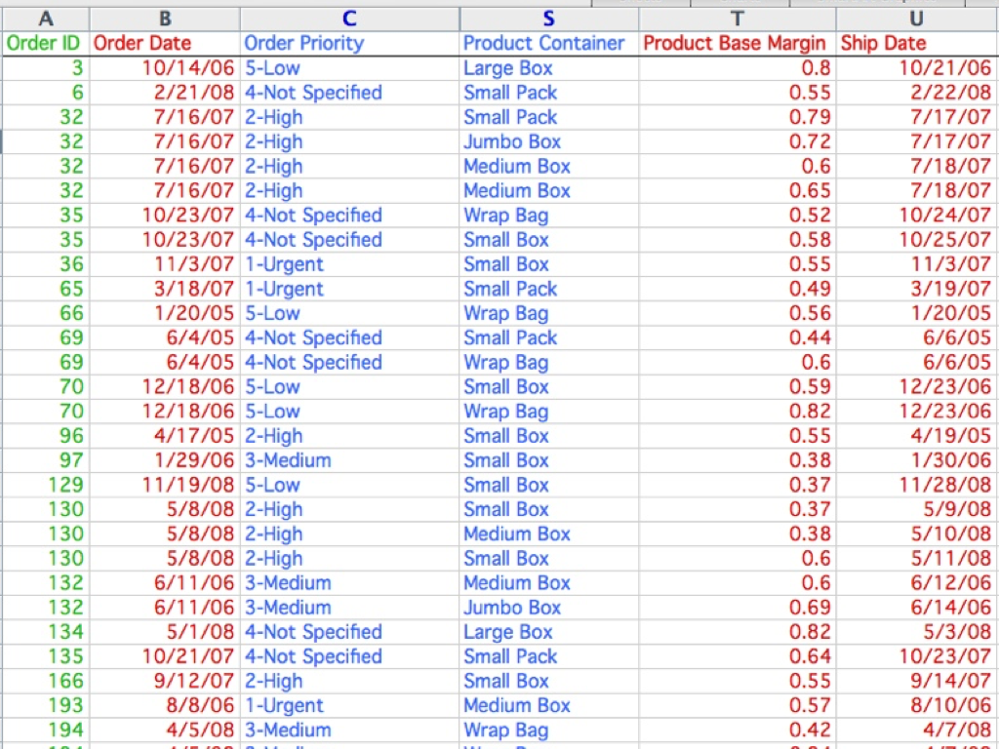
categorical
ordinal
quantitative

Slide 73
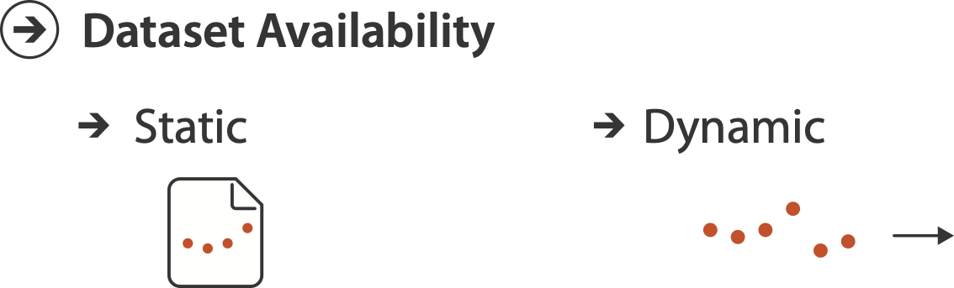
Other data concerns

Slide 74
Data abstraction: Three operations
translate from domain-specific language to generic visualization language
identify dataset type(s), attribute types
identify cardinality
  how many items in the dataset?
  what is cardinality of each attribute?
    number of levels for categorical data
    range for quantitative data
consider whether to transform data
  guided by understanding of task

Slide 75
Data vs conceptual models
data model
  mathematical abstraction
    sets with operations, eg floats with * / - +
    variable data types in programming languages
conceptual model
  mental construction (semantics)
  supports reasoning
  typically based on understanding of tasks [stay tuned!]
data abstraction process relies on conceptual model
  for transforming data if needed

Slide 76
Data vs conceptual model, example

Slide 77
Data vs conceptual model, example
data model: floats
  32.52, 54.06, -14.35, ...

Slide 78
Data vs conceptual model, example
data model: floats
  32.52, 54.06, -14.35, ...
conceptual model
  temperature

Slide 79
Data vs conceptual model, example
data model: floats
  32.52, 54.06, -14.35, ...
conceptual model
  temperature
multiple possible data abstractions

Slide 80
Data vs conceptual model, example
data model: floats
  32.52, 54.06, -14.35, ...
conceptual model
  temperature
multiple possible data abstractions
  continuous to 2 significant figures: quantitative
    task: forecasting the weather

Slide 81
Data vs conceptual model, example
data model: floats
  32.52, 54.06, -14.35, ...
conceptual model
  temperature
multiple possible data abstractions
  continuous to 2 significant figures: quantitative
    task: forecasting the weather
  hot, warm, cold: ordinal
    task: deciding if bath water is ready

Slide 82
Data vs conceptual model, example
data model: floats
  32.52, 54.06, -14.35, ...
conceptual model
  temperature
multiple possible data abstractions
  continuous to 2 significant figures: quantitative
    task: forecasting the weather
  hot, warm, cold: ordinal
    task: deciding if bath water is ready
  above freezing, below freezing: categorical
    task: decide if I should leave the house today

Slide 83
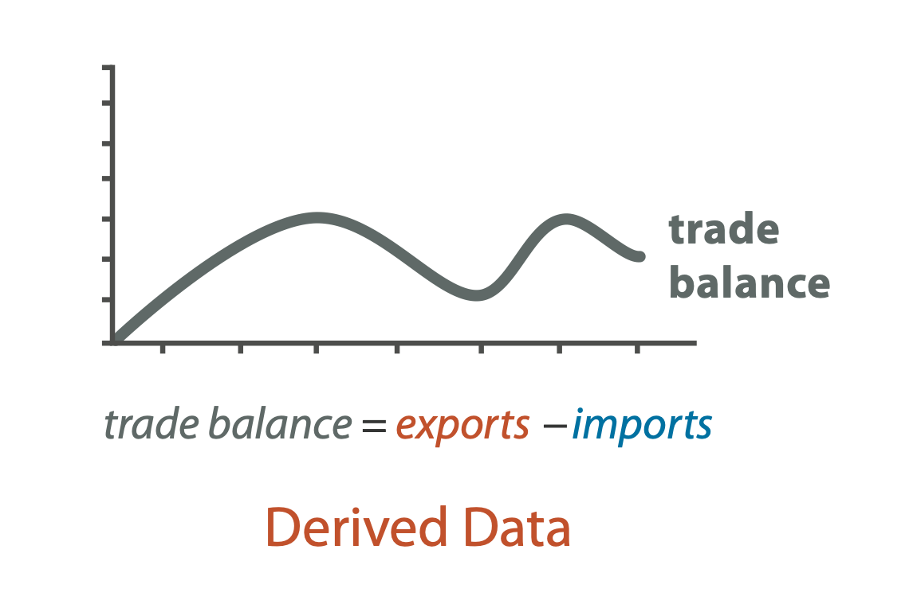
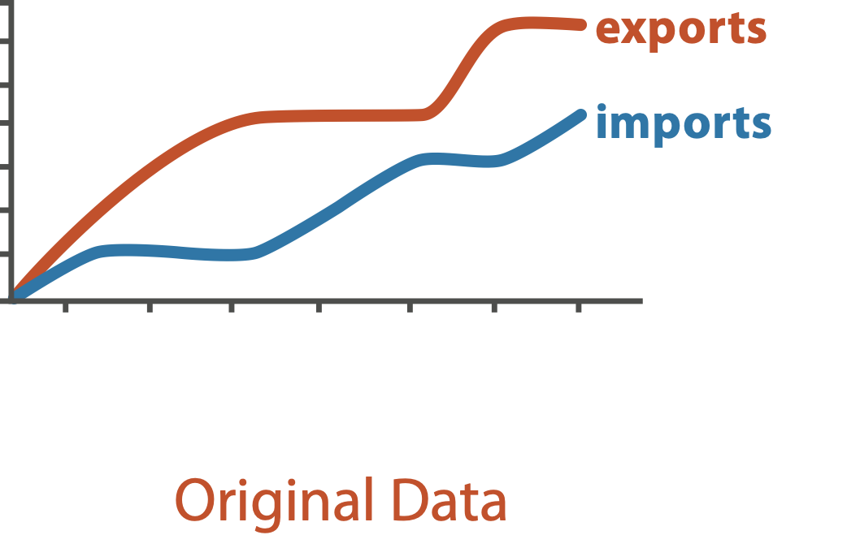
Derived attributes
derived attribute: compute from originals
  simple change of type
  acquire additional data
  complex transformation

Slide 84
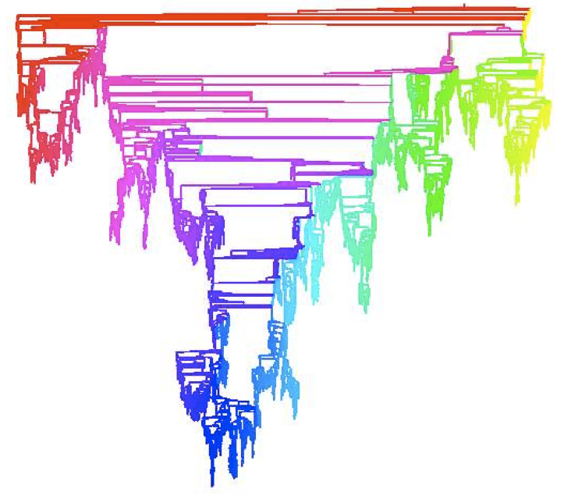
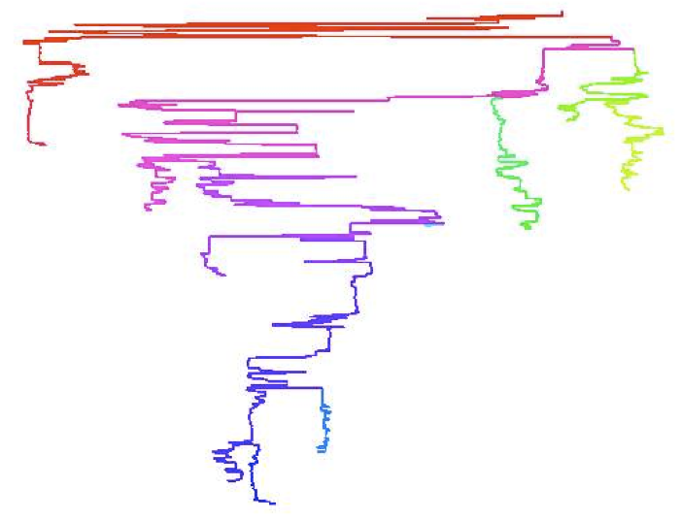
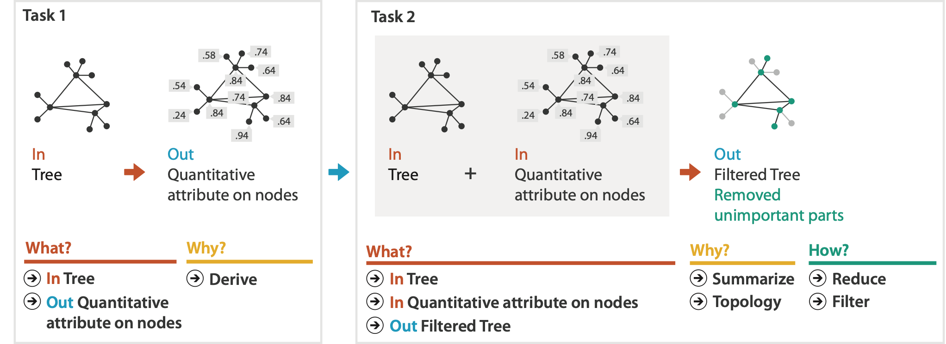
Analysis example: Derive one attribute
Strahler number
  centrality metric for trees/networks
  derived quantitative attribute
  draw top 5K of 500K for good skeleton
[Using Strahler numbers for real time visual exploration of huge graphs. Auber. Proc. Intl. Conf. Computer Vision and Graphics, pp. 56–69, 2002.]

Slide 85
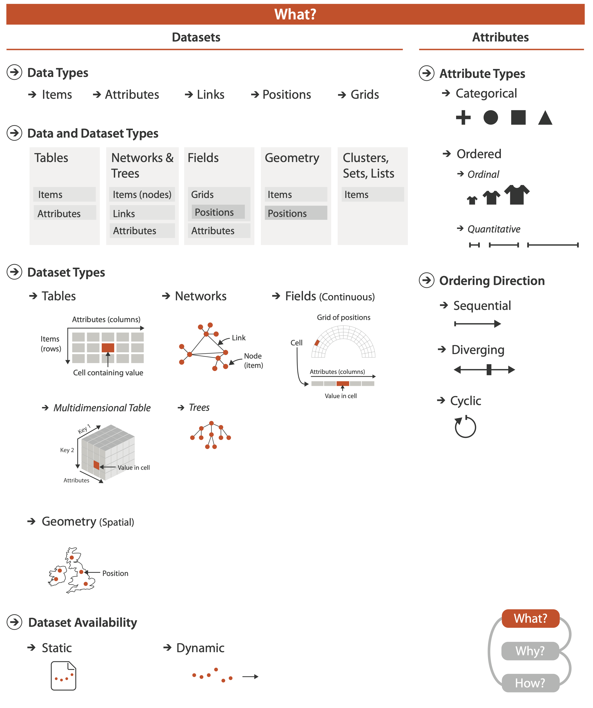
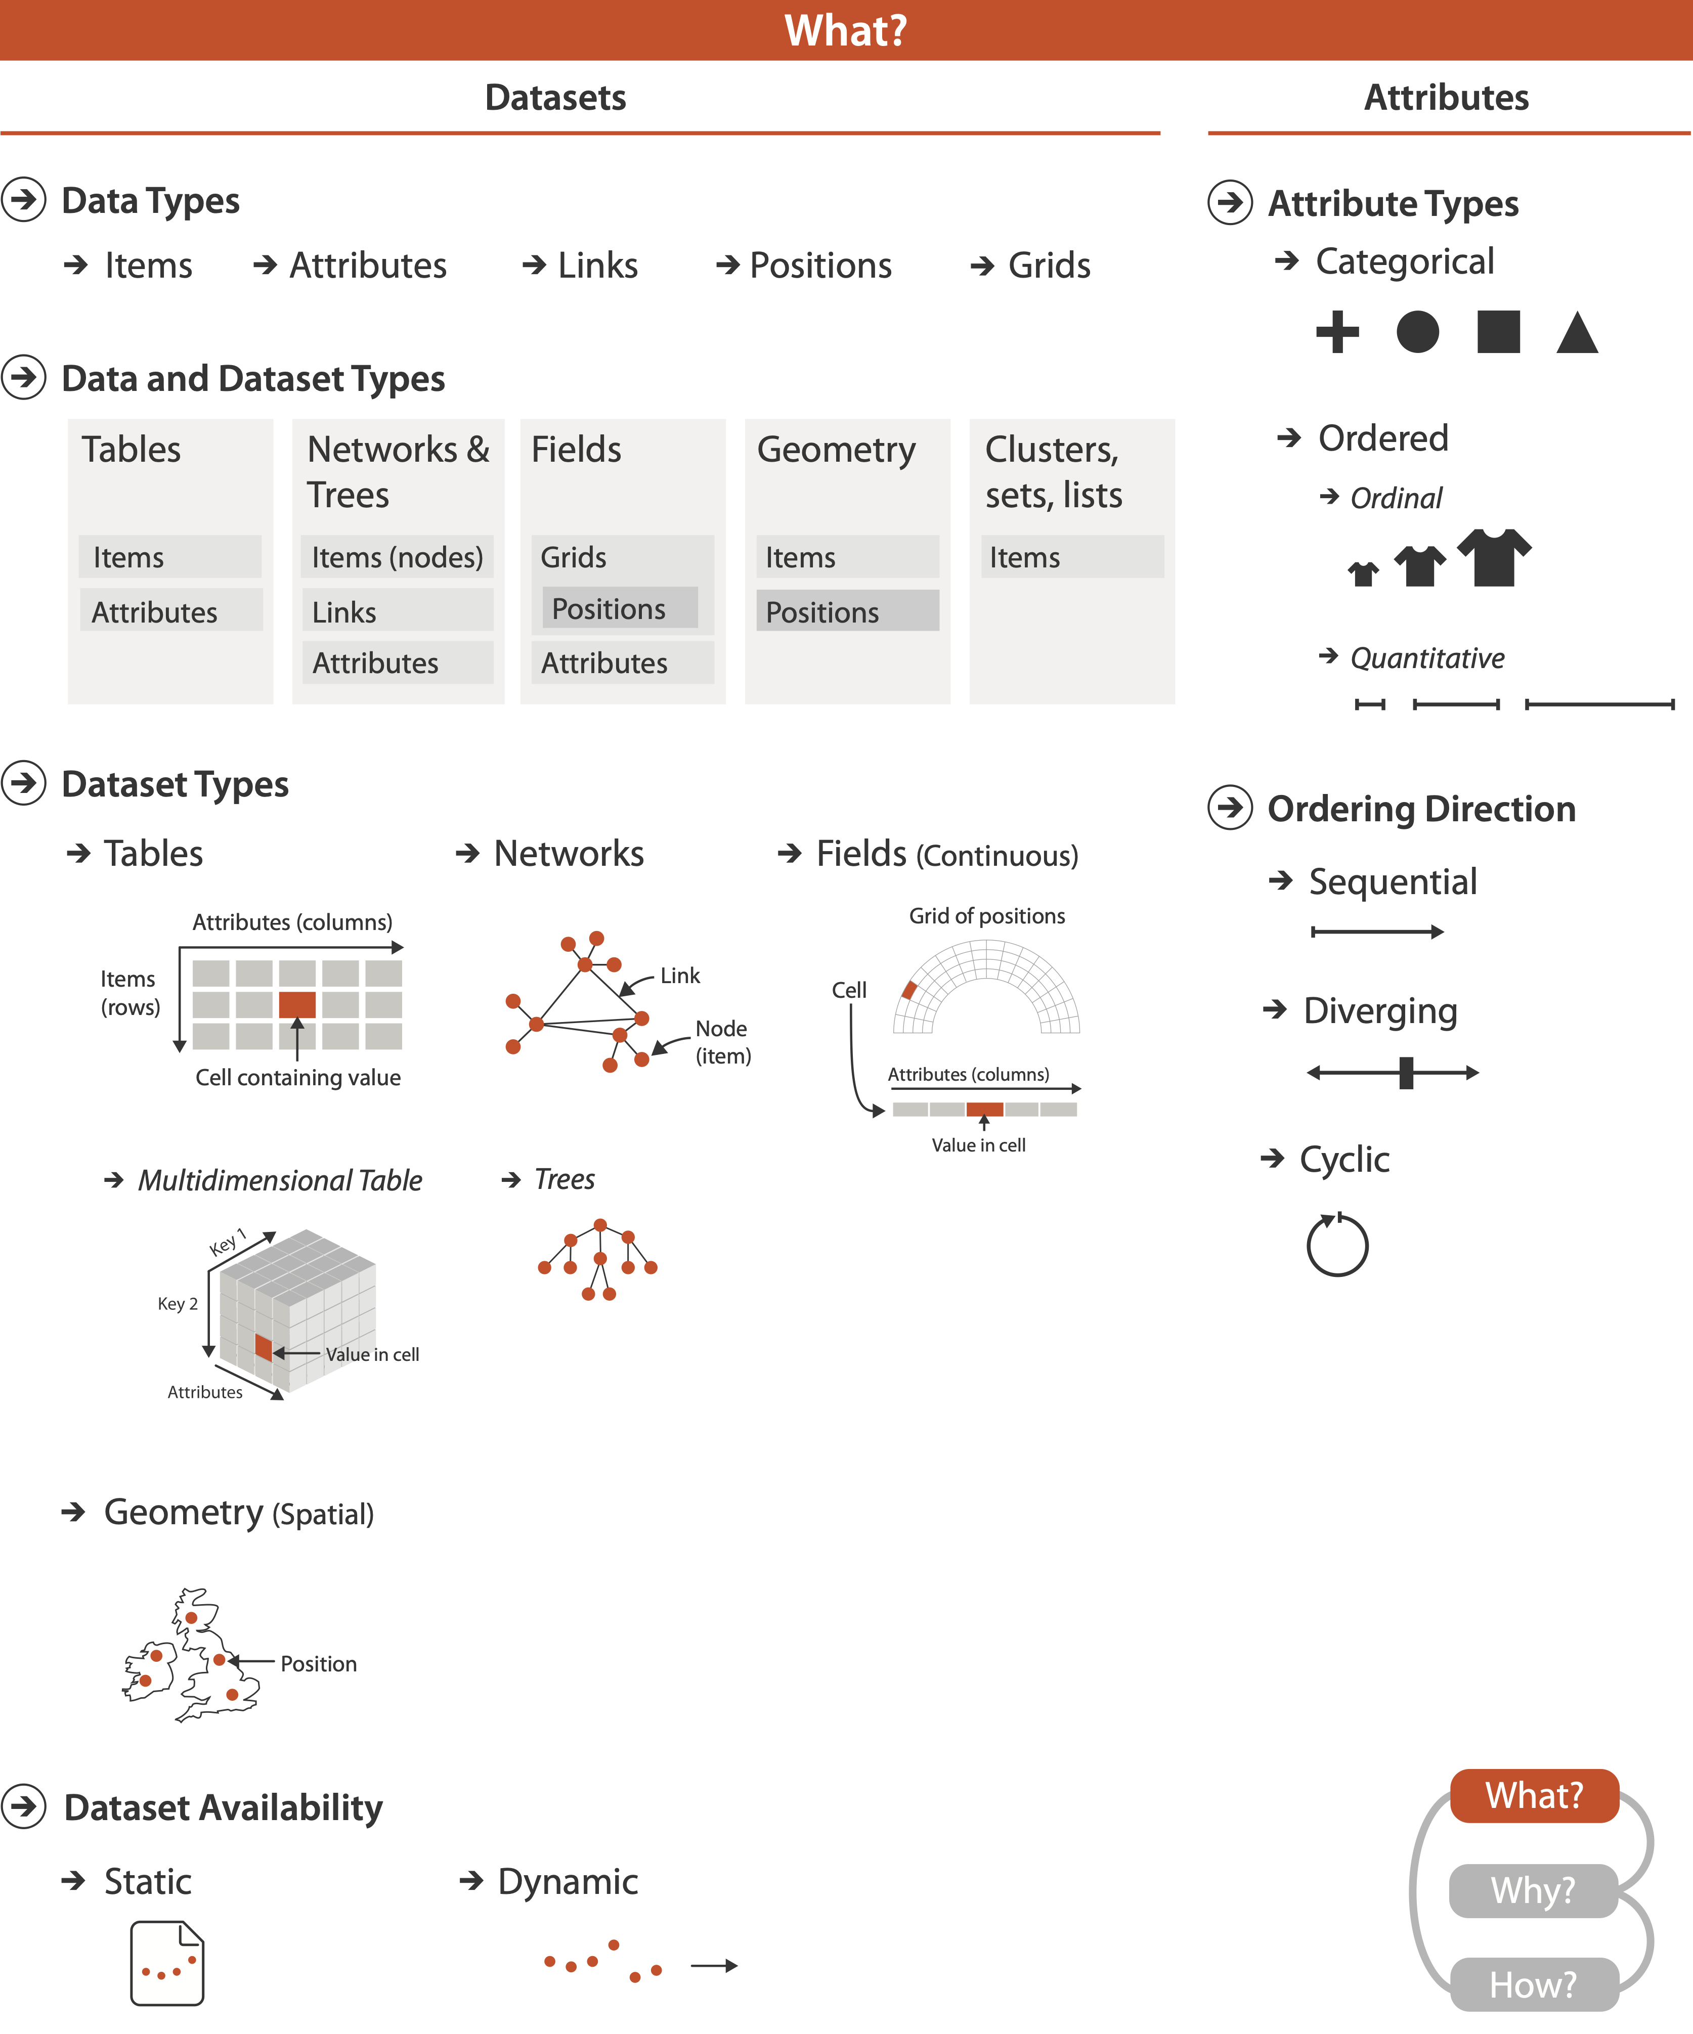

Slide 86
Visualization Analysis & Design
Task Abstraction (Ch 3)
Tamara Munzner
  Department of Computer Science
    University of British Columbia
@tamaramunzner

Slide 87
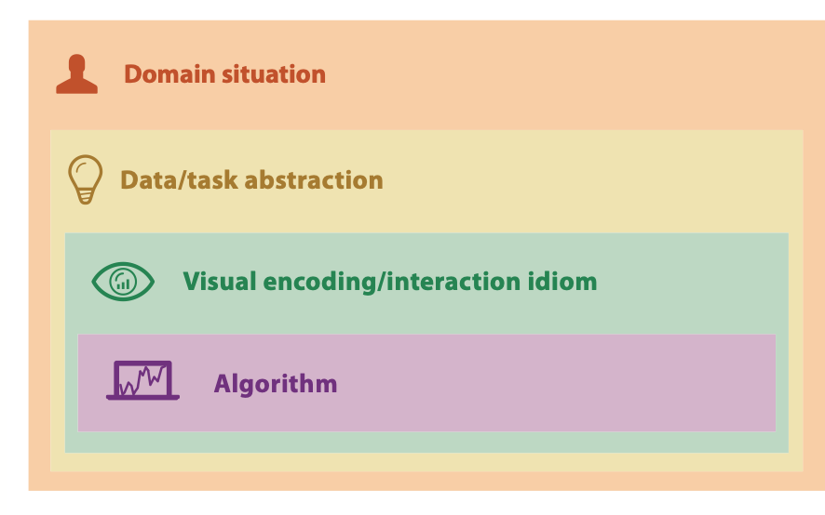
From domain to abstraction
Notes:
How did we decide to use those particular visual channels? How many more visual channels are there? What kinds of information and how much information can each channel encode? Are some channels better than others? Can all of the channels be used independently or do they interfere with each other?

Slide 88
From domain to abstraction
domain characterization:
details of application domain
domain

Slide 89
From domain to abstraction
domain characterization:
details of application domain
  group of users, target domain, their questions & data
    varies wildly by domain
    must be specific enough to get traction
domain

Slide 90
From domain to abstraction
domain characterization:
details of application domain
  group of users, target domain, their questions & data
    varies wildly by domain
    must be specific enough to get traction
  domain questions/problems
    break down into simpler abstract tasks
domain

Slide 91
From domain to abstraction
domain characterization:
details of application domain
  group of users, target domain, their questions & data
    varies wildly by domain
    must be specific enough to get traction
  domain questions/problems
    break down into simpler abstract tasks
abstraction: data & task
  map what and why into generalized terms
domain
abstraction

Slide 92
From domain to abstraction
domain characterization:
details of application domain
  group of users, target domain, their questions & data
    varies wildly by domain
    must be specific enough to get traction
  domain questions/problems
    break down into simpler abstract tasks
abstraction: data & task
  map what and why into generalized terms
    identify tasks that users wish to perform, or already do
    find data types that will support those tasks
      possibly transform /derive if need be
domain
abstraction

Slide 93
Design process
Characterize Domain Situation
Map Domain-Language
Data Description to
Data Abstraction
Map Domain-Language Task
to Abstract Task
Identify/Create Suitable Idiom/Technique
Identify/Create Suitable Algorithm

Slide 94
Task abstraction: Actions and targets
very high-level pattern
{action, target} pairs
  discover distribution
  compare trends
  locate outliers
  browse topology

Slide 95
Task abstraction: Actions and targets
very high-level pattern
actions
  analyze
    high-level choices
  search
    find a known/unknown item
  query
    find out about characteristics of item
{action, target} pairs
  discover distribution
  compare trends
  locate outliers
  browse topology

Slide 96
Task abstraction: Actions and targets
very high-level pattern
actions
  analyze
    high-level choices
  search
    find a known/unknown item
  query
    find out about characteristics of item
targets
  what is being acted on
{action, target} pairs
  discover distribution
  compare trends
  locate outliers
  browse topology

Slide 97
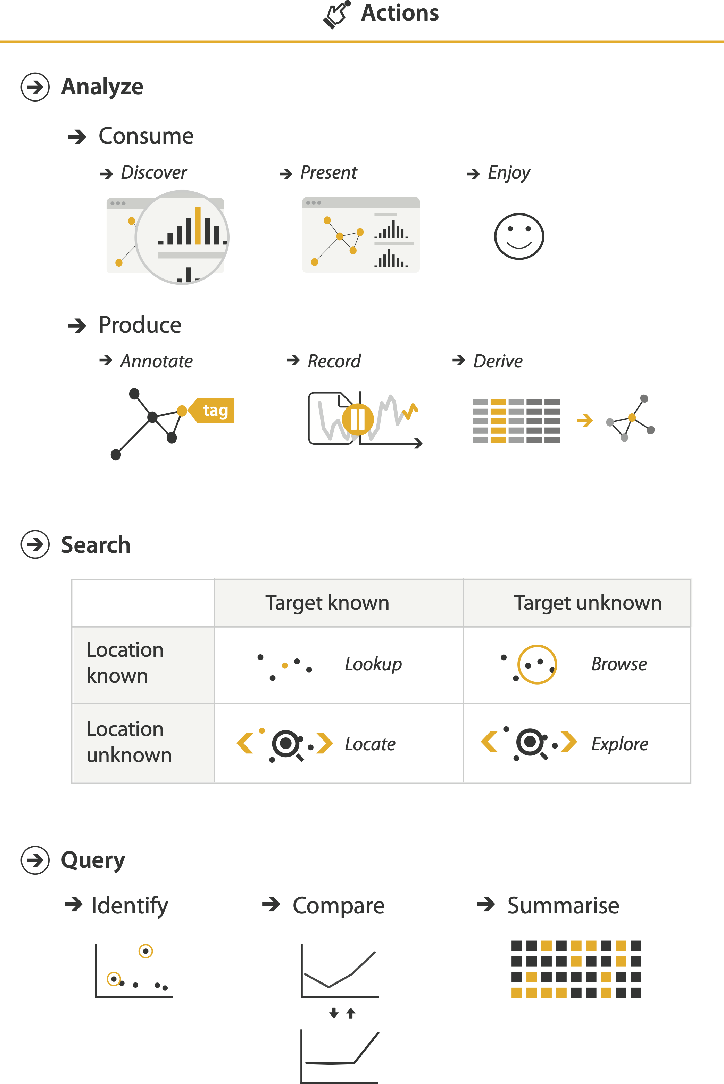
Actions: Analyze
consume
  discover vs present
    classic split
    aka explore vs explain
  enjoy
    newcomer
    aka casual, social
produce
  annotate, record
  derive
    crucial design choice

Slide 98
Actions: Search

Slide 99
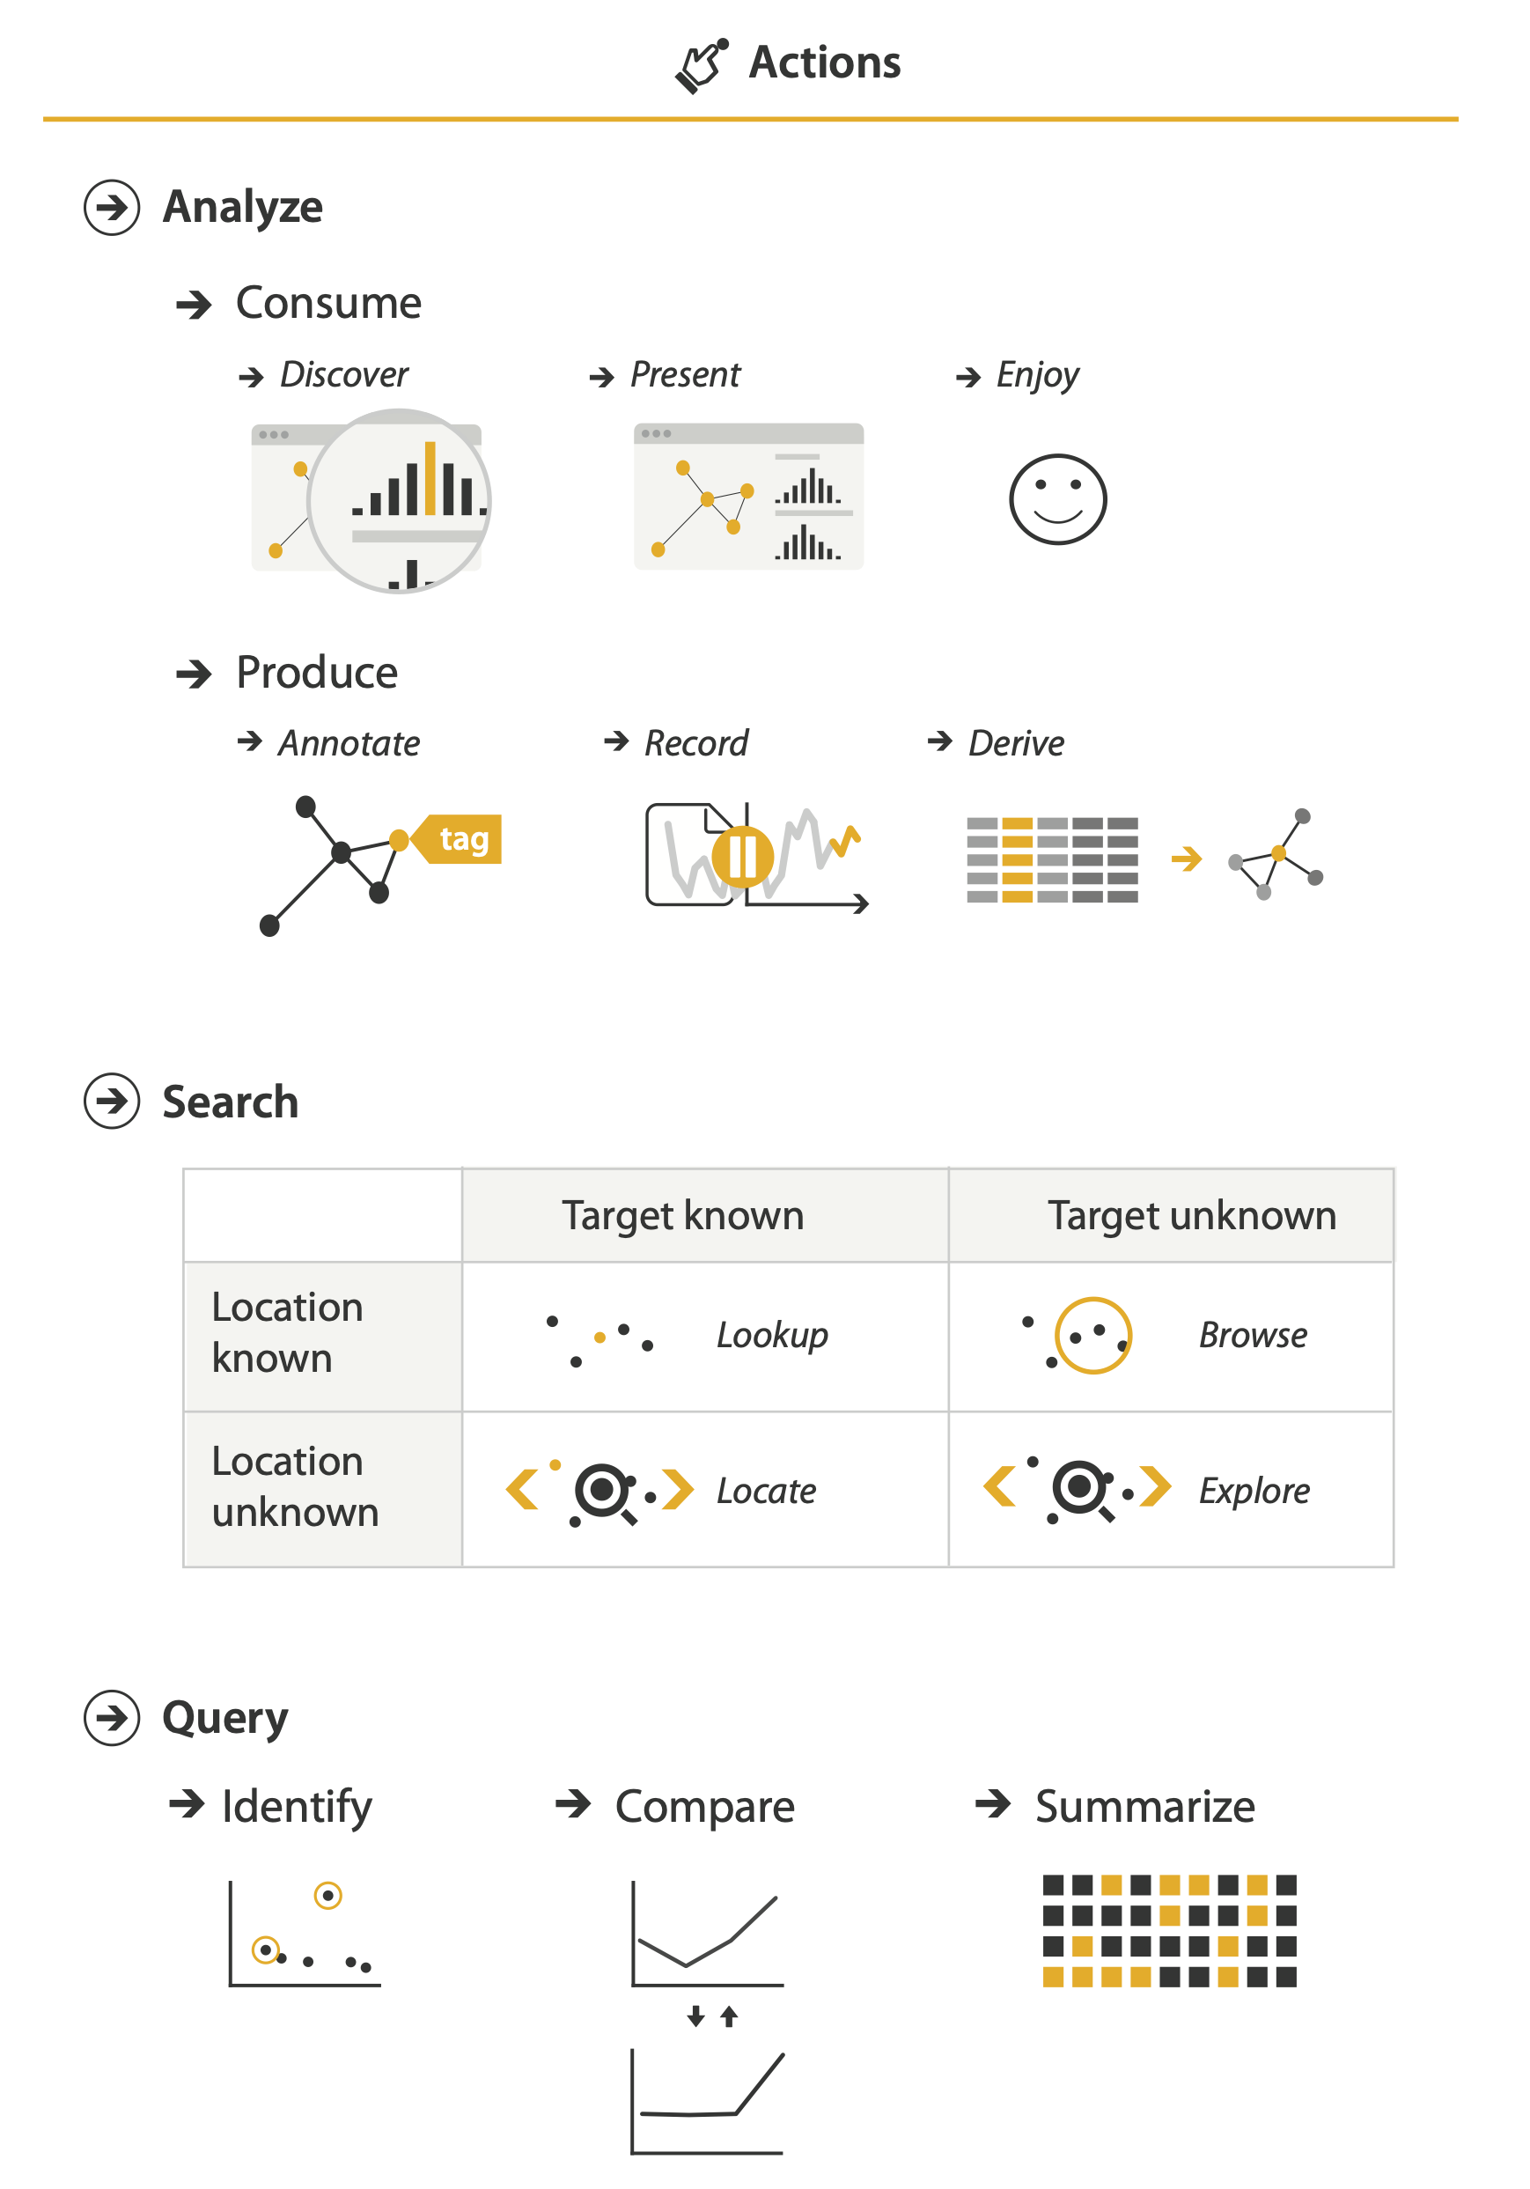
Actions: Search
what does user know?
  target, location

Slide 100
Actions: Search
what does user know?
  target, location
lookup
  ex: word in dictionary
    alphabetical order

Slide 101
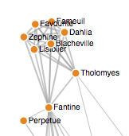
Actions: Search
what does user know?
  target, location
lookup
  ex: word in dictionary
    alphabetical order
locate
  ex: keys in your house
  ex: node in network
https://bl.ocks.org/heybignick/3faf257bbbbc7743bb72310d03b86ee8

Slide 102
Actions: Search
what does user know?
  target, location
lookup
  ex: word in dictionary
    alphabetical order
locate
  ex: keys in your house
  ex: node in network
browse
  ex: books in bookstore
https://bl.ocks.org/heybignick/3faf257bbbbc7743bb72310d03b86ee8

Slide 103
Actions: Search
what does user know?
  target, location
lookup
  ex: word in dictionary
    alphabetical order
locate
  ex: keys in your house
  ex: node in network
browse
  ex: books in bookstore
explore
  ex: find cool neighborhood in new city
https://bl.ocks.org/heybignick/3faf257bbbbc7743bb72310d03b86ee8

Slide 104
Actions: Query
how much of the data matters?
  one: identify
  some: compare
  all: summarize

Slide 105
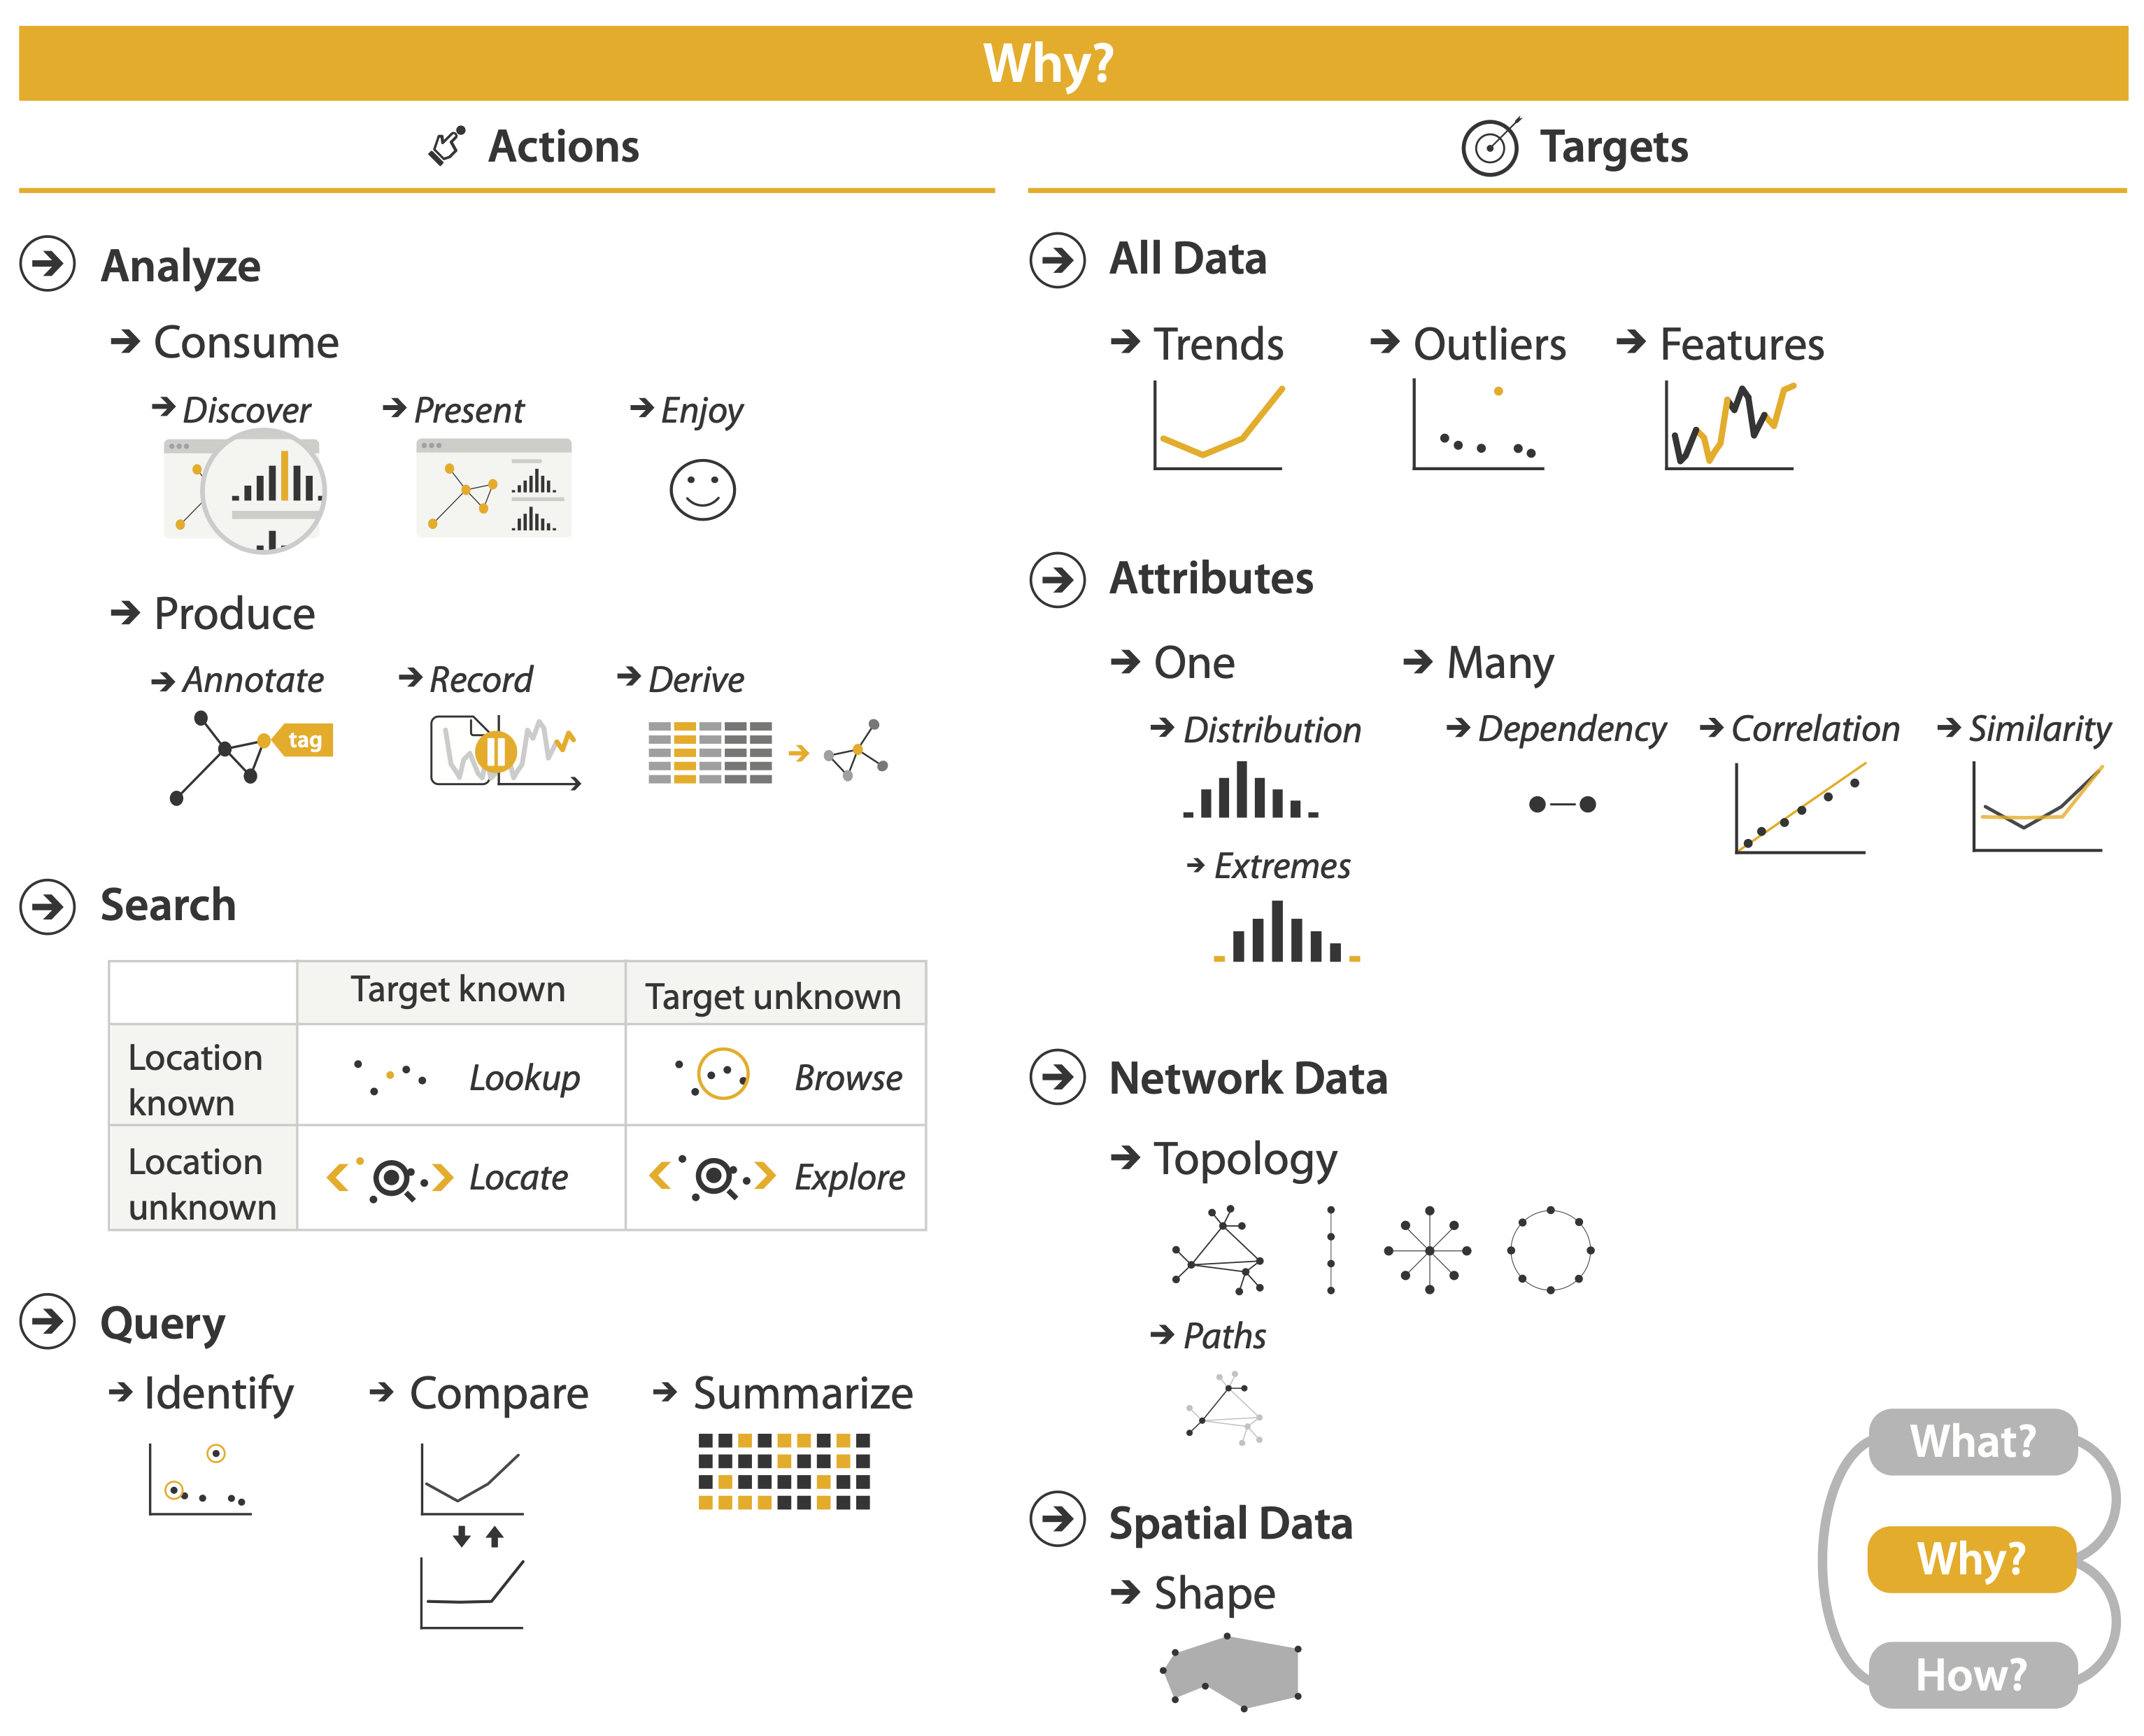
Actions
independent choices for each of these three levels
  analyze, search, query
  mix and match

Slide 106
Task abstraction: Targets

Slide 107
Task abstraction: Targets

Slide 108
Task abstraction: Targets

Slide 109
Task abstraction: Targets

Slide 110
Task abstraction: Targets

Slide 111
Abstraction
these {action, target} pairs are good starting point for vocabulary
  but sometimes you'll need more precision!
rule of thumb
  systematically remove all domain jargon
interplay: task and data abstraction
  need to use data abstraction within task abstraction
    to specify your targets!
    but task abstraction can lead you to transform the data
  iterate back and forth
    first pass data, first pass task, second pass data, ...

Slide 112
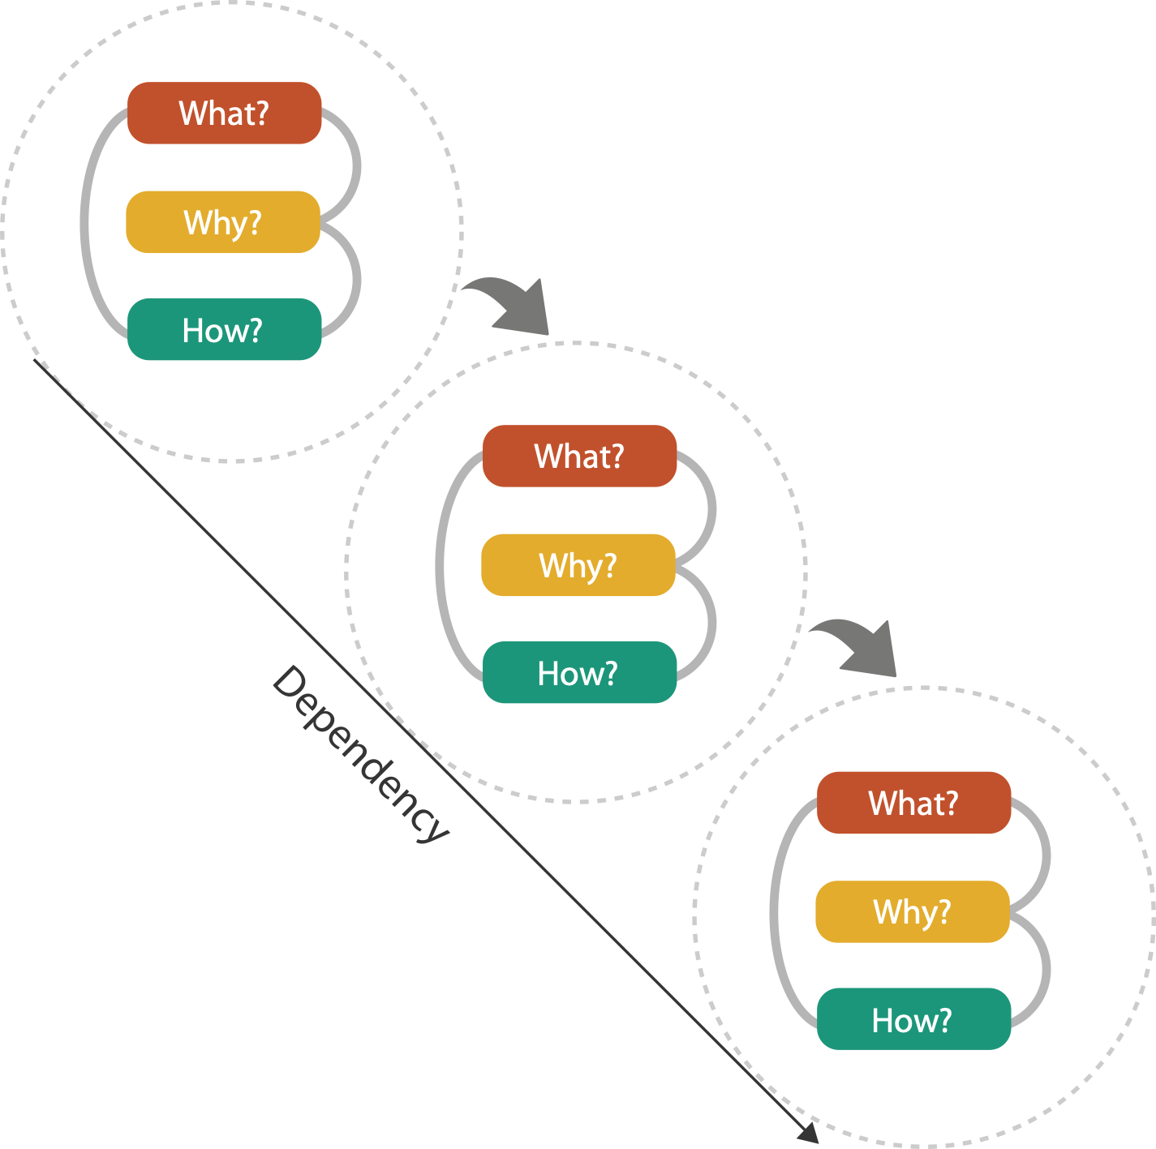
Means and ends

Slide 113
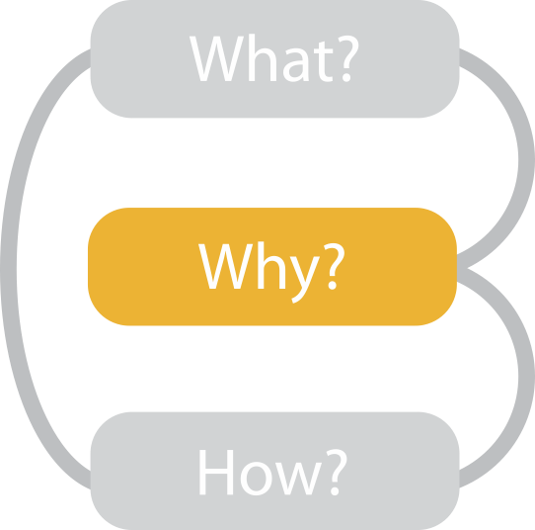
{action, target} pairs
  discover distribution
  compare trends
  locate outliers
  browse topology

Slide 114
Visualization Analysis & Design
Marks & Channels (Ch 5) I
Tamara Munzner
  Department of Computer Science
    University of British Columbia
@tamaramunzner

Slide 115
Visual encoding
how to systematically analyze idiom structure?
Notes:
How did we decide to use those particular visual channels? How many more visual channels are there? What kinds of information and how much information can each channel encode? Are some channels better than others? Can all of the channels be used independently or do they interfere with each other?

Slide 116
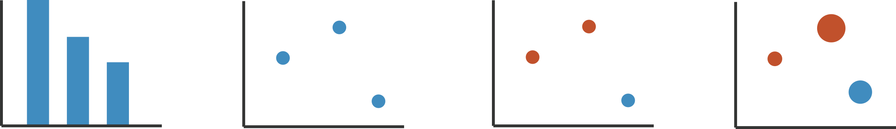
Visual encoding
how to systematically analyze idiom structure?
Notes:
How did we decide to use those particular visual channels? How many more visual channels are there? What kinds of information and how much information can each channel encode? Are some channels better than others? Can all of the channels be used independently or do they interfere with each other?

Slide 117
Visual encoding
how to systematically analyze idiom structure?
marks & channels
  marks: represent items or links
  channels: change appearance of marks based on attributes
Notes:
How did we decide to use those particular visual channels? How many more visual channels are there? What kinds of information and how much information can each channel encode? Are some channels better than others? Can all of the channels be used independently or do they interfere with each other?

Slide 118
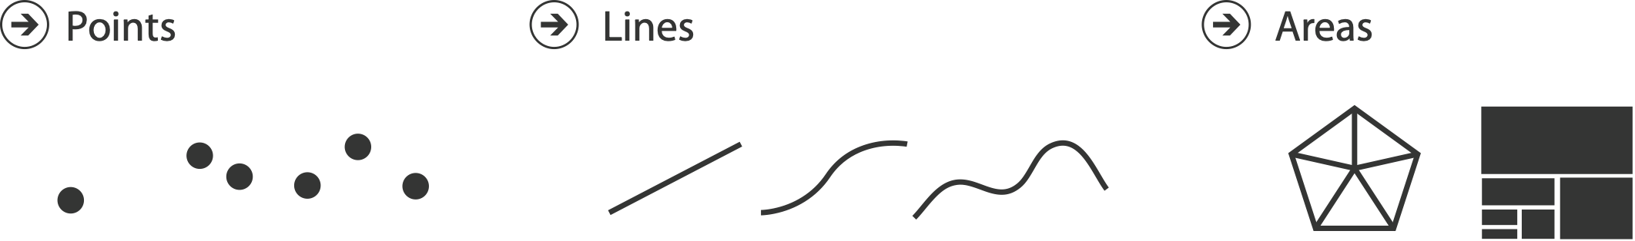
Marks for items
basic geometric elements
3D mark: volume, rarely used
Interlocking Areas
  0D
  1D
  2D

Slide 119
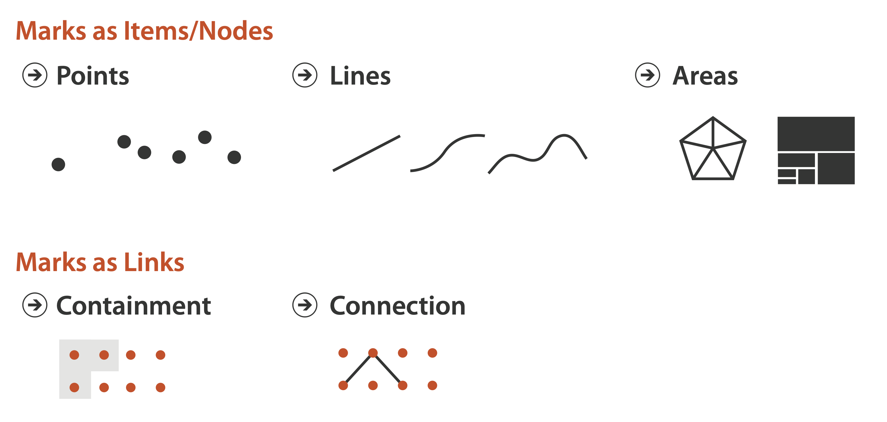
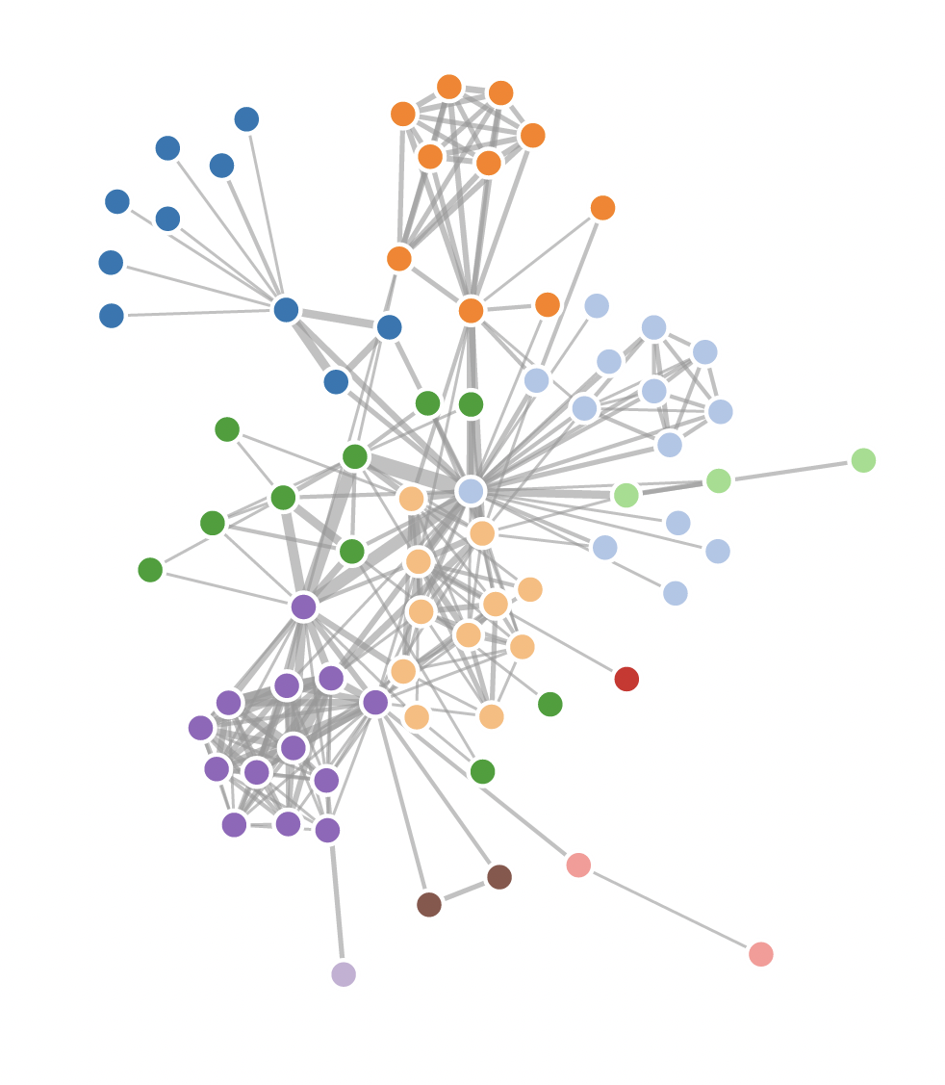
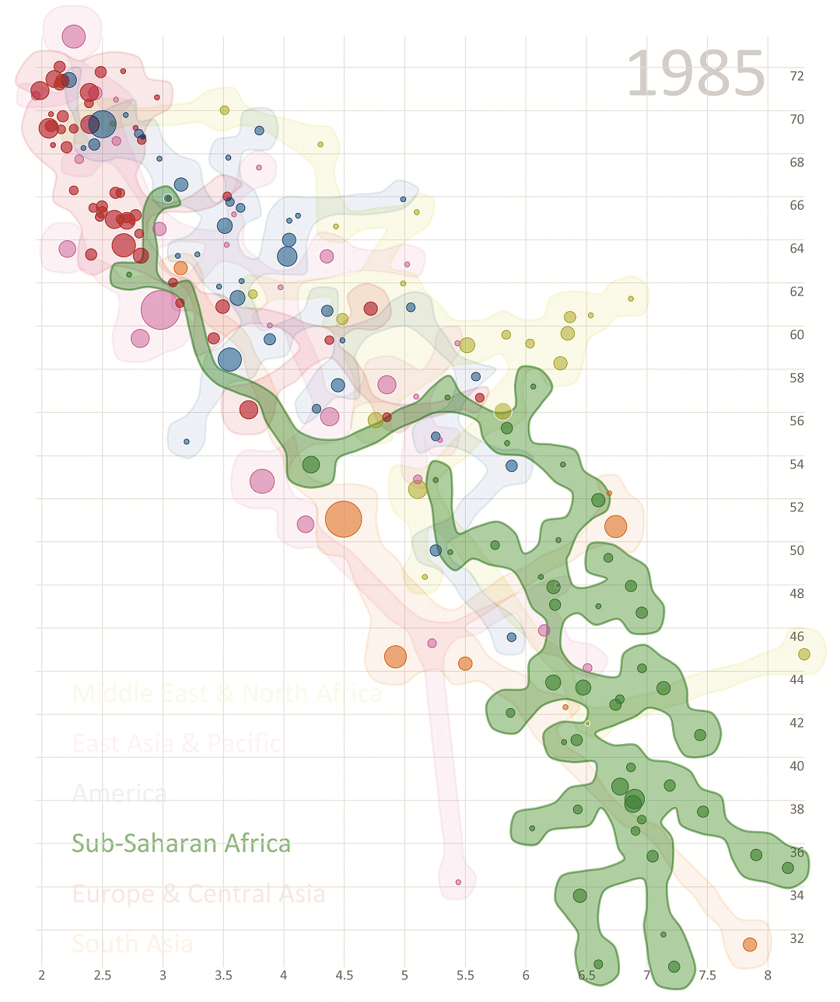
Marks for links
vialab.science.uoit.ca/portfolio/bubblesets
https://observablehq.com/@d3/force-directed-graph

Slide 120
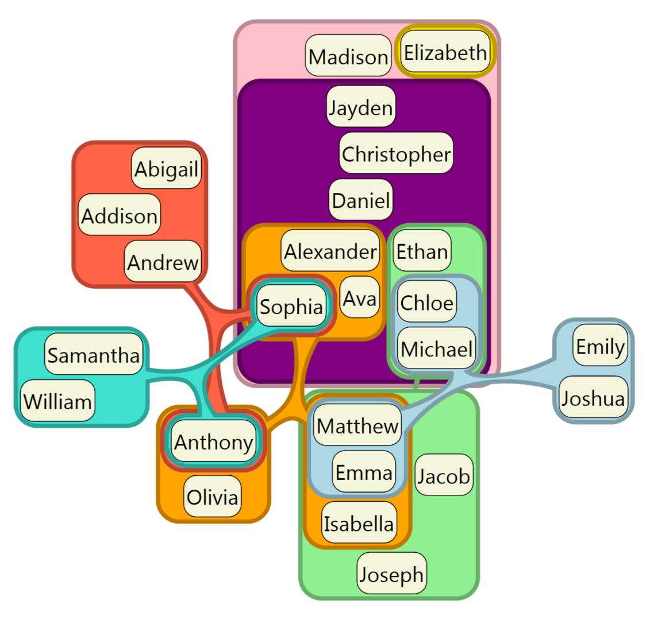
Containment can be nested
[Untangling Euler Diagrams, Riche and Dwyer, 2010]

Slide 121
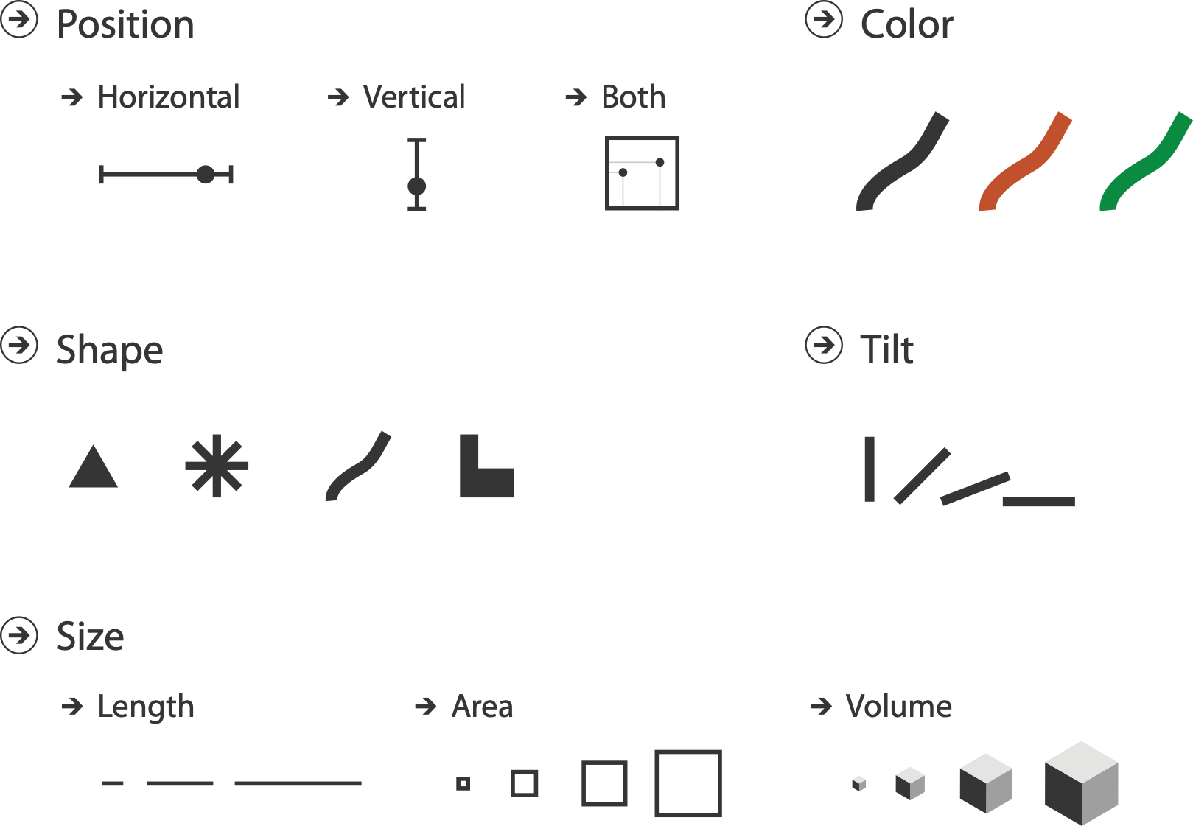
Channels
control appearance of marks
  proportional to or based on attributes
many names
  visual channels
  visual variables
  retinal channels
  visual dimensions
  ...

Slide 122
Definitions: Marks and channels
marks
  geometric primitives

Slide 123
Definitions: Marks and channels
Interlocking Areas
marks
  geometric primitives
channels
  control appearance of marks

Slide 124
Definitions: Marks and channels
Interlocking Areas
marks
  geometric primitives
channels
  control appearance of marks
channel properties differ
    type & amount of information that can be conveyed to human perceptual system

Slide 125
Visual encoding
analyze idiom structure as combination of marks and channels

Slide 126
Visual encoding
analyze idiom structure as combination of marks and channels
1:
vertical position
mark: line

Slide 127
Visual encoding
analyze idiom structure as combination of marks and channels
1:
vertical position
2:
vertical position
horizontal position
mark: line
mark: point

Slide 128
Visual encoding
analyze idiom structure as combination of marks and channels
1:
vertical position
2:
vertical position
horizontal position
3:
vertical position
horizontal position
color hue
mark: line
mark: point
mark: point

Slide 129
Visual encoding
analyze idiom structure as combination of marks and channels
1:
vertical position
2:
vertical position
horizontal position
3:
vertical position
horizontal position
color hue
4:
vertical position
horizontal position
color hue
size (area)
mark: line
mark: point
mark: point
mark: point

Slide 130




Redundant encoding
multiple channels
  sends stronger message
  but uses up channels
Length and Luminance

Slide 131

Marks as constraints
math view: geometric primitives have dimensions
Interlocking Areas
  0D
  1D
  2D

Slide 132
Marks as constraints
math view: geometric primitives have dimensions
constraint view: mark type constrains what else can be encoded
  points: 0 constraints on size, can encode more attributes w/ size & shape
  lines: 1 constraint on size (length), can still size code other way (width)
  interlocking areas: 2 constraints on size (length/width), cannot size or shape code
    interlocking: size, shape, position
Interlocking Areas
  0D
  1D
  2D

Slide 133
Marks as constraints
math view: geometric primitives have dimensions
constraint view: mark type constrains what else can be encoded
  points: 0 constraints on size, can encode more attributes w/ size & shape
  lines: 1 constraint on size (length), can still size code other way (width)
  interlocking areas: 2 constraints on size (length/width), cannot size or shape code
    interlocking: size, shape, position
quick check: can you size-code another attribute
  or is size/shape in use?
Interlocking Areas
  0D
  1D
  2D

Slide 134
Scope of analysis
simplifying assumptions: one mark per item, single view
later on
  multiple views
  multiple marks in a region (glyph)
  some items not represented by marks (aggregation and filtering)

Slide 135
When to use which channel?
  expressiveness
  match channel type to data type
  effectiveness
  some channels are better than others

Slide 136
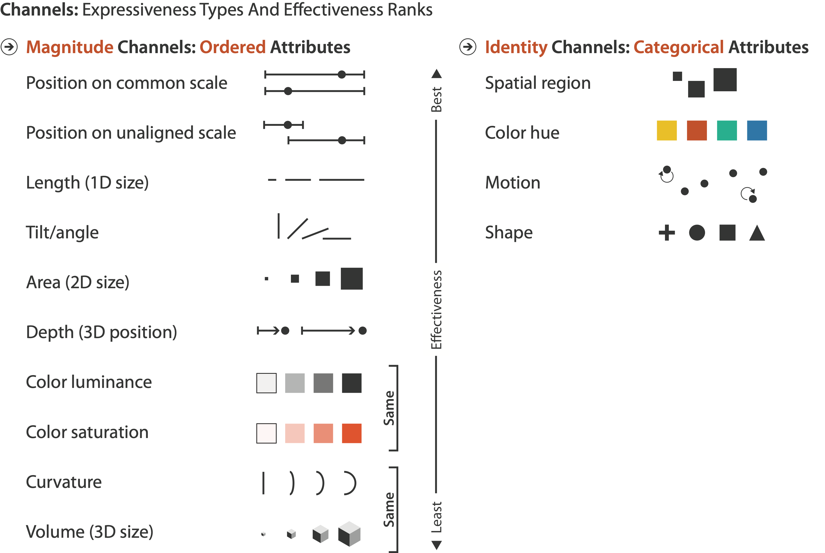
Channels: Rankings

Slide 137
Channels: Rankings
expressiveness
  match channel and data characteristics

Slide 138
Channels: Rankings
expressiveness
  match channel and data characteristics
    magnitude for ordered
      how much? which rank?
    identity for categorical
      what?

Slide 139
Channels: Rankings
expressiveness
  match channel and data characteristics
effectiveness
  channels differ in accuracy of perception

Slide 140


Channels: Rankings
expressiveness
  match channel and data characteristics
effectiveness
  channels differ in accuracy of perception
  spatial position ranks high for both

Slide 141
Grouping
containment
connection
proximity
  same spatial region
similarity
  same values as other categorical channels

Slide 142
Visualization Analysis & Design
Arrange Tables (Ch 7) I
Tamara Munzner
  Department of Computer Science
    University of British Columbia
@tamaramunzner

Slide 143

Focus on Tables
Spatial

Slide 144
Keys and values
key
  independent attribute
  used as unique index to look up items
  simple tables: 1 key
  multidimensional tables: multiple keys
value
  dependent attribute, value of cell
Notes:
Figs 7.1, 2.2
same small font problem as above

Slide 145


Keys and values
key
  independent attribute
  used as unique index to look up items
  simple tables: 1 key
  multidimensional tables: multiple keys
value
  dependent attribute, value of cell
classify arrangements by keys used
  0, 1, 2, ...
  0
Notes:
Figs 7.1, 2.2
same small font problem as above

Slide 146

Idiom: scatterplot
express values (magnitudes)
  quantitative attributes
no keys, only values
[A layered grammar of graphics. Wickham. Journ. Computational and Graphical Statistics 19:1 (2010), 3–28.]

Slide 147
Idiom: scatterplot
express values (magnitudes)
  quantitative attributes
no keys, only values
  data
    2 quant attribs
  mark: points
  channels
    horiz + vert position
[A layered grammar of graphics. Wickham. Journ. Computational and Graphical Statistics 19:1 (2010), 3–28.]

Slide 148
Idiom: scatterplot
express values (magnitudes)
  quantitative attributes
no keys, only values
  data
    2 quant attribs
  mark: points
  channels
    horiz + vert position
  tasks
    find trends, outliers, distribution, correlation, clusters
  scalability
    hundreds of items
[A layered grammar of graphics. Wickham. Journ. Computational and Graphical Statistics 19:1 (2010), 3–28.]

Slide 149


Scatterplots: Encoding more channels
additional channels viable since using point marks
  color
  size (1 quant attribute, used to control 2D area)
    note radius would mislead, take square root since area grows quadratically
  shape
https://www.d3-graph-gallery.com/graph/bubble_basic.html
https://observablehq.com/@d3/scatterplot-with-shapes

Slide 150
Scatterplot tasks

Slide 151
Scatterplot tasks
correlation
https://www.mathsisfun.com/data/scatter-xy-plots.html

Slide 152
Scatterplot tasks
correlation
clusters/groups, and clusters vs classes
https://www.mathsisfun.com/data/scatter-xy-plots.html
https://www.cs.ubc.ca/labs/imager/tr/2014/DRVisTasks/

Slide 153

Some keys
  0

Slide 154
Some keys: Categorical regions

Slide 155
Regions: Separate, order, align
regions: contiguous bounded areas distinct from each other
  separate into spatial regions: one mark per region (for now)
use categorical or ordered attribute to separate into regions
  no conflict with expressiveness principle for categorical attributes
use ordered attribute to order and align regions

Slide 156

Separated and aligned and ordered
best case

Slide 157

Separated and aligned but not ordered
limitation: hard to know rank. what's 4th? what's 7th?

Slide 158

Separated but not aligned or ordered
limitation: hard to make comparisons with size (vs aligned position)

Slide 159

Idiom: bar chart
one key, one value
  data
    1 categ attrib, 1 quant attrib
  mark: lines
  channels
    length to express quant value
    spatial regions: one per mark
      separated horizontally, aligned vertically
      ordered by quant attrib
        by label (alphabetical), by length attrib (data-driven)
  task
    compare, lookup values
  scalability
    dozens to hundreds of levels for key attrib [bars], hundreds for values

Slide 160

Idiom: stacked bar chart
one more key
  data
    2 categ attrib, 1 quant attrib
  mark: vertical stack of line marks
    glyph: composite object, internal structure from multiple marks
  channels
    length and color hue
    spatial regions: one per glyph
      aligned: full glyph, lowest bar component
      unaligned: other bar components
  task
    part-to-whole relationship
  scalability: asymmetric
    for stacked key attrib, 10-12 levels [segments]
    for main key attrib, dozens to hundreds of levels [bars]
https://www.d3-graph-gallery.com/graph/barplot_stacked_basicWide.html
Notes:
Thor computer memory profiler. The key used to distribute composite bars along the axis is the combination of a processor and a procedure. The key used to stack and color the glyph subcomponents is the type of cache miss; the height of each full bar encodes all cache misses for each processor-procedure combination.

Slide 161


Idiom: streamgraph
generalized stacked graph
  emphasizing horizontal continuity
    vs vertical items
  data
    1 categ key attrib (movies)
    1 ordered key attrib (time)
    1 quant value attrib (counts)
  derived data
    geometry: layers, where height encodes counts
    1 quant attrib (layer ordering)
[Stacked Graphs Geometry & Aesthetics. Byron and Wattenberg. IEEE Trans. Visualization and Computer Graphics (Proc. InfoVis 2008) 14(6): 1245–1252, (2008).]

Slide 162
Idiom: streamgraph
generalized stacked graph
  emphasizing horizontal continuity
    vs vertical items
  data
    1 categ key attrib (movies)
    1 ordered key attrib (time)
    1 quant value attrib (counts)
  derived data
    geometry: layers, where height encodes counts
    1 quant attrib (layer ordering)
  scalability
    hundreds of time keys
    dozens to hundreds of movies keys
      more than stacked bars: most layers don’t extend across whole chart
[Stacked Graphs Geometry & Aesthetics. Byron and Wattenberg. IEEE Trans. Visualization and Computer Graphics (Proc. InfoVis 2008) 14(6): 1245–1252, (2008).]
https://flowingdata.com/2008/02/25/ebb-and-flow-of-box-office-receipts-over-past-20-years/

Slide 163


Idiom: dot / line chart
one key, one value
  data
    2 quant attribs
  mark: points
  AND line connection marks between them
  channels
    aligned lengths to express quant value
    separated and ordered by key attrib into horizontal regions
  task
    find trend
      connection marks emphasize ordering of items along key axis by explicitly showing relationship between one item and the next
  scalability
    hundreds of key levels, hundreds of value levels
Notes:
good: height increases with age, 12 year olds are taller than 10 year olds
bad: the more male a person is, the taller he or she is
Zacks and Tversky

Slide 164
Idiom: dot / line chart
one key, one value
  data
    2 quant attribs
  mark: points
  AND line connection marks between them
  channels
    aligned lengths to express quant value
    separated and ordered by key attrib into horizontal regions
  task
    find trend
      connection marks emphasize ordering of items along key axis by explicitly showing relationship between one item and the next
  scalability
    hundreds of key levels, hundreds of value levels
Notes:
good: height increases with age, 12 year olds are taller than 10 year olds
bad: the more male a person is, the taller he or she is
Zacks and Tversky

Slide 165

Choosing bar vs line charts
depends on type of key attrib
  bar charts if categorical
  line charts if ordered
do not use line charts for categorical key attribs
  violates expressiveness principle
    implication of trend so strong that it overrides semantics!
      “The more male a person is, the taller he/she is”
after [Bars and Lines: A Study of Graphic Communication. Zacks and Tversky. Memory and Cognition 27:6 (1999), 1073–1079.]
Notes:
good: height increases with age, 12 year olds are taller than 10 year olds
bad: the more male a person is, the taller he or she is

Slide 166

Chart axes: label them!
best practice to label
  few exceptions: individual small multiple views could share axis label
https://xkcd.com/833/

Slide 167

Chart axes: avoid cropping y axis
include 0 at bottom left or slope misleads
[Truncating the Y-Axis: Threat or Menace?
Correll, Bertini, & Franconeri, CHI 2020.]

Slide 168

Chart axes: avoid cropping y axis
include 0 at bottom left or slope misleads
  some exceptions (arbitrary 0, small change matters)
[Truncating the Y-Axis: Threat or Menace?
Correll, Bertini, & Franconeri, CHI 2020.]

Slide 169

Idiom: Indexed line charts
data: 2 quant attribs
  1 key + 1 value
derived data: new quant value attrib
  index
  plot instead of original value
task: show change over time
  principle: normalized, not absolute
scalability
  same as standard line chart
https://public.tableau.com/profile/ben.jones#!/vizhome/CAStateRevenues/Revenues

Slide 170

Idiom: Gantt charts
one key, two (related) values
  data
    1 categ attrib, 2 quant attribs
  mark: line
    length: duration
  channels
    horiz position: start time
    (+end from duration)
  task
    emphasize temporal overlaps & start/end dependencies between items
  scalability
    dozens of key levels [bars]
    hundreds of value levels [durations]
https://www.r-bloggers.com/gantt-charts-in-r-using-plotly/

Slide 171

Idiom: Slopegraphs
two values
  data
    2 quant value attribs
    (1 derived attrib: change magnitude)
  mark: point + line
    line connecting mark between pts
  channels
    2 vertical pos: express attrib value
    (linewidth/size, color)
  task
    emphasize changes in rank/value
  scalability
    hundreds of value levels
    dozens of items
https://public.tableau.com/profile/ben.jones#!/vizhome/Slopegraphs/Slopegraphs

Slide 172

2 Keys
  0

Slide 173

Idiom: heatmap
two keys, one value
  data
    2 categ attribs (gene, experimental condition)
    1 quant attrib (expression levels)
  marks: point
    separate and align in 2D matrix
      indexed by 2 categorical attributes
  channels
    color by quant attrib
      (ordered diverging colormap)
  task
    find clusters, outliers
  scalability
    1M items, 100s of categ levels, ~10 quant attrib levels

Slide 174
Heatmap reordering
https://blogs.sas.com/content/iml/2018/05/02/reorder-variables-correlation-heat-map.html

Slide 175
Idiom: cluster heatmap
in addition
  derived data
    2 cluster hierarchies
  dendrogram
    parent-child relationships in tree with connection line marks
    leaves aligned so interior branch heights easy to compare
  heatmap
    marks (re-)ordered by cluster hierarchy traversal
    task: assess quality of clusters found by automatic methods

Slide 176
Visualization Analysis & Design
Tables (Ch 7) II
Tamara Munzner
  Department of Computer Science
    University of British Columbia
@tamaramunzner

Slide 177



Slide 178



Idioms: radial bar chart, star plot
star plot
  line mark, radial axes meet at central point
radial bar chart
  line mark, radial axes meet at central ring
  channels: length, angle/orientation
bar chart
  rectilinear axes, aligned vertically
accuracy
  length not aligned with radial layouts
    less accurately perceived than rectilinear aligned
[Vismon: Facilitating Risk Assessment and Decision Making In Fisheries Management. Booshehrian, Möller, Peterman, and Munzner. Technical Report TR 2011-04, Simon Fraser University, School of Computing Science, 2011.]

Slide 179

Idiom: radar plot
radial line chart
  point marks, radial layout
  connecting line marks
avoid unless data is cyclic

Slide 180


“Radar graphs: Avoid them (99.9% of the time)”
  original
  difficult to interpret
  redesign for
  rectilinear
http://www.thefunctionalart.com/2012/11/radar-graphs-avoid-them-999-of-time.html

Slide 181



Idioms: pie chart, coxcomb chart
pie chart
  interlocking area marks with angle channel: 2D area varies
    separated & ordered radially, uniform height
  accuracy: area less accurate than rectilinear aligned line length
  task: part-to-whole judgements
coxcomb chart
  line marks with length channel: 1D length varies
    separated & ordered radially, uniform width
  direct analog to radial bar charts
data
  1 categ key attrib, 1 quant value attrib
[A layered grammar of graphics. Wickham. Journ. Computational and Graphical Statistics 19:1 (2010), 3–28.]

Slide 182


Coxcomb / nightingale rose / polar area chart
invented by Florence Nightingale:
Diagram of the Causes of Mortality in the Army in the East

Slide 183
Coxcomb: perception
encode: 1D length
decode/perceive: 2D area
nonuniform line/sector width as length increases
  so area variation is nonlinear wrt line mark length!
bar chart safer: uniform width, so area is linear with line mark length
  both radial & rectilinear cases
  nonuniform width as length increases
  uniform width as length increases
  radial & rectilinear bars: uniform width as length increases

Slide 184

Pie charts: perception
some empirical evidence that people respond to arc length
  decode/perceive: not angles
  maybe also areas?…
donut charts no worse than pie charts
[Arcs, Angles, or Areas: Individual Data Encodings in Pie and Donut Charts.
Skau and Kosara. Proc. EuroVis 2016.]
https://eagereyes.org/blog/2016/an-illustrated-tour-of-the-pie-chart-study-results

Slide 185
Pie charts: best practices
not so bad for two (or few) levels, for part-to-whole task
https://eagereyes.org/pie-charts

Slide 186
Pie charts: best practices
not so bad for two (or few) levels, for part-to-whole task
dubious for several levels if details matter
https://eagereyes.org/pie-charts

Slide 187
Pie charts: best practices
not so bad for two (or few) levels, for part-to-whole task
dubious for several levels if details matter
terrible for many levels
https://eagereyes.org/pie-charts

Slide 188



Idioms: normalized stacked bar chart
task
  part-to-whole judgements
normalized stacked bar chart
  stacked bar chart, normalized to full vert height
  single stacked bar equivalent to full pie
    high information density: requires narrow rectangle
pie chart
  information density: requires large circle
http://bl.ocks.org/mbostock/3886208,
http://bl.ocks.org/mbostock/3887235,
http://bl.ocks.org/mbostock/3886394.

Slide 189




Idiom: glyphmaps
rectilinear good for
linear vs nonlinear trends
radial good for cyclic patterns
  evaluating periodicity
[Glyph-maps for Visually Exploring Temporal Patterns in Climate Data and Models. Wickham, Hofmann, Wickham, and Cook. Environmetrics 23:5 (2012), 382–393.]

Slide 190


Slide 191

Idiom: SPLOM
scatterplot matrix (SPLOM)
  rectilinear axes,
  point mark
  all possible pairs of axes
  scalability
    one dozen attribs
    dozens to hundreds of items

Slide 192

Idioms: parallel coordinates
scatterplot limitation
  visual representation with orthogonal axes
  can show only two attributes with spatial position channel
after [Visualization Course Figures. McGuffin, 2014. http://www.michaelmcguffin.com/courses/vis/]

Slide 193
Idioms: parallel coordinates
scatterplot limitation
  visual representation with orthogonal axes
  can show only two attributes with spatial position channel
alternative: line up axes in parallel to show many attributes with position
  item encoded with a line with n segments
  n is the number of attributes shown
parallel coordinates
  parallel axes, jagged line for item
  rectilinear axes, item as point
    axis ordering is major challenge
  scalability
    dozens of attribs
    hundreds of items
after [Visualization Course Figures. McGuffin, 2014. http://www.michaelmcguffin.com/courses/vis/]

Slide 194

Task: Correlation
scatterplot matrix
  positive correlation
    diagonal low-to-high
  negative correlation
    diagonal high-to-low
  uncorrelated: spread out
parallel coordinates
  positive correlation
    parallel line segments
  negative correlation
    all segments cross at halfway point
  uncorrelated
    scattered crossings
https://www.mathsisfun.com/data/scatter-xy-plots.html
[Hyperdimensional Data Analysis Using Parallel Coordinates. Wegman. Journ. American Statistical Association 85:411 (1990), 664–675.]

Slide 195

Parallel coordinates, limitations
visible patterns only between neighboring axis pairs
how to pick axis order?
  usual solution: reorderable axes, interactive exploration
  same weakness as many other techniques
    downside of interaction: human-powered search
  some algorithms proposed, none fully solve

Slide 196
Orientation limitations
rectilinear: scalability wrt #axes
    2 axes best, 3 problematic, 4+ impossible

Slide 197
Orientation limitations
rectilinear: scalability wrt #axes
    2 axes best, 3 problematic, 4+ impossible
parallel: unfamiliarity, training time

Slide 198

Orientation limitations
rectilinear: scalability wrt #axes
    2 axes best, 3 problematic, 4+ impossible
parallel: unfamiliarity, training time
radial: perceptual limits
  polar coordinate asymmetry
    angles lower precision than length
    nonuniform sector width/size depending on radial distance
  frequently problematic
    but sometimes can be deliberately exploited!
      for 2 attribs of very unequal importance
[Uncovering Strengths and Weaknesses of Radial Visualizations - an Empirical Approach. Diehl, Beck and Burch. IEEE TVCG (Proc. InfoVis) 16(6):935--942, 2010.]

Slide 199
Layout density

Slide 200

Idiom: Dense software overviews
data: text
  text + 1 quant attrib per line
derived data:
  one pixel high line
  length according to original
color line by attrib
scalability
  10K+ lines
[Visualization of test information to assist fault localization. Jones, Harrold, Stasko. Proc. ICSE 2002, p 467-477.]

Slide 201
Arrange tables

Slide 202





Slide 204
Visualization Analysis & Design
Network Data (Ch 9)
Tamara Munzner
  Department of Computer Science
    University of British Columbia
@tamaramunzner

Slide 205

Network data
networks
  model relationships between things
    aka graphs
  two kinds of items,
  both can have attributes
    nodes
    links
tree
  special case
  no cycles
    one parent per node
Spatial

Slide 206

Network tasks: topology-based and attribute-based
topology based tasks
  find paths
  find (topological) neighbors
  compare centrality/importance measures
  identify clusters / communities
attribute based tasks (similar to table data)
  find distributions, ...
combination tasks, incorporating both
  example: find friends-of-friends who like cats
    topology: find all adjacent nodes of given node
    attributes: check if has-pet (node attribute) == cat

Slide 207


Node-link diagrams
nodes: point marks
links: line marks
  straight lines or arcs
  connections between nodes
intuitive & familiar
  most common
  many, many variants

Slide 208
Criteria for good node-link layouts
minimize
  edge crossings, node overlaps
  distances between topological neighbor nodes
  total drawing area
  edge bends
maximize
  angular distance between different edges
  aspect ratio disparities
emphasize symmetry
  similar graph structures should look similar in layout

Slide 209


Criteria conflict
most criteria NP-hard individually
many criteria directly conflict with each other

Slide 210
Optimization-based layouts
formulate layout problem as optimization problem
convert criteria into weighted cost function
  F(layout) = a*[crossing counts] + b*[drawing space used]+...
use known optimization techniques to find layout at minimal cost
  energy-based physics models
  force-directed placement
  spring embedders

Slide 211


Force-directed placement
physics model
  links = springs pull together
  nodes = magnets repulse apart
algorithm
  place vertices in random locations
  while not equilibrium
    calculate force on vertex
      sum of
        pairwise repulsion of all nodes
        attraction between connected nodes
    move vertex by c * vertex_force
http://mbostock.github.com/d3/ex/force.html

Slide 212

Force-directed placement properties
strengths
  reasonable layout for small, sparse graphs
  clusters typically visible
  edge length uniformity
weaknesses
  nondeterministic
  computationally expensive: O(n^3) for n nodes
    each step is n^2, takes ~n cycles to reach equilibrium
  naive FD doesn't scale well beyond 1K nodes
  iterative progress: engaging but distracting
https://bl.ocks.org/steveharoz/8c3e2524079a8c440df60c1ab72b5d03

Slide 213

Idiom: force-directed placement
visual encoding
  link connection marks, node point marks
considerations
  spatial position: no meaning directly encoded
    left free to minimize crossings
  proximity semantics?
    sometimes meaningful
    sometimes arbitrary, artifact of layout algorithm
    tension with length
      long edges more visually salient than short
tasks
  explore topology; locate paths, clusters
scalability
  node/edge density E < 4N
http://mbostock.github.com/d3/ex/force.html

Slide 214


Idiom: circular layouts / arc diagrams (node-link)
restricted node-link layouts: lay out nodes around circle or along line
data
  original: network
  derived: node ordering attribute (global computation)
considerations: node ordering crucial to avoid
excessive clutter from edge crossings
  examples: before & after barycentric ordering
http://profs.etsmtl.ca/mmcguffin/research/2012-mcguffin-simpleNetVis/mcguffin-2012-simpleNetVis.pdf

Slide 215

Adjacency matrix representations
derive adjacency matrix from network

Slide 216


Adjacency matrix examples

Slide 217

Node order is crucial: Reordering
https://bost.ocks.org/mike/miserables/

Slide 218

Adjacency matrix
˜
bad for topology tasks
related to paths
good for topology tasks
related to neighborhoods
(node 1-hop neighbors)

Slide 219
Structures visible in both
http://www.michaelmcguffin.com/courses/vis/patternsInAdjacencyMatrix.png

Slide 220




Idiom: adjacency matrix view
data: network
  transform into same data/encoding as heatmap
derived data: table from network
  1 quant attrib
    weighted edge between nodes
  2 categ attribs: node list x 2
visual encoding
  cell shows presence/absence of edge
scalability
  1K nodes, 1M edges
[NodeTrix: a Hybrid Visualization of Social Networks. Henry, Fekete, and McGuffin. IEEE TVCG (Proc. InfoVis) 13(6):1302-1309, 2007.]
[Points of view: Networks. Gehlenborg and Wong. Nature Methods 9:115.]

Slide 221
Node-link vs. matrix comparison
node-link diagram strengths
  topology understanding, path tracing
  intuitive, flexible, no training needed
adjacency matrix strengths
  focus on edges rather than nodes
  layout straightforward (reordering needed)
  predictability, scalability
  some topology tasks trainable
empirical study
  node-link best for small networks
  matrix best for large networks
    if tasks don’t involve path tracing!
http://www.michaelmcguffin.com/courses/vis/patternsInAdjacencyMatrix.png
[On the readability of graphs using node-link and matrix-based representations: a controlled experiment and statistical analysis. Ghoniem, Fekete, and Castagliola. Information Visualization 4:2 (2005), 114–135.]

Slide 222

Idiom: NodeTrix
hybrid nodelink/matrix
capture strengths of both
[NodeTrix: a Hybrid Visualization of Social Networks. Henry, Fekete, and McGuffin. IEEE TVCG (Proc. InfoVis) 13(6):1302-1309, 2007.]

Slide 223
Trees

Slide 224


Node-link trees
Reingold-Tilford
  tidy drawings of trees
    exploit parent/child structure
  allocate space: compact but without overlap
    rectilinear and radial variants
  nice algorithm writeup
[Tidier drawing of trees. Reingold and Tilford. IEEE Trans. Software Eng., SE-7(2):223–228, 1981.]
http://billmill.org/pymag-trees/
http://bl.ocks.org/mbostock/4339184
http://bl.ocks.org/mbostock/4063550

Slide 225

Idiom: radial node-link tree
http://mbostock.github.com/d3/ex/tree.html
data
  tree
encoding
  link connection marks
  point node marks
  radial axis orientation
    angular proximity: siblings
    distance from center: depth in tree
tasks
  understanding topology, following paths
scalability
  1K - 10K nodes (with/without labels)

Slide 226



Link marks: Connection and containment
marks as links (vs. nodes)
  common case in network drawing
  1D case: connection
    ex: all node-link diagrams
    emphasizes topology, path tracing
    networks and trees
  2D case: containment
    ex: all treemap variants
    emphasizes attribute values at leaves (size coding)
    only trees
[Elastic Hierarchies: Combining Treemaps and Node-Link Diagrams. Dong, McGuffin, and Chignell. Proc. InfoVis 2005, p. 57-64.]
Notes:
many techniques using each method

Slide 227

Idiom: treemap
data
  tree
  1 quant attrib at leaf nodes
encoding
  area containment marks for hierarchical structure
  rectilinear orientation
  size encodes quant attrib
tasks
  query attribute at leaf nodes
  ex: disk space usage within filesystem
scalability
  1M leaf nodes
https://www.win.tue.nl/sequoiaview/
[Cushion Treemaps. van Wijk and van de Wetering.
Proc. Symp. InfoVis 1999, 73-78.]

Slide 228


Idiom: implicit tree layouts (sunburst, icicle plot)
alternative to connection and containment: position
  show parent-child relationships only through relative positions
containment
position (radial)
position (rectilinear)

Slide 229
Idiom: implicit tree layouts (sunburst, icicle plot)
alternative to connection and containment: position
  show parent-child relationships only through relative positions
containment
position (radial)
position (rectilinear)
only leaves visible
inner nodes & leaves visible
inner nodes & leaves visible

Slide 230
Idiom: implicit tree layouts (sunburst, icicle plot)
alternative to connection and containment: position
  show parent-child relationships only through relative positions
containment
position (radial)
position (rectilinear)
only leaves visible
inner nodes & leaves visible
inner nodes & leaves visible
Implicit
Spatial Position

Slide 231

Tree drawing idioms comparison
[Quantifying the Space-Efficiency of 2D Graphical Representations of Trees.
McGuffin and Robert. Information Visualization 9:2 (2010), 115–140.]

Slide 232
Comparison: tree drawing idioms
data shown
  link relationships
  tree depth
  sibling order
[Quantifying the Space-Efficiency of 2D Graphical Representations of Trees.
McGuffin and Robert. Information Visualization 9:2 (2010), 115–140.]

Slide 233
Comparison: tree drawing idioms
data shown
  link relationships
  tree depth
  sibling order
design choices
  connection vs containment link marks
  rectilinear vs radial layout
  spatial position channels
[Quantifying the Space-Efficiency of 2D Graphical Representations of Trees.
McGuffin and Robert. Information Visualization 9:2 (2010), 115–140.]

Slide 234
Comparison: tree drawing idioms
data shown
  link relationships
  tree depth
  sibling order
design choices
  connection vs containment link marks
  rectilinear vs radial layout
  spatial position channels
considerations
  redundant? arbitrary?
  information density?
    avoid wasting space
    consider where to fit labels!
[Quantifying the Space-Efficiency of 2D Graphical Representations of Trees.
McGuffin and Robert. Information Visualization 9:2 (2010), 115–140.]

Slide 235

treevis.net: Many, many options!
https://treevis.net/

Slide 236
Arrange networks and trees
Implicit
Spatial Position

Slide 237
Visualization Analysis & Design
Spatial Data (Ch 9)
Tamara Munzner
  Department of Computer Science
    University of British Columbia
@tamaramunzner

Slide 238

Focus on Spatial
Spatial

Slide 239


Slide 240


Slide 241
Spatial data
use given spatial position
when?
  dataset contains spatial attributes and they have primary importance
  central tasks revolve around understanding spatial relationships
examples
  geographical/cartographic data
  sensor/simulation data

Slide 242
Geographic Maps

Slide 243

Geographic Map
Interlocking marks
shape coded
area coded
position coded
cannot encode another attribute with these channels, they're "taken"
Notes:
Canada has a specific shape and area and position which don't change no matter what.
You can't encode an arbitrary new attribute with shape or area or position, they are taken already (in traditional maps)

Slide 244
Thematic maps
show spatial variability of attribute ("theme")
  combine geographic / reference map with (simple, flat) tabular data
  join together
    region: interlocking area marks (provinces, countries with outline shapes)
      also could have point marks (cities, locations with 2D lat/lon coords)
    region: categorical key attribute in table
      use to look up value attributes
major idioms
  choropleth
  symbol maps
  cartograms
  dot density maps

Slide 245

Idiom: choropleth map
use given spatial data
  when central task is understanding spatial relationships
data
  geographic geometry
  table with 1 quant attribute per region
encoding
  position:
  use given geometry for area mark boundaries
  color:
  sequential segmented colormap
http://bl.ocks.org/mbostock/4060606

Slide 246

Beware: Population maps trickiness!
[ https://xkcd.com/1138 ]

Slide 247
Beware: Population maps trickiness!
spurious correlations: most attributes just show where people live
[ https://xkcd.com/1138 ]

Slide 248
Beware: Population maps trickiness!
spurious correlations: most attributes just show where people live
consider when to normalize by population density
    encode raw data values
      tied to underlying population
    but should use normalized values
      unemployed people per 100 citizens, mean family income
[ https://xkcd.com/1138 ]

Slide 249
Beware: Population maps trickiness!
spurious correlations: most attributes just show where people live
consider when to normalize by population density
    encode raw data values
      tied to underlying population
    but should use normalized values
      unemployed people per 100 citizens, mean family income
general issue
  absolute counts vs relative/normalized data
  failure to normalize is common error
[ https://xkcd.com/1138 ]

Slide 250
Choropleth maps: Recommendations
only use when central task is understanding spatial relationships
show only one variable at a time
normalize when appropriate
be careful when choosing colors & bins
best case: regions are roughly equal sized

Slide 251
Choropleth map: Pros & cons
pros
  easy to read and understand
  well established visualization (no learning curve)
  data is often collected and aggregated by geographical regions
cons
  most effective visual variable used for geographic location
  visual salience depends on region size, not true importance wrt attribute value
    large regions appear more important than small ones
  color palette choice has a huge influence on the result

Slide 252

Idiom: Symbol maps
symbol is used to represent aggregated data (mark or glyph)
  allows use of size and shape and color channels
    aka proportional symbol maps, graduated symbol maps
keep original spatial geometry in the background
often a good alternative to choropleth maps
State population
Notes:
Larger symbol represents a greater value

Slide 253
Symbol maps with glyphs

Slide 254
Symbol map: Pros & cons
pros
  somewhat intuitive to read and understand
  mitigate problems with region size vs data salience
    marks: symbol size follows attribute value
    glyphs: symbol size can be uniform
cons
  possible occlusion / overlap
    symbols could overlap each other
    symbols could occlude region boundaries
  complex glyphs may require explanation / training

Slide 255


Idiom: Contiguous cartogram
interlocking marks:
shape, area, and position coded
derive new interlocking marks
  based on combination of original interlocking marks and new quantitative attribute
algorithm to create new marks
  input: target size
  goal: shape as close to the original as possible
  requirement: maintain constraints
    relative position
    contiguous boundaries with their neighbours
Greenhouse Emissions
Child Mortality
Mark Newman, Univ. Michigan

Slide 256
Idiom: Grid Cartogram
uniform-sized shapes arranged in rectilinear grid
maintain approximate spatial position and arrangement
Notes:
Very popular at the moment
You have probably seen them in news articles

Slide 257
Cartogram: Pros & cons
pros
  can be intriguing and engaging
  best case: strong and surprising size disparities
  non-contiguous cartograms often easier to understand
cons
  require substantial familiarity with original dataset & use of memory
    compare distorted marks to memory of original marks
    mitigation strategies: transitions or side by side views
  major distortion is problematic
    may be aesthetically displeasing
    may result in unrecognizable marks
  difficult to extract exact quantities

Slide 258
Idiom: Dot density maps
visualize distribution of a phenomenon by placing dots
one symbol represents
a constant number of items
  dots have uniform size & shape
  allows use of color channel
task:
show spatial patterns, clusters
Notes:
* Dot maps are easy readable
* Data must be geo-referenced with coordinates

Slide 259
Dot density maps: Pros and cons
pros
  straightforward to understand
  avoids choropleth non-uniform region size problems
cons
  challenge: normalization, just like choropleths
    show population density (correlated with attribute), not effect of interest
  perceptual disadvantage:
  difficult to extract quantities
  performance disadvantage:
  rendering many dots can be slow

Slide 260
Map Projections
mathematical functions that map 3D surface geometry of the Earth to 2D maps
all projections of sphere on plane necessarily distort surface in some way
interactive: philogb.github.io/page/myriahedral/ and jasondavies.com/maps/
Notes:
Open philogb.github.io/page/myriahedral/ if there is enough time.

Slide 261
Mercator Projection
Heavily distorts country sizes; particularly close to the poles.

Slide 262
Visualization Analysis & Design
Spatial Data (Ch 9) II
Tamara Munzner
  Department of Computer Science
    University of British Columbia
@tamaramunzner

Slide 263

Focus on Spatial
Spatial

Slide 264
Spatial Fields

Slide 265

Idiom: topographic map
data
  geographic geometry
  scalar spatial field
    1 quant attribute per grid cell
derived data
  isoline geometry
    isocontours computed for
    specific levels of scalar values
task
  understanding terrain shape
    densely lined regions = steep
pros
  use only 2D position, avoid 3D challenges
  color channel available for other attributes
cons
  significant clutter from additional lines
Land Information New Zealand Data Service

Slide 266
Idioms: isosurfaces, direct volume rendering
data
  scalar spatial field (3D volume)
    1 quant attribute per grid cell
task
  shape understanding, spatial relationships
[Interactive Volume Rendering Techniques. Kniss. Master’s thesis, University of Utah Computer Science, 2002.]
[Multidimensional Transfer Functions for Volume Rendering. Kniss, Kindlmann, and Hansen. In The Visualization Handbook, edited by Charles Hansen and Christopher Johnson, pp. 189–210. Elsevier, 2005.]

Slide 267

Idioms: isosurfaces, direct volume rendering
data
  scalar spatial field (3D volume)
    1 quant attribute per grid cell
task
  shape understanding, spatial relationships
isosurface
  derived data: isocontours computed for specific levels of scalar values
[Interactive Volume Rendering Techniques. Kniss. Master’s thesis, University of Utah Computer Science, 2002.]
[Multidimensional Transfer Functions for Volume Rendering. Kniss, Kindlmann, and Hansen. In The Visualization Handbook, edited by Charles Hansen and Christopher Johnson, pp. 189–210. Elsevier, 2005.]

Slide 268

Idioms: isosurfaces, direct volume rendering
data
  scalar spatial field (3D volume)
    1 quant attribute per grid cell
task
  shape understanding, spatial relationships
isosurface
  derived data: isocontours computed for specific levels of scalar values
direct volume rendering
  transfer function maps scalar values to color, opacity
    no derived geometry
[Interactive Volume Rendering Techniques. Kniss. Master’s thesis, University of Utah Computer Science, 2002.]
[Multidimensional Transfer Functions for Volume Rendering. Kniss, Kindlmann, and Hansen. In The Visualization Handbook, edited by Charles Hansen and Christopher Johnson, pp. 189–210. Elsevier, 2005.]

Slide 269


Vector and tensor fields
data
  multiple attribs per cell (vector: 2)
idiom families
  flow glyphs
    purely local
  geometric flow
    derived data from tracing particle trajectories
    sparse set of seed points
  texture flow
    derived data, dense seeds
  feature flow
    global computation to detect features
      encoded with one of methods above
[Comparing 2D vector field visualization methods: A user study. Laidlaw et al. IEEE Trans. Visualization and Computer Graphics (TVCG) 11:1 (2005), 59–70.]
[Topology tracking for the visualization of time-dependent two-dimensional flows. Tricoche, Wischgoll, Scheuermann, and Hagen. Computers & Graphics 26:2 (2002), 249–257.]
Notes:
three local glyph idioms, one dense texture idiom, and two geometric idioms using streamlines.
a) GRID: arrow glyphs on a regular grid. b) JIT: arrow glyphs on a jittered grid. c) LIT: triangular wedge glyphs inspired by oil painting strokes. d) LIC: dense texture-based idiom. e) OSTR: curved arrow glyphs with image-guided streamline seeding. f) GSTR: curved arrow glyphs with regular grid streamline seeding. From [Laidlaw et al. 05], Fig- ure 1.

Slide 270
Vector fields
empirical study tasks
  finding critical points, identifying their types
  identifying what type of critical point is at a specific location
  predicting where a particle starting at a specified point will end up (advection)
[Comparing 2D vector field visualization methods: A user study. Laidlaw et al. IEEE Trans. Visualization and Computer Graphics (TVCG) 11:1 (2005), 59–70.]
[Topology tracking for the visualization of time-dependent two-dimensional flows. Tricoche, Wischgoll, Scheuermann, and Hagen. Computers & Graphics 26:2 (2002), 249–257.]
Notes:
three local glyph idioms, one dense texture idiom, and two geometric idioms using streamlines.
a) GRID: arrow glyphs on a regular grid. b) JIT: arrow glyphs on a jittered grid. c) LIT: triangular wedge glyphs inspired by oil painting strokes. d) LIC: dense texture-based idiom. e) OSTR: curved arrow glyphs with image-guided streamline seeding. f) GSTR: curved arrow glyphs with regular grid streamline seeding. From [Laidlaw et al. 05], Fig- ure 1.

Slide 271

Idiom: similarity-clustered streamlines
data
  3D vector field
derived data (from field)
  streamlines: trajectory particle will follow
derived data (per streamline)
  curvature, torsion, tortuosity
  signature: complex weighted combination
  compute cluster hierarchy across all signatures
  encode: color and opacity by cluster
tasks
  find features, query shape
scalability
  millions of samples, hundreds of streamlines
[Similarity Measures for Enhancing Interactive Streamline Seeding. McLoughlin,. Jones, Laramee, Malki, Masters, and. Hansen. IEEE Trans. Visualization and Computer Graphics 19:8 (2013), 1342–1353.]
Notes:
curvature, namely the curve’s deviation from a straight line; torsion, namely how much the curve bends, out of its plane; and tortuosity, namely how twisted the curve is.

Slide 272
Idiom: Ellipsoid Tensor Glyphs
data
  tensor field: multiple attributes at each cell (entire matrix)
    stress, conductivity, curvature, diffusivity...
  derived data:
    shape (eigenvalues)
    orientation (eigenvectors)
visual encoding
  glyph: 3D ellipsoid
[Superquadric Tensor Glyphs. Kindlmann. Proc. VisSym04, p147-154, 2004.]
Notes:
three local glyph idioms, one dense texture idiom, and two geometric idioms using streamlines.
a) GRID: arrow glyphs on a regular grid. b) JIT: arrow glyphs on a jittered grid. c) LIT: triangular wedge glyphs inspired by oil painting strokes. d) LIC: dense texture-based idiom. e) OSTR: curved arrow glyphs with image-guided streamline seeding. f) GSTR: curved arrow glyphs with regular grid streamline seeding. From [Laidlaw et al. 05], Fig- ure 1.

Slide 273

Arrange spatial data
Notes:
placeholder slide, put eamonn fig here

Slide 274
Visualization Analysis & Design
Color (Ch 10)
Tamara Munzner
  Department of Computer Science
    University of British Columbia
@tamaramunzner

Slide 275

Idiom design choices: Visual encoding

Slide 276

Idiom design choices: Beyond spatial arrangement

Slide 277
Channels: What's up with color?

Slide 278
Decomposing color

Slide 279
Decomposing color
first rule of color: do not (just) talk about color!
  color is confusing if treated as monolithic

Slide 280

Decomposing color
first rule of color: do not (just) talk about color!
  color is confusing if treated as monolithic
decompose into three channels
  ordered can show magnitude
    luminance: how bright (B/W)
    saturation: how colourful
  categorical can show identity
    hue: what color

Slide 281
Decomposing color
first rule of color: do not (just) talk about color!
  color is confusing if treated as monolithic
decompose into three channels
  ordered can show magnitude
    luminance: how bright (B/W)
    saturation: how colourful
  categorical can show identity
    hue: what color
channels have different properties
  what they convey directly to perceptual system
  how much they can convey
    how many discriminable bins can we use?

Slide 282
Color Channels in Visualization

Slide 283



Categorical vs ordered color
  [Seriously Colorful: Advanced Color Principles & Practices. Stone.Tableau Customer Conference 2014.]

Slide 284
Categorical color: limited number of discriminable bins
human perception built on relative comparisons
[Cinteny: flexible analysis and visualization of synteny and genome rearrangements in multiple organisms. Sinha and Meller. BMC Bioinformatics, 8:82, 2007.]
Notes:
emphasize: greens/blues can't tell apart

Slide 285

Categorical color: limited number of discriminable bins
human perception built on relative comparisons
  great if color contiguous
[Cinteny: flexible analysis and visualization of synteny and genome rearrangements in multiple organisms. Sinha and Meller. BMC Bioinformatics, 8:82, 2007.]
Notes:
emphasize: greens/blues can't tell apart

Slide 286
Categorical color: limited number of discriminable bins
human perception built on relative comparisons
  great if color contiguous
  surprisingly bad for absolute comparisons
[Cinteny: flexible analysis and visualization of synteny and genome rearrangements in multiple organisms. Sinha and Meller. BMC Bioinformatics, 8:82, 2007.]
Notes:
emphasize: greens/blues can't tell apart

Slide 287
Categorical color: limited number of discriminable bins
human perception built on relative comparisons
  great if color contiguous
  surprisingly bad for absolute comparisons
noncontiguous small regions of color
  fewer bins than you want
  rule of thumb: 6-12 bins, including background and highlights
[Cinteny: flexible analysis and visualization of synteny and genome rearrangements in multiple organisms. Sinha and Meller. BMC Bioinformatics, 8:82, 2007.]
Notes:
emphasize: greens/blues can't tell apart

Slide 288


Categorical color: limited number of discriminable bins
https://archive.nytimes.com/www.nytimes.com/interactive/2008/05/05/science/20080506_DISEASE.html

Slide 289







Ordered color: limited number of discriminable bins
Gregor Aisch, vis4.net/blog/posts/choropleth-maps/
Notes:
It’s kind of interesting to see how dramatically the map changes if we increase the number of bins or classes
Trade-of between correctness and color distinguishability!
With unclassed choropleth maps, each unique data value gets a unique color. But in case of many regions it is very hard to compare or rank them (from lowest to highest) it’s nearly impossible.

Slide 290

Ordered color: Rainbow is poor default
problems
  perceptually unordered
  perceptually nonlinear

Slide 291

Ordered color: Rainbow is poor default
problems
  perceptually unordered
  perceptually nonlinear

Slide 292


Ordered color: Rainbow is poor default
problems
  perceptually unordered
  perceptually nonlinear
benefits
  fine-grained structure visible and nameable
[A Rule-based Tool for Assisting Colormap Selection. Bergman,. Rogowitz, and. Treinish. Proc. IEEE Visualization (Vis), pp. 118–125, 1995.]
[Why Should Engineers Be Worried About Color? Treinish and Rogowitz 1998. http://www.research.ibm.com/people/l/lloydt/color/color.HTM]

Slide 293

Ordered color: Rainbow is poor default
problems
  perceptually unordered
  perceptually nonlinear
benefits
  fine-grained structure visible and nameable
alternatives
  large-scale structure: fewer hues
[A Rule-based Tool for Assisting Colormap Selection. Bergman,. Rogowitz, and. Treinish. Proc. IEEE Visualization (Vis), pp. 118–125, 1995.]
[Why Should Engineers Be Worried About Color? Treinish and Rogowitz 1998. http://www.research.ibm.com/people/l/lloydt/color/color.HTM]

Slide 294
Ordered color: Rainbow is poor default
problems
  perceptually unordered
  perceptually nonlinear
benefits
  fine-grained structure visible and nameable
alternatives
  large-scale structure: fewer hues
  fine structure: multiple hues with monotonically increasing luminance [eg viridis]
[A Rule-based Tool for Assisting Colormap Selection. Bergman,. Rogowitz, and. Treinish. Proc. IEEE Visualization (Vis), pp. 118–125, 1995.]
[Why Should Engineers Be Worried About Color? Treinish and Rogowitz 1998. http://www.research.ibm.com/people/l/lloydt/color/color.HTM]

Slide 295




Viridis / Magma: sequential colormaps
monotonically increasing luminance, perceptually uniform
colorful, colorblind-safe
  R, python, D3
https://cran.r-project.org/web/packages/viridis/vignettes/intro-to-viridis.html

Slide 296

Ordered color: Rainbow is poor default
problems
  perceptually unordered
  perceptually nonlinear
benefits
  fine-grained structure visible and nameable
alternatives
  large-scale structure: fewer hues
  fine structure: multiple hues with monotonically increasing luminance [eg viridis]
legit for categorical
  segmented saturated rainbow is good!
[A Rule-based Tool for Assisting Colormap Selection. Bergman,. Rogowitz, and. Treinish. Proc. IEEE Visualization (Vis), pp. 118–125, 1995.]
[Why Should Engineers Be Worried About Color? Treinish and Rogowitz 1998. http://www.research.ibm.com/people/l/lloydt/color/color.HTM]
[Transfer Functions in Direct Volume Rendering: Design, Interface, Interaction. Kindlmann. SIGGRAPH 2002 Course Notes]

Slide 297


Interaction between channels: Not fully separable
color channel interactions
  size heavily affects salience
  small regions need high saturation
  large regions need low saturation
http://colorbrewer2.org/

Slide 298


Interaction between channels: Not fully separable
color channel interactions
  size heavily affects salience
  small regions need high saturation
  large regions need low saturation
saturation & luminance:
  not separable from each other!
  also not separable from transparency
http://colorbrewer2.org/

Slide 299
Interaction between channels: Not fully separable
color channel interactions
  size heavily affects salience
  small regions need high saturation
  large regions need low saturation
saturation & luminance:
  not separable from each other!
  also not separable from transparency
  small separated regions: 2 bins safest (use only one of these channels), 3-4 bins max
  contiguous regions: many bins (use only one of these channels)
http://colorbrewer2.org/

Slide 300
Color Palettes

Slide 301


Color palettes: univariate
categorical
categorical
  aim for maximum distinguishability
  aka qualitative, nominal
after [Color Use Guidelines for Mapping and Visualization. Brewer, 1994. http://www.personal.psu.edu/faculty/c/a/cab38/ColorSch/Schemes.html]
Notes:
fix still needed: categorial for qualitative

Slide 302
Color palettes: univariate
diverging
  useful when data has meaningful "midpoint"
  use neutral color for midpoint
    white, yellow, grey
  use saturated colors for endpoints
sequential
  ramp luminance or saturation
diverging
sequential
after [Color Use Guidelines for Mapping and Visualization. Brewer, 1994. http://www.personal.psu.edu/faculty/c/a/cab38/ColorSch/Schemes.html]
Notes:
fix still needed: categorial for qualitative

Slide 303

Color palettes: univariate
diverging
  useful when data has meaningful "midpoint"
  use neutral color for midpoint
    white, yellow, grey
  use saturated colors for endpoints
sequential
  ramp luminance or saturation
  if multi-hue, good to order by luminance
diverging
sequential
after [Color Use Guidelines for Mapping and Visualization. Brewer, 1994. http://www.personal.psu.edu/faculty/c/a/cab38/ColorSch/Schemes.html]
Notes:
fix still needed: categorial for qualitative

Slide 304

Color palettes: univariate
cyclic multihue
https://github.com/d3/d3-scale-chromatic
after [Color Use Guidelines for Mapping and Visualization. Brewer, 1994. http://www.personal.psu.edu/faculty/c/a/cab38/ColorSch/Schemes.html]
Notes:
fix still needed: categorial for qualitative

Slide 305

Color palette design considerations: univariate
segmented
continuous
sequential
single hue
diverging
sequential
categorical
diverging
two hue
sequential
multihue
cyclic multihue
segmented or continuous?
diverging or sequential or cyclic?
single-hue or two-hue or multi-hue?
perceptually linear?
ordered by luminance?
colorblind safe?
[A Study of Colormaps in Network Visualization. Karim et al. Appl. Sci. 2019, 9, 4228; doi:10.3390/app9204228]
https://github.com/d3/d3-scale-chromatic

Slide 306
Colormaps: bivariate
bivariate best case
  binary in one of the directions
binary saturation
# d3.schemePaired <>
categorical hue
after [Color Use Guidelines for Mapping and Visualization. Brewer, 1994. http://www.personal.psu.edu/faculty/c/a/cab38/ColorSch/Schemes.html]
Notes:
fix still needed: categorial for qualitative

Slide 307
Colormaps: bivariate
after [Color Use Guidelines for Mapping and Visualization. Brewer, 1994. http://www.personal.psu.edu/faculty/c/a/cab38/ColorSch/Schemes.html]
Notes:
fix still needed: categorial for qualitative

Slide 308

Colormaps
  use with care!
bivariate can be very difficult to interpret
  when multiple levels in each direction
after [Color Use Guidelines for Mapping and Visualization. Brewer, 1994. http://www.personal.psu.edu/faculty/c/a/cab38/ColorSch/Schemes.html]
Notes:
fix still needed: categorial for qualitative

Slide 309
Visualization Analysis & Design
Color (Ch 10) II
Tamara Munzner
  Department of Computer Science
    University of British Columbia
@tamaramunzner

Slide 310
Decomposing color
decompose into three channels
  ordered can show magnitude
    luminance: how bright (B/W)
    saturation: how colourful
  categorical can show identity
    hue: what color

Slide 311
Color Deficiency

Slide 312



Luminance
need luminance for edge detection
  fine-grained detail only visible through luminance contrast
  legible text requires luminance contrast!
Luminance information
Saturation/hue information
  [Seriously Colorful: Advanced Color Principles & Practices. Stone.Tableau Customer Conference 2014.]

Slide 313
Opponent color and color deficiency
perceptual processing before optic nerve
  one achromatic luminance channel (L*)
    edge detection through luminance contrast
  2 chroma channels
    red-green (a*) & yellow-blue axis (b*)
Luminance information
Chroma information
  [Seriously Colorful: Advanced Color Principles & Practices. Stone.Tableau Customer Conference 2014.]

Slide 314
Opponent color and color deficiency
perceptual processing before optic nerve
  one achromatic luminance channel (L*)
    edge detection through luminance contrast
  2 chroma channels
    red-green (a*) & yellow-blue axis (b*)
“colorblind”: degraded acuity, one axis
  8% of men are red/green color deficient
  blue/yellow is rare
Luminance information
Chroma information
  [Seriously Colorful: Advanced Color Principles & Practices. Stone.Tableau Customer Conference 2014.]

Slide 315







Designing for color deficiency: Check with simulator
Normal vision
Deuteranope
green-weak
Protanope
red-weak
Tritanope
blue-weak
https://www.color-blindness.com/coblis-color-blindness-simulator/
  [Seriously Colorful: Advanced Color Principles & Practices. Stone.Tableau Customer Conference 2014.]

Slide 316


Designing for color deficiency: Avoid encoding by hue alone
redundantly encode
  vary luminance
  change shape
Deuteranope simulation
Change the shape
Vary luminance
  [Seriously Colorful: Advanced Color Principles & Practices. Stone.Tableau Customer Conference 2014.]
Notes:
Focus and annotate

Slide 317




Color deficiency: Reduces color to 2 dimensions
Normal
Protanope
Deuteranope
Tritanope
  [Seriously Colorful: Advanced Color Principles & Practices. Stone.Tableau Customer Conference 2014.]
Notes:
Discuss what part of the hue space is missing. Note the darkening caused by protan. Note the loss of distinction between yellow, orange, red, green. Blue-purple, and also gray-brown. Could show the Tableau colors here.

Slide 318

Designing for color deficiency: Blue-Orange is safe
  [Seriously Colorful: Advanced Color Principles & Practices. Stone.Tableau Customer Conference 2014.]

Slide 319
Visualization Analysis & Design
Interactive Views (Ch 11/12)
Tamara Munzner
  Department of Computer Science
    University of British Columbia
@tamaramunzner

Slide 320
How to handle complexity: 1 previous strategy
derive new data to show within view

Slide 321
How to handle complexity: 1 previous strategy + 2 more
derive new data to show within view
change view over time
facet across multiple views

Slide 322
Manipulate View

Slide 323

Manipulate
Notes:
change any of the other choices
encoding itself
parameters
arrange: rearrange, reorder
aggregation level, what is filtered...
most obvious, powerful, flexible
interaction entails change

Slide 324
Change over time
change any of the other choices
  encoding itself
  parameters
  arrange: rearrange, reorder
  aggregation level, what is filtered...
  interaction entails change
powerful & flexible

Slide 325




Idiom: Re-encode
made with Tableau, http://tableausoftware.com

Slide 326

Idiom: Change parameters
widgets and controls
  sliders, buttons, radio buttons,
  checkboxes,
  dropdowns/comboboxes
pros
  clear affordances,
  self-documenting (with labels)
cons
  uses screen space
design choices
  separated vs interleaved
    controls & canvas
[Growth of a Nation](http://laurenwood.github.io/)
made with D3

Slide 327


Idiom: Change order/arrangement
what: simple table
how: data-driven reordering
why: find extreme values, trends
[Sortable Bar Chart] https://observablehq.com/@d3/sortable-bar-chart
made with D3

Slide 328

Idiom: Reorder
System: DataStripes
what: table with many attributes
how: data-driven reordering by selecting column
why: find correlations between attributes
[http://carlmanaster.github.io/datastripes/]
made with D3

Slide 329


Idiom: Change alignment
System: LineUp
stacked bars
  easy to compare
    first segment
    total bar
align to different segment
  supports flexible comparison
[LineUp: Visual Analysis of Multi-Attribute Rankings.Gratzl, Lex, Gehlenborg, Pfister, and Streit. IEEE Trans. Visualization and Computer Graphics (Proc. InfoVis 2013) 19:12 (2013), 2277–2286.]
Notes:
video: 1:06 to 1:10 fisheye
1:31 reorder, 2:04 sort, 2:34 end of reordering

Slide 330


Idiom: Animated transitions - visual encoding change
smooth transition from one state to another
  alternative to jump cuts, supports item tracking
    best case for animation
  staging to reduce cognitive load
[Stacked to Grouped Bars] https://observablehq.com/@d3/stacked-to-grouped-bars

Slide 331


Idiom: Animated transition - tree detail
animated transition
  network drilldown/rollup
[Collapsible Tree] https://observablehq.com/@d3/collapsible-tree

Slide 332

Manipulate
Notes:
change any of the other choices
encoding itself
parameters
arrange: rearrange, reorder
aggregation level, what is filtered...
most obvious, powerful, flexible
interaction entails change

Slide 333


Interaction technology
what do you design for?
  mouse & keyboard on desktop?
    large screens, hover, multiple clicks
  touch interaction on mobile?
    small screens, no hover, just tap
  gestures from video / sensors?
    ergonomic reality vs movie bombast
  eye tracking?
Data visualization and the news - Gregor Aisch (37 min)
vimeo.com/182590214
I Hate Tom Cruise - Alex Kauffmann (5 min)
www.youtube.com/watch?v=QXLfT9sFcbc

Slide 334

Selection
selection: basic operation for most interaction
design choices
  how many selection types?
    interaction modalities
      click/tap (heavyweight) vs hover (lightweight but not available on most touchscreens)
      multiple click types (shift-click, option-click, …)
      proximity beyond click/hover (touching vs nearby vs distant)
    application semantics
      adding to selection set vs replacing selection
      can selection be null?
        ex: toggle so nothing selected if click on background
      primary vs secondary (ex: source/target nodes in network)
      group membership (add/delete items, name group, …)
Notes:
jump back 3 slides to show grey selected row

Slide 335
Highlighting
highlight: change visual encoding for selection targets
  visual feedback closely tied to but separable from selection (interaction)
design choices: typical visual channels
  change item color
    but hides existing color coding
  add outline mark
  change size (ex: increase outline mark linewidth)
  change shape (ex: from solid to dashed line for link mark)
unusual channels: motion
  motion: usually avoid for single view
    with multiple views, could justify to draw attention to other views
Notes:
jump back 3 slides to show grey selected row

Slide 336
Manipulate
Notes:
change any of the other choices
encoding itself
parameters
arrange: rearrange, reorder
aggregation level, what is filtered...
most obvious, powerful, flexible
interaction entails change

Slide 337

Manipulate
Notes:
change any of the other choices
encoding itself
parameters
arrange: rearrange, reorder
aggregation level, what is filtered...
most obvious, powerful, flexible
interaction entails change

Slide 338
Navigate: Changing viewpoint/visibility
change viewpoint
  changes which items are visible within view
camera metaphor
  pan/translate/scroll
    move up/down/sideways
Notes:
jump back 3 slides to show grey selected row

Slide 339

Idiom: Scrollytelling
how: navigate page by scrolling (panning down)
pros:
  familiar & intuitive, from standard web browsing
  linear (only up & down) vs possible overload of click-based interface choices
cons:
  full-screen mode may lack affordances
  scrolljacking, no direct access
  unexpected behaviour
  continuous control for discrete steps
[How to Scroll, Bostock](https://bost.ocks.org/mike/scroll/)
https://eagereyes.org/blog/2016/the-scrollytelling-scourge

Slide 340
Navigate: Changing viewpoint/visibility
change viewpoint
  changes which items are visible within view
camera metaphor
  pan/translate/scroll
    move up/down/sideways
  rotate/spin
    typically in 3D
  zoom in/out
    enlarge/shrink world == move camera closer/further
    geometric zoom: standard, like moving physical object
Notes:
jump back 3 slides to show grey selected row

Slide 341
Navigate: Unconstrained vs constrained
unconstrained navigation
  easy to implement for designer
  hard to control for user
    easy to overshoot/undershoot
constrained navigation
  typically uses animated transitions
  trajectory automatically computed based on selection
    just click; selection ends up framed nicely in final viewport
Notes:
jump back 3 slides to show grey selected row

Slide 342

Idiom: Animated transition + constrained navigation
example: geographic map
  simple zoom, only viewport changes, shapes preserved
[Zoom to Bounding Box] https://observablehq.com/@d3/zoom-to-bounding-box

Slide 343


Navigate: Reducing attributes
continuation of camera metaphor
  slice
    show only items matching specific value for given attribute: slicing plane
    axis aligned, or arbitrary alignment
  cut
    show only items on far slide of plane from camera
  project
    change mathematics of image creation
      orthographic
      perspective
      many others: Mercator, cabinet, ...
[Interactive Visualization of Multimodal Volume Data for Neurosurgical Tumor Treatment. Rieder, Ritter, Raspe, and Peitgen. Computer Graphics Forum (Proc. EuroVis 2008) 27:3 (2008), 1055–1062.]
Notes:
jump back 3 slides to show grey selected row

Slide 344
Interaction benefits
interaction pros
  major advantage of computer-based vs paper-based visualization
  flexible, powerful, intuitive
    exploratory data analysis: change as you go during analysis process
    fluid task switching: different visual encodings support different tasks
  animated transitions provide excellent support
    empirical evidence that animated transitions help people stay oriented

Slide 345
Interaction limitations
interaction has a time cost
  sometimes minor, sometimes significant
  degenerates to human-powered search in worst case
remembering previous state imposes cognitive load
controls may take screen real estate
  or invisible functionality may be difficult to discover (lack of affordances)
users may not interact as planned by designer
  NYTimes logs show ~90% don’t interact beyond scrollytelling - Aisch, 2016

Slide 346
Visualization Analysis & Design
Interactive Views (Ch 11/12) II
Tamara Munzner
  Department of Computer Science
    University of British Columbia
@tamaramunzner

Slide 347

How to handle complexity: 1 previous strategy + 2 more
derive new data to show within view
change view over time
facet across multiple views

Slide 348
Multiple Views

Slide 349
Facet

Slide 350

Facet

Slide 351

Juxtapose and coordinate views

Slide 352

Idiom: Linked highlighting
System: EDV
see how regions contiguous in one view are distributed within another
  powerful and pervasive interaction idiom
encoding: different
  multiform
data: all shared
  all items shared
  different attributes across the views
aka: brushing and linking
[Visual Exploration of Large Structured Datasets. Wills.
Proc. New Techniques and Trends in Statistics (NTTS), pp. 237–246. IOS Press, 1995.]
Notes:
Linked highlighting between views shows how regions that are contiguous in one view are distributed within another. (a) Selecting the high salaries in the upper right window shows different distributions in the other views. (b) Selecting the bottom group in the Assists-Putouts window shows that the clump corresponds to specific positions played.

Slide 353

Linked views: Directionality
unidirectional vs bidirectional linking
  bidirectional almost always better!
http://pbeshai.github.io/linked-highlighting-react-vega-redux/
https://medium.com/@pbesh/linked-highlighting-with-react-d3-js-and-reflux-16e9c0b2210b

Slide 354

Idiom: Overview-detail views
System: Google Maps
encoding: same or different
  ex: same (birds-eye map)
data: subset shared
  viewpoint differences:
  subset of data items
navigation: shared
  bidirectional linking
other differences
  (window size)
[A Review of Overview+Detail, Zooming, and Focus+Context Interfaces. Cockburn, Karlson, and Bederson. ACM Computing Surveys 41:1 (2008), 1–31.]

Slide 355

Idiom: Overview-detail navigation
encoding: same or different
data: subset shared
navigation: shared
  unidirectional linking
  select in small overview,
  change extent in large detail view
https://observablehq.com/@uwdata/interaction

Slide 356

Idiom: Tooltips
popup information for selection
  hover or click
  specific case of detail view:
  provide useful additional detail on demand
  beware: does not support overview!
    always consider if there’s a way to visually encode directly to provide overview
    “If you make a rollover or tooltip, assume nobody will see it. If it's important, make it explicit. “
      Gregor Aisch, NYTimes
[https://www.highcharts.com/demo/dynamic-master-detail]

Slide 357

Idiom: Small multiples
encoding: same
  ex: line charts
data: none shared
  different slices of dataset
    items or attributes
    ex: stock prices for different companies
[https://bl.ocks.org/mbostock/1157787]

Slide 358
Interactive small multiples
linked highlighting:
analogous item/attribute across views
  same year highlighted across all charts if hover within any chart
[https://bl.ocks.org/ColinEberhardt/3c780088c363d1515403f50a87a87121]
[https://blog.scottlogic.com/2017/04/05/interactive-responsive-small-multiples.html]
[http://projects.flowingdata.com/tut/linked_small_multiples_demo/]

Slide 359

Example: Combining many interaction idioms
System: Buckets
multiform
multidirectional linked highlighting of small multiples
tooltips
http://buckets.peterbeshai.com/

Slide 360

Juxtapose views: tradeoffs
juxtapose costs
  display area
    2 views side by side: each has only half the area of one view
juxtapose benefits
  cognitive load: eyes vs memory
    lower cognitive load: move eyes between 2 views
    higher cognitive load: compare single changing view to memory of previous state

Slide 361

Juxtapose vs animate
animate: hard to follow if
many scattered changes or
many frames
  vs easy special case: animated transitions
[Cerebral: Visualizing Multiple Experimental Conditions on a Graph with Biological Context. Barsky, Munzner, Gardy, and Kincaid. IEEE Trans. Visualization and Computer Graphics (Proc. InfoVis 2008) 14:6 (2008), 1253–1260.]

Slide 362
Juxtapose vs animate
animate: hard to follow if
many scattered changes or
many frames
  vs easy special case: animated transitions
juxtapose: easier to compare across small multiples
  different conditions (color),
  same gene (layout)
[Cerebral: Visualizing Multiple Experimental Conditions on a Graph with Biological Context. Barsky, Munzner, Gardy, and Kincaid. IEEE Trans. Visualization and Computer Graphics (Proc. InfoVis 2008) 14:6 (2008), 1253–1260.]

Slide 363

View coordination: Design choices

Slide 364
Idiom: Reorderable lists
System: Improvise
list views
  easy lookup
  useful when linked to other views
how many views is ok vs too complex?
  open research question
[Building Highly-Coordinated Visualizations In Improvise. Weaver.
Proc. IEEE Symp. Information Visualization (InfoVis), pp. 159–166, 2004.]
Notes:
geographic and multidimensional table (census data): 1 key attrib (county), many quantitative attribs (demographic information)
views: scatterplot matrix, parallel coordinates, choropleth map with size-coded city points, birdseye map overview, scatterplot, reorderable text lists, text matrix. bivariate sequential-sequential colormap
partition: small-multiple, multiform, overview-detail views; linked highlighting

Slide 365

Facet

Slide 366

Partition into views
how to divide data between views
  split into regions by attributes
  encodes association between items using spatial proximity
  order of splits has major implications for what patterns are visible
Notes:
Partioning and grouping are inverse terms; the term partitioning is natural when considering starting from the top and gradually refining; the term grouping is more natural when considering a bottom-up process of gradually consolidating. Conditioning is a synonym for partitioning that is used heavily in the statistics literature.

Slide 367

Partitioning: Grouped vs small-multiple bars
single bar chart with grouped bars
  split by state into regions
    complex glyph within each region showing all ages
  compare: easy within state, hard across ages
small-multiple bar charts
  split by age into regions
    one chart per region
  compare: easy within age, harder across states
[https://observablehq.com/@d3/grouped-bar-chart]
[https://bl.ocks.org/mbostock/4679202]

Slide 368

Partitioning: Recursive subdivision
System: HIVE
split by neighborhood
then by type
  flat, terrace, semi-detached, detached
then time
  years as rows
  months as columns
color by price
neighborhood patterns
  where it’s expensive
  where you pay much more for detached type
[Configuring Hierarchical Layouts to Address Research Questions. Slingsby, Dykes, and Wood.
IEEE Transactions on Visualization and Computer Graphics (Proc. InfoVis 2009) 15:6 (2009), 977–984.]

Slide 369

Partitioning: Recursive subdivision
System: HIVE
switch order of splits
  type then neighborhood
switch color
  by price variation
type patterns
  within specific type, which neighborhoods inconsistent
[Configuring Hierarchical Layouts to Address Research Questions. Slingsby, Dykes, and Wood.
IEEE Transactions on Visualization and Computer Graphics (Proc. InfoVis 2009) 15:6 (2009), 977–984.]

Slide 370

Partitioning: Recursive subdivision
System: HIVE
different encoding for second-level regions
  choropleth maps
[Configuring Hierarchical Layouts to Address Research Questions. Slingsby, Dykes, and Wood.
IEEE Transactions on Visualization and Computer Graphics (Proc. InfoVis 2009) 15:6 (2009), 977–984.]

Slide 371

Facet

Slide 372
Superimpose layers
layer: set of objects spread out over region
  each set is visually distinguishable group
  extent: whole view
design choices
  how many layers, how to distinguish?
    encode with different, nonoverlapping channels
    two layers achievable, three with careful design
  small static set, or dynamic from many possible?

Slide 373

Static visual layering
foreground layer: roads
  hue, size distinguishing main from minor
  high luminance contrast from background
background layer: regions
  desaturated colors for water, parks, land areas
user can selectively focus attention
[Get it right in black and white. Stone. 2010.
http://www.stonesc.com/wordpress/2010/03/get-it-right-in-black-and-white]

Slide 374

Idiom: Trellis plots
superimpose within same frame
  color code by year
partitioning
  split by site, rows are barley varieties
main-effects ordering
  derive value of median for group
  order rows within view by variety median
  order views themselves by site median
[The Visual Design and Control of Trellis Display. Becker, Cleveland, & Shyu.
Journal of Computational and Graphical Statistics 5(2):123-155 1996.]

Slide 375



Superimposing limits (static)
few layers, more lines
  up to a few dozen lines
  but not hundreds
superimpose vs juxtapose: empirical study
  same size: all multiples, vs single superimposed
    superimposed: local tasks
    juxtaposed: global tasks, esp. for many charts
[Graphical Perception of Multiple Time Series. Javed, McDonnel, and Elmqvist. IEEE Transactions on Visualization and Computer Graphics (Proc. IEEE InfoVis 2010) 16:6 (2010), 927–934.]
Notes:
local maximum task of finding the time series with the highest value at a specific point in time, global slope task of finding the time series with the highest increase during the entire time period, and the global discrimination task to check whether values were higher at different time points across the series.

Slide 376


Dynamic visual layering
interactive, based on selection
one-hop neighbour highlighting
click (heavyweight)
hover (fast)
https://mariandoerk.de/edgemaps/demo/
http://mbostock.github.io/d3/talk/20111116/airports.html

Slide 377


Slide 378
Visualization Analysis & Design
Reduce: Aggregation & Filtering (Ch 13)
Tamara Munzner
  Department of Computer Science
    University of British Columbia
@tamaramunzner

Slide 379
How to handle complexity: 3 previous strategies
derive new data to show within view
change view over time
facet across
multiple views

Slide 380

How to handle complexity: 3 previous strategies + 1 more
derive new data to show within view
change view over time
facet across
multiple views
reduce items/attributes within single view

Slide 381

Reduce items and attributes
reduce/increase: inverses
filter
  pro: straightforward and intuitive
    to understand and compute
  con: out of sight, out of mind

Slide 382
Reduce items and attributes
reduce/increase: inverses
filter
  pro: straightforward and intuitive
    to understand and compute
  con: out of sight, out of mind
aggregation
  pro: inform about whole set
  con: difficult to avoid losing signal
not mutually exclusive
  combine filter, aggregate
  combine reduce, change, facet

Slide 383
Filter
eliminate some elements
  either items or attributes
according to what?
  any possible function that partitions
  dataset into two sets
    attribute values bigger/smaller than x
    noise/signal
filters vs queries
  query: start with nothing, add in elements
  filters: start with everything, remove elements
  best approach depends on dataset size

Slide 384


Idiom: FilmFinder
dynamic queries/filters for items
  tightly coupled interaction and visual encoding idioms, so user can immediately see results of action
[Ahlberg & Shneiderman, Visual Information Seeking: Tight Coupling of Dynamic Query Filters with Starfield Displays. CHI 1994.]

Slide 385

Idiom: cross filtering
System: Crossfilter
item filtering
coordinated views/controls combined
  all scented histogram bisliders update when any ranges change
http://square.github.io/crossfilter/
https://observablehq.com/@uwdata/interaction

Slide 386
Aggregate
a group of elements is represented by a smaller number of derived elements

Slide 387

Idiom: histogram
static item aggregation
task: find distribution
data: table
derived data
  new table: keys are bins, values are counts
bin size crucial
  pattern can change dramatically depending on discretization
  opportunity for interaction: control bin size on the fly

Slide 388

Idiom: scented widgets
augmented widgets show information scent
  better cues for information foraging: show whether value in drilling down further vs looking elsewhere
concise use of space: histogram on slider
[Scented Widgets: Improving Navigation Cues with Embedded Visualizations. Willett, Heer, and Agrawala. IEEE TVCG (Proc. InfoVis 2007) 13:6 (2007), 1129–1136.]

Slide 389

Idiom: scented widgets
augmented widgets show information scent
  better cues for information foraging: show whether value in drilling down further vs looking elsewhere
concise use of space: histogram on slider
[Scented Widgets: Improving Navigation Cues with Embedded Visualizations. Willett, Heer, and Agrawala. IEEE TVCG (Proc. InfoVis 2007) 13:6 (2007), 1129–1136.]
[Multivariate Network Exploration and Presentation: From Detail to Overview via Selections and Aggregations. van den Elzen, van Wijk, IEEE TVCG 20(12): 2014 (Proc. InfoVis 2014).]

Slide 390


Idiom: scented widgets
augmented widgets show information scent
  better cues for information foraging: show whether value in drilling down further vs looking elsewhere
concise use of space: histogram on slider
[Scented Widgets: Improving Navigation Cues with Embedded Visualizations. Willett, Heer, and Agrawala. IEEE TVCG (Proc. InfoVis 2007) 13:6 (2007), 1129–1136.]
[Multivariate Network Exploration and Presentation: From Detail to Overview via Selections and Aggregations. van den Elzen, van Wijk, IEEE TVCG 20(12): 2014 (Proc. InfoVis 2014).]

Slide 391

Scented histogram bisliders: detailed
[ICLIC: Interactive categorization of large image collections. van der Corput and van Wijk. Proc. PacificVis 2016. ]

Slide 392

Idiom: boxplot
static item aggregation
task: find distribution
data: table
derived data
  5 quant attribs
    median: central line
    lower and upper quartile: boxes
    lower upper fences: whiskers
      values beyond which items are outliers
  outliers beyond fence cutoffs explicitly shown
scalability
  unlimited number of items!
[40 years of boxplots. Wickham and Stryjewski. 2012]

Slide 393

Idiom: Continuous scatterplot
static item aggregation
data: table
derived data: table
  key attribs x,y for pixels
  quant attrib: overplot density
dense space-filling 2D matrix
color:
sequential categorical hue + ordered luminance colormap
scalability
  no limits on overplotting:
  millions of items
[Continuous Scatterplots. Bachthaler and Weiskopf.
IEEE TVCG (Proc. Vis 08) 14:6 (2008), 1428–1435. 2008. ]

Slide 394





Spatial aggregation
MAUP: Modifiable Areal Unit Problem
  changing boundaries of cartographic regions can yield dramatically different results
  zone effects
  scale effects
[http://www.e-education.psu/edu/geog486/l4_p7.html, Fig 4.cg.6]
https://blog.cartographica.com/blog/2011/5/19/the-modifiable-areal-unit-problem-in-gis.html

Slide 395


Gerrymandering: MAUP for political gain
A real district in Pennsylvania:
Democrats won 51% of the vote but only 5 out of 18 house seats
https://www.washingtonpost.com/news/wonk/wp/2015/03/01/this-is-the-best-explanation-of-gerrymandering-you-will-ever-see/

Slide 396
Dynamic aggregation: Clustering
clustering: classification of items into similar bins
  based on similiarity measure
  hierarchical algorithms produce "similarity tree": cluster hierarchy
    agglomerative clustering: start w/ each node as own cluster, then iteratively merge
cluster hierarchy: derived data used w/ many dynamic aggregation idioms
  cluster more homogeneous than whole dataset
    statistical measures & distribution more meaningful

Slide 397



Idiom: Hierarchical parallel coordinates
dynamic item aggregation
derived data: cluster hierarchy
encoding:
  cluster band with variable transparency, line at mean, width by min/max values
  color by proximity in hierarchy
[Hierarchical Parallel Coordinates for Exploration of Large Datasets. Fua, Ward, and Rundensteiner. Proc. IEEE Visualization Conference (Vis ’99), pp. 43– 50, 1999.]
Notes:
8 attribs, 230K items

Slide 398



Attribute aggregation: Dimensionality reduction
attribute aggregation
  derive low-dimensional target space from high-dimensional measured space
    capture most of variance with minimal error
  use when you can’t directly measure what you care about
    true dimensionality of dataset conjectured to be smaller than dimensionality of measurements
    latent factors, hidden variables
benign
tumor
measurement
data
DR
malignant
data:
9D measured space
derived data:
2D target space

Slide 399

Idiom: Dimensionality reduction for documents

Slide 400


Slide 401
Visualization Analysis & Design
Rules of Thumb (Ch 6)
Tamara Munzner
  Department of Computer Science
    University of British Columbia
@tamaramunzner

Slide 402
Rules of Thumb
Guidelines and considerations, not absolute rules
  when to use 3D? when to use 2D?
  when to use eyes instead of memory?
  when does immersion help?
  when to use overviews?
  how long is too long?
  which comes first, form or function?

Slide 403


Unjustified 3D all too common, in the news and elsewhere
http://viz.wtf/post/137826497077/eye-popping-3d-triangles
http://viz.wtf/post/139002022202/designer-drugs-ht-ducqn

Slide 404
Depth vs power of the plane
high-ranked spatial position channels: planar spatial position
  not depth!

Slide 405

Depth vs power of the plane
high-ranked spatial position channels: planar spatial position
  not depth!

Slide 406

Depth vs power of the plane
high-ranked spatial position channels: planar spatial position
  not depth!

Slide 407



Depth vs power of the plane
high-ranked spatial position channels: planar spatial position
  not depth!

Slide 408

No unjustified 3D: Danger of depth
we don’t really live in 3D: we see in 2.05D
  acquire more info on image plane quickly from eye movements
  acquire more info for depth slower, from head/body motion
Notes:
up/down and sideways: image plane: acquire more info quickly from eye movements
away: depth into scene: only acquire more info from head/body motion

Slide 409

Occlusion hides information
occlusion
interaction can resolve, but at cost of time and cognitive load
[Distortion Viewing Techniques for 3D Data. Carpendale et al. InfoVis1996.]

Slide 410

Perspective distortion loses information
perspective distortion
  interferes with all size channel encodings
  power of the plane is lost!
[Visualizing the Results of Multimedia Web Search Engines. Mukherjea, Hirata, and Hara. InfoVis 96]

Slide 411

3D vs 2D bar charts
3D bars:
very difficult to justify!
  perspective distortion
  occlusion
faceting into 2D almost always better choice
[http://perceptualedge.com/files/GraphDesignIQ.html]

Slide 412

Tilted text isn’t legible
text legibility
  far worse when tilted from image plane
further reading
Exploring and Reducing the Effects of Orientation
on Text Readability in Volumetric Displays.
Grossman et al. CHI 2007
[Visualizing the World-Wide Web with the Navigational View Builder. Mukherjea and Foley. Computer Networks and ISDN Systems, 1995.]

Slide 413

No unjustified 3D example: Time-series data
extruded curves: detailed comparisons impossible
[Cluster and Calendar based Visualization of Time Series Data. van Wijk and van Selow, Proc. InfoVis 99.]
Notes:
start with axes explain: power, time of day, day of year
then explain problems

Slide 414

No unjustified 3D example: Transform for new data abstraction
derived data: cluster hierarchy
juxtapose multiple views: calendar, superimposed 2D curves
[Cluster and Calendar based Visualization of Time Series Data. van Wijk and van Selow, Proc. InfoVis 99.]

Slide 415


Justified 3D: shape perception
benefits outweigh costs when task is shape perception for 3D spatial data
  interactive navigation supports synthesis across many viewpoints
[Image-Based Streamline Generation and Rendering. Li and Shen.
IEEE Trans. Visualization and Computer Graphics (TVCG) 13:3 (2007), 630–640.]

Slide 416

Justified 3D: Economic growth curve
constrained navigation steps through carefully designed viewpoints
http://www.nytimes.com/interactive/2015/03/19/upshot/3d-yield-curve-economic-growth.html

Slide 417

No unjustified 3D
3D legitimate for true 3D spatial data
3D needs very careful justification for abstract data
  enthusiasm in 1990s, but now skepticism
  be especially careful with 3D for point clouds or networks
[WEBPATH-a three dimensional Web history. Frecon and Smith. Proc. InfoVis 1999]

Slide 418

No unjustified 2D
consider whether network data requires 2D spatial layout
  especially if reading text is central to task!
  arranging as network means lower information density and harder label lookup compared to text lists
benefits outweigh costs when topological structure/context important for task
  be especially careful for search results, document collections, ontologies

Slide 419
Eyes beat memory
principle: external cognition vs. internal memory
  easy to compare by moving eyes between side-by-side views
  harder to compare visible item to memory of what you saw
implications for animation
  great for choreographed storytelling
  great for transitions between two states
  poor for many states with changes everywhere
    consider small multiples instead
literal
abstract
animation
small multiples
show time with time
show time with space

Slide 420

Resolution beats immersion
immersion typically not helpful for abstract data
  do not need sense of presence or stereoscopic 3D
  desktop also better for workflow integration
resolution much more important: pixels are the scarcest resource
first wave: virtual reality for abstract data difficult to justify
second wave: AR/MR (augmented/mixed reality) has more promise
[Development of an information visualization tool using virtual reality. Kirner and Martins. Proc. Symp. Applied Computing 2000]
[A Design Space for Spatio-Data Coordination: Tangible Interaction Devices for Immersive Information Visualisation. Cordeil, Bach, Li, Elliott, and Dwyer. Proc. PacificVis 2017 Notes.]

Slide 421
Overview first, zoom and filter, details on demand
influential mantra from Shneiderman
overview = summary
  microcosm of full vis design problem
[The Eyes Have It: A Task by Data Type Taxonomy for Information Visualizations. Shneiderman. Proc. IEEE Visual Languages, pp. 336–343, 1996.]

Slide 422
Rule of thumb: Responsiveness is required
visual feedback: three rough categories

Slide 423
Rule of thumb: Responsiveness is required
visual feedback: three rough categories
  0.1 seconds: perceptual processing
    subsecond response for mouseover highlighting - ballistic motion

Slide 424
Rule of thumb: Responsiveness is required
visual feedback: three rough categories
  0.1 seconds: perceptual processing
    subsecond response for mouseover highlighting - ballistic motion
  1 second: immediate response
    fast response after mouseclick, button press - Fitts’ Law limits on motor control

Slide 425
Rule of thumb: Responsiveness is required
visual feedback: three rough categories
  0.1 seconds: perceptual processing
    subsecond response for mouseover highlighting - ballistic motion
  1 second: immediate response
    fast response after mouseclick, button press - Fitts’ Law limits on motor control
  10 seconds: brief tasks
    bounded response after dialog box - mental model of heavyweight operation (file load)

Slide 426
Rule of thumb: Responsiveness is required
visual feedback: three rough categories
  0.1 seconds: perceptual processing
    subsecond response for mouseover highlighting - ballistic motion
  1 second: immediate response
    fast response after mouseclick, button press - Fitts’ Law limits on motor control
  10 seconds: brief tasks
    bounded response after dialog box - mental model of heavyweight operation (file load)
scalability considerations

Slide 427
Rule of thumb: Responsiveness is required
visual feedback: three rough categories
  0.1 seconds: perceptual processing
    subsecond response for mouseover highlighting - ballistic motion
  1 second: immediate response
    fast response after mouseclick, button press - Fitts’ Law limits on motor control
  10 seconds: brief tasks
    bounded response after dialog box - mental model of heavyweight operation (file load)
scalability considerations
  highlight selection without complete redraw of view (graphics frontbuffer)

Slide 428
Rule of thumb: Responsiveness is required
visual feedback: three rough categories
  0.1 seconds: perceptual processing
    subsecond response for mouseover highlighting - ballistic motion
  1 second: immediate response
    fast response after mouseclick, button press - Fitts’ Law limits on motor control
  10 seconds: brief tasks
    bounded response after dialog box - mental model of heavyweight operation (file load)
scalability considerations
  highlight selection without complete redraw of view (graphics frontbuffer)
  show hourglass for multi-second operations (check for cancel/undo)

Slide 429
Rule of thumb: Responsiveness is required
visual feedback: three rough categories
  0.1 seconds: perceptual processing
    subsecond response for mouseover highlighting - ballistic motion
  1 second: immediate response
    fast response after mouseclick, button press - Fitts’ Law limits on motor control
  10 seconds: brief tasks
    bounded response after dialog box - mental model of heavyweight operation (file load)
scalability considerations
  highlight selection without complete redraw of view (graphics frontbuffer)
  show hourglass for multi-second operations (check for cancel/undo)
  show progress bar for long operations (process in background thread)

Slide 430
Rule of thumb: Responsiveness is required
visual feedback: three rough categories
  0.1 seconds: perceptual processing
    subsecond response for mouseover highlighting - ballistic motion
  1 second: immediate response
    fast response after mouseclick, button press - Fitts’ Law limits on motor control
  10 seconds: brief tasks
    bounded response after dialog box - mental model of heavyweight operation (file load)
scalability considerations
  highlight selection without complete redraw of view (graphics frontbuffer)
  show hourglass for multi-second operations (check for cancel/undo)
  show progress bar for long operations (process in background thread)
  rendering speed when item count is large (guaranteed frame rate)

Slide 431
Function first, form next
dangerous to start with aesthetics
  usually impossible to add function retroactively

Slide 432
Function first, form next
dangerous to start with aesthetics
  usually impossible to add function retroactively
start with focus on functionality
  possible to improve aesthetics later on, as refinement
  if no expertise in-house, find good graphic designer to work with
  aesthetics do matter! another level of function
    visual hierarchy, alignment, flow
    Gestalt principles in action

Slide 433
Form: Basic graphic design ideas

Slide 434

Form: Basic graphic design ideas

Slide 435
Form: Basic graphic design ideas
proximity
  do group related items together
  avoid equal whitespace between unrelated

Slide 436

Form: Basic graphic design ideas
proximity
  do group related items together
  avoid equal whitespace between unrelated
alignment
  do find/make strong line, stick to it
  avoid automatic centering

Slide 437

Form: Basic graphic design ideas
proximity
  do group related items together
  avoid equal whitespace between unrelated
alignment
  do find/make strong line, stick to it
  avoid automatic centering

Slide 438
Form: Basic graphic design ideas
proximity
  do group related items together
  avoid equal whitespace between unrelated
alignment
  do find/make strong line, stick to it
  avoid automatic centering
repetition
  do unify by pushing existing consistencies

Slide 439

Form: Basic graphic design ideas
proximity
  do group related items together
  avoid equal whitespace between unrelated
alignment
  do find/make strong line, stick to it
  avoid automatic centering
repetition
  do unify by pushing existing consistencies

Slide 440
Form: Basic graphic design ideas
proximity
  do group related items together
  avoid equal whitespace between unrelated
alignment
  do find/make strong line, stick to it
  avoid automatic centering
repetition
  do unify by pushing existing consistencies
contrast
  if not identical, then very different
  avoid not quite the same

Slide 441

Form: Basic graphic design ideas
proximity
  do group related items together
  avoid equal whitespace between unrelated
alignment
  do find/make strong line, stick to it
  avoid automatic centering
repetition
  do unify by pushing existing consistencies
contrast
  if not identical, then very different
  avoid not quite the same

Slide 442
Form: Basic graphic design ideas
proximity
  do group related items together
  avoid equal whitespace between unrelated
alignment
  do find/make strong line, stick to it
  avoid automatic centering
repetition
  do unify by pushing existing consistencies
contrast
  if not identical, then very different
  avoid not quite the same
The Non-Designer’s Design Book, 4th ed. Robin Williams, Peachpit Press, 2015.
  fast read, very practical to work through whole thing

Slide 443

Best practices: Labelling
make visualizations as self-documenting as possible
  meaningful & useful title, labels, legends
    axes and panes/subwindows should have labels
      and axes should have good mix/max boundary tick marks
    everything that’s plotted should have a legend
      and own header/labels if not redundant with main title
    use reasonable numerical format
      avoid scientific notation in most cases
[https://xkcd.com/833/]

Slide 444
Rules of Thumb Summary
No unjustified 3D
  Power of the plane
  Disparity of depth
  Occlusion hides information
  Perspective distortion dangers
  Tilted text isn’t legible
No unjustified 2D
Eyes beat memory
Resolution over immersion
Overview first, zoom and filter, details on demand
Responsiveness is required
Function first, form next

Slide 445


Slide 446
Visualization Analysis & Design
Wrapup
Tamara Munzner
  Department of Computer Science
    University of British Columbia
@tamaramunzner

Slide 447
domain
abstraction
idiom
algorithm

Slide 448
domain
abstraction
idiom
algorithm

Slide 449
domain
abstraction
idiom
algorithm

Slide 450
domain
abstraction
idiom
algorithm

Slide 451

More information
book
http://www.cs.ubc.ca/~tmm/vadbook
  20% promo code for book+ebook combo: HVN17
  http://www.crcpress.com/product/isbn/9781466508910
  illustration acknowledgement: Eamonn Maguire
full courses, papers, videos, software, talks
http://www.cs.ubc.ca/group/infovis
http://www.cs.ubc.ca/~tmm
Visualization Analysis and Design. Munzner.
CRC Press, AK Peters Visualization Series, 2014.
@tamaramunzner

