Slide 1
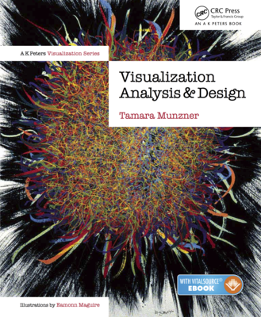
Visualization Analysis & Design
Full-Day Tutorial
Tamara Munzner
  Department of Computer Science
    University of British Columbia
      VIS 2017 Tutorial
      September 2017, Phoenix AZ
www.cs.ubc.ca/~tmm/talks.html#vad17fullday
@tamaramunzner

Slide 2
Outline
Session 1 8:30-10:10am
Visualization Analysis Framework
  Introduction: Definitions
  Analysis: What, Why, How
  Marks and Channels
Session 2 10:30am-12:10pm
Spatial Layout
  Arrange Tables
  Arrange Spatial Data
  Arrange Networks and Trees
Session 3 2:00-3:40pm
Color & Interaction
  Map Color
  Manipulate: Change, Select, Navigate
Facet: Juxtapose, Partition, Superimpose
Session 4 4:15-5:55pm
Guidelines & Methods
  Reduce: Filter, Aggregate
  Rules of Thumb
  Design Study Methodology
http://www.cs.ubc.ca/~tmm/talks.html#vad17fullday
@tamaramunzner

Slide 3
Defining visualization (vis)
Computer-based visualization systems provide visual representations of datasets designed to help people carry out tasks more effectively.
Why?...

Slide 4


Visualization (vis) defined & motivated
Computer-based visualization systems provide visual representations of datasets designed to help people carry out tasks more effectively.
Visualization is suitable when there is a need to augment human capabilities rather than replace people with computational decision-making methods.
human in the loop needs the details & no trusted automatic solution exists
  doesn't know exactly what questions to ask in advance
  exploratory data analysis
    speed up through human-in-the-loop visual data analysis
  present known results to others
  stepping stone towards automation
    before model creation to provide understanding
    during algorithm creation to refine, debug, set parameters
    before or during deployment to build trust and monitor
Notes:
defining better: faster, easier, more correct, novel capabilities

Slide 5


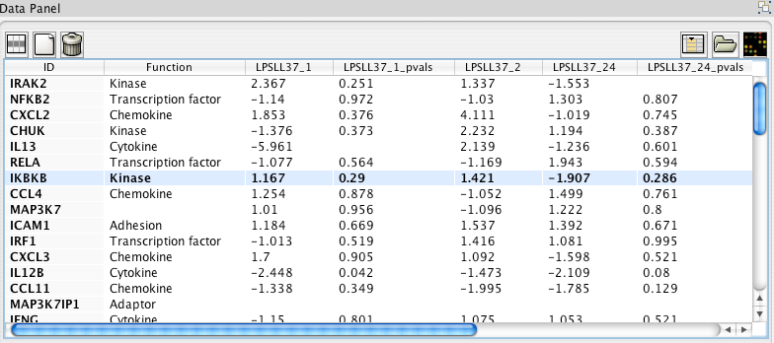
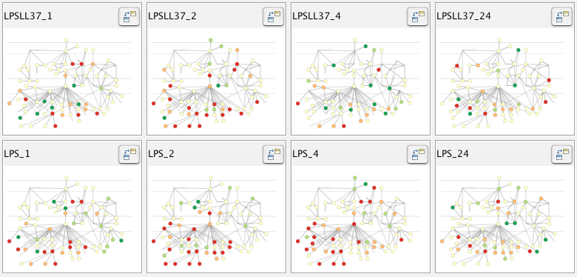
Why use an external representation?
Computer-based visualization systems provide visual representations of datasets designed to help people carry out tasks more effectively.
external representation: replace cognition with perception
[Cerebral: Visualizing Multiple Experimental Conditions on a Graph with Biological Context. Barsky, Munzner, Gardy, and Kincaid. IEEE TVCG (Proc. InfoVis) 14(6):1253-1260, 2008.]

Slide 6

Why depend on vision?
Computer-based visualization systems provide visual representations of datasets designed to help people carry out tasks more effectively.
human visual system is high-bandwidth channel to brain
  overview possible due to background processing
    subjective experience of seeing everything simultaneously
    significant processing occurs in parallel and pre-attentively
sound: lower bandwidth and different semantics
  overview not supported
    subjective experience of sequential stream
touch/haptics: impoverished record/replay capacity
  only very low-bandwidth communication thus far
taste, smell: no viable record/replay devices

Slide 7

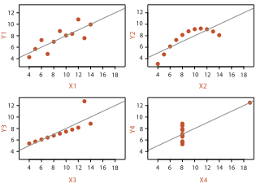
Why represent all the data?
Computer-based visualization systems provide visual representations of datasets designed to help people carry out tasks more effectively.
summaries lose information, details matter
  confirm expected and find unexpected patterns
  assess validity of statistical model
    Anscombe’s Quartet
Identical statistics
x mean | 9
x variance | 10
y mean | 7.5
y variance | 3.75
x/y correlation | 0.816
https://www.youtube.com/watch?v=DbJyPELmhJc
Same Stats, Different Graphs

Slide 8



Why focus on tasks and effectiveness?
Computer-based visualization systems provide visual representations of datasets designed to help people carry out tasks more effectively.
effectiveness requires match between data/task and representation
  set of representations is huge
  many are ineffective mismatch for specific data/task combo
  increases chance of finding good solutions if you understand full space of possibilities
what counts as effective?
  novel: enable entirely new kinds of analysis
  faster: speed up existing workflows
how to validate effectiveness
  many methods, must pick appropriate one for your context

Slide 9
What resource limitations are we faced with?
Vis designers must take into account three very different kinds of resource limitations: those of computers, of humans, and of displays.
computational limits
  processing time
  system memory
human limits
  human attention and memory
display limits
  pixels are precious resource, the most constrained resource
  information density: ratio of space used to encode info vs unused whitespace
    tradeoff between clutter and wasting space, find sweet spot between dense and sparse

Slide 10
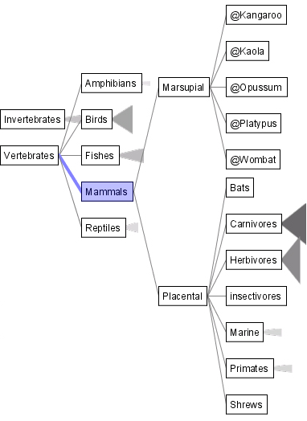
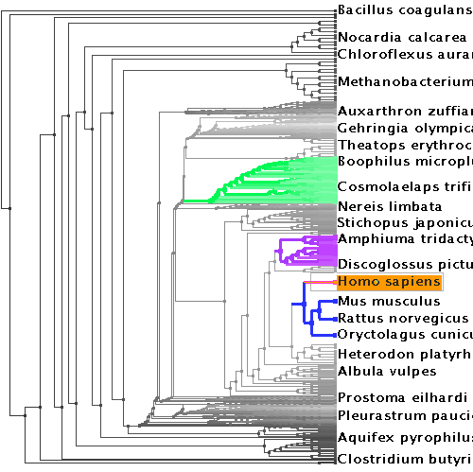
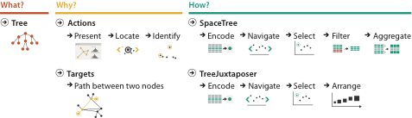

Why analyze?
SpaceTree
TreeJuxtaposer
imposes structure on huge design space
  scaffold to help you think systematically about choices
  analyzing existing as stepping stone to designing new
  most possibilities ineffective for particular task/data combination
[SpaceTree: Supporting Exploration in Large Node Link Tree, Design Evolution and Empirical Evaluation. Grosjean, Plaisant, and Bederson. Proc. InfoVis 2002, p 57–64.]
[TreeJuxtaposer: Scalable Tree Comparison Using Focus+Context With Guaranteed Visibility. ACM Trans. on Graphics (Proc. SIGGRAPH) 22:453– 462, 2003.]

Slide 11
Further reading
Visualization Analysis and Design. Munzner. AK Peters Visualization Series, CRC Press, 2014.
  Chap 1: What’s Vis, and Why Do It?

Slide 12
Outline
Session 1 8:30-10:10am
Visualization Analysis Framework
  Introduction: Definitions
  Analysis: What, Why, How
  Marks and Channels
Session 2 10:30am-12:10pm
Spatial Layout
  Arrange Tables
  Arrange Spatial Data
  Arrange Networks and Trees
Session 3 2:00-3:40pm
Color & Interaction
  Map Color
  Manipulate: Change, Select, Navigate
Facet: Juxtapose, Partition, Superimpose
Session 4 4:15-5:55pm
Guidelines & Methods
  Reduce: Filter, Aggregate
  Rules of Thumb
  Design Study Methodology
http://www.cs.ubc.ca/~tmm/talks.html#vad17fullday
@tamaramunzner

Slide 13

Nested model: Four levels of vis design
domain situation
  who are the target users?
abstraction
  translate from specifics of domain to vocabulary of vis
    what is shown? data abstraction
    why is the user looking at it? task abstraction
idiom
  how is it shown?
    visual encoding idiom: how to draw
    interaction idiom: how to manipulate
algorithm
  efficient computation
[A Nested Model of Visualization Design and Validation.
Munzner. IEEE TVCG 15(6):921-928, 2009
(Proc. InfoVis 2009). ]
domain
abstraction
idiom
algorithm
[A Multi-Level Typology of Abstract Visualization Tasks
Brehmer and Munzner. IEEE TVCG 19(12):2376-2385, 2013 (Proc. InfoVis 2013). ]

Slide 14
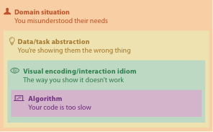
Why is validation difficult?
different ways to get it wrong at each level

Slide 15
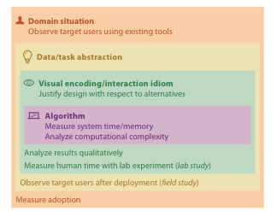


Why is validation difficult?
solution: use methods from different fields at each level
  problem-driven work
  anthropology/
  ethnography
  design
  computer science
  technique-driven work
  cognitive psychology
  anthropology/
  ethnography
[A Nested Model of Visualization Design and Validation. Munzner. IEEE TVCG 15(6):921-928, 2009 (Proc. InfoVis 2009). ]

Slide 16
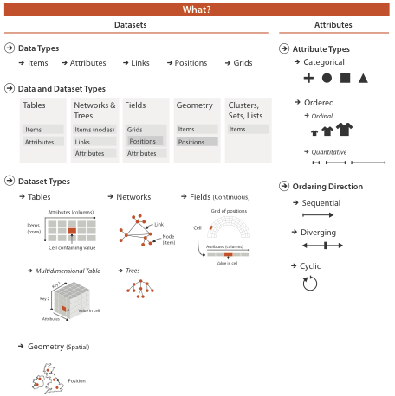
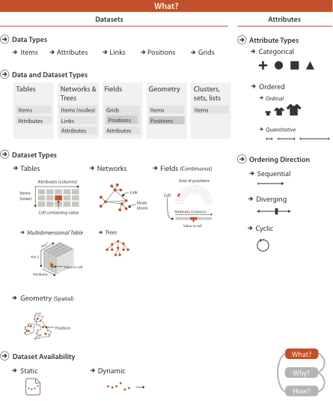

Slide 17
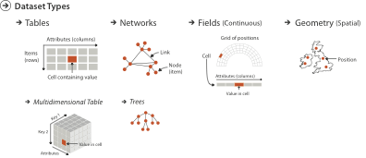
Three major datatypes
Spatial
visualization vs computer graphics
  geometry is design decision

Slide 18
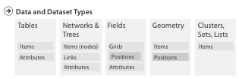

Dataset and data types

Slide 19
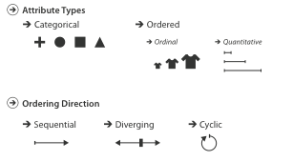
Attribute types

Slide 20
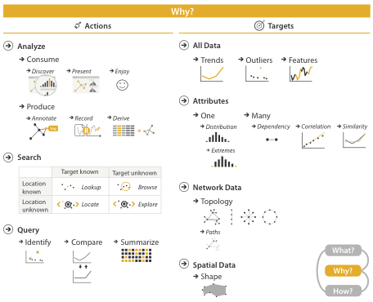

{action, target} pairs
  discover distribution
  compare trends
  locate outliers
  browse topology

Slide 21
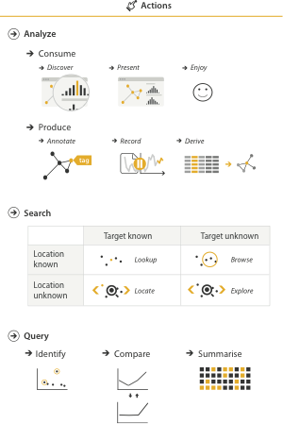
Actions: Analyze
consume
  discover vs present
    classic split
    aka explore vs explain
  enjoy
    newcomer
    aka casual, social
produce
  annotate, record
  derive
    crucial design choice

Slide 22
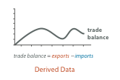

Derive
don’t just draw what you’re given!
  decide what the right thing to show is
  create it with a series of transformations from the original dataset
  draw that
one of the four major strategies for handling complexity

Slide 23
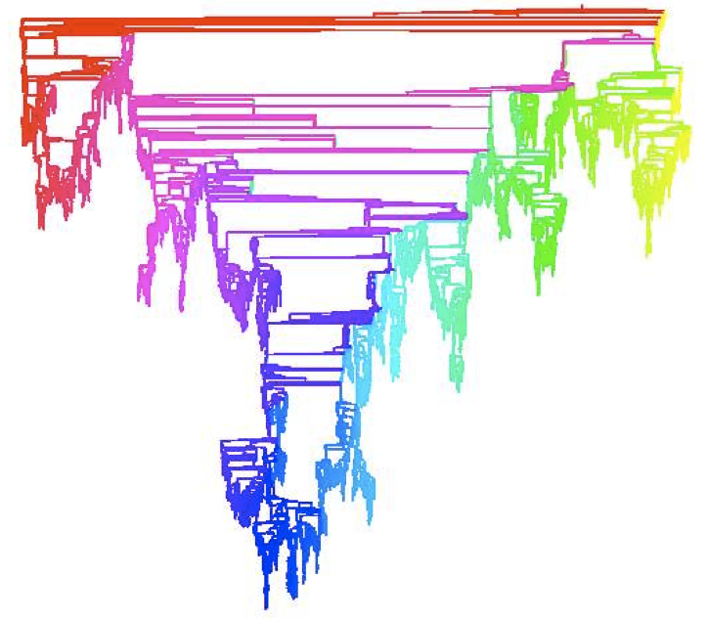
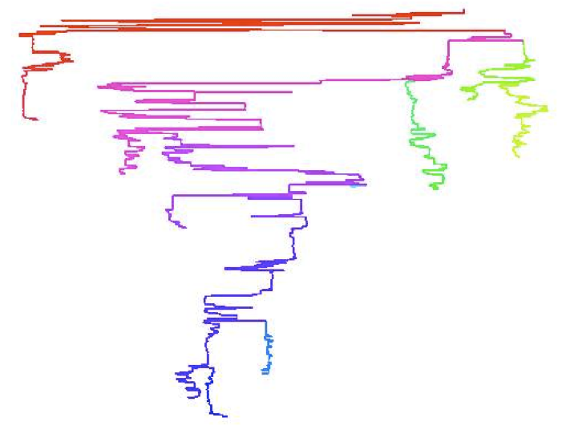
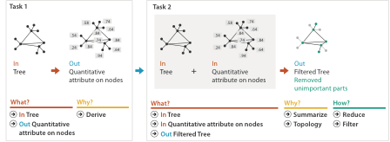
Analysis example: Derive one attribute
Strahler number
  centrality metric for trees/networks
  derived quantitative attribute
  draw top 5K of 500K for good skeleton
[Using Strahler numbers for real time visual exploration of huge graphs. Auber. Proc. Intl. Conf. Computer Vision and Graphics, pp. 56–69, 2002.]

Slide 24
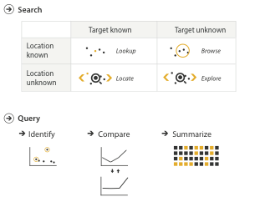
Actions: Search, query
what does user know?
  target, location
how much of the data matters?
  one, some, all
independent choices for each of these three levels
  analyze, search, query
  mix and match

Slide 25
Why: Targets

Slide 26
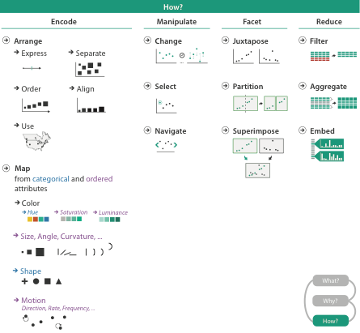
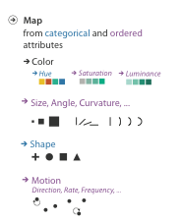


Slide 27
Further reading
Visualization Analysis and Design. Munzner. AK Peters Visualization Series, CRC Press, 2014.
  Chap 2: What: Data Abstraction
  Chap 3: Why: Task Abstraction
A Multi-Level Typology of Abstract Visualization Tasks. Brehmer and Munzner. IEEE Trans. Visualization and Computer Graphics (Proc. InfoVis) 19:12 (2013), 2376–2385.
Low-Level Components of Analytic Activity in Information Visualization. Amar, Eagan, and Stasko. Proc. IEEE InfoVis 2005, p 111–117.
A taxonomy of tools that support the fluent and flexible use of visualizations. Heer and Shneiderman. Communications of the ACM 55:4 (2012), 45–54.
Rethinking Visualization: A High-Level Taxonomy. Tory and Möller. Proc. IEEE InfoVis 2004, p 151–158.
Visualization of Time-Oriented Data. Aigner, Miksch, Schumann, and Tominski. Springer, 2011.

Slide 28
Outline
Session 1 8:30-10:10am
Visualization Analysis Framework
  Introduction: Definitions
  Analysis: What, Why, How
  Marks and Channels
Session 2 10:30am-12:10pm
Spatial Layout
  Arrange Tables
  Arrange Spatial Data
  Arrange Networks and Trees
Session 3 2:00-3:40pm
Color & Interaction
  Map Color
  Manipulate: Change, Select, Navigate
Facet: Juxtapose, Partition, Superimpose
Session 4 4:15-5:55pm
Guidelines & Methods
  Reduce: Filter, Aggregate
  Rules of Thumb
  Design Study Methodology
http://www.cs.ubc.ca/~tmm/talks.html#vad17fullday
@tamaramunzner

Slide 29

Visual encoding
analyze idiom structure
Notes:
How did we decide to use those particular visual channels? How many more visual channels are there? What kinds of information and how much information can each channel encode? Are some channels better than others? Can all of the channels be used independently or do they interfere with each other?

Slide 30

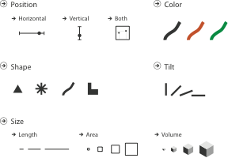
Definitions: Marks and channels
marks
  geometric primitives
channels
  control appearance of marks
  can redundantly code with multiple channels

Slide 31
Visual encoding
analyze idiom structure
  as combination of marks and channels
1:
vertical position
2:
vertical position
horizontal position
3:
vertical position
horizontal position
color hue
4:
vertical position
horizontal position
color hue
size (area)
mark: line
mark: point
mark: point
mark: point

Slide 32
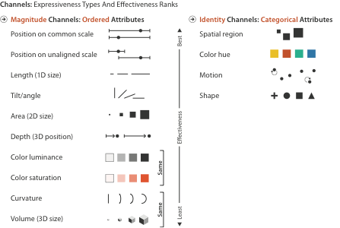
Channels: Expressiveness types and effectiveness rankings

Slide 33
Channels: Matching Types
expressiveness principle
  match channel and data characteristics

Slide 34
Channels: Rankings
expressiveness principle
  match channel and data characteristics
effectiveness principle
  encode most important attributes with highest ranked channels

Slide 35


Channels: Expressiveness types and effectiveness rankings
expressiveness principle
  match channel and data characteristics
effectiveness principle
  encode most important attributes with highest ranked channels
  spatial position ranks high for both

Slide 36
Channels: Rankings
expressiveness principle
  match channel and data characteristics
effectiveness principle
  encode most important attributes with highest ranked channels
distinguishability
  enough levels in channel to match data

Slide 37
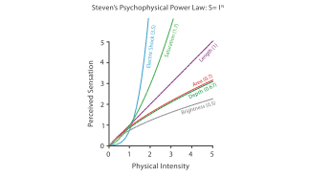
Accuracy: Fundamental Theory

Slide 38
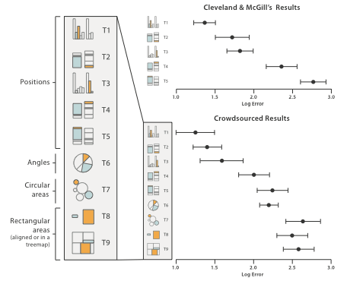
Accuracy: Vis experiments
[Crowdsourcing Graphical Perception: Using Mechanical Turk to Assess Visualization Design. Heer and Bostock. Proc ACM Conf. Human Factors in Computing Systems (CHI) 2010, p. 203–212.]
after Michael McGuffin course slides, http://profs.etsmtl.ca/mmcguffin/

Slide 39
Discriminability: How many usable steps?
must be sufficient for number of attribute levels to show
  linewidth: few bins
[mappa.mundi.net/maps/maps 014/telegeography.html]

Slide 40
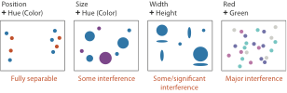
Separability vs. Integrality
2 groups each
2 groups each
3 groups total:
integral area
4 groups total:
integral hue

Slide 41






Popout
find the red dot
  how long does it take?
parallel processing on many individual channels
  speed independent of distractor count
  speed depends on channel and amount of difference from distractors
serial search for (almost all) combinations
  speed depends on number of distractors

Slide 42
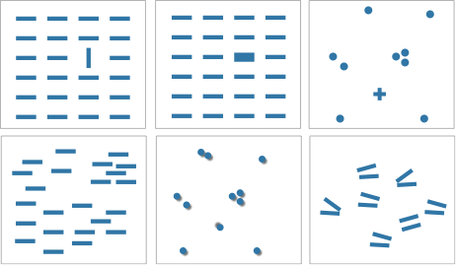

Popout
many channels: tilt, size, shape, proximity, shadow direction, ...
but not all! parallel line pairs do not pop out from tilted pairs
Notes:
Fig 5.12

Slide 43
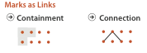
Grouping
containment
connection
proximity
  same spatial region
similarity
  same values as other categorical channels

Slide 44
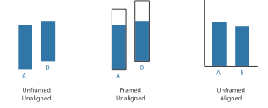
Relative vs. absolute judgements
perceptual system mostly operates with relative judgements, not absolute
  that’s why accuracy increases with common frame/scale and alignment
  Weber’s Law: ratio of increment to background is constant
    filled rectangles differ in length by 1:9, difficult judgement
    white rectangles differ in length by 1:2, easy judgement
length
position along unaligned common scale
position along aligned scale
after [Graphical Perception: Theory, Experimentation, and Application to the Development of Graphical Methods. Cleveland and McGill. Journ. American Statistical Association 79:387 (1984), 531–554.]
length
position along unaligned common scale
position along aligned scale

Slide 45
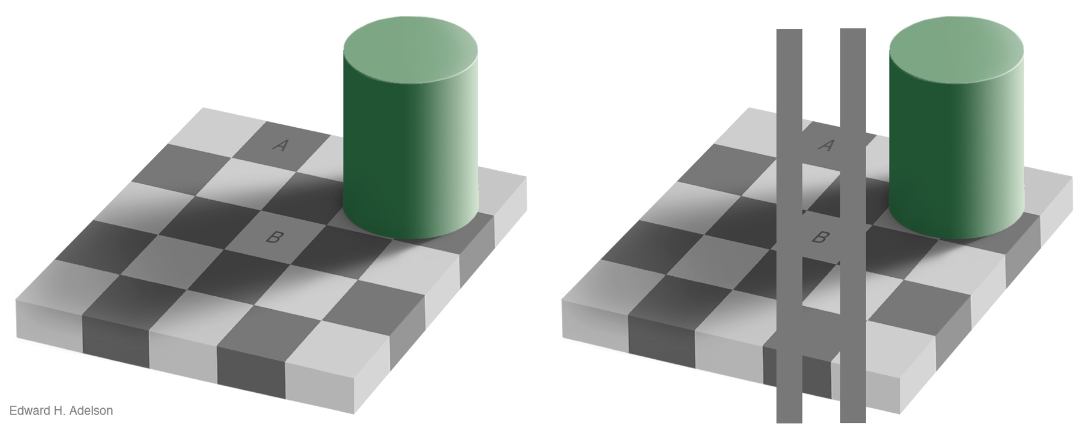
Relative luminance judgements
perception of luminance is contextual based on contrast with surroundings
http://persci.mit.edu/gallery/checkershadow

Slide 46
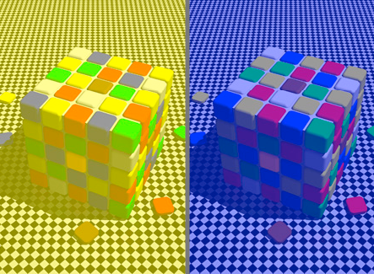
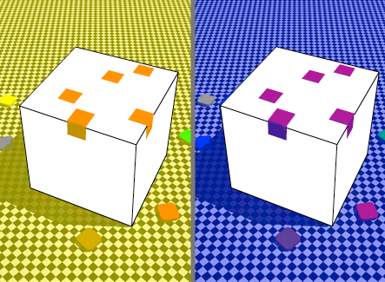
Relative color judgements
color constancy across broad range of illumination conditions
http://www.purveslab.net/seeforyourself/

Slide 47
Further reading
Visualization Analysis and Design. Munzner. AK Peters Visualization Series, CRC Press, 2014.
  Chap 5: Marks and Channels
On the Theory of Scales of Measurement. Stevens. Science 103:2684 (1946), 677–680.
Psychophysics: Introduction to its Perceptual, Neural, and Social Prospects. Stevens. Wiley, 1975.
Graphical Perception: Theory, Experimentation, and Application to the Development of Graphical Methods. Cleveland and McGill. Journ. American Statistical Association 79:387 (1984), 531–554.
Perception in Vision. Healey. http://www.csc.ncsu.edu/faculty/healey/PP
Visual Thinking for Design. Ware. Morgan Kaufmann, 2008.
Information Visualization: Perception for Design, 3rd edition. Ware. Morgan Kaufmann /Academic Press, 2004.

Slide 48
Outline
Session 1 8:30-10:10am
Visualization Analysis Framework
  Introduction: Definitions
  Analysis: What, Why, How
  Marks and Channels
Session 2 10:30am-12:10pm
Spatial Layout
  Arrange Tables
  Arrange Spatial Data
  Arrange Networks and Trees
Session 3 2:00-3:40pm
Color & Interaction
  Map Color
  Manipulate: Change, Select, Navigate
Facet: Juxtapose, Partition, Superimpose
Session 4 4:15-5:55pm
Guidelines & Methods
  Reduce: Filter, Aggregate
  Rules of Thumb
  Design Study Methodology
http://www.cs.ubc.ca/~tmm/talks.html#vad17fullday
@tamaramunzner

Slide 49


Slide 50
Encode tables: Arrange space

Slide 51
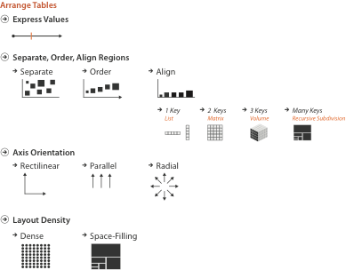
Arrange tables

Slide 52
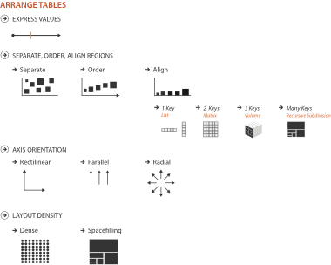
Keys and values
key
  independent attribute
  used as unique index to look up items
  simple tables: 1 key
  multidimensional tables: multiple keys
value
  dependent attribute, value of cell
classify arrangements by key count
  0, 1, 2, many...
Notes:
Figs 7.1, 2.2
same small font problem as above

Slide 53
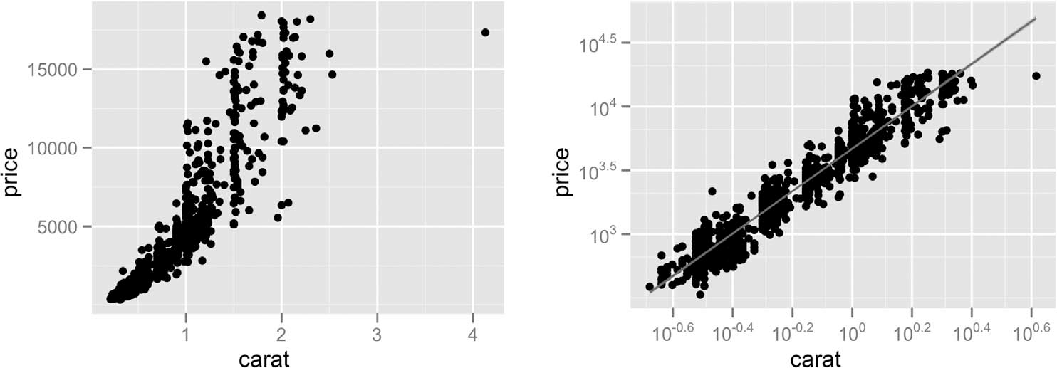
Idiom: scatterplot
express values
  quantitative attributes
no keys, only values
  data
    2 quant attribs
  mark: points
  channels
    horiz + vert position
  tasks
    find trends, outliers, distribution, correlation, clusters
  scalability
    hundreds of items
[A layered grammar of graphics. Wickham. Journ. Computational and Graphical Statistics 19:1 (2010), 3–28.]

Slide 54
Some keys: Categorical regions
regions: contiguous bounded areas distinct from each other
  using space to separate (proximity)
  following expressiveness principle for categorical attributes
use ordered attribute to order and align regions

Slide 55
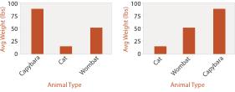
Idiom: bar chart
one key, one value
  data
    1 categ attrib, 1 quant attrib
  mark: lines
  channels
    length to express quant value
    spatial regions: one per mark
      separated horizontally, aligned vertically
      ordered by quant attrib
        by label (alphabetical), by length attrib (data-driven)
  task
    compare, lookup values
  scalability
    dozens to hundreds of levels for key attrib

Slide 56
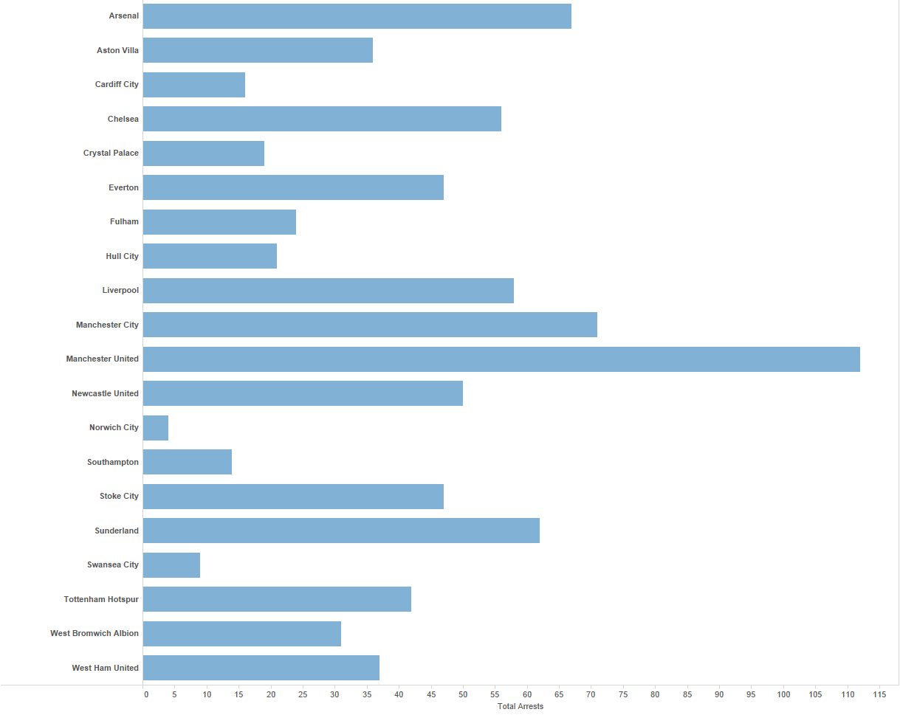
Separated and Aligned but not Ordered
LIMITATION: Hard to know rank. What’s the 4th most? The 7th?
[Slide courtesy of Ben Jones]

Slide 57
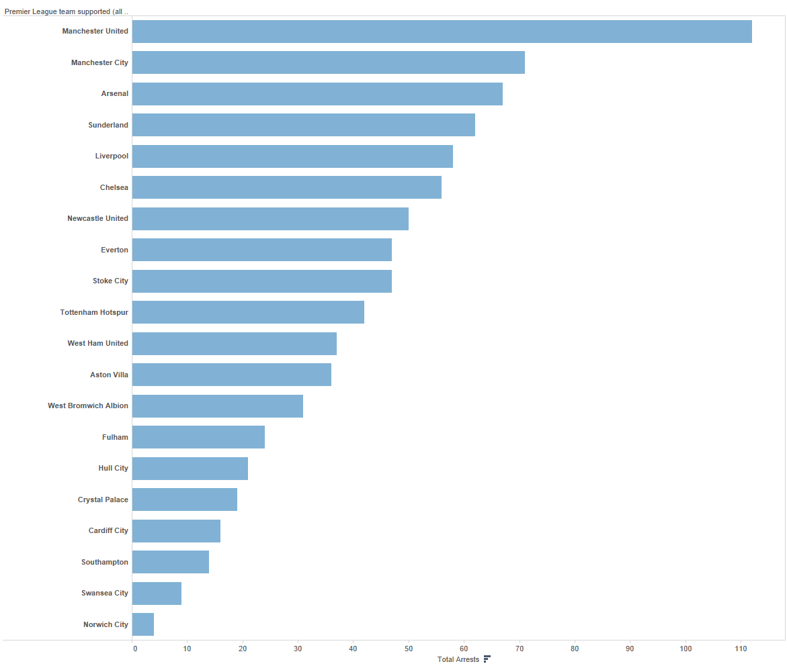
Separated, Aligned and Ordered
[Slide courtesy of Ben Jones]

Slide 58
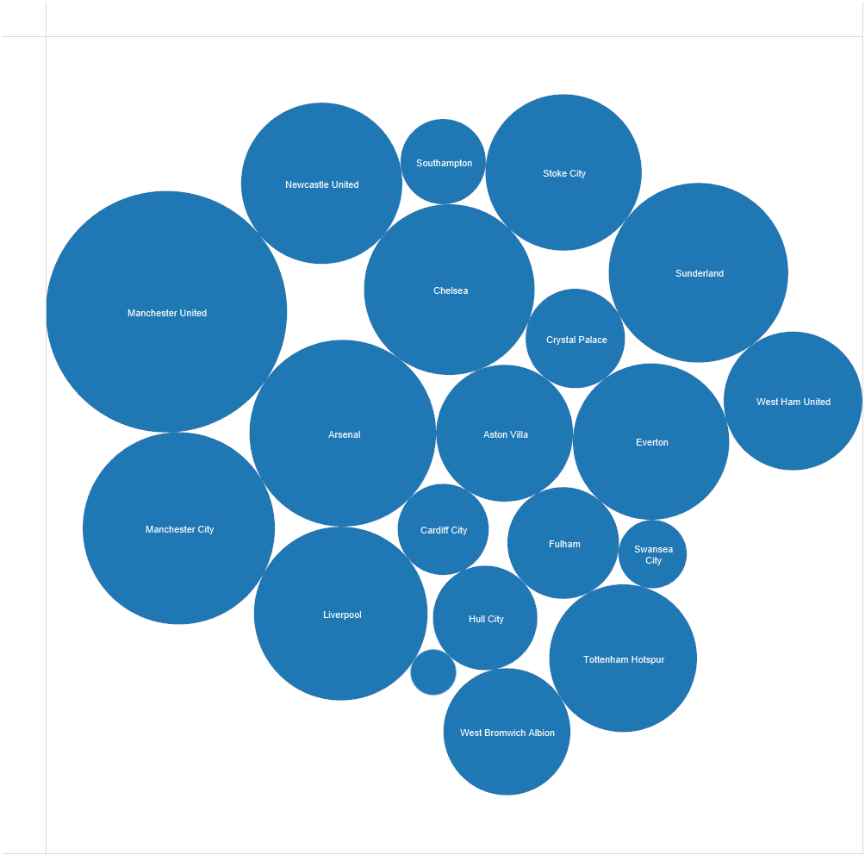
Separated but not Ordered or Aligned
LIMITATION: Hard to make comparisons
[Slide courtesy of Ben Jones]

Slide 59
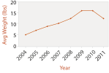
Idiom: line chart / dot plot
one key, one value
  data
    2 quant attribs
  mark: points
    line connection marks between them
  channels
    aligned lengths to express quant value
    separated and ordered by key attrib into horizontal regions
  task
    find trend
      connection marks emphasize ordering of items along key axis by explicitly showing relationship between one item and the next
  scalability
    hundreds of key levels, hundreds of value levels
Notes:
good: height increases with age, 12 year olds are taller than 10 year olds
bad: the more male a person is, the taller he or she is
Zacks and Tversky

Slide 60
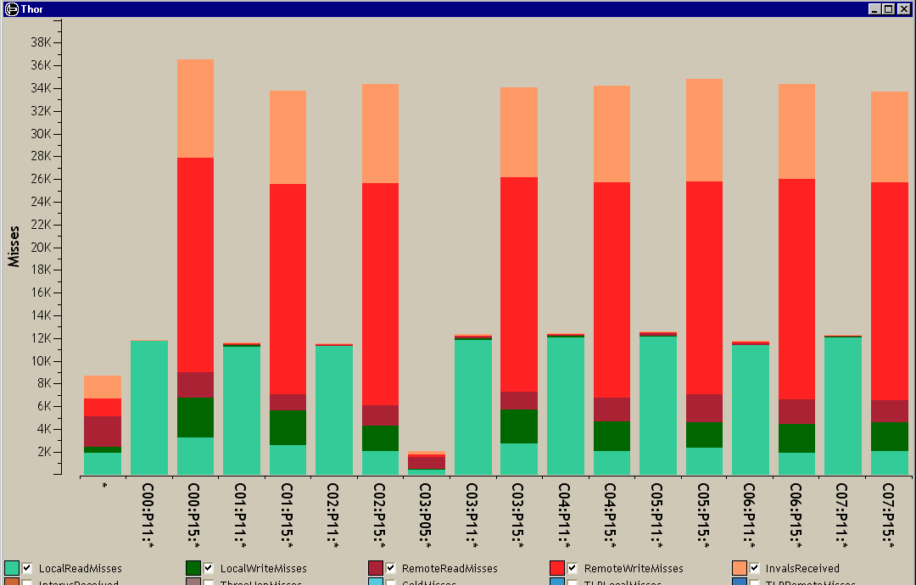
Idiom: stacked bar chart
one more key
  data
    2 categ attrib, 1 quant attrib
  mark: vertical stack of line marks
    glyph: composite object, internal structure from multiple marks
  channels
    length and color hue
    spatial regions: one per glyph
      aligned: full glyph, lowest bar component
      unaligned: other bar components
  task
    part-to-whole relationship
  scalability
    several to one dozen levels for stacked attrib
[Using Visualization to Understand the Behavior of Computer Systems. Bosch. Ph.D. thesis, Stanford Computer Science, 2001.]
Notes:
Thor computer memory profiler. The key used to distribute composite bars along the axis is the combination of a processor and a procedure. The key used to stack and color the glyph subcomponents is the type of cache miss; the height of each full bar encodes all cache misses for each processor-procedure combination.

Slide 61
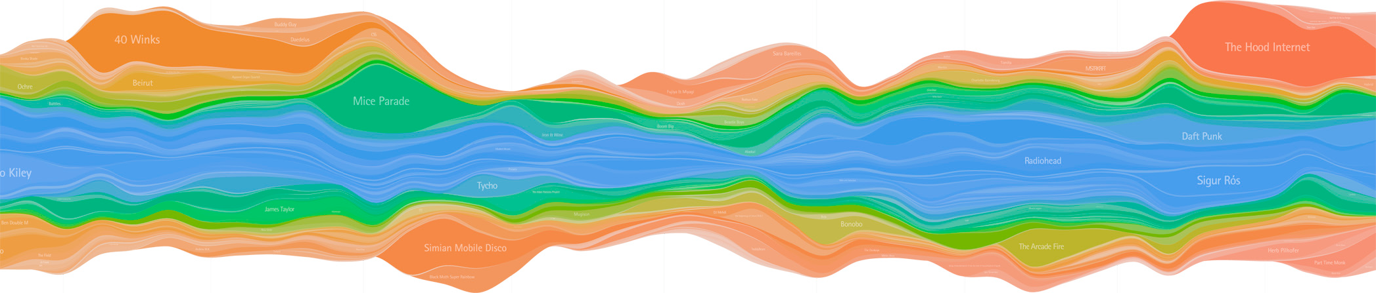
Idiom: streamgraph
generalized stacked graph
  emphasizing horizontal continuity
    vs vertical items
  data
    1 categ key attrib (artist)
    1 ordered key attrib (time)
    1 quant value attrib (counts)
  derived data
    geometry: layers, where height encodes counts
    1 quant attrib (layer ordering)
  scalability
    hundreds of time keys
    dozens to hundreds of artist keys
      more than stacked bars, since most layers don’t extend across whole chart
[Stacked Graphs Geometry & Aesthetics. Byron and Wattenberg. IEEE Trans. Visualization and Computer Graphics (Proc. InfoVis 2008) 14(6): 1245–1252, (2008).]

Slide 62
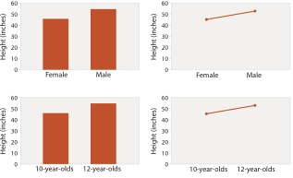
Choosing bar vs line charts
depends on type of key attrib
  bar charts if categorical
  line charts if ordered
do not use line charts for categorical key attribs
  violates expressiveness principle
    implication of trend so strong that it overrides semantics!
      “The more male a person is, the taller he/she is”
after [Bars and Lines: A Study of Graphic Communication. Zacks and Tversky. Memory and Cognition 27:6 (1999), 1073–1079.]
Notes:
good: height increases with age, 12 year olds are taller than 10 year olds
bad: the more male a person is, the taller he or she is

Slide 63
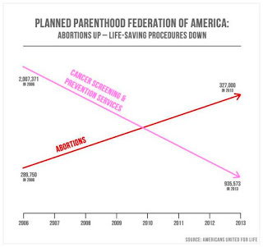
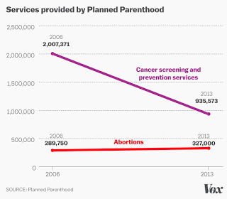
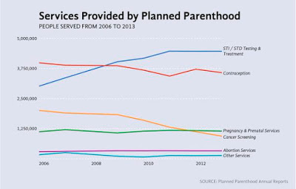
Chart axes
labelled axis is critical
avoid cropping y-axis
  include 0 at bottom left
  or slope misleads
dual axes controversial
  acceptable if commensurate
  beware, very easy to mislead!
http://www.thefunctionalart.com/2015/10/if-you-see-bullshit-say-bullshit.html

Slide 64
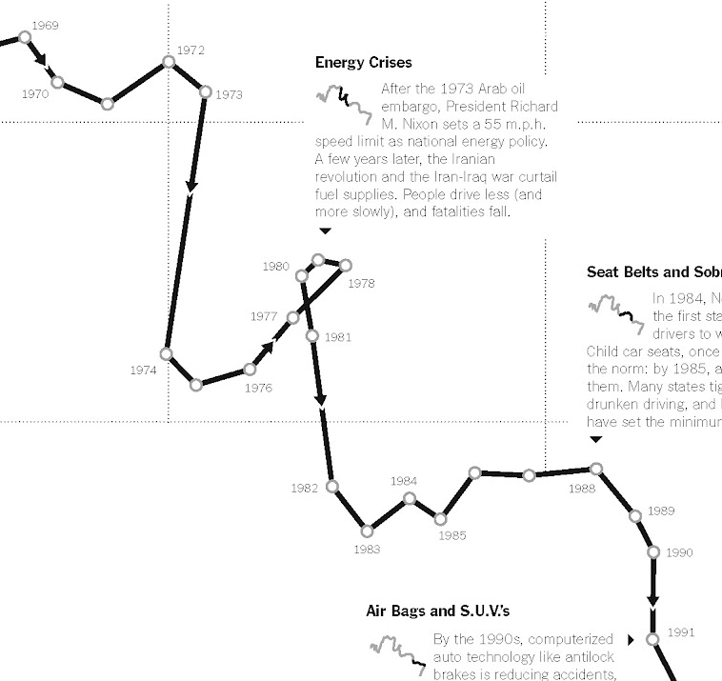
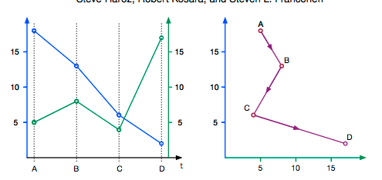

Idiom: connected scatterplots
scatterplot with line connection marks
  popular in journalism
  horiz + vert axes: value attribs
  line connection marks:
  temporal order
  alternative to dual-axis charts
    horiz: time
    vert: two value attribs
empirical study
  engaging, but correlation unclear
[The Connected Scatterplot for Presenting Paired Time Series. Haroz, Kosara and Franconeri. IEEE TVCG 22(9):2174-86, 2016.]
http://steveharoz.com/research/connected_scatterplot/

Slide 65

Idiom: Indexed line charts
data: 2 quant attires
  1 key + 1 value
derived data: new quant value attrib
  index
  plot instead of original value
task: show change over time
  principle: normalized, not absolute
scalability
  same as standard line chart
https://public.tableau.com/profile/ben.jones#!/vizhome/CAStateRevenues/Revenues

Slide 66


Idiom: Gantt charts
one key, two (related) values
  data
    1 categ attrib, 2 quant attribs
  mark: line
    length: duration
  channels
    horiz position: start /end times
    horiz length: duration
  task
    emphasize temporal overlaps, start/end dependencies between items
  scalability
    dozens of key levels
    hundreds of value levels
https://www.r-bloggers.com/gantt-charts-in-r-using-plotly/
[Performance Analysis and Visualization of Parallel Systems Using SimOS and Rivet: A Case Study. Bosch, Stolte, Stoll, Rosenblum, and Hanrahan. Proc. HPCA 2000.]

Slide 67


Idiom: heatmap
two keys, one value
  data
    2 categ attribs (gene, experimental condition)
    1 quant attrib (expression levels)
  marks: area
    separate and align in 2D matrix
      indexed by 2 categorical attributes
  channels
    color by quant attrib
      (ordered diverging colormap)
  task
    find clusters, outliers
  scalability
    1M items, 100s of categ levels, ~10 quant attrib levels

Slide 69

Idioms: scatterplot matrix, parallel coordinates
scatterplot matrix (SPLOM)
  rectilinear axes, point mark
  all possible pairs of axes
  scalability
    one dozen attribs
    dozens to hundreds of items
parallel coordinates
  parallel axes, jagged line representing item
  rectilinear axes, item as point
    axis ordering is major challenge
  scalability
    dozens of attribs
    hundreds of items
after [Visualization Course Figures. McGuffin, 2014. http://www.michaelmcguffin.com/courses/vis/]

Slide 70

Task: Correlation
scatterplot matrix
  positive correlation
    diagonal low-to-high
  negative correlation
    diagonal high-to-low
  uncorrelated
parallel coordinates
  positive correlation
    parallel line segments
  negative correlation
    all segments cross at halfway point
  uncorrelated
    scattered crossings
[A layered grammar of graphics. Wickham. Journ. Computational and Graphical Statistics 19:1 (2010), 3–28.]
[Hyperdimensional Data Analysis Using Parallel Coordinates. Wegman. Journ. American Statistical Association 85:411 (1990), 664–675.]

Slide 71



Idioms: radial bar chart, star plot
radial bar chart
  radial axes meet at central ring, line mark
star plot
  radial axes, meet at central point, line mark
bar chart
  rectilinear axes, aligned vertically
accuracy
  length unaligned with radial
    less accurate than aligned with rectilinear
[Vismon: Facilitating Risk Assessment and Decision Making In Fisheries Management. Booshehrian, Möller, Peterman, and Munzner. Technical Report TR 2011-04, Simon Fraser University, School of Computing Science, 2011.]

Slide 72



Idioms: pie chart, polar area chart
pie chart
  area marks with angle channel
  accuracy: angle/area less accurate than line length
    arclength also less accurate than line length
polar area chart
  area marks with length channel
  more direct analog to bar charts
data
  1 categ key attrib, 1 quant value attrib
task
  part-to-whole judgements
[A layered grammar of graphics. Wickham. Journ. Computational and Graphical Statistics 19:1 (2010), 3–28.]

Slide 73



Idioms: normalized stacked bar chart
task
  part-to-whole judgements
normalized stacked bar chart
  stacked bar chart, normalized to full vert height
  single stacked bar equivalent to full pie
    high information density: requires narrow rectangle
pie chart
  information density: requires large circle
http://bl.ocks.org/mbostock/3887235,
http://bl.ocks.org/mbostock/3886208,
http://bl.ocks.org/mbostock/3886394.

Slide 74




Idiom: glyphmaps
rectilinear good for linear vs nonlinear trends
radial good for cyclic patterns
[Glyph-maps for Visually Exploring Temporal Patterns in Climate Data and Models. Wickham, Hofmann, Wickham, and Cook. Environmetrics 23:5 (2012), 382–393.]

Slide 75
Orientation limitations
rectilinear: scalability wrt #axes
    2 axes best
    3 problematic
      more in afternoon
    4+ impossible
parallel: unfamiliarity, training time
radial: perceptual limits
  angles lower precision than lengths
  asymmetry between angle and length
    can be exploited!
[Uncovering Strengths and Weaknesses of Radial Visualizations - an Empirical Approach. Diehl, Beck and Burch. IEEE TVCG (Proc. InfoVis) 16(6):935--942, 2010.]

Slide 76

dense software overviews
[Visualization of test information to assist fault localization. Jones, Harrold, Stasko. Proc. ICSE 2002, p 467-477.]

Slide 77
Further reading
Visualization Analysis and Design. Munzner. AK Peters Visualization Series, CRC Press, 2014.
  Chap 7: Arrange Tables
Visualizing Data. Cleveland. Hobart Press, 1993.
A Brief History of Data Visualization. Friendly. 2008.
http://www.datavis.ca/milestones

Slide 78
Outline
Session 1 8:30-10:10am
Visualization Analysis Framework
  Introduction: Definitions
  Analysis: What, Why, How
  Marks and Channels
Session 2 10:30am-12:10pm
Spatial Layout
  Arrange Tables
  Arrange Spatial Data
  Arrange Networks and Trees
Session 3 2:00-3:40pm
Color & Interaction
  Map Color
  Manipulate: Change, Select, Navigate
Facet: Juxtapose, Partition, Superimpose
Session 4 4:15-5:55pm
Guidelines & Methods
  Reduce: Filter, Aggregate
  Rules of Thumb
  Design Study Methodology
http://www.cs.ubc.ca/~tmm/talks.html#vad17fullday
@tamaramunzner

Slide 79

Arrange spatial data

Slide 80

Idiom: choropleth map
use given spatial data
  when central task is understanding spatial relationships
data
  geographic geometry
  table with 1 quant attribute per region
encoding
  use given geometry for area mark boundaries
  sequential segmented colormap [more later]
  (geographic heat map)
http://bl.ocks.org/mbostock/4060606

Slide 81

Population maps trickiness
beware!
absolute vs relative again
  population density vs per capita
investigate with Ben Jones Tableau Public demo
  http://public.tableau.com/profile/ben.jones#!/vizhome/PopVsFin/PopVsFin
  Are Maps of Financial Variables just Population Maps?
    yes, unless you look at per capita (relative) numbers
[ https://xkcd.com/1138 ]

Slide 82

Idiom: Bayesian surprise maps
use models of expectations to highlight surprising values
confounds (population) and variance (sparsity)
[Surprise! Bayesian Weighting for De-Biasing Thematic Maps. Correll and Heer. Proc InfoVis 2016]
https://medium.com/@uwdata/surprise-maps-showing-the-unexpected-e92b67398865
https://idl.cs.washington.edu/papers/surprise-maps/

Slide 83

Idiom: topographic map
data
  geographic geometry
  scalar spatial field
    1 quant attribute per grid cell
derived data
  isoline geometry
    isocontours computed for specific levels of scalar values
Land Information New Zealand Data Service

Slide 84


Idioms: isosurfaces, direct volume rendering
data
  scalar spatial field
    1 quant attribute per grid cell
task
  shape understanding, spatial relationships
isosurface
  derived data: isocontours computed for specific levels of scalar values
direct volume rendering
  transfer function maps scalar values to color, opacity
    no derived geometry
[Interactive Volume Rendering Techniques. Kniss. Master’s thesis, University of Utah Computer Science, 2002.]
[Multidimensional Transfer Functions for Volume Rendering. Kniss, Kindlmann, and Hansen. In The Visualization Handbook, edited by Charles Hansen and Christopher Johnson, pp. 189–210. Elsevier, 2005.]

Slide 85


Vector and tensor fields
data
  many attribs per cell
idiom families
  flow glyphs
    purely local
  geometric flow
    derived data from tracing particle trajectories
    sparse set of seed points
  texture flow
    derived data, dense seeds
  feature flow
    global computation to detect features
      encoded with one of methods above
[Comparing 2D vector field visualization methods: A user study. Laidlaw et al. IEEE Trans. Visualization and Computer Graphics (TVCG) 11:1 (2005), 59–70.]
[Topology tracking for the visualization of time-dependent two-dimensional flows. Tricoche, Wischgoll, Scheuermann, and Hagen. Computers & Graphics 26:2 (2002), 249–257.]
Notes:
three local glyph idioms, one dense texture idiom, and two geometric idioms using streamlines.
a) GRID: arrow glyphs on a regular grid. b) JIT: arrow glyphs on a jittered grid. c) LIT: triangular wedge glyphs inspired by oil painting strokes. d) LIC: dense texture-based idiom. e) OSTR: curved arrow glyphs with image-guided streamline seeding. f) GSTR: curved arrow glyphs with regular grid streamline seeding. From [Laidlaw et al. 05], Fig- ure 1.

Slide 86
Vector fields
empirical study tasks
  finding critical points, identifying their types
  identifying what type of critical point is at a specific location
  predicting where a particle starting at a specified point will end up (advection)
[Comparing 2D vector field visualization methods: A user study. Laidlaw et al. IEEE Trans. Visualization and Computer Graphics (TVCG) 11:1 (2005), 59–70.]
[Topology tracking for the visualization of time-dependent two-dimensional flows. Tricoche, Wischgoll, Scheuermann, and Hagen. Computers & Graphics 26:2 (2002), 249–257.]
Notes:
three local glyph idioms, one dense texture idiom, and two geometric idioms using streamlines.
a) GRID: arrow glyphs on a regular grid. b) JIT: arrow glyphs on a jittered grid. c) LIT: triangular wedge glyphs inspired by oil painting strokes. d) LIC: dense texture-based idiom. e) OSTR: curved arrow glyphs with image-guided streamline seeding. f) GSTR: curved arrow glyphs with regular grid streamline seeding. From [Laidlaw et al. 05], Fig- ure 1.

Slide 87

Idiom: similarity-clustered streamlines
data
  3D vector field
derived data (from field)
  streamlines: trajectory particle will follow
derived data (per streamline)
  curvature, torsion, tortuosity
  signature: complex weighted combination
  compute cluster hierarchy across all signatures
  encode: color and opacity by cluster
tasks
  find features, query shape
scalability
  millions of samples, hundreds of streamlines
[Similarity Measures for Enhancing Interactive Streamline Seeding. McLoughlin,. Jones, Laramee, Malki, Masters, and. Hansen. IEEE Trans. Visualization and Computer Graphics 19:8 (2013), 1342–1353.]
Notes:
curvature, namely the curve’s deviation from a straight line; torsion, namely how much the curve bends, out of its plane; and tortuosity, namely how twisted the curve is.

Slide 88
Further reading
Visualization Analysis and Design. Munzner. AK Peters Visualization Series, CRC Press, 2014.
  Chap 8: Arrange Spatial Data
How Maps Work: Representation, Visualization, and Design. MacEachren. Guilford Press, 1995.
Overview of visualization. Schroeder and. Martin. In The Visualization Handbook, edited by Charles Hansen and Christopher Johnson, pp. 3–39. Elsevier, 2005.
Real-Time Volume Graphics. Engel, Hadwiger, Kniss, Reza-Salama, and Weiskopf. AK Peters, 2006.
Overview of flow visualization. Weiskopf and Erlebacher. In The Visualization Handbook, edited by Charles Hansen and Christopher Johnson, pp. 261–278. Elsevier, 2005.

Slide 89
Outline
Session 1 8:30-10:10am
Visualization Analysis Framework
  Introduction: Definitions
  Analysis: What, Why, How
  Marks and Channels
Session 2 10:30am-12:10pm
Spatial Layout
  Arrange Tables
  Arrange Spatial Data
  Arrange Networks and Trees
Session 3 2:00-3:40pm
Color & Interaction
  Map Color
  Manipulate: Change, Select, Navigate
Facet: Juxtapose, Partition, Superimpose
Session 4 4:15-5:55pm
Guidelines & Methods
  Reduce: Filter, Aggregate
  Rules of Thumb
  Design Study Methodology
http://www.cs.ubc.ca/~tmm/talks.html#vad17fullday
@tamaramunzner

Slide 90

Arrange networks and trees

Slide 91

Idiom: force-directed placement
visual encoding
  link connection marks, node point marks
considerations
  spatial position: no meaning directly encoded
    left free to minimize crossings
  proximity semantics?
    sometimes meaningful
    sometimes arbitrary, artifact of layout algorithm
    tension with length
      long edges more visually salient than short
tasks
  explore topology; locate paths, clusters
scalability
  node/edge density E < 4N
http://mbostock.github.com/d3/ex/force.html

Slide 92


Idiom: sfdp (multi-level force-directed placement)
data
  original: network
  derived: cluster hierarchy atop it
considerations
  better algorithm for same encoding technique
    same: fundamental use of space
    hierarchy used for algorithm speed/quality but not shown explicitly
    (more on algorithm vs encoding in afternoon)
scalability
  nodes, edges: 1K-10K
  hairball problem eventually hits
[Efficient and high quality force-directed graph drawing. Hu. The Mathematica Journal 10:37–71, 2005.]
http://www.research.att.com/yifanhu/GALLERY/GRAPHS/index1.html
Notes:
hairball: 26K nodes, 100K edges

Slide 93




Idiom: adjacency matrix view
data: network
  transform into same data/encoding as heatmap
derived data: table from network
  1 quant attrib
    weighted edge between nodes
  2 categ attribs: node list x 2
visual encoding
  cell shows presence/absence of edge
scalability
  1K nodes, 1M edges
[NodeTrix: a Hybrid Visualization of Social Networks. Henry, Fekete, and McGuffin. IEEE TVCG (Proc. InfoVis) 13(6):1302-1309, 2007.]
[Points of view: Networks. Gehlenborg and Wong. Nature Methods 9:115.]

Slide 94
Connection vs. adjacency comparison
adjacency matrix strengths
  predictability, scalability, supports reordering
  some topology tasks trainable
node-link diagram strengths
  topology understanding, path tracing
  intuitive, no training needed
empirical study
  node-link best for small networks
  matrix best for large networks
    if tasks don’t involve topological structure!
http://www.michaelmcguffin.com/courses/vis/patternsInAdjacencyMatrix.png
[On the readability of graphs using node-link and matrix-based representations: a controlled experiment and statistical analysis. Ghoniem, Fekete, and Castagliola. Information Visualization 4:2 (2005), 114–135.]

Slide 95

Idiom: radial node-link tree
data
  tree
encoding
  link connection marks
  point node marks
  radial axis orientation
    angular proximity: siblings
    distance from center: depth in tree
tasks
  understanding topology, following paths
scalability
  1K - 10K nodes
http://mbostock.github.com/d3/ex/tree.html

Slide 96

Idiom: treemap
data
  tree
  1 quant attrib at leaf nodes
encoding
  area containment marks for hierarchical structure
  rectilinear orientation
  size encodes quant attrib
tasks
  query attribute at leaf nodes
scalability
  1M leaf nodes
http://tulip.labri.fr/Documentation/3_7/userHandbook/html/ch06.html

Slide 97



Link marks: Connection and containment
marks as links (vs. nodes)
  common case in network drawing
  1D case: connection
    ex: all node-link diagrams
    emphasizes topology, path tracing
    networks and trees
  2D case: containment
    ex: all treemap variants
    emphasizes attribute values at leaves (size coding)
    only trees
[Elastic Hierarchies: Combining Treemaps and Node-Link Diagrams. Dong, McGuffin, and Chignell. Proc. InfoVis 2005, p. 57-64.]
Notes:
many techniques using each method

Slide 98

Tree drawing idioms comparison
data shown
  link relationships
  tree depth
  sibling order
design choices
  connection vs containment link marks
  rectilinear vs radial layout
  spatial position channels
considerations
  redundant? arbitrary?
  information density?
    avoid wasting space
[Quantifying the Space-Efficiency of 2D Graphical Representations of Trees. McGuffin and Robert. Information Visualization 9:2 (2010), 115–140.]

Slide 99
Further reading
Visualization Analysis and Design. Munzner. AK Peters Visualization Series, CRC Press, 2014.
  Chap 9: Arrange Networks and Trees
Visual Analysis of Large Graphs: State-of-the-Art and Future Research Challenges. von Landesberger et al. Computer Graphics Forum 30:6 (2011), 1719–1749.
Simple Algorithms for Network Visualization: A Tutorial. McGuffin. Tsinghua Science and Technology (Special Issue on Visualization and Computer Graphics) 17:4 (2012), 383–398.
Drawing on Physical Analogies. Brandes. In Drawing Graphs: Methods and Models, LNCS Tutorial, 2025, edited by M. Kaufmann and D. Wagner, LNCS Tutorial, 2025, pp. 71–86. Springer-Verlag, 2001.
http://www.treevis.net Treevis.net: A Tree Visualization Reference. Schulz. IEEE Computer Graphics and Applications 31:6 (2011), 11–15.
Perceptual Guidelines for Creating Rectangular Treemaps. Kong, Heer, and Agrawala. IEEE Trans. Visualization and Computer Graphics (Proc. InfoVis) 16:6 (2010), 990–998.

Slide 100
Outline
Session 1 8:30-10:10am
Visualization Analysis Framework
  Introduction: Definitions
  Analysis: What, Why, How
  Marks and Channels
Session 2 10:30am-12:10pm
Spatial Layout
  Arrange Tables
  Arrange Spatial Data
  Arrange Networks and Trees
Session 3 2:00-3:40pm
Color & Interaction
  Map Color
  Manipulate: Change, Select, Navigate
Facet: Juxtapose, Partition, Superimpose
Session 4 4:15-5:55pm
Guidelines & Methods
  Reduce: Filter, Aggregate
  Rules of Thumb
  Design Study Methodology
http://www.cs.ubc.ca/~tmm/talks.html#vad17fullday
@tamaramunzner

Slide 101


Idiom design choices: Encode

Slide 102



Categorical vs ordered color
  [Seriously Colorful: Advanced Color Principles & Practices. Stone.Tableau Customer Conference 2014.]

Slide 103

Decomposing color
first rule of color: do not talk about color!
  color is confusing if treated as monolithic
decompose into three channels
  ordered can show magnitude
    luminance: how bright
    saturation: how colorful
  categorical can show identity
    hue: what color
channels have different properties
  what they convey directly to perceptual system
  how much they can convey: how many discriminable bins can we use?

Slide 104

Spectral sensitivity

Slide 105



Luminance
need luminance for edge detection
  fine-grained detail only visible through luminance contrast
  legible text requires luminance contrast!
intrinsic perceptual ordering
Luminance information
Chroma information
  [Seriously Colorful: Advanced Color Principles & Practices. Stone.Tableau Customer Conference 2014.]

Slide 106
Opponent color and color deficiency
perceptual processing before optic nerve
  one achromatic luminance channel (L*)
    edge detection through luminance contrast
  2 chroma channels
    red-green (a*) & yellow-blue axis (b*)
“color blind”: one axis has degraded acuity
  8% of men are red/green color deficient
  blue/yellow is rare
Luminance information
Chroma information
  [Seriously Colorful: Advanced Color Principles & Practices. Stone.Tableau Customer Conference 2014.]

Slide 107




Color spaces
CIE L*a*b*: good for computation
  L* intuitive: perceptually linear luminance
  a*b* axes: perceptually linear but nonintuitive
RGB: good for display hardware
  poor for encoding
HSL/HSV: somewhat better for encoding
  hue/saturation wheel intuitive
  beware: only pseudo-perceptual!
  lightness (L) or value (V) ≠ luminance or L*
Luminance, hue, saturation
  good for encoding
  but not standard graphics/tools colorspace
[https://en.wikipedia.org/wiki/HSL_and_HSV]

Slide 108







Designing for color deficiency: Check with simulator
Normal vision
Deuteranope
Protanope
Tritanope
http://rehue.net
  [Seriously Colorful: Advanced Color Principles & Practices. Stone.Tableau Customer Conference 2014.]

Slide 109


Designing for color deficiency: Avoid encoding by hue alone
redundantly encode
  vary luminance
  change shape
Deuteranope simulation
Change the shape
Vary luminance
  [Seriously Colorful: Advanced Color Principles & Practices. Stone.Tableau Customer Conference 2014.]
Notes:
Focus and annotate

Slide 110




Color deficiency: Reduces color to 2 dimensions
Normal
Protanope
Deuteranope
Tritanope
  [Seriously Colorful: Advanced Color Principles & Practices. Stone.Tableau Customer Conference 2014.]
Notes:
Discuss what part of the hue space is missing. Note the darkening caused by protan. Note the loss of distinction between yellow, orange, red, green. Blue-purple, and also gray-brown. Could show the Tableau colors here.

Slide 111

Designing for color deficiency: Blue-Orange is safe
  [Seriously Colorful: Advanced Color Principles & Practices. Stone.Tableau Customer Conference 2014.]

Slide 112

Bezold Effect: Outlines matter
color constancy: simultaneous contrast effect
  [Seriously Colorful: Advanced Color Principles & Practices. Stone.Tableau Customer Conference 2014.]

Slide 113

Color/Lightness constancy: Illumination conditions
Image courtesy of John McCann

Slide 114
Color/Lightness constancy: Illumination conditions
Image courtesy of John McCann

Slide 115

Categorical color: limited number of discriminable bins
human perception built on relative comparisons
  great if color contiguous
  surprisingly bad for absolute comparisons
noncontiguous small regions of color
  fewer bins than you want
  rule of thumb: 6-12 bins, including background and highlights
  alternatives? this afternoon!
[Cinteny: flexible analysis and visualization of synteny and genome rearrangements in multiple organisms. Sinha and Meller. BMC Bioinformatics, 8:82, 2007.]
Notes:
emphasize: greens/blues can't tell apart

Slide 116


ColorBrewer
http://www.colorbrewer2.org
saturation and area example: size affects salience!

Slide 117




Ordered color: Rainbow is poor default
problems
  perceptually unordered
  perceptually nonlinear
benefits
  fine-grained structure visible and nameable
[A Rule-based Tool for Assisting Colormap Selection. Bergman,. Rogowitz, and. Treinish. Proc. IEEE Visualization (Vis), pp. 118–125, 1995.]
[Why Should Engineers Be Worried About Color? Treinish and Rogowitz 1998. http://www.research.ibm.com/people/l/lloydt/color/color.HTM]
[Transfer Functions in Direct Volume Rendering: Design, Interface, Interaction. Kindlmann. SIGGRAPH 2002 Course Notes]

Slide 118
Ordered color: Rainbow is poor default
problems
  perceptually unordered
  perceptually nonlinear
benefits
  fine-grained structure visible and nameable
alternatives
  large-scale structure: fewer hues
[A Rule-based Tool for Assisting Colormap Selection. Bergman,. Rogowitz, and. Treinish. Proc. IEEE Visualization (Vis), pp. 118–125, 1995.]
[Why Should Engineers Be Worried About Color? Treinish and Rogowitz 1998. http://www.research.ibm.com/people/l/lloydt/color/color.HTM]
[Transfer Functions in Direct Volume Rendering: Design, Interface, Interaction. Kindlmann. SIGGRAPH 2002 Course Notes]

Slide 119
Ordered color: Rainbow is poor default
problems
  perceptually unordered
  perceptually nonlinear
benefits
  fine-grained structure visible and nameable
alternatives
  large-scale structure: fewer hues
  fine structure: multiple hues with monotonically increasing luminance [eg viridis R/python]
[A Rule-based Tool for Assisting Colormap Selection. Bergman,. Rogowitz, and. Treinish. Proc. IEEE Visualization (Vis), pp. 118–125, 1995.]
[Why Should Engineers Be Worried About Color? Treinish and Rogowitz 1998. http://www.research.ibm.com/people/l/lloydt/color/color.HTM]
[Transfer Functions in Direct Volume Rendering: Design, Interface, Interaction. Kindlmann. SIGGRAPH 2002 Course Notes]

Slide 120




Viridis
colorful, perceptually uniform, colorblind-safe, monotonically increasing luminance
https://cran.r-project.org/web/packages/viridis/vignettes/intro-to-viridis.html

Slide 121

Ordered color: Rainbow is poor default
problems
  perceptually unordered
  perceptually nonlinear
benefits
  fine-grained structure visible and nameable
alternatives
  large-scale structure: fewer hues
  fine structure: multiple hues with monotonically increasing luminance [eg viridis R/python]
  segmented rainbows for binned or categorical
[A Rule-based Tool for Assisting Colormap Selection. Bergman,. Rogowitz, and. Treinish. Proc. IEEE Visualization (Vis), pp. 118–125, 1995.]
[Why Should Engineers Be Worried About Color? Treinish and Rogowitz 1998. http://www.research.ibm.com/people/l/lloydt/color/color.HTM]
[Transfer Functions in Direct Volume Rendering: Design, Interface, Interaction. Kindlmann. SIGGRAPH 2002 Course Notes]

Slide 122


Colormaps
after [Color Use Guidelines for Mapping and Visualization. Brewer, 1994. http://www.personal.psu.edu/faculty/c/a/cab38/ColorSch/Schemes.html]
Notes:
fix still needed: categorial for qualitative

Slide 123
Colormaps
after [Color Use Guidelines for Mapping and Visualization. Brewer, 1994. http://www.personal.psu.edu/faculty/c/a/cab38/ColorSch/Schemes.html]
Notes:
fix still needed: categorial for qualitative

Slide 124

Colormaps
  use with care!
after [Color Use Guidelines for Mapping and Visualization. Brewer, 1994. http://www.personal.psu.edu/faculty/c/a/cab38/ColorSch/Schemes.html]
Notes:
fix still needed: categorial for qualitative

Slide 125
Colormaps
color channel interactions
  size heavily affects salience
    small regions need high saturation
    large need low saturation
  saturation & luminance: 3-4 bins max
    also not separable from transparency
after [Color Use Guidelines for Mapping and Visualization. Brewer, 1994. http://www.personal.psu.edu/faculty/c/a/cab38/ColorSch/Schemes.html]
Notes:
fix still needed: categorial for qualitative

Slide 126
Map other channels
size
  length accurate, 2D area ok, 3D volume poor
angle
  nonlinear accuracy
    horizontal, vertical, exact diagonal
shape
  complex combination of lower-level primitives
  many bins
motion
  highly separable against static
    binary: great for highlighting
  use with care to avoid irritation
Notes:
standin for now: needs to change

Slide 127

Angle
Notes:
swap with new linebreak figure if done in time

Slide 128
Further reading
Visualization Analysis and Design. Munzner. AK Peters Visualization Series, CRC Press, 2014
  Chap 10: Map Color and Other Channels
ColorBrewer, Brewer.
  http://www.colorbrewer2.org
Color In Information Display. Stone. IEEE Vis Course Notes, 2006.
  http://www.stonesc.com/Vis06
A Field Guide to Digital Color. Stone. AK Peters, 2003.
Rainbow Color Map (Still) Considered Harmful. Borland and Taylor. IEEE Computer Graphics and Applications 27:2 (2007), 14–17.
Visual Thinking for Design. Ware. Morgan Kaufmann, 2008.
Information Visualization: Perception for Design, 3rd edition. Ware. Morgan Kaufmann /Academic Press, 2004.
https://cran.r-project.org/web/packages/viridis/vignettes/intro-to-viridis.html

Slide 129
Outline
Session 1 8:30-10:10am
Visualization Analysis Framework
  Introduction: Definitions
  Analysis: What, Why, How
  Marks and Channels
Session 2 10:30am-12:10pm
Spatial Layout
  Arrange Tables
  Arrange Spatial Data
  Arrange Networks and Trees
Session 3 2:00-3:40pm
Color & Interaction
  Map Color
  Manipulate: Change, Select, Navigate
Facet: Juxtapose, Partition, Superimpose
Session 4 4:15-5:55pm
Guidelines & Methods
  Reduce: Filter, Aggregate
  Rules of Thumb
  Design Study Methodology
http://www.cs.ubc.ca/~tmm/talks.html#vad17fullday
@tamaramunzner

Slide 130


Slide 131
How to handle complexity: 1 previous strategy + 3 more
derive new data to show within view
change view over time
facet across multiple views
reduce items/attributes within single view

Slide 132


Manipulate
Notes:
change any of the other choices
encoding itself
parameters
arrange: rearrange, reorder
aggregation level, what is filtered...
most obvious, powerful, flexible
interaction entails change

Slide 133
Change over time
change any of the other choices
  encoding itself
  parameters
  arrange: rearrange, reorder
  aggregation level, what is filtered...
  interaction entails change

Slide 134




Idiom: Re-encode
System: Tableau
made using Tableau, http://tableausoftware.com

Slide 135


Idiom: Realign
System: LineUp
stacked bars
  easy to compare
    first segment
    total bar
align to different segment
  supports flexible comparison
[LineUp: Visual Analysis of Multi-Attribute Rankings.Gratzl, Lex, Gehlenborg, Pfister, and Streit. IEEE Trans. Visualization and Computer Graphics (Proc. InfoVis 2013) 19:12 (2013), 2277–2286.]
Notes:
video: 1:06 to 1:10 fisheye
1:31 reorder, 2:04 sort, 2:34 end of reordering

Slide 136

Idiom: Animated transitions
smooth interpolation from one state to another
  alternative to jump cuts, supports item tracking
    best case for animation
  staging to reduce cognitive load
example: animated transitions in statistical data graphics
video: vimeo.com/19278444
[Animated Transitions in Statistical Data Graphics. Heer and Robertson. IEEE TVCG (Proc InfoVis 2007) 13(6):1240-1247, 2007]

Slide 137


Idiom: Animated transitions - visual encoding change
smooth transition from one state to another
  alternative to jump cuts, supports item tracking
    best case for animation
  staging to reduce cognitive load
[Stacked to Grouped Bars](http://bl.ocks.org/mbostock/3943967)

Slide 138


Idiom: Animated transition - tree detail
animated transition
  network drilldown/rollup
[Collapsible Tree](https://bl.ocks.org/mbostock/4339083)

Slide 139

Idiom: Animated transition - bar detail
example: hierarchical bar chart
  add detail during transition to new level of detail
[Hierarchical Bar Chart](https://bl.ocks.org/mbostock/1283663)

Slide 140
Navigate: Changing item visibility
change viewpoint
  changes which items are visible within view
  camera metaphor
    zoom
      geometric zoom: familiar semantics
      semantic zoom: adapt object representation based on available pixels
        dramatic change, or more subtle one
    pan/translate
    rotate
      especially in 3D
  constrained navigation
    often with animated transitions
    often based on selection set
Notes:
jump back 3 slides to show grey selected row

Slide 141

Idiom: Semantic zooming
System: LiveRAC
visual encoding change
  colored box
  sparkline
  simple line chart
  full chart: axes and tickmarks
[LiveRAC - Interactive Visual Exploration of System Management Time-Series Data. McLachlan, Munzner, Koutsofios, and North. Proc. ACM Conf. Human Factors in Computing Systems (CHI), pp. 1483–1492, 2008.]

Slide 142


Navigate: Reducing attributes
continuation of camera metaphor
  slice
    show only items matching specific value for given attribute: slicing plane
    axis aligned, or arbitrary alignment
  cut
    show only items on far slide of plane from camera
  project
    change mathematics of image creation
      orthographic
      perspective
      many others: Mercator, cabinet, ...
[Interactive Visualization of Multimodal Volume Data for Neurosurgical Tumor Treatment. Rieder, Ritter, Raspe, and Peitgen. Computer Graphics Forum (Proc. EuroVis 2008) 27:3 (2008), 1055–1062.]
Notes:
jump back 3 slides to show grey selected row

Slide 143
Further reading
Visualization Analysis and Design. Munzner. AK Peters Visualization Series, CRC Press, 2014.
  Chap 11: Manipulate View
Animated Transitions in Statistical Data Graphics. Heer and Robertson. IEEE Trans. on Visualization and Computer Graphics (Proc. InfoVis07) 13:6 (2007), 1240– 1247.
Selection: 524,288 Ways to Say “This is Interesting”. Wills. Proc. IEEE Symp. Information Visualization (InfoVis), pp. 54–61, 1996.
Smooth and efficient zooming and panning. van Wijk and Nuij. Proc. IEEE Symp. Information Visualization (InfoVis), pp. 15–22, 2003.
Starting Simple - adding value to static visualisation through simple interaction. Dix and Ellis. Proc. Advanced Visual Interfaces (AVI), pp. 124–134, 1998.

Slide 144
Outline
Session 1 8:30-10:10am
Visualization Analysis Framework
  Introduction: Definitions
  Analysis: What, Why, How
  Marks and Channels
Session 2 10:30am-12:10pm
Spatial Layout
  Arrange Tables
  Arrange Spatial Data
  Arrange Networks and Trees
Session 3 2:00-3:40pm
Color & Interaction
  Map Color
  Manipulate: Change, Select, Navigate
Facet: Juxtapose, Partition, Superimpose
Session 4 4:15-5:55pm
Guidelines & Methods
  Reduce: Filter, Aggregate
  Rules of Thumb
  Design Study Methodology
http://www.cs.ubc.ca/~tmm/talks.html#vad17fullday
@tamaramunzner

Slide 145
Facet

Slide 146

Juxtapose and coordinate views

Slide 147

Idiom: Linked highlighting
System: EDV
see how regions contiguous in one view are distributed within another
  powerful and pervasive interaction idiom
encoding: different
  multiform
data: all shared
[Visual Exploration of Large Structured Datasets. Wills. Proc. New Techniques and Trends in Statistics (NTTS), pp. 237–246. IOS Press, 1995.]
Notes:
Linked highlighting between views shows how regions that are contiguous in one view are distributed within another. (a) Selecting the high salaries in the upper right window shows different distributions in the other views. (b) Selecting the bottom group in the Assists-Putouts window shows that the clump corresponds to specific positions played.

Slide 148

Idiom: cross filtering
System: Crossfilter
item filtering
coordinated views/controls combined
  all scented histogram bisliders update when any ranges change
[http://square.github.io/crossfilter/]

Slide 149

Idiom: bird’s-eye maps
System: Google Maps
encoding: same
data: subset shared
navigation: shared
  bidirectional linking
differences
  viewpoint
  (size)
overview-detail
[A Review of Overview+Detail, Zooming, and Focus+Context Interfaces. Cockburn, Karlson, and Bederson. ACM Computing Surveys 41:1 (2008), 1–31.]

Slide 150





Idiom: Small multiples
System: Cerebral
encoding: same
data: none shared
  different attributes for node colors
  (same network layout)
navigation: shared
[Cerebral: Visualizing Multiple Experimental Conditions on a Graph with Biological Context. Barsky, Munzner, Gardy, and Kincaid. IEEE Trans. Visualization and Computer Graphics (Proc. InfoVis 2008) 14:6 (2008), 1253–1260.]

Slide 151

Coordinate views: Design choice interaction
why juxtapose views?
  benefits: eyes vs memory
    lower cognitive load to move eyes between 2 views than remembering previous state with single changing view
  costs: display area, 2 views side by side each have only half the area of one view

Slide 152

Why not animation?
disparate frames and regions: comparison difficult
  vs contiguous frames
  vs small region
  vs coherent motion of group
safe special case
  animated transitions

Slide 153
System: Improvise
investigate power of multiple views
  pushing limits on view count, interaction complexity
  how many is ok?
    open research question
  reorderable lists
    easy lookup
    useful when linked to other encodings
[Building Highly-Coordinated Visualizations In Improvise. Weaver. Proc. IEEE Symp. Information Visualization (InfoVis), pp. 159–166, 2004.]
Notes:
geographic and multidimensional table (census data): 1 key attrib (county), many quantitative attribs (demographic information)
views: scatterplot matrix, parallel coordinates, choropleth map with size-coded city points, birdseye map overview, scatterplot, reorderable text lists, text matrix. bivariate sequential-sequential colormap
partition: small-multiple, multiform, overview-detail views; linked highlighting

Slide 154


Partition into views
how to divide data between views
  split into regions by attributes
  encodes association between items using spatial proximity
  order of splits has major implications for what patterns are visible
no strict dividing line
  view: big/detailed
    contiguous region in which visually encoded data is shown on the display
  glyph: small/iconic
    object with internal structure that arises from multiple marks
Notes:
Partioning and grouping are inverse terms; the term partitioning is natural when considering starting from the top and gradually refining; the term grouping is more natural when considering a bottom-up process of gradually consolidating. Conditioning is a synonym for partitioning that is used heavily in the statistics literature.

Slide 155

Partitioning: List alignment
single bar chart with grouped bars
  split by state into regions
    complex glyph within each region showing all ages
  compare: easy within state, hard across ages
small-multiple bar charts
  split by age into regions
    one chart per region
  compare: easy within age, harder across states

Slide 156

Partitioning: Recursive subdivision
System: HIVE
split by neighborhood
then by type
then time
  years as rows
  months as columns
color by price
neighborhood patterns
  where it’s expensive
  where you pay much more for detached type
[Configuring Hierarchical Layouts to Address Research Questions. Slingsby, Dykes, and Wood. IEEE Transactions on Visualization and Computer Graphics (Proc. InfoVis 2009) 15:6 (2009), 977–984.]

Slide 157

Partitioning: Recursive subdivision
System: HIVE
switch order of splits
  type then neighborhood
switch color
  by price variation
type patterns
  within specific type, which neighborhoods inconsistent
[Configuring Hierarchical Layouts to Address Research Questions. Slingsby, Dykes, and Wood. IEEE Transactions on Visualization and Computer Graphics (Proc. InfoVis 2009) 15:6 (2009), 977–984.]

Slide 158

Partitioning: Recursive subdivision
System: HIVE
different encoding for second-level regions
  choropleth maps
[Configuring Hierarchical Layouts to Address Research Questions. Slingsby, Dykes, and Wood. IEEE Transactions on Visualization and Computer Graphics (Proc. InfoVis 2009) 15:6 (2009), 977–984.]

Slide 159

Partitioning: Recursive subdivision
System: HIVE
size regions by sale counts
  not uniformly
result: treemap
[Configuring Hierarchical Layouts to Address Research Questions. Slingsby, Dykes, and Wood. IEEE Transactions on Visualization and Computer Graphics (Proc. InfoVis 2009) 15:6 (2009), 977–984.]

Slide 160
Superimpose layers
layer: set of objects spread out over region
  each set is visually distinguishable group
  extent: whole view
design choices
  how many layers, how to distinguish?
    encode with different, nonoverlapping channels
    two layers achieveable, three with careful design
  small static set, or dynamic from many possible?

Slide 161


Static visual layering
foreground layer: roads
  hue, size distinguishing main from minor
  high luminance contrast from background
background layer: regions
  desaturated colors for water, parks, land areas
user can selectively focus attention
“get it right in black and white”
  check luminance contrast with greyscale view
[Get it right in black and white. Stone. 2010.
http://www.stonesc.com/wordpress/2010/03/get-it-right-in-black-and-white]

Slide 162



Superimposing limits
few layers, but many lines
  up to a few dozen
  but not hundreds
superimpose vs juxtapose: empirical study
  superimposed for local, multiple for global
  tasks
    local: maximum, global: slope, discrimination
  same screen space for all multiples vs single superimposed
[Graphical Perception of Multiple Time Series. Javed, McDonnel, and Elmqvist. IEEE Transactions on Visualization and Computer Graphics (Proc. IEEE InfoVis 2010) 16:6 (2010), 927–934.]
Notes:
local maximum task of finding the time series with the highest value at a specific point in time, global slope task of finding the time series with the highest increase during the entire time period, and the global discrimination task to check whether values were higher at different time points across the series.

Slide 163

Idiom: Trellis plots
superimpose within same frame
  color code by year
partitioning
  split by site, rows are wheat varieties
main-effects ordering
  derive value of median for group, use to order
  order rows within view by variety median
  order views themselves by site median

Slide 164


Dynamic visual layering
interactive based on selection
one-hop neighbour highlighting demos: click vs hover (lightweight)
http://mariandoerk.de/edgemaps/demo/
http://mbostock.github.io/d3/talk/20111116/airports.html

Slide 165
Further reading
Visualization Analysis and Design. Munzner. AK Peters Visualization Series, CRC Press, 2014.
  Chap 12: Facet Into Multiple Views
A Review of Overview+Detail, Zooming, and Focus+Context Interfaces. Cockburn, Karlson, and Bederson. ACM Computing Surveys 41:1 (2008), 1–31.
A Guide to Visual Multi-Level Interface Design From Synthesis of Empirical Study Evidence. Lam and Munzner. Synthesis Lectures on Visualization Series, Morgan Claypool, 2010.
Zooming versus multiple window interfaces: Cognitive costs of visual comparisons. Plumlee and Ware. ACM Trans. on Computer-Human Interaction (ToCHI) 13:2 (2006), 179–209.
Exploring the Design Space of Composite Visualization. Javed and Elmqvist. Proc. Pacific Visualization Symp. (PacificVis), pp. 1–9, 2012.
Visual Comparison for Information Visualization. Gleicher, Albers, Walker, Jusufi, Hansen, and Roberts. Information Visualization 10:4 (2011), 289–309.
Guidelines for Using Multiple Views in Information Visualizations. Baldonado, Woodruff, and Kuchinsky. In Proc. ACM Advanced Visual Interfaces (AVI), pp. 110–119, 2000.
Cross-Filtered Views for Multidimensional Visual Analysis. Weaver. IEEE Trans. Visualization and Computer Graphics 16:2 (Proc. InfoVis 2010), 192–204, 2010.
Linked Data Views. Wills. In Handbook of Data Visualization, Computational Statistics, edited by Unwin, Chen, and Härdle, pp. 216–241. Springer-Verlag, 2008.
Glyph-based Visualization: Foundations, Design Guidelines, Techniques and Applications. Borgo, Kehrer, Chung, Maguire, Laramee, Hauser, Ward, and Chen. In Eurographics State of the Art Reports, pp. 39–63, 2013.

Slide 166
Outline
Session 1 8:30-10:10am
Visualization Analysis Framework
  Introduction: Definitions
  Analysis: What, Why, How
  Marks and Channels
Session 2 10:30am-12:10pm
Spatial Layout
  Arrange Tables
  Arrange Spatial Data
  Arrange Networks and Trees
Session 3 2:00-3:40pm
Color & Interaction
  Map Color
  Manipulate: Change, Select, Navigate
Facet: Juxtapose, Partition, Superimpose
Session 4 4:15-5:55pm
Guidelines & Methods
  Reduce: Filter, Aggregate
  Rules of Thumb
  Design Study Methodology
http://www.cs.ubc.ca/~tmm/talks.html#vad17fullday
@tamaramunzner

Slide 167

Reduce items and attributes
reduce/increase: inverses
filter
  pro: straightforward and intuitive
    to understand and compute
  con: out of sight, out of mind
aggregation
  pro: inform about whole set
  con: difficult to avoid losing signal
not mutually exclusive
  combine filter, aggregate
  combine reduce, change, facet

Slide 168


Idiom: dynamic filtering
System: FilmFinder
item filtering
browse through tightly coupled interaction
  alternative to queries that might return far too many or too few
[Visual information seeking: Tight coupling of dynamic query filters with starfield displays. Ahlberg and Shneiderman. Proc. ACM Conf. on Human Factors in Computing Systems (CHI), pp. 313–317, 1994.]

Slide 169

Idiom: histogram
static item aggregation
task: find distribution
data: table
derived data
  new table: keys are bins, values are counts
bin size crucial
  pattern can change dramatically depending on discretization
  opportunity for interaction: control bin size on the fly

Slide 170




Idiom: scented widgets
augmented widgets show information scent
  cues to show whether value in drilling down further vs looking elsewhere
concise use of space: histogram on slider
[Scented Widgets: Improving Navigation Cues with Embedded Visualizations. Willett, Heer, and Agrawala. IEEE TVCG (Proc. InfoVis 2007) 13:6 (2007), 1129–1136.]
[Multivariate Network Exploration and Presentation: From Detail to Overview via Selections and Aggregations. van den Elzen, van Wijk, IEEE TVCG 20(12): 2014 (Proc. InfoVis 2014).]

Slide 171

Scented histogram bisliders: detailed
[ICLIC: Interactive categorization of large image collections. van der Corput and van Wijk. Proc. PacificVis 2016. ]

Slide 172

Continuous scatterplot
static item aggregation
data: table
derived data: table
  key attribs x,y for pixels
  quant attrib: overplot density
dense space-filling 2D matrix
color: sequential categorical hue + ordered luminance colormap
[Continuous Scatterplots. Bachthaler and Weiskopf. IEEE TVCG (Proc. Vis 08) 14:6 (2008), 1428–1435. 2008. ]

Slide 173





Spatial aggregation
MAUP: Modifiable Areal Unit Problem
  gerrymandering (manipulating voting district boundaries) is only one example!
  zone effects
  scale effects
[http://www.e-education.psu/edu/geog486/l4_p7.html, Fig 4.cg.6]
https://blog.cartographica.com/blog/2011/5/19/the-modifiable-areal-unit-problem-in-gis.html

Slide 174

Idiom: boxplot
static item aggregation
task: find distribution
data: table
derived data
  5 quant attribs
    median: central line
    lower and upper quartile: boxes
    lower upper fences: whiskers
      values beyond which items are outliers
  outliers beyond fence cutoffs explicitly shown
[40 years of boxplots. Wickham and Stryjewski. 2012. had.co.nz]

Slide 175



Idiom: Hierarchical parallel coordinates
dynamic item aggregation
derived data: hierarchical clustering
encoding:
  cluster band with variable transparency, line at mean, width by min/max values
  color by proximity in hierarchy
[Hierarchical Parallel Coordinates for Exploration of Large Datasets. Fua, Ward, and Rundensteiner. Proc. IEEE Visualization Conference (Vis ’99), pp. 43– 50, 1999.]
Notes:
8 attribs, 230K items

Slide 176



Dimensionality reduction
attribute aggregation
  derive low-dimensional target space from high-dimensional measured space
  use when you can’t directly measure what you care about
    true dimensionality of dataset conjectured to be smaller than dimensionality of measurements
    latent factors, hidden variables
Malignant
Benign
Tumor
Measurement Data
DR
data: 9D measured space
derived data: 2D target space
46

Slide 177

Idiom: Dimensionality reduction for documents

Slide 178
Further reading
Visualization Analysis and Design. Munzner. AK Peters Visualization Series, CRC Press, 2014.
  Chap 13: Reduce Items and Attributes
Hierarchical Aggregation for Information Visualization: Overview, Techniques and Design Guidelines. Elmqvist and Fekete. IEEE Transactions on Visualization and Computer Graphics 16:3 (2010), 439–454.
A Review of Overview+Detail, Zooming, and Focus+Context Interfaces. Cockburn, Karlson, and Bederson. ACM Computing Surveys 41:1 (2008), 1–31.
A Guide to Visual Multi-Level Interface Design From Synthesis of Empirical Study Evidence. Lam and Munzner. Synthesis Lectures on Visualization Series, Morgan Claypool, 2010.

Slide 179
Outline
Session 1 8:30-10:10am
Visualization Analysis Framework
  Introduction: Definitions
  Analysis: What, Why, How
  Marks and Channels
Session 2 10:30am-12:10pm
Spatial Layout
  Arrange Tables
  Arrange Spatial Data
  Arrange Networks and Trees
Session 3 2:00-3:40pm
Color & Interaction
  Map Color
  Manipulate: Change, Select, Navigate
Facet: Juxtapose, Partition, Superimpose
Session 4 4:15-5:55pm
Guidelines & Methods
  Reduce: Filter, Aggregate
  Rules of Thumb
  Design Study Methodology
http://www.cs.ubc.ca/~tmm/talks.html#vad17fullday
@tamaramunzner

Slide 180
Rules of Thumb
No unjustified 3D
  Power of the plane
  Disparity of depth
  Occlusion hides information
  Perspective distortion dangers
  Tilted text isn’t legible
No unjustified 2D
Eyes beat memory
Resolution over immersion
Overview first, zoom and filter, details on demand
Responsiveness is required
Function first, form next

Slide 181


Unjustified 3D all too common, in the news and elsewhere
http://viz.wtf/post/137826497077/eye-popping-3d-triangles
http://viz.wtf/post/139002022202/designer-drugs-ht-ducqn

Slide 182




Depth vs power of the plane
high-ranked spatial position channels: planar spatial position
  not depth!

Slide 183
No unjustified 3D: Power of the plane
high-ranked spatial position channels: planar spatial position
  not depth!

Slide 184

No unjustified 3D: Danger of depth
we don’t really live in 3D: we see in 2.05D
  acquire more info on image plane quickly from eye movements
  acquire more info for depth slower, from head/body motion
Notes:
up/down and sideways: image plane: acquire more info quickly from eye movements
away: depth into scene: only acquire more info from head/body motion

Slide 185

Occlusion hides information
occlusion
interaction can resolve, but at cost of time and cognitive load
[Distortion Viewing Techniques for 3D Data. Carpendale et al. InfoVis1996.]

Slide 186

Perspective distortion loses information
perspective distortion
  interferes with all size channel encodings
  power of the plane is lost!
[Visualizing the Results of Multimedia Web Search Engines.
Mukherjea, Hirata, and Hara. InfoVis 96]

Slide 187

3D vs 2D bar charts
3D bars very difficult to justify!
  perspective distortion
  occlusion
faceting into 2D almost always better choice
[http://perceptualedge.com/files/GraphDesignIQ.html]

Slide 188

Tilted text isn’t legible
text legibility
  far worse when tilted from image plane
further reading
[Exploring and Reducing the Effects of Orientation on Text Readability in Volumetric Displays.
Grossman et al. CHI 2007]
[Visualizing the World-Wide Web with the Navigational View Builder.
Mukherjea and Foley. Computer Networks and ISDN Systems, 1995.]
]

Slide 189

No unjustified 3D example: Time-series data
extruded curves: detailed comparisons impossible
[Cluster and Calendar based Visualization of Time Series Data. van Wijk and van Selow, Proc. InfoVis 99.]
Notes:
start with axes explain: power, time of day, day of year
then explain problems

Slide 190

No unjustified 3D example: Transform for new data abstraction
derived data: cluster hierarchy
juxtapose multiple views: calendar, superimposed 2D curves
[Cluster and Calendar based Visualization of Time Series Data. van Wijk and van Selow, Proc. InfoVis 99.]

Slide 191


Justified 3D: shape perception
benefits outweigh costs when task is shape perception for 3D spatial data
  interactive navigation supports synthesis across many viewpoints
[Image-Based Streamline Generation and Rendering. Li and Shen. IEEE Trans. Visualization and Computer Graphics (TVCG) 13:3 (2007), 630–640.]

Slide 192

Justified 3D: Economic growth curve
constrained navigation steps through carefully designed viewpoints
http://www.nytimes.com/interactive/2015/03/19/upshot/3d-yield-curve-economic-growth.html

Slide 193

No unjustified 3D
3D legitimate for true 3D spatial data
3D needs very careful justification for abstract data
  enthusiasm in 1990s, but now skepticism
  be especially careful with 3D for point clouds or networks
[WEBPATH-a three dimensional Web history. Frecon and Smith. Proc. InfoVis 1999]

Slide 194

No unjustified 2D
consider whether network data requires 2D spatial layout
  especially if reading text is central to task!
  arranging as network means lower information density and harder label lookup compared to text lists
benefits outweigh costs when topological structure/context important for task
  be especially careful for search results, document collections, ontologies

Slide 195
Eyes beat memory
principle: external cognition vs. internal memory
  easy to compare by moving eyes between side-by-side views
  harder to compare visible item to memory of what you saw
implications for animation
  great for choreographed storytelling
  great for transitions between two states
  poor for many states with changes everywhere
    consider small multiples instead
literal
abstract
animation
small multiples
show time with time
show time with space

Slide 196


Eyes beat memory example: Cerebral
small multiples: one graph instance per experimental condition
  same spatial layout
  color differently, by condition
[Cerebral: Visualizing Multiple Experimental Conditions on a Graph with Biological Context. Barsky, Munzner, Gardy, and Kincaid. IEEE Trans. Visualization and Computer Graphics (Proc. InfoVis 2008) 14:6 (2008), 1253–1260.]

Slide 197
Why not animation?
disparate frames and regions: comparison difficult
  vs contiguous frames
  vs small region
  vs coherent motion of group
safe special case
  animated transitions

Slide 198


Resolution beats immersion
immersion typically not helpful for abstract data
  do not need sense of presence or stereoscopic 3D
  desktop also better for workflow integration
resolution much more important: pixels are the scarcest resource
virtual reality for abstract data difficult to justify thus far
  but stay tuned with second wave
[Development of an information visualization tool using virtual reality. Kirner and Martins. Proc. Symp. Applied Computing 2000]

Slide 199
Overview first, zoom and filter, details on demand
influential mantra from Shneiderman
overview = summary
  microcosm of full vis design problem
[The Eyes Have It: A Task by Data Type Taxonomy for Information Visualizations. Shneiderman. Proc. IEEE Visual Languages, pp. 336–343, 1996.]

Slide 200
Responsiveness is required
three major categories
  0.1 seconds: perceptual processing
  1 second: immediate response
  10 seconds: brief tasks
importance of visual feedback

Slide 201
Function first, form next
start with focus on functionality
  possible to improve aesthetics later on, as refinement
  if no expertise in-house, find good graphic designer to work with
  aesthetics do matter: another level of function
    visual hierarchy, alignment, flow
    Gestalt principles in action
dangerous to start with aesthetics
  usually impossible to add function retroactively
[The Non-Designer’s Design Book. Robin Williams. 3rd edition. Peachpit Press, 2008.]

Slide 202
Further reading
Visualization Analysis and Design. Tamara Munzner. CRC Press, 2014.
  Chap 6: Rules of Thumb
Designing with the Mind in Mind: Simple Guide to Understanding User Interface Design Rules. Jeff Johnson. Morgan Kaufmann, 2010.
  Chap 12: We Have Time Requirements
The Non-Designer’s Design Book. 3rd edition. Robin Williams. Peachpit Press, 2008.

Slide 203
Outline
Session 1 8:30-10:10am
Visualization Analysis Framework
  Introduction: Definitions
  Analysis: What, Why, How
  Marks and Channels
Session 2 10:30am-12:10pm
Spatial Layout
  Arrange Tables
  Arrange Spatial Data
  Arrange Networks and Trees
Session 3 2:00-3:40pm
Color & Interaction
  Map Color
  Manipulate: Change, Select, Navigate
Facet: Juxtapose, Partition, Superimpose
Session 4 4:15-5:55pm
Guidelines & Methods
  Reduce: Filter, Aggregate
  Rules of Thumb
  Design Study Methodology
http://www.cs.ubc.ca/~tmm/talks.html#vad17fullday
@tamaramunzner

Slide 204


Michael Sedlmair
Miriah Meyer
Design Study Methodology
Reflections from the Trenches and from the Stacks
Tamara Munzner
@tamaramunzner
http://www.cs.ubc.ca/labs/imager/tr/2012/dsm/
Design Study Methodology: Reflections from the Trenches and from the Stacks.
Sedlmair, Meyer, Munzner. IEEE Trans. Visualization and Computer Graphics 18(12): 2431-2440, 2012 (Proc. InfoVis 2012).

Slide 205







Methodology for problem-driven work
definitions
9-stage framework
32 pitfalls & how to avoid them
comparison to related methodologies

Slide 206










Lessons learned from the trenches: 21 between us
Cerebral
genomics
MizBee
genomics
Pathline
genomics
MulteeSum
genomics
Vismon
fisheries management
QuestVis
sustainability
WiKeVis
in-car networks
MostVis
in-car networks
Car-X-Ray
in-car networks
ProgSpy2010
in-car networks
RelEx
in-car networks
Cardiogram
in-car networks
AutobahnVis
in-car networks
VisTra
in-car networks
Constellation
linguistics
LibVis
cultural heritage
Caidants
multicast
SessionViewer
web log analysis
LiveRAC
server hosting
PowerSetViewer
data mining
LastHistory
music listening
Notes:
many domains, and visual representations cross-cut them - some different for same domain, some related representations for very different domains

Slide 207

Design study methodology: definitions

Slide 208
9 stage framework
learn
winnow
cast
discover
design
implement
deploy
reflect
write
PRECONDITION
CORE
ANALYSIS
Notes:
- 3 phases

Slide 209
9-stage framework
learn
winnow
cast
learn
cast
learn
winnow
cast
discover
design
implement
reflect
winnow
deploy
write
PRECONDITION
CORE
ANALYSIS
Notes:
includes learning and knowing the vis literature as an important precondition
but mostly is about setting up promising collaboration
winnow and cast ... come back later

Slide 210
9-stage framework
discover
design
implement
deploy
learn
winnow
cast
discover
design
implement
deploy
reflect
write
PRECONDITION
CORE
ANALYSIS
Notes:
next set of stages is the core of a design study which is the
process that many successful design study papers followed
understanding the problem ... designing and implementing a vis tool
... deploying it to your users and learning how it made their lives better

Slide 211
9-stage framework
reflect
write
guidelines: confirm, refine, reject, propose
learn
winnow
cast
discover
design
implement
deploy
reflect
write
PRECONDITION
CORE
ANALYSIS
Notes:
but there is more, you’re not done ...
final analysis stages:
reflect to figure out what your contributions to the vis community are and write them down

Slide 212
9-stage framework
iterative
learn
winnow
cast
discover
design
implement
deploy
reflect
write
PRECONDITION
CORE
ANALYSIS
Notes:
Lastly, there are all these arrows which indicate the the process is highly iterative and that
revisiting earlier stages is the norm and not an exception
For each of the stages we offer guidance on what to do but also ...

Slide 213

Design study methodology: 32 pitfalls
and how to avoid them

Slide 214




I’m a domain expert!
Wanna collaborate?
Of course!!!
Notes:
This situation might look familiar to many of you ...
-Here is a domain expert who has seen our exiting vis work and get’s interested in a collaboration
-we are excited (people are interested in our work), of course let’s collaborate
-Might find ourselves signed up to a multi-year project, without actually knowing too much about this collaboration ...

Slide 215
considerations
Interesting problem?
...
Have data?
Have time?
Have need?
...
Notes:
So before diving into a huge time commitment, what we actually should do is
... carefully asking questions ... evaluating the potentials of a collaboration
data: or do you just say you will have data soon, which might or might not happen ...
time: ds need quite a bit of time on both sides
need: or are current tools already good enough?
consider yourself ... problem: my interests? engineering?

Slide 216
roles
... or maybe a fellow tool builder?
Are you a
user???
Notes:
You should also think about, who the person is you are talking to ...
All too often, we are very quick in assuming that these guys are our “users”
but instead they might have other interests in collaborating with visualization folks
... one example are fellow tool builders
developing their own data analysis tool want to enrich it with visualization
but might not actually now about the real user needs

Slide 217

Metaphor
Winnowing
Notes:
So what can you do about it:
be careful when committing to collaborations,
in our framework, we offer the analogy of winnowing
process of separating the wheat from the chaff

Slide 218




Collaborator winnowing
initial
conversation
(potential collaborators)
Notes:
So the basic idea is that you have many initial conversations with potential collaborators
(funnel)

Slide 219
Collaborator winnowing
initial
conversation
further
meetings
Notes:
and step for step winnow some of them out ....
... further meetings with a subset
funnel / fewer

Slide 220
Collaborator winnowing
initial
conversation
further
meetings
prototyping
Notes:
prototyping with even fewer ...
funnel / fewer

Slide 221
Collaborator winnowing
initial
conversation
further
meetings
prototyping
full
collaboration
collaborator
Notes:
and finally only stay with a small number of real collaborators that you have carefully selected
over a longer process of due diligence
funnel

Slide 222
Collaborator winnowing
Talk with many,
stay with few!
initial
conversation
further
meetings
prototyping
full
collaboration
Notes:
So the take home message is:

Slide 223


Example From The Trenches
Premature Collaboration!
PowerSet Viewer
2 years / 4 researchers
WikeVis
0.5 years / 2 researchers
Notes:
So, why am I talking about all these questions ...
The thing is that prematurely signing up to collaboration can be very costly on both sides
... here are 2 examples from the trenches where we spent quite a bit of time working on ds projects that turned
out not to be super successful ...

Slide 224
Example From The Trenches
Premature Collaboration!
PowerSet Viewer
2 years / 4 researchers
WikeVis
0.5 years / 2 researchers
- Fellow tool builders
- Data promised
Notes:
In both cases, the problem were early pitfalls on premature collaboration
... in both examples we started a collaboration with fellow tool builders who had not a very good understanding of the real users needs, which we didn’t know of course,
... and promised to have data
but the data either never showed up or came into the game way too late

Slide 225


Design study methodology: 32 pitfalls

Slide 226
Pitfall
Of course they need the cool technique I built last year!
Premature Design Commitment
Notes:
Again, here is Mr. Vis showing a stereotype of ourselves saying:
“Of course ... ”
The tricky think about this attitude is that while the technique might be a solution it does not necessarily mean that is a good solution to the problem at hand.

Slide 227
Metaphor
Design Space
o
-
+
good
okay
poor
-
+
o
o
o
o
o
-
-
-
-
o
-
o
-
-
+
o
-
o
-
-
o
+
-
-
-
o
+
Notes:
To clarify that, we offer a design space metaphor that can be used to think about the implications of such situations.
2D design space -- good sol. -- okay -- poor

Slide 228
Metaphor
Design Space
o
-
+
good
okay
poor
-
+
o
o
o
o
o
-
-
-
-
o
-
o
-
-
your technique...
+
o
-
o
-
-
o
+
-
-
-
o
+
Notes:
In a situation where you focus on a specific technique, it is very likely that you miss other solutions that
might have been better,
even if you consider some of the local neighbours to your solution

Slide 229
Metaphor
Design Space
-
know
o
+
-
o
o
-
o
o
-
-
o
-
o
-
-
+
o
-
o
-
-
o
+
-
-
-
o
+
Notes:
Instead we argue that you should consider broadly...
This starts with having a good understanding of the potential solution space ...

Slide 230
Metaphor
Design Space
-
know
o
+
-
o
o
-
o
o
-
-
consider
o
-
o
-
-
+
o
-
o
-
-
o
+
-
-
-
o
+
Notes:
From your knowledge space you then can consider broadly potential solutions for the problem at hand

Slide 231
Metaphor
Design Space
-
know
o
+
-
o
o
-
o
o
-
-
consider
o
-
o
-
-
+
o
-
o
propose
-
-
o
+
-
-
-
o
+
Notes:
then you can filter them down to a smaller set of solutions that you propose and discuss with your users

Slide 232
Metaphor
Design Space
-
know
o
+
-
o
o
-
o
o
-
-
consider
o
-
o
-
-
+
o
-
o
propose
-
-
o
+
-
-
-
o
select
+
Notes:
And finally select one of the good solutions for the problem
... we argue (+ HCI and SE), higher probability of finding a good solution for problem at hand

Slide 233
Metaphor
Design Space
Think
broad!
o
-
+
good
okay
poor
-
+
o
o
-
o
o
-
o
-
-
o
-
o
-
-
consider
+
o
-
o
-
-
propose
o
+
-
-
-
o
select
+
Notes:
So again, the general guideline here is: Think broad!

Slide 234


Design study methodology: 32 pitfalls

Slide 235
Pitfall
I can write a design study paper in a week!
Premature Publishing
“writing is research”
[Wolcott: Writing up qualitative research, 2009]
Notes:
So, here is Mr Vis again who thinks he can write a design study paper in a week ...
Our experience showed that writing a design study paper can actually be very challenging
as writing down a design study does usually take way more effort than just reporting what has been done ...
[click] In fact, we argue that a design study as highly qualitative approach has a lot in common with writing down
qualitative research such as ethnographies were writing is considered to be an active part of doing research
rather than a straight forward reporting method ...

Slide 236
Metaphor
Horse Race vs. Music Debut
Must be first!
Am I ready?
http://www.prlog.org/10480334-wolverhampton-horse-racing-live-streaming-wolverhampton-handicap-8-jan-2010.html
http://www.alaineknipes.com/interests/violin_concert.jpg
technique-driven
problem-driven
Notes:
Another factor in premature publishing is guided by the wrong instincts that one might have from technique-driven work
-We again offer a metaphor to think about these instincts:
So tech.-dr. work is like a horse race, where the threat is that so. overtakes you and published a technique or a finding first...
In problem-dr work it is very unlikely that someone is working on the exact same problem and potential solution
so it the instincts here should be more like preparing a music debut:
... the threat here is that you haven’t practiced enough before you give your first concert

Slide 237


Example From The Trenches
Don’t step on your own toes!
First design round published
Subsequent work not stand-alone paper
AutobahnVis 1.0
[Sedlmair et al., Smart Graphics, 2009]
AutobahnVis 2.0
[Sedlmair et al., Information Visualization 10(3), 2011]
Notes:
Here is another example form the trenches...
During my PhD, I published a paper on an early design iteration of one of the design studies we did at BMW,
However there were many things that still could be improved and we therefore build another version of the tool which was much stronger and which we deployed for a field study to the engineers ...
The problem however was that this subsequent work was not enough for a stand-alone paper
and we therefore only could include it as secondary contribution in another paper
... Had we waited, we probably would have had a much stronger design study paper with everything in one place

Slide 238

Reflections from the stacks: Wholesale adoption inappropriate
ethnography
  rapid, goal-directed fieldwork
grounded theory
  not empty slate: vis background is key
action research
  aligned
    intervention as goal
    transferability not reproducibility
    personal involvement is key
  opposition
    translation of participant concepts into visualization language
    researcher lead not facilitate design
    orthogonal to vis concerns: participants as writers, adversarial to status quo, postmodernity
www.freegreatpicture.com/city-impression/trinity-college-dublin-the-old-library-14885

Slide 239
Outline
Session 1 8:30-10:10am
Visualization Analysis Framework
  Introduction: Definitions
  Analysis: What, Why, How
  Marks and Channels
Session 2 10:30am-12:10pm
Spatial Layout
  Arrange Tables
  Arrange Spatial Data
  Arrange Networks and Trees
Session 3 2:00-3:40pm
Color & Interaction
  Map Color
  Manipulate: Change, Select, Navigate
Facet: Juxtapose, Partition, Superimpose
Session 4 4:15-5:55pm
Guidelines & Methods
  Reduce: Filter, Aggregate
  Rules of Thumb
  Design Study Methodology
http://www.cs.ubc.ca/~tmm/talks.html#vad17fullday
@tamaramunzner

Slide 240
domain
abstraction
idiom
algorithm

Slide 241

More Information
@tamaramunzner
this talk
http://www.cs.ubc.ca/~tmm/talks.html#vad17fullday
book page (including tutorial lecture slides)
http://www.cs.ubc.ca/~tmm/vadbook
  20% promo code for book+ebook combo: HVN17
  http://www.crcpress.com/product/isbn/9781466508910
  illustrations: Eamonn Maguire
papers, videos, software, talks, courses
http://www.cs.ubc.ca/group/infovis
http://www.cs.ubc.ca/~tmm
Visualization Analysis and Design.
Munzner. A K Peters Visualization Series, CRC Press, Visualization Series, 2014.

