Slide 1
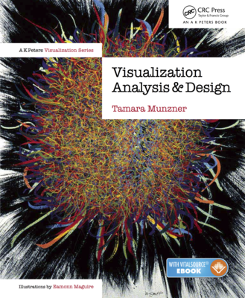
Visualization Analysis & Design
Half-Day Tutorial
Tamara Munzner
  Department of Computer Science
    University of British Columbia
      IEEE VIS 2020 Tutorial
      October 2020, Salt Lake City UT (online)
@tamaramunzner
http://www.cs.ubc.ca/~tmm/talks.html#halfdaycourse20

Slide 2
Visualization Analysis & Design, Half-Day Tutorial
Session 1
  Analysis: What, Why, How
  Marks and Channels
  Arrange Tables
  Arrange Spatial Data
Session 2
  Arrange Networks and Trees
  Map Color and Other Channels
  Manipulate: Change, Select, Navigate
  Facet: Juxtapose, Partition, Superimpose
  Reduce: Filter, Aggregate
@tamaramunzner
http://www.cs.ubc.ca/~tmm/talks.html#halfdaycourse20

Slide 3
Defining visualization (vis)
Computer-based visualization systems provide visual representations of datasets designed to help people carry out tasks more effectively.

Slide 4
Defining visualization (vis)
Computer-based visualization systems provide visual representations of datasets designed to help people carry out tasks more effectively.
Why?...

Slide 5


Why have a human in the loop?
Computer-based visualization systems provide visual representations of datasets designed to help people carry out tasks more effectively.

Slide 6
Why have a human in the loop?
Computer-based visualization systems provide visual representations of datasets designed to help people carry out tasks more effectively.
Visualization is suitable when there is a need to augment human capabilities rather than replace people with computational decision-making methods.

Slide 7
Why have a human in the loop?
Computer-based visualization systems provide visual representations of datasets designed to help people carry out tasks more effectively.
Visualization is suitable when there is a need to augment human capabilities rather than replace people with computational decision-making methods.
don’t need vis when fully automatic solution exists and is trusted
many analysis problems ill-specified
  don’t know exactly what questions to ask in advance
possibilities
  long-term use for end users (ex: exploratory analysis of scientific data)
  presentation of known results (ex: New York Times Upshot)
  stepping stone to assess requirements before developing models
  help automatic solution developers refine & determine parameters
  help end users of automatic solutions verify, build trust

Slide 8

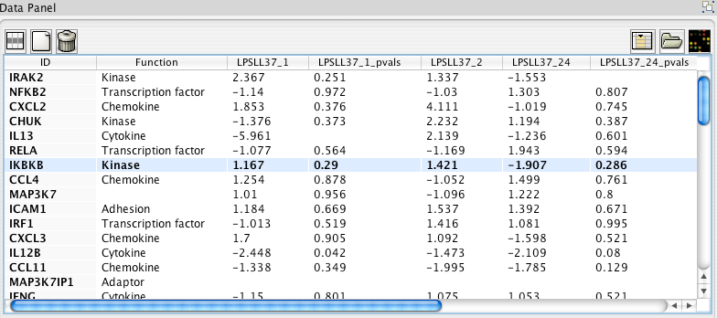
Why use an external representation?
Computer-based visualization systems provide visual representations of datasets designed to help people carry out tasks more effectively.
external representation: replace cognition with perception
[Cerebral: Visualizing Multiple Experimental Conditions on a Graph with Biological Context. Barsky, Munzner, Gardy, and Kincaid. IEEE TVCG (Proc. InfoVis) 14(6):1253-1260, 2008.]

Slide 9
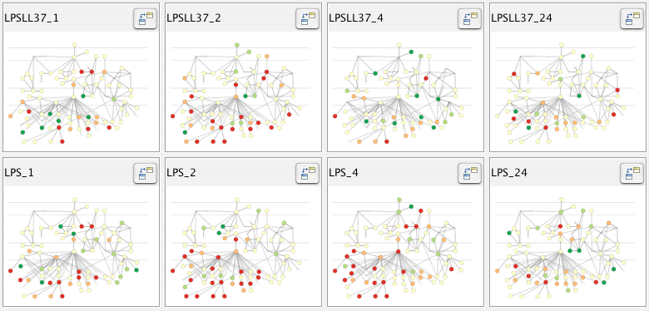

Why use an external representation?
Computer-based visualization systems provide visual representations of datasets designed to help people carry out tasks more effectively.
external representation: replace cognition with perception
[Cerebral: Visualizing Multiple Experimental Conditions on a Graph with Biological Context. Barsky, Munzner, Gardy, and Kincaid. IEEE TVCG (Proc. InfoVis) 14(6):1253-1260, 2008.]

Slide 10

Why represent all the data?
Computer-based visualization systems provide visual representations of datasets designed to help people carry out tasks more effectively.
summaries lose information, details matter
  confirm expected and find unexpected patterns
  assess validity of statistical model
    Anscombe’s Quartet
Identical statistics
x mean | 9
x variance | 10
y mean | 7.5
y variance | 3.75
x/y correlation | 0.816

Slide 11
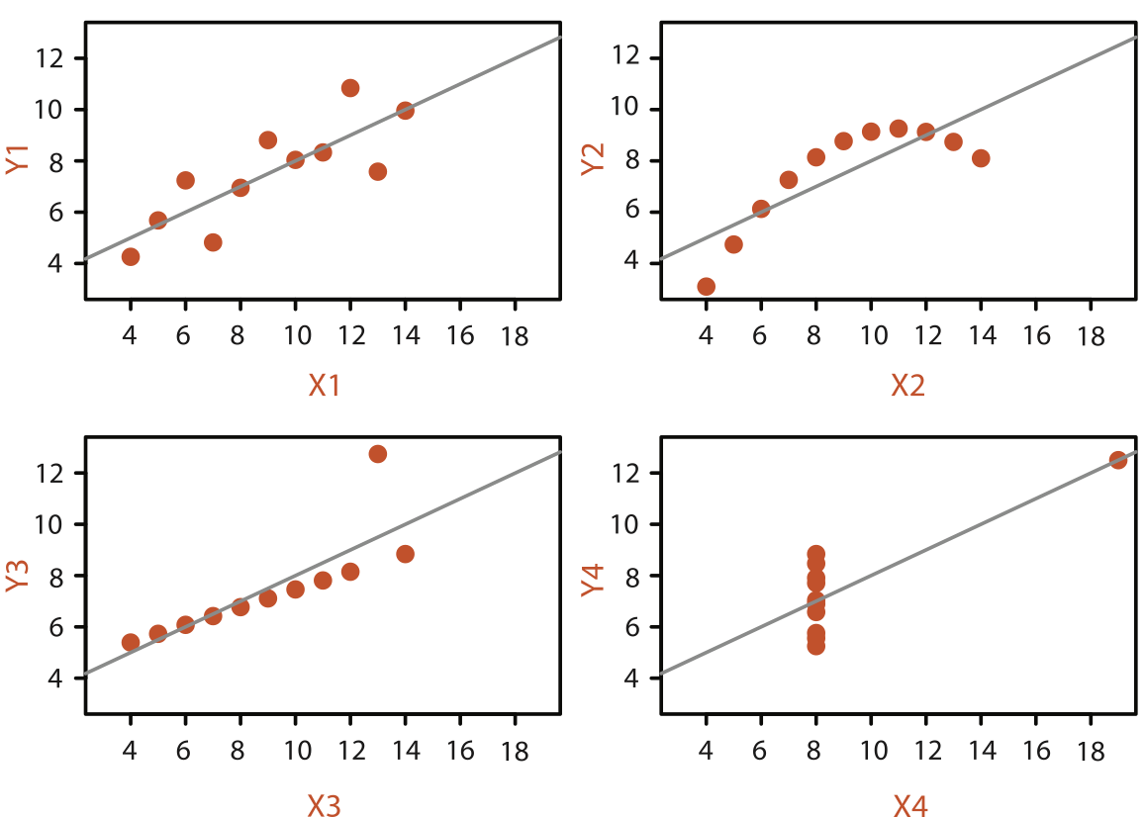
Why represent all the data?
Computer-based visualization systems provide visual representations of datasets designed to help people carry out tasks more effectively.
summaries lose information, details matter
  confirm expected and find unexpected patterns
  assess validity of statistical model
    Anscombe’s Quartet
Identical statistics
x mean | 9
x variance | 10
y mean | 7.5
y variance | 3.75
x/y correlation | 0.816

Slide 12
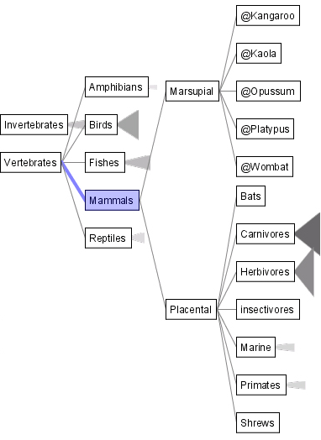
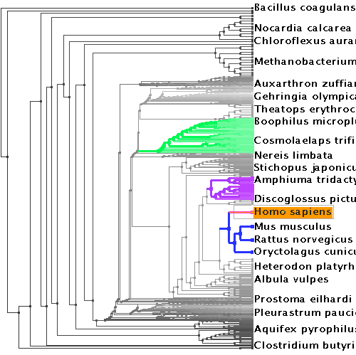
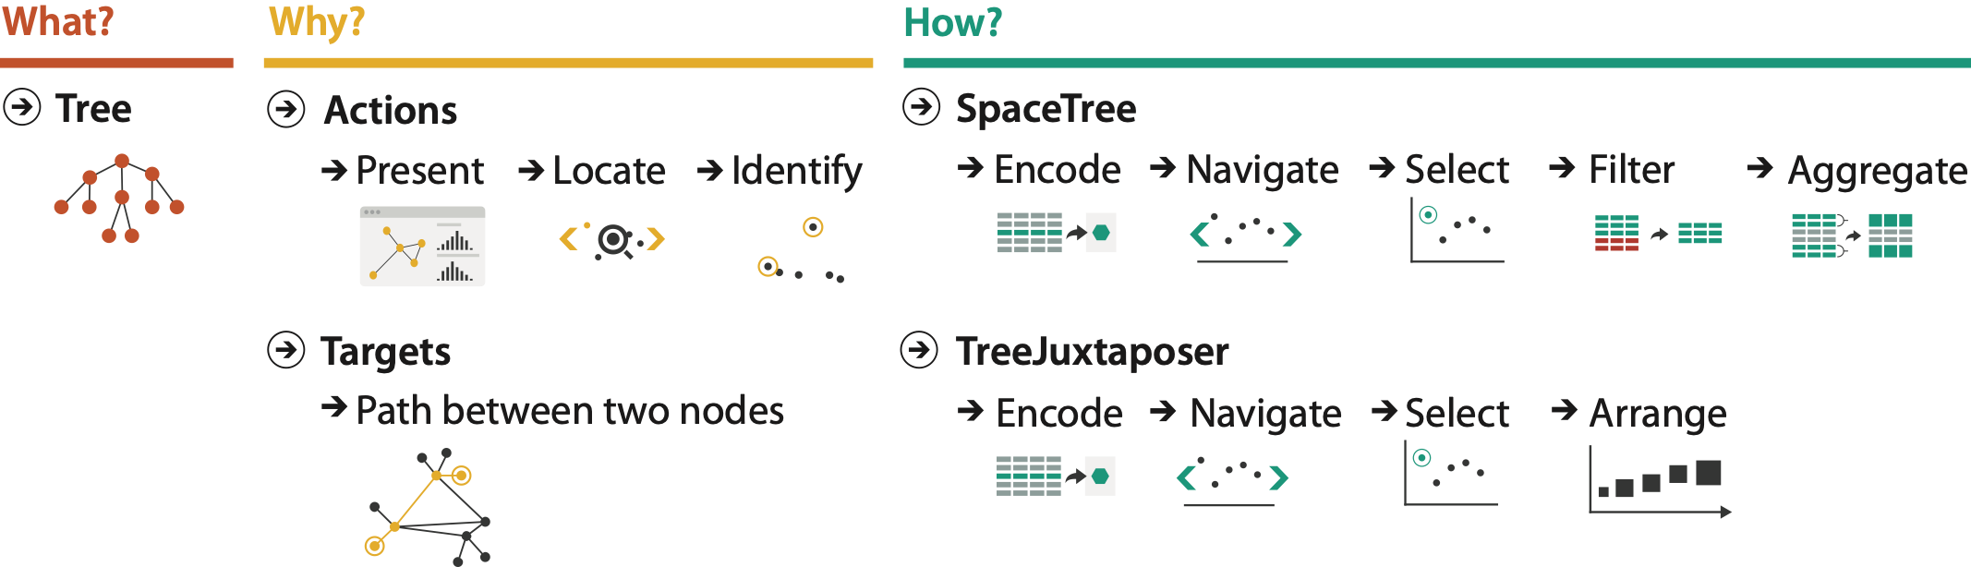
Why analyze?
SpaceTree
TreeJuxtaposer
imposes structure on huge design space
  scaffold to help you think systematically about choices
  analyzing existing as stepping stone to designing new
  most possibilities ineffective for particular task/data combination
[SpaceTree: Supporting Exploration in Large Node Link Tree, Design Evolution and Empirical Evaluation. Grosjean, Plaisant, and Bederson. Proc. InfoVis 2002, p 57–64.]
[TreeJuxtaposer: Scalable Tree Comparison Using Focus+Context With Guaranteed Visibility. ACM Trans. on Graphics (Proc. SIGGRAPH) 22:453– 462, 2003.]

Slide 13
Analysis framework: Four levels, three questions
domain situation
  who are the target users?

Slide 14
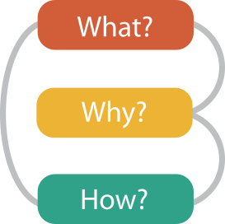
Analysis framework: Four levels, three questions
domain situation
  who are the target users?
abstraction
  translate from specifics of domain to vocabulary of vis
    what is shown? data abstraction
    why is the user looking at it? task abstraction
[A Nested Model of Visualization Design and Validation.
Munzner. IEEE TVCG 15(6):921-928, 2009
(Proc. InfoVis 2009). ]
domain
abstraction
idiom
algorithm
[A Multi-Level Typology of Abstract Visualization Tasks
Brehmer and Munzner. IEEE TVCG 19(12):2376-2385, 2013 (Proc. InfoVis 2013). ]

Slide 15
Analysis framework: Four levels, three questions
domain situation
  who are the target users?
abstraction
  translate from specifics of domain to vocabulary of vis
    what is shown? data abstraction
    why is the user looking at it? task abstraction
idiom
  how is it shown?
    visual encoding idiom: how to draw
    interaction idiom: how to manipulate
[A Nested Model of Visualization Design and Validation.
Munzner. IEEE TVCG 15(6):921-928, 2009
(Proc. InfoVis 2009). ]
domain
abstraction
idiom
algorithm
[A Multi-Level Typology of Abstract Visualization Tasks
Brehmer and Munzner. IEEE TVCG 19(12):2376-2385, 2013 (Proc. InfoVis 2013). ]

Slide 16
Analysis framework: Four levels, three questions
domain situation
  who are the target users?
abstraction
  translate from specifics of domain to vocabulary of vis
    what is shown? data abstraction
    why is the user looking at it? task abstraction
idiom
  how is it shown?
    visual encoding idiom: how to draw
    interaction idiom: how to manipulate
algorithm
  efficient computation
[A Nested Model of Visualization Design and Validation.
Munzner. IEEE TVCG 15(6):921-928, 2009
(Proc. InfoVis 2009). ]
domain
abstraction
idiom
algorithm
[A Multi-Level Typology of Abstract Visualization Tasks
Brehmer and Munzner. IEEE TVCG 19(12):2376-2385, 2013 (Proc. InfoVis 2013). ]

Slide 17
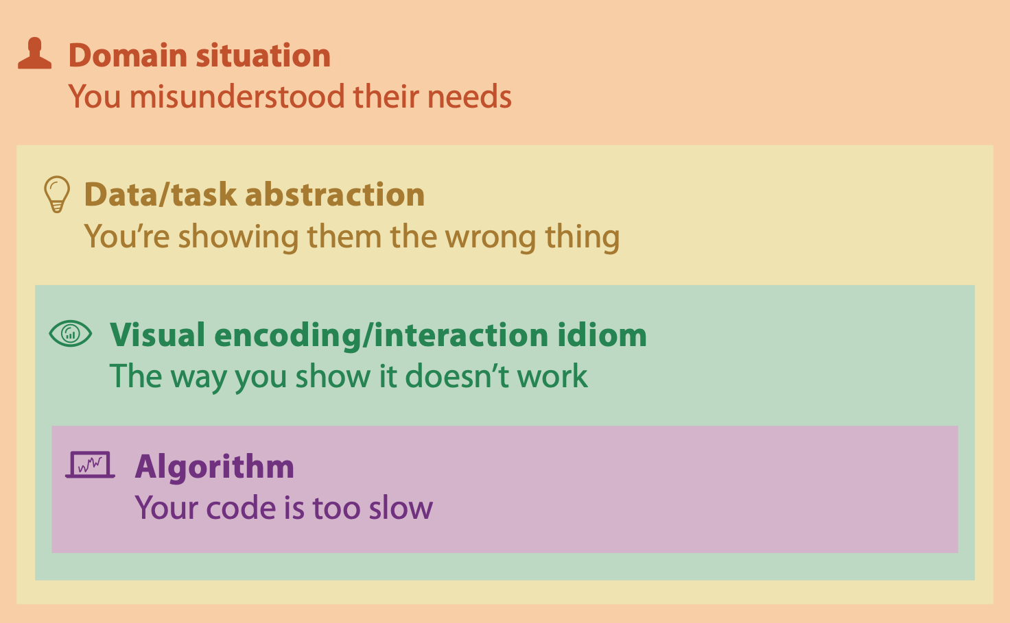
Why is validation difficult?
different ways to get it wrong at each level

Slide 18
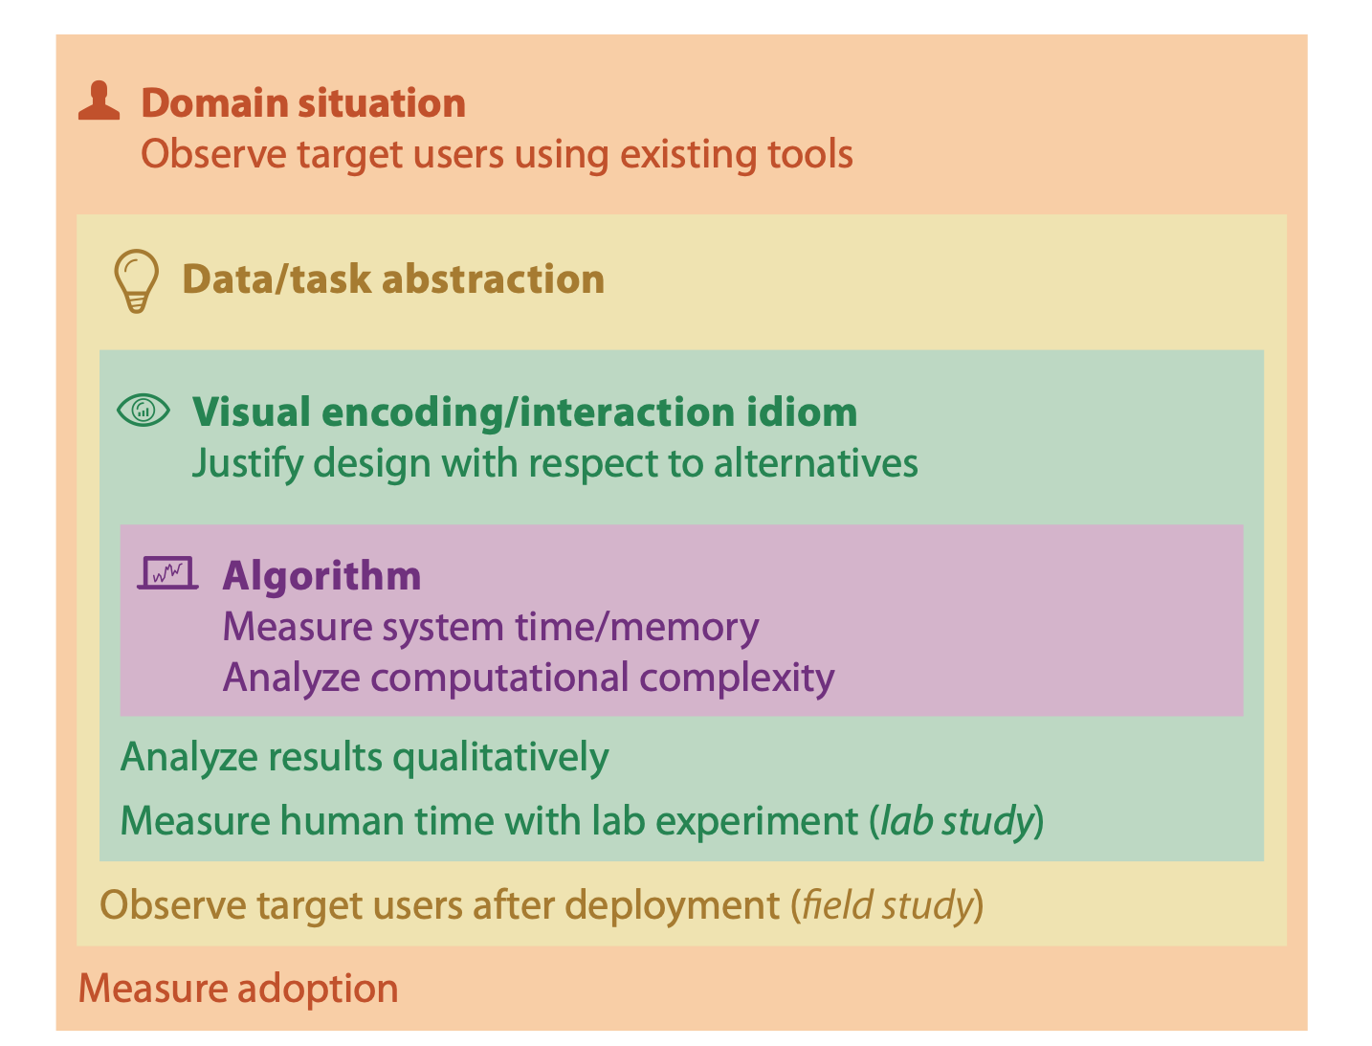

Why is validation difficult?
solution: use methods from different fields at each level
[A Nested Model of Visualization Design and Validation. Munzner. IEEE TVCG 15(6):921-928, 2009 (Proc. InfoVis 2009). ]

Slide 19
Why is validation difficult?
solution: use methods from different fields at each level
  computer science
  technique-driven work
[A Nested Model of Visualization Design and Validation. Munzner. IEEE TVCG 15(6):921-928, 2009 (Proc. InfoVis 2009). ]

Slide 20
Why is validation difficult?
solution: use methods from different fields at each level
  design
  computer science
  technique-driven work
  cognitive psychology
[A Nested Model of Visualization Design and Validation. Munzner. IEEE TVCG 15(6):921-928, 2009 (Proc. InfoVis 2009). ]

Slide 21

Why is validation difficult?
solution: use methods from different fields at each level
  problem-driven work (design study)
  anthropology/
  ethnography
  design
  computer science
  technique-driven work
  cognitive psychology
  anthropology/
  ethnography
[A Nested Model of Visualization Design and Validation. Munzner. IEEE TVCG 15(6):921-928, 2009 (Proc. InfoVis 2009). ]

Slide 22
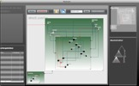
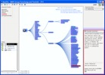
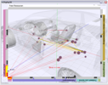
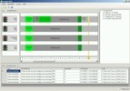
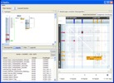
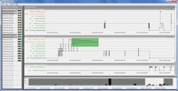
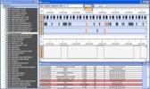
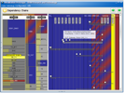
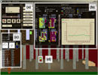
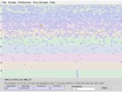
Design Studies: Lessons learned after 21 of them
Cerebral
genomics
MizBee
genomics
Pathline
genomics
MulteeSum
genomics
Vismon
fisheries management
QuestVis
sustainability
WiKeVis
in-car networks
MostVis
in-car networks
Car-X-Ray
in-car networks
ProgSpy2010
in-car networks
RelEx
in-car networks
Cardiogram
in-car networks
AutobahnVis
in-car networks
VisTra
in-car networks
Constellation
linguistics
LibVis
cultural heritage
Caidants
multicast
SessionViewer
web log analysis
LiveRAC
server hosting
PowerSetViewer
data mining
LastHistory
music listening
Notes:
many domains, and visual representations cross-cut them - some different for same domain, some related representations for very different domains

Slide 23

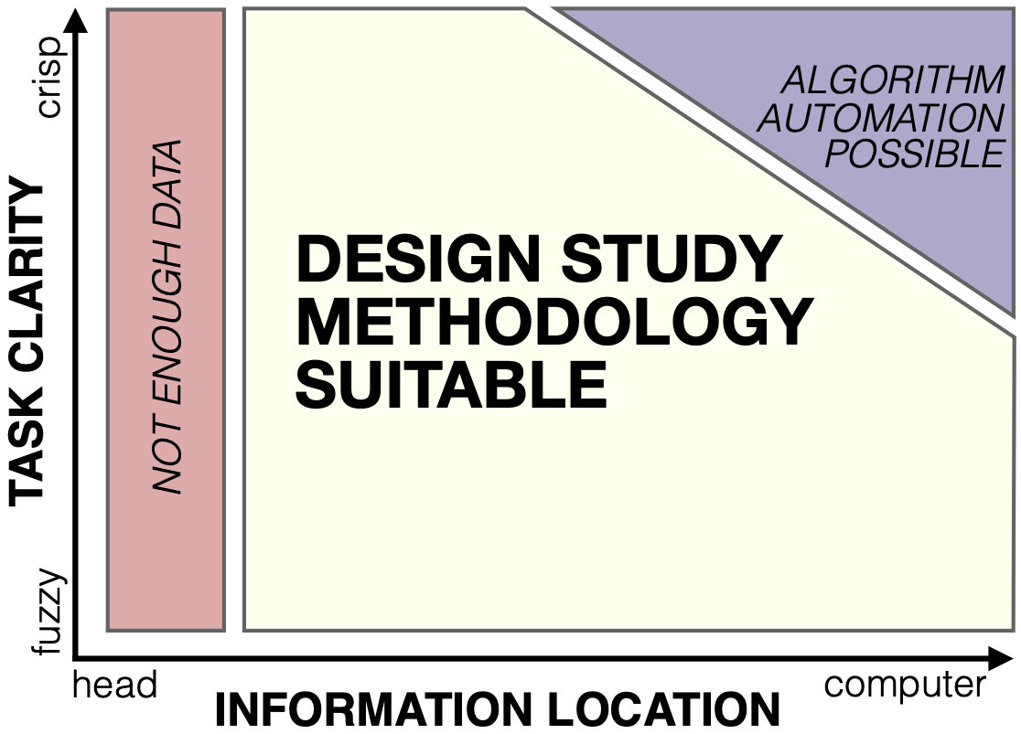

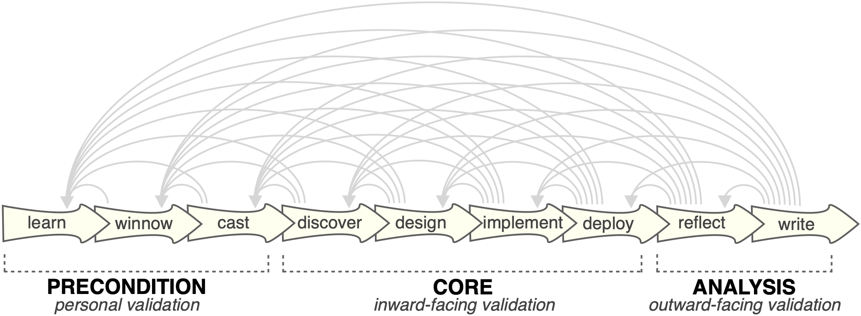

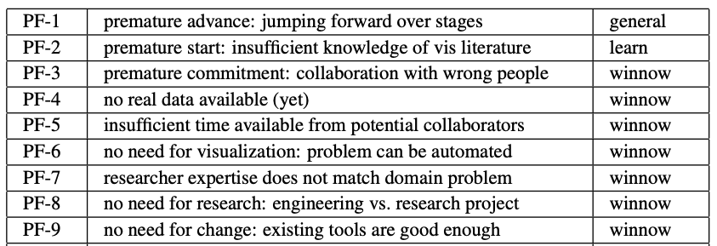
Design Study Methodology: Reflections from the Trenches and the Stacks
definitions
9-stage framework
32 pitfalls
and how to avoid them
[Sedlmair, Meyer, Munzner.
IEEE Trans. Visualization and Computer Graphics
18(12): 2431-2440, 2012
(Proc. InfoVis 2012).]

Slide 24
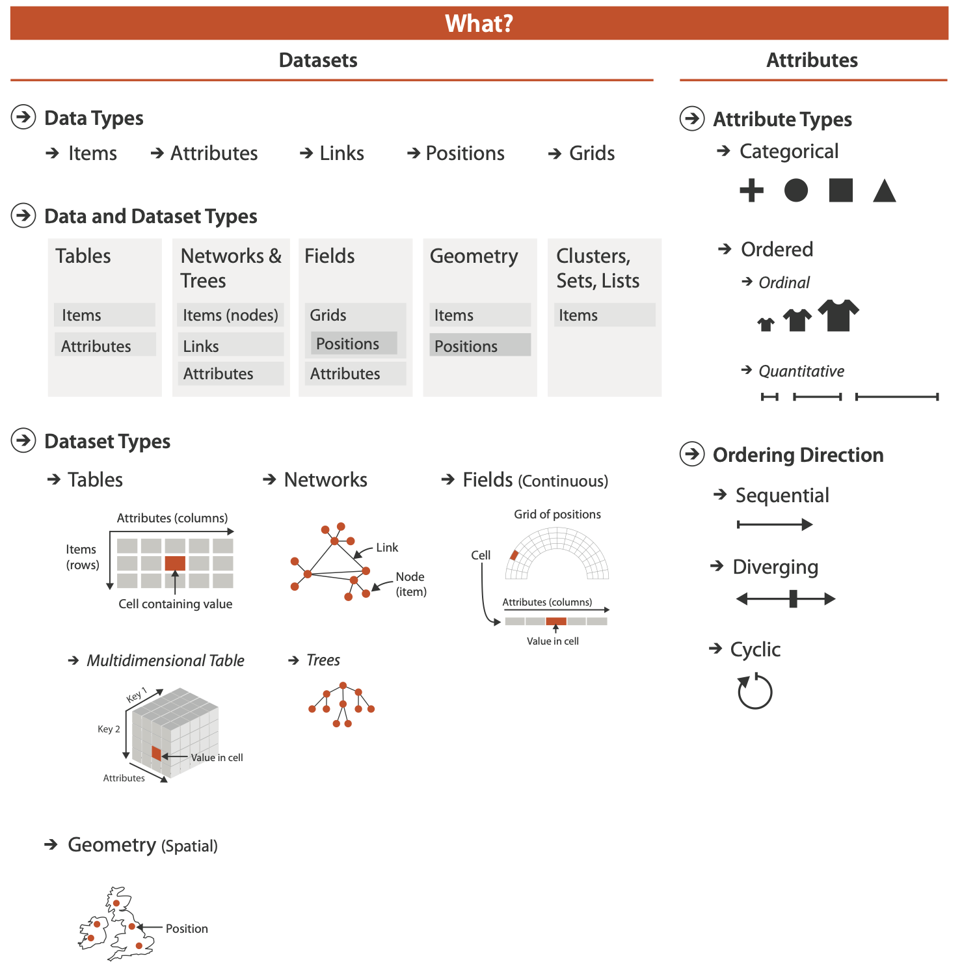
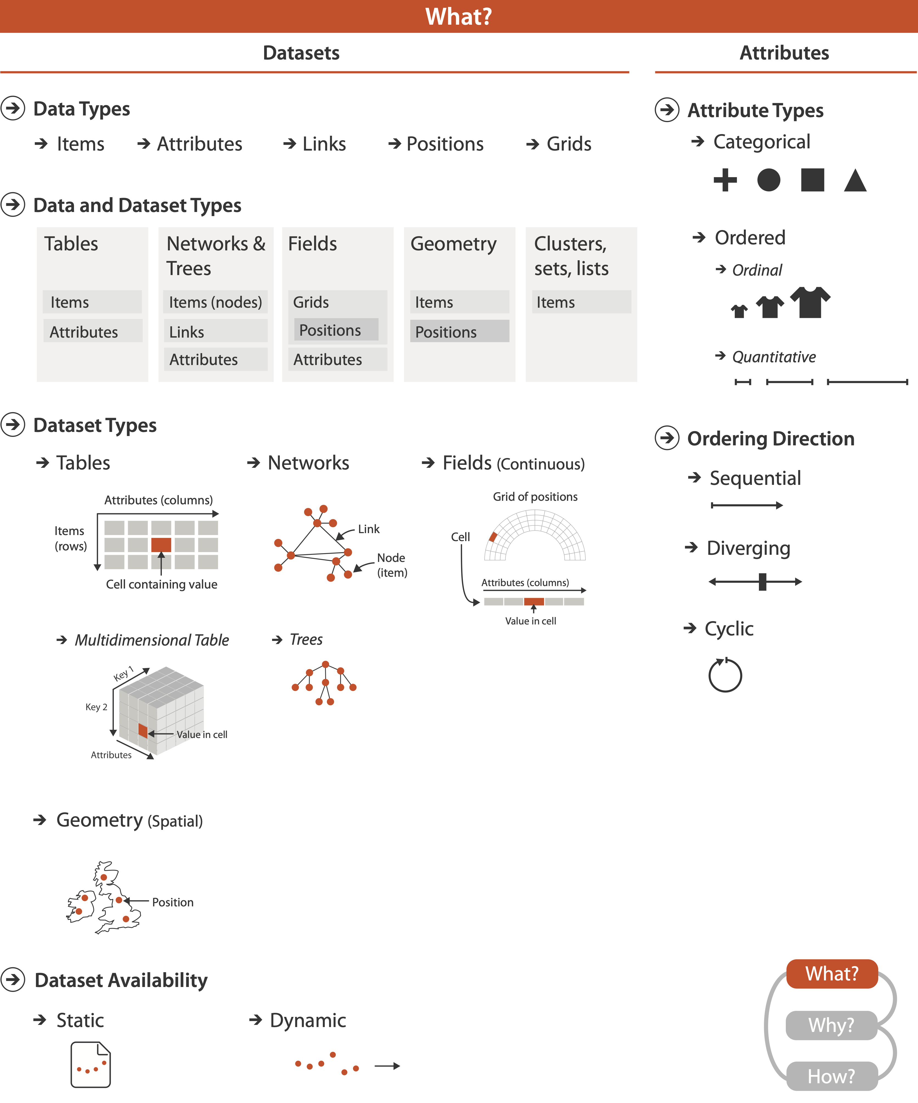

Slide 25
Three major datatypes

Slide 26
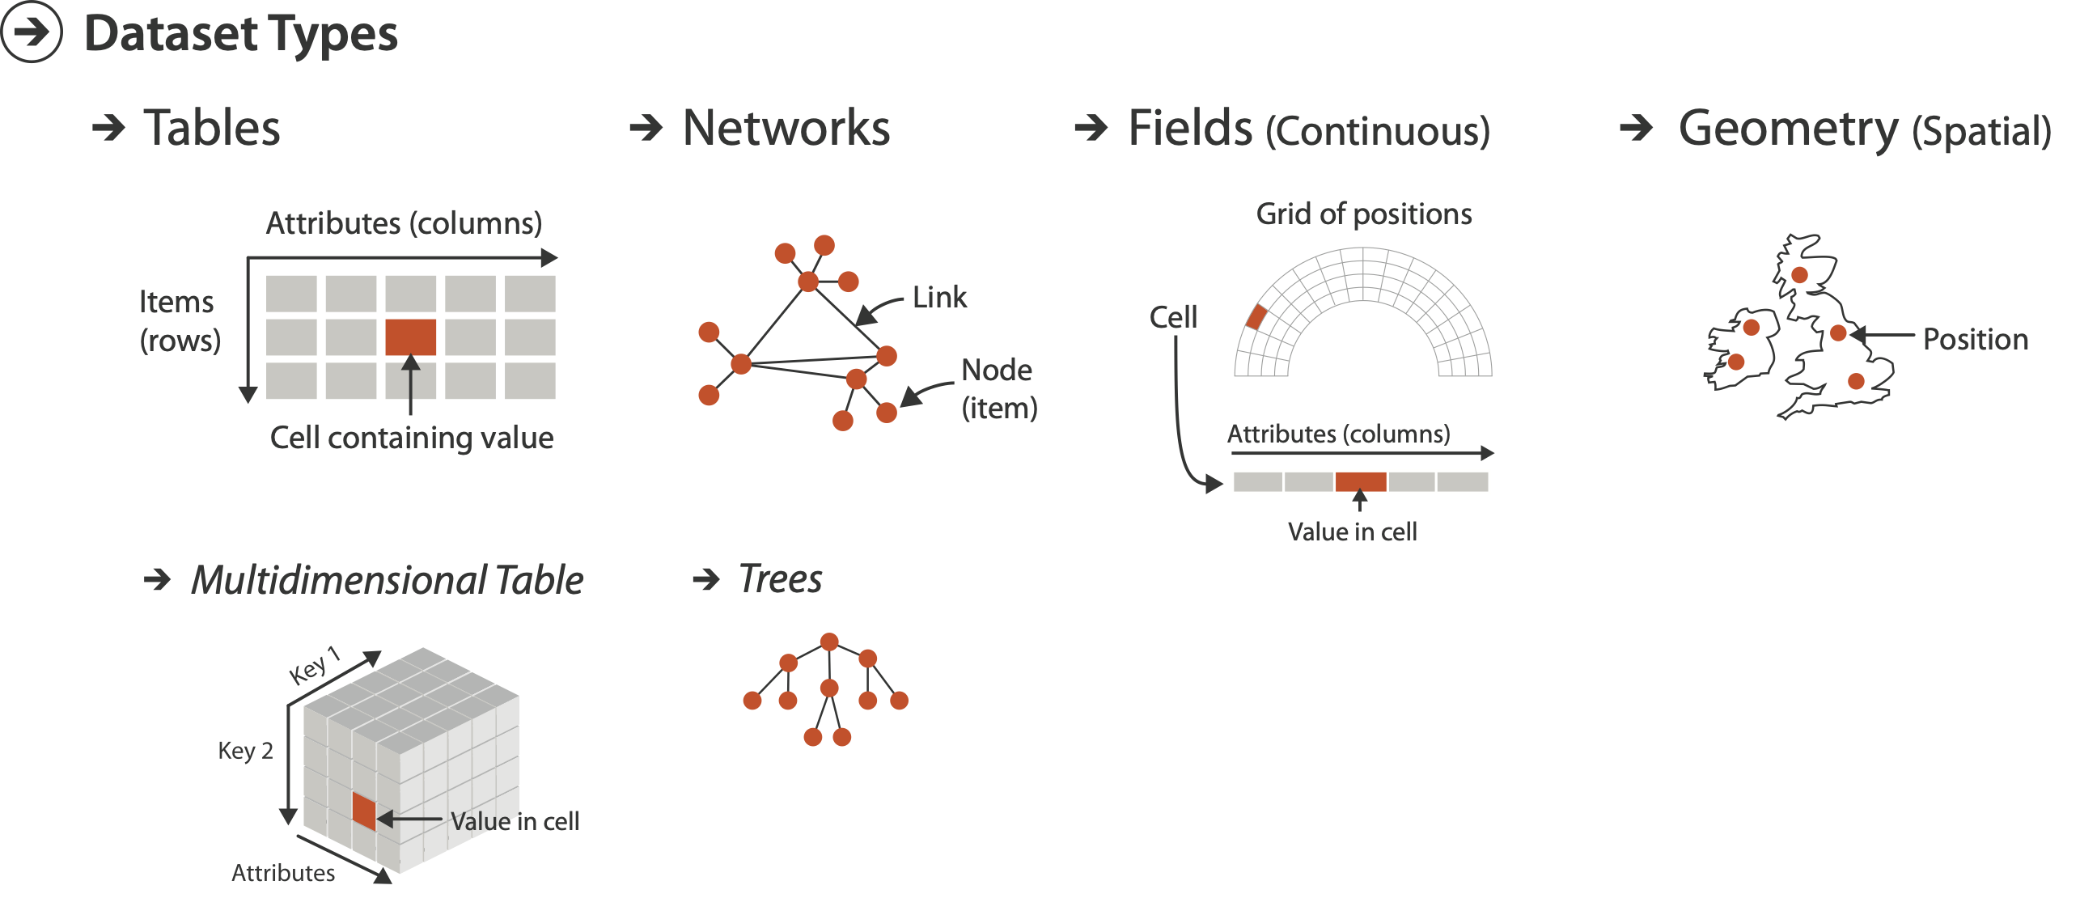
Three major datatypes

Slide 27
Three major datatypes

Slide 28
Three major datatypes
Spatial

Slide 29
Three major datatypes
Spatial
visualization vs computer graphics
  geometry is design decision

Slide 30
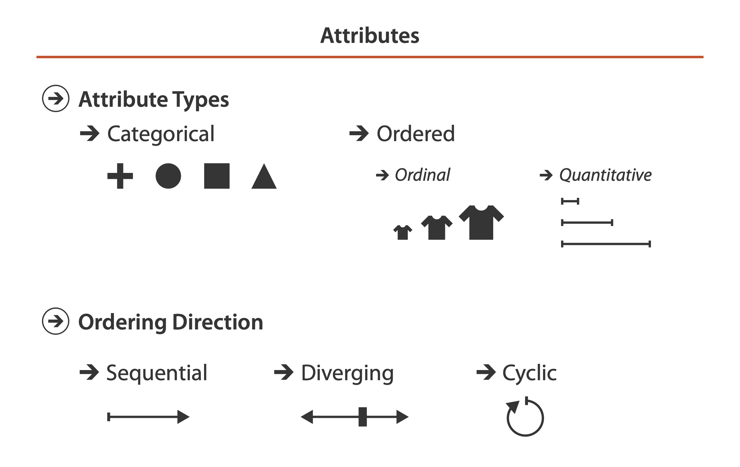
Attribute types

Slide 31
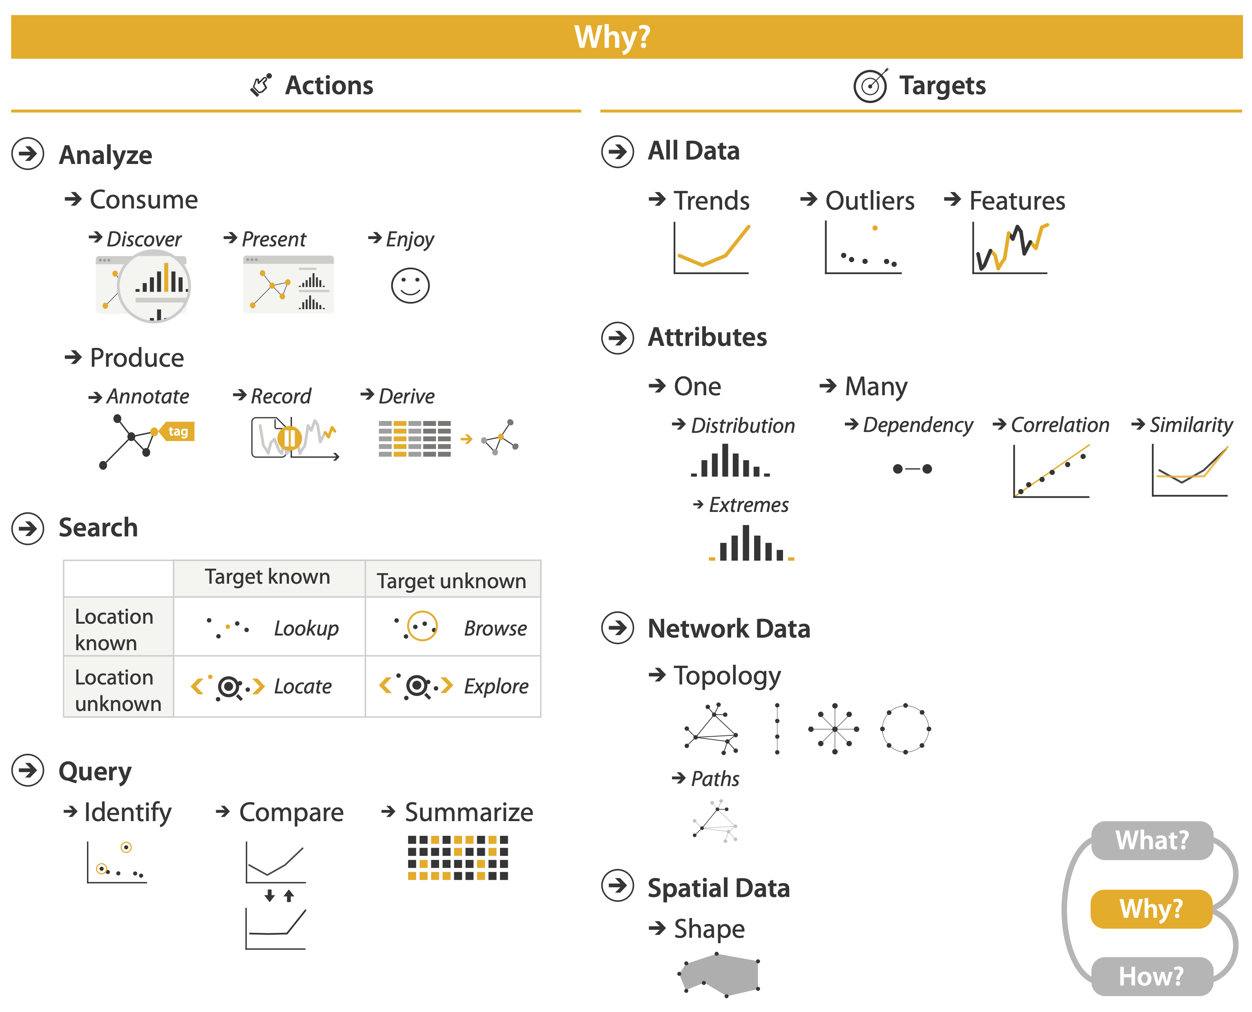
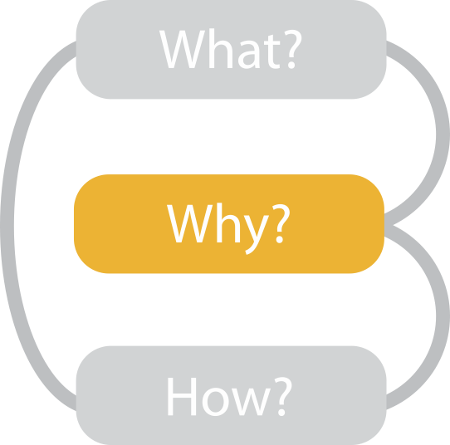

Slide 32
{action, target} pairs
  discover distribution
  compare trends
  locate outliers
  browse topology

Slide 33
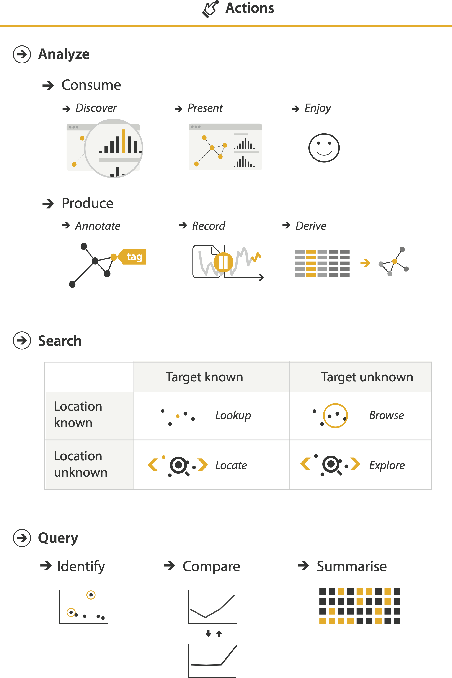
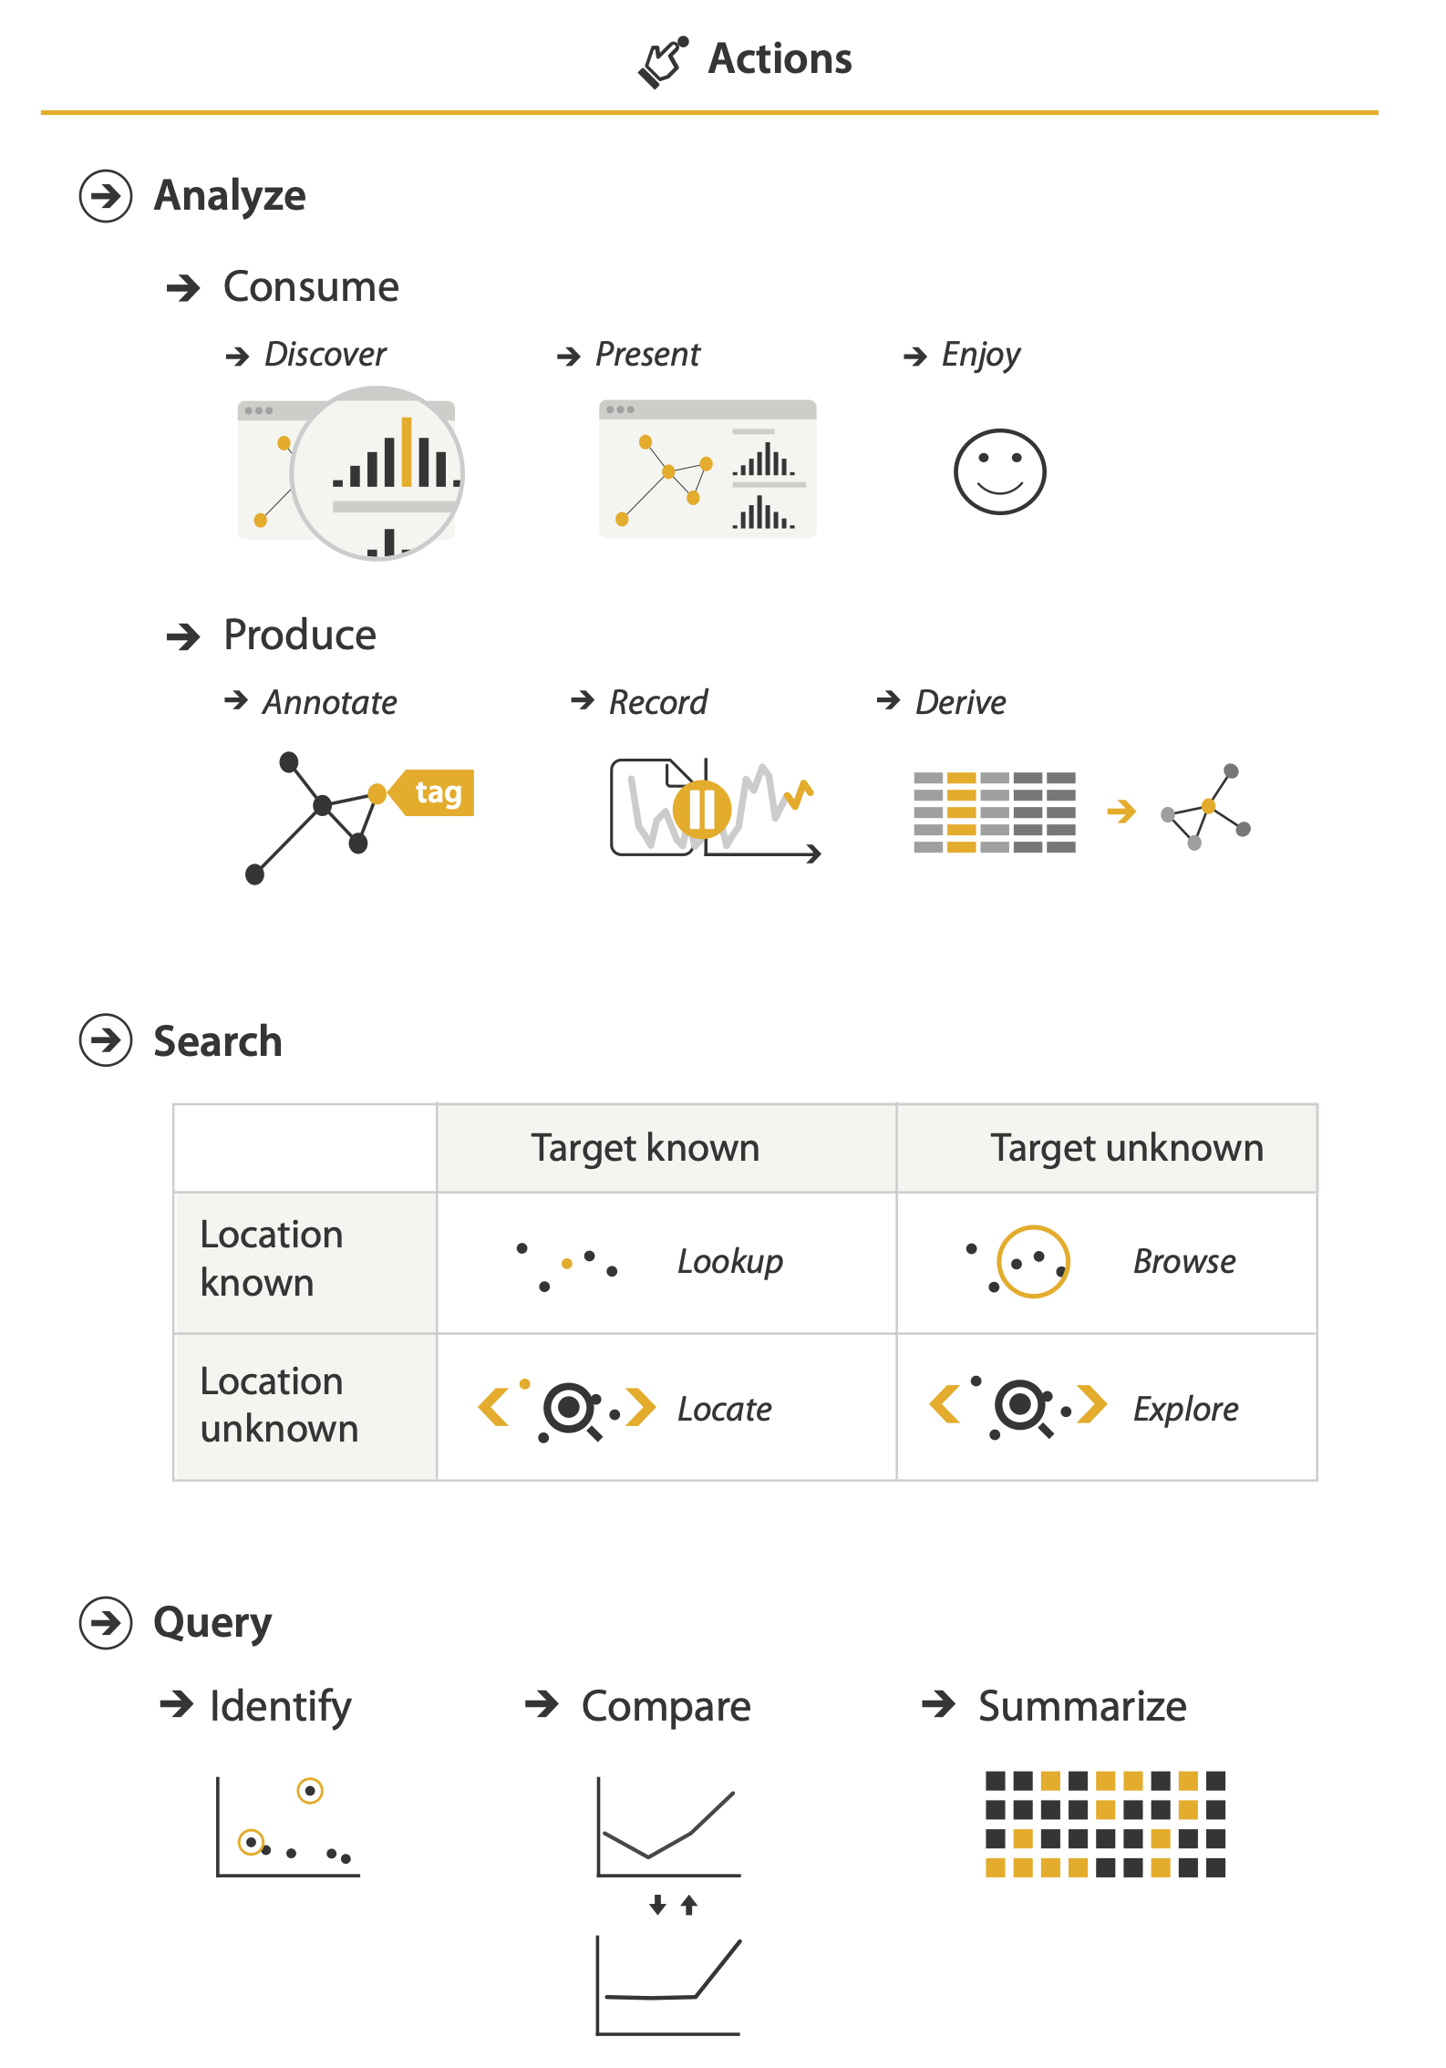
Actions: Analyze, Query
analyze
  consume
    discover vs present
      aka explore vs explain
    enjoy
      aka casual, social
  produce
    annotate, record, derive
query
  how much data matters?
    one, some, all
independent choices
  analyze, query, (search)

Slide 34

Actions: Analyze, Query
analyze
  consume
    discover vs present
      aka explore vs explain
    enjoy
      aka casual, social
  produce
    annotate, record, derive
query
  how much data matters?
    one, some, all
independent choices
  analyze, query, (search)

Slide 35
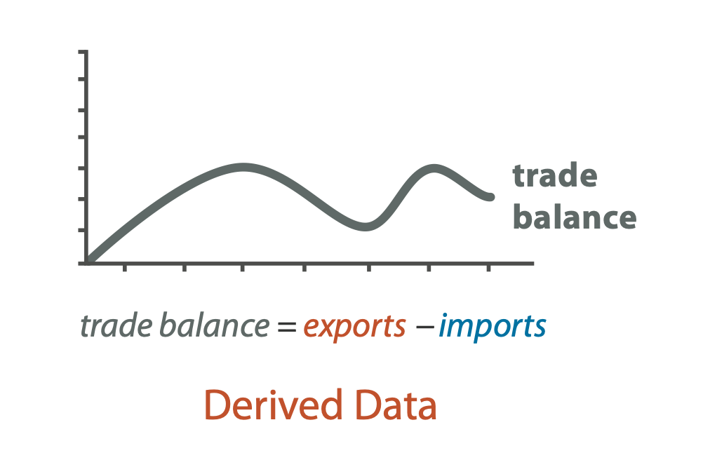
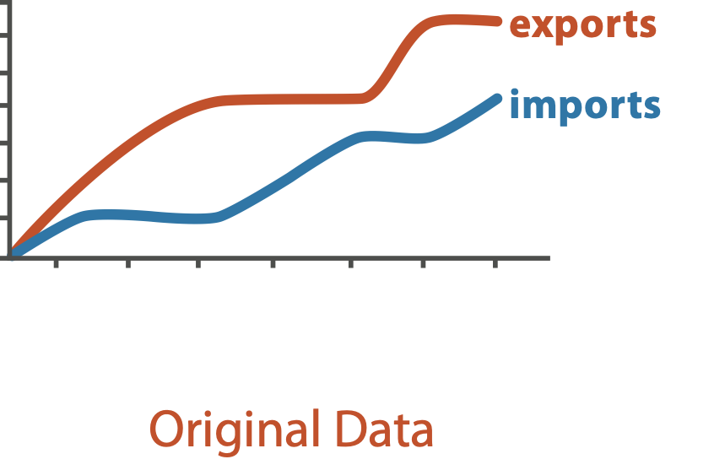
Derive
don’t necessarily just draw what you’re given!
  decide what the right thing to show is
  create it with a series of transformations from the original dataset
  draw that
one of the four major strategies for handling complexity

Slide 36
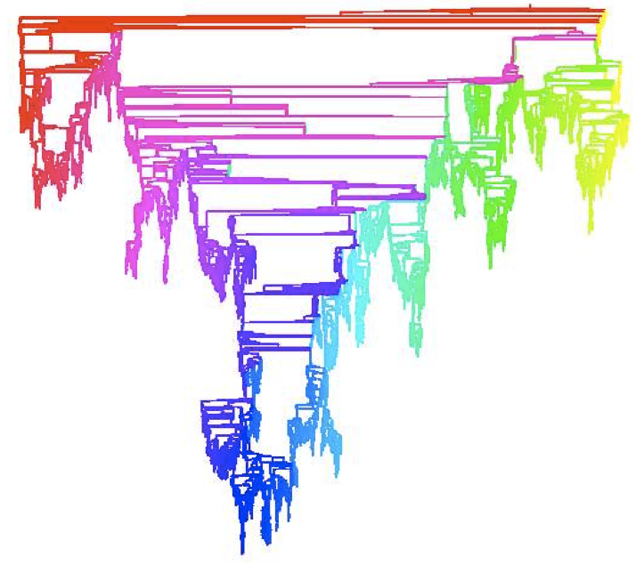
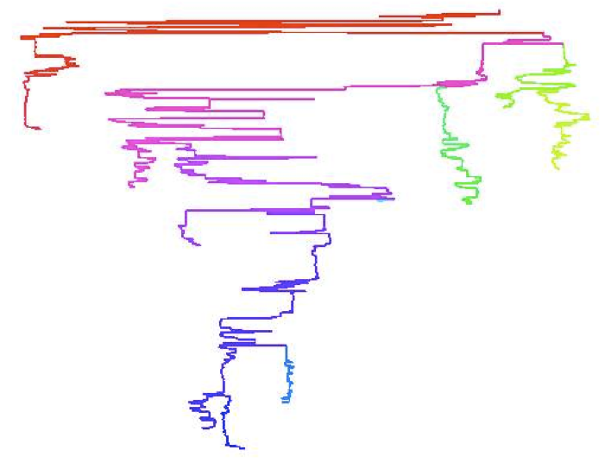
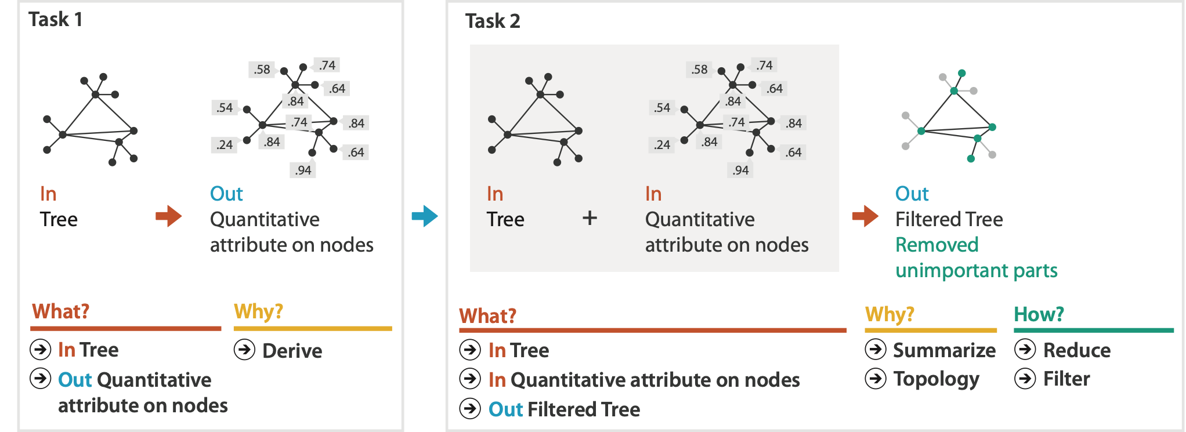
Analysis example: Derive one attribute
Strahler number
  centrality metric for trees/networks
  derived quantitative attribute
  draw top 5K of 500K for good skeleton
[Using Strahler numbers for real time visual exploration of huge graphs. Auber. Proc. Intl. Conf. Computer Vision and Graphics, pp. 56–69, 2002.]

Slide 37
Why: Targets

Slide 38
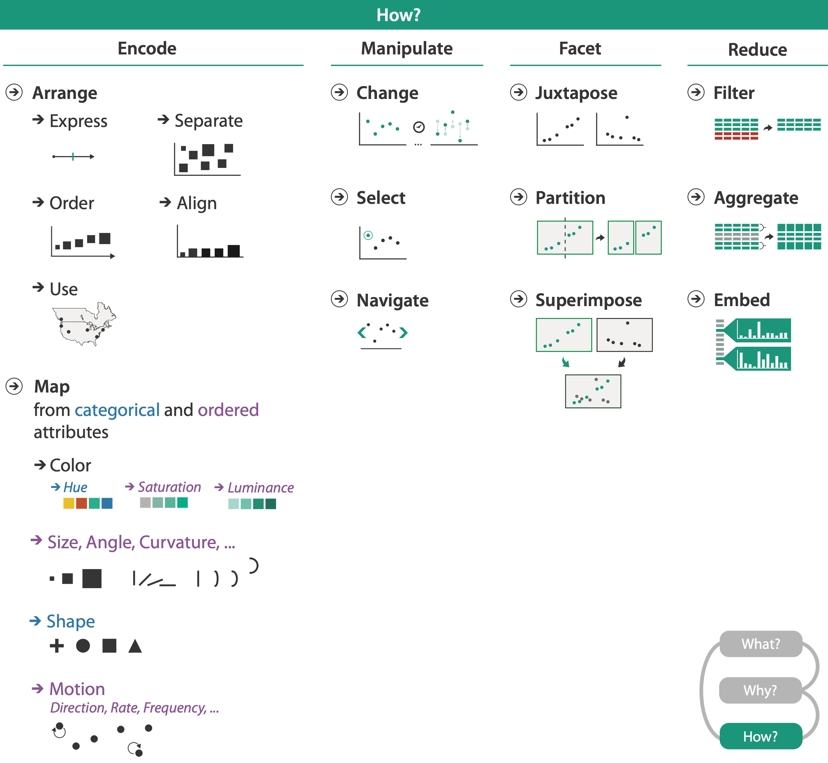
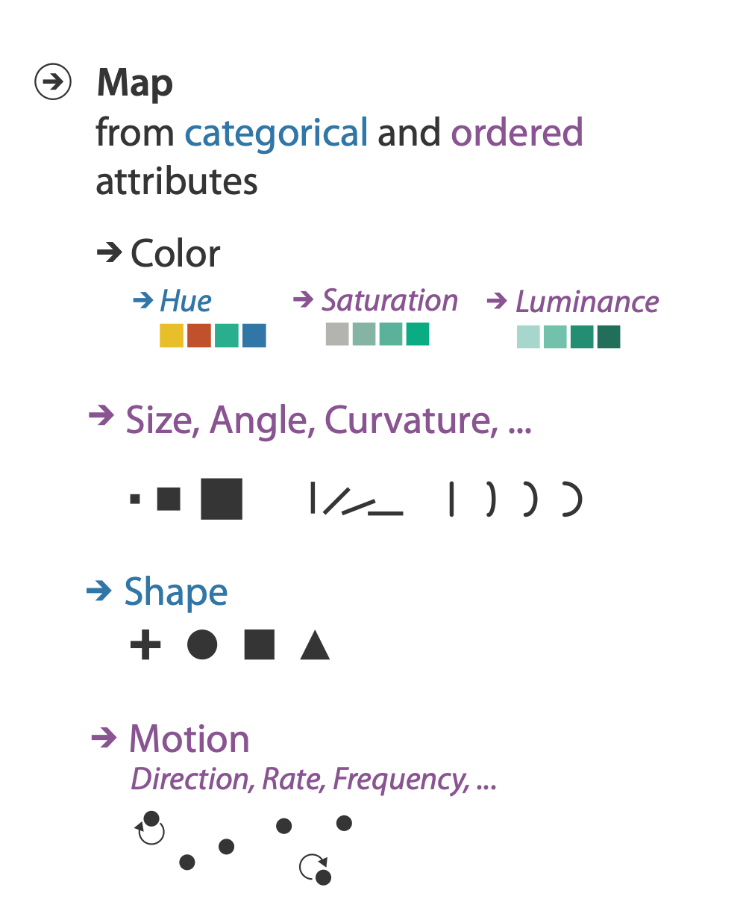
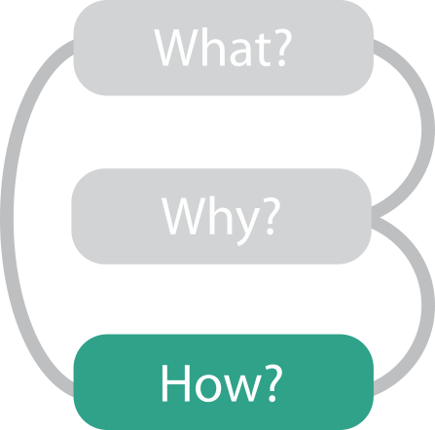

Slide 39
Further reading
Visualization Analysis and Design. Munzner. AK Peters Visualization Series, CRC Press, Nov 2014.
  Chap 1: What’s Vis, and Why Do It?
  Chap 2: What: Data Abstraction
  Chap 3: Why: Task Abstraction
A Multi-Level Typology of Abstract Visualization Tasks. Brehmer and Munzner. IEEE Trans. Visualization and Computer Graphics (Proc. InfoVis) 19:12 (2013), 2376–2385.
Low-Level Components of Analytic Activity in Information Visualization. Amar, Eagan, and Stasko. Proc. IEEE InfoVis 2005, p 111–117.
A taxonomy of tools that support the fluent and flexible use of visualizations. Heer and Shneiderman. Communications of the ACM 55:4 (2012), 45–54.
Rethinking Visualization: A High-Level Taxonomy. Tory and Möller. Proc. IEEE InfoVis 2004, p 151–158.
Visualization of Time-Oriented Data. Aigner, Miksch, Schumann, and Tominski. Springer, 2011.

Slide 40
Visualization Analysis & Design, Half-Day Tutorial
Session 1
  Analysis: What, Why, How
  Marks and Channels
  Arrange Tables
  Arrange Spatial Data
Session 2
  Arrange Networks and Trees
  Map Color and Other Channels
  Manipulate: Change, Select, Navigate
  Facet: Juxtapose, Partition, Superimpose
  Reduce: Filter, Aggregate
@tamaramunzner
http://www.cs.ubc.ca/~tmm/talks.html#halfdaycourse20

Slide 42


Slide 43
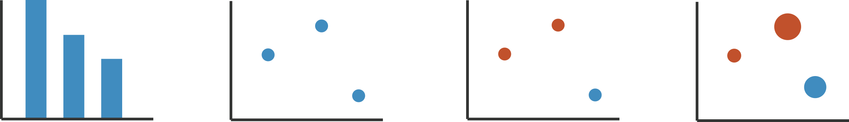
Visual encoding
analyze idiom structure
Notes:
How did we decide to use those particular visual channels? How many more visual channels are there? What kinds of information and how much information can each channel encode? Are some channels better than others? Can all of the channels be used independently or do they interfere with each other?

Slide 44
Definitions: Marks and channels

Slide 45
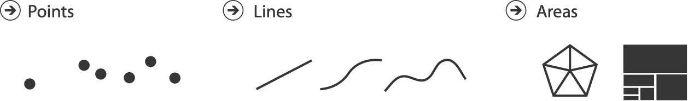
Definitions: Marks and channels
marks
  geometric primitives

Slide 46
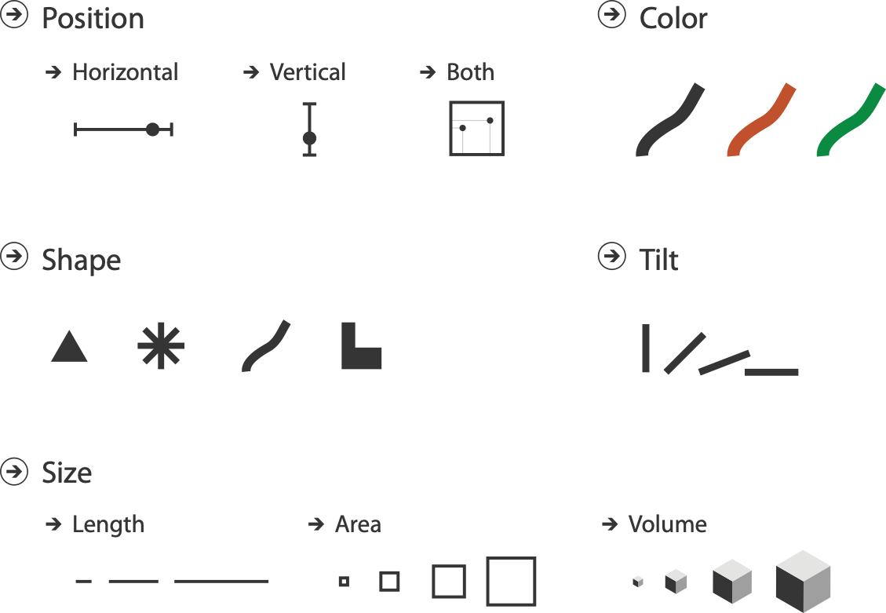
Definitions: Marks and channels
marks
  geometric primitives
channels
  control appearance of marks

Slide 47
Definitions: Marks and channels
marks
  geometric primitives
channels
  control appearance of marks
channel properties differ
    type & amount of information that can be conveyed to human perceptual system

Slide 48
Visual encoding
analyze idiom structure as combination of marks and channels
1:
vertical position
mark: line

Slide 49
Visual encoding
analyze idiom structure as combination of marks and channels
1:
vertical position
2:
vertical position
horizontal position
mark: line
mark: point

Slide 50
Visual encoding
analyze idiom structure as combination of marks and channels
1:
vertical position
2:
vertical position
horizontal position
3:
vertical position
horizontal position
color hue
mark: line
mark: point
mark: point

Slide 51
Visual encoding
analyze idiom structure as combination of marks and channels
1:
vertical position
2:
vertical position
horizontal position
3:
vertical position
horizontal position
color hue
4:
vertical position
horizontal position
color hue
size (area)
mark: line
mark: point
mark: point
mark: point

Slide 52
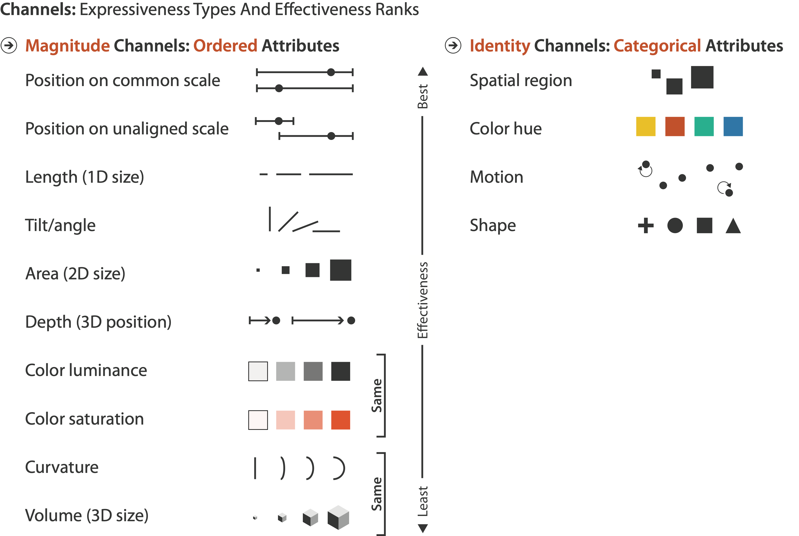
Channels: Rankings

Slide 53
Channels: Rankings
expressiveness
  match channel and data characteristics

Slide 54
Channels: Rankings
expressiveness
  match channel and data characteristics
effectiveness
  channels differ in accuracy of perception

Slide 55
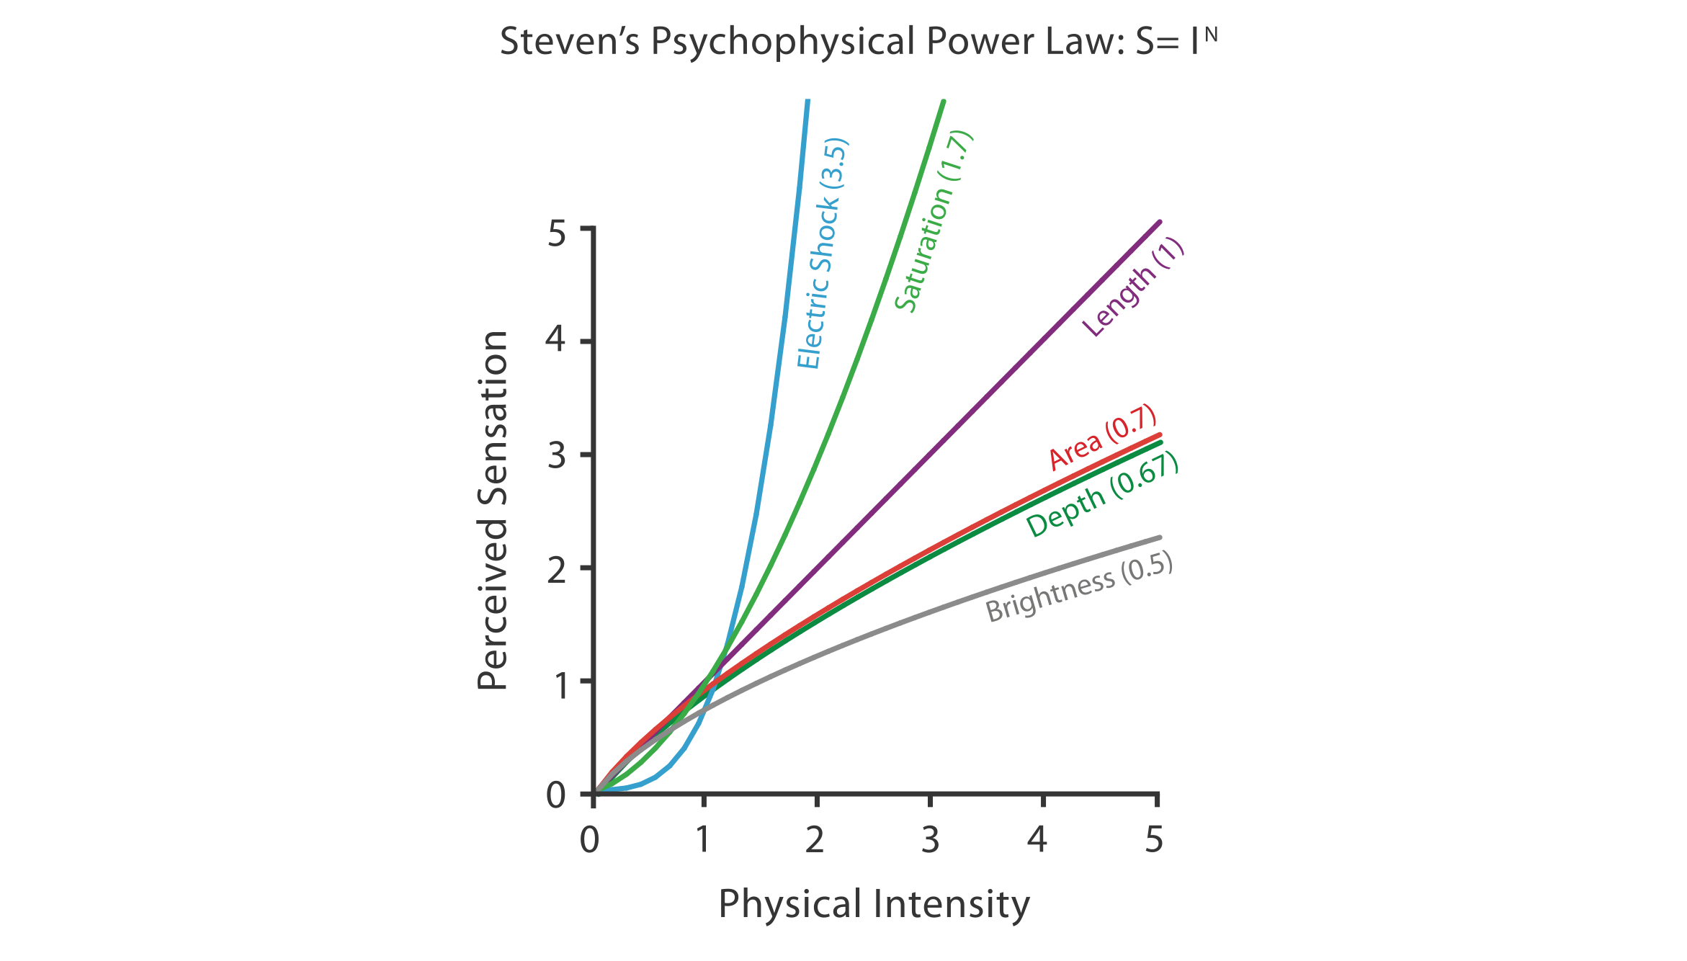
Accuracy: Fundamental Theory

Slide 56
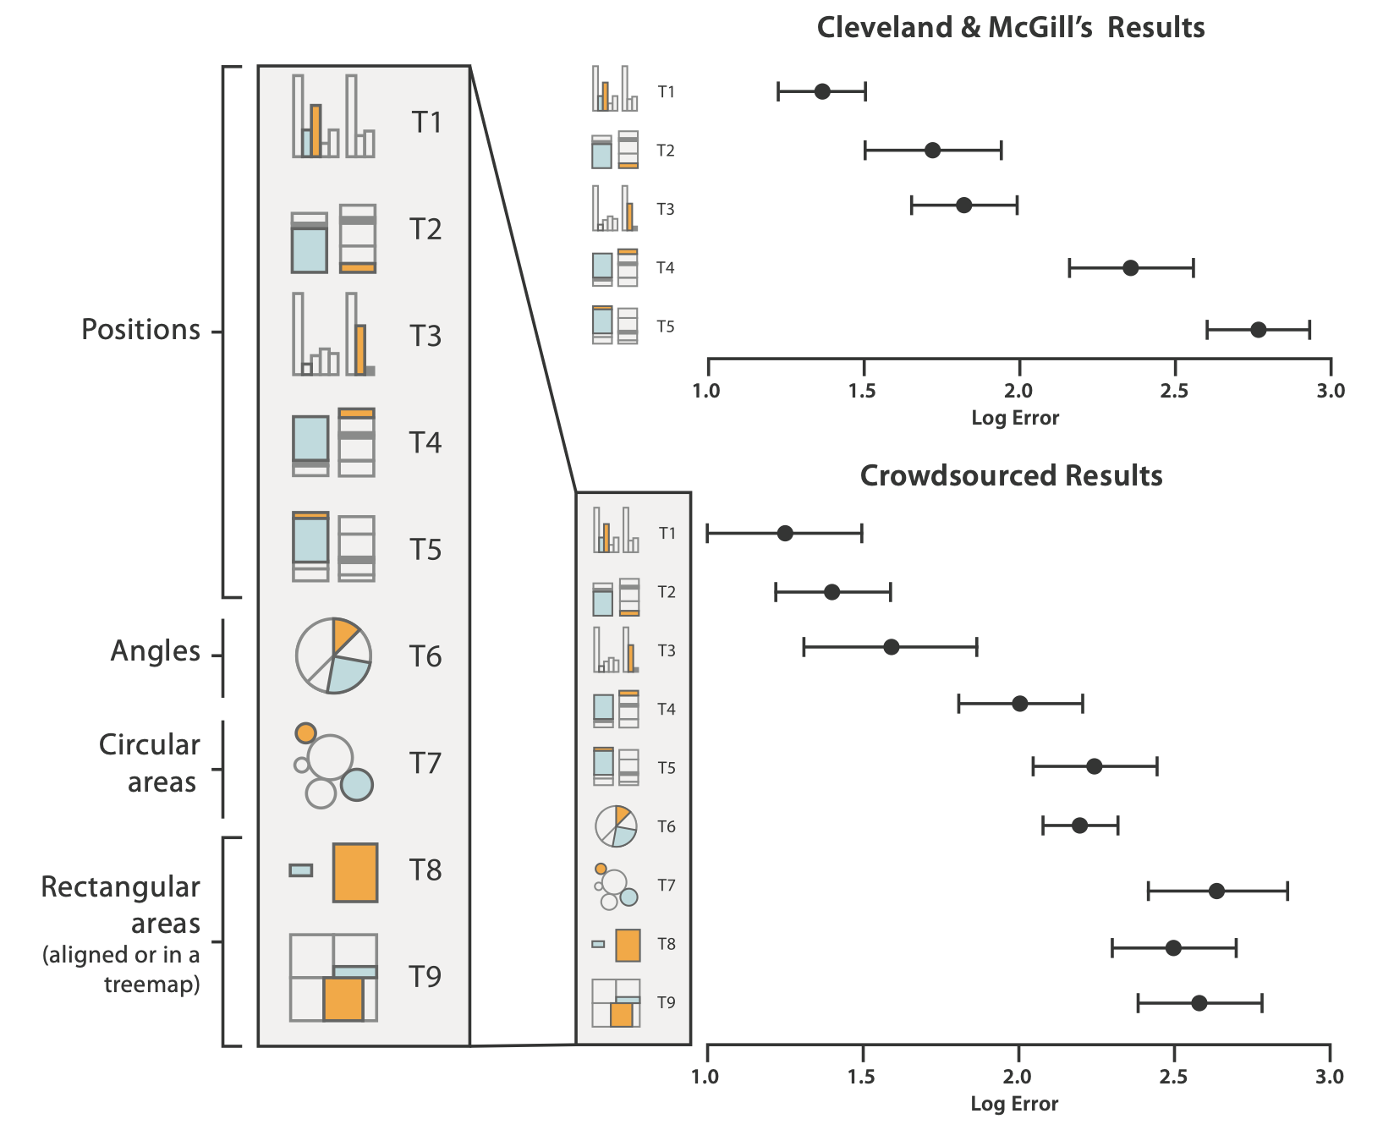
Accuracy: Vis experiments
[Crowdsourcing Graphical Perception: Using Mechanical Turk to Assess Visualization Design. Heer and Bostock. Proc ACM Conf. Human Factors in Computing Systems (CHI) 2010, p. 203–212.]
after Michael McGuffin course slides, http://profs.etsmtl.ca/mmcguffin/

Slide 57
Discriminability: How many usable steps?
must be sufficient for number of attribute levels to show
  linewidth: few bins
[mappa.mundi.net/maps/maps 014/telegeography.html]

Slide 58
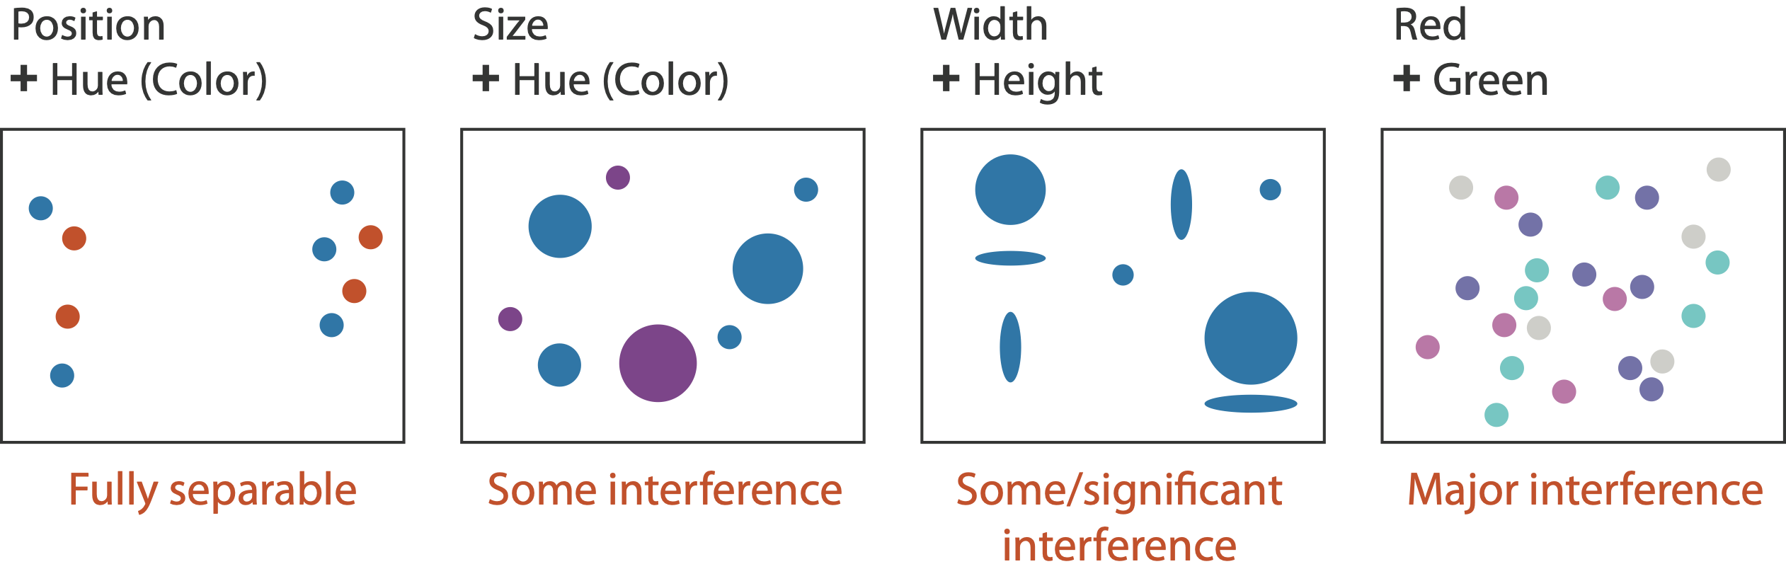
Separability vs. Integrality
2 groups each
2 groups each
3 groups total:
integral area
4 groups total:
integral hue
Notes:
Fig 5.10
fonts are fine

Slide 59
Popout
find the red dot
  how long does it take?
Notes:
Fig 5.11
just fine, no fonts :-)

Slide 60
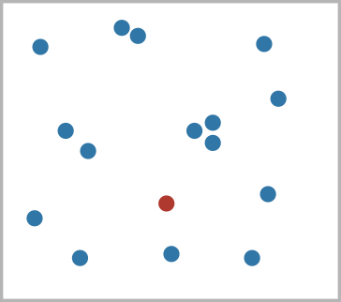
Popout
find the red dot
  how long does it take?
Notes:
Fig 5.11
just fine, no fonts :-)

Slide 61
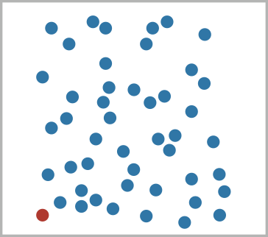
Popout
find the red dot
  how long does it take?
Notes:
Fig 5.11
just fine, no fonts :-)

Slide 62
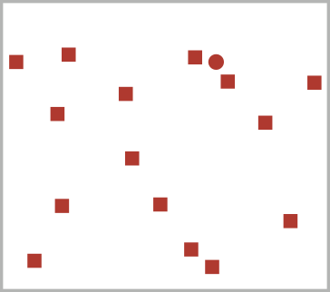
Popout
find the red dot
  how long does it take?
Notes:
Fig 5.11
just fine, no fonts :-)

Slide 63
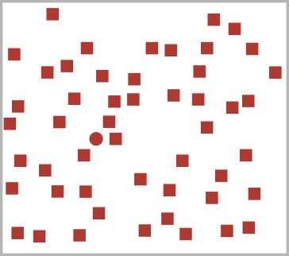
Popout
find the red dot
  how long does it take?
Notes:
Fig 5.11
just fine, no fonts :-)

Slide 64

Popout
find the red dot
  how long does it take?
Notes:
Fig 5.11
just fine, no fonts :-)

Slide 65

Popout
find the red dot
  how long does it take?
Notes:
Fig 5.11
just fine, no fonts :-)

Slide 66
Popout
find the red dot
  how long does it take?
parallel processing on many individual channels
  speed independent of distractor count
  speed depends on channel and amount of difference from distractors
serial search for (almost all) combinations
  speed depends on number of distractors
Notes:
Fig 5.11
just fine, no fonts :-)

Slide 67

Popout
many channels
  tilt, size, shape, proximity, shadow direction, ...
Notes:
Fig 5.12

Slide 68

Popout
many channels
  tilt, size, shape, proximity, shadow direction, ...
but not all!
  parallel line pairs do not pop out from tilted pairs
Notes:
Fig 5.12

Slide 69

Grouping
containment
connection
proximity
  same spatial region
similarity
  same values as other categorical channels

Slide 70
Further reading
Visualization Analysis and Design. Munzner. AK Peters Visualization Series, CRC Press, Nov 2014.
  Chap 5: Marks and Channels
On the Theory of Scales of Measurement. Stevens. Science 103:2684 (1946), 677–680.
Psychophysics: Introduction to its Perceptual, Neural, and Social Prospects. Stevens. Wiley, 1975.
Graphical Perception: Theory, Experimentation, and Application to the Development of Graphical Methods. Cleveland and McGill. Journ. American Statistical Association 79:387 (1984), 531–554.
Perception in Vision. Healey. http://www.csc.ncsu.edu/faculty/healey/PP
Visual Thinking for Design. Ware. Morgan Kaufmann, 2008.
Information Visualization: Perception for Design, 3rd edition. Ware. Morgan Kaufmann /Academic Press, 2004.

Slide 71
Visualization Analysis & Design, Half-Day Tutorial
Session 1
  Analysis: What, Why, How
  Marks and Channels
  Arrange Tables
  Arrange Spatial Data
Session 2
  Arrange Networks and Trees
  Map Color and Other Channels
  Manipulate: Change, Select, Navigate
  Facet: Juxtapose, Partition, Superimpose
  Reduce: Filter, Aggregate
@tamaramunzner
http://www.cs.ubc.ca/~tmm/talks.html#halfdaycourse20

Slide 72


Slide 73

Arrange tables

Slide 74

Keys and values
key
  independent attribute
  used as unique index to look up items
  simple tables: 1 key
  multidimensional tables: multiple keys
value
  dependent attribute, value of cell
classify arrangements by key count
  0, 1, 2, many...
Notes:
Figs 7.1, 2.2
same small font problem as above

Slide 75

Idiom: scatterplot
express values
  quantitative attributes
no keys, only values
  data
    2 quant attribs
  mark: points
  channels
    horiz + vert position
  tasks
    find trends, outliers, distribution, correlation, clusters
  scalability
    hundreds of items
[A layered grammar of graphics. Wickham. Journ. Computational and Graphical Statistics 19:1 (2010), 3–28.]

Slide 76
Some keys: Categorical regions
regions: contiguous bounded areas distinct from each other
  using space to separate (proximity)
  following expressiveness principle for categorical attributes
use ordered attribute to order and align regions

Slide 77

Idiom: bar chart
one key, one value
  data
    1 categ attrib, 1 quant attrib
  mark: lines
  channels
    length to express quant value
    spatial regions: one per mark
      separated horizontally, aligned vertically
      ordered by quant attrib
        by label (alphabetical), by length attrib (data-driven)
  task
    compare, lookup values
  scalability
    dozens to hundreds of levels for key attrib

Slide 78

Idiom: stacked bar chart
one more key
  data
    2 categ attrib, 1 quant attrib
  mark: vertical stack of line marks
    glyph: composite object, internal structure from multiple marks
  channels
    length and color hue
    spatial regions: one per glyph
      aligned: full glyph, lowest bar component
      unaligned: other bar components
  task
    part-to-whole relationship
  scalability
    several to one dozen levels for stacked attrib
[Using Visualization to Understand the Behavior of Computer Systems. Bosch. Ph.D. thesis, Stanford Computer Science, 2001.]
Notes:
Thor computer memory profiler. The key used to distribute composite bars along the axis is the combination of a processor and a procedure. The key used to stack and color the glyph subcomponents is the type of cache miss; the height of each full bar encodes all cache misses for each processor-procedure combination.

Slide 79

Idiom: streamgraph
generalized stacked graph
  emphasizing horizontal continuity
    vs vertical items
  data
    1 categ key attrib (artist)
    1 ordered key attrib (time)
    1 quant value attrib (counts)
  derived data
    geometry: layers, where height encodes counts
    1 quant attrib (layer ordering)
  scalability
    hundreds of time keys
    dozens to hundreds of artist keys
      more than stacked bars: most layers don’t extend across whole chart
[Stacked Graphs Geometry & Aesthetics. Byron and Wattenberg. IEEE Trans. Visualization and Computer Graphics (Proc. InfoVis 2008) 14(6): 1245–1252, (2008).]

Slide 80

Idiom: line chart / dot plot
one key, one value
  data
    2 quant attribs
  mark: points
    line connection marks between them
  channels
    aligned lengths to express quant value
    separated and ordered by key attrib into horizontal regions
  task
    find trend
      connection marks emphasize ordering of items along key axis
      by explicitly showing relationship between one item and the next

Slide 81

Choosing bar vs line charts
depends on type of key attrib
  bar charts if categorical
  line charts if ordered
do not use line charts for categorical key attribs
  violates expressiveness principle
    implication of trend so strong that it overrides semantics!
      “The more male a person is, the taller he/she is”
after [Bars and Lines: A Study of Graphic Communication. Zacks and Tversky. Memory and Cognition 27:6 (1999), 1073–1079.]
Notes:
good: height increases with age, 12 year olds are taller than 10 year olds
bad: the more male a person is, the taller he or she is

Slide 82


Idiom: heatmap
two keys, one value
  data
    2 categ attribs (gene, experimental condition)
    1 quant attrib (expression levels)
  marks: area
    separate and align in 2D matrix
      indexed by 2 categorical attributes
  channels
    color by quant attrib
      (ordered diverging colormap)
  task
    find clusters, outliers
  scalability
    1K categorical levels, 1M items; ~10 quantitative attribute levels

Slide 84

Idioms: scatterplot matrix, parallel coordinates
scatterplot matrix (SPLOM)
  rectilinear axes, point mark
  all possible pairs of axes
  scalability
    one dozen attribs
    dozens to hundreds of items
parallel coordinates
  parallel axes, jagged line representing item
  rectilinear axes, item as point
    axis ordering is major challenge
  scalability
    dozens of attribs
    hundreds of items
after [Visualization Course Figures. McGuffin, 2014.
http://www.michaelmcguffin.com/courses/vis/]

Slide 85

Task: Correlation
scatterplot matrix
  positive correlation
    diagonal low-to-high
  negative correlation
    diagonal high-to-low
  uncorrelated
parallel coordinates
  positive correlation
    parallel line segments
  negative correlation
    all segments cross at halfway point
  uncorrelated
    scattered crossings
[A layered grammar of graphics. Wickham. Journ. Computational and Graphical Statistics 19:1 (2010), 3–28.]
[Hyperdimensional Data Analysis Using Parallel Coordinates. Wegman. Journ. American Statistical Association 85:411 (1990), 664–675.]

Slide 86



Idioms: pie chart, polar area chart
pie chart
  area marks with angle channel
  accuracy: angle/area much less accurate than line length
    arclength also less accurate than line length
polar area chart
  area marks with length channel
  more direct analog to bar charts
data
  1 categ key attrib, 1 quant value attrib
task
  part-to-whole judgements
[A layered grammar of graphics. Wickham. Journ. Computational and Graphical Statistics 19:1 (2010), 3–28.]

Slide 87



Idioms: normalized stacked bar chart
task
  part-to-whole judgements
normalized stacked bar chart
  stacked bar chart, normalized to full vert height
  single stacked bar equivalent to full pie
    high information density: requires narrow rectangle
pie chart
  information density: requires large circle
http://bl.ocks.org/mbostock/3887235,
http://bl.ocks.org/mbostock/3886208,
http://bl.ocks.org/mbostock/3886394.

Slide 88




Idiom: glyphmaps
rectilinear good for linear vs nonlinear trends
radial good for cyclic patterns
[Glyph-maps for Visually Exploring Temporal Patterns in Climate Data and Models. Wickham, Hofmann, Wickham, and Cook. Environmetrics 23:5 (2012), 382–393.]

Slide 89
Orientation limitations
rectilinear: scalability wrt #axes
    2 axes best
    3 problematic
      more in afternoon
    4+ impossible
parallel: unfamiliarity, training time
radial: perceptual limits
  angles lower precision than lengths
  asymmetry between angle and length
    can be exploited!
[Uncovering Strengths and Weaknesses of Radial Visualizations - an Empirical Approach. Diehl, Beck and Burch. IEEE TVCG (Proc. InfoVis) 16(6):935--942, 2010.]

Slide 90
Further reading
Visualization Analysis and Design. Munzner. AK Peters Visualization Series, CRC Press, Nov 2014.
  Chap 7: Arrange Tables
Visualizing Data. Cleveland. Hobart Press, 1993.
A Brief History of Data Visualization. Friendly. 2008.
http://www.datavis.ca/milestones

Slide 91
Visualization Analysis & Design, Half-Day Tutorial
Session 1
  Analysis: What, Why, How
  Marks and Channels
  Arrange Tables
  Arrange Spatial Data
Session 2
  Arrange Networks and Trees
  Map Color and Other Channels
  Manipulate: Change, Select, Navigate
  Facet: Juxtapose, Partition, Superimpose
  Reduce: Filter, Aggregate
@tamaramunzner
http://www.cs.ubc.ca/~tmm/talks.html#halfdaycourse20

Slide 92

Arrange spatial data
Notes:
placeholder slide, put eamonn fig here

Slide 93

Idiom: choropleth map
use given spatial data
  when central task is understanding spatial relationships
data
  geographic geometry
  table with 1 quant attribute per region
encoding
  use given geometry for area mark boundaries
  sequential segmented colormap [more later]
http://bl.ocks.org/mbostock/4060606

Slide 94

Beware: Population maps trickiness!
consider when to normalize by population density
general issue
  absolute counts vs relative/normalized data
[ https://xkcd.com/1138 ]

Slide 95

Idiom: topographic map
data
  geographic geometry
  scalar spatial field
    1 quant attribute per grid cell
derived data
  isoline geometry
    isocontours computed for
    specific levels of scalar values
Land Information New Zealand Data Service

Slide 96


Idioms: isosurfaces, direct volume rendering
data
  scalar spatial field
    1 quant attribute per grid cell
task
  shape understanding, spatial relationships
isosurface
  derived data: isocontours computed for specific levels of scalar values
direct volume rendering
  transfer function maps scalar values to color, opacity
    no derived geometry
[Interactive Volume Rendering Techniques. Kniss. Master’s thesis, University of Utah Computer Science, 2002.]
[Multidimensional Transfer Functions for Volume Rendering. Kniss, Kindlmann, and Hansen. In The Visualization Handbook, edited by Charles Hansen and Christopher Johnson, pp. 189–210. Elsevier, 2005.]

Slide 97


Vector and tensor fields
data
  many attribs per cell
idiom families
  flow glyphs
    purely local
  geometric flow
    derived data from tracing particle trajectories
    sparse set of seed points
  texture flow
    derived data, dense seeds
  feature flow
    global computation to detect features
      encoded with one of methods above
[Comparing 2D vector field visualization methods: A user study. Laidlaw et al. IEEE Trans. Visualization and Computer Graphics (TVCG) 11:1 (2005), 59–70.]
[Topology tracking for the visualization of time-dependent two-dimensional flows. Tricoche, Wischgoll, Scheuermann, and Hagen. Computers & Graphics 26:2 (2002), 249–257.]
Notes:
three local glyph idioms, one dense texture idiom, and two geometric idioms using streamlines.
a) GRID: arrow glyphs on a regular grid. b) JIT: arrow glyphs on a jittered grid. c) LIT: triangular wedge glyphs inspired by oil painting strokes. d) LIC: dense texture-based idiom. e) OSTR: curved arrow glyphs with image-guided streamline seeding. f) GSTR: curved arrow glyphs with regular grid streamline seeding. From [Laidlaw et al. 05], Fig- ure 1.

Slide 98

Idiom: similarity-clustered streamlines
data
  3D vector field
derived data (from field)
  streamlines: trajectory particle will follow
derived data (per streamline)
  curvature, torsion, tortuosity
  signature: complex weighted combination
  compute cluster hierarchy across all signatures
  encode: color and opacity by cluster
tasks
  find features, query shape
scalability
  millions of samples, hundreds of streamlines
[Similarity Measures for Enhancing Interactive Streamline Seeding. McLoughlin,. Jones, Laramee, Malki, Masters, and. Hansen. IEEE Trans. Visualization and Computer Graphics 19:8 (2013), 1342–1353.]
Notes:
curvature, namely the curve’s deviation from a straight line; torsion, namely how much the curve bends, out of its plane; and tortuosity, namely how twisted the curve is.

Slide 99
Further reading
Visualization Analysis and Design. Munzner. AK Peters Visualization Series, CRC Press, 2014.
  Chap 8: Arrange Spatial Data
How Maps Work: Representation, Visualization, and Design. MacEachren. Guilford Press, 1995.
Overview of visualization. Schroeder and. Martin. In The Visualization Handbook, edited by Charles Hansen and Christopher Johnson, pp. 3–39. Elsevier, 2005.
Real-Time Volume Graphics. Engel, Hadwiger, Kniss, Reza-Salama, and Weiskopf. AK Peters, 2006.
Overview of flow visualization. Weiskopf and Erlebacher. In The Visualization Handbook, edited by Charles Hansen and Christopher Johnson, pp. 261–278. Elsevier, 2005.

Slide 100
Visualization Analysis & Design, Half-Day Tutorial
Session 1
  Analysis: What, Why, How
  Marks and Channels
  Arrange Tables
  Arrange Spatial Data
Session 2
  Arrange Networks and Trees
  Map Color and Other Channels
  Manipulate: Change, Select, Navigate
  Facet: Juxtapose, Partition, Superimpose
  Reduce: Filter, Aggregate
@tamaramunzner
http://www.cs.ubc.ca/~tmm/talks.html#halfdaycourse20

Slide 101

Arrange networks and trees

Slide 102

Idiom: force-directed placement
visual encoding: node-link diagram
  link connection marks, node point marks
algorithm: energy minimization
  analogy: nodes repel, links draw together like springs
  optimization problem: minimize crossings
spatial position: no meaning directly encoded
    sometimes proximity meaningful
    sometimes proximity arbitrary, artifact of layout algorithm
tasks
  explore topology; locate paths, clusters
scalability
  node/edge density E < 4N
http://mbostock.github.com/d3/ex/force.html

Slide 103


Idiom: sfdp (multi-level force-directed placement)
data
  original: network
  derived: cluster hierarchy atop it
considerations
  better algorithm for same encoding technique
    same: fundamental use of space
    hierarchy used for algorithm speed/quality but not shown explicitly
scalability
  nodes, edges: 1K-10K
  hairball problem still hits eventually
[Efficient and high quality force-directed graph drawing. Hu. The Mathematica Journal 10:37–71, 2005.]
http://www.research.att.com/yifanhu/GALLERY/GRAPHS/index1.html
Notes:
hairball: 26K nodes, 100K edges

Slide 104




Idiom: adjacency matrix view
data: network
  transform into same data/encoding as heatmap
derived data: table from network
  1 quant attrib
    weighted edge between nodes
  2 categ attribs: node list x 2
visual encoding
  cell shows presence/absence of edge
scalability
  1K nodes, 1M edges
[NodeTrix: a Hybrid Visualization of Social Networks. Henry, Fekete, and McGuffin. IEEE TVCG (Proc. InfoVis) 13(6):1302-1309, 2007.]
[Points of view: Networks. Gehlenborg and Wong. Nature Methods 9:115.]

Slide 105
Connection vs. adjacency comparison
adjacency matrix strengths
  predictability, scalability, supports reordering
  some topology tasks trainable
node-link diagram strengths
  topology understanding, path tracing
  intuitive, no training needed
empirical study
  node-link best for small networks
  matrix best for large networks
    if tasks don’t involve topological structure!
http://www.michaelmcguffin.com/courses/vis/patternsInAdjacencyMatrix.png
[On the readability of graphs using node-link and matrix-based representations: a controlled experiment and statistical analysis. Ghoniem, Fekete, and Castagliola. Information Visualization 4:2 (2005), 114–135.]

Slide 106

Idiom: radial node-link tree
data
  tree
encoding
  link connection marks
  point node marks
  radial axis orientation
    angular proximity: siblings
    distance from center: depth in tree
tasks
  understanding topology, following paths
scalability
  1K - 10K nodes
http://mbostock.github.com/d3/ex/tree.html

Slide 107

Idiom: treemap
data
  tree
  1 quant attrib at leaf nodes
encoding
  area containment marks for hierarchical structure
  rectilinear orientation
  size encodes quant attrib
tasks
  query attribute at leaf nodes
scalability
  1M leaf nodes
http://tulip.labri.fr/Documentation/3_7/userHandbook/html/ch06.html

Slide 108



Link marks: Connection and containment
marks as links (vs. nodes)
  common case in network drawing
  1D case: connection
    ex: all node-link diagrams
    emphasizes topology, path tracing
    networks and trees
  2D case: containment
    ex: all treemap variants
    emphasizes attribute values at leaves (size coding)
    only trees
[Elastic Hierarchies: Combining Treemaps and Node-Link Diagrams. Dong, McGuffin, and Chignell. Proc. InfoVis 2005, p. 57-64.]
Notes:
many techniques using each method

Slide 109
Further reading
Visualization Analysis and Design. Munzner. AK Peters Visualization Series, CRC Press, Nov 2014.
  Chap 9: Arrange Networks and Trees
Visual Analysis of Large Graphs: State-of-the-Art and Future Research Challenges. von Landesberger et al. Computer Graphics Forum 30:6 (2011), 1719–1749.
Simple Algorithms for Network Visualization: A Tutorial. McGuffin. Tsinghua Science and Technology (Special Issue on Visualization and Computer Graphics) 17:4 (2012), 383–398.
Drawing on Physical Analogies. Brandes. In Drawing Graphs: Methods and Models, LNCS Tutorial, 2025, edited by M. Kaufmann and D. Wagner, LNCS Tutorial, 2025, pp. 71–86. Springer-Verlag, 2001.
http://www.treevis.net Treevis.net: A Tree Visualization Reference. Schulz. IEEE Computer Graphics and Applications 31:6 (2011), 11–15.
Perceptual Guidelines for Creating Rectangular Treemaps. Kong, Heer, and Agrawala. IEEE Trans. Visualization and Computer Graphics (Proc. InfoVis) 16:6 (2010), 990–998.

Slide 110
Visualization Analysis & Design, Half-Day Tutorial
Session 1
  Analysis: What, Why, How
  Marks and Channels
  Arrange Tables
  Arrange Spatial Data
Session 2
  Arrange Networks and Trees
  Map Color and Other Channels
  Manipulate: Change, Select, Navigate
  Facet: Juxtapose, Partition, Superimpose
  Reduce: Filter, Aggregate
@tamaramunzner
http://www.cs.ubc.ca/~tmm/talks.html#halfdaycourse20

Slide 111

Idiom design choices: First half

Slide 112
Decomposing color
first rule of color: do not talk about color!
  color is confusing if treated as monolithic

Slide 113

Decomposing color
first rule of color: do not talk about color!
  color is confusing if treated as monolithic
decompose into three channels

Slide 114
Decomposing color
first rule of color: do not talk about color!
  color is confusing if treated as monolithic
decompose into three channels
  ordered can show magnitude
    luminance
    saturation
  categorical can show identity
    hue

Slide 115
Decomposing color
first rule of color: do not talk about color!
  color is confusing if treated as monolithic
decompose into three channels
  ordered can show magnitude
    luminance
    saturation
  categorical can show identity
    hue
perceptual colorspace, in contrast to three channels of RGB

Slide 116
Decomposing color
first rule of color: do not talk about color!
  color is confusing if treated as monolithic
decompose into three channels
  ordered can show magnitude
    luminance
    saturation
  categorical can show identity
    hue
perceptual colorspace, in contrast to three channels of RGB

Slide 117



Luminance
need luminance for edge detection
  fine-grained detail only visible through luminance contrast
  legible text requires luminance contrast!
Luminance information
Color information
  [Seriously Colorful: Advanced Color Principles & Practices. Stone.Tableau Customer Conference 2014.]

Slide 118

Luminance
need luminance for edge detection
  fine-grained detail only visible through luminance contrast
  legible text requires luminance contrast!
HLS better than RGB for encoding but beware
  L lightness ≠ L* luminance
Luminance information
Color information
  [Seriously Colorful: Advanced Color Principles & Practices. Stone.Tableau Customer Conference 2014.]

Slide 119

Categorical color: Discriminability constraints
noncontiguous small regions of color: only 6-12 bins
[Cinteny: flexible analysis and visualization of synteny and genome rearrangements in multiple organisms. Sinha and Meller. BMC Bioinformatics, 8:82, 2007.]
Notes:
emphasize: greens/blues can't tell apart

Slide 120

Ordered color: Rainbow is poor default
problems
  perceptually unordered
  perceptually nonlinear

Slide 121

Ordered color: Rainbow is poor default
problems
  perceptually unordered
  perceptually nonlinear

Slide 122


Ordered color: Rainbow is poor default
problems
  perceptually unordered
  perceptually nonlinear
benefits
  fine-grained structure visible and nameable
[A Rule-based Tool for Assisting Colormap Selection. Bergman,. Rogowitz, and. Treinish. Proc. IEEE Visualization (Vis), pp. 118–125, 1995.]
[Why Should Engineers Be Worried About Color? Treinish and Rogowitz 1998. http://www.research.ibm.com/people/l/lloydt/color/color.HTM]

Slide 123

Ordered color: Rainbow is poor default
problems
  perceptually unordered
  perceptually nonlinear
benefits
  fine-grained structure visible and nameable
alternatives
  large-scale structure: fewer hues
[A Rule-based Tool for Assisting Colormap Selection. Bergman,. Rogowitz, and. Treinish. Proc. IEEE Visualization (Vis), pp. 118–125, 1995.]
[Why Should Engineers Be Worried About Color? Treinish and Rogowitz 1998. http://www.research.ibm.com/people/l/lloydt/color/color.HTM]

Slide 124
Ordered color: Rainbow is poor default
problems
  perceptually unordered
  perceptually nonlinear
benefits
  fine-grained structure visible and nameable
alternatives
  large-scale structure: fewer hues
  fine structure: multiple hues with monotonically increasing luminance [eg viridis]
[A Rule-based Tool for Assisting Colormap Selection. Bergman,. Rogowitz, and. Treinish. Proc. IEEE Visualization (Vis), pp. 118–125, 1995.]
[Why Should Engineers Be Worried About Color? Treinish and Rogowitz 1998. http://www.research.ibm.com/people/l/lloydt/color/color.HTM]

Slide 125




Viridis / Magma
monotonically increasing luminance, perceptually uniform
colorful, colourblind-safe
  R, python, D3
https://cran.r-project.org/web/packages/viridis/vignettes/intro-to-viridis.html

Slide 126

Ordered color: Rainbow is poor default
problems
  perceptually unordered
  perceptually nonlinear
benefits
  fine-grained structure visible and nameable
alternatives
  large-scale structure: fewer hues
  fine structure: multiple hues with monotonically increasing luminance [eg viridis]
  categorical: segmented saturated rainbow is good!
[A Rule-based Tool for Assisting Colormap Selection. Bergman,. Rogowitz, and. Treinish. Proc. IEEE Visualization (Vis), pp. 118–125, 1995.]
[Why Should Engineers Be Worried About Color? Treinish and Rogowitz 1998. http://www.research.ibm.com/people/l/lloydt/color/color.HTM]
[Transfer Functions in Direct Volume Rendering: Design, Interface, Interaction. Kindlmann. SIGGRAPH 2002 Course Notes]

Slide 127


Colormaps
after [Color Use Guidelines for Mapping and Visualization. Brewer, 1994. http://www.personal.psu.edu/faculty/c/a/cab38/ColorSch/Schemes.html]
Notes:
fix still needed: categorial for qualitative

Slide 128

Colormaps
  use with care if more
  than two levels (binary)!
after [Color Use Guidelines for Mapping and Visualization. Brewer, 1994. http://www.personal.psu.edu/faculty/c/a/cab38/ColorSch/Schemes.html]
Notes:
fix still needed: categorial for qualitative

Slide 129
Colormaps
color channel interactions
  size heavily affects salience
    small regions need high saturation
    large need low saturation
  saturation & luminance: 3-4 bins max
    also not separable from transparency
after [Color Use Guidelines for Mapping and Visualization. Brewer, 1994. http://www.personal.psu.edu/faculty/c/a/cab38/ColorSch/Schemes.html]
Notes:
fix still needed: categorial for qualitative

Slide 130
Further reading
Visualization Analysis and Design. Munzner. AK Peters Visualization Series, CRC Press, Nov 2014.
  Chap 10: Map Color and Other Channels
ColorBrewer, Brewer.
  http://www.colorbrewer2.org
Color In Information Display. Stone. IEEE Vis Course Notes, 2006.
  http://www.stonesc.com/Vis06
A Field Guide to Digital Color. Stone. AK Peters, 2003.
Rainbow Color Map (Still) Considered Harmful. Borland and Taylor. IEEE Computer Graphics and Applications 27:2 (2007), 14–17.
Visual Thinking for Design. Ware. Morgan Kaufmann, 2008.
Information Visualization: Perception for Design, 3rd edition. Ware. Morgan Kaufmann /Academic Press, 2004.
http://www.r-bloggers.com/using-the-new-viridis-colormap-in-r-thanks-to-simon-garnier/

Slide 131
Visualization Analysis & Design, Half-Day Tutorial
Session 1
  Analysis: What, Why, How
  Marks and Channels
  Arrange Tables
  Arrange Spatial Data
Session 2
  Arrange Networks and Trees
  Map Color and Other Channels
  Manipulate: Change, Select, Navigate
  Facet: Juxtapose, Partition, Superimpose
  Reduce: Filter, Aggregate
@tamaramunzner
http://www.cs.ubc.ca/~tmm/talks.html#halfdaycourse20

Slide 133


Slide 134
How to handle complexity: 1 previous strategy + 3 more
derive new data to show within view
change view over time
facet across multiple views
reduce items/attributes within single view

Slide 135


Manipulate
Notes:
change any of the other choices
encoding itself
parameters
arrange: rearrange, reorder
aggregation level, what is filtered...
most obvious, powerful, flexible
interaction entails change

Slide 136


Idiom: Change order/arrangement
what: simple table
how: data-driven reordering
why: find extreme values, trends
[Sortable Bar Chart](https://bl.ocks.org/mbostock/3885705)

Slide 137

Idiom: Change order
System: DataStripes
what: table with many attributes
how: data-driven reordering by selecting column
why: find correlations between attributes
[http://carlmanaster.github.io/datastripes/]

Slide 138


Idiom: Change align
System:
LineUp
stacked bars
  easy to compare
    first segment
    total bar
align to different segment
  supports flexible comparison
[LineUp: Visual Analysis of Multi-Attribute Rankings.Gratzl, Lex, Gehlenborg, Pfister, and Streit.
IEEE Trans. Visualization and Computer Graphics (Proc. InfoVis 2013) 19:12 (2013), 2277–2286.]
Notes:
video: 1:06 to 1:10 fisheye
1:31 reorder, 2:04 sort, 2:34 end of reordering

Slide 139
Navigate: Changing item visibility
change viewpoint
  changes which items are visible within view
  camera metaphor
    zoom
      geometric zoom: familiar semantics
      semantic zoom: adapt object representation based on available pixels
        dramatic change, or more subtle one
    pan/translate
    rotate
      especially in 3D
  constrained navigation
    often with animated transitions
    often based on selection set
Notes:
jump back 3 slides to show grey selected row

Slide 140

Idiom: Semantic zooming
System: LiveRAC
visual encoding change
  colored box
  sparkline
  simple line chart
  full chart: axes and tickmarks
[LiveRAC - Interactive Visual Exploration of System Management Time-Series Data. McLachlan, Munzner, Koutsofios, and North. Proc. ACM Conf. Human Factors in Computing Systems (CHI), pp. 1483–1492, 2008.]

Slide 141


Navigate: Reducing attributes
continuation of camera metaphor
  slice
    show only items matching specific value for given attribute: slicing plane
    axis aligned, or arbitrary alignment
  cut
    show only items on far slide of plane from camera
  project
    change mathematics of image creation
      orthographic
      perspective
      many others: Mercator, cabinet, ...
[Interactive Visualization of Multimodal Volume Data for Neurosurgical Tumor Treatment. Rieder, Ritter, Raspe, and Peitgen. Computer Graphics Forum (Proc. EuroVis 2008) 27:3 (2008), 1055–1062.]
Notes:
jump back 3 slides to show grey selected row

Slide 142
Further reading
Visualization Analysis and Design. Munzner. AK Peters Visualization Series, CRC Press, 2014.
  Chap 11: Manipulate View
Animated Transitions in Statistical Data Graphics. Heer and Robertson. IEEE Trans. on Visualization and Computer Graphics (Proc. InfoVis 07) 13:6 (2007), 1240– 1247.
Selection: 524,288 Ways to Say “This is Interesting”. Wills. Proc. IEEE Symp. Information Visualization (InfoVis), pp. 54–61, 1996.
Smooth and efficient zooming and panning. van Wijk and Nuij. Proc. IEEE Symp. Information Visualization (InfoVis), pp. 15–22, 2003.
Starting Simple - adding value to static visualisation through simple interaction. Dix and Ellis. Proc. Advanced Visual Interfaces (AVI), pp. 124–134, 1998.

Slide 143
Visualization Analysis & Design, Half-Day Tutorial
Session 1
  Analysis: What, Why, How
  Marks and Channels
  Arrange Tables
  Arrange Spatial Data
Session 2
  Arrange Networks and Trees
  Map Color and Other Channels
  Manipulate: Change, Select, Navigate
  Facet: Juxtapose, Partition, Superimpose
  Reduce: Filter, Aggregate
@tamaramunzner
http://www.cs.ubc.ca/~tmm/talks.html#halfdaycourse20

Slide 144
Facet

Slide 145

Juxtapose and coordinate views

Slide 146

Idiom: Linked highlighting
System: EDV
see how regions contiguous in one view are distributed within another
  powerful and pervasive interaction idiom
encoding: different
  multiform
data: all shared
[Visual Exploration of Large Structured Datasets. Wills. Proc. New Techniques and Trends in Statistics (NTTS), pp. 237–246. IOS Press, 1995.]
Notes:
Linked highlighting between views shows how regions that are contiguous in one view are distributed within another. (a) Selecting the high salaries in the upper right window shows different distributions in the other views. (b) Selecting the bottom group in the Assists-Putouts window shows that the clump corresponds to specific positions played.

Slide 147

Idiom: bird’s-eye maps
System: Google Maps
encoding: same
data: subset shared
navigation: shared
  bidirectional linking
differences
  viewpoint
  (size)
overview-detail
[A Review of Overview+Detail, Zooming, and Focus+Context Interfaces.
Cockburn, Karlson, and Bederson. ACM Computing Surveys 41:1 (2008), 1–31.]

Slide 148





Idiom: Small multiples
System: Cerebral
encoding: same
data:
  different items:
  different condition keys, same gene keys
  same attributes: expression values
  for node colors
  (same network layout for nodes=genes)
navigation: shared
[Cerebral: Visualizing Multiple Experimental Conditions on a Graph with Biological Context. Barsky, Munzner, Gardy, and Kincaid. IEEE Trans. Visualization and Computer Graphics (Proc. InfoVis 2008) 14:6 (2008), 1253–1260.]

Slide 149

Coordinate views: Design choice interaction

Slide 150
Coordinate views: Design choice interaction
why juxtapose views?
  benefits: eyes vs memory
    lower cognitive load to move eyes between 2 views than remembering previous state with single changing view
  costs: display area, 2 views side by side each have only half the area of one view

Slide 151
System: Improvise
investigate power of multiple views
  pushing limits on view count, interaction complexity
  how many is ok?
    open research question
  reorderable lists
    easy lookup
    useful when linked to other encodings
[Building Highly-Coordinated Visualizations In Improvise. Weaver.
Proc. IEEE Symp. Information Visualization (InfoVis), pp. 159–166, 2004.]
Notes:
geographic and multidimensional table (census data): 1 key attrib (county), many quantitative attribs (demographic information)
views: scatterplot matrix, parallel coordinates, choropleth map with size-coded city points, birdseye map overview, scatterplot, reorderable text lists, text matrix. bivariate sequential-sequential colormap
partition: small-multiple, multiform, overview-detail views; linked highlighting

Slide 152

Partition into views
how to divide data between views
  split into regions by attributes
  encodes association between items using spatial proximity
  order of splits has major implications for what patterns are visible
Notes:
Partioning and grouping are inverse terms; the term partitioning is natural when considering starting from the top and gradually refining; the term grouping is more natural when considering a bottom-up process of gradually consolidating. Conditioning is a synonym for partitioning that is used heavily in the statistics literature.

Slide 153

Partitioning: List alignment
single bar chart with grouped bars
  split by state into regions
    complex glyph within each region showing all ages
  compare: easy within state, hard across ages
small-multiple bar charts
  split by age into regions
    one chart per region
  compare: easy within age, harder across states

Slide 154

Partitioning: Recursive subdivision
System: HIVE
split by neighborhood
then by type
then time
  years as rows
  months as columns
color by price
neighborhood patterns
  where it’s expensive
  where you pay much more for detached type
[Configuring Hierarchical Layouts to Address Research Questions. Slingsby, Dykes, and Wood. IEEE Transactions on Visualization and Computer Graphics (Proc. InfoVis 2009) 15:6 (2009), 977–984.]

Slide 155

Partitioning: Recursive subdivision
System: HIVE
switch order of splits
  type then neighborhood
switch color
  by price variation
type patterns
  within specific type, which neighborhoods inconsistent
[Configuring Hierarchical Layouts to Address Research Questions. Slingsby, Dykes, and Wood. IEEE Transactions on Visualization and Computer Graphics (Proc. InfoVis 2009) 15:6 (2009), 977–984.]

Slide 156

Partitioning: Recursive subdivision
System: HIVE
different encoding for second-level regions
  choropleth maps
[Configuring Hierarchical Layouts to Address Research Questions. Slingsby, Dykes, and Wood. IEEE Transactions on Visualization and Computer Graphics (Proc. InfoVis 2009) 15:6 (2009), 977–984.]

Slide 157
Superimpose layers
layer: set of objects spread out
over region
  each set is visually distinguishable group
  extent: whole view
design choices
  how many layers, how to distinguish?
    encode with different, nonoverlapping channels
    two layers achieveable, three with careful design
  small static set, or dynamic from many possible?

Slide 158

Static visual layering
foreground layer: roads
  hue, size distinguishing main from minor
  high luminance contrast from background
background layer: regions
  desaturated colors for water, parks, land areas
user can selectively focus attention
[Get it right in black and white. Stone. 2010.
http://www.stonesc.com/wordpress/2010/03/get-it-right-in-black-and-white]

Slide 159

Static visual layering
foreground layer: roads
  hue, size distinguishing main from minor
  high luminance contrast from background
background layer: regions
  desaturated colors for water, parks, land areas
user can selectively focus attention
“get it right in black and white”
  check luminance contrast with greyscale view
[Get it right in black and white. Stone. 2010.
http://www.stonesc.com/wordpress/2010/03/get-it-right-in-black-and-white]

Slide 160

Idiom: Trellis plots
superimpose within same frame
  color code by year
partitioning
  split by site, rows are wheat varieties
main-effects ordering
  derive value of median for group, use to order
  order rows within view by variety median
  order views themselves by site median

Slide 161


Dynamic visual layering
interactive based on selection
one-hop neighbour highlighting demos: click vs hover (lightweight)
http://mariandoerk.de/edgemaps/demo/
http://mbostock.github.io/d3/talk/20111116/airports.html

Slide 162
Further reading
Visualization Analysis and Design. Munzner. AK Peters Visualization Series, CRC Press, 2014.
  Chap 12: Facet Into Multiple Views
A Review of Overview+Detail, Zooming, and Focus+Context Interfaces. Cockburn, Karlson, and Bederson. ACM Computing Surveys 41:1 (2008), 1–31.
A Guide to Visual Multi-Level Interface Design From Synthesis of Empirical Study Evidence. Lam and Munzner. Synthesis Lectures on Visualization Series, Morgan Claypool, 2010.
Zooming versus multiple window interfaces: Cognitive costs of visual comparisons. Plumlee and Ware. ACM Trans. on Computer-Human Interaction (ToCHI) 13:2 (2006), 179–209.
Exploring the Design Space of Composite Visualization. Javed and Elmqvist. Proc. Pacific Visualization Symp. (PacificVis), pp. 1–9, 2012.
Visual Comparison for Information Visualization. Gleicher, Albers, Walker, Jusufi, Hansen, and Roberts. Information Visualization 10:4 (2011), 289–309.
Guidelines for Using Multiple Views in Information Visualizations. Baldonado, Woodruff, and Kuchinsky. In Proc. ACM Advanced Visual Interfaces (AVI), pp. 110–119, 2000.
Cross-Filtered Views for Multidimensional Visual Analysis. Weaver. IEEE Trans. Visualization and Computer Graphics 16:2 (Proc. InfoVis 2010), 192–204, 2010.
Linked Data Views. Wills. In Handbook of Data Visualization, Computational Statistics, edited by Unwin, Chen, and Härdle, pp. 216–241. Springer-Verlag, 2008.
Glyph-based Visualization: Foundations, Design Guidelines, Techniques and Applications. Borgo, Kehrer, Chung, Maguire, Laramee, Hauser, Ward, and Chen. In Eurographics State of the Art Reports, pp. 39–63, 2013.

Slide 163
Visualization Analysis & Design, Half-Day Tutorial
Session 1
  Analysis: What, Why, How
  Marks and Channels
  Arrange Tables
  Arrange Spatial Data
Session 2
  Arrange Networks and Trees
  Map Color and Other Channels
  Manipulate: Change, Select, Navigate
  Facet: Juxtapose, Partition, Superimpose
  Reduce: Filter, Aggregate
@tamaramunzner
http://www.cs.ubc.ca/~tmm/talks.html#halfdaycourse20

Slide 164

Reduce items and attributes
reduce/increase: inverses
filter
  pro: straightforward and intuitive
    to understand and compute
  con: out of sight, out of mind
aggregation
  pro: inform about whole set
  con: difficult to avoid losing signal
not mutually exclusive
  combine filter, aggregate
  combine reduce, change, facet

Slide 165

Idiom: cross filtering
System: Crossfilter
item filtering
coordinated views/controls combined
  all scented histogram bisliders update when any ranges change
[http://square.github.io/crossfilter/]

Slide 166

Idiom: histogram
static item aggregation
task: find distribution
data: table
derived data
  new table: keys are bins, values are counts
bin size crucial
  pattern can change dramatically depending on discretization
  opportunity for interaction: control bin size on the fly

Slide 167




Idiom: scented widgets
augmented widgets show information scent
  better cues for information foraging: show whether value in drilling down further vs looking elsewhere
concise use of space: histogram on slider
[Scented Widgets: Improving Navigation Cues with Embedded Visualizations. Willett, Heer, and Agrawala. IEEE TVCG (Proc. InfoVis 2007) 13:6 (2007), 1129–1136.]
[Multivariate Network Exploration and Presentation: From Detail to Overview via Selections and Aggregations. van den Elzen, van Wijk, IEEE TVCG 20(12): 2014 (Proc. InfoVis 2014).]

Slide 168

Idiom: boxplot
static item aggregation
task: find distribution
data: table
derived data
  5 quant attribs
    median: central line
    lower and upper quartile: boxes
    lower upper fences: whiskers
      values beyond which items are outliers
  outliers beyond fence cutoffs explicitly shown
[40 years of boxplots. Wickham and Stryjewski. 2012. had.co.nz]

Slide 169

Idiom: Continuous scatterplot
static item aggregation
data: table
derived data: table
  key attribs x,y for pixels
  quant attrib: overplot density
dense space-filling 2D matrix
color: sequential categorical hue + ordered luminance colormap
scalability
  no limits on overplotting: millions of items
[Continuous Scatterplots. Bachthaler and Weiskopf.
IEEE TVCG (Proc. Vis 08) 14:6 (2008), 1428–1435. 2008. ]

Slide 170





Spatial aggregation
MAUP: Modifiable Areal Unit Problem
  changing boundaries of cartographic regions can yield dramatically different results
  zone effects
  scale effects
[http://www.e-education.psu/edu/geog486/l4_p7.html, Fig 4.cg.6]
https://blog.cartographica.com/blog/2011/5/19/the-modifiable-areal-unit-problem-in-gis.html

Slide 171



Idiom: Hierarchical parallel coordinates
dynamic item aggregation
derived data: hierarchical clustering
encoding:
  cluster band with variable transparency, line at mean, width by min/max values
  color by proximity in hierarchy
[Hierarchical Parallel Coordinates for Exploration of Large Datasets. Fua, Ward, and Rundensteiner. Proc. IEEE Visualization Conference (Vis ’99), pp. 43– 50, 1999.]
Notes:
8 attribs, 230K items

Slide 172



Dimensionality reduction
attribute aggregation
  derive low-dimensional target space from high-dimensional measured space
  use when you can’t directly measure what you care about
    true dimensionality of dataset conjectured to be smaller than dimensionality of measurements
    latent factors, hidden variables
Malignant
Benign
Tumor
Measurement Data
DR
data: 9D measured space
derived data:
2D target space
46

Slide 173

Idiom: Dimensionality reduction for documents

Slide 174
Further reading
Visualization Analysis and Design. Munzner. AK Peters Visualization Series, CRC Press, 2014.
  Chap 13: Reduce Items and Attributes
Hierarchical Aggregation for Information Visualization: Overview, Techniques and Design Guidelines. Elmqvist and Fekete. IEEE Transactions on Visualization and Computer Graphics 16:3 (2010), 439–454.
A Review of Overview+Detail, Zooming, and Focus+Context Interfaces. Cockburn, Karlson, and Bederson. ACM Computing Surveys 41:1 (2008), 1–31.
A Guide to Visual Multi-Level Interface Design From Synthesis of Empirical Study Evidence. Lam and Munzner. Synthesis Lectures on Visualization Series, Morgan Claypool, 2010.

Slide 175
Not covered
Rules of Thumb
  No unjustified 3D
    Power of the plane, dangers of depth
    Occlusion hides information
    Perspective distortion loses information
    Tilted text isn’t legible
  No unjustified 2D
  Eyes beat memory
  Resolution over immersion
  Overview first, zoom and filter, details on demand
  Responsiveness is required
  Function first, form next
Embed: Focus+Context

Slide 176
domain
abstraction
idiom
algorithm

Slide 177

More information
this tutorial
http://www.cs.ubc.ca/~tmm/talks.html#halfdaycourse20
book
http://www.cs.ubc.ca/~tmm/vadbook
  20% promo code for book+ebook combo: HVN17
  http://www.crcpress.com/product/isbn/9781466508910
  illustration acknowledgement: Eamonn Maguire
full courses, papers, videos, software, talks
http://www.cs.ubc.ca/group/infovis
http://www.cs.ubc.ca/~tmm
Visualization Analysis and Design. Munzner.
CRC Press, AK Peters Visualization Series, 2014.
@tamaramunzner

