Slide 1
Visualization Process and Collaboration
Tamara Munzner
Department of Computer Science
University of British Columbia
Dagstuhl Scientific Visualization Workshop
June 2009
http://www.cs.ubc.ca/~tmm/talks.html#dagstuhl09

Slide 2
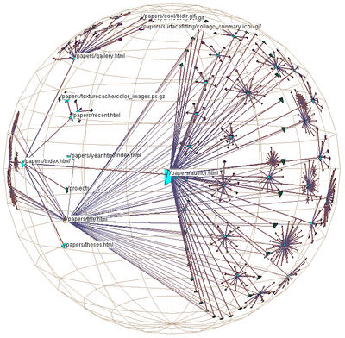
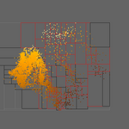
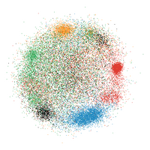
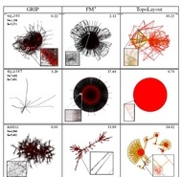
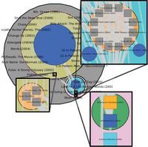
Technique-driven work
3D hyperbolic graphs
  H3
dimensionality reduction
  steerable
    MDSteer
  GPU accelerated
    Glimmer
general multilevel graphs
  layout
    TopoLayout
  interaction
    Grouse, GrouseFlocks,
    TugGraph

Slide 3
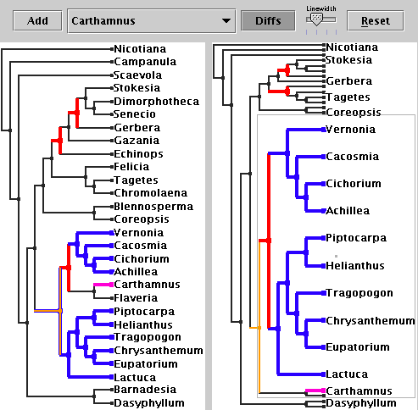
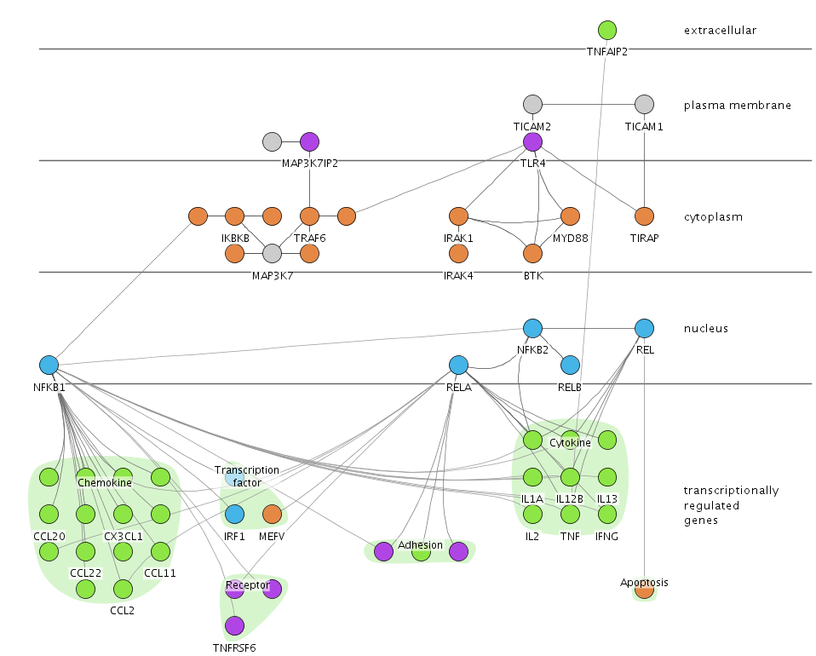
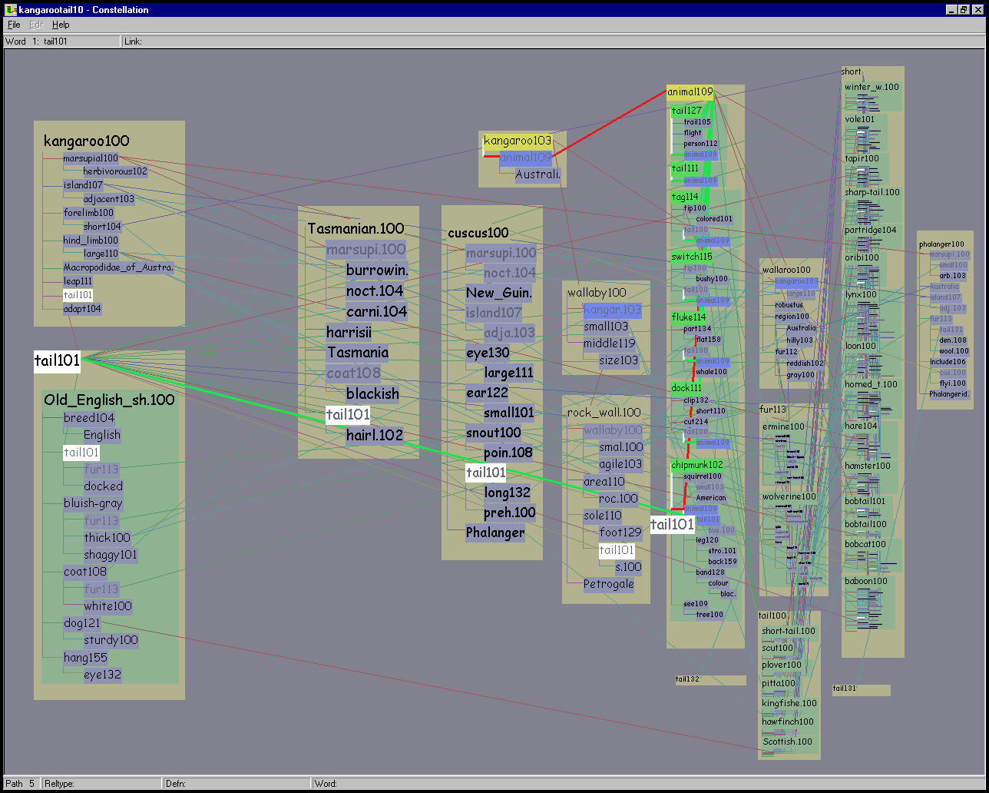
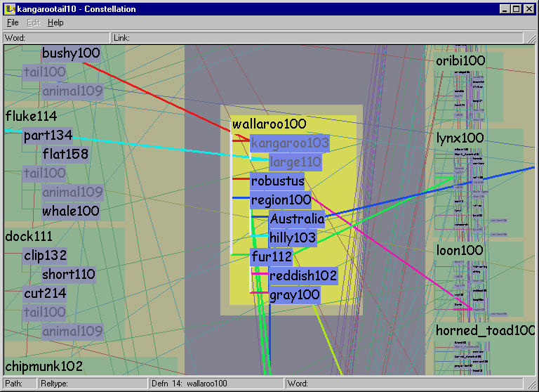
Problem-driven work
evolutionary tree comparison
  TreeJuxtaposer
protein-gene interaction networks
  Cerebral
linguistic graphs
  Constellation

Slide 4
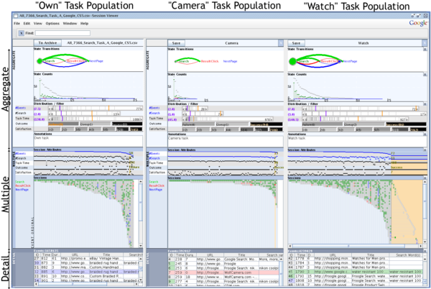
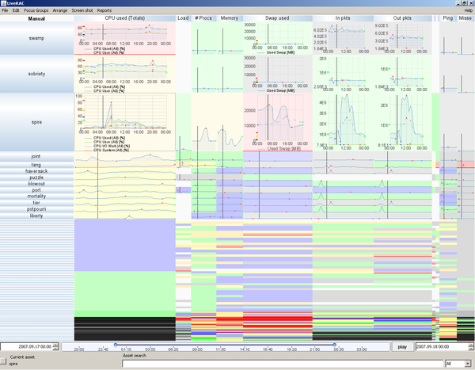
Problem-driven work
web logs
  SessionViewer
large-scale
system monitoring
  LiveRAC

Slide 5
Collaboration
sometimes you approach users
sometimes they approach you
  not guarantee of success!
challenges
  learning each others’ language
  finding right people/problems where needs of both are met
collaboration as dance/negotation
  initial contact is only the beginning
  continuous decision process: when to end the dance?
    after initial talk?
    after further discussion?
    after get feet wet with start on real work?
    after one project?
    after many projects?

Slide 6
Research Cycles, Collaboration, and Visualization
http://www.cs.ubc.ca/~tmm/talks.html#leiden07
4-slide version of hour-long collaboration talk
  research cycles and collaborator roles
  value of collaboration: success stories
  difficulty of collaboration: when to walk away

Slide 7
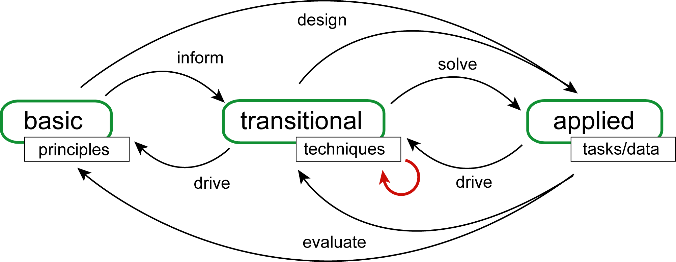
Research cycles
Johnson, Moorhead, Munzner, Pfister, Rheingans, and Yoo.
NIH/NSF Visualization Research Challenges Report. IEEE CS Press, 2006.
difficult for one person to cover all roles
collaboration is obvious way to fill in gaps

Slide 8
Four process questions
ask them early in dance/negotiation!
what is the role of my collaborators?
is there a real need for my new approach/tool?
am I addressing a real task?
does real data exist and can I get it?

Slide 9
Collaborator roles
left: providers of principles/methodologies
  HCI, cognitive psychology
  computer graphics
  math, statistics
right: providers of driving problems
  domain experts, target app users
middle: fellow vis practitioners
middle: fellow tool builders, outside of vis
  often want vis interface for their tools/algs
  do not take their word for it on needs of real users

Slide 10
Characteristics I look for in collaborators
people with driving problems
  big data
  clear questions
  need for human in the loop
  enthusiasm/respect for vis possibilities
all collaborators
  has enough time for the project
  research meetings are fun
    no laughter is a very bad sign
  (project has funding - ideally...)

Slide 11
Tricky collaboration: sustainability vis
environmental sustainability simulation
  citizens in communities making policy choices
  facilitator leads workshops
initial focus: high-dimensional dataset
  11 input variables, 3 choices each
  100K output scenarios, with 300 indicators
  existing tool only shows a few outputs at once
    hard to understand entire scenario
    impossible to compare scenarios
  goal: show linkages between inputs and outputs

Slide 12
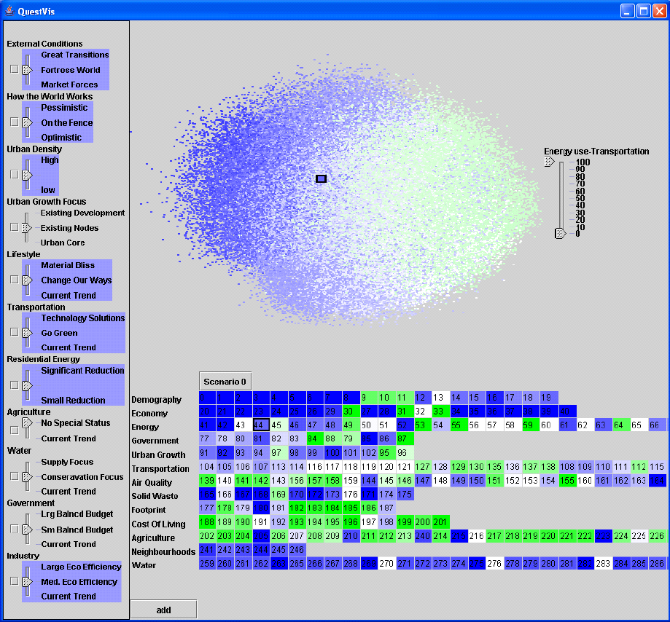
First prototype
linked views
  needed refining
dimensionality reduction
  too confusing for general public use
  bad match to true dimensionality of dataset

Slide 13
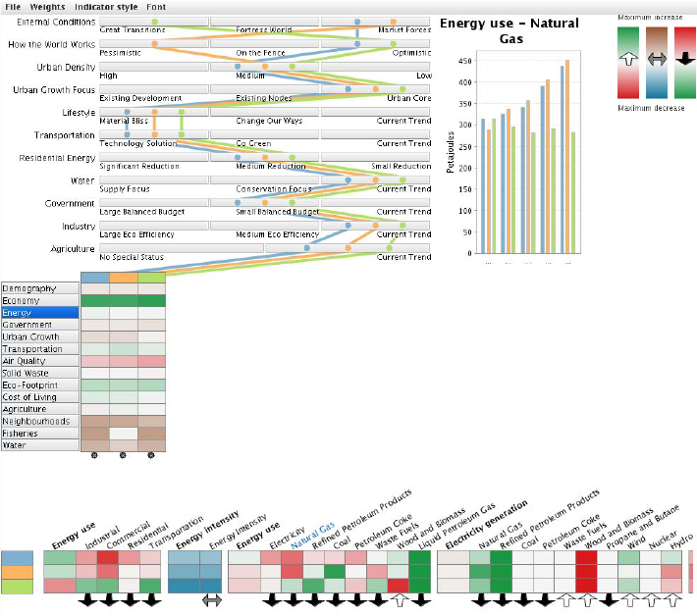
Second prototype
better linked views
  solved interesting
  aggregation problem
but not deployed
  real goal was policy choices and behavior change
  not to absorb details of how simulation works!
got the task wrong!

Slide 14
Process model: what can go wrong?
wrong problem: they don’t do that
wrong abstraction: you’re showing them the wrong thing
wrong encoding/interaction: the way you show it doesn’t work
wrong algorithm: your code is too slow
  domain problem characterization
  data/operation abstraction design
  encoding/interaction technique design
  algorithm design

Slide 15
Different threats to validity at each level
threat: wrong problem
validate: observe and interview target users
threat: bad data/operation abstraction
threat: ineffective encoding/interaction technique
validate: justify encoding/interaction design
threat: slow algorithm
validate: analyze computational complexity
implement system
validate: measure system time/memory
validate: qualitative/quantitative result image analysis
[test on any users, informal usability study]
validate: lab study, measure human time/errors for operation
validate: test on target users, collect anecdotal evidence of utility
validate: field study, document human usage of deployed system
validate: observe adoption rates
http://www.cs.ubc.ca/labs/imager/tr/2009/process

Slide 16
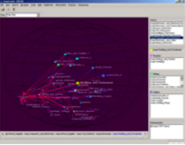
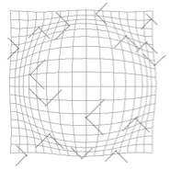
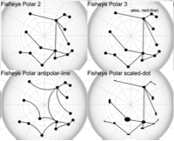
Studies: different flavors
head to head
system comparison
(HCI)
  H3 vs. 2D web browser
psychophysical characterization
(cog psych)
  impact of distortion on visual search
  on visual memory

Slide 17
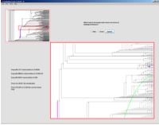
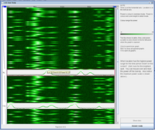

Studies: different flavors
characterize
technique applicability,
derive design guidelines
  stretch and squish vs. pan/zoom navigation
  separate vs. integrated views
  2D points vs. 3D landscapes

Slide 18
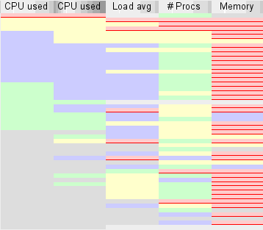

Studies: different flavors
requirements analysis
(before starting)
  semi-structured interviews
  watch what they do before new tool introduced:
  current workflow analysis
field study of deployed system
(after prototype refined)
  watch them use tool:
  characterize what they can do now

