Slide 1
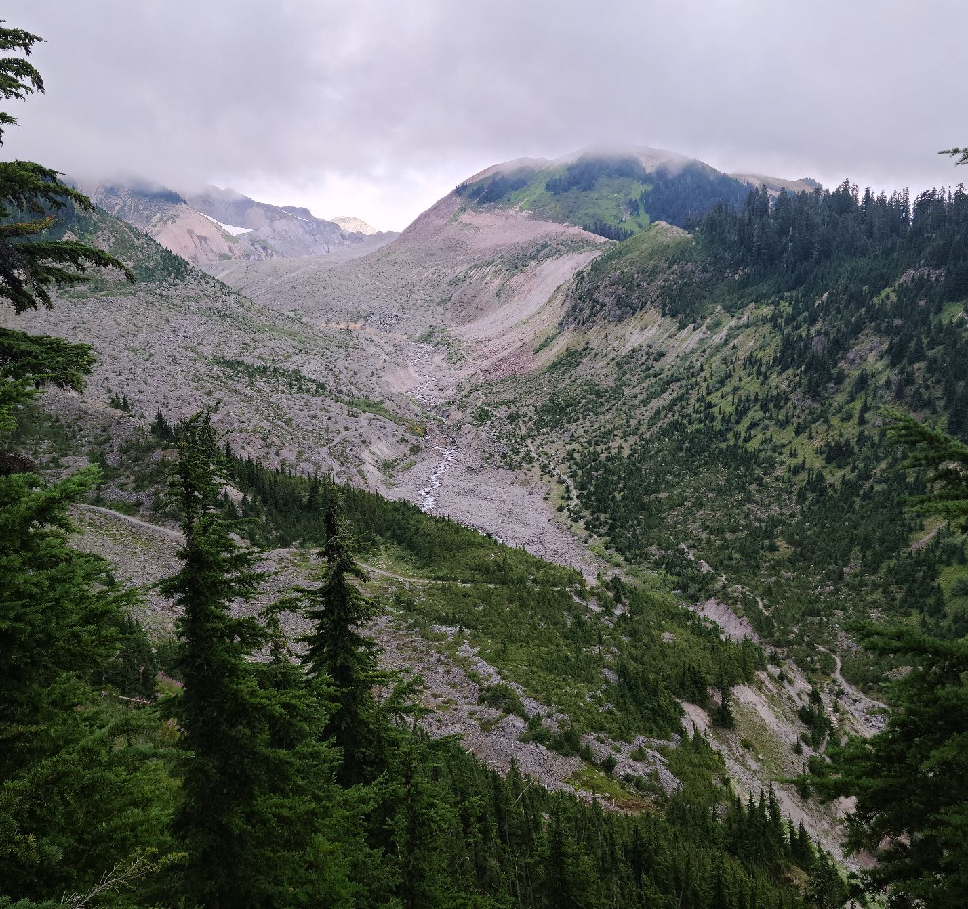
GraceFall:
Visualizing wear-out data for exploratory analysis
Ian Hill & Matthew Tang
Dec. 14th, 2022

Slide 2
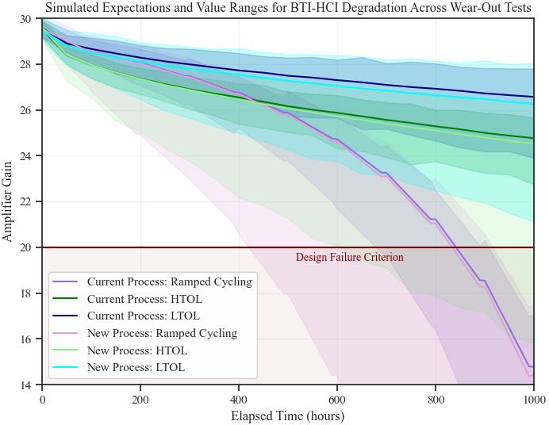
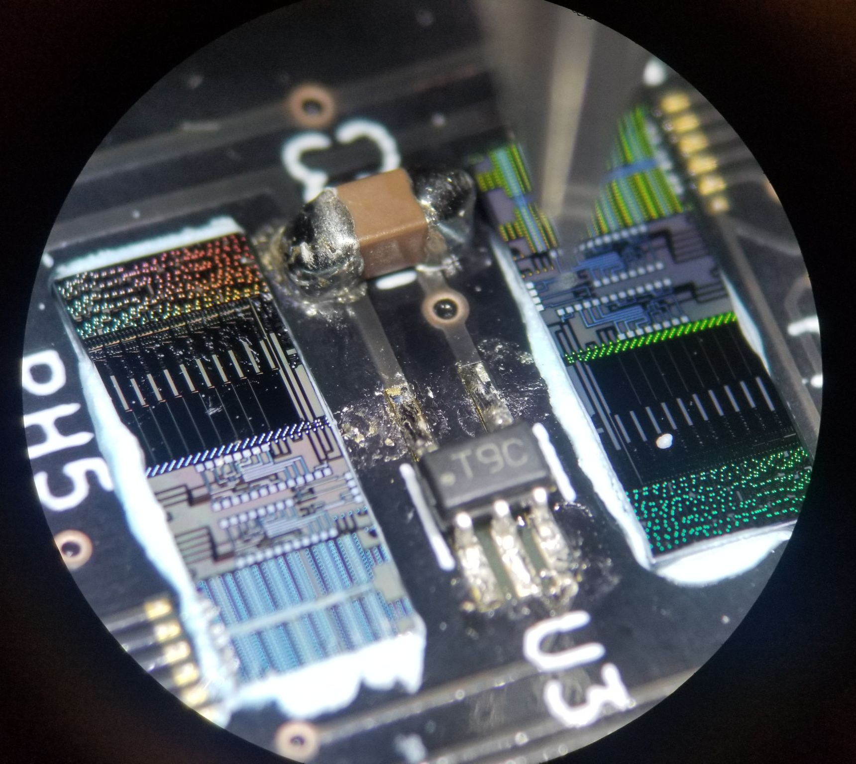
Problem introduction
Integrated circuits degrade and eventually fail with time
Tests produce large quantities of data series that are dependent on complex physical factors
Desirable to find causes of increased degradation during tests and analyze product quality in terms of statistical performance

Slide 3
Abstract Task Definition
More tasks exist but were not incorporated for project release version due to time constraints

Slide 4
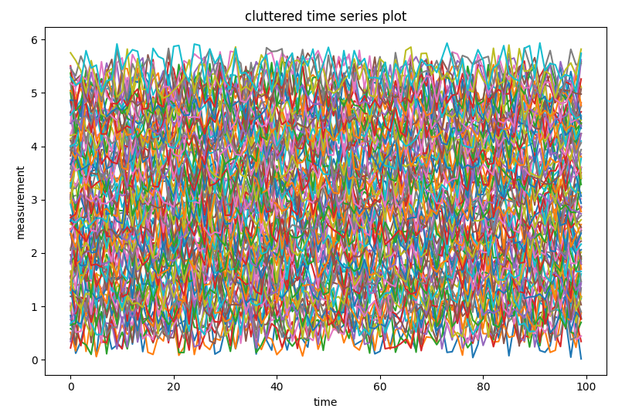
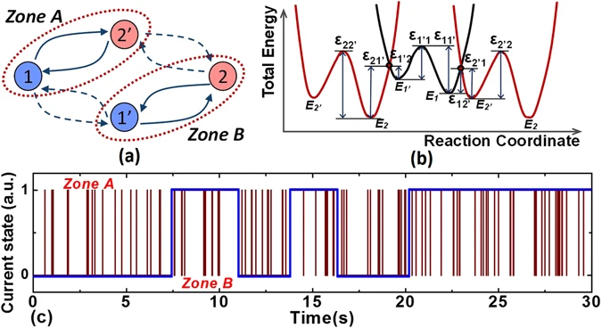
Visualization Challenges
Time series clutter resulting from large data sets
Displaying multiple parameters or tests in one tool
Generalization for time scales, data ranges, groupings
Guo, S., Wang, R., Mao, D. et al. Anomalous random telegraph noise in nanoscale transistors as direct evidence of two metastable states of oxide traps. Sci Rep 7, 6239 (2017). https://doi.org/10.1038/s41598-017-06467-7

Slide 5
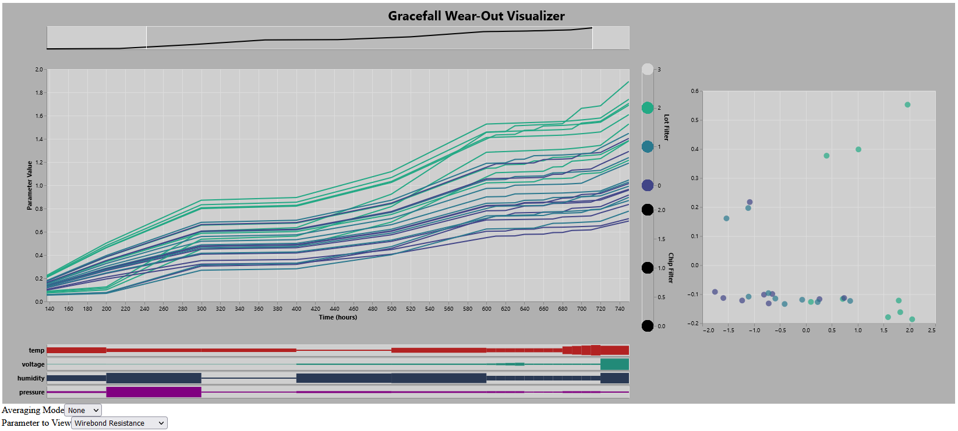
Design decisions
a) Time summary view
d) Hierarchical group filters
c) PCA plot
b) Time series plot
e) Meta/stress data panel
f) Aggregation and series type toggling

Slide 6
Shifting Resistances Demo
Identifying outlier series
Reduce visual cluttering to find trends
Attribute trends to meta/stress data

Slide 7
Implementation and Limitations
GraceFall was implemented in Python using the Altair library to produce Vega-Lite specifications
Our code uses generator functions to produce individual views, joined via arranger functions
Limiting of project design due to bounds of Vega-Lite grammar
No saturation or luminance encoding channels
No support for hierarchical/nested selection groups
Interactivity for dynamic text and view switching unachievable
Poor configurability for selectors, visual quality, colour schemes

Slide 8
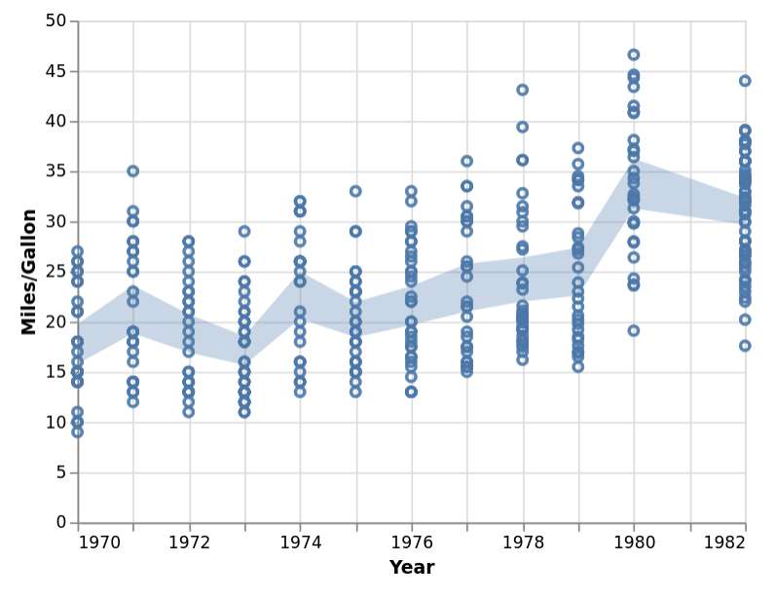
Future Work
Model visualization to enable comparison of data series to predictions

Slide 9
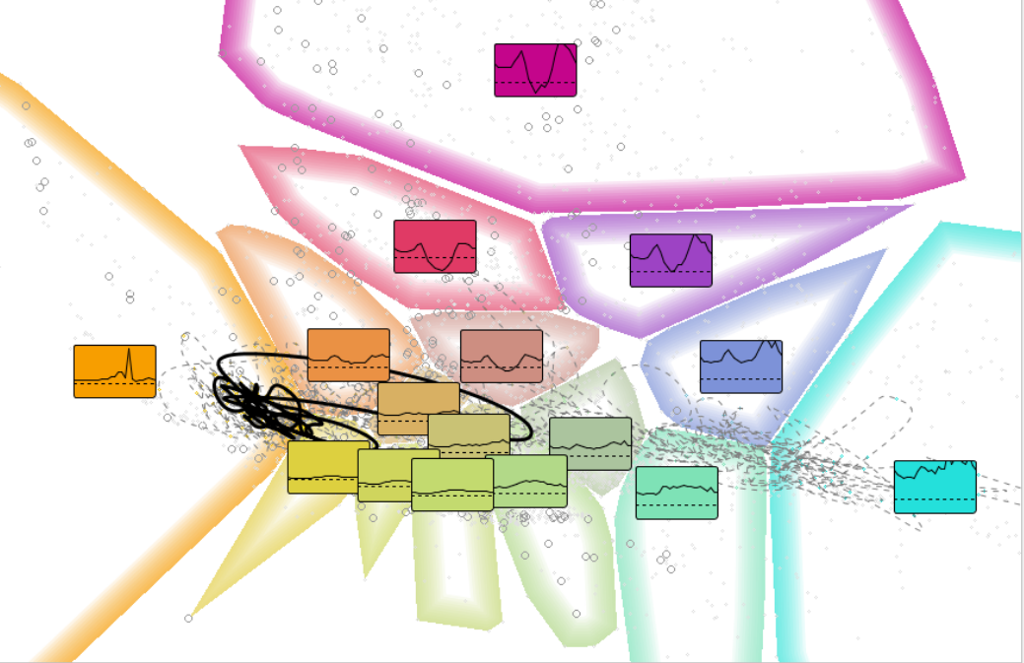
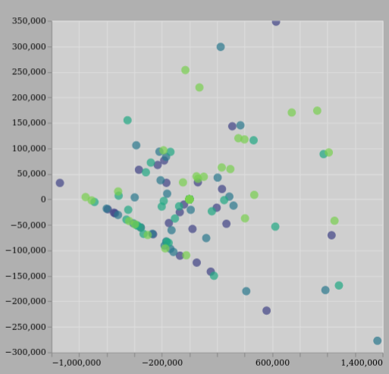
Future Work
Showing mean time-series on PCA to clarify underlying data

Slide 10
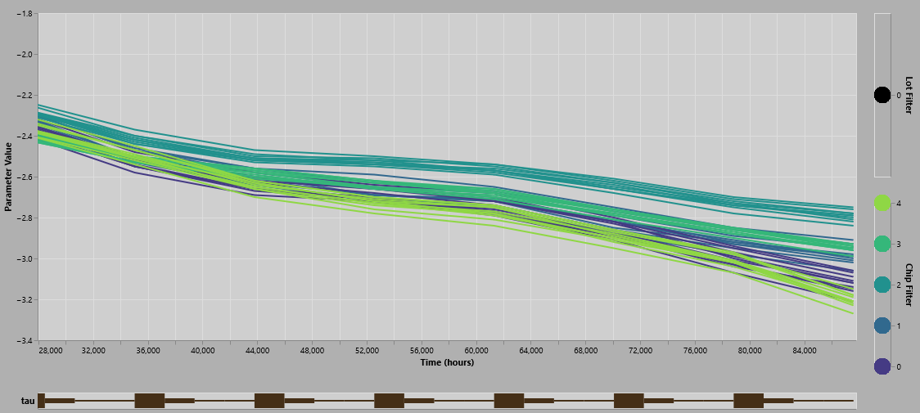
Future Work
Adding vertical separators at meta data points for better comparison

Slide 11
Thank You
Any questions?
ianhill@ece.ubc.ca
weiztang@student.ubc.ca

