Slide 1
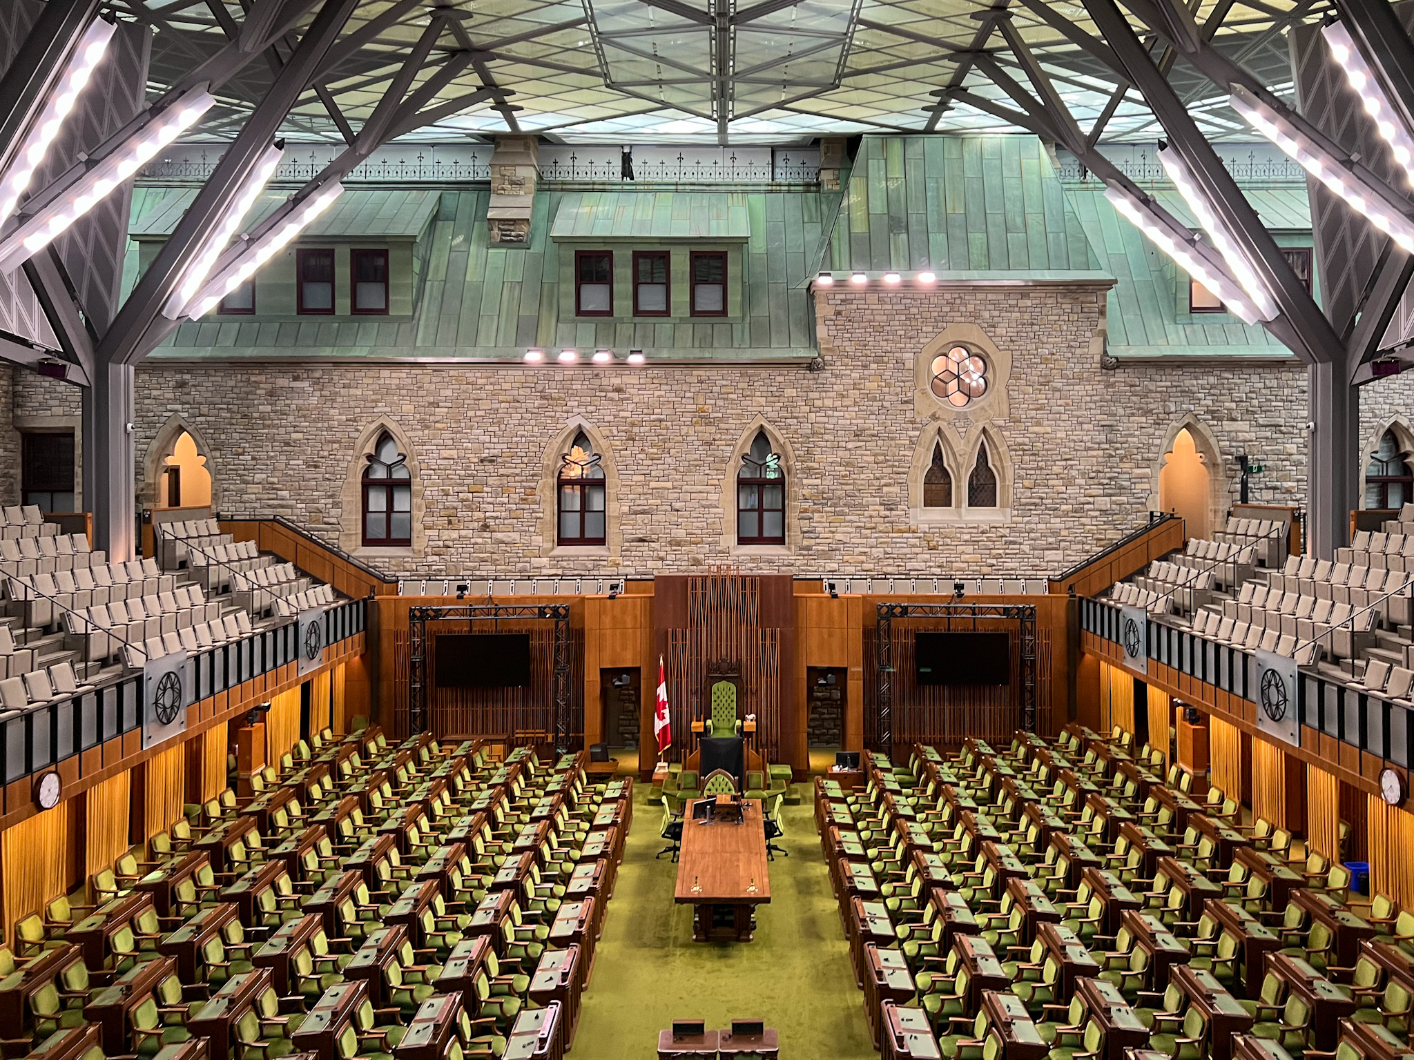
CPSC 547 Pitch
Ricky Curry

Slide 2
Canadian federal candidates 1867–2021
Biographical data about every federal candidate in every election (besides 2025)
Age
Birth nationality
Occupation
Gender
Openly LGBTQ2S+
Indigenous
Plus all the election-related data you’d expect (vote share, incumbency, etc.)

Slide 3
Prior work citing this dataset
Minority groups in Canadian federal elections, 2015–2021
Is incumbency advantage gendered?
Political dynasties in Canada (combined with another dataset)
Legislative reciprocity: Using a proposal lottery to identify causal effects (combined with another dataset)
Why does a legislator's age matter?
Does Democracy Die in Darkness? An Examination of the Relationship between Local Newspaper Health and Turnout in Municipal Politics

Slide 4
Suggestions from the author (directly quoted)
The share of female candidates over an extended period of time;
Which occupations do better in politics;
If women get fewer votes than men;
How long politicians tend to stay in politics;
The advantage gained by incumbency;
How well independents do;
The consequences for politicians who are elected under a party banner and then switch their party affiliation and run again either at the same level of government or across two different levels (provincial and federal);
The progressive ambition of politicians across different levels of elections;
If by-elections are more favourable to smaller parties and/or independent candidates.

Slide 5
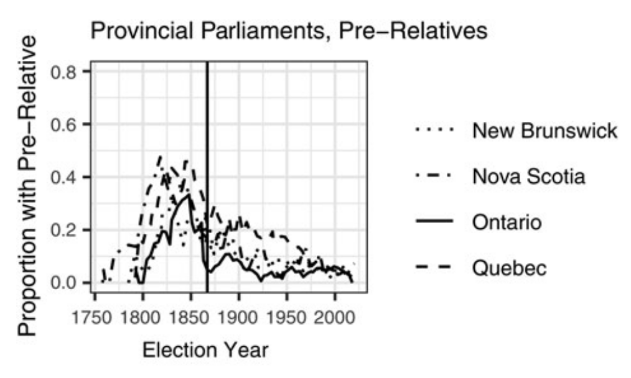
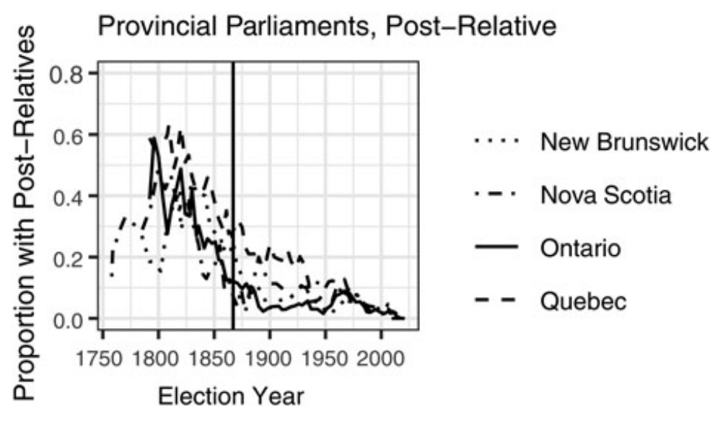
Existing visualizations of this data from the literature
These are (somewhat) good for quantifying the electoral dynastic effect
More interesting to visualize dynasties themselves, e.g. as a network, for biographical exploration

Slide 6
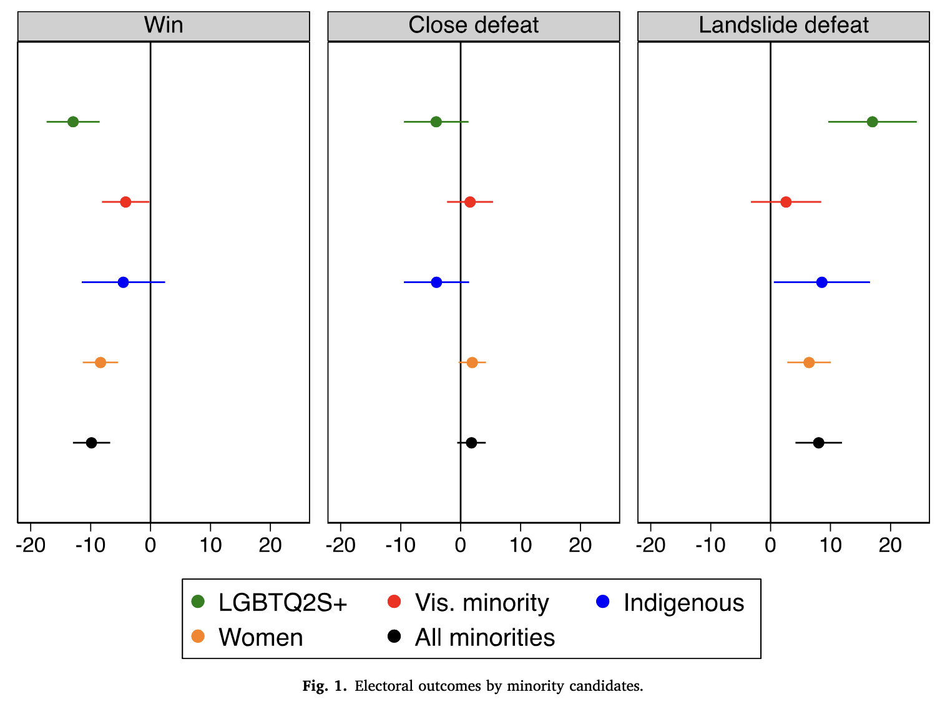
Existing visualizations of this data from the literature
Not great!
Very low information density
Needs significant explanation
No x-axis labels
Problematic colour selection
Would like to further explore demographics vs electoral outcomes throughout history

Slide 7
Potential vis design directions
Choropleth maps to find geographic trends
How did ridings themselves change? 234 -> 338 seats
Scrub through history with interactive timeline
Changes in profession over time
Hierarchical arrangement of parties and factions
So many other options I haven’t thought about yet!

Slide 8
Questions?

