Slide 1
Visualizing Biking Networks in Canada
2025.09.23
GALE CHEN
CPSC 547

Slide 2




Motivation
Biking Networks in Canada
Notes:
On the weekend, I was biking with my partner, the sun was shining, I thought to myself, wow, biking is so great.
But you know what’s not great?

Slide 3
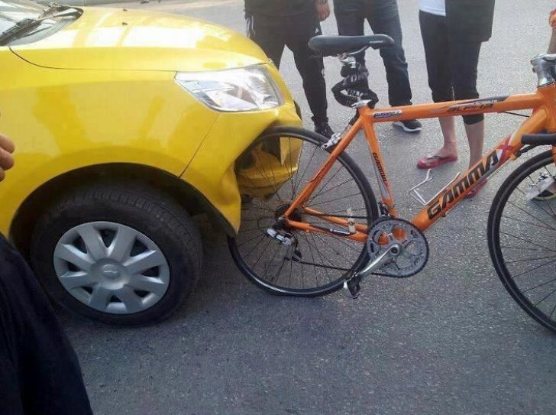


Motivation
Biking Networks in Canada
Notes:
Cyclist-motor accidents!

Slide 4

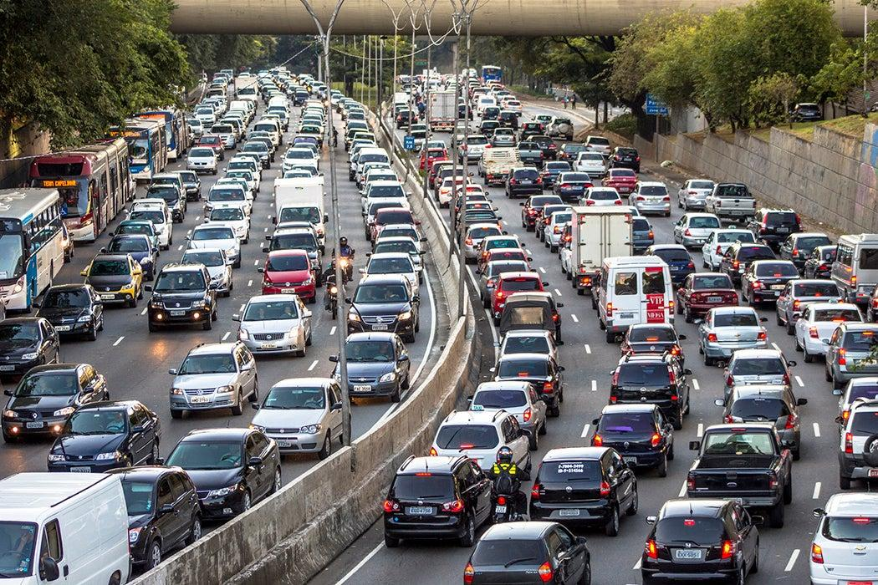
Motivation
Biking Networks in Canada
Biking is great for…
Personal health
Accessibility of neighbourhoods
Reduction of air pollution emissions
Well designed biking infrastructure increases bike ridership and decreases cycle-motorist crash fatalities.
Rerat & Schmassmann, 2024; Reynolds et al., 2009
Notes:
I’m sure we all agree, but just in case, let me explain.
Biking is associated with many health benefits, drastically decreasing risks of heart disease and type 2 diabetes. It’s a great, low impact activity.
Biking also is an accessible way for people who cannot drive to get around the neighbourhood, for example, kids.
Cycling is a great way to reduce carbon emissions. Replacing car trips with bike trips can reduce the average person's carbon emissions from transportation by 67%

Slide 5
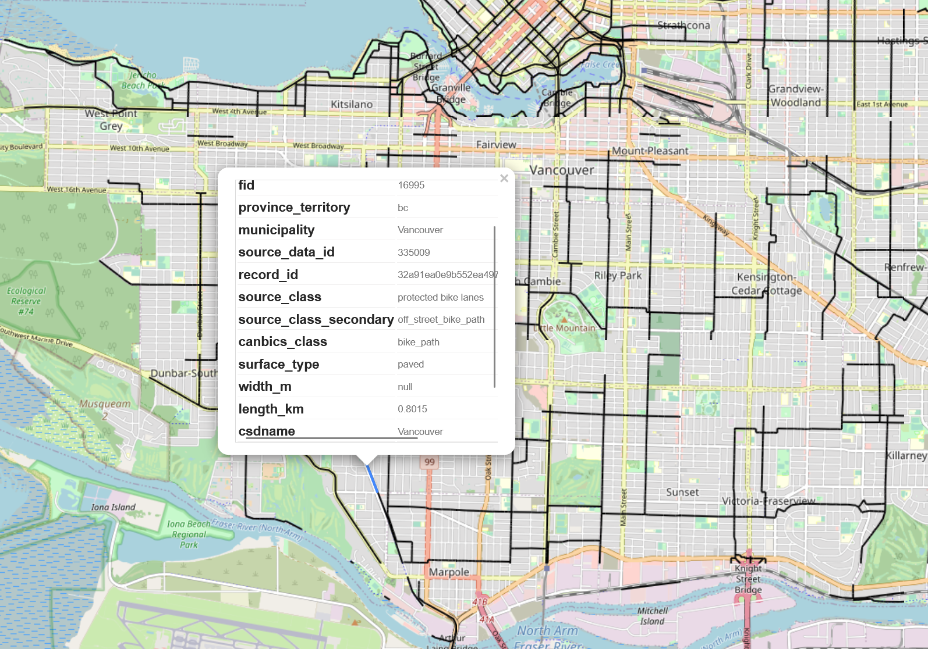
Data
Biking Networks in Canada
Canadian Cycling Network Database:
18700 km of cycling infrastructure across 75 municipalities
Geospatial data
Infrastructure Classifications
Distance Metrics
cycle_network_2024.gpkg
Notes:
Geospatial dataset: National cycling network file (compatible with geographic information systems).
Infrastructure classifications: Categorized according to Can-BICS standards.
Distance metrics: Lengths of each cycle infrastructure type for each municipality, provided as a comma-separated values (CSV) file.
Metadata: Details on data sources and processing methods.
Metadata report: Further information on methodology and results

Slide 6
Possible Exploration Questions
Biking Networks in Canada
Underserved neighborhoods?
Correlation between bike infrastructure and demographics?
EQUITY & ACCESS
Type of biking infrastructure in region?
Missing links in biking network?
INFRASTRUCTURE PLANNING
Relationship between cycle-motorist accidents and biking infrastructure?
Correlation between bike infrastructure development and physical activity levels?
HEALTH & SAFETY

Slide 7
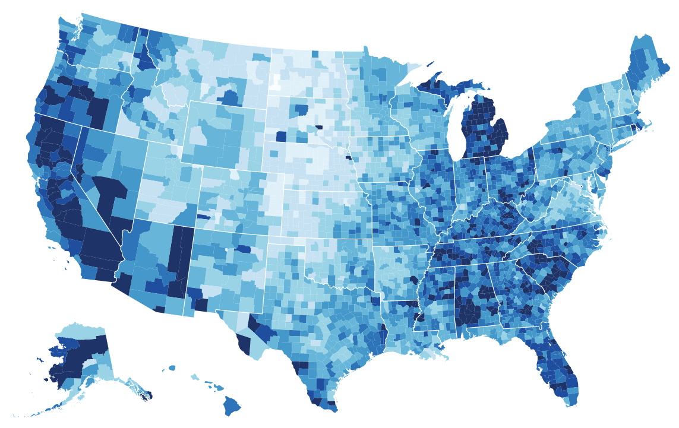
How?
Biking Networks in Canada
Data already contains geospatial (GeoPackage) data.
Geopackage file viewing tools exist: https://ngageoint.github.io/geopackage-viewer-js/
If visualization of geospatial data, needs to meaningfully add functionality/information.
Maybe Choropleth map?
Overlayed datasets using different channels?
Change idiom completely
Network Analysis of how paths are connected?
Notes:
Geospatial dataset: National cycling network file (compatible with geographic information systems).
Infrastructure classifications: Categorized according to Can-BICS standards.
Distance metrics: Lengths of each cycle infrastructure type for each municipality, provided as a comma-separated values (CSV) file.
Metadata: Details on data sources and processing methods.
Metadata report: Further information on methodology and results

Slide 8
References
Biking Networks in Canada
Dataset: https://www150.statcan.gc.ca/n1/pub/23-26-0004/232600042024001-eng.htm
Urban Data Lab, Centre for Special Business Projects, Statistics Canada (2025). Bikeways Canada. Available at: http://www.statcan.gc.ca.
Reynolds, C. C., Harris, M. A., Teschke, K., Cripton, P. A., & Winters, M. (2009). The impact of transportation infrastructure on bicycling injuries and crashes: a review of the literature. Environmental health : a global access science source, 8, 47. https://doi.org/10.1186/1476-069X-8-47
Rérat, P., & Schmassmann, A. (2024). Build it and they will come? The effects of a new infrastructure on cycling practices and experiences. Transportation research interdisciplinary perspectives, 25, 101121.

