Slide 1

Visualizing Population Decline in the Four Asian Tigers
Alice Kang - CPSC 547 Project Pitch

Slide 2
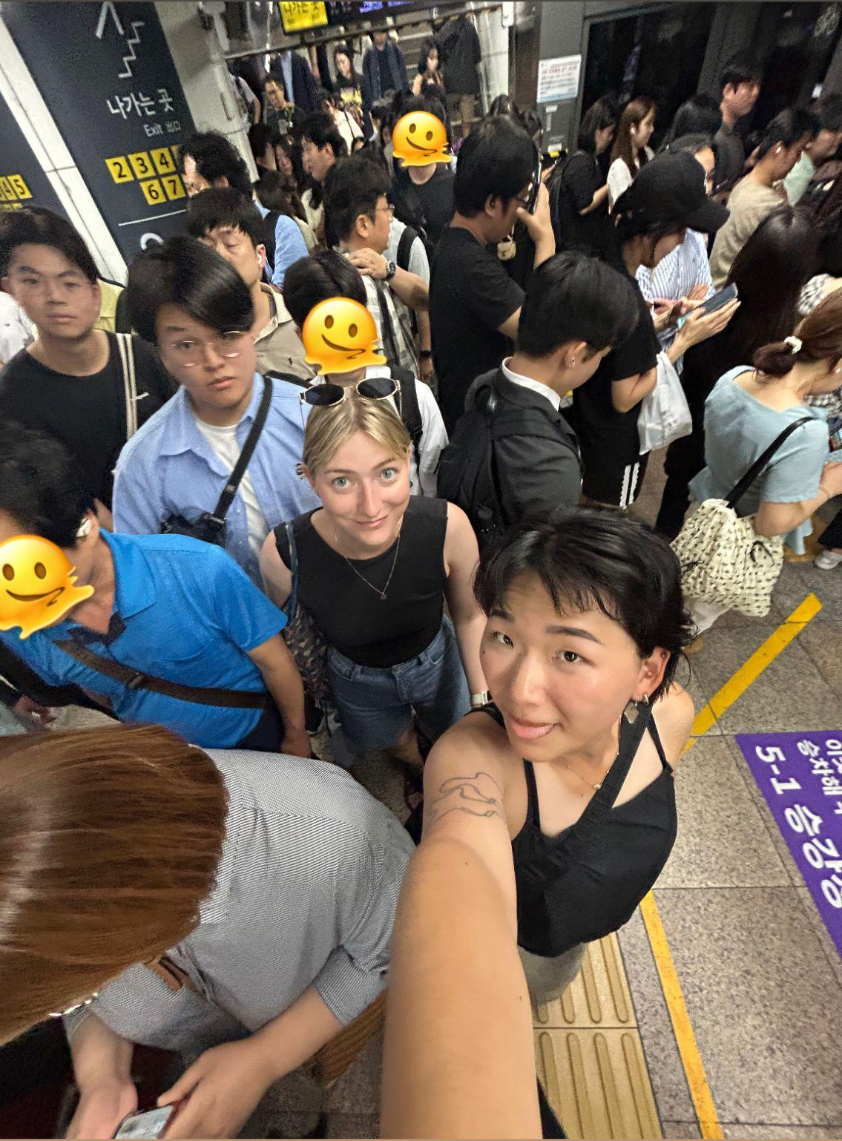

Slide 3
Me and my friends, trying to take the subway in Seoul at 6PM on a weekday, wondering…

Slide 4
How are there SO MANY people in Seoul??

Slide 5
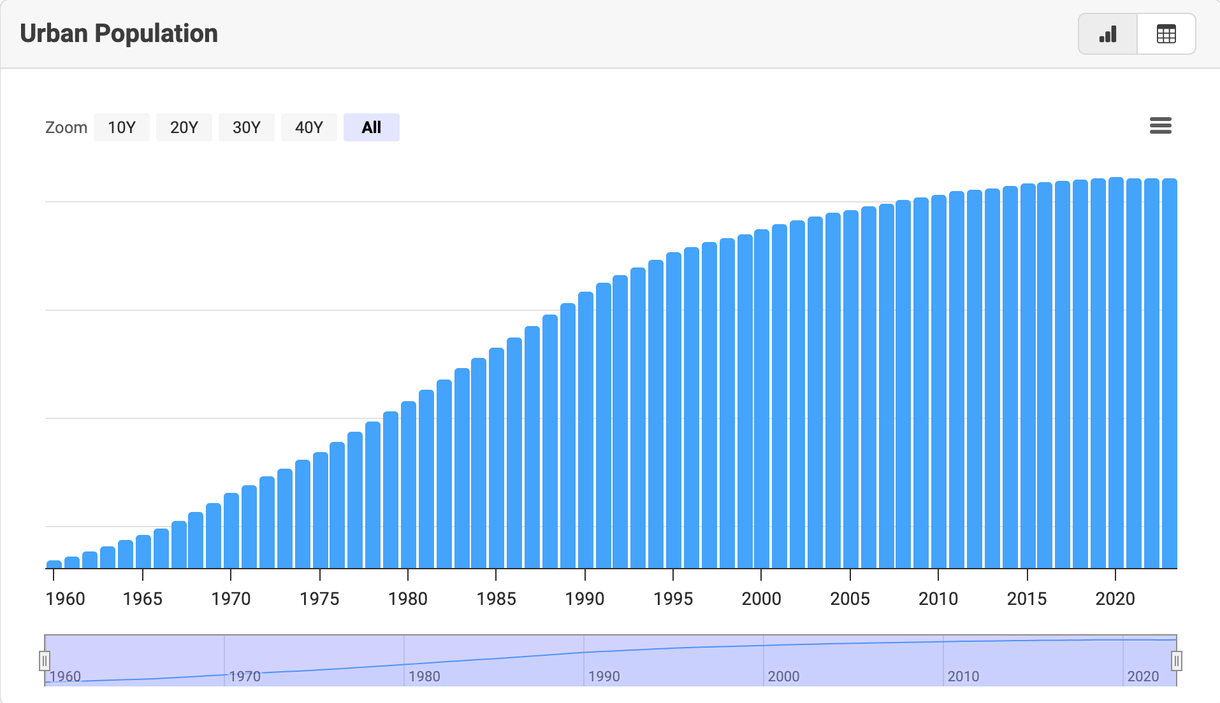
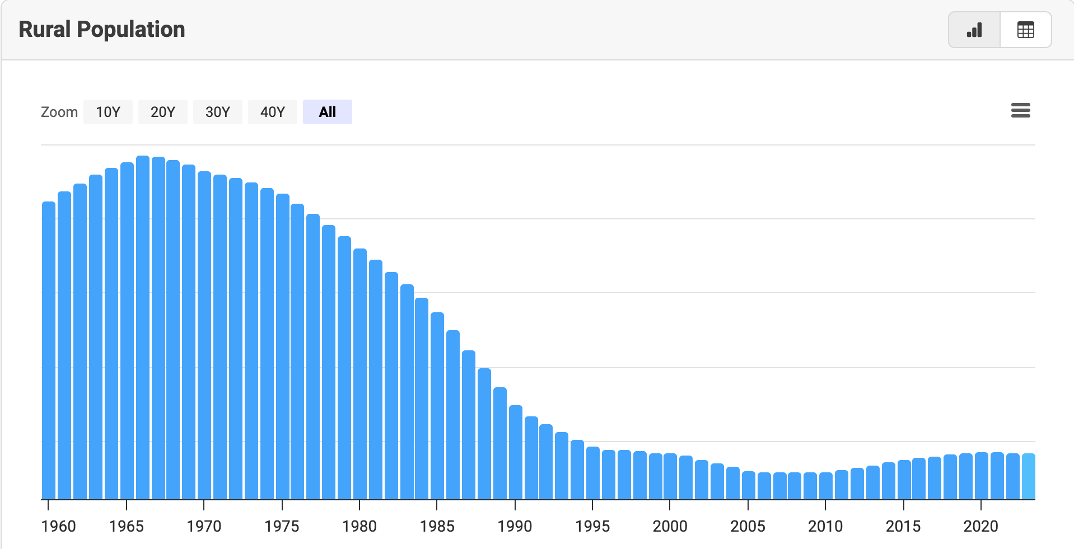
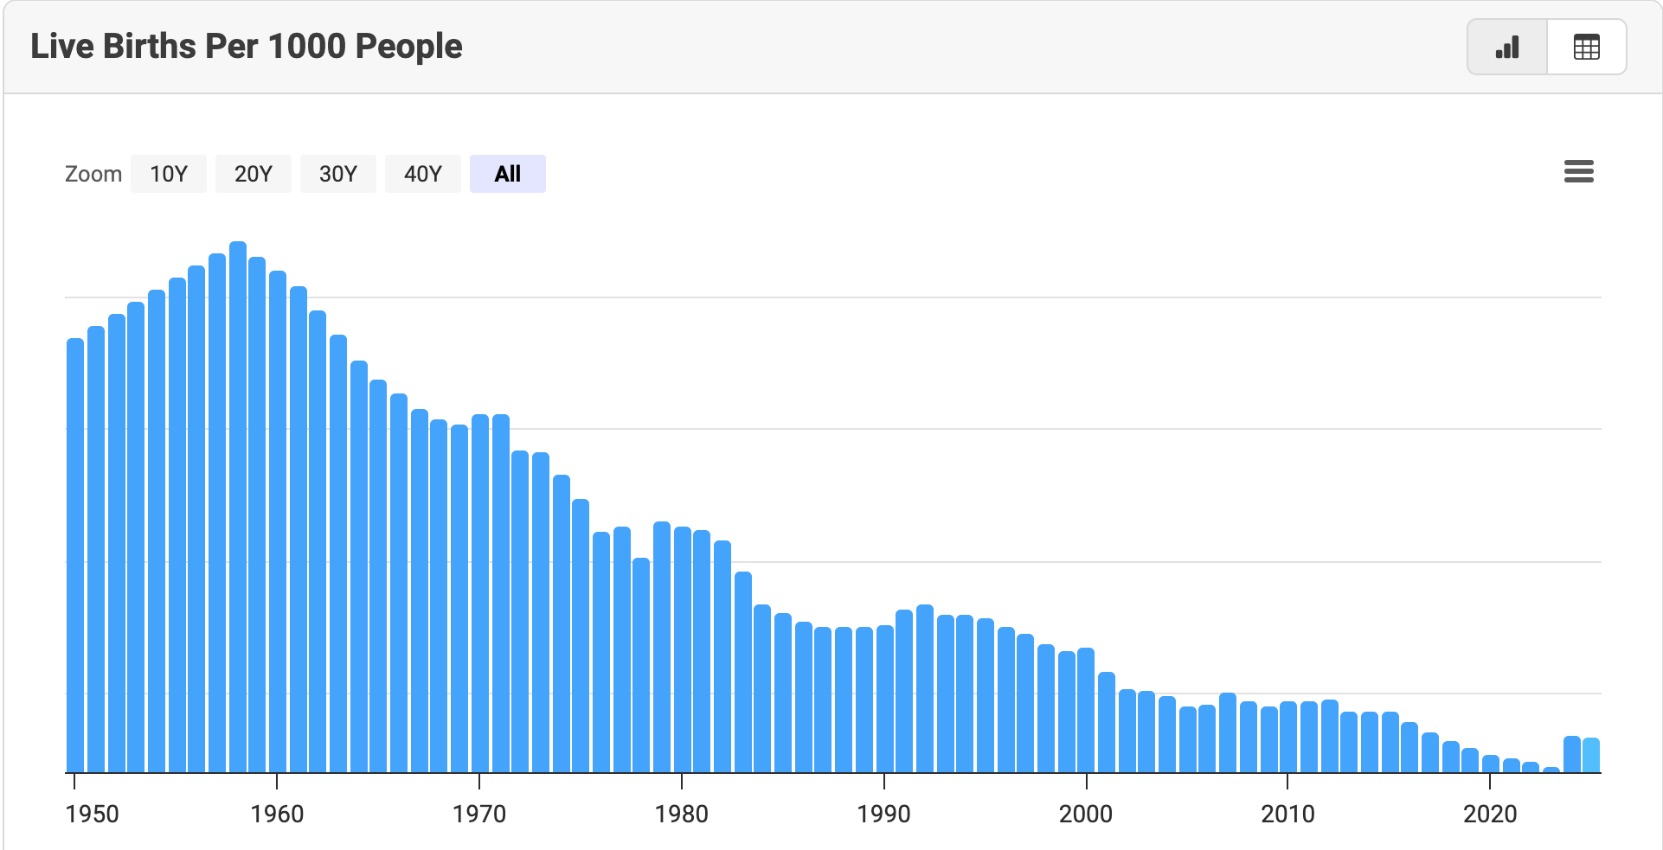
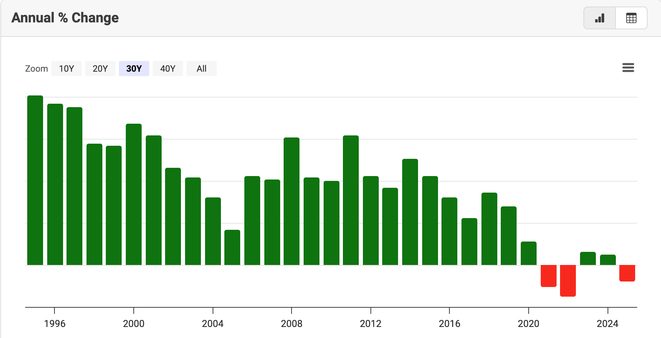
Source: https://www.macrotrends.net/global-metrics/countries/kor/south-korea/population

Slide 6
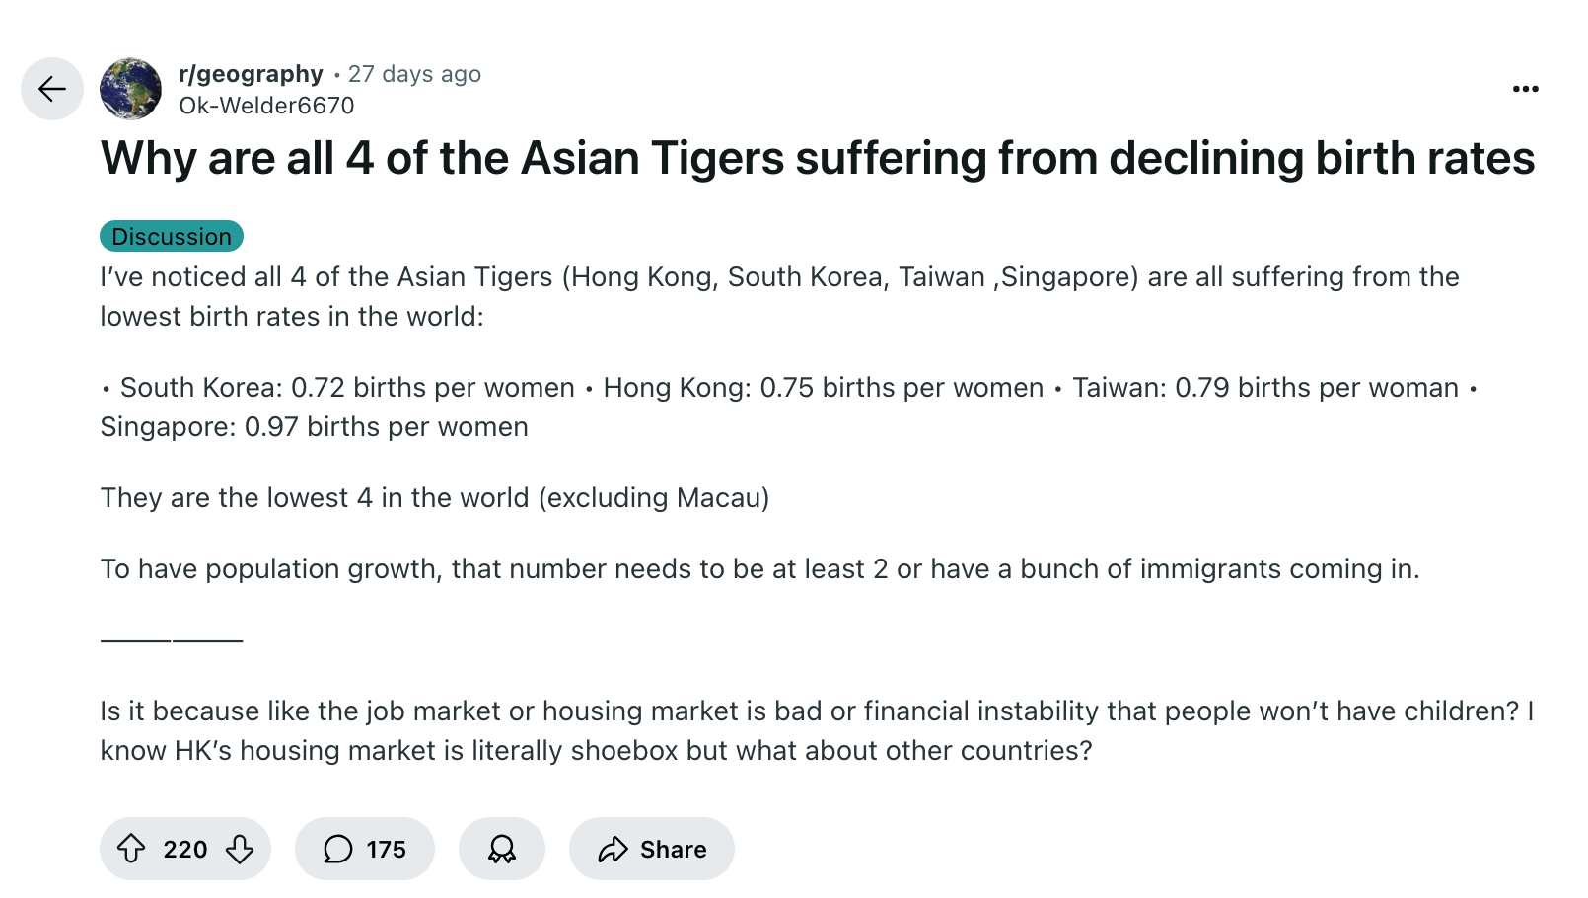
Source: https://www.reddit.com/r/geography/comments/1n2z06x/why_are_all_4_of_the_asian_tigers_suffering_from/

Slide 7
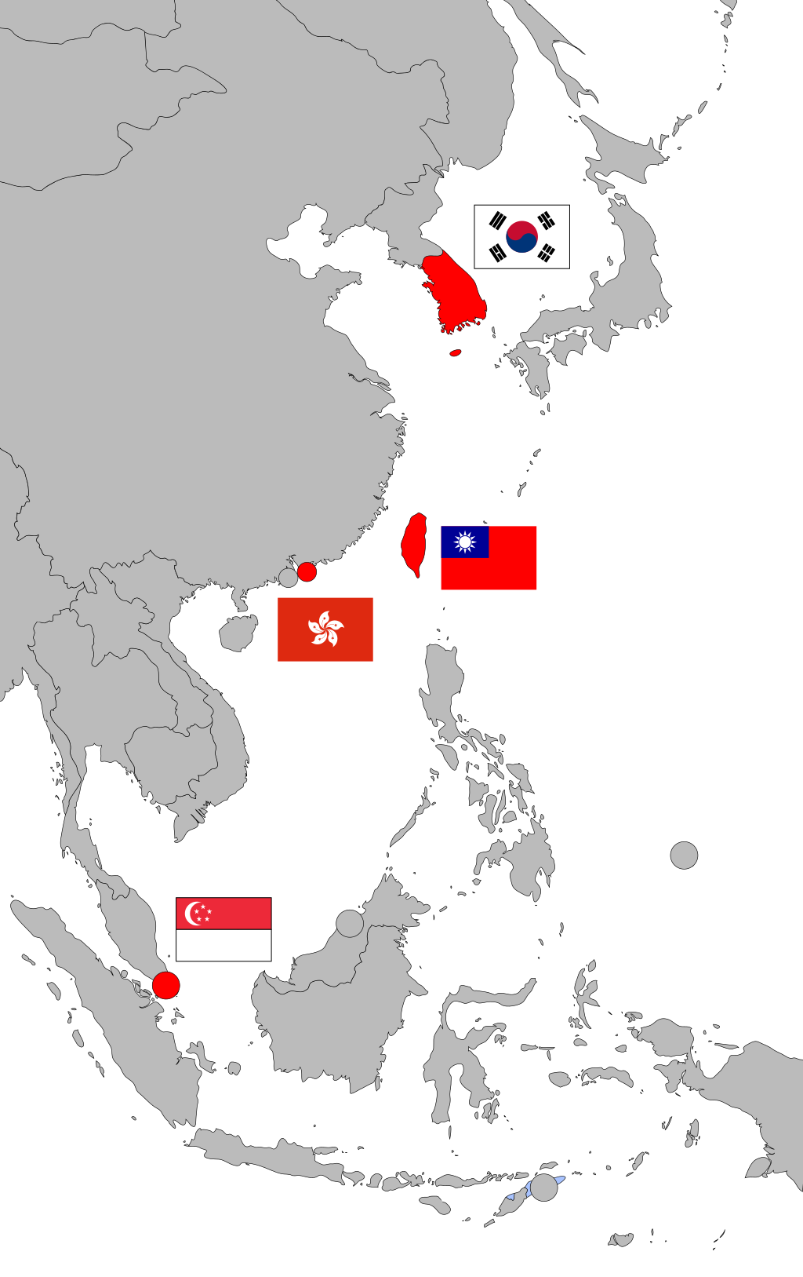
The “Four Asian Tigers”
Rapid industrialization after WWII, between the 1950s and 1990s
  Followed by a very quick economic development from low- to high-income economies with trades with the West
Highly educated and skilled working class
High literacy rate and level of education
  Small gap in male and female literacy

Slide 8
The “Four Asian Tigers”
Declining birth rate
  Fun Fact: Singapore introduced a government-funded dating program (SDN) in 1985, and revamped it in the early 2000s when it actually gained a lot of traction!
Aging population
Centralization of younger population to the capital cities (Seoul, Taipei, Hong Kong, Singapore)
Notes:
To combat this issue, Singapore introduced a government-funded dating program (SDN) in 1985, and revamped it in the early 2000s when it actually gained a lot of traction!

Slide 9
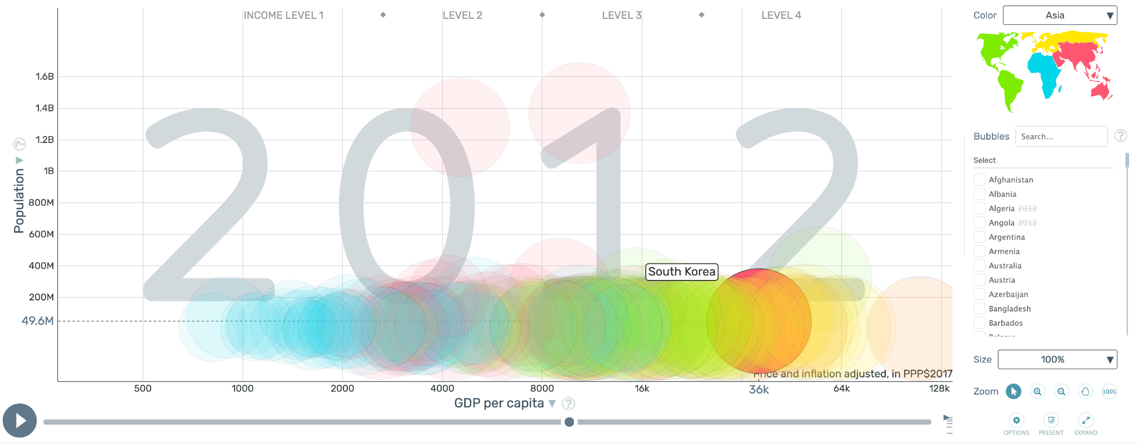
Data
Gapminder, which is already an excellent data vis tool
  But, I want to explore how I can visualize the specific factors (e.g. education, birth rate, etc.) that contribute to population decline in the four Tigers specifically.

Slide 10
You should join me if, like me, you:
are a Geography nerd
like to look at people data
like maps
like pretty colours
have a complicated relationship with your heritage to a culture within the four Asian tigers, or any country for that matter, having grown up as a 1.5 generation kid in an immigrant household and want to understand why your home country is going through its struggles while coming to terms with the fact that you’ll never really understand the life of the local people there as a complete foreigner

Slide 11

Thank you!

