Slide 1
MultiChIPViewer
A Tool to View ChIP-seq Data from
Multiple Experimental Conditions
By Alexander Adrian-Hamazaki, Rodrigo Conceição, and Yerin Kim

Slide 2


Slide 3
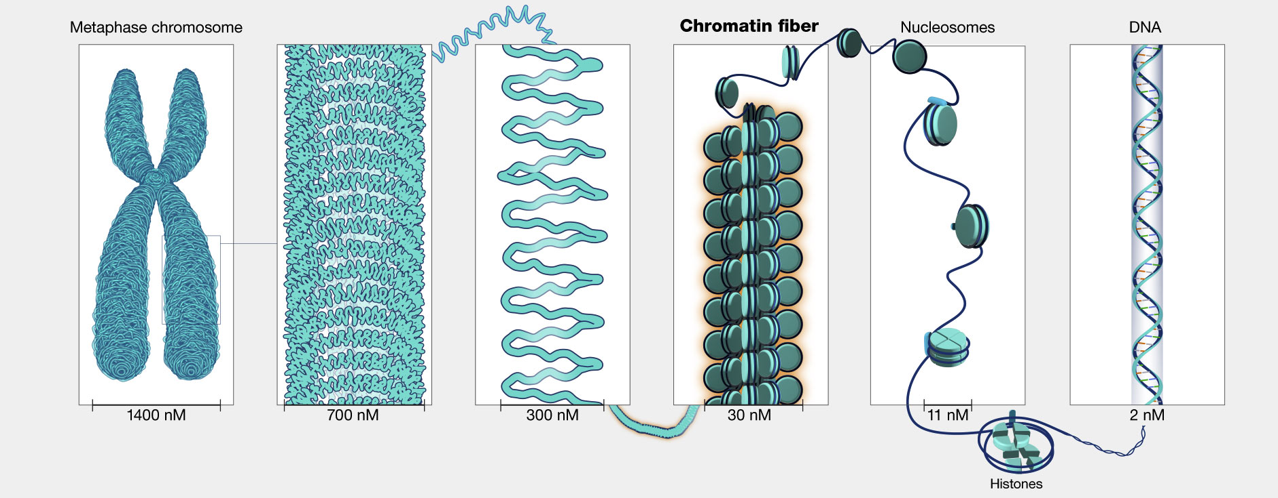
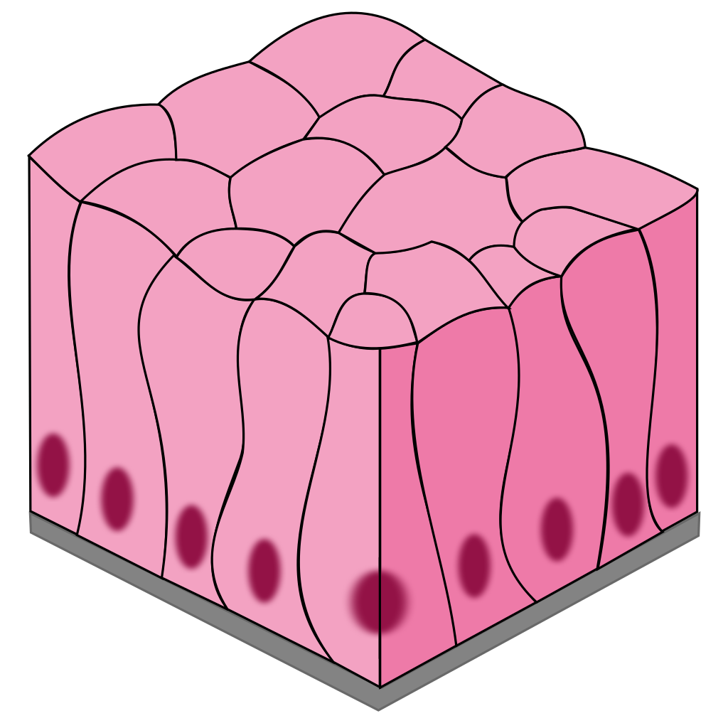
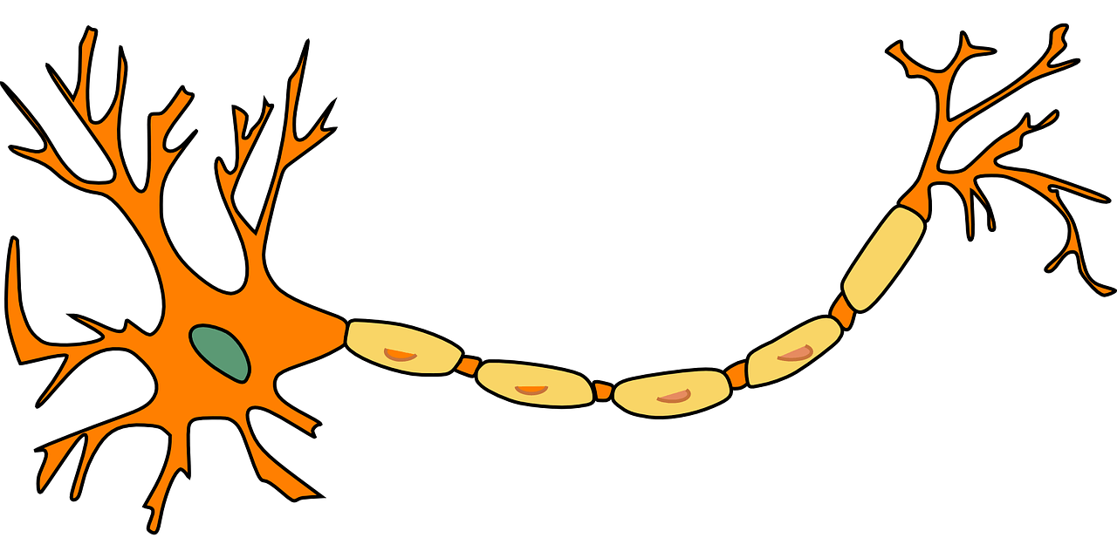

Background
Our body is made of trillions of cells containing the same DNA stored in the nucleus
DNA is wrapped by histones proteins + other proteins => Chromatin
Epithelial
Neurons
Photo:National Human Genome Research Institute
If the DNA is the same, why do we have different types of cells with different functions?
Muscle
Largely because of the genes that are being expressed in each cell

Slide 4
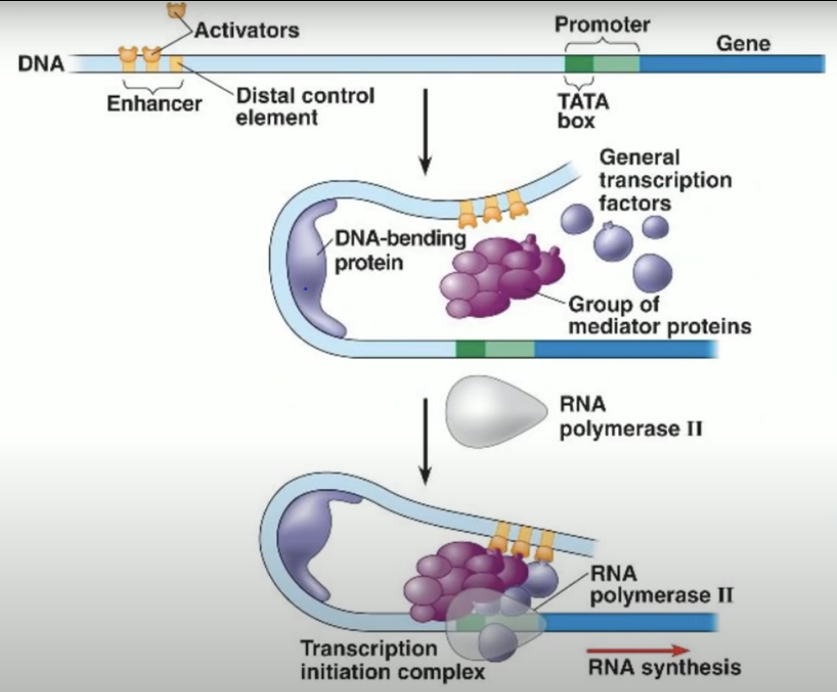
Background - Genes
Gene - Sequence of DNA encoding a function
Promoter - Region upstream the gene that signals where the transcription starts
Enhancer - Sequence of DNA that enhances the transcription
Gene regulation is key to unravel molecular biology
Photo: Biology Lectures
Notes:
Also bring up the fact that PROTEINS are binding the DNA. This is what REGULATION is. Because we need to motivate that CHIPSEQ is a way of getting info about gene regulation because we are identifying what proteins bind to the DNA.

Slide 5
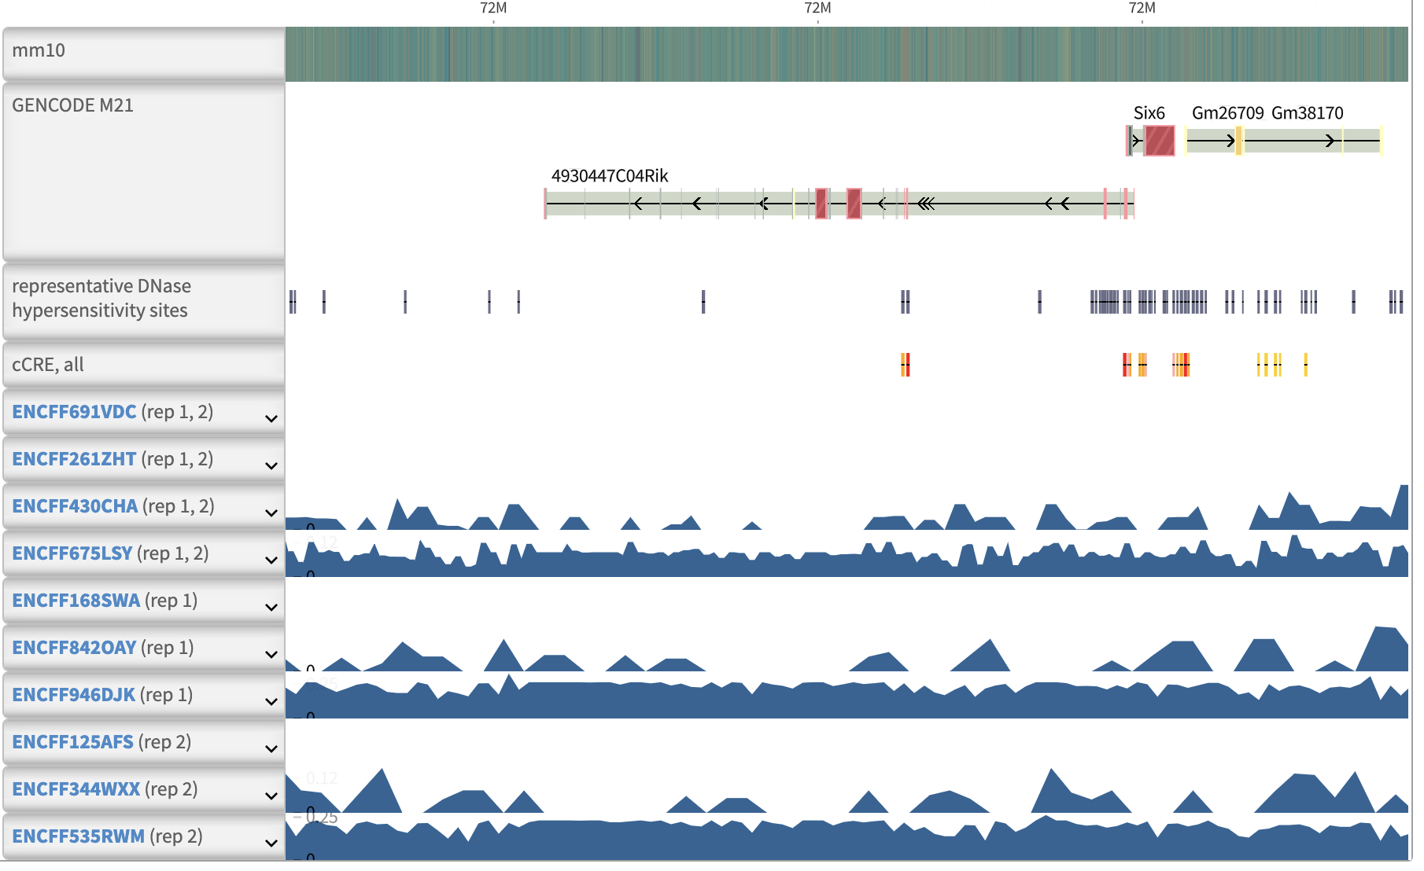
Background - Technologies
ChIP-seq: Chromatin immunoprecipitation followed by sequencing - Identify the locations of where specific proteins are bound to the genome
ATAC-seq: Assay for Transposase-Accessible Chromatin - Identify accessible regions of the genome
Canonical ChIP-seq is shown as “peaks” vertically aligned to genome
Photo: Genome Browser (https://www.encodeproject.org/experiments/ENCSR000CEX/)

Slide 6
Background - Technologies
ChIP-seq: Chromatin immunoprecipitation followed by sequencing - Identify the locations in the genome bound by proteins
ATAC-seq: Assay for Transposase-Accessible Chromatin - Identify accessible regions of DNA
Canonical ChIP-seq is shown as “peaks” vertically aligned to genome
Photo: Genome Browser (https://www.encodeproject.org/experiments/ENCSR000CEX/)

Slide 7
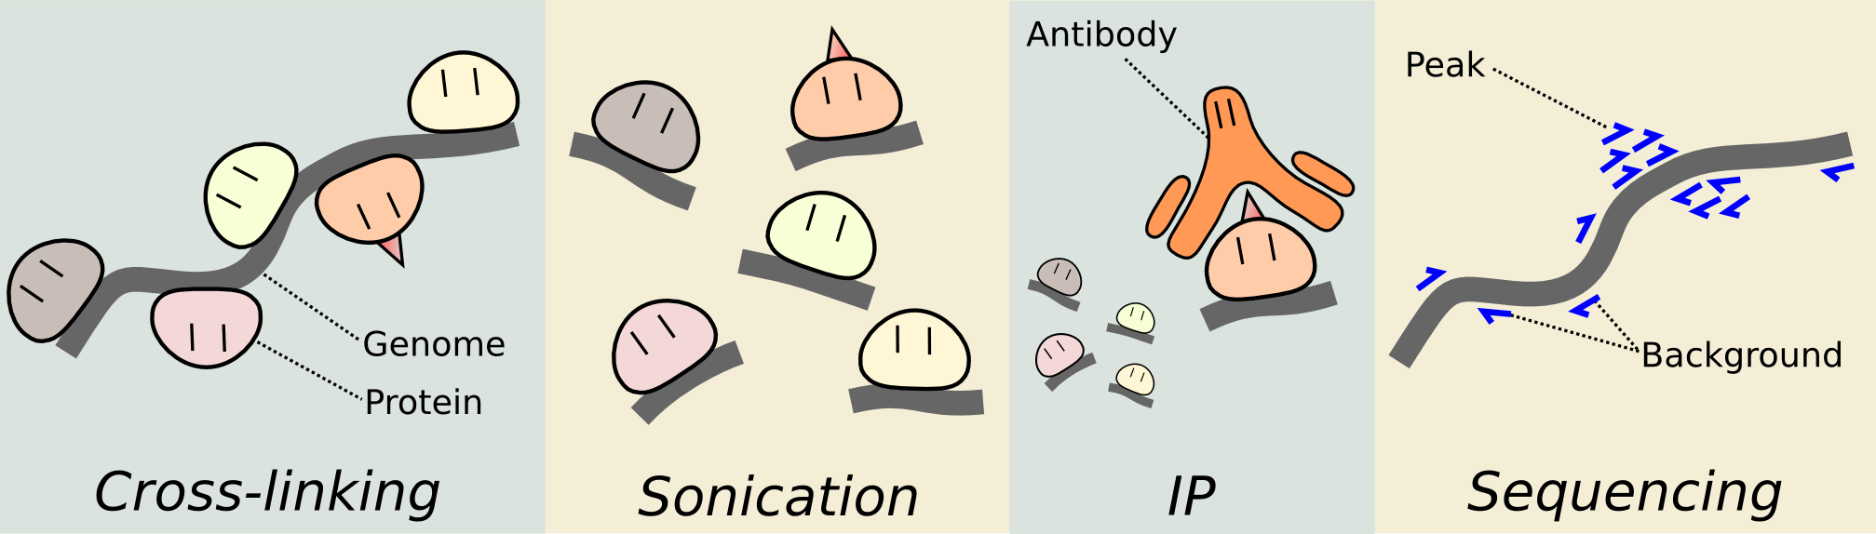
Background: ChIP-seq
ChIP-seq: Chromatin immunoprecipitation followed by sequencing - Identify the locations of where specific proteins are bound to the genome
Image adapted from: http://bioconductor.org/help/course-materials/2015/Uruguay2015/V7-ChIPSeq.html
Notes:
Important Parts:
Proteins are bound to the Genome.
Then After sequencing (last panel) you get peaks that tell you that there was a protein at that specific location

Slide 8
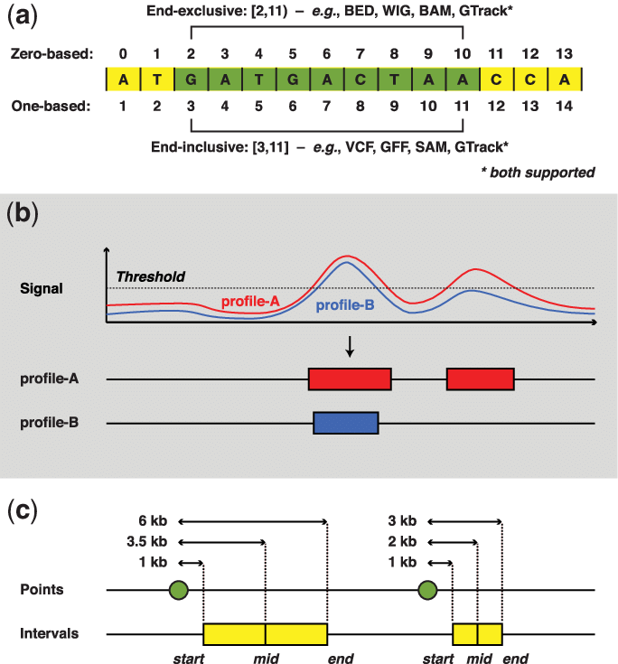
Background: Genomic Coordinates
Locations in the Genome have specific Genomic Coordinates
Chromosome name
Start position
End position
Ex. Chr16: 30,065,500 - 30,066,000
Notes:
Different histone markers
H3K4me3, H3K27ac, and H3K36me3
Heart vs Liver
Cancer Cells vs Healthy Cells
ChIP-seq
stored in one of 2 formats, BED-narrowpeak or BigWig
BED-narrowpeak files are are comma delimited files that contain 10 columns with specific names (Table 1).
There are four fundamental BED-narrowpeak columns.
1) The signal strength of an ATAC or ChIP-seq peak.
2) The chromosome containing the peak.
3) The starting position of the peak on the given chromosome.
4) The end of the peak on the given chromosome.
the remaining columns in BED-narrowpeak files pertain to quality metrics.
BigWig files contain the four fundamental BED-narrowpeak columns (Table 1).
BigWig format is typically used when ChIP and ATAC-seq data is meant to be visualized.
When using this format, only the genomic regions that are being visualized are sent to the display.
This leads to a considerable performance
Mice and Human cells
male mice 21 unique chromosomes
female mice 20 unique chromosomes
male human 24 unique chromosomes
female human 23 unique chromosomes
location of promoters and enhancers

Slide 9
The Data: ChIP-seq Files
Ex. Hes1
The signal strength of ChIP-seq
Chromosome | Start coordinate | End coordinate | SignalValue | Others
chr16 | 30,065,500 | 30,065,717 | 332.408892269 | Quality metrics
chr16 | 30,065,215 | 30,065,310 | 298.507146331
chr16 | 30,065,412 | 30,065,658 | 297.599438795

Slide 10
Related Work: Genome Browser
Canonically ChIP-seq is shown as “peaks” vertically aligned to genome
Researchers are interested in:
  Overlap of peaks with specific regions in the genome
    Enhancers
    Promoters
    Genes
  Overlaps of peaks with each other
Photo: Genome Browser (https://www.encodeproject.org/experiments/ENCSR000CEX/)
Notes:
Point out on the screen the vertical alignment.

Slide 11


Related Works
 | Genome Browser | SeqCode | EaSeq | MultiChIPViewer
Barrier to entry | Low | Low | High | Low
Ability to compare overlaps | Difficult | Easy | Difficult | Easy
Interaction | Pan and Zoom explore gene regions |  | Select regions of interest | Pan and Zoom explore gene regions
Compare experimental conditions |  |  | 2 experimental conditions | 6 experimental conditions
Ability to load own data
Notes:
Important things to touch on:
WHY people look at overlaps is explained in prior slide, so shouldnt have to touch on it here
Interaction: People often need to look at what is SURROUNDING genes/enhancers/promoters of interest
Explain what an “experimental condition is”. Ex. Heart vs Liver

Slide 12
Related Works
 | Genome Browser | SeqCode | EaSeq | MultiChIPViewer
Barrier to entry | Low | Low | High | Low
Ability to compare overlaps | Difficult | Easy | Difficult | Easy
Interaction | Pan and Zoom explore gene regions |  | Select regions of interest | Pan and Zoom explore gene regions
Compare experimental conditions |  |  | 2 experimental conditions | 6 experimental conditions
Ability to load own data
Notes:
Important things to touch on:
WHY people look at overlaps is explained in prior slide, so shouldnt have to touch on it here
Interaction: People often need to look at what is SURROUNDING genes/enhancers/promoters of interest
Explain what an “experimental condition is”. Ex. Heart vs Liver

Slide 13
A Walkthrough of
MultiChIPViewer

Slide 14
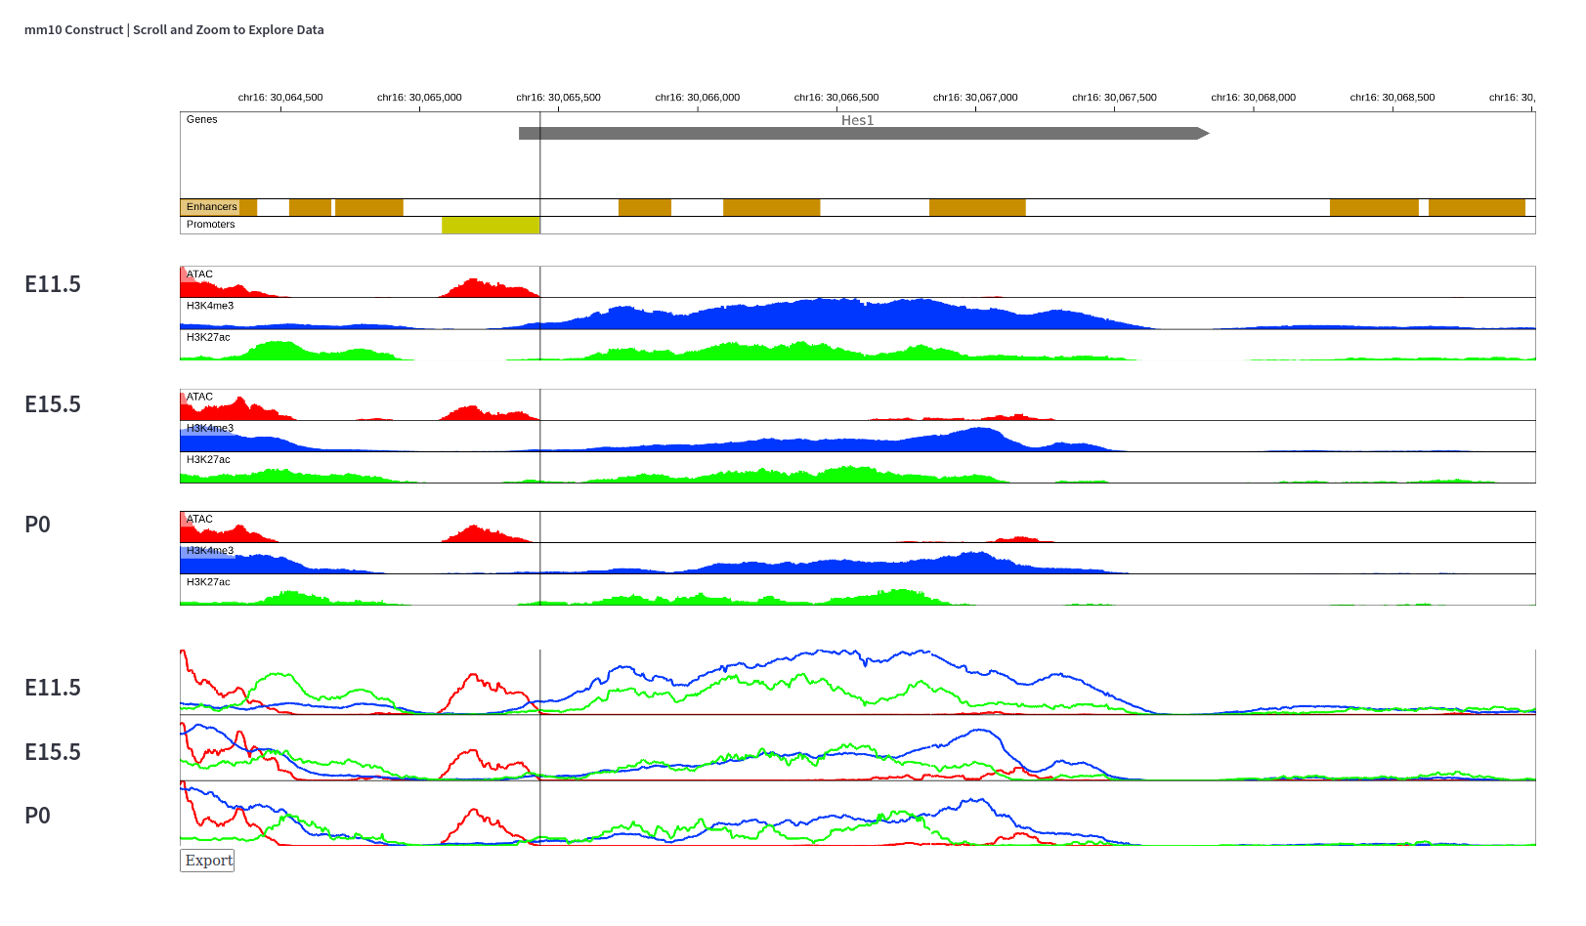
MultiChIPViewer: Overview
Hard Coded
  Genes
  Enhancers
  Promoters
Experimental Conditions
  3 Timepoints
3 ChIP-seq Types
  ATACseq
  H3K4me3
  H3K27ac
ChIP-seq normalized to surrounding area
Notes:
Genomic Coardinates on top. You can see we are at ch.16 around 30 million base pairs from the start
Genes, gene here is Hes1
Enhancers. Implies there is an enhancer in this genomic coordinate range
Promoters
Now you have three experimental conditions I’ve loaded in: Embryonic day 11.5-, 15.5, and P0, postnatal day 0. You can see that all 3 are vertically aligned with the genome
But they are separated by some white space
Into each experimental condition, I’ve loaded a three chipseq datasets. For example, in the bright green here I’ve loaded a chipseq dataset that targets H3K27ac.
Remember, for chIPseq we are getting info on what protein is bound to the genome at what region. So you can see that there is lots of H3K27ac protein
Across the Hes1 gene, as well as akong these enhancers.
In total I’ve loaded 9 datasets.
Its also important to note that a given row is normalized to itself. The magntutes between different chipseq types can vary a lot.

Slide 15
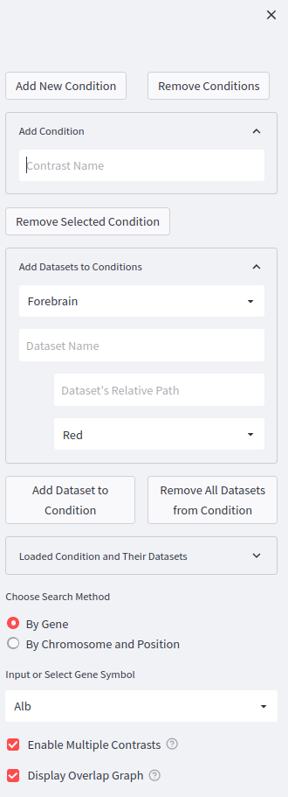
MultiChIPViewer: Overview
Notes:
SO to the left of this display, there is a collapsible data toolbox.

Slide 16
MultiChIPViewer: Overview
Goal : Low Barrier to Entry
Notes:
This toolbox contributes a lot to our goal of having a really low barrier to entry for this.

Slide 17
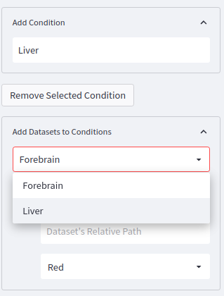
Data Loader: Add Contrasts and Datasets
Users add experimental conditions of interest
Users add and remove ChIP-seq datasets to experimental conditions
  Name
  Path
  Color
Goal: Ability to load own data

Slide 18
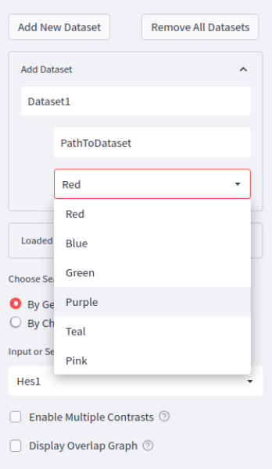
Data Loader: Select Color
Users select 1 of 6 colors
Max 6 ChIP-seq types can be compared

Slide 19
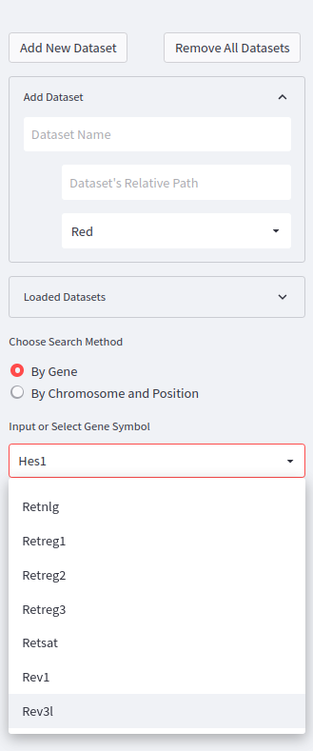
Data Loader: Jump To Gene
Selecting a gene jumps the display to the gene

Slide 20
MultiChIPViewer: Merged View Enabled
Goal: See vertical alignment and overlapping of peaks
  Vertical line tracks mouse
  Merged View
Notes:
So another one of our main goals is to be able to easily see the vertical alignment of where a peak is to the genome. And as well as if a peak overlaps
With another peak within an experimental condition. So here we are not as intereacted as seeing if this peak overlaps with that peak. But we are more interested in if the peaks in E11.5 overlap with eachother.
One way we’ve helped do this is by having a vertical line that moves along the display with your mouse
Another way we’ve tried to help this is by allowing users to create this Merged View at the bottom. This is not a canonical representation of ChIPseq.
But essentially, a given experimental condition is overlayed onto one track. In these merged tracks you can see if peaks within an experimental condition overlap with echother.

Slide 21
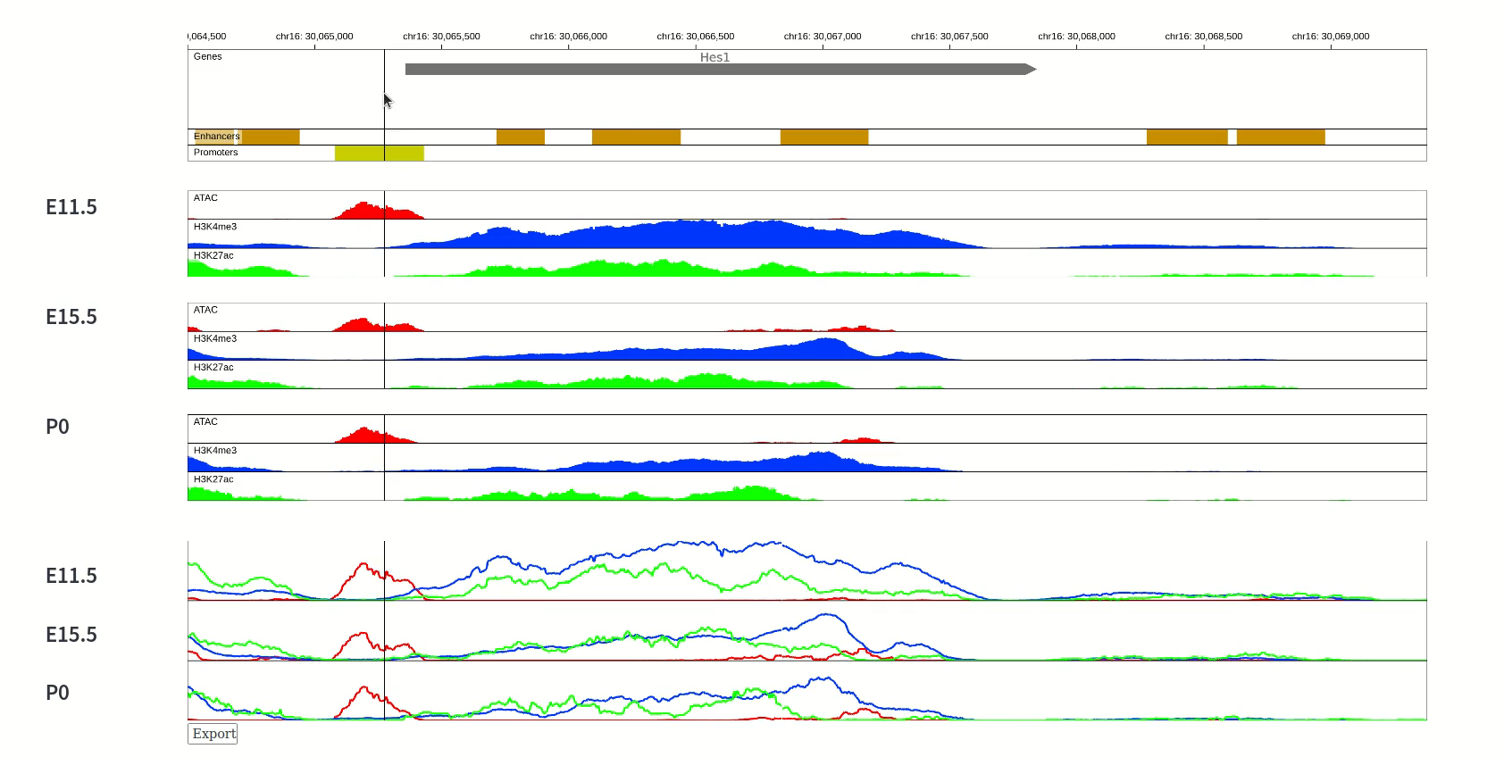
MultiChIPViewer: Interaction
Goal: Implement panning and zooming to enable searching around a gene of interest
Notes:
So we also implemented a panning and zooming interaction element to enable exploration surrounding agene of interest.

Slide 22
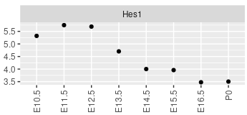
MultiChIPViewer: Comparing Multiple Conditions
Goal: Compare multiple experimental conditions
Expect to see drop in all 3 signals
Notes:
Perhaps our main goal was this idea of allowing the user to compare multiple experimental conditions at once. The primary thing
We are interested in here is a change in peak intensity as a biological condition changes. SO to exemplify how we’ve done we are going to collectively analyze
This data we’ve been looking at the whole time.
So this is the expression pattern of this Hes1 gene that we are expecting to see. You can see that the expression goes down over time.
I can tell you, that based on this I’m expecgint to see all 3 ChipSeq signals drop as we progress from E11.5 to P0.
This is maybe somewhat apparent lookinga t the Merged view here. Tak for example the red peak at the promoter. You can see a slight drop, and then perhaps a resurgence. If you look at the blue peak I think that becomes quite more apparent. Same with the grean I think there’s quite a drop there. So did we achieve our goal of being able to compare multiple experimental conditions. Kindof. I think there’s future work to be done here.

Slide 23
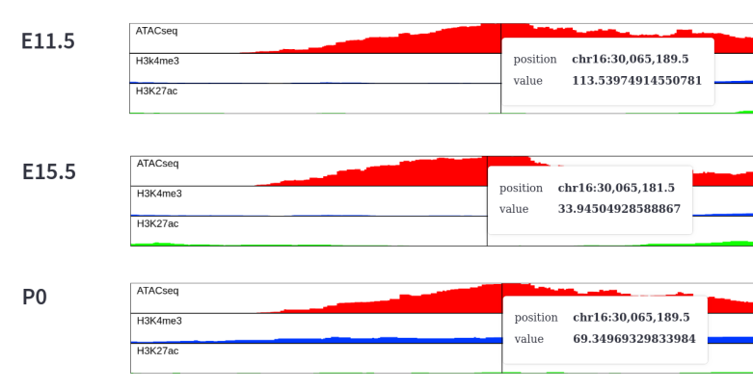
Future Work: Normalization Problems
Labels show decrease in ATACseq signal
Indicative of decrease in Hes1 expression over time
ChIPseq data from all conditions needs to be normalized identically
Notes:
Specifically, the future work we need to do is change how we are normalizing our data. I mentioned before that each row is individually normalized. But what I realized recently is that we should be normalizing all ChipSeq signals of the same type identically across all experimental conditions. SO here you can see that when you zoom into the previous picture and you can see the value of the signal. There is a 4x change between E11.5 and E15.5. that’s not super apparent because the data is normalized differently. When we look a this photo, we can see that Hes1 expression is probably going to decrease over time, like we expect. But I think we need to normalize properly to truly see this change.

Slide 24
Thank You!

