Slide 1
CPSC 314
21 – Global illumination ugrad.cs.ubc.ca/~cs314
Textbook: 20
Mikhail Bessmeltsev

Slide 2
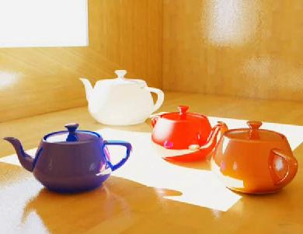
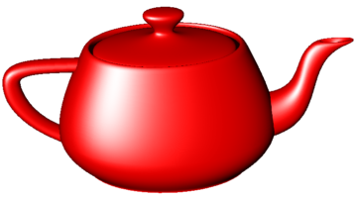
Illumination Models/Algorithms
Local illumination - Fast
  Ignore real physics, approximate the look
  Interaction of each object with light
    Compute on surface (light to viewer)
Global illumination – Slow
  Physically based
  Interactions between objects

Slide 3
Illumination Models/Algorithms
Local illumination - Fast
  Ignore real physics, approximate the look
  Interaction of each object with light
    Compute on surface (light to viewer)
Global illumination – Slow
  Physically based
  Interactions between objects

Slide 4
Illumination Models/Algorithms
Local illumination - Fast
  Ignore real physics, approximate the look
  Interaction of each object with light
    Compute on surface (light to viewer)
Global illumination – Slow
  Physically based
  Interactions between objects
How?

Slide 5
What was non-physical in Local Illumination?

Slide 6
HOW should global illumination work?

Slide 7
HOW should global illumination work?
Simulate light
As it is emitted from light sources
As it bounces off objects / get absorbed / refracted
As some of the rays hit the camera
Light
Source
Eye
Image Plane
Reflected
Ray
Refracted
Ray

Slide 8
PROBLEM?

Slide 9
RAY TRACING: IDEA
Light
Source
Eye
Image Plane
Reflected
Ray
Refracted
Ray

Slide 10
RAY TRACING: IDEA
Light
Source
Eye
Image Plane
Shadow
Rays
Reflected
Ray
Refracted
Ray

Slide 11
rAY TRACING
Invert the direction of rays!
Shoot rays from CAMERA through each pixel
  “Trace the rays back”
Simulate whatever the light rays do:
  Reflection
  Refraction
  …
Each interaction of the ray with an object adds to the final color
Those rays are never gonna hit the light source, so
  Shoot “shadow rays” to compute direct illumination

Slide 12
Reflection
n
Mirror effects
  Perfect specular reflection
© 2010 Jules Berman , http://julesberman.blogspot.ca/

Slide 13
Refraction
Snell’s Law
n
Interface between transparent object and surrounding medium
  E.g. glass/air boundary
Light ray breaks (changes direction) based on refractive indices c₁, c₂

Slide 14
Basic Ray-Tracing Algorithm
RayTrace(r,scene)
obj = FirstIntersection(r,scene)
if (no obj) return BackgroundColor;
else {
if (Reflect(obj))
reflect_color = RayTrace(ReflectRay(r,obj));
else
reflect_color = Black;
if (Transparent(obj))
refract_color = RayTrace(RefractRay(r,obj));
else
refract_color = Black;
return Shade(reflect_color, refract_color, obj);
}

Slide 15
when to stop?
Algorithm above does not terminate
Termination Criteria
  No intersection
  Contribution of secondary ray attenuated below threshold – each reflection/refraction attenuates ray
  Maximal depth is reached

Slide 16
Sub-Routines
ReflectRay(r,obj) – computes reflected ray (use obj normal at intersection)
RefractRay(r,obj) - computes refracted ray
  Note: ray is inside obj
Shade(reflect_color,refract_color,obj) – compute illumination given three components

Slide 17
Simulating Shadows
Trace ray from each ray-object intersection point to light sources
  If the ray intersects an object in between ⇒ point is shadowed from the light source
shadow = RayTrace(LightRay(obj,r,light));
return Shade(shadow,reflect_color,refract_color,obj);

Slide 18
RAY TRACING: IDEA
Light
Source
Eye
Image Plane
Shadow
Rays
Reflected
Ray
Refracted
Ray

Slide 19
Ray-Tracing: Practicalities
Generation of rays
Intersection of rays with geometric primitives
Geometric transformations
Lighting and shading
Speed: Reducing number of intersection tests
  E.g. use BSP trees or other types of space partitioning

Slide 20
Ray-Tracing: Generation of Rays
Camera Coordinate System
  Origin: C (camera position)
  Viewing direction: w
  Up vector: v
  u direction: u= w×v
Corresponds to viewing
transformation in rendering pipeline!
v
w
C
x

Slide 21


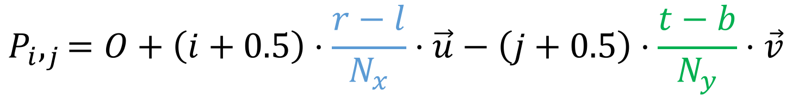

Ray-Tracing: Generation of Rays
Distance to image plane: d
Image resolution (in pixels):
Image plane dimensions: l, r, t, b
Pixel at position i, j $(i=0,…,N_{x}−1;j=0,…,N_{y}−1)$
v
$$N_{x},N_{y}$$
w
C
u
$$O=C+d\vec{w}+l\vec{u}+t\vec{v}$$
$$P_{i},_{j}=O+\left(i+0.5\right)⋅\frac{r−l}{N_{x}}⋅\vec{u}−\left(j+0.5\right)⋅\frac{t−b}{N_{y}}⋅\vec{v}$$
$$=O+\left(i+0.5\right)⋅Δu⋅\vec{u}−\left(j+0.5\right)⋅Δv⋅\vec{v}$$

Slide 22
Ray-Tracing: Generation of Rays
Parametric equation of a ray:
  where t= 0…∞

Slide 23
Ray-Tracing: Practicalities
Generation of rays
Intersection of rays with geometric primitives
Geometric transformations
Lighting and shading
Speed: Reducing number of intersection tests
  E.g. use BSP trees or other types of space partitioning

Slide 24
RAY-Object intersections
In OpenGL pipeline, we were limited to discrete objects:
  Triangle meshes
In ray tracing, we can support analytic surfaces!
  No problem with interpolating z and normals, # of triangles, etc.
    Almost

Slide 25
Ray-Object Intersections
Core of ray-tracing ⇒ must be extremely efficient
Usually involves solving a set of equations
  Using implicit formulas for primitives
Example: Ray-Sphere intersection
ray:
(unit) sphere:
quadratic equation in t :
v
p

Slide 26
Ray Intersections with OTHER PRIMITIVES
Implicit functions:
  Spheres at arbitrary positions
    Same thing
  Conic sections (hyperboloids, ellipsoids, paraboloids, cones, cylinders)
    Same thing (all are quadratic functions!)
  Higher order functions (e.g. tori and other quartic functions)
    In principle the same
    But root-finding difficult
    Numerical methods

Slide 27
Ray Intersections with other primitives
Polygons:
  First intersect ray with plane
    linear implicit function
  Then test whether point is inside or outside of polygon (2D test)
  For convex polygons
    Suffices to test whether point in on the right side of every boundary edge

Slide 28
Ray-Tracing: Practicalities
Generation of rays
Intersection of rays with geometric primitives
Geometric transformations
Lighting and shading
Speed: Reducing number of intersection tests
  E.g. use BSP trees or other types of space partitioning

Slide 29
Ray-Tracing: Transformations
Note: rays replace perspective transformation
Geometric Transformations:
  Similar goal as in rendering pipeline:
    Modeling scenes convenient using different coordinate systems for individual objects
  Problem:
    Not all object representations are easy to transform
      This problem is fixed in rendering pipeline by restriction to polygons (affine invariance!)

Slide 30
Ray-Tracing: Transformations
Ray Transformation:
  For intersection test, it is only important that ray is in same coordinate system as object representation
  Transform all rays into object coordinates
    Transform camera point and ray direction by inverse of model/view matrix
  Shading has to be done in world coordinates (where light sources are given)
    Transform object space intersection point to world coordinates
    Thus have to keep both world and object-space ray

Slide 31
Ray-Tracing: Practicalities
Generation of rays
Intersection of rays with geometric primitives
Geometric transformations
Lighting and shading
Speed: Reducing number of intersection tests
  E.g. use BSP trees or other types of space partitioning

Slide 32
Ray-Tracing: DIRECT ILLUMINATION
Light sources:
  For the moment: point and directional lights
  More complex lights are possible
    Area lights
    Fluorescence

Slide 33
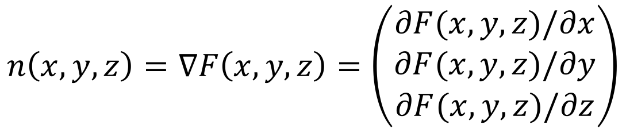
Ray-Tracing: DIRECT ILLUMINATION
Local surface information (normal…)
  For implicit surfaces F(x,y,z)=0:
  normal n(x,y,z) is gradient of F:
  Example:
$$n\left(x,y,z\right)=∇F\left(x,y,z\right)=\left(\begin{aligned}∂F(x,y,z)/∂x \\ ∂F(x,y,z)/∂y \\ ∂F(x,y,z)/∂z\end{aligned}\right)$$
Needs to be normalized!

Slide 34
Ray-Tracing: DIRECT ILLUMINATION
For triangle meshes
  Interpolate per-vertex information as in rendering pipeline
    Phong shading!
    Same as discussed for rendering pipeline
  Difference to rendering pipeline:
    Have to compute Barycentric coordinates for every intersection point (e.g plane equation for triangles)

Slide 35
Ray-Tracing: Practicalities
Generation of rays
Intersection of rays with geometric primitives
Geometric transformations
Lighting and shading
Speed: Reducing number of intersection tests

Slide 36
Optimized Ray-Tracing
Basic algorithm is simple but VERY expensive
Optimize…
  Reduce number of rays traced
  Reduce number of ray-object intersection calculations
Parallelize
  Cluster
  GPU
Methods
  Bounding Boxes
  Spatial Subdivision
    Visibility, Intersection/Collision
  Tree Pruning

Slide 37
Spatial Subdivision DATA STRUCTURES
Goal: reduce number of intersection tests per ray
Lots of different approaches:
  (Hierarchical) bounding volumes
  Hierarchical space subdivision
    Octree, k-D tree, BSP tree

Slide 38
Bounding Volumes: IDEA
Don’t test each ray against complex objects (e.g. triangle mesh)
Do a quick conservative test first which eliminates most rays
  Surround complex object by simple, easy to test geometry (e.g. sphere or axis-aligned box)
    Reduce false positives: make bounding volume as tight as possible!

Slide 39
Hierarchical Bounding Volumes
Extension of previous idea:
  Use bounding volumes for groups of objects

Slide 40
Spatial Subdivision Data Structures
Bounding Volumes:
  Find simple object completely enclosing complicated objects
    Boxes, spheres
  Hierarchically combine into larger bounding volumes
Spatial subdivision data structure:
  Partition the whole space into cells
    Grids, octrees, (BSP trees)
  Simplifies and accelerates traversal
  Performance less dependent on order in which objects are inserted

Slide 41
Regular Grid
Subdivide space into rectangular grid:
  Associate every
  object with the
  cell(s) that it
  overlaps with
  Find intersection:
  traverse grid
In 3D: regular grid of
cubes (voxels):

Slide 42
Creating a Regular Grid
Steps:
  Find bounding box of scene
  Choose grid resolution in x, y, z
  Insert objects
  Objects that overlap multiple cells get referenced by all cells they overlap

Slide 43
Grid Traversal
Start at ray origin
While no intersection found
  Go to next grid cell along ray
  Compute intersection of ray with all objects in the cell
  Determine closest such intersection
  Check if intersection is inside the cell
    If so, terminate search

Slide 44
Traversal
Note:
  This algorithm calls for computing the intersection points multiple times (once per grid cell)
  In practice: store intersections for a (ray, object) pair once computed, reuse for future cells

Slide 45
Regular Grid Discussion
Advantages?
  Easy to construct
  Easy to traverse
Disadvantages?
  May be only sparsely filled
  Geometry may still be clumped

Slide 46
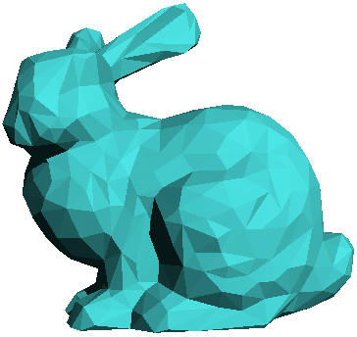
Adaptive Grids
  Subdivide until each cell contains no more than
  n elements, or maximum depth d is reached
  This slide is curtsey of Fredo Durand at MIT
Nested Grids
Octree/(Quadtree)

Slide 47
Soft Shadows: Area Light Sources
So far:
  All lights were either point-shaped or directional
    Both for ray-tracing and the rendering pipeline
  Thus, at every point, we only need to compute lighting formula and shadowing for ONE direction per light
In reality:
  All lights have a finite area
  Instead of just dealing with one direction, we now have to integrate over all directions that go to the light source

Slide 48
Area Light Sources
Area lights produce soft shadows:
  In 2D:
Area light
Occluding surface
Receiving surface
Umbra
(core shadow)
Penumbra
(partial shadow)

Slide 49

Area Light Sources
Point lights:
  Only one light direction:
  V is visibility of light (0 or 1)
  ρ is lighting
  model (e.g.
  diffuse or Phong)
Point light

Slide 50
AreA Light Sources
Area Lights:
  Infinitely many light rays
  Need to integrate
  over all of them:
  Lighting model
  visibility and
  light intensity
  can now be different
  for every ray!
Area light

Slide 51
Integrating over Light Source
Rewrite the integration
  Instead of integrating over directions
  integrate over points on the light source
    q point on reflecting surface
    p= F(s,t) point on the area light
    We are integrating over p

Slide 52
Integration
Problem:
  Except for basic case not solvable analytically!
    Largely due to the visibility term
So:
  Use numerical integration = approximate light with lots of point lights

Slide 53
Numerical Integration
Area light
Regular grid of point lights
  Problem: Too regular
  see 4 hard shadows
  Need LOTS of points
  to avoid this problem
  Solution: Monte-Carlo!

Slide 54
GLOBAL ILLUMINATION ALGORITHMS
Ray Tracing
Path Tracing
Photon Mapping
Radiosity
Metropolis light transport
…

