Slide 1
Final Review I
University of British Columbia
CPSC 314 Computer Graphics
Jan-Apr 2016
Tamara Munzner
http://www.ugrad.cs.ubc.ca/~cs314/Vjan2016

Slide 2
Beyond 314: Other Graphics Courses
426: Computer Animation
will be offered next year (2016/2017)
424: Geometric Modelling
will be offered in two years (2017/2018)
526: Algorithmic Animation - van de Panne
530P: Sensorimotor Computation - Pai
533A: Digital Geometry – Sheffer
547: Information Visualization - Munzner

Slide 3
Final
exam notes: noon Thu Apr 14 SWNG 122
exam will be timed for 2.5 hours, but reserve entire 3-hour block of time just in case
closed book, closed notes
except for 2-sided 8.5”x11” sheet of handwritten notes
ok to staple midterm sheet + new one back to back
calculator: a good idea, but not required
graphical OK, smartphones etc not ok
IDs out and face up

Slide 4
Final Emphasis
covers entire course
includes some material from before midterm
transformations, viewing
H1/H2, P1/P2
but much heavier weighting for material after midterm
H3/H4, P3/P4
post-midterm topics:
shaders
lighting/shading
raytracing
collision
rasterization / clipping
hidden surfaces / blending / picking
textures / procedural
color
light coverage
animation, visualization

Slide 5
Sample Final
final+solutions now posted
Jan 2007
note some material not covered this time
projection types like cavalier/cabinet: Q1b, Q1c,
antialiasing/sampling: Q1d, Q1l, Q12
image-based rendering: Q1g
clipping algorithms: Q8, Q9
scientific visualization: Q14
curves/splines: Q18, Q19
missing some new material
shaders

Slide 6
Studying Advice
do problems!
work through old homeworks, exams
especially from years where I taught

Slide 7
Review – Fast!!

Slide 8
Review: 2D Rotation
x′ = x cos(θ) - y sin(θ)
y′ = x sin(θ) + y cos(θ)
(x′, y′)
(x, y)
θ
counterclockwise, RHS

Slide 9
Review: Shear, Reflection
shear along x axis
push points to right in proportion to height
reflect across x axis
mirror
y
y
x
x
x
x

Slide 10
Review: 2D Transformations
matrix multiplication
matrix multiplication
scaling matrix
rotation matrix
vector addition
(x′,y′)
(x,y)
translation multiplication matrix??

Slide 11
Review: Linear Transformations
linear transformations are combinations of
shear
scale
rotate
reflect
properties of linear transformations
satisifes T(sx+ty) = s T(x) + t T(y)
origin maps to origin
lines map to lines
parallel lines remain parallel
ratios are preserved
closed under composition

Slide 12
Review: Affine Transformations
affine transforms are combinations of
linear transformations
translations
properties of affine transformations
origin does not necessarily map to origin
lines map to lines
parallel lines remain parallel
ratios are preserved
closed under composition

Slide 13
Review: Homogeneous Coordinates
homogeneous
cartesian
/ w
homogenize to convert homog. 3D point to cartesian 2D point:
divide by w to get (x/w, y/w, 1)
projects line to point onto w=1 plane
like normalizing, one dimension up
when w=0, consider it as direction
points at infinity
these points cannot be homogenized
lies on x-y plane
(0,0,0) is undefined
w
w=1
y
x

Slide 14
Review: 3D Homog Transformations
use 4x4 matrices for 3D transformations
translate(a,b,c)
scale(a,b,c)

Slide 15
Review: 3D Shear
general shear
"x-shear" usually means shear along x in direction of some other axis
correction: not shear along some axis in direction of x
to avoid ambiguity, always say "shear along <axis> in direction of <axis>"

Slide 16
Review: Composing Transformations
Ta Tb = Tb Ta, but Ra Rb != Rb Ra and Ta Rb != Rb Ta
translations commute
rotations around same axis commute
rotations around different axes do not commute
rotations and translations do not commute

Slide 17
Review: Composing Transformations
which direction to read?
right to left
interpret operations wrt fixed coordinates
moving object
left to right
interpret operations wrt local coordinates
changing coordinate system
OpenGL updates current matrix with postmultiply
glTranslatef(2,3,0);
glRotatef(-90,0,0,1);
glVertexf(1,1,1);
specify vector last, in final coordinate system
first matrix to affect it is specified second-to-last
OpenGL pipeline ordering!

Slide 18
Review: Interpreting Transformations
right to left: moving object
(1,1)
intuitive?
translate by (-1,0)
(2,1)
left to right: changing coordinate system
(1,1)
GL
same relative position between object and basis vectors

Slide 19
Review: General Transform Composition
transformation of geometry into coordinate system where operation becomes simpler
typically translate to origin
perform operation
transform geometry back to original coordinate system

Slide 20
Review: Arbitrary Rotation
(b_{x}, b_{y}, b_{z}, 1)
B
Y
(a_{x}, a_{y}, a_{z}, 1)
Y
B
A
A
X
X
C
C
Z
Z
(c_{x}, c_{y}, c_{z}, 1)
arbitrary rotation: change of basis
given two orthonormal coordinate systems XYZ and ABC
A’s location in the XYZ coordinate system is (a_{x}, a_{y}, a_{z}, 1), ...
transformation from one to the other is matrix R whose columns are A,B,C:

Slide 21
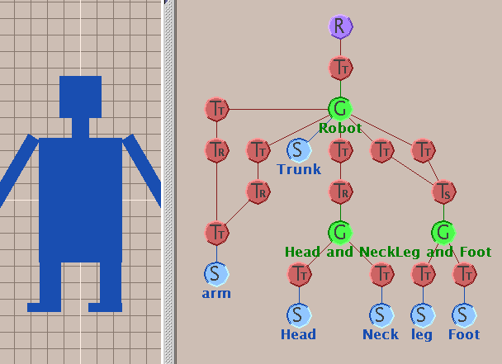
Review: Transformation Hierarchies
transforms apply to graph nodes beneath them

Slide 22
Review: Normals
polygon:
assume vertices ordered CCW when viewed from visible side of polygon
normal for a vertex
specify polygon orientation
used for lighting
supplied by model (i.e., sphere), or computed from neighboring polygons

Slide 23
Review: Transforming Normals
cannot transform normals using same matrix as points
nonuniform scaling would cause to be not perpendicular to desired plane!
given M,
what should Q be?
inverse transpose of the modelling transformation

Slide 24
Review: Camera Motion
rotate/translate/scale difficult to control
arbitrary viewing position
eye point, gaze/lookat direction, up vector
y
lookat
x
Pref
WCS
view
z
up
eye
Peye

Slide 25
Review: Constructing Lookat
translate from origin to eye
rotate view vector (lookat – eye) to w axis
rotate around w to bring up into vw-plane
y
lookat
x
Pref
WCS
v
view
VCS
up
z
eye
Peye
u
w

Slide 26
Review: V2W vs. W2V
M_{V2W}=TR
we derived position of camera as object in world
invert for gluLookAt: go from world to camera!
M_{W2V}=(M_{V2W})⁻¹₌R⁻¹T⁻¹

Slide 27
Review: Graphics Cameras
real pinhole camera: image inverted
eye
point
image
plane
computer graphics camera: convenient equivalent
eye
point
center of
projection
image
plane
Notes:
stand at p and look through hole. anything in cone visible
shrink hole to a point, cone collapses to line (ray)

Slide 28
Review: Basic Perspective Projection
similar triangles
y
P(x,y,z)
P(x’,y’,z’)
z
z’=d
homogeneous
coords

Slide 29
Review: Asymmetric Frusta
our formulation allows asymmetry
why bother? binocular stereo
view vector not perpendicular to view plane
Left Eye
Right Eye
Notes:
Q: why would we want to do this?
A: stereo viewing.
can’t just rotate because axes of projection differ
then z-order could differ, orientation of shapes differ.
so use skewed frustum.

Slide 30
Review: Field-of-View Formulation
FOV in one direction + aspect ratio (w/h)
determines FOV in other direction
also set near, far (reasonably intuitive)
x
w
Frustum
fovx/2
h
α
-z
fovy/2
z=-n
z=-f

