Slide 1
minimesh
Mesh editing codebase for CPSC 524
Shayan Hoshyari

Slide 2
Code Structure
minimesh/core: Mesh Data Structure + I/O
minimesh/cli: empty executable for testing and playing around
minmiesh/gui: a very basic viewer

Slide 3
Code Structure
minimesh/core: Mesh Data Structure + I/O + Mesh Editting Algs
minimesh/cli: empty executable for testing and playing around
minmiesh/gui: a very basic viewer
-- Your code mainly goes into ``core’’. Feel free to add your own files

Slide 4
Code Structure
minimesh/core: Mesh Data Structure + I/O + Mesh Editting Algs
minimesh/cli: empty executable for testing and playing around
minmiesh/gui: a very basic viewer
-- Your code mainly goes into ``core’’. Feel free to add your own files.
-- Your tests go into ``cli’’. Strongly recommended.
-- Add functionality to ``gui’’ to Demo your code.

Slide 5
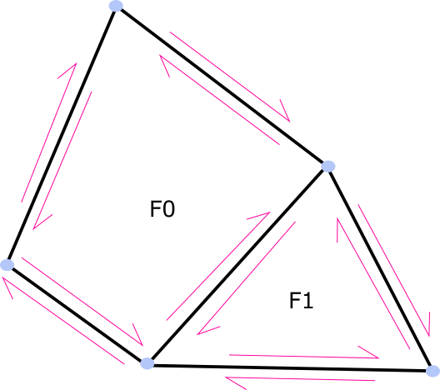
Half-Edge Methodology
Data structure
Mesh traversal mechanism
We use it for both

Slide 6
Storage
struct Vertex_data
{
int half_edge;
Eigen::Vector3d xyz;
bool is_active;
}

Slide 7
Storage
struct Face_data
{
int half_edge;
bool is_active;
}

Slide 8
Storage
struct Half_Edge_data
{
int next;
int prev;
int twin;
int face;
int origin;
bool is_active;
}

Slide 9
Storage
Struct Mesh_connectivity
{
std::vector<Vertex_data> _vertices;
std::stack<int> _inactive_vertices;
std::vector<Half_edge_data> _half_edges;
std::stack<int> _inactive_half_edges;
std::vector<Face_data> _faces;
std::stack<int> _inactive_faces;
}

Slide 10
Traversal
for(int face_id = 0 ; face_id < mesh.n_total_faces() ; ++face_id)
{
Mesh_connectivty::Face_iterator face_handle = mesh.face_at( face_id );
if( face_handle.is_active() )
{
Mesh_connectivty::Half_edge_iterator he_handle = face.half_edge();
}
}

Slide 11
Deleting Entities
Mesh_connectivity::Face_iterator = mesh.face_at( some_id );
face.deactivate();

Slide 12
Adding Entities
// Add a new face
Mesh_connectivity::Face_iterator = mesh.add_face();
Mesh_connectivity::Half_edge_iterator = mesh.add_half_edge();

Slide 13
Connectivity Modification
// Add a new face
Mesh_connectivity::Face_iterator = mesh.add_face();
Mesh_connectivity::Half_edge_iterator = mesh.add_half_edge();
// Modify Connectivity
face.data().half_edge = half_edge.index();

Slide 14
Connectivity Modification
// Add a new face
Mesh_connectivity::Face_iterator = mesh.add_face();
Mesh_connectivity::Half_edge_iterator = mesh.add_half_edge();
// Modify Connectivity
face.data().half_edge = half_edge.index();
face.data().half_edge = half_edge.index();

Slide 15
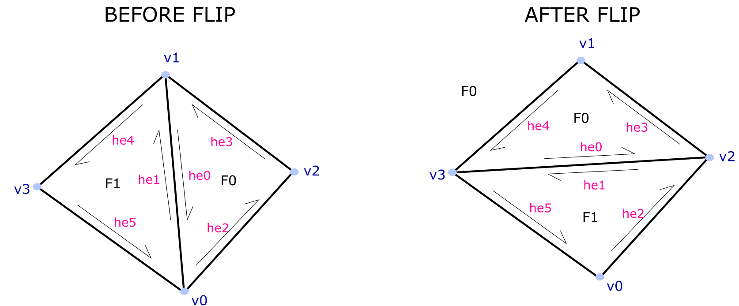
Example – Flipping An Edge
The command line executable contains a simple example that reads a mesh and flips one of its edges. Look into:
  minimesh/cli/main.cpp
  minimesh/cli/edge-flip.svg

Slide 16
Setting up the environment
Read the readme.txt carefully.
cmake-example.txt is your friend.
Ask questions on Piazza.

Slide 17
Setting up the environment
Read the readme.txt carefully.
cmake-example.txt is your friend.
Ask questions on Piazza. Be specific. So I can reproduce.

Slide 18
Setting up the environment
Demo

