Slide 1
Multiple Kernel Learning
November 5, 2013
Hossein Hajimirsadeghi
School of Computing Science
Simon Fraser University

Slide 2
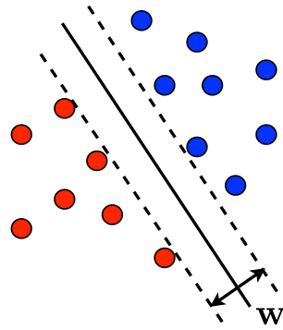
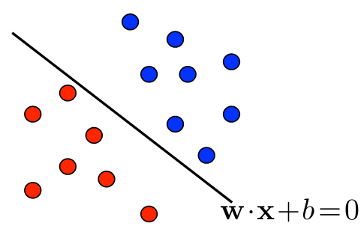
Introduction - SVM
Max . Margin
s.t.

Slide 3
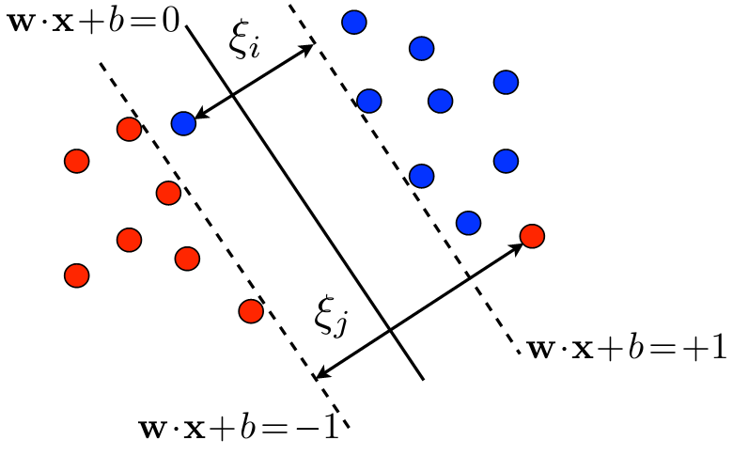
s.t.

Slide 4
Regularizer
Loss Function

Slide 5
SVM: Optimization Problem
s.t.

Slide 6
SVM: Dual
Primal
s.t.
s.t.
Dual

Slide 7
SVM-Dual
s.t.
Resulting Classifier:

Slide 8
Kernel Methods
Ideas:
K often interpreted as a similarity measure
Benefits:
Efficiency
Flexibility

Slide 9
Kernelized SVM
s.t.
Classifier:

Slide 10
Kernelized
s.t.
Classifier:

Slide 11
Kernelized SVM
Subject to

Slide 12
Ideal Kernel Matrix

Slide 13
Motivation for MKL
Success of SVM is dependent on choice of good kernel:
How to choose kernels
Kernel function
Parameters
Practical problems involve multiple heterogeneous data sources
How can kernels help to fuse features
Esp. features from different modalities
Notes:
In standard SVM good kernels are handcrafted and fixed

Slide 14
Multiple Kernel Learning
General MKL:
Linear MKL:

Slide 15
MKL Algorithms
Fixed Rules
Heuristic Approaches
Similarity Optimization
Maximizing the similarity to ideal kernel matrix
Structural Risk Optimization
Minimizing “regularization term” + “error term”

Slide 16
Similarity Optimization
Similarity:
kernel alignment
Euclidean distance
Kullback-Leibler (KL) divergence

Slide 17
Similarity Optimization
Lanckriet et al. (2004)
Can be converted to a Semi-definite programming problem
Better Results: Centered Kernel Alignment
Cortes et al (2010)

Slide 18
Structural Risk Optimization
Subject to
Subject to

Slide 19
Structural Risk Optimization
General MKL (Varma et al. 2009)
Subject to
Coordinate descent algorithm:
1-Fix kernel parameters and find
2-Fix and update by gradient

Slide 20
Structural Risk: Another View

Slide 21
Structural Risk: Another View

Slide 22
Structural Risk: Another View
s.t.
s.t.

Slide 23
Structural Risk Optimization
Rakotomamonjy et al. 2008
Simple MKL
s.t.
Such that

Slide 24
Multi-Class SVM
s.t.

Slide 25
Latent SVM
…
…
…
s.t.

Slide 26
Multi-Class Latent SVM
…
…
…
s.t.

Slide 27
Latent Kernelized Structural SVM
Wu and Jia 2012

Slide 28
Latent Kernelized Structural SVM
Find the dual
The dual Variables:

Slide 29
Latent Kernelized Structural SVM
Inference
NO EFFICIENT EXACT SOLUTION

Slide 30
Latent MKL
Coordinate descent Learning Algorithm:
1-Perform inference for positive samples
2-Solve the dual optimization problem like SimpleMKL
Vahdat et al. 2013
Latent Version of SimpleMKL
s.t.
Find the dual

Slide 31
Some other works
Hierarchical MKL (Bach 2008)
Latent Kernel SVM (Yang et al. 2012)
Deep MKL (Strobl and Visweswaran 2013)

Slide 32
References
Gönen, M., & Alpaydın, E. (2011). Multiple kernel learning algorithms. The Journal of Machine Learning Research, 2211-2268.
Rakotomamonjy, A., Bach, F., Canu, S., and Grandvalet, Y. (2008). SimpleMKL.Journal of Machine Learning Research, 9, 2491-2521.
Varma, M., & Babu, B. R. (2009, June). More generality in efficient multiple kernel learning. In Proceedings of the 26th Annual International Conference on Machine Learning (pp. 1065-1072).
Cortes, C., Mohri, M., & Rostamizadeh, A. (2010). Two-stage learning kernel algorithms. In Proceedings of the 27th International Conference on Machine Learning (ICML-10) (pp. 239-246).
Lanckriet, G. R., Cristianini, N., Bartlett, P., Ghaoui, L. E., & Jordan, M. I. (2004). Learning the kernel matrix with semidefinite programming. The Journal of Machine Learning Research, 5, 27-72.
Wu, X., & Jia, Y. (2012). View-invariant action recognition using latent kernelized structural SVM. In Computer Vision–ECCV 2012 (pp. 411-424). Springer Berlin Heidelberg.
Felzenszwalb, P., McAllester, D., & Ramanan, D. (2008, June). A discriminatively trained, multiscale, deformable part model. In Computer Vision and Pattern Recognition, 2008. CVPR 2008. IEEE Conference on (pp. 1-8). IEEE.
Yang, W., Wang, Y., Vahdat, A., & Mori, G. (2012). Kernel Latent SVM for Visual Recognition. In Advances in Neural Information Processing Systems(pp. 818-826).
Vahdat, A., Cannons, K., Mori, G., Oh, S., & Kim, I. (2013). Compositional Models for Video Event Detection: A Multiple Kernel Learning Latent Variable Approach. IEEE International Conference on Computer Vision (ICCV).
Cortes, C., Mohri, M., Rostamizadeh, A., ICML 2011 Tutorial: Learning Kernels.

