Slide 1
Comparison of Parallel DB and MapReduce
MapReduce: A Flexible Data Processing Tool
Grey Beards:“ MapReduce is a major step backwards”
Young Turks:” No, it’s because you have so many misconceptions about MapReduce.”
Original Slides Author: John Kubiatowicz
Modified by: Yisheng Zhu (Ethan)
Presentor: Yisheng Zhu (Ethan)
Discussion Leader: Jianjun Liu (Winston)

Slide 2
Architectural Difference
 | Parallel | MapReduce
Schema Support | Yes | No
Built-in Index | Yes | No
Programming Model | SQL | C/ C++/ Java
Optimization | Yes | Locality optimization
Flexibility | Not as high | High
Fault Tolerance | Not as good | Good
Node Scalability | < 100 | > 10,000

Slide 3
Schema Support
MapReduce
Flexible, programmers write code to interpret input data
Good for single application scenario
Bad if data are shared by multiple applications. Must address data syntax, consistency, etc.
Parallel DBMS
Relational schema required
Good if data are shared by
multiple applications

Slide 4
Google’s Defense
Protocol Buffer format

Slide 5
Indexing
MapReduce
No native index support
Programmers can implement their own index support in Map/ Reduce code (not easy)
But hard to share the customized indices in multiple applications
Parallel DBMS
Hash/b-tree indexes well supported
Notes:
Lack of standard format of index

Slide 6
MapReduce’s Defence
Take advantage of pre-generated indices
Sub-range instead of full scanning
Read selected columns instead of all
Notes:
Use indices before call MapReduce. If the data is stored in D database partitions, run D database queries using indices.

Slide 7
Programming Model & Flexibility
MapReduce
Simple model: map and reduce
Low level
  “We argue that MR programming is somewhat analogous to Codasyl programming…”
  “Nobody advocates returning to assembly language; similarly nobody should be forced to program in MapReduce”
“Anecdotal evidence from the MR community suggests that there is widespread sharing of MR code fragments to do common tasks, such as joining data sets.”
very flexible
Parallel DBMS
High Level SQL (easier to write, easier to modify, and easier for a new person to understand)
user-defined functions, stored procedures, user-defined aggregates in SQL
Notes:
Criticized
Trade off between high level PL and felexibility

Slide 8
Data Distribution & Execution Strategy & Fault Tolerance
MapReduce
Pull: seek data for computation
Intermediate results are saved to local files
If a node fails, run the node-task again on another node
At a mapper machine, when multiple reducers are reading multiple local files, there could be large numbers of disk seeks, leading to poor performance.
Parallel DBMS
Push: send computation to data
Avoid Intermediate results, push across network
If a node fails, must re-run the entire query
Notes:
Sacrifice fault tolerance for performance

Slide 9
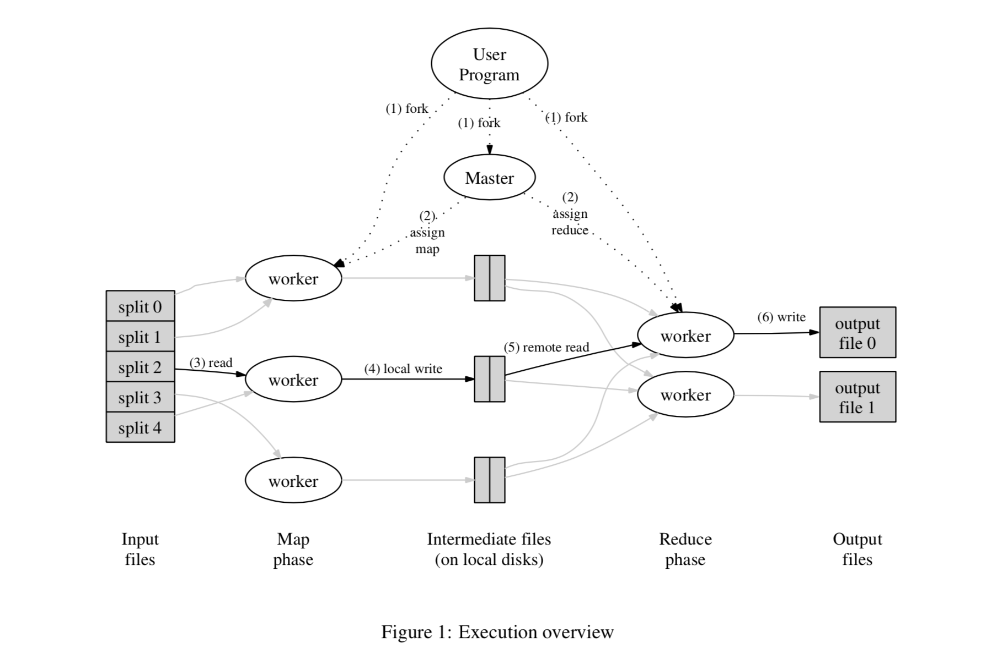

Slide 10
MapReduce’s Defence
Fault-tolerance properties required by Google’s developers
Fault-tolerance being more important in the future

Slide 11
Discussion
Rank the following features in large-scale data analysis from the most important one to the least.
Schema support
Indexing => query optimization paper
Programming model =>
Data distribution
Execution strategy
Flexibility
Fault tolerance

Slide 12
Performance Benchmarks
Benchmark Environment
Original MR task (Grep: globally search a regular expression and print)
Analytical Tasks
Selection
Aggregation
Join
User-defined-function (UDF) aggregation

Slide 13
Grep Task Data Loading
Data Inputs: (2 Data sets)
Fix the size of data per node (535MB/node)
Fix the total data size (1TB)
Hadoop:
Copy text files into HDFS (Hadoop Distributed File System) in parallel
DBMS-X:
Load SQL command executed on each node in parallel: it performs hash partitioning and distributes records to multiple machines
(the data was actually loaded on each node sequentially)
Reorganize data on each node: compress data, build index, perform other housekeeping
(this happened in parallel)
Vertica:
Copy command to load data in parallel
Data is redistributed, then compressed
Notes:
Above 4.21, p170

Slide 14
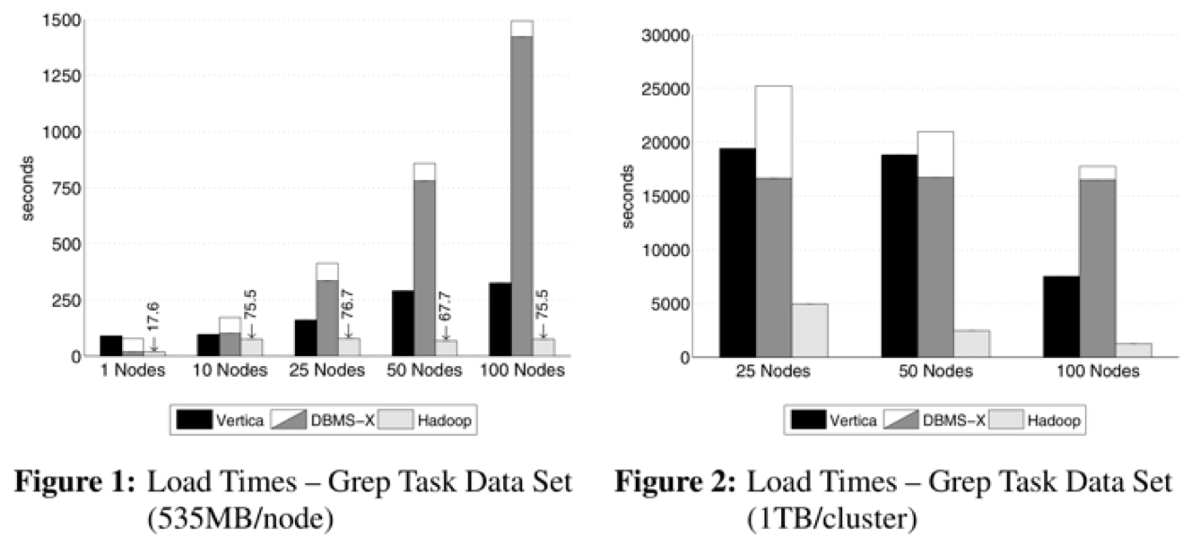
Grep Task Data Loading
Notes:
DBMS-X Sequential loading and parallel housekeeping/ reorganize per node
Why MR importing so fast?

Slide 15
Grep Task
Task Description:
Input data set: 100-byte records
Look for a three-character pattern
One match per 10,000 records
SQL:
SELECT * FROM data WHERE field LIKE “%XYZ%”
Full table scan
MapReduce:
Map: pattern search
No reduce
An additional Reduce job to combine the output into a single file

Slide 16
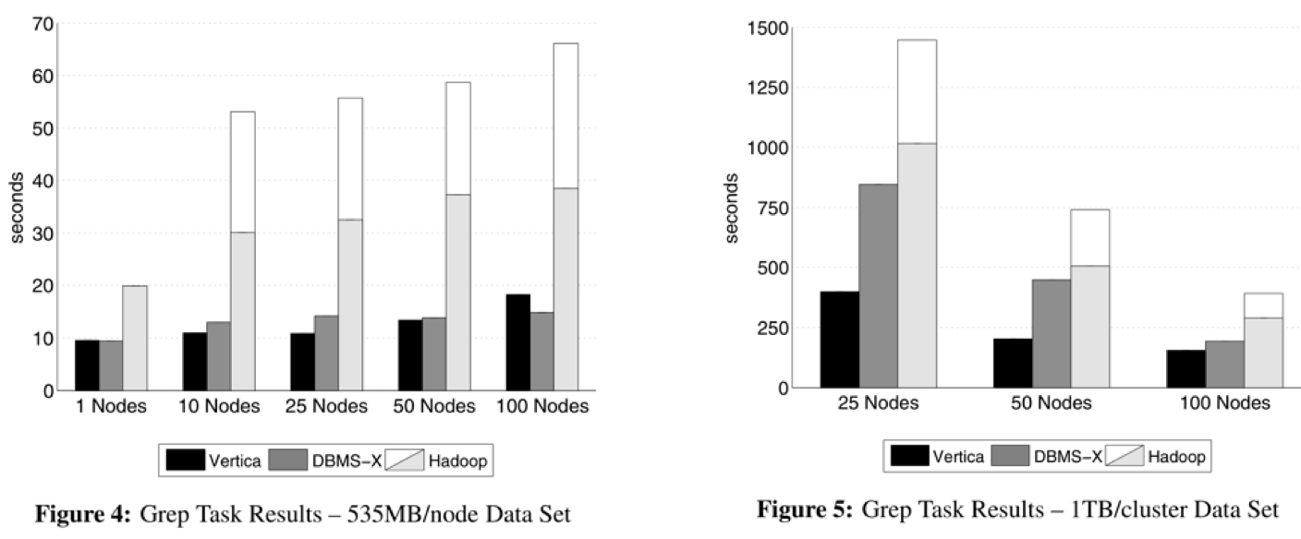
Grep Task Execution Performance
Notes:
High start-up cost for Hadoop: dominant cost for easy query
More data stored per node, the better Vertica is

Slide 17
Analytical Tasks Select, Aggregation, Join, UDF Aggregation
Data Inputs
Input #1: random HTML documents
Inside an html doc, links are generated with Zipfian distribution
600,000 unique html docs with unique urls per node
Input #2: 155 million UserVisits records
20GB/node
Input #3: 18 million Ranking records
1GB/node
documents:-(url, text)
UserVisits:-(sourceIP, destURL, visitDate, adRevenue, userAgent, countryCode, languageCode, searchWord, duration)
Rankings:-(pageURL, pageRank, avgDuration)
Notes:
Data Import is similar to Figure 1

Slide 18
Analytical Tasks Select, Aggregation, Join, UDF Aggregation
Task Description:
Find the pageURLs in the rankings table (1GB/node) with a pageRank > threshold
36,000 records per data file (very selective)
SQL:
SELECT pageURL, pageRank
FROM Rankings WHERE pageRank> X;
MR:
single Map, no Reduce

Slide 19
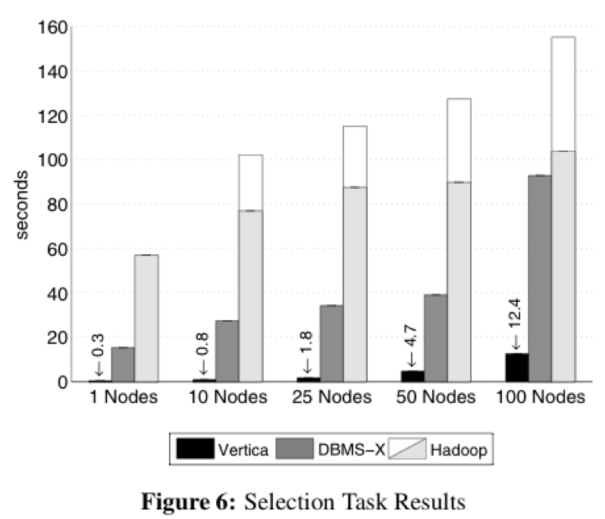
Select Task Performances
Notes:
Hadoop: High start-up cost for short query
(Vertica time increases relatively high because of bottleneck: control messages)

Slide 20
Analytical Tasks Select, Aggregation, Join, UDF Aggregation
Task Description:
Calculate the total adRevenue generated for each sourceIP in the UserVisitstable (20GB/node), grouped by the sourceIP column.
Nodes must exchange info for computing groupby
Generate 53 MB data regardless of number of nodes
SQL:
SELECT sourceIP, SUM(adRevenue)
FROM UserVisits GROUP BY sourceIP;
MR:
Map: outputs (sourceIP, adRevenue)
Reduce: compute sum per sourceIP
“Combine” was used
Notes:
Column values

Slide 21
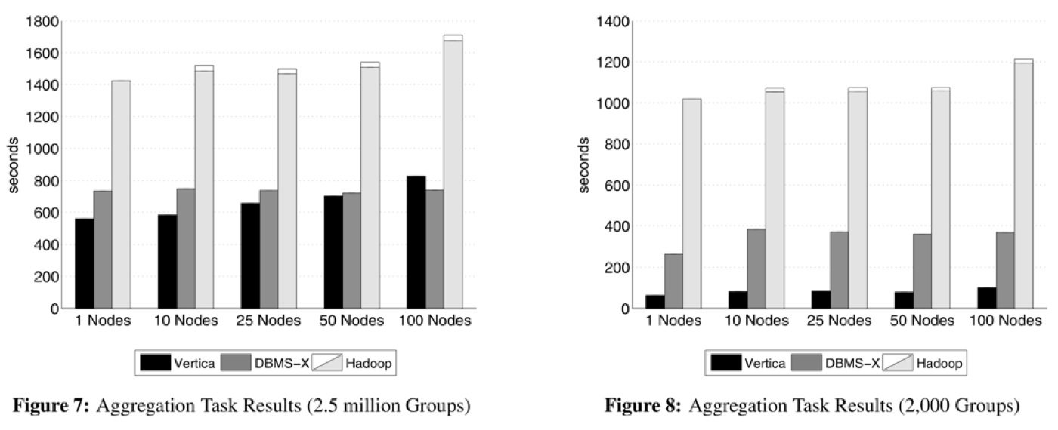
Aggregation Performances
Notes:
A column-store system has advantage because it has accesses to columns, less merging needed, lower communication cost

Slide 22
Analytical Task Select, Aggregation, Join, UDF Aggregation
Task Description:
Find the sourceIP that generated the most revenue within Jan 15-22, 2000, then calculate the average pageRank of all the pages visited by the sourceIP during this interval.
SQL:
SELECT INTO Temp sourceIP,
AVG(pageRank) as avgPageRank,
SUM(adRevenue) as totalRevenue
FROM Rankings AS R, UserVisitsAS UV
WHERER.pageURL= UV.destURL
AND UV.visitDateBETWEEN Date(‘2000-01-15’)
AND Date(‘2000-01-22’)
GROUP BY UV.sourceIP;
SELECTsourceIP,totalRevenue,avgPageRank
FROM Temp
ORDER BY totalRevenueDESC LIMIT 1;

Slide 23
Analytical Task Select, Aggregation, Join, UDF Aggregation
MapReduce:
Phase 1: filter UserVisits that are outside the desired date range, joins the qualifying records with records from the Ranking file
Map: filter (selection)
Reduce: Join
Phase 2: compute total adRevenue and average pageRank per sourceIP
Reduce: GroupBy (average and sum)
Phase 3: produce the largest record
Reduce: OrderBy LIMIT 1 ???

Slide 24
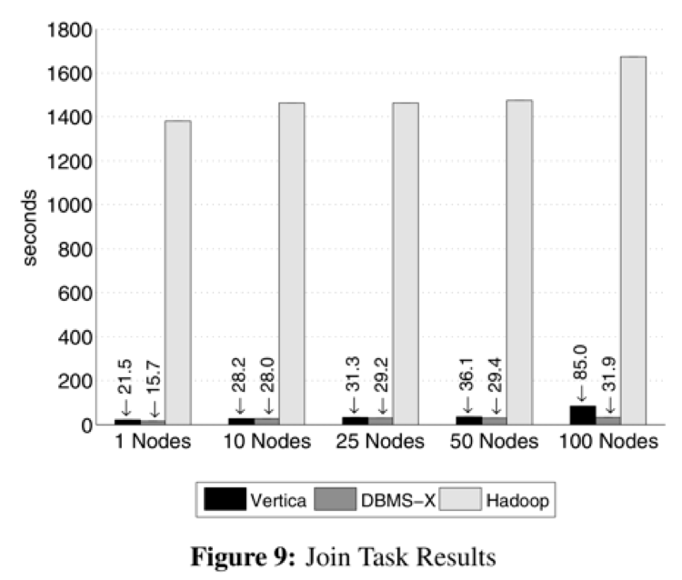
Join Performances

Slide 25
Analytical Tasks Select, Aggregation, Join, UDF Aggregation
Task Description:
Count the number of inlinks for each document
SQL:
SELECT INTO Temp F(contents) FROM Documents;
SELECT url, SUM(value) FROM Temp GROUP BY url;
Need a user-defined-function to parse HTML docs (C program using POSIX regex lib)
Both DBMS’s do not support UDF very well, requiring separate program using local disk and bulk loading of the DBMS – why was MR always forced to use Reduce to combine results?
MR:
A standard MR program

Slide 26
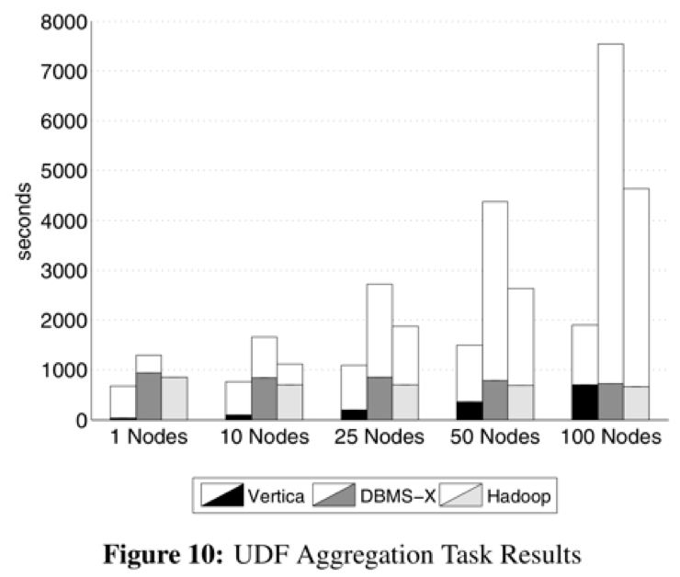
UDF Aggregation Performances

Slide 27
Why Hadoop performs so bad in comparison paper?
Reading unnecessary data (select, aggregation, join)
No need for merging results
Tons of loading time wasted in parallel DBMSs

Slide 28
Why is MapReduce better?
Heterogeneous system
  Definition: A production environment contains a mix of storage systems.
  Example: customer data stored in a relational database, user requests logged to a file system
  Data migration
Storage-system independent
  Tons of loading time wasted in parallel DBMSs (5 to 50 times)
Data analyzed only once or twice (eg. Web-search index-building system)
Notes:
Human’s demand of query type is changing in web 2.0

Slide 29
Discussion Question
The authors in this paper argued fiercely on the misconceptions on MapReduce from previous comparison paper. According to your opinion, why there are many “incorrect understandings” on MapReduce (MapReduce cannot use indices and implies a full scan of all input data; MapReduce input and outputs are always simple files in a file system; MapReduce requires the use of inefficient textual data formats)?

Slide 30
History Repeats Itself: Sensible and NonsenSQL Aspects of the NoSQL Hoopla
“Not everything needs to be done differently just because it is supposedly a very different world now!”
--- C.Mohan
Slides Made By: Yisheng Zhu (Ethan)
Presentation Leader: Yisheng Zhu (Ethan)
Discussion Leader: Jianjun Liu (Winston)

Slide 31
Why RDBMSs are inadequate nowaday?
Data structures change a lot.
To Become a master of RDBMS, you need learn SQL
Flexibility
Types of query has changed: simple data accesses but large volumes of data
Commodity servers
Fault tolerance
Lower consistency requirements
Notes:
Data managed by social media applications changes a lot. RDBS are bad in support for schema evolution
To improve programmer productivity, we need a single language for both imperative programming and persistent data manipulation

Slide 32
Observed Problems of NoSQL
ARIES is worth being paid attention to.
Goodness of standards are forgotten in the context of NoSQL systems.
No built-in query optimization exists.
Indexing should not be lost.
Data model of NoSQL is not necessarily simpler.
Varying data modeling constructs can be crazy.
Not supporting transaction is oversimplification.
Notes:
Approaches to locking and recovery
Lack of standards will cause nightmare when we port applications from one NoSQL system to another
Application writers need to master all the decades of sophisticated optimization technologies that have gone into query optimizers and then choose to implement a subset of them outside of the DBMS with all the restrictions that it entails
Indexing is still important even though most key-value stores relying on hashing. Index locking and recovery makes high concurrency easier.
Some NoSQL data models are more complicated than SQL’s and there are many database design tools for SQL but none for NoSQL so far
Concurrency support is important even if at the individual object level

Slide 33
Discussion Problem
This paper compared similarity and new requirements of NoSQL over RDBMS in indexing, data models, document stores and transactions. Think of other features that NoSQL might distinct from RDBMS.

