Slide 1
Data Cube: A Relational Aggregation Operator Generalizing Group-By, Cross-Tab, and Sub-Totals
Paper II
Slides based on those originally by : Parminder Jeet Kaur

Slide 2
1
Introduction Data Analysis: What? Why is it useful? How this is done?
2
Standard SQL features & GROUP-BY Operator Relevant features of SQL Problems with Group-By operator
3
CUBE and ROLL-UP Operators General idea of Cube operator Why are they different?

Slide 3
Data Analysis
Applications look for unusual patterns in data
Four steps:
Formulating a complex query
Extracting the aggregated data from DB into a relation
Visualizing results in N-dimensional space
Analyzing the results to find unusual or interesting patterns by roll-up and drill-down on data
Facilitate decision making

Slide 4
1
Introduction Data Analysis: What? Why is it useful? How this is done?
2
Standard SQL features & GROUP-BY Operator Relevant features of SQL Problems with Group-By operator
3
CUBE and ROLL-UP Operators General idea of Cube operator Why are they different?

Slide 5
Relevant features of SQL
Relational system models N-dimensional data as a relation with N-attribute domains
Example: 4D Earth temperature data
Notes:
First four columns represents 4 dimensions: time, latitude, longitude, altitude
Weather measurement is recorded as new row

Slide 6
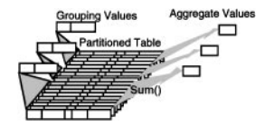
continued… Relevant features of SQL
For summarization, standard SQL supports group-by op
GROUP-BY operator
Partitions the relation into disjoint tuple set
Then, aggregates over each sets
Notes:
Group-by returns single tuple correspond to each tuple set

Slide 7
Problems with GROUP-BY operator
Histograms (i.e., creating buckets)
-Weather table, group time into days, weeks or months and group locations into areas (US, Canada) by mapping longitude and latitude to country’s name
Standard SQL requires computing of histograms indirectly from a table expression. Much more complicated:
Not allowed!
Notes:
Certain common forms of data analysis are difficult with SQL constructs
Group by operator doesn’t allow direct construction of histograms

Slide 8
Problems with GROUP-BY operator
2. Roll-up Totals and Sub-Totals for drill-downs. Let’s start by looking a bit more at aggregation
One dimensional Aggregation
SELECT Models, SUM(Sales)
FROM Sales
GROUP BY Models
Two dimensional Aggregation
SELECT Years, Color, SUM(Sales)
FROM Sales
GROUP BY Year, Color
Models | Sales
Chevy | 290
Ford | 220
Year | Color | Sales
1994 | Black | 50
1995 | Black | 85
1994 | White | 40
1995 | White | 115

Slide 9
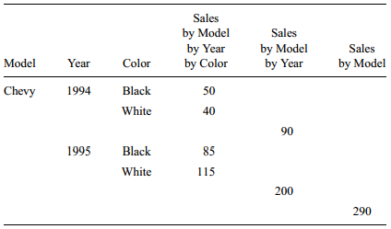
Problems with GROUP-BY operator
2. Roll-up Totals and Sub-Totals for drill-downs
Three dimensional aggregation (by Model by Year by Color)
Not relational (can’t form a key)

Slide 10
Problems with GROUP-BY operator
2. Roll-up Totals and Sub-Totals for drill-downs
Alternate representation 3D aggregation (Pivot table)
Creates columns based on subsets of column values rather than subsets of column name (as recommended by Chris Date approach)
Results in larger set
If one pivots on two columns containing N and M values, the resulting pivot table has N x M values, that’s, so many columns and such obtuse column names!

Slide 11
ALL value approach
Rather than extending result table by adding new cols
Prevents the exponential growth of columns
“ALL” added to fill in the super-aggregation items

Slide 12
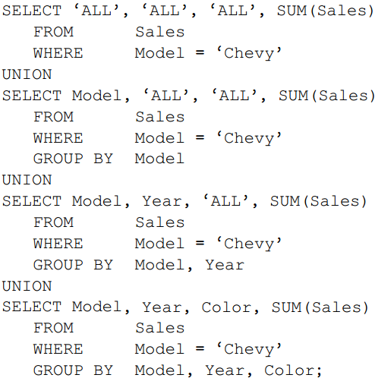
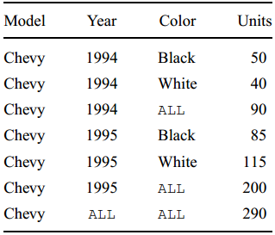
ALL value approach
- SQL statement to build 3D roll- up
- Aggregating over N dimensions requires N unions

Slide 13
Discussion
The authors state "Veteran SQL implementers will be terrified of the ALL value --- like NULL, it will create many special cases."
What are some of the special cases that you can imagine are created by NULL? What cases can you imagine being created by ALL?
Do think ALL is a bigger or a lesser concern than NULL?

Slide 14
Problems with GROUP-BY operator
3. Cross Tabulations
Expressing cross-tab queries with conventional SQL is daunting
6D cross-tab requires 64-way union of 64 different GROUP BY operators!
Resulting representation is too complex for optimization

Slide 15
Data Cube
A data cube is a k-dimensional object containing both fact data and dimensions.
A cube contains pre-calculated, aggregated, summary information to yield fast queries.
…
Cust3
Customers
Cust2
…
Store5
Cust1
Store4
Store3
Stores
Store2
Store1
…
Item4
Item3
Item2
Item1
Items
Notes:
The difference from before is the aggregated summary information

Slide 16
Let’s look a bit at why there are this many group by expressions
{S, T, C}
{S, T}
{S, C}
{T, C}
C
{S}
{T}
{C}
T
{}
S

Slide 17
Discussion
How many applications can you imagine using Data Cubes? What kinds of applications can you think of?

Slide 18
1
Introduction Data Analysis: What? Why is it useful? How this is done?
2
Standard SQL features & GROUP-BY Operator Relevant features of SQL Problems with Group-By operator
3
CUBE and ROLL-UP Operators General idea of Cube operator Why are they different?

Slide 19
CUBE operator
N dimensional generalization of simple aggregate function
N-1 lower-dimensional aggregates points, lines, planes, cubes
Data cube operator builds a table containing all these aggregated values
Unifies several common and popular concepts: such as aggregates, group by, histograms, roll-ups and drill-downs and, cross tabs
Notes:
0D data cube is a point
1D data cube is a line with a point
2D data cube is a cross tab, a plane, two lines and a point
3D data cube is a cube with three intersecting 2D cross tabs

Slide 20
CUBE operator
SELECT Model, Year, Color, SUM (Sales) AS sales
FROM Sales
WHERE Model in ['Ford', 'Chevy'] AND year BETWEEN 1994 AND 1995
GROUP BY CUBE Model, Year, Color
A relational operator
GROUP BY and ROLL UP are degenerate forms of the operator.
Aggregates over all <select list> attributes in GROUP BY clause as in standard GROUP BY
It UNIONs in each super-aggregate of global cube—substituting ALL for the aggregation columns
If there are N attributes in the <select list>, there will be 2^{N} -1 super-aggregate value
Notes:
0D data cube is a point
1D data cube is a line with a point
2D data cube is a cross tab, a plane, two lines and a point
3D data cube is a cube with three intersecting 2D cross tabs

Slide 21
Discussion
Does the cube operator strike you as a big or a small change to SQL? What about to the mentality of relational databases?

