Slide 1
An Overview of Data Warehousing and OLTP Technology
Slides based on those originally by: Parminder Jeet Kaur

Slide 2

Data Warehouse Motivation
Businesses have a lot of data, operational data and facts.
Data is usually in different databases and in different physical places.
Decision makers need to access information (data that has been summarized) virtually on the single site.
Access needs to be fast regardless of the size of data, and how data’s age.

Slide 3

What is Decision Support
Information system that supports business/organization decision making activities.
Decision support systems usually require consolidating data form many heterogeneous sources: these might include external sources.
Decision support’s data is maintained separately from organization’s operational database
Ex. stock market feeds

Slide 4
What is a Data Warehouse
“A data warehouse is a subject-oriented, integrated, time-variant, and nonvolatile collection of data in support of management’s decision-making process.”
Subject-oriented: organized around major subjects
Integrated: multiple heterogeneous data sources
Time-variant: contains element of time implicitly or explicitly
Non-volatile: stored separately for long time
Data warehousing: Process of constructing and using data warehouse
Notes:
Major subjects like product, sales, customer etc.

Slide 5
Discussion
How does the heterogeneity in data warehouses differ from the topics that we've discussed in data integration?
What are some applications that you would use data integration for? A data warehouse?
Can you think of any applications for which both would be a good solution?

Slide 6
OLAP vs OLTP
 | OLTP | OLAP
Users | IT Professional | Data Analyst
Purpose | Daily transaction | Decision Support
DB Design | Application oriented (ER Diagram) | Subject-oriented (Star Schema)
Velocity | High | Low
Access | Read/Write | Scan
# of record access per unit of time | Tens | Millions
DB Size | 100 MB-GB | 100GB-TB
Metric | Transaction throughput | Query throughput

Slide 7
Why do we separate Data Warehouses from Databases?
Performance
    OLAP requires special data organization that supports multidimensional views
    OLAP queries would degrade operational DB
    OLAP is read only
    No concurrency control and recovery

Slide 8
Data Warehousing
Architechure
EXTERNAL DATA SOURCES
EXTRACT
TRANSFORM
LOAD
REFRESH
Metadata
Repository
DATA
WAREHOUSE
SUPPORTS
DATA
MINING
OLAP

Slide 9
Multidimensional Data Model
The main relation, which relates dimensions to a measure via references called foreign keys, is called the fact table.
Each dimension can have additional attributes and an associated dimension table.
  Attributes can be numeric, categorical, temporal, counts, sums
Fact tables are much larger than dimensional tables.
There can be multiple fact tables.
  You may wish to have many measures in the same fact table.

Slide 10
Dimension hierarchies
For each dimension, the set of values can be organized in a hierarchy:
State
County
Gender
Age
City
Category
Color
Customer
Store
Item

Slide 11
DW Design Methodology: Star Schema
Most DWs use a star schema to represent the multi-dimensional data model
Data warehouses consist of a small number of fact tables and a separate table for each dimension
Each tuple in fact-table consists of a pointer to each of the dimension-tables
Each dimension table consists of columns that correspond to attributes of the dimension
Notes:
ER diagrams are inappropriate for DSS where speed of data retrieval is more important than the efficiency of data manipulations

Slide 12
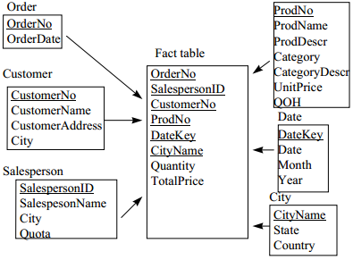
Star Schema Example
  Links between the fact-table in the center and the dimension-tables form a shape like a STAR

Slide 13
Discussion
Do you think that star schemas are more useful in data warehouses than in RDBMSs? Why or why not?

Slide 14
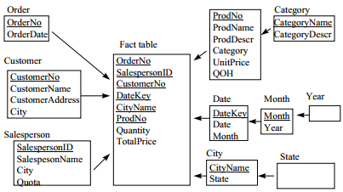
DW Design Methodology: Snowflake Schema
Centralized fact table connected to multiple dimensions
Dimension table are normalized into multiple related table
Adds complexity to source query joins
Notes:
In the snowflake schema, dimensions are normalized into multiple related tables, whereas the star schema's dimensions are denormalized with each dimension represented by a single table (Wikipedia)

Slide 15
Materialized Views
DW queries require summary data
In addition to indices, materializing summary data can accelerate common queries
Challenges in exploiting materialized views:
  Identify the views to materialize
  Exploit materialized views to answer queries
  Efficiently update the materialized views during load and refresh
Notes:
Physical database tuning
DW requires highly efficient access method and query processing techniques
Physical design problem:
Choosing which indices to build, Choosing which view to materialized

Slide 16
Discussion
The warehousing systems are tuned in many different ways (query operators, storage schemas, etc.). Which tuning do you expect to be most critical to the performance/maintainability of these systems? Why?

