Slide 1
MapReduce: Simplified Data Processing on Large Clusters
Jeff Dean, Sanjay Ghemawat, Google, OSDI 2004
Slides based on those by authors and other online sources
Presenter: Jixing (Leo) Li
Discussion Lead: Zhe (Jimmy) Jiang

Slide 2
Motivation
Inspired by similar primitives in LISP and other functional languages
Large scale data processing
Using hundreds or thousands of machines but without the hassle of management
MapReduce benefits
Automatic parallelization & distribution
Fault tolerance
I/O scheduling
Monitoring & status updates

Slide 3
Programming model
Input & Output: each a set of key/value pairs
Programmer specifies two functions:
map(in_key, in_value) -> list(out_key, intermediate_value)
Processes each input key/value pair
Produces set of intermediate pairs
reduce(out_key, list(intermediate_value)) -> list(out_value)
Combines all intermediate values for a particular key
Produces a set of merged output values (usually just one)

Slide 4
Example: Count word occurrences
Input: (URL, content) pairs
map(key=URL, value=content):
for each word w in content, output (w, 1)
reduce(key=word, values=uniq_counts_list)
sum all 1’s in uniq_counts_list
output(word, sum)

Slide 5
Word count example illustrated
map(key=url, val=content):
For each word w in contents, emit (w, “1”)
reduce(key=word, values=uniq_counts_list):
Sum all “1”s in values list
Emit result “(word, sum)”
see 1
bob 1
run 1
see 1
spot 1
throw 1
bob 1
run 1
see 2
spot 1
throw 1
see bob throw
see spot run

Slide 6
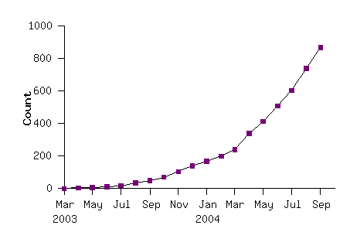
MapReduce model widely applicable
MapReduce programs in Google source tree (2003-04)
Examples
distributed grep |  | distributed sort |  | web link-graph reversal
term-vector / host |  | web access log stats |  | inverted index construction
document clustering |  | machine learning |  | statistical machine translation
... |  | ... |  | ...

Slide 7
Implementation overview
Typical cluster:
100s/1000s of dual-CPU x86 machines, 2-4 GB of memory
Limited bisection bandwidth, typically 100 – 1000MB/s
Storage is on local IDE disks
GFS: distributed file system manages data (SOSP'03)
Job scheduling system: jobs made up of tasks, scheduler assigns tasks to machines
Implementation as C++ library linked into user programs

Slide 8
Overall execution workflow

Slide 9
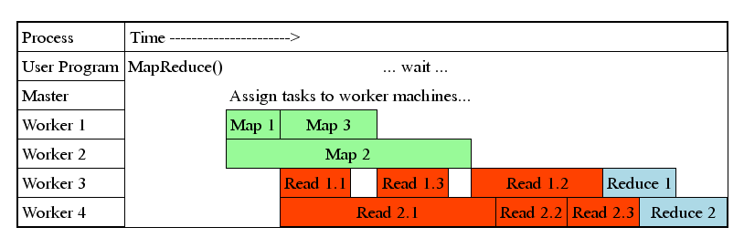
Task Granularity & Pipelining
Fine granularity tasks: map tasks >> machines
Minimizes time for fault recovery
Can pipeline shuffling with map execution
Better dynamic load balancing
Often use 200K map and 5000 reduce tasks running on 2000 machines

Slide 10
Fault-tolerance via re-execution
On worker failure:
Detect failure via periodic heartbeats
Re-execute completed and in-progress map tasks (why?)
Re-execute in progress reduce tasks
Task completion committed through master
Master failure:
Left unhandled as considered unlikely
Onus on users to restart computation
Robust: lost 1600 of 1800 machines, but finished fine

Slide 11
Discussion Question
In what scenarios would the parallel style execution that MapReduce uses be inefficient? Also, what other disadvantages of its execution design can you think of?
Hint: data types, algorithm complexity, I/O cost during execution, iterations, etc

Slide 12
Refinement: Redundant Execution
Slow workers significantly lengthen completion time
Other jobs consuming resources on machine
Bad disks with soft errors transfer data very slowly
Weird things: processor caches disabled (!!)
Solution: Near end of phase, spawn backup task copies
Whichever one finishes first "wins"
Benefit: Dramatically shortens job completion time

Slide 13
Refinement: Locality Optimization
Master scheduling policy:
Asks GFS for locations of replicas of input file blocks
Map tasks typically split into 64MB (== GFS block size)
Map tasks scheduled so GFS input block replica are on same machine or same rack
Effect: Thousands of machines read input at local disk speed
Without this, rack switches limit read rate

Slide 14
Refinement: Skipping Bad Records
Map/Reduce functions sometimes fail for particular inputs
Best solution is to debug & fix, but not always possible
Sometimes, it is acceptable to skip the bad record
On segmentation fault:
Send UDP packet to master from signal handler
Include sequence number of record being processed
If master sees two failures for same record:
Next worker is told to skip the record
Effect: Can work around bugs in third-party libraries

Slide 15
Other Refinements
Sorting guarantees within each reduce partition
Compression of intermediate data
Combiner: useful for saving network bandwidth
Local execution for debugging/testing
User-defined counters

Slide 16
Conclusions
MapReduce has proven to be a useful abstraction
Greatly simplifies large-scale computations at Google
Fun to use: focus on problem, let library deal w/ messy details

Slide 17
Discussion Question
In your opinion, why do you think that makes MapReduce a huge success? How would you relate this to the cause(s) of Gamma's "failure"?

Slide 18
Thank You!

