Slide 1
The Gamma Database Machine Project
Author: David DeWitt, Shahram Ghandeharizadeh, Donovan Schcheider, Allan Bricker, Hui-i Hsiao, and Rick Rasmussen
Presenter: Jixing (Leo) Li
Discussion Leader: Zhe (Jimmy) Jiang

Slide 2
Table of content
Introduction
Key ideas
Hardware Architecture
Software Architecture
Query Processing Algorithms
Transaction and Failure Management
Conclusion

Slide 3
Introduction
DIRECT
early database machine project
Flaws curtailed scalability
shared memory
central control of execution

Slide 4
Key ideas
Shared-nothing
Hash-based parallel
Horizontal partition (declustering)

Slide 5
Table of content
Introduction
Key ideas
Hardware Architecture
Software Architecture
Query Processing Algorithms
Transaction and Failure Management
Conclusion

Slide 6
Gamma version 1.0
Hardware:
17 VAX 11/750 processors, each with 2 MB memory
An 80 MB/s token ring
8 * 333 MB Fujitsu disk drives
Problems:
The token ring had a maximum network packet size of 2K bytes
The network interface and the Unibus on the 11/750 are bottleneck
Other problems like insufficient memory

Slide 7
Gamma version 2.0
Hardware:
32 process Inter iPSC/2 hypercube
x386 process with 8MB memory
330 MB MAXTOR 4380 disk drive with 45 KB RAM
Custom VLSI routing modules
support 8 full-duplex, serial, reliable
2.8 MB/s

Slide 8
Table of content
Introduction
Key ideas
Hardware Architecture
Software Architecture
Query Processing Algorithms
Transaction and Failure Management
Conclusion

Slide 9
Gamma Storage Organizations
Relations in Gamma are horizontally partitioned
Three alternative declustering strategies
Round-robin
Hashed
Range partitioned
Both clustered and non-clustered indices

Slide 10
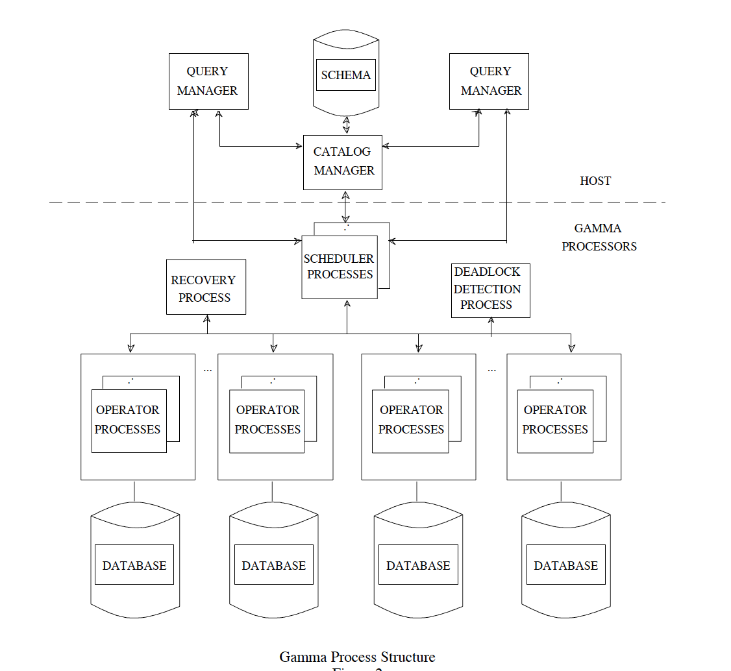
Gamma Process Structure
Catalog Manager
Query Manager
Scheduler Processes
Operator Process

Slide 11
Query execution
Gamma uses traditional relational techniques for query parsing, optimization, and code generation.
Hash-based algorithms for joins
Only left-deep tree due to insufficient memory
No more than two join operations are active simultaneously

Slide 12
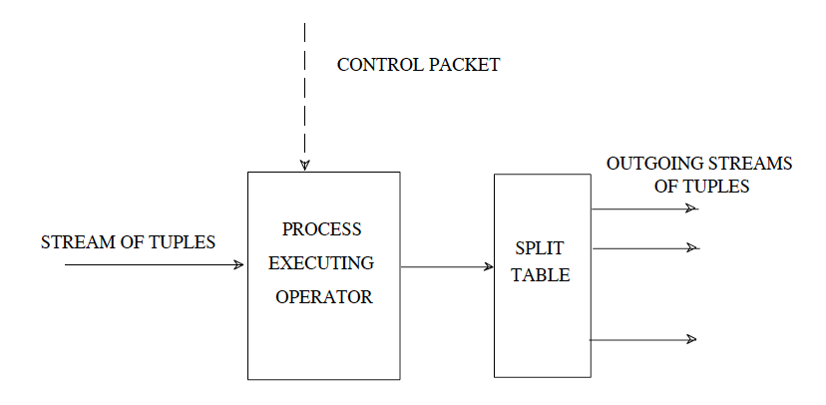
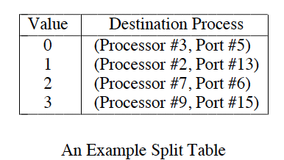
Operator and Process Structure
The relational operators are same as on a single processor
The split table defines a mapping of values to a set of destination processes.

Slide 13
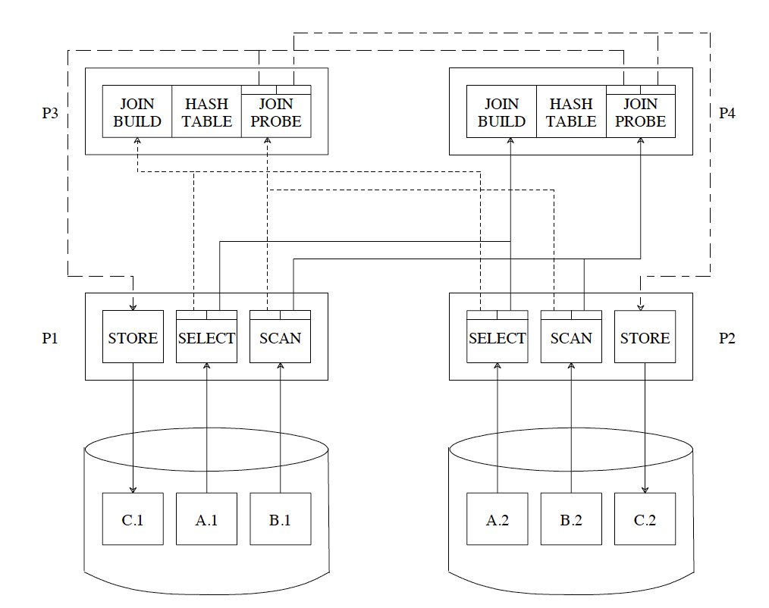
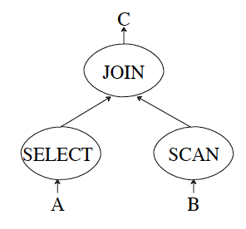
An example: parallel hash join

Slide 14
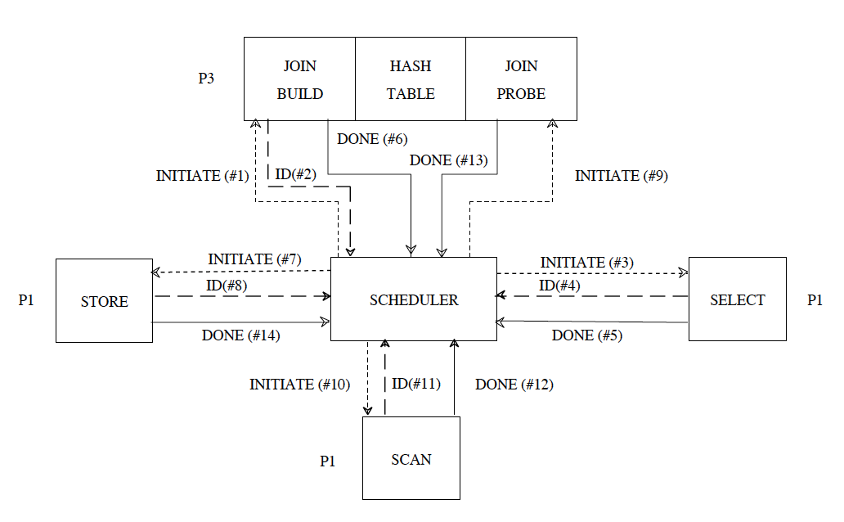
An example: parallel hash join

Slide 15
Table of content
Introduction
Key ideas
Hardware Architecture
Software Architecture
Query Processing Algorithms
Transaction and Failure Management
Conclusion

Slide 16
Selection
If the relation is hash or range partitioned
Direct the selection to a subset of the nodes
If the relation is round-robin partitioned or the predicate is not the partitioning attribute
Scan all nodes
One page read-ahead mechanism when scanning – for performance

Slide 17
Join
Partition the relations into disjoint subsets, called buckets
Four join algorithms on the Gamma: sort-merge, Grace, Simple, and Hybrid
Hybrid hash join provides the best performance on average

Slide 18
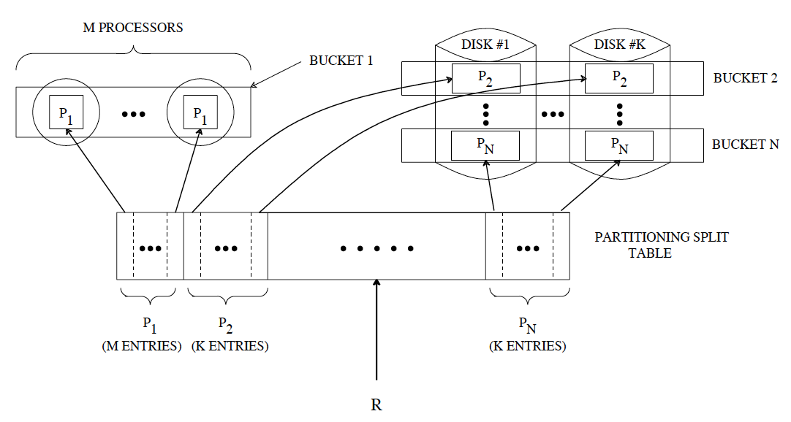
Hybrid hash-Join
A centralized Hybrid hash-join in three phases.
Partition inner R into N buckets using h1
Partition outer S into N buckets using h1
Join the remaining N-1 buckets from R with
the corresponding S buckets using h2.
How about the parallel version?

Slide 19
Discussion question
Consider the parallel hash join in this paper and the hybrid hash join in Volcano. Are they the same, and why? Also, do you think the parallel hash join was a good strategy for Gamma, and why? What disadvantages/challenges does it have?

Slide 20
Table of content
Introduction
Key ideas
Hardware Architecture
Software Architecture
Query Processing Algorithms
Transaction and Failure Management
Conclusion

Slide 21
Concurrency Control
Two-phase locking
Granularities: file and page
5 lock mode: S, X, IS, IX, and SIX
Local lock manager
a lock table
a transaction wait-for-graph.
Deadlock detector.
Periodically sends a message to each node, requesting the local transaction wait-for-graph of that node
Recovery Architecture: Standard WAL protocol

Slide 22
Failure Management
Interleaved declustering
Divide each fragment into units of size N – 1 sub-fragments
Chained declustering
primary copy: i mod M
backup copy: (i + 1) mod M

Slide 23
Failure Management
Chained declustering
primary copy: i mod M
backup copy: (i + 1) mod M

Slide 24
Discussion question
The authors proposed the availability technique Chained declustering for handling disk failures. Do you think it was a better choice and why?
In addition, how do you think of such failure management in Gamma(considering it was especially designed for a parallel database system) also with comparison that in ARIES?
Hint: you may think about different scenarios such as multiple node fails.

Slide 25
Performance overview
100K, 1 M, and 10 M tuple versions of the benchmark relations.
Tables are hash partitioned
Selections: 1% + 10% for both non indexed and clustered index
Join two tables

Slide 26
conclusion
Three key ideas which enable the architecture to be scaled:
Shared-nothing architecture
Horizontal partitioning
Hash-based parallel algorithm

Slide 27
Discussion question
Although the authors proposed some later work in the last section, parallel databases did not get developed well after that. Looking back from today, what factors do you think caused this (think about the technology itself, the market, etc)?
We will continue this thread later.

