Slide 1
Indexing XML Data Stored in a Relational Database
VLDB`2004 Shankar Pal, Istvan Cseri, Gideon Schaller, Oliver Seeliger, Leo Giakoumakis, Vasili Vasili Zolotov
Presenter: Mani
Discussion: Vyas
Ref: Paper, wiki & Older slide

Slide 2
Challenges
Database – supports fast unordered tuple retrieval
XML – supports representing semi/unstructured data but order of elements and hierarchy are important
As seen in last paper, large # of joins is required to query XML
Shredding – decomposes XML based on its schema into Relational tables
Notes:
Shredding is suitable only for well defined XML structure.
Reassembly cost of XML subtree is very expensive
Shredding relies deeply on well defined structure of XML and RDBMS has weak support for hierarchical data

Slide 3
Motivation
XML should be a native data type in RDBMS ! And we should be able to process the XML data types effectively by indexing XML data types !!!
Store XML data as BLOB In XML Column and enforce XML semantics during query processing
Use XQuery expressions within SQL to query XML data
Discusses about ORDPATH, Primary & Secondary indexes
Notes:
Increasing demand to support data & document centric applications – XML data model increases interoperability between relational & XML schema
We create primary index on XML column and then we create secondary indexes over primary XML index for different class to increase performance ! Page 1147 -3rd para
Actually B+ tree indexing is used to index XML blobs

Slide 4
What is XML data type ?
Create table DOCS (ID int primary key, XDOC xml)
Internals
Should conform to XML namespace from Schema collection
XML type information is stored in DB`s meta-data and has mapping b/w primitive XSD and relational type systems
Above enables building domain based value indexes and efficient lookups
Notes:
XDOC is XML data type column which can store either XML document (tree) or XML content (fragments) and
supplied values are checked for structure conformity (validation of start & end tags)
XSD – XML Schema Definition similar to DTD

Slide 5
Indexing XML Blobs
Use B+ tree index on XML blobs
B+ tree can handle recursions
Primary XML index
Query execution should preserve Document order & structure (XML serialization)
Notes:
Primary XML index = shredded representation conforming to infoset items ( from Wiki infoset defines an abstract data model of an XML documents in terms of set of information items)
there are 2 info sets latest 1 adopted after Feb 2004 !
Document structure is preserved by ORDPATH a node labeling scheme

Slide 6
Discussion question Duration : 5 minutes (Discuss as groups with 3 to 4 members per group)
We have seen two approaches of using XML in our traditional database.
a) Decomposing XML into tables with the help of DTD
b) storing XML as blobs.
1. What advantages (especially with implementation and performance) do you think each method has?
2. Which one would you prefer? and Why?
3. Can you think of applications were these can be used?

Slide 7
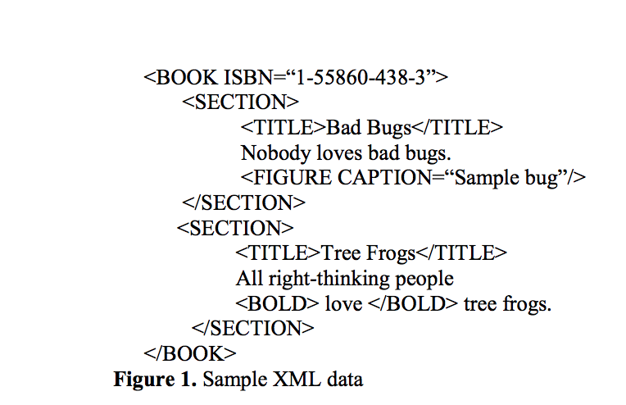
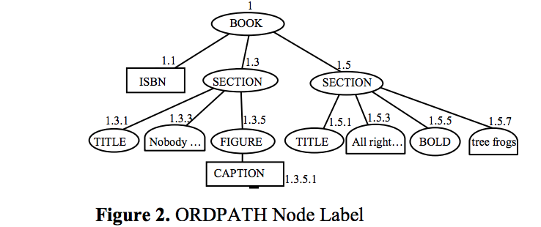
ORDPATH
Preserves XML data structure
Allows insertion of nodes anywhere without need for re-labeling existing nodes
Notes:
Mechanism:
Initial Load:
Odd positive integers are assigned to nodes
Inserting new node (Even integer in between left & right siblings is assigned )
Leftmost insertion : negative integer
Rightmost insertion: Positive integer
Benefits: maintains relative ordering structure of the tree

Slide 8
XQUERY
XQuery to retrieve title for a specific ISBN
The above is very costly
XDOC column value in each row must be shredded at run time to evaluate query
No way to determine which rows satisfies the ISBN condition without processing all XDOC values
SELECT ID, XDOC.query('
for $s in
/BOOK[@ISBN= “1-55860-438-3”]//SECTION
return <topic>{data($s/TITLE)} </topic>')
FROM DOCS
Notes:
Methods such as query(), value() .. Exists for querying XML values
Solution – Index XML data primary & secondary execution
If indexes are available Query processor decides for top-down execution or use bottom-up execution

Slide 9
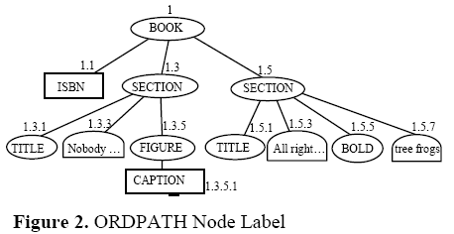
Primary Index
Primary key ID (of base table) + ORDPATH of infoset table
ID
Notes:
Nodes of XML tree are traversed in XML document order & ORDPATH labels are generated during population of primary XML index
ORDPATH : preserves the structure fidelity
TAG : markups found in XML instance, actual implementation : each markup is mapped to integer value and mapped values are used here (technique is called TOKENIZATION and offers
Significant compression) see 10 is used for TEXT , 4 for TITLE , 3 for SECTION
NODE_TYPE : Type of the Node (Infoset content) again tokenized approach is used for TYPED XML
VALUE : store`s node`s value (stored as SQL server`s native type within a generic type)
PATH_ID : tokenized path value from root to node uses tag value to compute path for example for ORDPATH 1.3.1 & 1.5.1 they refer to two different TITLES but are accessed by
/BOOK (#1) / SECTION (3) / TITLE (4)
CONS:
Increased in Size, redundancy (primary key information Is repeated for all rows),
retrieval of whole XML blob is cheaper because increased I/O cost + cost of converting shredded rows in infoset table to XML
Overcoming CONS:
Generate one row instead of two rows for simple valued elements, avoid redundancy by pointing back from VALUE column to XML blob

Slide 10
Query Compilation & Execution
XQuery expression is translated to relational operations on Infoset table which produces set of rows that must be reassembled to XML
Incase of retrieving full XML schema it is cheaper to retrieve XML blob over going through XML primary indexing
Should consider cost of modification of XML elements & Primary index maintenance

Slide 11
Secondary Indexes
Poor performance for large XML values, hence create Indexes (based on classes of queries) over primary index
PATH and PATH_VALUE Indexes
Create a reversed representation of path
Very useful for wildcard
PROPERTY Index
Cluster properties of each object into a property INDEX
Enables retrievals of objects based on known properties
VALUE Index
Index built on value instead of property
Useful for selecting records based on Values
Content Index
Full Text Index - discards XML markups, but creates inverted word index with full support of SQL text (not optimal if we want to combine searching for a certain word within specific context)
Word Break Index – break up text nodes into words according to XML namespace, preserving same structure as Infoset table – very effective for full-text searching – doesn’t support relevance oriented information, ranking etc..

Slide 12
Discussion Question Duration : 3 Minutes (Discuss with the person sitting next to you)
Does the amount of Index used (Primary and Secondary) surprise you? Can you think of any adverse effects of having too many indexes?

Slide 13
Benchmark - XMark
Primary & Property indexes share similar performance
Path_value & Value indexes share similar performance

Slide 14
Conclusion
Primary XML index encodes Infoset items of XML nodes
Secondary XML indexes significantly improves performance based on classes of Queries
Avoided decomposition of XML instances based on their schema
Future works – XML index maintenance, explore BFS for navigational queries so on..

