Slide 1
Relational Databases for Querying XML Documents: Limitations & Opportunities VLDB`99 Shanmugasundaram, J., Tufte, K., He, G., Zhang, C., DeWitt, D., Naughton, J
Presenter: Mani
Discussion: Vyas
Ref: Paper, Wiki & older slides

Slide 2
Motivations:
XML standard for representing Data on Internet
XML DESCRIBES Data where as HTML describes HOW TO DISPLAY data
What is the best way ?
Make use of existing RDBMS techniques for XML processing
Reinvent wheel: seriously ? (throw away 20 years of RDBMS research and develop semi-structured Query Language and Query Evaluation technique)
We are sticking with Plan “A” for now

Slide 3
What`s in the paper ?
What in world is XML, its Schema & ways to query them ?
Algorithms to translate DTD (Document Type Descriptors) into relational format
Translate XML queries into SQL queries and convert the result back to XML duh !
Notes:
But before that .. Let`s look at the approach

Slide 4
Approach
Process DTD to generate relational Schema
Parse XML (conforming to DTD) and load them into tuples of relational tables in a RDBMS
Translate semi-structured Queries over XML into SQL over corresponding data in RDBMS
Convert results back to XML
Notes:
DTD = Document Type Descriptors similar to XML Schema acts as an agreement amongst applications to understand the XML tags
Why this approach : Instead of re-inventing the wheel, by sticking to this approach we can make use of RDBMS concepts to the fullest ! And every thing is done automatically (sounds like a magic !)
But, there are limitations – Relational concepts are quiet inefficient to process COMPLEX XML constructs (handling set valued attributes)

Slide 5
Discussion Question Duration : 5 minutes (Discuss as groups with 3 to 4 members per group)
1. If you were to build a XML database, which approach would you prefer? and Why?
a) Start with a standard relational technology and try to remove these limitations.
(OR)
b) Start with a semi-structured system and try to add the power and sophistication of current relational DB.
2. What do you think are the possible reasons/uses for providing the output as a XML?

Slide 6
XML - Structure
Sub-elements
Attribute for “author” sub element
Root Element
Nested sub elements for Author
Notes:
XML consists of Nested elements starting with ROOT element.
Element data can be sub-elements or set of attributes and sub-elements can have nested sub-elements (since NESTED ATTRIBUTES in XML is not supported)
XML structure should conform DTD standard (something like BNF to describe syntax of languages) more on DTD next slide

Slide 7
DTD
Article should have one Title, one contactauthor one author but with 0 or more sub-elements
Address can have an XML fragment
Notes:
Specifies structure of an XML element by specifying names of its sub-elements and attributes
All values are assumed to be STRING unless type is ANY (in this case value can be an arbitrary XML fragment)
Sub element structure is specified using operators
* -> set with 0 or more elements
+ -> set with 1 or more elements
? -> optional element

Slide 8
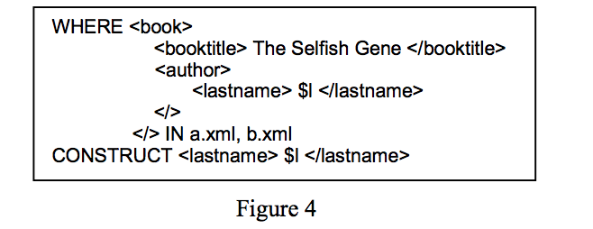
XML - QL
Lorel
XML-QL
Notes:
LOREL SQL Like and is very readable
XML-QL uses nested XML-like structure to specify part of document to be selected and structure of result (XML format)
Selects Last name of Author within <lastname> tag for the book with title “The Selfish Gene”

Slide 9
Inlining Techniques to Store XML documents
Basic
Shared
Hybrid
Notes:
DTDs have to simplified by applying below transformations
Flattening => converts nested definition into flat representation (e1,e2)* -> e1*,e2*
Simplification => reduce many unary operators into single unary operators e1 ** -> e1* ; e1?* -> e1*
Grouping => group sub elements with same name into 1 .., a*,….,a* -> a*
All ? Operators are transformed into *
Remind to reference figure 8 for all Inline Techniques

Slide 10
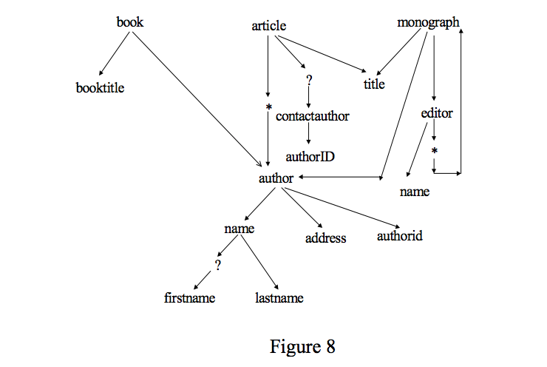
Basic
For every element create a relation
DTD for article (fig.2)
DTD graph
Join between article and author
Notes:
Because XML document can be rooted any element in DTD
Relational model does not support set valued attributes, hence use standard technique for storing sets in RDBMS and create a relation for author and link authors to articles using foreign key

Slide 11
Basic
Pros
Good for queries such as “list all authors of books”
Cons
Not suitable for “list all authors with first name = “xxxx” because filter & join should happen across 5 relations (author, name, firstname, lastname, address) –ref: fig.10 last 5 relation
Large number of relations are created since we create separate relation for every element

Slide 12
Shared
Create relations only when
Nodes have in-degree > 1
Nodes have in-degree = 0
For mutual recursive nodes determine which node has strong connected components
Create inline relations when
Nodes have in-degree = 1
Sample – fig 11
Notes:
In figure 8 nodes (Editor, Monograph) are recursive nodes / elements and Monograph is strongly connected to other elements such as Title, Author and so on.. Hence relation for monograph is created and editor is included as part of that relation

Slide 13
Shared
Pros
Number of relations is reduced Cons
Reduces join by inlined relations
Cons
Decreased performance over Basic
Notes:
Pros
14 vs 5 Basic has 14 relations where as Shared has 5
Only 1 relation Author needs to be queried to display all authors compared to 5 relations
Cons
- Basic reduces number of Joins to query a particular element node, where as for Shared if we need to query just editor name we need to query monograph relation which has Editor relation

Slide 14
Hybrid
Same as shared, but relations are inlined if node`s In-degree is > 1 but the nodes should not be recursive or be reached “*” node
Notes:
Element author has in-degree >1 and can be reached via book, monograph and article (but for article it can be reached using * ) hence inlining with book & monograph element
For Title, we are inlining with article & monograph element
So number of relations is reduced to 4

Slide 15
Evaluation
Efficiency of query processing
Basic ran out of Virtual Memory because of number of relations, hence not considered for comparison
For some DTDs Hybrid eliminates large number of Joins per query (due to recursions might be like author relation)
For some DTDs Shared uses lesser Query than Hybrid (direct querying of relation w/o joins like title relation)
Shared produced same# of joins per SQL as Hybrid for any path expressions (like author relation)
Notes:
Efficiency = average # of SQL joins required to process path expressions of length N
Figure 13 & 14 are more or less similar

Slide 16
Discussion Question Duration : 3 Minutes (Discuss with the person sitting next to you)
The paper uses average number of SQL joins required to process path expressions for a certain path length multiplied by average number of SQL query per XML query as a metric to evaluate the various techniques. Do you think this is a valid metric? Why or why not?
Metric : Total average number of joins = average number of SQL queries * average number of joins in each SQL query

Slide 17
Conclusion
Reuses mature Relational concepts instead of reinventing wheel
Simple XML queries requires too many SQL or requires few SQL with many JOINS
Extensions such as Support for Sets, Information Retrieval Style Indices (helps to index over ANY fields) to relational systems could effectively handle XML query workloads

