Slide 1
An Overview of Data Warehousing and OLTP Technology
Presenter: Parminder Jeet Kaur
Discussion Lead: Kailang

Slide 2
Presentation Outline
Data Warehouse Motivation
What is Decision Support
What is Data Warehouse
OLAP vs OLTP
OLAP Architecture
Database Design Methodology
Materialized Views
Metadata requirements

Slide 3

Data Warehouse Motivation
Businesses have a lot of data, operational data and facts.
Data is usually in different databases and in different physical places.
Decision makers need to access information (data that has been summarized) virtually on the single site.
Access needs to be fast regardless of the size of data, and how data’s age.

Slide 4

What is Decision Support
Information system that supports business/organization decision making activities.
Decision support systems usually require consolidating data form many heterogeneous sources: these might include external sources.
DS DB is maintained separately from organization’s operational database
Ex. stock market feeds

Slide 5
What is Data Warehouse
“A data warehouse is a subject-oriented, integrated, time-variant, and nonvolatile collection of data in support of management’s decision-making process.”
Subject-oriented: organized around major subjects
Integrated: multiple heterogeneous data sources
Time-variant: contains element of time implicitly or explicitly
Non-volatile: stored separately for long time
Data warehousing: Process of constructing and using data warehouse
Notes:
Major subjects like product, sales, customer etc.

Slide 6
OLAP vs OLTP
 | OLTP | OLAP
Users | IT Professional | Data Analyst
Purpose | Daily transaction | Decision Support
DB Design | Application oriented (ER Diagram) | Subject-oriented (Star Schema)
Velocity | High | Low
Access | Read/Write | Scan
# of record access per unit of time | Tens | Millions
DB Size | 100 MB-GB | 100GB-TB
Metric | Transaction throughput | Query throughput

Slide 7
Why do we separate DW from DB?
Performance reasons:
    OLAP requires special data organization that supports multidimensional views
    OLAP queries would degrade operational DB
    OLAP is read only
    No concurrency control and recovery

Slide 8
OLAP Architecture
ETL tools for extracting data from DBs; for cleaning and transforming this data; and loading data into DW
Data marts stored and managed by warehouse servers
Front end tools for multi-d views
Repository for storing and managing metadata
Back end tools for monitoring and administering the warehousing system

Slide 9
DB Design Methodology: Star Schema
Most DWs use a star schema to represent the multi-dimensional data model
DB consists of a single fact table and a single table for each dimension
Each tuple in fact-table consists of a pointer to each of the dimension-tables
Each dimension table consists of columns that correspond to attributes of the dimension
Notes:
ER diagrams are inappropriate for DSS where speed of data retrieval is more important than the efficiency of data manipulations

Slide 10
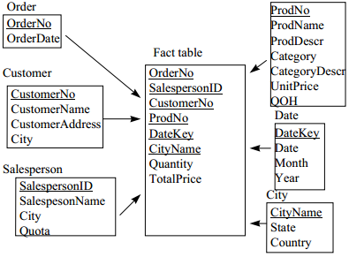
Star Schema Example
  Links between the fact-table in the center and the dimension-tables form a shape like a STAR

Slide 11
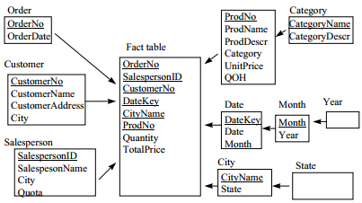
DB Design Methodology: Snowflakes Schema
Centralized fact table connected to multiple dimensions
Dimension table are normalized into multiple related table
Adds complexity to source query joins
Notes:
In the snowflake schema, dimensions are normalized into multiple related tables, whereas the star schema's dimensions are denormalized with each dimension represented by a single table (Wikipedia)

Slide 12
Materialized Views
DW queries require summary data
In addition to indices, materializing summary data can accelerate common queries
Challenges in exploiting materialized views:
  Identify the views to materialize
  Exploit materialized views to answer queries
  Efficiently update the materialized views during load and refresh
Notes:
Physical database tuning
DW requires highly efficient access method and query processing techniques
Physical design problem:
Choosing which indices to build, Choosing which view to materialized

Slide 13
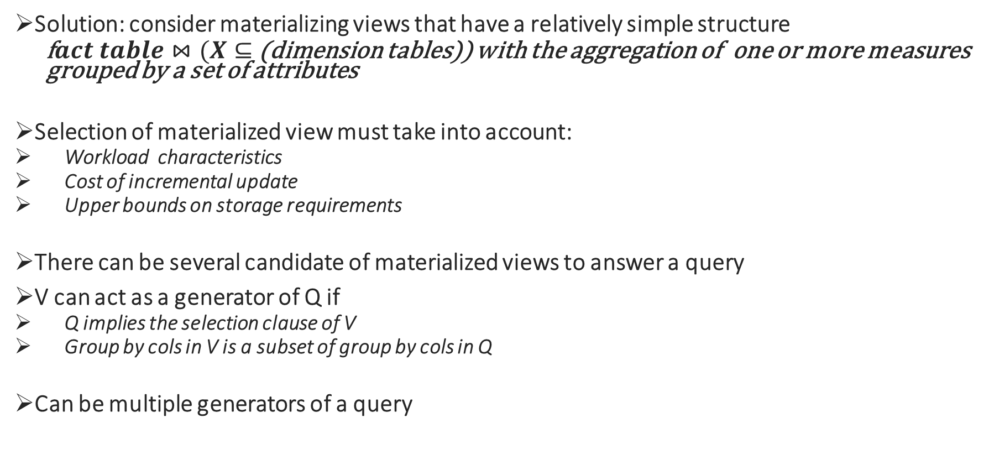
Solution: consider materializing views that have a relatively simple structure
  f$act table⋈(X⊆$ (dimension tables)) with the aggregation of one or more measures grouped by a set of attributes
Selection of materialized view must take into account:
    Workload characteristics
    Cost of incremental update
    Upper bounds on storage requirements
There can be several candidate of materialized views to answer a query
V can act as a generator of Q if
    Q implies the selection clause of V
    Group by cols in V is a subset of group by cols in Q
Can be multiple generators of a query
Notes:
The notion of minimal generator can be used by optimiser to narrow down the search for the appropriate materialized view to use

Slide 14
Metadata Requirements
Administrator metadata:
    Information necessary for setting up and using a warehouse
Business metadata:
    Includes business terms and definitions, ownership and policies
Operational metadata
    Information collected using operation of the warehouse

Slide 15
Discussion Questions
#TODO

