Slide 1
Mathematical Programs
Linear Program (LP)
Integer Program (IP)
Can be efficiently solved e.g., by Ellipsoid Method
Cannot be efficiently solved assuming P ≠ NP

Slide 2
Combinatorial Optimization
Study of optimization problems that have discrete solutions and some combinatorial flavor (e.g., involving graphs)
Why are we interested in this?
Applications: OR (planning, scheduling, supply chain), Computer networks (shortest paths, low-cost trees), Compilers (coloring), Online advertising (matching)...
Rich theory of what can be solved efficiently and what cannot
Underlying math can be very interesting

Slide 3
Combinatorial IPs are often nice
Max-Weight Perfect Matching
Given bipartite graph G=(V, E). Every edge e has a weight w_{e}.
Find a maximum-weight perfect matching
A set M µ E s.t. every vertex has exactly one incident edge in M
3
1
2
4
2
5
2
1

Slide 4
Combinatorial IPs are often nice
Max-Weight Perfect Matching
Given bipartite graph G=(V, E). Every edge e has a weight w_{e}.
Find a maximum-weight perfect matching
A set M µ E s.t. every vertex has exactly one incident edge in M
3
1
2
The blue edges are a max-weight perfect matching M
4
2
5
2
1

Slide 5
Combinatorial IPs are often nice
Max-Weight Perfect Matching
Given bipartite graph G=(V, E). Every edge e has a weight w_{e}.
Find a maximum-weight perfect matching
A set M µ E s.t. every vertex has exactly one incident edge in M
The natural integer program
This IP can be efficiently solved, in many different ways

Slide 6
How to solve combinatorial IPs?
Two common approaches
Design combinatorial algorithm that directly solves IP
Often such algorithms have a nice LP interpretation
Relax IP to an LP; prove that they give same solution; solve LP by the ellipsoid method
Need to show special structure of the LP’s extreme points
Sometimes we can analyze the extreme points combinatorially
Sometimes we can use algebraic structure of the constraints. For example, if constraint matrix is Totally Unimodular then IP and LP are equivalent
We’ll see examples of these approaches

Slide 7
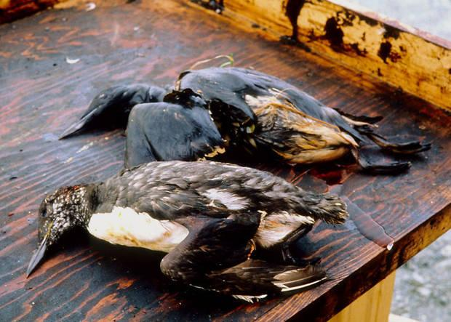
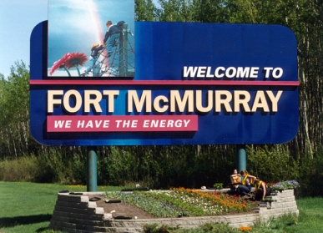
Network Flow
Let D=(N,A) be a directed graph.
Every arc a has a “capacity” c_{a}¸0. (Think of it as an oil pipeline)
Want to send oil from node s to node t through pipelines
Oil must not leak at any node, except s and t: flow in = flow out.
How much oil can we send?
For simplicity, assume no arc enters s and no arc leaves t.
3
7
4
2
5
1
8
1
2
t
s
2
2
2
1
1
3

Slide 8
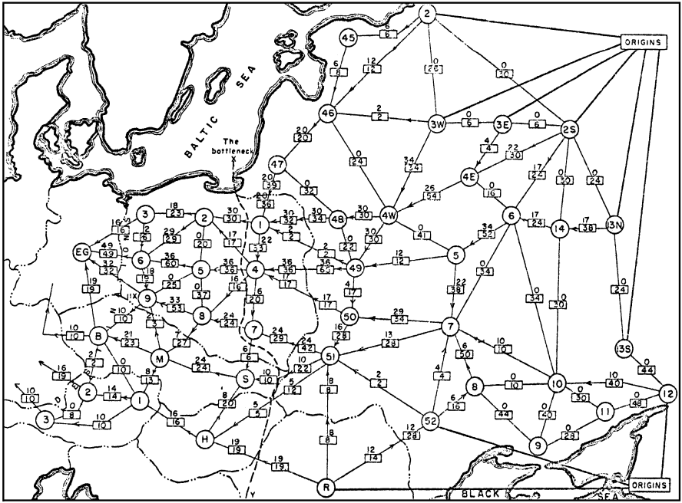
Max Flow & Min Cut
Harris and Ross [1955]
Schematic diagram of the railway network of the Western Soviet Union and Eastern European countries, with a maximum flow of value 163,000 tons from Russia to Eastern Europe, and a cut of capacity 163,000 tons indicated as ‘The bottleneck’. [Schrijver, 2005]

Slide 9
Max Flow & Min Cut
Let D=(N,A) be a digraph, where arc a has capacity c_{a}.
Definition: For any UµN, the cut ±⁺(U) is:
The capacity of the cut is:
Theorem: [Ford & Fulkerson 1956] The maximum amount of flow from s to t equals the minimum capacity of a cut ±⁺(U), where s2U and t2U
Furthermore, if c is integral then there is an integral flow that achieves the maximum flow.
Delbert Ray Fulkerson

Slide 10
LP Formulation of Max Flow
Variables: x_{a} = amount of flow to send on arc a
Constraints: For every node except s & t, flow in = flow out. Flow through each arc can not exceed its capacity.
Objective value: Total amount of flow sent by s.
Notation: ±⁺(v) = arcs with tail at v ±⁻(v) = arcs with head at v
The LP is:

Slide 11
Max Flow & Min Cut
Let D=(N,A) be a digraph, where arc a has capacity c_{a}.
Definition: For any UµN, the cut ±⁺(U) is:
The capacity of the cut is:
“Weak Duality”: For any flow and any U with s2U, t∉U, the amount of flow from s to t is at most c(±⁺(U)).
Proof: The net amount of flow crossing U is
since 0 · x · c.
Notes:
Weak duality:
For any U containing s but not t,
x(delta^+(U)) - x(delta^+(V\U)) = value of the flow x
This is upper bounded by c(delta^+(U)) because 0 <= x <= c.

Slide 12
Incidence Matrix of a Directed Graph
What is the matrix M defining the constraints of this LP?
Row for every node (except s or t)
Column for every arc
Goal: Analyze extreme points of this LP.
+1 if node v is the head of arc a
M_{v,a} =
-1 if node v is the tail of arc a
0 otherwise

Slide 13
Total Unimodularity
Let M be a real mxn matrix
Definition: Suppose that every square submatrix of M has determinant in {0, +1, -1}. Then M is totally unimodular (TUM).
In particular, every entry of M must be in {0, +1, -1}
Key point: Polytopes defined by TUM matrices have integral extreme points.
Lemma: Suppose M is TUM. Let b, c be integer vectors. Then every extreme point of P = { x : Mx·b } is integral. And every extreme point of P = { x : Mx=b, 0·x·c } is integral.

Slide 14
Total Unimodularity
Let A be a real mxn matrix
Definition: Suppose that every square submatrix of A has determinant in {0, +1, -1}. Then A is totally unimodular (TUM).
In particular, every entry of A must be in {0, +1, -1}
Lemma: Suppose A is TUM. Let b be any integer vector. Then every basic feasible solution of P = { x : Ax·b } is integral.
Proof: Let x be a basic feasible solution.
Then the constraints that are tight at x have rank n.
Let A’ be a submatrix of A and b’ a subvector of b corresponding to n linearly independent constraints that are tight at x.
Then x is the unique solution to A’ x = b’, i.e., x = (A’)⁻¹ b’.
Cramer’s Rule: If M is a square, non-singular matrix then (M⁻¹)_{i,j} = (-1)^{i+j} det M_{del(j,i)} / det M.
Submatrix of M obtained by deleting row j and column i

Slide 15
Total Unimodularity
Let A be a real mxn matrix
Definition: Suppose that every square submatrix of A has determinant in {0, +1, -1}. Then A is totally unimodular (TUM).
Lemma: Suppose A is TUM. Let b be any integer vector. Then every basic feasible solution of P = { x : Ax·b } is integral.
Proof: Let x be a basic feasible solution.
Then the constraints that are tight at x have rank n.
Let A’ be the submatrix of A and b’ the subvector of b containing n linearly independent constraints that are tight at x.
Then x is the unique solution to A’ x = b’, i.e., x = (A’)⁻¹ b’.
Cramer’s Rule: If M is a square, non-singular matrix then (M⁻¹)_{i,j} = (-1)^{i+j} det M_{del(j,i)} / det M.
Thus all entries of (A’)⁻¹ are in {0, +1, -1}.
Since b’ is integral, x is also integral. ¥

Slide 16
Incidence Matrices are TUM
Let D=(N, A) be a directed graph. Define M by:
Lemma: M is TUM.
Proof: Let Q be a kxk submatrix of M. Argue by induction on k.
If k=1 then Q is a single entry of M, so det(Q) is either 0 or §1.
So assume k>1.
+1 if node u is the head of arc a
M_{u,a} =
-1 if node u is the tail of arc a
0 otherwise

Slide 17
Lemma: M is TUM.
Proof: Let Q be a kxk submatrix of M. Assume k>1.
Case 1:
If some column of Q has no non-zero entries, then det(Q)=0.
Case 2:
Suppose j^{th} column of Q has exactly one non-zero entry, say Q_{t,j} ≠0
Use “Column Expansion” of determinant:
,
where t is the unique non-zero entry in column j.
By induction, det Q_{del(t,j)} in {0,+1,-1} ) det Q in {0,+1,-1}.
Case 3:
Suppose every column of Q has exactly two non-zero entries.
For each column, one non-zero is a +1 and the other is a -1.
So summing all rows in Q gives the vector [0,0,…,0].
Thus Q is singular, and det Q = 0. ¥

Slide 18
The Max Flow LP
Observations:
The LP is feasible (assume the capacities are all non-negative)
The LP is bounded (because the feasible region is bounded)
It has an optimal solution, i.e., a maximum flow. (by FTLP)
The feasible region is P = { x : Mx=b, 0·x·c } where M is TUM.
Corollary: If c is integral, then every extreme point is integral, and so there is a maximum flow that is integral.
Q: Why does P have any extreme points?
A: It contains no line.

Slide 19
Max Flow LP & Its Dual
Dual variables:
A variable y_{v} for every v 2 N \ {s,t}
A variable z_{uv} for every arc uv
The dual is
Let’s simplify: Set y_{s} = 1 and y_{t} = 0

Slide 20
The Dual
where y_{s} and y_{t} are not variables: y_{s} = 1 and y_{t} = 0
We will show: Given an optimal solution (y,z), we can construct a cut ±⁺(U) such that
In other words, the capacity of the cut ±⁺(U) equals the optimal value of the dual LP.
By strong LP duality, this equals the optimal value of the primal LP, which is the maximum flow value.
Weak duality: Every cut has capacity at least the max flow value, so this must be a minimum cut.

Slide 21
Primal: max { d^{T}x : Mx=0, 0·x·c } Dual: = min { c^{T}z : ¸0, z¸0, y_{s}=1, y_{t}=0 }
=
Claim: [ M^{T} I ] is also TUM
Any extreme point solution of Dual has y and z integral
Since we’re minimizing, can assume z_{uv} = max { y_{u}-y_{v}, 0}
Define U = { v : y_{v}¸1 }. Then s2U, t∉U.
Note z_{uv}¸1 for all uv 2 ±⁺(U).
Max Flow Value = §_{a} z_{a}c_{a} ¸ c(±⁺(U)) ¸ Max Flow Value
±⁺(U) is a cut separating s&t with capacity = max flow
y_{s}=1, y_{t}=0
)
Strong Duality
Weak Duality
Notes:
Weak duality:
For any U containing s but not t,
x(delta^+(U)) - x(delta^+(V\U)) = value of the flow x
This is upper bounded by c(delta^+(U)) because 0 <= x <= c.

Slide 22
Summary
We have proven:
Theorem: [Ford & Fulkerson 1956] The maximum amount of flow from s to t equals the minimum capacity of a cut ±⁺(U), where s2U and t2U Furthermore, if c is integral then there is an integral flow that achieves the maximum flow.
We also get an algorithm for finding max flow & min cut
Solve Max Flow LP by the ellipsoid method.
Get an extreme point solution. It is an integral max flow.
Solve Dual LP by the ellipsoid method.
Get an extreme point solution. U = { v : y_{v}¸1 } is a min cut.
This algorithm runs in polynomial time

