Slide 1
Polynomial Time Algorithms
P = { computational problems that can be solved efficiently } i.e., solved in time ·n^{c}, for some constant c, where n=input size
This is a bit vague
Consider an LP max { c^{T}x : Ax·b } where A has size m x d
Input is a binary file containing the matrix A, vectors b and c
Two ways to define “input size”
# of bits used to store the binary input file
# of numbers in input file, i.e., m¢d + m + d
Leads to two definitions of “efficient algorithms”
Running time ·n^{c} where n = # bits in input file
Running time ·n^{c} where n = m¢d + m + d
“Polynomial Time
Algorithm”
“Strongly Polynomial Time Algorithm”

Slide 2
Algorithms for Solving LPs
Name | Publication | Running Time | Practical?
Fourier-Motzkin Elimination | Fourier 1827, Motzkin 1936 | Exponential | No
Simplex Method | Dantzig '47 | Exponential | Yes
Perceptron Method | Agmon '54, Rosenblatt '62 | Exponential | Sort of
Ellipsoid Method | Khachiyan '79 | Polynomial | No
Interior Point Method | Karmarkar '84 | Polynomial | Yes
Analytic Center Cutting Plane Method | Vaidya '89 & '96 | Polynomial | No
Random Walk Method | Bertsimas & Vempala '02-'04 | Polynomial | Probably not
Boosted Perceptron Method | Dunagan & Vempala '04 | Polynomial | Probably not
Random Shadow-Vertex Method | Kelner & Spielman '06 | Polynomial | Probably not
Unsolved Problems:
Is there a strongly polynomial time algorithm?
Does some implementation of simplex method run in polynomial time?

Slide 3
Ellipsoids
Def: Let B = { x : kxk·1 }. Let f : R^{n} ! R^{m} be an affine map. Then f(B) is an ellipsoid.
We restrict to the case n=m and f invertible, i.e., f(x) = Ax+b where A is square and non-singular
Claim 2: f(B) = { x2R^{n} : (x-b)^{T}A^{-T}A⁻¹(x-b) · 1 }.
Notes:
It is also true that an affine map applied to a polyhedron is a polyhedron. But this is not easy to prove!
Claim 1: Suppose x,y in f(C). We need to show ax+(1-a)y in f(C).
Then there exists X, Y in C such that x=f(X) and y=f(Y).
Since C is convex, aX+(1-a)Y in C.
But f(aX+(1-a)Y) = A(aX+(1-a)Y) + b = aAX + ab + (1-a)AY + (1-a)b = a f(X) + (1-a) f(Y).
Claim 2:
As shown on Asst 0, (A^{-1})^T = (A^T)^{-1}. So we can just call it A^{-T}.

Slide 4
2D Example
Ellipsoid T(B)
Unit ball B

Slide 5
Ellipsoids
Def: Let B = { x : kxk·1 }. Let f : R^{n} ! R^{m} be an affine map. Then f(B) is an ellipsoid.
We restrict to the case n=m and f invertible, i.e., f(x) = Ax+b where A is square and non-singular
Claim 2: f(B) = { x2R^{n} : (x-b)^{T}A^{-T}A⁻¹(x-b) · 1 }.
This ellipsoid can also be denoted E(M,b) = { x2R^{n} : (x-b)^{T}M⁻¹(x-b) · 1 }, for the positive definite matrix M=AA^{T} and vector b.
Note that E(aM⁻¹,0) is a level set of f(x) = x^{T} M x: E(aM⁻¹,0) = { x2R^{n} : x^{T}Mx · a }.
Notes:
It is also true that an affine map applied to a polyhedron is a polyhedron. But this is not easy to prove!
Claim 1: Suppose x,y in f(C). We need to show ax+(1-a)y in f(C).
Then there exists X, Y in C such that x=f(X) and y=f(Y).
Since C is convex, aX+(1-a)Y in C.
But f(aX+(1-a)Y) = A(aX+(1-a)Y) + b = aAX + ab + (1-a)AY + (1-a)b = a f(X) + (1-a) f(Y).
Claim 2:
As shown on Asst 0, (A^{-1})^T = (A^T)^{-1}. So we can just call it A^{-T}.

Slide 6
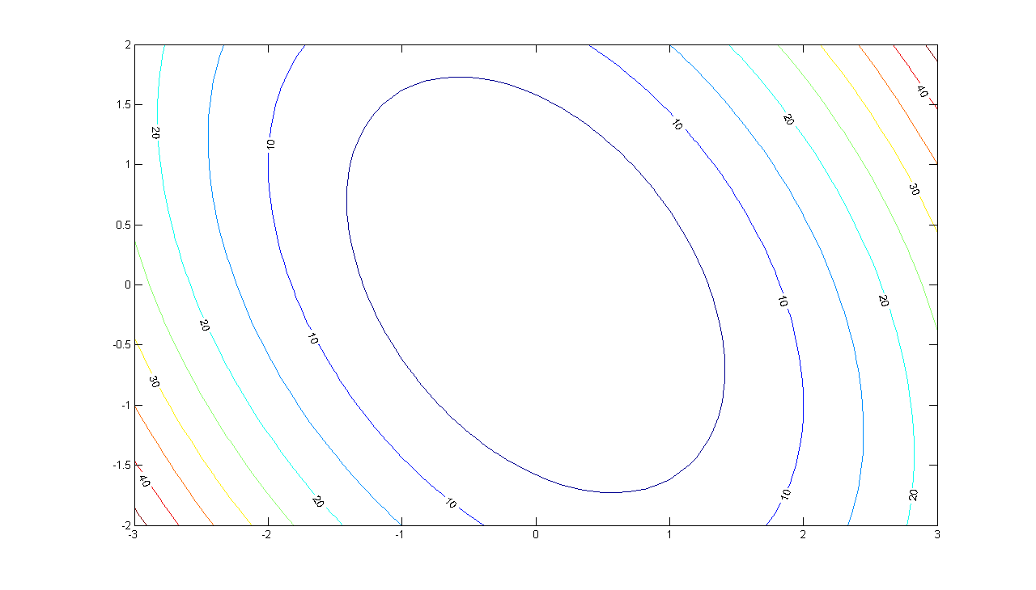
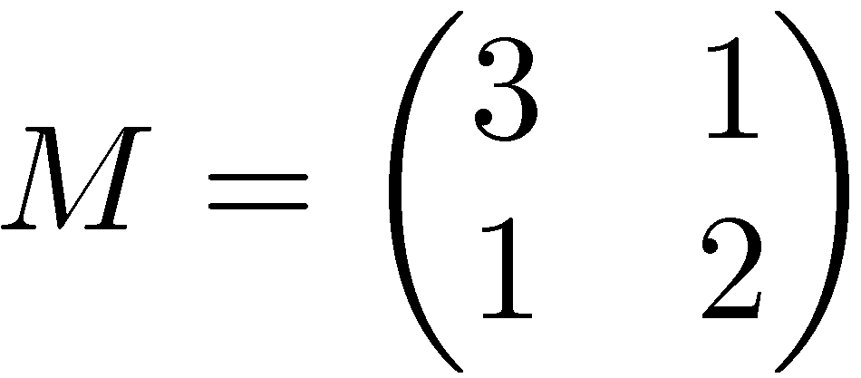
Let
Plot of level sets of x^{T} M x.
Notes:
Matlab code:
[X,Y] = meshgrid(-3:.1:3,-2:.1:2);
Z = 3*X.*X + 2*X.*Y + 2*Y.*Y;
[C,h] = contour(X,Y,Z);
set(h,'ShowText','on','TextStep',get(h,'LevelStep')*2);

Slide 7
Covering Hemispheres by Ellipsoids
H_{u}
B’
B
u
Let B = { unit ball }.
Let H_{u} = { x : x^{T}u¸0 }, where kuk=1.
Find a small ellipsoid B’ that covers BÅH.

Slide 8
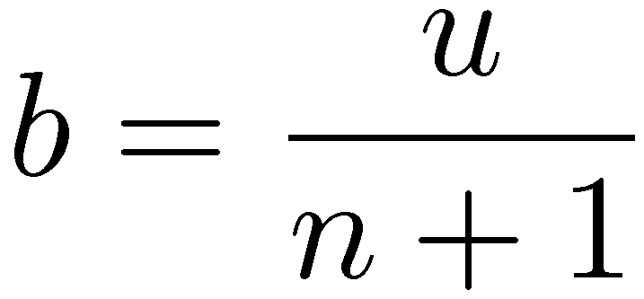
Main Theorem:
Let B = { x : kxk·1 } and H_{u} = { x : x^{T}u¸0 }, where kuk=1.
Let and .
Let B’ = E( M, b ). Then:
1) B Å H_{u} µ B’.
2)

Slide 9
Covering Half-ellipsoids by Ellipsoids
H_{a}
E’
E
z
Let E be an ellipsoid centered at z
Let H_{a} = { x : a^{T}x ¸ a^{T}z }
Find a small ellipsoid E’ that covers EÅH_{a}

Slide 10
Use our solution for hemispheres!
H_{u}
B’
E’
B
H_{a}
E
z
Goal Find an affine map f and choose u such that: f(B) = E and f(H_{u}) = H_{a} Define E’ = f(B’). Claim: E’ is an ellipsoid. Claim: E Å H_{a} µ E’.
Notes:
Why is E’ an ellipsoid? Recall that an ellipsoid is obtained from applying a (non-singular) affine map to the unit ball. B’ is obtained in such a way. And E’ is obtained by applying a linear map to B’. Composing those two maps shows that E’ is also obtained by applying an affine map to the unit ball.

Slide 11
The Genius behind the Ellipsoid Method
“Intelligence gathered by this and other governments leaves no doubt that the Iraq regime continues to possess and conceal some of the most lethal weapons ever devised”
George W. Bush, 3/18/2003

Slide 12
WMD in Iraq
“We are learning more as we interrogate or have discussions with Iraqi scientists and people within the Iraqi structure, that perhaps he destroyed some, perhaps he dispersed some. And so we will find them.” George W. Bush, 4/24/2003
Notes:
Intelligence gathered by this and other governments leaves no doubt that the Iraq regime continues to possess and conceal some of the most lethal weapons ever devised.
George Bush March 18, 2003
We are learning more as we interrogate or have discussions with Iraqi scientists and people within the Iraqi structure, that perhaps he destroyed some, perhaps he dispersed some. And so we will find them.
George Bush April 24, 2003

Slide 13
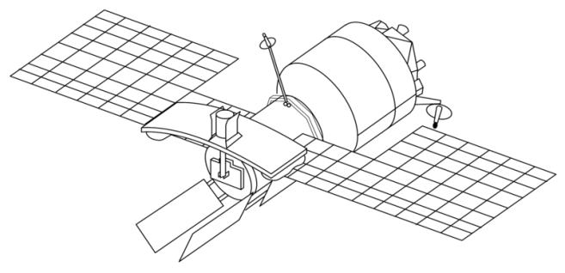
Finding WMD
USA have a satellite with a WMD detector
The detector scans a round region of the earth
It can compare two halves of the region, and decide which half is “more likely” to have WMD

Slide 14
Finding WMD
USA have a satellite with a WMD detector
The detector scans a round region of the earth
It can compare two halves of the region, and decide which half is “more likely” to have WMD
It continues by rescanning the “more likely” half

Slide 15
Finding WMD
USA have a satellite with a WMD detector
The detector scans a round region of the earth
It can compare two halves of the region, and decide which half is “more likely” to have WMD
It continues by rescanning the “more likely” half

Slide 16
Finding WMD
USA have a satellite with a WMD detector
The detector scans a round region of the earth
It can compare two halves of the region, and decide which half is “more likely” to have WMD
It continues by rescanning the “more likely” half

Slide 17
Finding WMD
It continues by rescanning the “more likely” half
If region is so small that it obviously contains no WMD, then conclude: Iraq has no WMD
“No one was more surprised than I that we didn't find [WMDs].” U.S. General Tommy Franks, 12/2/2005
http://www.flickr.com/photos/sunfox/17620516/

Slide 18
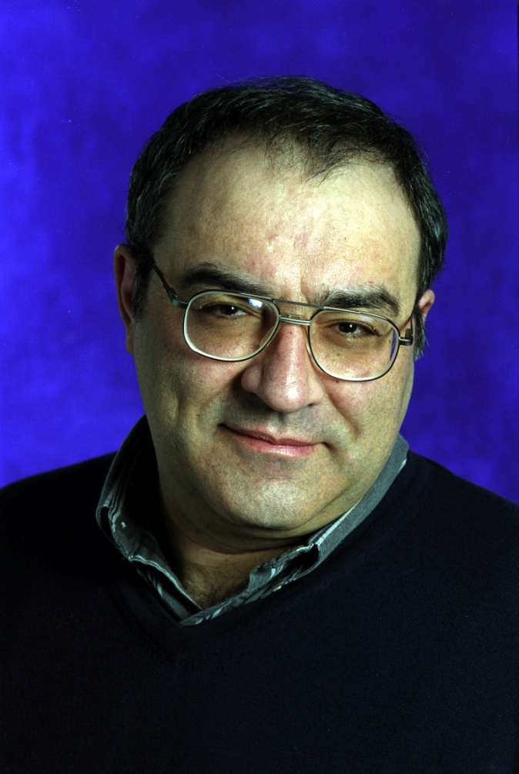
Generalization to Higher Dimensions
Leonid Khachiyan
Even smarter than George W. Bush!

Slide 19
The Ellipsoid Method
Want to find x2P
Have ellipsoid E(M,z) ¶ P
If z∉P then it violates a constraint “a_{i}^{T}x · b_{i}”
So P µ { x : a_{i}^{T}x · a_{i}^{T}z }
So P µ E(M,z) Å { x : a_{i}^{T}x · a_{i}^{T}z }
E(M,z)
z
P

Slide 20
The Ellipsoid Method
Have ellipsoid E(M,z) ¶ P
If z∉P then it violates a constraint “a_{i}^{T}x · b_{i}”
So P µ { x : a_{i}^{T}x · a_{i}^{T}z }
So P µ E(M,z) Å { x : a_{i}^{T}x · a_{i}^{T}z }
Let E(M’,z’) be ellipsoid covering E(M,z) Å {x : a_{i}^{T}x·a_{i}^{T}z}
Repeat…
E(M’,z’)
z’
P

Slide 21
The Ellipsoid Method
Input: A polytope P = { Ax·b } (e.g., P=WMD)
Output: A point x2P, or announce “P is empty”
and R and r.
Let E(M,z) be an ellipsoid s.t. PµE(M,z) (e.g., E(M,z)=B(0,R))
If vol E(M,z) < vol B(0,r) then Halt: “P is empty”
If z2P, Halt: “z 2 P”
Else
Let “a_{i}^{T}x · b_{i}” be a constraint of P violated by z (i.e., a_{i}^{T}z>b_{i})
Let H = { x : a_{i}^{T}x · a_{i}^{T}z } (so P µ E(M,z)ÅH)
Let E(M’,z’) be an ellipsoid covering E(M,z)ÅH
Set M←M’ and z←z’ and go back to Start
How to find this?
Notation: Let B(z,r) = ball of radius r around point z2R^{n}
Assumptions:
“The WMD is in Iraq”: 9R>0 such that P µ B(0,R)
“WMD bigger than cow”: If P≠; then 9r>0, z2R^{n} s.t. B(z,r)µP

Slide 22
Covering Half-ellipsoids by Ellipsoids
Let E be an ellipsoid centered at z
Let H_{a} = { x : a^{T}x · a^{T}z }
H_{a}
E’
E
z
Solution
As stated earlier, we can find an ellipsoid E’ such that
EÅH_{a} µ E’
vol(E’) · vol(E) ¢ e^{-1/4(n+1)}

Slide 23
How many iterations?
E_{i} = ellipsoid in i^{th} iteration. Initially E₀ = B(0,R)
Claim 1:
Proof: We showed
So ¥
Claim 2: Number of iterations · 4 n(n+1) log(R/r).
Proof: Suppose
Then
So
By Claim 1,
So the algorithm stops. ¥

Slide 24
Ellipsoid Method for Solving LPs
Ellipsoid method finds feasible point in P = { x : Ax · b } i.e., it can solve a system of inequalities
But we want to optimize, i.e., solve max { c^{T}x : x2P }
Restatement of Strong Duality Theorem: (from Lecture 3) Primal has optimal solution , Dual has optimal solution , the following system is solvable:
Important Point Solving an LP is equivalent to solving a system of inequalities
) Ellipsoid method can be used to solve LPs

Slide 25
Ellipsoid Method for Solving LPs
Ellipsoid method finds feasible point in P = { x : Ax · b } i.e., it can solve a system of inequalities
But we want to optimize, i.e., solve max { c^{T}x : x2P }
Alternative approach: Binary search for optimal value
Suppose we know optimal value is in interval [L,U]
Add a new constraint c^{T}x ¸ (L+U)/2
If LP still feasible, replace L with (L+U)/2 and repeat
If LP not feasible, replace U with (L+U)/2 and repeat
c^{T}x¸(L+U)/2
c^{T}x = L
c^{T}x = U
P

Slide 26
Issues with Ellipsoid Method
It needs to compute square roots, so it must work with irrational numbers
Solution: Approximate irrational numbers by rationals. Approximations proliferate, and it gets messy.
Can only work with bounded polyhedra P
Solution: If P non-empty, there exists a feasible x s.t. |x_{i}|·U 8i, where U is a bound based on numbers in A and b. So we can assume that -U · x_{i} · U for all i.
Polyhedron P needs to contain a small ball B(z,k)
Solution: If P = { x : Ax·b } then we can perturb b by a tiny amount. The perturbed polyhedron is feasible iff P is, and if it is feasible, it contains a small ball.
Notes:
See:
- Korte-Vygen “Combinatorial Optimization: Theory and Algorithms”, Chapter 4
- Schrijver “Theory of Linear and Integer Programming”, Chapter 13
- Grotschel-Lovasz-Schrijver “Geometric Algorithms and Combinatorial Optimization”
The main trouble in Issue 3 is that P might not be full-dimensional (i.e., it has volume 0). The perturbation makes it full-dimensional.

Slide 27
Ellipsoid Method in Polynomial Time
Input: A polyhedron P = { x : Ax·b } where A has size m x d. This is given as a binary file containing matrix A and vector b.
Input size: n = # of bits used to store this binary file
Output: A point x2P, or announce “P is empty”
Boundedness: Can add constraints -U·x_{i}·U, where U = 16^{d2n}. The new P is contained in a ball B(0,R), where R<n¢U.
Contains ball: Add ² to b_{i}, for every i, where ² = 1/U². The new P contains a ball of radius r = ²¢2^{-dn} > 1/U³.
Iterations: We proved that: # iterations · 4d(d+1)log(R/r), and this is < 40d⁶n²
Each iteration does only basic matrix operations and can be implemented in polynomial time.
Conclusion: Overall running time is polynomial in n (and d)!

Slide 28
What Does Ellipsoid Method Need?
The algorithm uses no properties of polyhedra
It just needs to (repeatedly) answer the question: Is z2P? If not, give me a constraint “a^{T}x·b” of P violated by z
Let E(M,z) be an ellipsoid s.t. PµE(M,z)
If vol E(M,z) < vol B(0,r) then Halt: “P is empty”
If z2P, Halt: “z 2 P”
Else
Let “a_{i}^{T}x · b_{i}” be a constraint of P violated by z (i.e., a_{i}^{T}z>b_{i})
Let H = { x : a_{i}^{T}x · a_{i}^{T}z } (so P µ E(M,z)ÅH)
Let E(M’,z’) be an ellipsoid covering E(M,z)ÅH
Set M←M’ and z←z’ and go back to Start
Input: A polytope P = { Ax·b }
Output: A point x2P, or announce “P is empty”

Slide 29
The Ellipsoid Method
The algorithm uses almost nothing about polyhedra (basic feasible solutions, etc.)
It just needs to (repeatedly) answer the question:
The algorithm works for any convex set P, as long as you can give a separation oracle.
P still needs to be bounded and contain a small ball.
Remarkable Theorem: [Grotschel-Lovasz-Schijver ‘81] For any convex set PµR^{n} with a separation oracle, you can find a feasible point efficiently.
Caveats:
“Efficiently” depends on size of ball containing P and inside P.
Errors approximating irrational numbers means we get “approximately feasible point”
Separation Oracle
Is z2P?
If not, find a vector a s.t. a^{T}x<a^{T}z 8x2P

Slide 30
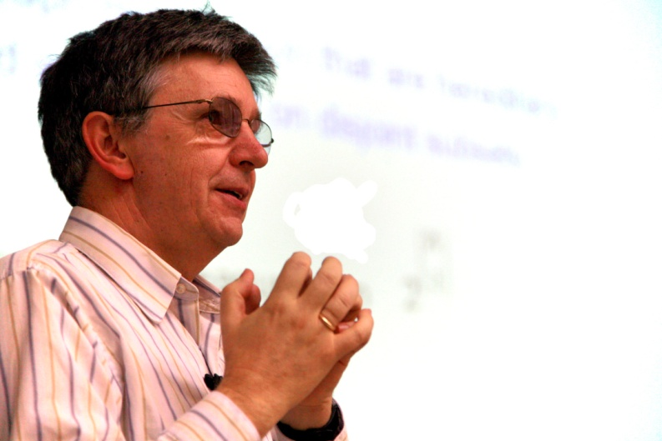
Martin Grotschel
Laszlo Lovasz
Alexander Schrijver

Slide 31
The Ellipsoid Method For Convex Sets
Feasibility Theorem: [Grotschel-Lovasz-Schijver ‘81] For any convex set PµR^{n} with a separation oracle, you can find a feasible point efficiently.
Ignoring (many, technical) details, this follows from ellipsoid algorithm
Optimization Theorem: [Grotschel-Lovasz-Schijver ‘81]
For any convex set PµR^{n} with a separation oracle, you can solve optimization problem max { c^{T}x : x2P }.
How?
Follows from previous theorem and binary search on objective value.
This can be generalized to minimizing non-linear (convex) objective functions.
Separation Oracle
Is z2P?
If not, find a vector a s.t. a^{T}x<a^{T}z 8x2P

Slide 32
Separation Oracle for Ball
Let’s design a separation oracle for the convex set P = { x : kxk·1 } = unit ball B(0,1).
Input: a point z2R^{n}
If kzk·1, return “Yes”
If kzk>1, return a=z/kzk
For all x2P we have a^{T}x = z^{T}x/kzk · kxk Why?
For z we have a^{T}z = z^{T}z/kzk = kzk > 1 ¸ kxk ) a^{T}x < a^{T}z
Separation Oracle
Is z2P?
If not, find a vector a s.t. a^{T}x<a^{T}z 8x2P
Cauchy-Schwarz

Slide 33
Separation Oracle for Ball
Let’s design a separation oracle for the convex set P = { x : kxk·1 } = unit ball B(0,1).
Separation Oracle
Is z2P?
If not, find a vector a s.t. a^{T}x<a^{T}z 8x2P
Conclusion: Since we were able to give a separation oracle for P, we can optimize a linear function over it.
Note: max { c^{T}x : x2P } is a non-linear program. (Actually, it’s a convex program.)

