Slide 1
What is a corner point?
How should we define corner points?
Under any reasonable definition, point x should be considered a corner point
x

Slide 2
What is a corner point?
Attempt #1: “x is the ‘farthest point’ in some direction”
Let P = { feasible region }
There exists c2R^{n} s.t. c^{T}x>c^{T}y for all y2Pn{x}
“For some objective function, x is the unique optimal point when maximizing over P”
Such a point x is called a “vertex”
x is unique optimal point
c
Notes:
Textbook p53

Slide 3
What is a corner point?
Attempt #2: “There is no feasible line-segment that goes through x in both directions”
Whenever x=®y+(1-®)z with y,z≠x and ®2(0,1), then either y or z must be infeasible.
“If you write x as a convex combination of two feasible points y and z, the only possibility is x=y=z”
Such a point x is called an “extreme point”
x
z (infeasible)
y
Notes:
Textbook p55

Slide 4
What is a corner point?
Attempt #3: “x lies on the boundary of many constraints”
4x₁ - x₂ · 10
x₁ + 6x₂ · 15
x
x lies on boundary of
two constraints

Slide 5
What is a corner point?
Attempt #3: “x lies on the boundary of many constraints”
What if I introduce redundant constraints?
Not the right
condition
x₁ + 6x₂ · 15
2x₁ + 12x₂ · 30
y also lies on boundary
of two constraints
y

Slide 6
What is a corner point?
Revised Attempt #3: “x lies on the boundary of many
linearly independent constraints”
Feasible region: P = { x : a_{i}^{T}x·b_{i} 8 i } ½ R^{n}
Let I_{x}={ i : a_{i}^{T}x=b_{i} } and A_{x}={ a_{i} : i2I_{x} }. (“Tight constraints”)
x is a “basic feasible solution (BFS)” if rank A_{x} = n
x₁ + 6x₂ · 15
4x₁ - x₂ · 10
2x₁ + 12x₂ · 30
y
x₁ + 6x₂ · 15
y’s constraints are linearly dependent
x
x’s constraints are linearly independent

Slide 7
Lemma: Let P be a polyhedron. The following are equivalent.
  x is a vertex (unique maximizer)
  x is an extreme point (not convex combination of other points)
  x is a basic feasible solution (BFS) (tight constraints have rank n)
Proof of (i))(ii):
x is a vertex ) 9 c s.t. x is unique maximizer of c^{T}x over P
Suppose x = ®y + (1-®)z where y,z2P and ®2(0,1).
Suppose y≠x. Then
c^{T}x = ® c^{T}y + (1-®) c^{T}z
) c^{T}x < ® c^{T}x + (1-®) c^{T}x = c^{T} x Contradiction!
So y=x. Symmetrically, z=x.
So x is an extreme point of P. ¥
· c^{T} x (since c^{T}x is optimal value)
< c^{T} x (since x is unique optimizer)
Notes:
This is Thm 2.28 in Cunningham-Lewis.
Why is this lemma worth proving?
Corner points are important, so it’s worth characterizing them in many ways.

Slide 8
Lemma: Let P={ x : a_{i}^{T}x·b_{i} 8i }½R^{n}. The following are equivalent.
  x is a vertex (unique maximizer)
  x is an extreme point (not convex combination of other points)
  x is a basic feasible solution (BFS) (tight constraints have rank n)
Proof Idea of (ii))(iii):
x not a BFS ) rank A_{x} · n-1
Each tight constraint removes one degree of freedom
At least one degree of freedom remains
So x can “wiggle” while staying on all the tight constraints
Then x is a convex combination of two points obtained by “wiggling”.
So x is not an extreme point.
x-w
x
x+w

Slide 9
Lemma: Let P={ x : a_{i}^{T}x·b_{i} 8i }½R^{n}. The following are equivalent.
  x is a vertex (unique maximizer)
  x is an extreme point (not convex combination of other points)
  x is a basic feasible solution (BFS) (tight constraints have rank n)
Proof of (ii))(iii): x not a BFS ) rank A_{x}<n (Recall A_{x} = { a_{i} : a_{i}^{T}x=b_{i} })
Claim: 9w2R^{n}, w≠0, s.t. a_{i}^{T}w=0 8a_{i}2A_{x} (w orthogonal to all of A_{x})
Proof: Let M be matrix whose rows are the a_{i}’s in A_{x}.
dim row-space(M) + dim null-space(M) = n
But dim row-space(M)<n ) 9w≠0 in the null space. ¤
Notes:
The fact used in the claim is sometimes called “The Fundamental Theorem of Linear Algebra”

Slide 10
Lemma: Let P={ x : a_{i}^{T}x·b_{i} 8i }½R^{n}. The following are equivalent.
  x is a vertex (unique maximizer)
  x is an extreme point (not convex combination of other points)
  x is a basic feasible solution (BFS) (tight constraints have rank n)
Proof of (ii))(iii): x not a BFS ) rank A_{x}<n (Recall A_{x} = { a_{i} : a_{i}^{T}x=b_{i} })
Claim: 9w2R^{n}, w≠0, s.t. a_{i}^{T}w=0 8a_{i}2A_{x} (w orthogonal to all of A_{x})
Let y=x+²w and z=x-²w, where ²>0.
Claim: If ² very small then y,z2P.
Proof: First consider tight constraints at x. (i.e., those in I_{x})
a_{i}^{T}y = a_{i}^{T}x + ²a_{i}^{T}w = b_{i} + 0
So y satisfies this constraint. Similarly for z.
Next consider the loose constraints at x. (i.e., those not in I_{x})
b_{i} - a_{i}^{T}y = b_{i} - a_{i}^{T}x - ²a_{i}^{T}w
So y satisfies these constraints. Similarly for z. ¤
Then x=®y+(1-®)z, where y,z2P, y,z≠x, and ®=1/2.
So x is not an extreme point. ¥
¸ 0
Positive
As small as we like
Notes:
So taking epsilon = min { (b_i – a_i^Tx) / a_i^T w : a_i^T w >0 } is enough.

Slide 11
Lemma: Let P={ x : a_{i}^{T}x·b_{i} 8i }½R^{n}. The following are equivalent.
  x is a vertex (unique maximizer)
  x is an extreme point (not convex combination of other points)
  x is a basic feasible solution (BFS) (tight constraints have rank n)
Proof of (iii))(i): Let x be a BFS ) rank A_{x}=n (Recall A_{x} = { a_{i} : a_{i}^{T}x=b_{i} })
Let c = §_{i2Ix} a_{i}.
Claim: c^{T}x = §_{i2Ix} b_{i}
Proof: c^{T}x = §_{i2Ix} a_{i}^{T}x = §_{i2Ix} b_{i}. ¤
Claim: x is an optimal point of max { c^{T}x : x 2 P }.
Proof: y2P ) a_{i}^{T}y · b_{i} for all i
) c^{T}y = §_{i2Ix} a_{i}^{T}y ·§_{i2Ix} b_{i} = c^{T}x. ¤
Claim: x is the unique optimal point of max { c^{T}x : x 2 P }.
Proof: If for any i2I_{x} we have a_{i}^{T}y<b_{i} then c^{T}y<c^{T}x.
So every optimal point y has a_{i}^{T}y=b_{i} for all i2I_{x}.
Since rank A_{x}=n, there is only one solution: y=x! ¤
So x is a vertex. ¥
If one of these is strict,
then this is strict.

Slide 12
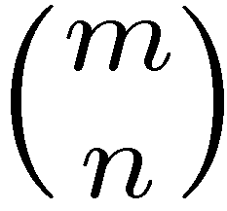
Lemma: Let P={ x : a_{i}^{T}x·b_{i} 8i }½R^{n}. The following are equivalent.
  x is a vertex (unique maximizer)
  x is an extreme point (not convex combination of other points)
  x is a basic feasible solution (BFS) (tight constraints have rank n)
Interesting Corollary
Corollary: Any polyhedron has finitely many extreme points.
Proof: Suppose the polyhedron is defined by m inequalities.
Each extreme point is a BFS, so it corresponds to a choice of
n linearly independent tight constraints.
There are · ways to choose these tight constraints. ¥
Notes:
Corollary 2.30

Slide 13
Optimal solutions at extreme points
Definition: A line is a set L={ r+¸s : ¸2R } where r,s2R^{n} and s≠0.
Lemma: Let P={ x : a_{i}^{T}x·b_{i} 8i }. Suppose P does not contain any line. Suppose the LP max { c^{T}x : x2P } has an optimal solution.
Then some extreme point is an optimal solution.
Proof Idea: Let x be optimal. Suppose x not a BFS.
At least one degree of freedom remains at x
So x can “wiggle” while staying on all the tight constraints
x cannot wiggle off to infinity in both directions because P contains no line
So when x wiggles, it hits a constraint
When it hits first constraint, it is still feasible.
So we have found a point y which has a new tight constraint.
Repeat until we get a BFS.
x
y
Notes:
This is Theorem 2.27 in Cunningham-Lewis.

Slide 14
Lemma: Let P={ x : a_{i}^{T}x·b_{i} 8i }. Suppose P does not contain any line. Suppose the LP max { c^{T}x : x2P } has an optimal solution.
Then some extreme point is an optimal solution.
Proof: Let x be optimal, with maximal number of tight constraints.
Suppose x not a BFS.
Claim: 9w2R^{n}, w≠0, s.t. a_{i}^{T}w=0 8i2I_{x} (We saw this before)
Let y(²)=x+²w. Suppose c^{T}w = 0.
Claim: 9± s.t. y(±)∉P. WLOG ±>0. (Otherwise P contains a line)
Set ±=0 and gradually increase ±. What is largest ± s.t. y(±)2P?
y(±)2P , a_{i}^{T}y(±)·b_{i} 8i
, a_{i}^{T}x+±a_{i}^{T}w·b_{i} 8i (Always satisfied if a_{i}^{T}w·0)
, ± · (b_{i}-a_{i}^{T}x)/a_{i}^{T}w 8i s.t. a_{i}^{T}w>0
Let h be the i that minimizes this. So ±=(b_{h}-a_{h}^{T}x)/a_{h}^{T}w.
y(±) is also optimal because c^{T}y(±) = c^{T}(x+±w) = c^{T}x.
But y(±) has one more tight constraint than x. Contradiction!
Notes:
Assume epsilon>0.
Let y(e) = x+e*w.
y(e) is feasible if a_i*y(e)<=b_i ⬄ a_i*x+e*a_i*w<=b_i.
If a_i*w<=0 then we can choose any e.
If a_i*w>0, then need b_i-a_i*x >= e*a_i*w ⬄ e <= (b_i-a_i*x)/a_i*w.
Let z(e) = x-e*w.
z(e) is feasible if a_i*z(e)<=b_i ⬄ a_i*x -e*a_i*w<=b_i.
If a_i*w>=0 then we can choose any e.
If a_i*w<0, then need a_i*x - b_i <= e*a_i*w ⬄ e <= (a_i*x – b_i)/a_i*w.

Slide 15
Lemma: Let P={ x : a_{i}^{T}x·b_{i} 8i }. Suppose P does not contain any line. Suppose the LP max { c^{T}x : x2P } has an optimal solution.
Then some extreme point is an optimal solution.
Proof: Let x be optimal, with maximal number of tight constraints.
Suppose x not a BFS.
Claim: 9w2R^{n}, w≠0, s.t. a_{i}^{T}w=0 8i2I_{x} (We saw this before)
Let y(²)=x+²w. Suppose c^{T}w > 0.
Claim: 9±>0 s.t. y(±)2P. (Same argument as before)
But then c^{T}y(±) = c^{T}(x+±w) > c^{T}x.
This contradicts optimality of x. ¥

Slide 16
Lemma: Let P={ x : a_{i}^{T}x·b_{i} 8i }. Suppose P does not contain any line. Suppose the LP max { c^{T}x : x2P } has an optimal solution.
Then some extreme point is an optimal solution.
Interesting Consequence
A simple but finite algorithm for solving LPs
Input: An LP max { c^{T}x : x2P } where P={ x : a_{i}^{T}x·b_{i} 8i=1…m }.
Caveat: We assume P contains no line, and the LP has an optimal solution.
Output: An optimal solution.
For every choice of n of the constraints
If these constraints are linearly independent
Find the unique point x for which these constraints are tight
If x is feasible, add it to a list of all extreme points.
End
End
Output the extreme point that maximizes c^{T}x

Slide 17
Dimension of Sets
Def: An affine space A is a set A = { x+z : x2L }, where L is a linear space and z is any vector.
The dimension of A is dim L.
Let’s say dim ; = -1.
Def: Let C µ R^{n} be non-empty. The dimension of C is
min { dim A : A is an affine space with CµA }.

Slide 18
Faces
Def: Let Cµ R^{n} be any convex set. An inequality
“a^{T}x·b” is called valid for C if a^{T}x·b 8x2C.
Def: Let PµR^{n} be a polyhedron. A face of P is a set
F = P Å { x : a^{T}x = b }
where “a^{T}x·b” is a valid inequality for P.
Clearly every face of P is also a polyhedron.
Claim: P is a face of P.
Proof: Take a=0 and b=0.
Claim: ; is a face of P.
Proof: Take a=0 and b=1.

Slide 19
k-Faces
Def: Let PµR^{n} be a polyhedron. A face of P is a set
F = P Å { x : a^{T}x = b }
where “a^{T}x·b” is a valid inequality for P.
Def: A face F with dim F = k is called a k-face.
Suppose dim P = d
  A (d-1)-face is called a facet.
  A 1-face is called an edge.
  A 0-face F has the form F = {v} where v2P.
Claim: If F={v} is a 0-face then v is a vertex of P.
Notes:
Proof: { v } = P n { x : a^T x = b } where every x in P satisfies a^T x <= b.
So every x in P\{v} satisfies a^T x < b, and thus v is the unique optimal solution to max { a^T x : x in P }.

Slide 20
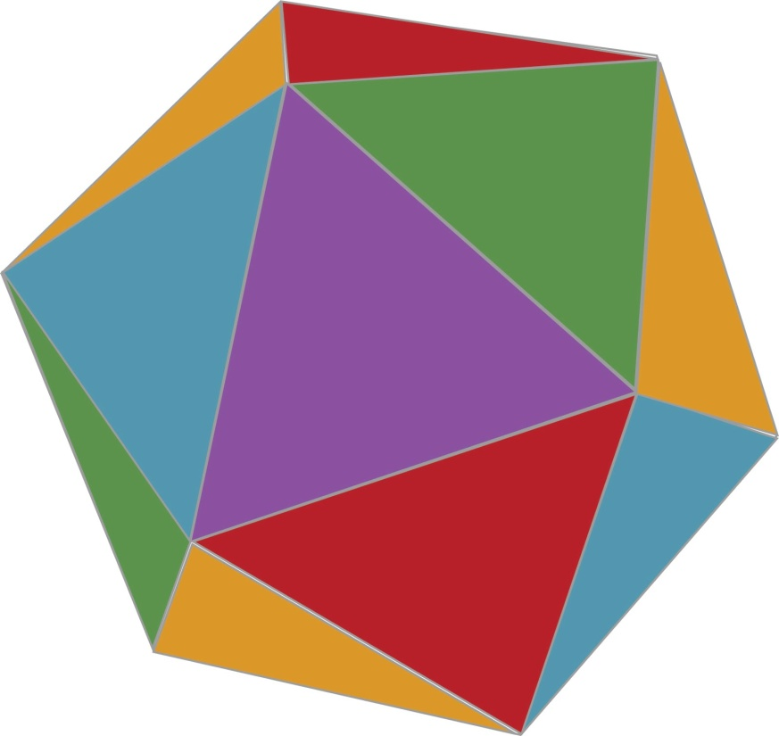
k-Faces
Def: Let PµR^{n} be a polyhedron. A face of P is a set
F = P Å { x : a^{T}x = b }
where “a^{T}x·b” is a valid inequality for P.
Def: A face F with dim F = k is called a k-face.
0-face
(vertex)
1-face
(edge)
(d-1)-face
(facet)
Image: http://torantula.blogspot.com/

Slide 21
The Simplex Method
“The obvious idea of moving along edges from one vertex of a convex polygon to the next” [Dantzig, 1963]
Algorithm
Let x be any vertex (we assume LP is feasible)
For each edge containing x
  If moving along the edge increases the objective function
  If the edge is infinitely long,
  Halt: LP is unbounded
  Else
  Set x to be other vertex in the edge
  Restart loop
Halt: x is optimal
In practice, very efficient.
In theory, very hard to analyze.
How many edges must we traverse in the worst case?

Slide 22
Why is analyzing the simplex method hard?
For any polyhedron, and for any two vertices, are they connected by a path of few edges?
The Hirsch Conjecture (1957)
Let P = { x : Ax·b } where A has size m x n. Then any two vertices are connected by a path of · m-n edges.
Example: A cube.
Dimension n=3.
# constraints m=6.
Connected by a length-3 path?
Yes!

Slide 23
Why is analyzing the simplex method hard?
For any polyhedron, and for any two vertices, are they connected by a path of few edges?
The Hirsch Conjecture (1957)
Let P = { x : Ax·b } where A has size m x n. Then any two vertices are connected by a path of · m-n edges.
We have no idea how to prove this.
Disproved! There is a polytope with n=43, m=86, and two vertices with no path of length · 43 [Santos, 2010].
Theorem: [Kalai-Kleitman 1992] There is always a path
with · m^{log n+2} edges.
Notes:
Actually, the Hirsch Conjecture was disproved for unbounded polyhedra by Klee & Walkup in 1967. The conjecture was still open for polytopes.

