Slide 1
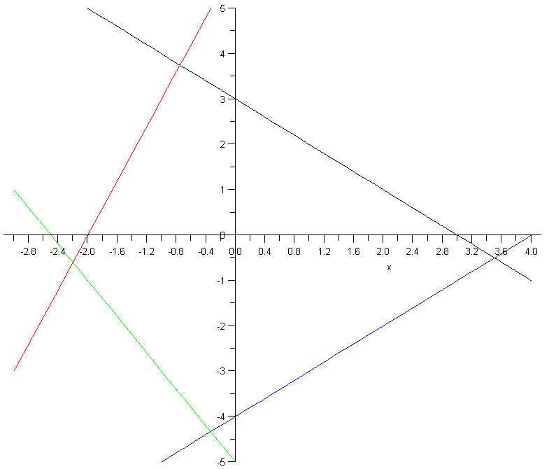
2D System of Inequalities
y
-3x+y·6
x+y·3
Consider the polyhedron
Q = { (x,y) : -3x+y·6,
x+y·3,
-y-2x·5,
x-y·4 }
x
x-y·4
-y-2x·5
Given x, for what values of y is (x,y) feasible?
  Need: y·3x+6, y·-x+3, y¸-2x-5, and y¸x-4

Slide 2
2D System of Inequalities
x=-3
x=-0.8
y
-3x+y·6
x+y·3
Consider the polyhedron
Q = { (x,y) : -3x+y·6,
x+y·3,
-y-2x·5,
x-y·4 }
x
x-y·4
-y-2x·5
Given x, for what values of y is (x,y) feasible?
  i.e., y·min{3x+6, -x+3} and y¸max{ -2x-5, x-4 }
  For x=-0.8, (x,y) feasible if y·min{3.6,3.8} and y¸max{-3.4,-4.8}
  For x=-3, (x,y) feasible if y·min{-3,6} and y¸max{1,-7}
Impossible!

Slide 3
2D System of Inequalities
Consider the set
Q = { (x,y) : -3x+y·6, x+y·3, -y-2x·5, x-y·4 }
Given x, for what values of y is (x,y) feasible?
  i.e., y·min{3x+6, -x+3} and y¸max{ -2x-5, x-4 }
  Such a y exists , max{-2x-5, x-4} · min{3x+6, -x+3}
  , the following inequalities are solvable
Conclusion: Q is non-empty , Q’ is non-empty.
This is easy to decide because Q’ involves only 1 variable!
-2x-5 · 3x+6
x-4 · 3x+6
-2x-5 · -x+3
x-4 · -x+3
-5x·11
-2x·10
-x·8
2x·7
x¸-11/5
x¸-5
x¸-8
x·7/2
Every “lower” constraint is · every “upper” constraint
´
Q’ = x :
= x :

Slide 4
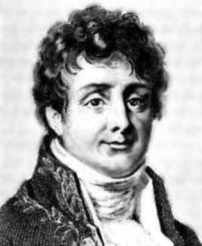

Fourier-Motzkin Elimination
Joseph Fourier
Theodore Motzkin
Generalization: given a set Q = { (x₁,…,x_{n}) : Ax·b },
we want to find set Q’ = { (x’₁,…,x’_{n-1}) : A’x’·b’ } satisfying
(x₁,…,x_{n-1})2Q’ , 9x_{n} s.t. (x₁,…,x_{n-1},x_{n})2Q
Q’ is called a projection of Q (onto the first n-1 coordinates)
Fourier-Motzkin Elimination is a procedure for producing Q’ from Q
Consequences:
  An (inefficient!) algorithm for solving systems of inequalities,
  and hence for solving LPs too
  A way of proving Farkas’ Lemma by induction

Slide 5
Lemma: Let Q = { (x₁,…,x_{n}) : Ax·b }. We can construct
Q’ = { (x’₁,…,x’_{n-1}) : A’x’·b’ } satisfying
  (1) (x₁,…,x_{n-1})2Q’ , 9x_{n} s.t. (x₁,…,x_{n-1},x_{n})2Q
  (2) Every inequality defining Q’ is a non-negative linear combination of the inequalities defining Q.
Proof: Put inequalities of Q in three groups: (a_{i} = i^{th} row of A)
Z={ i : a_{i,n}=0 } P={ j : a_{j,n}>0 } N={ k : a_{k,n}<0 }
WLOG, a_{j,n}=1 8j2P and a_{k,n}=-1 8k2N
For any x2R^{n}, let x’2R^{n-1} be vector obtained by deleting coordinate x_{n}
The constraints defining Q’ are:
  a_{i}’x’·b_{i} 8i2Z
  a_{j}’x’+a_{k}’x’ · b_{j}+b_{k} 8j2P, 8k2N
This proves (2).
In fact, (2) implies the “( direction” of (1):
For every x2Q, x’ satisfies all inequalities defining Q’.
Why? Because every constraint of Q’ is a non-negative lin. comb.
of constraints from Q, with n^{th} coordinate equal to 0.
This is sum of j^{th} and k^{th} constraints of Q,
because n^{th} coordinate of a_{j} +a_{k} is zero!
Notes:
This proof is from Matousek-Gartner Section 6.7

Slide 6
Lemma: Let Q = { (x₁,…,x_{n}) : Ax·b }. We can construct
Q’ = { (x’₁,…,x’_{n-1}) : A’x’·b’ } satisfying
  (x₁,…,x_{n-1})2Q’ , 9x_{n} s.t. (x₁,…,x_{n-1},x_{n})2Q
  Every inequality defining Q’ is a non-negative linear combination of the inequalities defining Q.
Proof: Put inequalities of Q in three groups:
Z={ i : a_{i,n}=0 } P={ j : a_{j,n}=1 } N={ k : a_{k,n}=-1 }
The constraints defining Q’ are:
  a_{i}’x’·b_{i} 8i2Z
  a_{j}’x’+a_{k}’x’ · b_{j}+b_{k} 8j2P, 8k2N
It remains to prove the “) direction” of (1).
Note that: a_{k}’x’-b_{k} · b_{j}-a_{j}’x’ 8j2P, 8k2N.
) max_{k2N} { a_{k}’x’-b_{k} } · min_{j2P} { b_{j}-a_{j}’x’ }
Let x_{n} be this value, and let x = (x’₁,…,x’_{n-1},x_{n}).
Then: a_{k}x-b_{k} = a_{k}’x’-x_{n}-b_{k} · 0 8k2N
b_{j}-a_{j}x = b_{j}-a_{j}’x’-x_{n} ¸ 0 8j2P
a_{i}x = a_{i}’x’ · b_{i} 8i2Z
By definition of x,
and since a_{k,n} = -1
By definition of x_{n},
a_{k}’x’ - b_{k} · x_{n}
) x2Q
¥

Slide 7
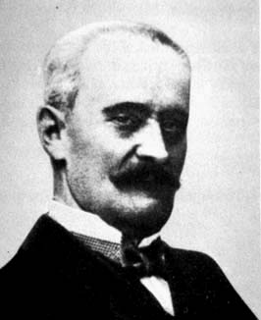
Variants of Farkas’ Lemma
Gyula Farkas
The System | Ax · b | Ax = b
has no solution x¸0 iff | 9y¸0, A^{T}y¸0, b^{T}y<0 | 9y2R^{n}, A^{T}y¸0, b^{T}y<0
has no solution x2R^{n} iff | 9y¸0, A^{T}y=0, b^{T}y<0 | 9y2R^{n}, A^{T}y=0, b^{T}y<0
We’ll prove this one
Notes:
This is Theorem 2.7 in Cunningham-Lewis

Slide 8
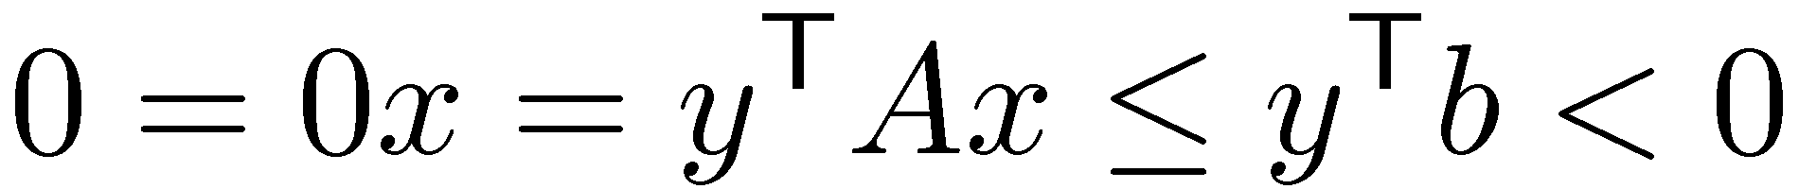
Lemma: Exactly one of the following holds:
  There exists x2R^{n} satisfying Ax·b
  There exists y¸0 satisfying y^{T}A=0 and y^{T}b<0
Proof: Suppose x exists. Need to show y cannot exist.
Suppose y also exists. Then:
Contradiction! y cannot exist.
Notes:
See Matousek-Gartner p103-104.

Slide 9
Lemma: Exactly one of the following holds:
  There exists x2R^{n} satisfying Ax·b
  There exists y¸0 satisfying y^{T}A=0 and y^{T}b<0
Proof: Suppose no solution x exists.
We use induction. Trivial for n=0, so let n¸1.
We use Fourier-Motzkin Elimination.
Get an equivalent system A’x’·b’ where
(A’|0)=MA b’=Mb
for some non-negative matrix M.
Lemma: Let Q = { (x₁,…,x_{n}) : Ax·b }. We can construct
Q’ = { (x₁,…,x_{n-1}) : A’x’·b’ } satisfying
  Q is non-empty , Q’ is non-empty
  Every inequality defining Q’ is a non-negative linear combination of the inequalities defining Q.
(This statement is slightly simpler than our previous lemma)

Slide 10
Lemma: Exactly one of the following holds:
  There exists x2R^{n} satisfying Ax·b
  There exists y¸0 satisfying y^{T}A=0 and y^{T}b<0
Proof:
Get an equivalent system A’x’·b’ where
(A’|0)=MA b’=Mb
for some non-negative matrix M.
We assume Ax · b has no solution, so A’x’·b’ has no solution.
By induction, 9y’¸0 s.t. y’^{T}A’=0 and y’^{T}b’< 0.
Define y=M^{T} y’.
Then: y¸0 , because y’¸0 and M non-negative
y^{T}A = y’^{T}MA = y’^{T}(A’|0) = 0
y^{T}b = y’^{T} Mb = y’^{T} b’ < 0 ¥

