Slide 1
CPSC 536N
Sparse Approximations
Winter 2013
Lecture 1
N. Harvey
TexPoint fonts used in EMF.
Read the TexPoint manual before you delete this box.: AAAAAAAAAA

Slide 2
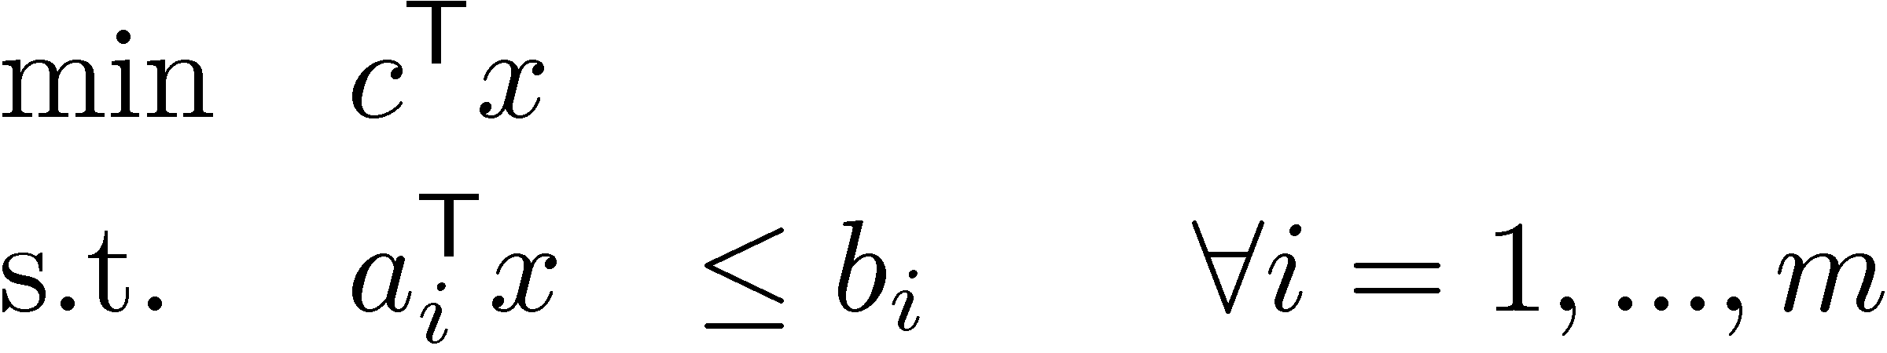
Linear Program
General definition
  Parameters: c, a₁,…,a_{m}2R^{n}, b1,…,bm2R
  Variables: x2R^{n}
Terminology
  Feasible point: any x satisfying constraints
  Optimal point: any feasible x that minimizes obj. func
  Optimal value: value of obj. func for any optimal point
Objective function
Constraints

Slide 3
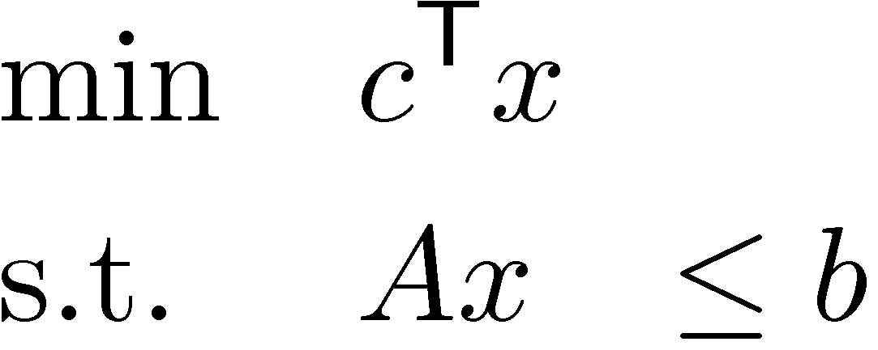
Linear Program
General definition
  Parameters: c, a₁,…,a_{m}2R^{n}, b1,…,bm2R
  Variables: x2R^{n}
Matrix form
  Parameters: c2R^{n}, A2R^{m£n}, b2R^{m}
  Variables: x2R^{n}

Slide 4
Simple LP Manipulations
“max” instead of “min”
  max c^{T} x ´ min –c^{T} x
“¸” instead of “·”
  a^{T}x ¸ b , -a^{T}x · -b
“=” instead of “·”
  a^{T}x=b , a^{T}x · b and a^{T}x ¸ b
Note: “<“ and “>” are not allowed in constraints
Because we want the feasible region to be closed, in the topological sense.

Slide 5
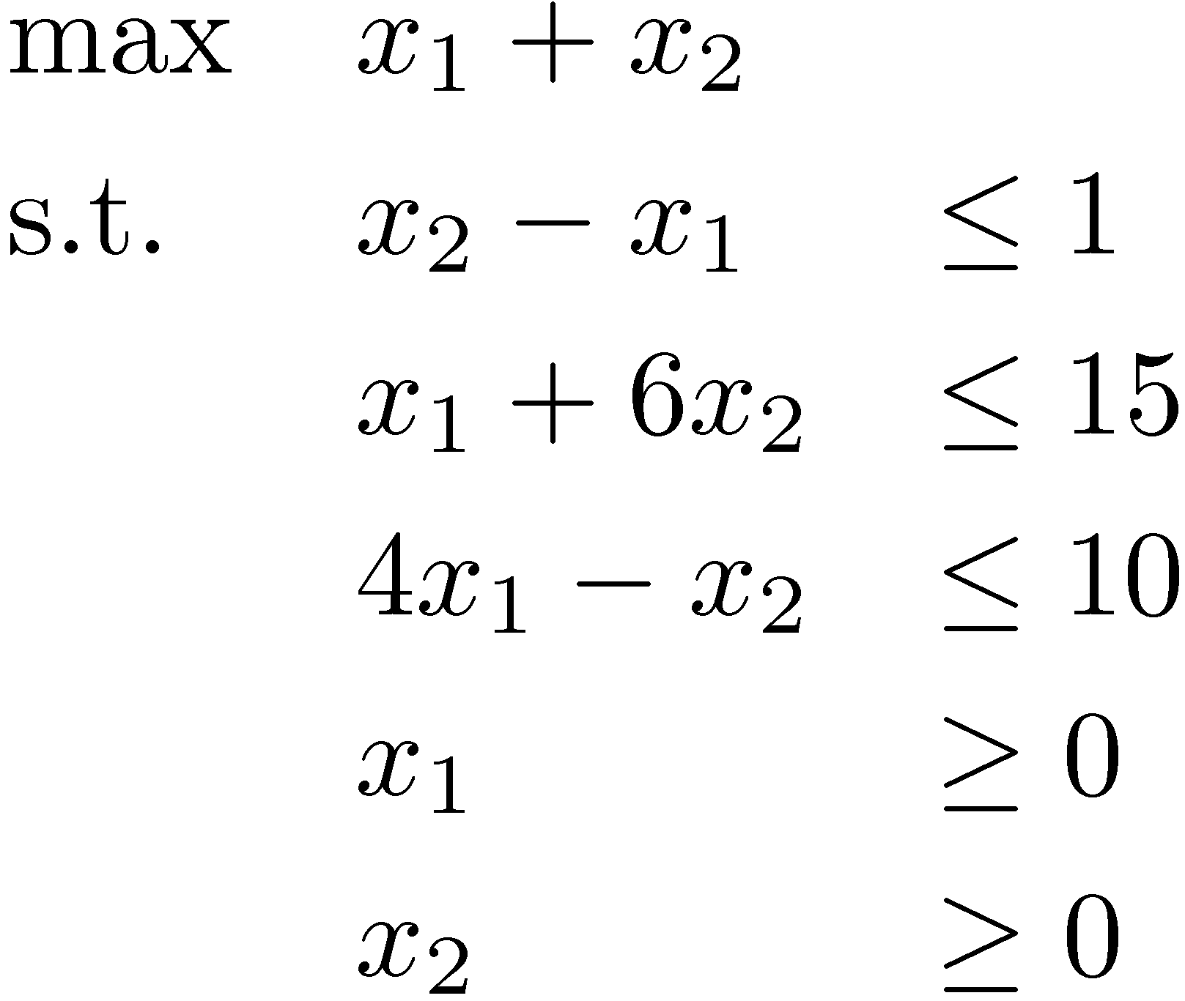
2D Example
Objective Function
Constraint
x₂
x₂ - x₁ · 1
Optimal
point
(3,2)
x₁ + 6x₂ · 15
Feasible region
Gradient of
Objective Function
x₂¸0
x₁
(0,0)
x₁¸0
4x₁ - x₂ · 10
Unique optimal solution exists
Notes:
This example is from Matousek-Gartner, Chapter 1

Slide 6
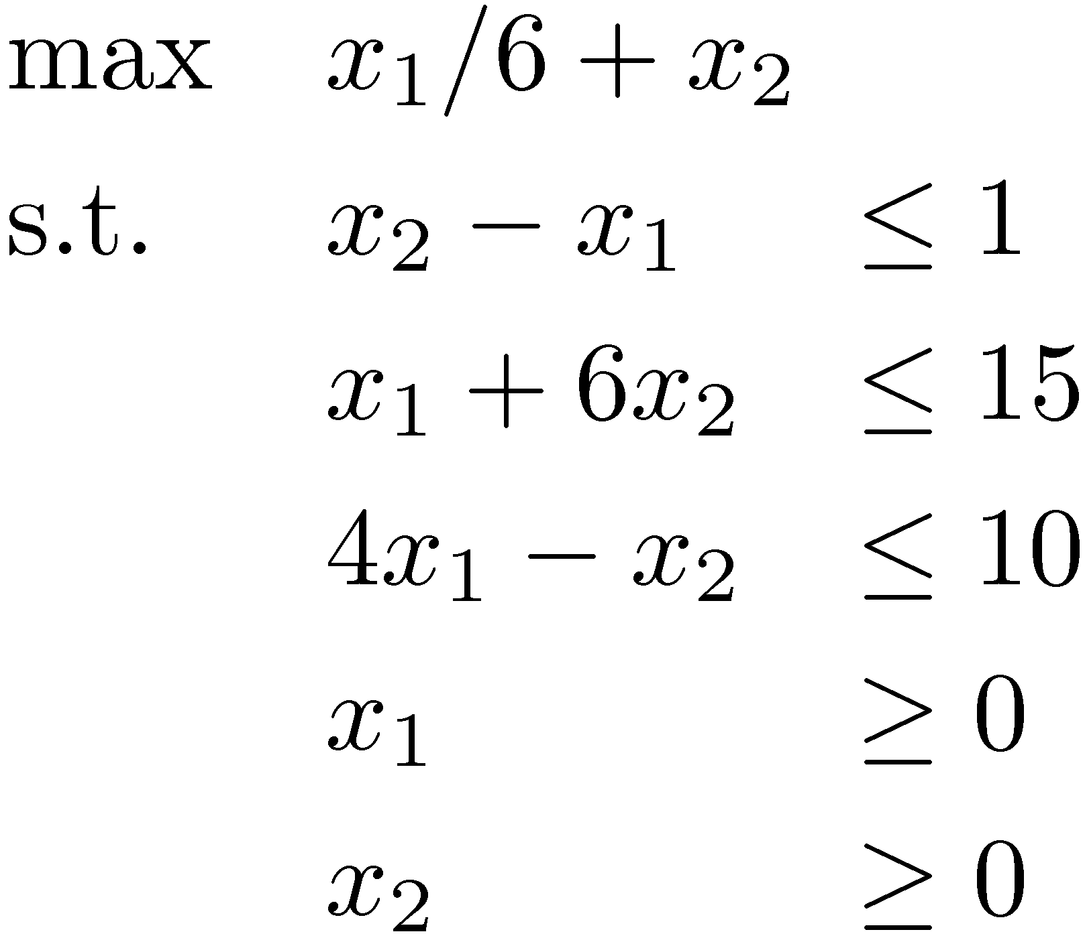
2D Example
Objective Function
Constraint
x₂
x₂ - x₁ · 1
Optimal
points
x₁ + 6x₂ · 15
Feasible region
Gradient of
Objective Function
x₂¸0
x₁
(0,0)
x₁¸0
4x₁ - x₂ · 10
Optimal solutions exist:
Infinitely many!
Notes:
This example is from Matousek-Gartner, Chapter 1

Slide 7

2D Example
Constraint
x₂
x₂ - x₁ ¸ 1
x₁ + 6x₂ · 15
Feasible region
is empty
Gradient of
Objective Function
x₂¸0
x₁
(0,0)
x₁¸0
4x₁ - x₂ ¸ 10
Infeasible
No feasible solutions
(so certainly no optimal solutions either)
Notes:
This example is from Matousek-Gartner, Chapter 1

Slide 8
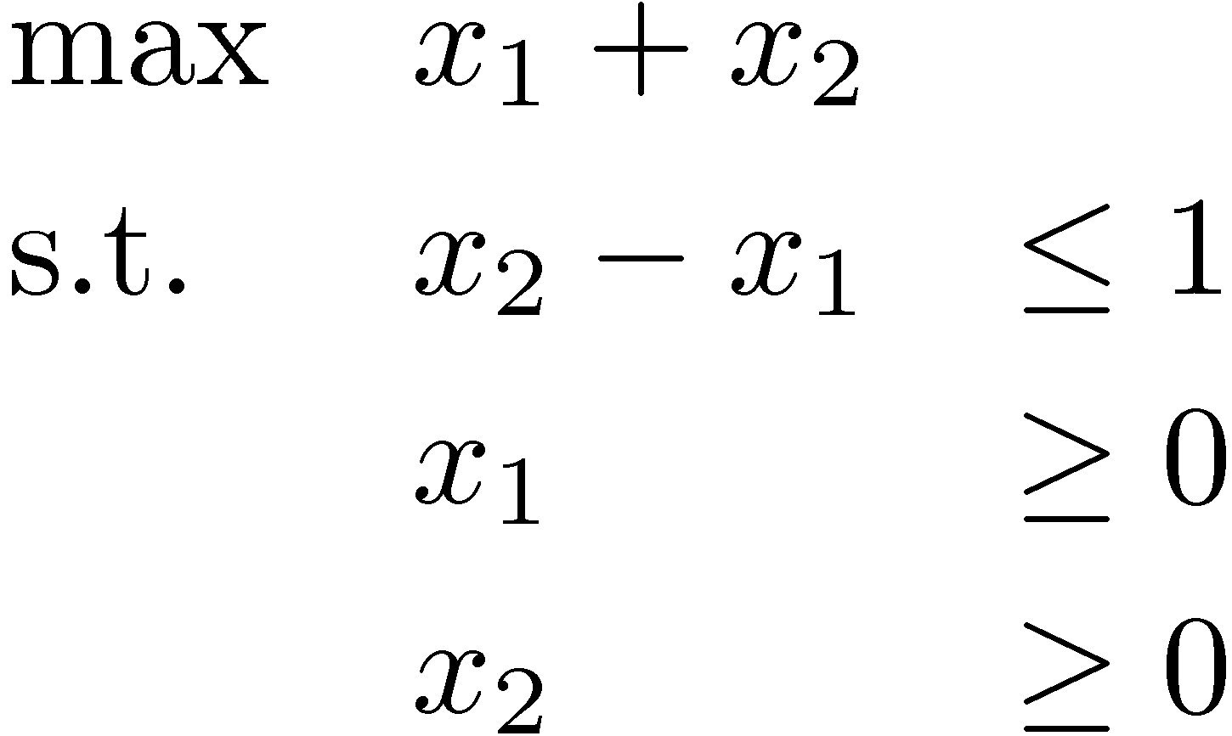
2D Example
Constraint
x₂
x₂ - x₁ · 1
Gradient of
Objective Function
x₂¸0
x₁
(0,0)
x₁¸0
Feasible region
Unbounded
Feasible solutions, but no optimal solution
(Informally, “optimal value = 1”)
Notes:
This example is from Matousek-Gartner, Chapter 1
“Unbounded” means the objective value can shoot off to infinity.

Slide 9
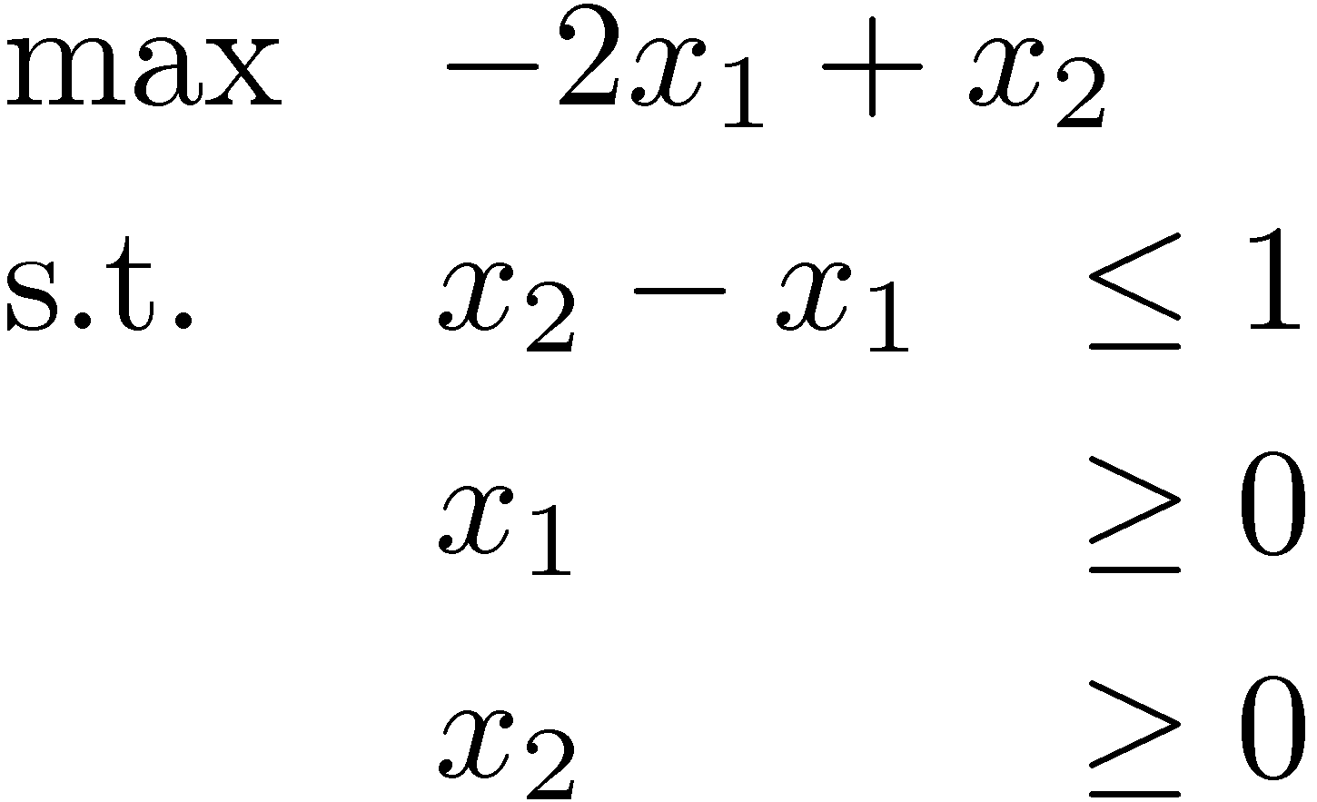
2D Example
Constraint
x₂
x₂ - x₁ · 1
Optimal point (0,1)
Gradient of
Objective Function
x₂¸0
x₁
(0,0)
x₁¸0
Feasible region
Important Point: This LP is NOT unbounded.
The feasible region is unbounded,
but optimal value is 1
Notes:
This example is from Matousek-Gartner, Chapter 1
Here the feasible region is infinitely big, but the objective value does not shoot off to infinity.

Slide 10
“Fundamental Theorem” of LP
Theorem: For any LP, the outcome is either:
  Optimal solution (unique or infinitely many)
  Infeasible
  Unbounded
  (optimal value is 1 for maximization problem,
  or -1 for minimization problem)
The main point is: if the LP is feasible and not unbounded, then the supremum is achieved.
Notes:
Cunningham-Lewis p13, or Theorem 2.12
Matousek-Gartner Theorem 4.2.3

Slide 11
Example: Bipartite Matching
Given bipartite graph G=(V, E)
Find a maximum size matching
  A set M µ E s.t. every vertex has at most one incident edge in M
Notes:
See http://en.wikipedia.org/wiki/Matching_%28graph_theory%29

Slide 12
Example: Bipartite Matching
Given bipartite graph G=(V, E)
Find a maximum size matching
  A set M µ E s.t. every vertex has at most one incident edge in M
The blue edges are a matching M

Slide 13
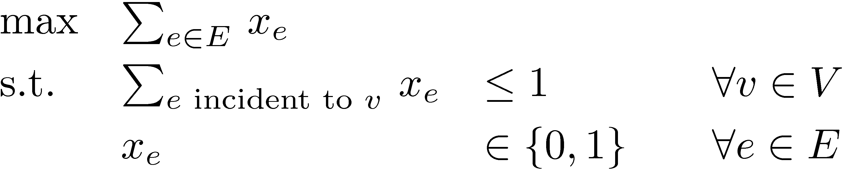
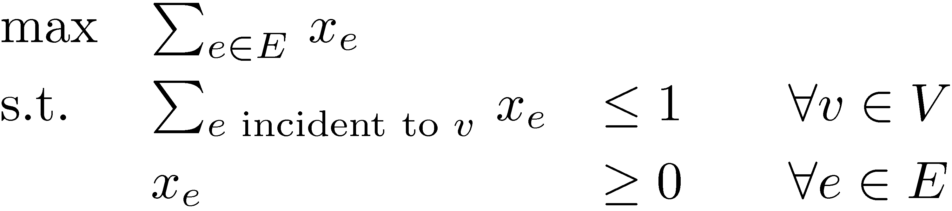
Example: Bipartite Matching
Given bipartite graph G=(V, E)
Find a maximum size matching
  A set M µ E s.t. every vertex has at most one incident edge in M
The natural integer program
(IP)
Solving IPs is very hard. Try an LP instead.
(LP)
Theorem: (IP) and (LP) have the same solution!
Proof: Later in the course!
Corollary: Bipartite matching can be solved by LP algorithms.
Notes:
The point here is that:
- natural combinatorial problems can be modeled by IPs.
- sometimes you can solve IPs by solving LPs.
This is an example of why LPs are very useful for designing algorithms.

Slide 14
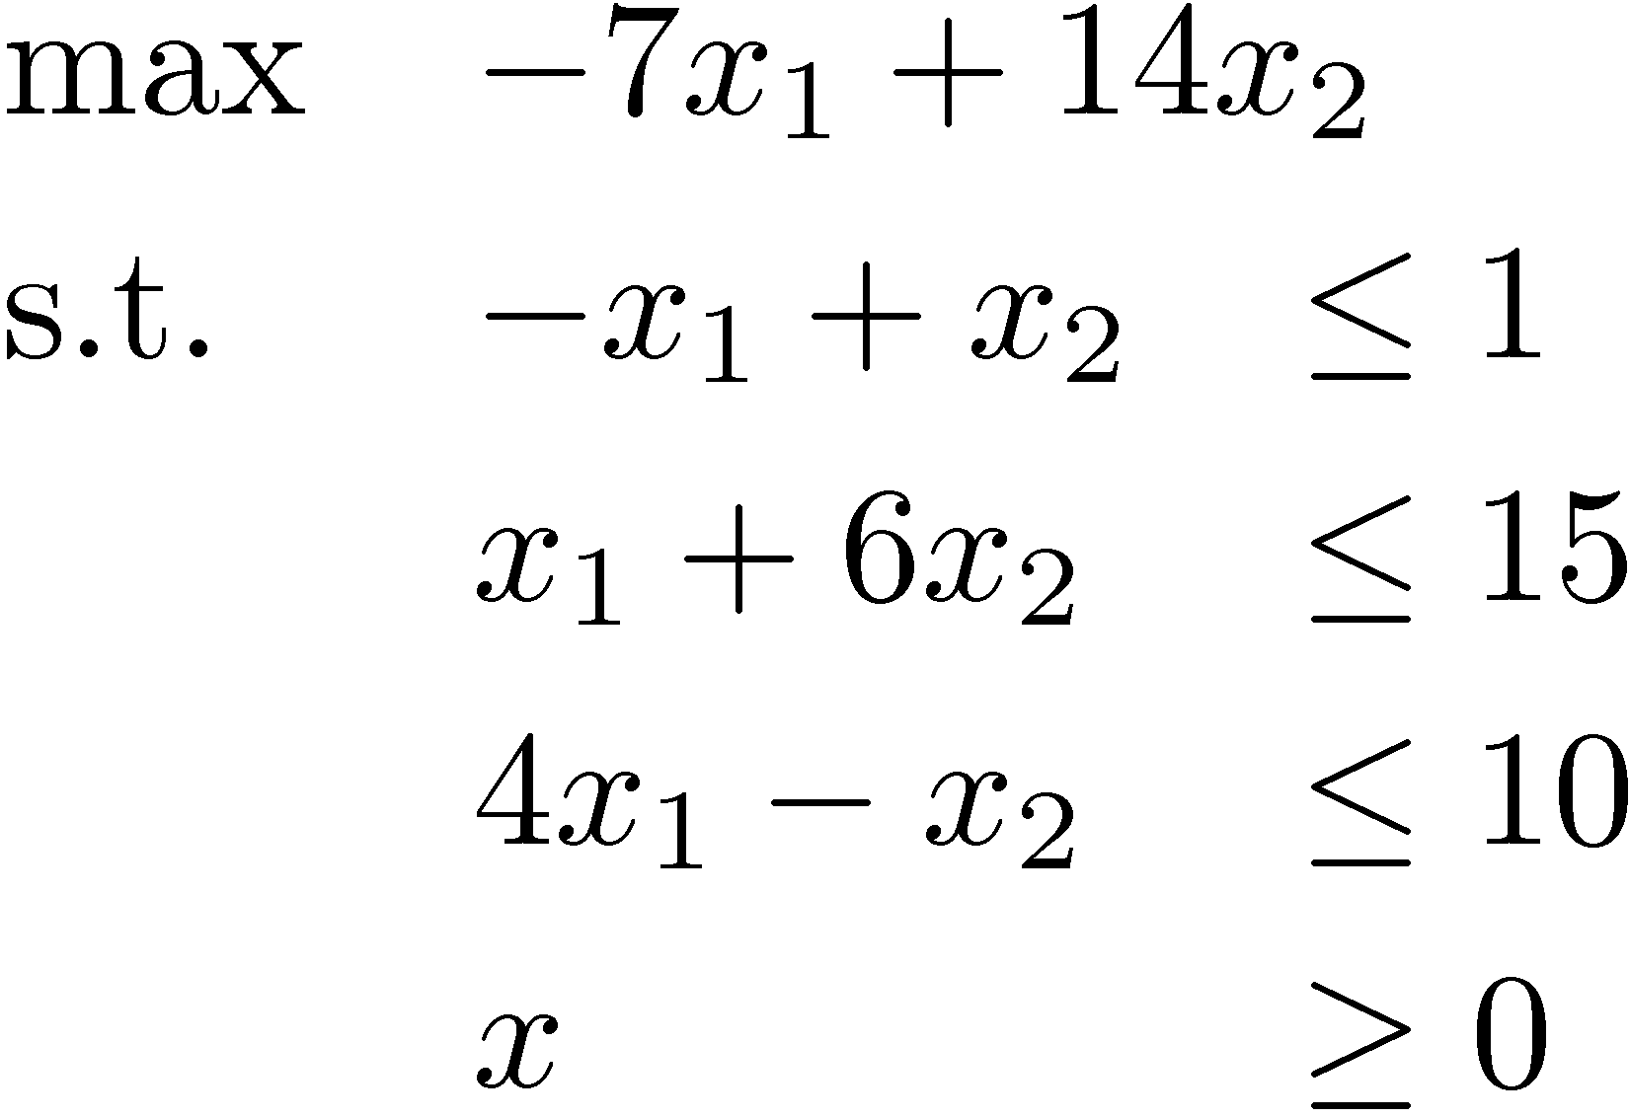
Duality: Proving optimality
Question: What is optimal point in direction c = (-7,14)?
Solution: Optimal point is x=(9/7,16/7), optimal value is 23.
How can I be sure?
  Every feasible point satisfies x₁+6x₂ · 15
  Every feasible point satisfies -x₁+x₂ · 1
  Every feasible point satisfies their sum: -7x₁+14x₂ · 23
) -8x₁+8x₂ · 8
x₂
This is the objective function!
(9/7,16/7)
-x₁+x₂ · 1
x₁ + 6x₂ · 15
x₁
4x₁ - x₂ · 10
Notes:
This topic is called “duality”. It is quite deep.
But don’t worry if you don’t understand it yet, this just an introductory example.
We’ll revisit this topic later.
Similar examples: Cunningham-Lewis page 14 and Matousek-Gartner page 81.

Slide 15
Duality: Proving optimality
Question: What is optimal point in direction c = (-7,14)?
Solution: Optimal point is x=(9/7,16/7), optimal value is 23.
How can I be sure?
  Every feasible point satisfies x₁+6x₂ · 15
  Every feasible point satisfies -x₁+x₂ · 1 ) -8x₁+8x₂ · 8
  Every feasible point satisfies their sum: -7x₁+14x₂ · 23
This is the objective function!
Certificates
  To convince you that optimal value is ¸ k, I can find x such that c^{T} x ¸ k.
  To convince you that optimal value is · k, I can find a linear combination of the constraints which proves that c^{T} x · k.
“Strong Duality Theorem”: Such certificates always exists.
Notes:
This is the “strong duality theorem of linear programming”.
See Matousek-Gartner Page 83, or Cunningham-Lewis Theorem 2.10.
In fact, Matousek-Gartner contains 5 proofs, all in Chapter 6.

Slide 16
Duality: Geometric View
Suppose c=[-1,1]
Then every feasible x satisfies c^{T}x = -x₁+x₂ · 1
If this constraint is tight at x ) x is optimal
i.e. -x₁+x₂=1
i.e. x lies on the red line
(because equality holds here)
x₂
-x₁+x₂· 1
x₁ + 6x₂ · 15
Objective Function c
x₁

Slide 17
Duality: Geometric View
Suppose c=[1,6]
Then every feasible x satisfies c^{T}x = x₁+6x₂ · 15
If this constraint is tight at x ) x is optimal
i.e. x₁+6x₂=15
i.e. x lies on the red line
(because equality holds here)
x₂
-x₁+x₂· 1
x₁ + 6x₂ · 15
Objective Function c
x₁

Slide 18
Duality: Geometric View
Suppose c=®¢[1,6], where ®¸0
Then every feasible x satisfies c^{T}x = ®¢(x₁+6x₂)·15®
If this constraint is tight at x ) x is optimal
i.e. x₁+6x₂=15
i.e. x lies on the red line
(because equality holds here)
x₂
-x₁+x₂· 1
x₁ + 6x₂ · 15
Objective Function c
x₁

Slide 19
Duality: Geometric View
What if c does not align with any constraint?
Can we “generate” a new constraint aligned with c?
x₂
-x₁+x₂· 1
x₁ + 6x₂ · 15
Objective Function c
x₁

Slide 20
Duality: Geometric View
Can we “generate” a new constraint aligned with c?
One way is to “average” the tight constraints
Example: Suppose c = u+v.
Then every feasible x satisfies
c^{T}x = (u+v)^{T}x = (-x₁+x₂) + (x₁+6x₂) · 1 + 15 = 16
x is feasible and both constraints tight ) x is optimal
v=[1,6]
u=[-1,1]
-x₁+x₂· 1
x₂
x₁+6x₂·15
Objective Function c
x₁

Slide 21
Duality: Geometric View
Can we “generate” a new constraint aligned with c?
One way is to “average” the tight constraints
More generally: Suppose c = ®u+¯v for ®,¯¸0
Then every feasible x satisfies
c^{T}x = (®u+¯v)^{T}x = ®(-x₁+x₂) + ¯(x₁+6x₂) · ®+15¯
x is feasible and both constraints tight ) x is optimal
v=[1,6]
u=[-1,1]
-x₁+x₂· 1
x₂
x₁+6x₂·15
Objective Function c
x₁

Slide 22
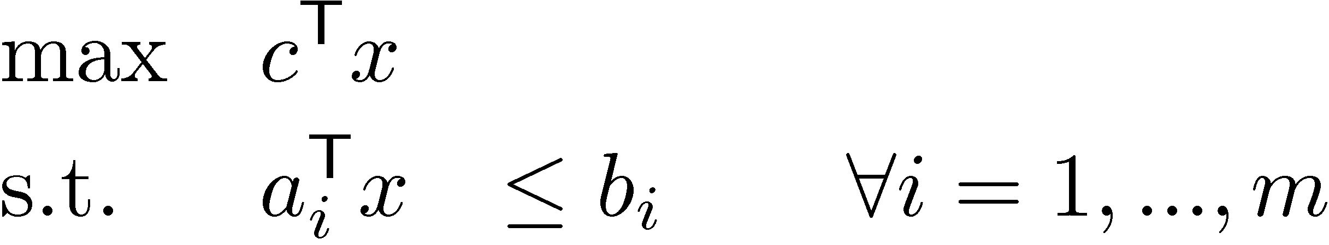
Duality: Algebraic View
Definition: A new constraint a^{T}x·b is valid if it is satisfied by all feasible points
x feasible ) a₁^{T} x · b₁ and a₂^{T} x · b₂
) (a₁+a₂)^{T} x · b₁+b₂ (new valid constraint)
More generally, for any ¸₁,…,¸_{m}¸0
x feasible ) (§_{i} ¸_{i}a_{i})^{T} x · §_{i} ¸_{i}b_{i} (new valid constraint)
“Any non-negative linear combination of the constraints gives a new valid constraint”
To get upper bound on objective function c^{T}x, need (§_{i} ¸_{i}a_{i}) = c
(because then our new valid constraint shows c^{T} x · §_{i} ¸_{i}b_{i})
Want best upper bound ) want to minimize §_{i} ¸_{i}b_{i}
Notes:
Note: This is not quite the same as what appears in Cunningham-Lewis Section 2.2 because they also assume x >= 0. In that case, you can relax the condition “\sum_i \lambda_i a_i = c” to“\sum_i \lambda_i a_i <= c”. See “Rules for Duals” below.

Slide 23
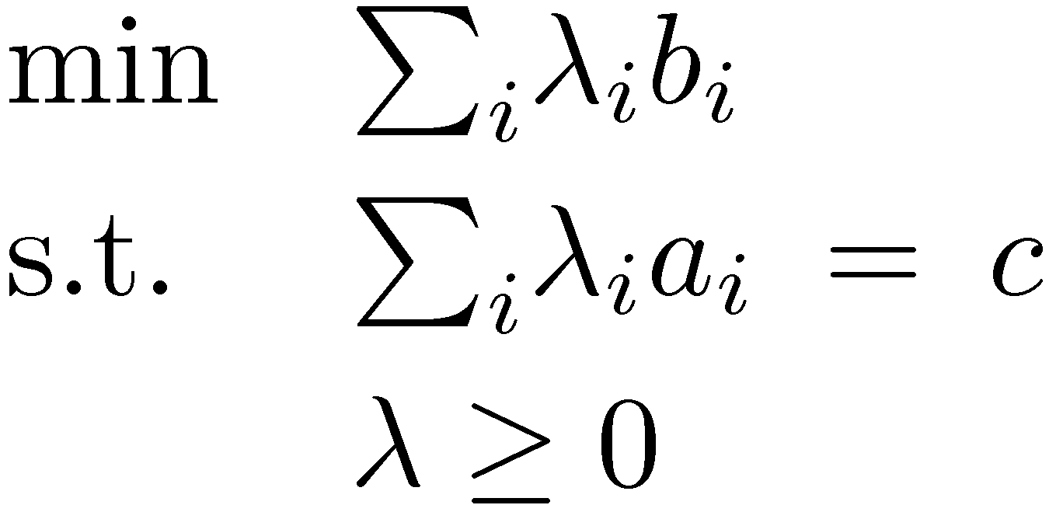
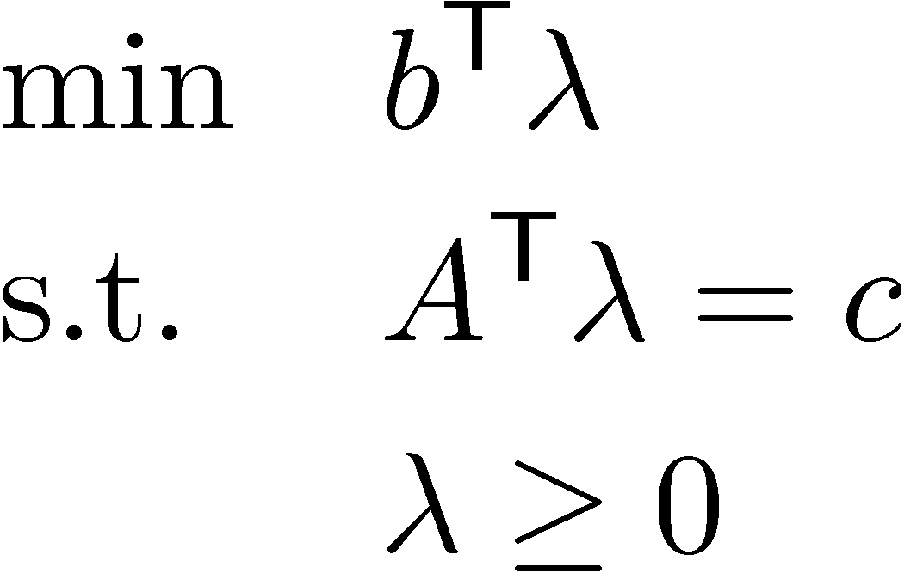
Duality: Algebraic View
Primal LP
To get upper bound on objective function c^{T}x, need (§_{i} ¸_{i}a_{i}) = c
Want best upper bound ) want to minimize §_{i} ¸_{i}b_{i}
We can write this as an LP too!
´
Dual LP
Theorem: “Weak Duality Theorem”
If x feasible for Primal and ¸ feasible for Dual then c^{T}x · b^{T}¸.
Proof: c^{T} x = (A^{T} ¸)^{T} x = ¸^{T} A x · ¸^{T} b. ¥
Since ¸¸0 and Ax·b
Notes:
Cunningham-Lewis Prop 2.1

Slide 24
Duality: Algebraic View
Primal LP
To get upper bound on objective function c^{T}x, need (§_{i} ¸_{i}a_{i}) = c
Want best upper bound ) want to minimize §_{i} ¸_{i}b_{i}
We can write this as an LP too!
´
Dual LP
Theorem: “Weak Duality Theorem”
If x feasible for Primal and ¸ feasible for Dual then c^{T}x · b^{T}¸.
Corollary: If x feasible for Primal and ¸ feasible for Dual and c^{T}x = b^{T}¸
then x optimal for Primal and ¸ optimal for Dual.
Notes:
Cunningham-Lewis Cor 2.2

Slide 25

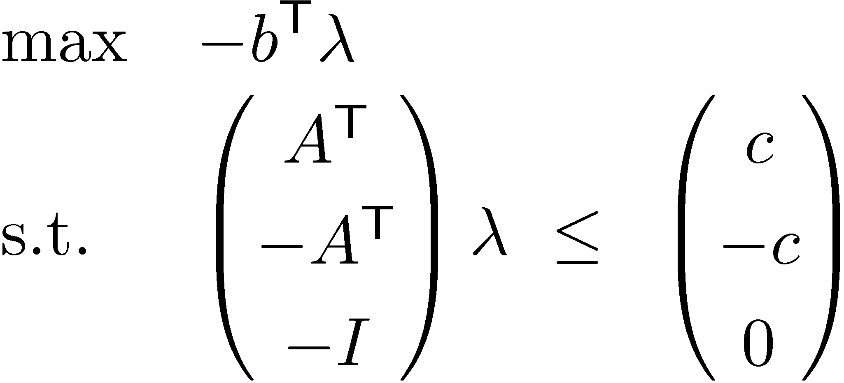
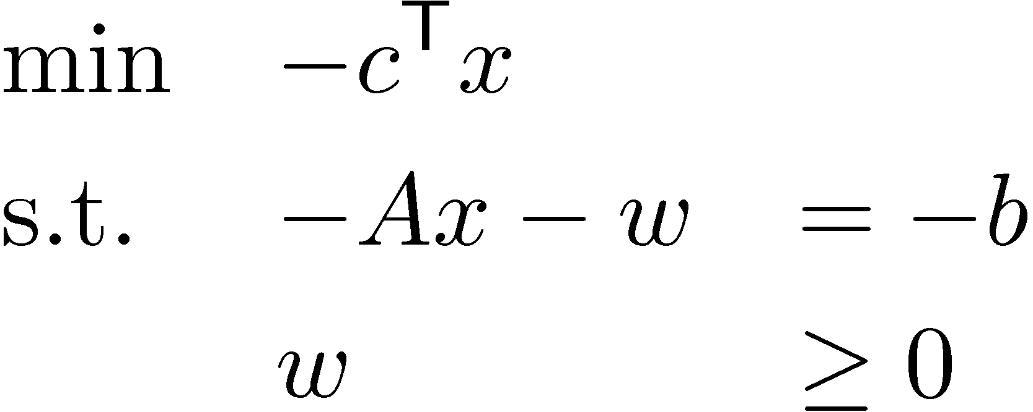
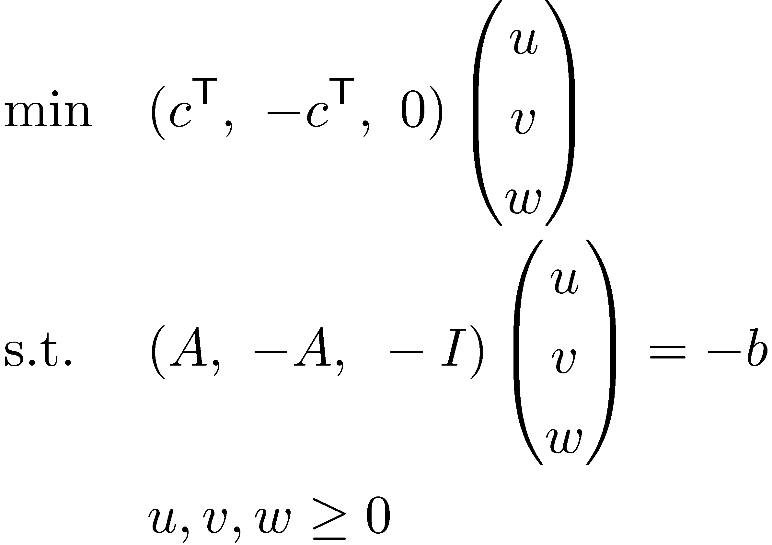
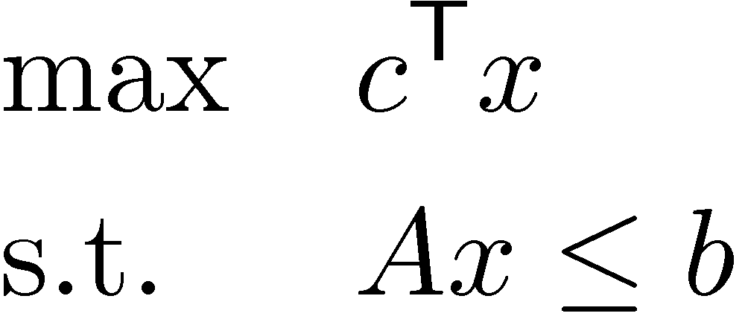
Dual of Dual
A has size m x n
c 2 R^{n} and b 2 R^{m}
Dual LP
Inequality Form
´
transpose
transpose
transpose
Dual of Dual
new variables
(non-negative)
Let x = v-u
u2R^{n}
v2R^{n}
w2R^{m}
´
´
Primal:
Conclusion: “Dual of Dual is Primal!”

Slide 26
Primal vs Dual
Fundamental Theorem of LP: For any LP, the outcome is either:
Infeasible, Unbounded, Optimum Point Exists.
Weak Duality Theorem:
If x feasible for Primal and ¸ feasible for Dual then c^{T}x · b^{T}¸.
Primal
(maximization)
Exercise!
 | Infeasible | Unbounded | Opt. Exists
Infeasible
Unbounded
Opt. Exists
Dual
(minimization)
Possible
Possible
Impossible
Possible
Impossible
Impossible
Impossible
Impossible
Possible
Strong Duality Theorem:
If Primal has an opt. solution x, then Dual has an opt. solution ¸.
Furthermore, optimal values are same: c^{T}x = b^{T}¸.
Notes:
See Cunningham-Lewis Thm 2.5

Slide 27

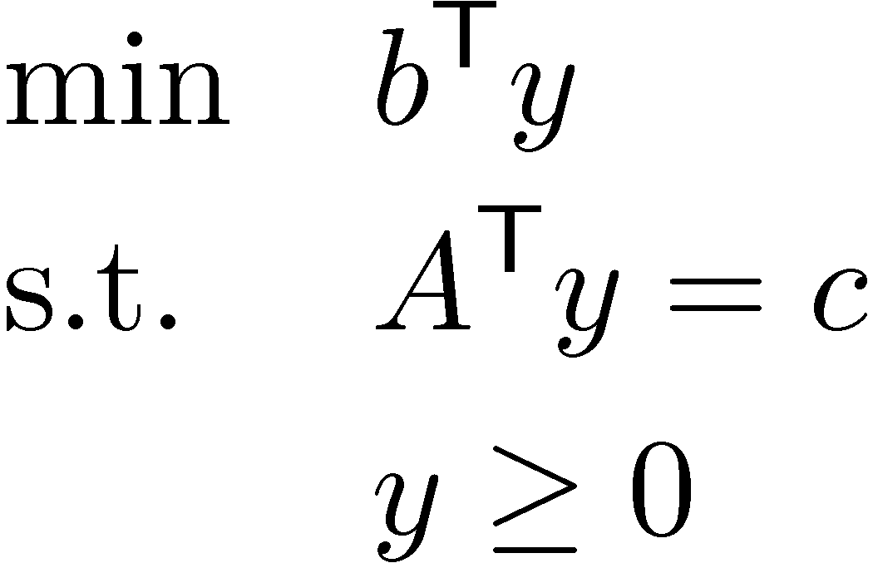
Strong Duality
Primal LP:
Dual LP:
Strong Duality Theorem:
Primal has an opt. solution x , Dual has an opt. solution y.
Furthermore, optimal values are same: c^{T}x = b^{T}y.
Weak Duality implies c^{T}x·b^{T}y. So strong duality says c^{T}x¸b^{T}y.
Restatement of Theorem:
Primal has an optimal solution
, Dual has an optimal solution
, the following system is solvable:
Punchline: Finding optimal primal & dual LP solutions
is equivalent to solving this system of inequalities.
Can we characterize when systems of inequalities are solvable?
(for any feasible x,y)
(for optimal x,y)
Notes:
Cunningham-Lewis (2.10)

Slide 28
Systems of Equalities
Lemma: Exactly one of the following holds:
  There exists x satisfying Ax=b
  There exists y satisfying y^{T}A=0 and y^{T}b>0
Geometrically…
(b is in column space of A)
x₂
span(A₁,…,A_{n}) = column space of A
b
A₁
A₂
x₁
x₃

Slide 29
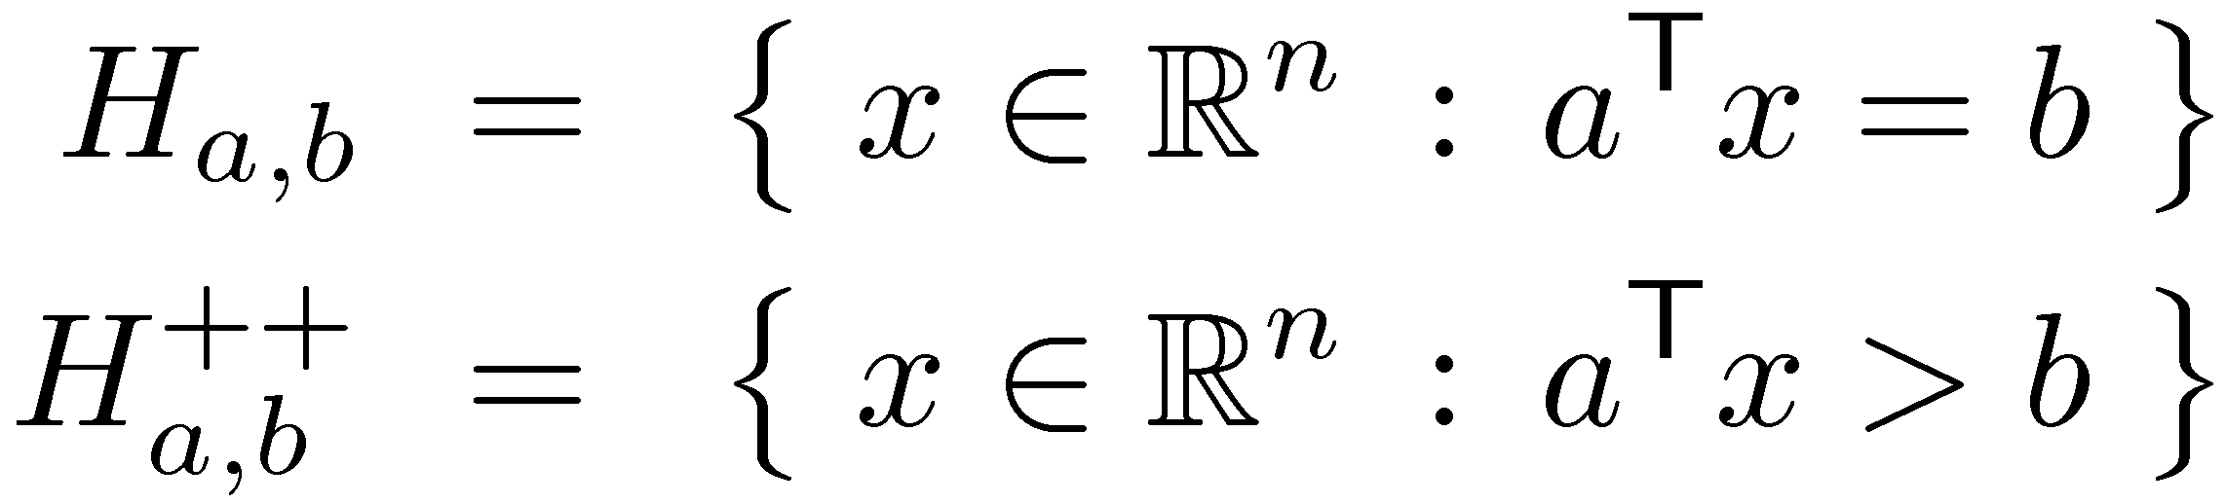
Systems of Equalities
Lemma: Exactly one of the following holds:
  There exists x satisfying Ax=b (b is in column space of A)
  There exists y satisfying y^{T}A=0 and y^{T}b>0 (or it is not)
Geometrically…
col-space(A)µH_{y,0} but b2H_{y,0}
++
Hyperplane
Positive open halfspace
b
y
x₂
column space of A
A₂
x₁
H_{a,0}
A₁
x₃

Slide 30
Systems of Inequalities
Lemma: Exactly one of the following holds:
  There exists x¸0 satisfying Ax=b
  There exists y satisfying y^{T}A¸0 and y^{T}b<0
Geometrically…
Let cone(A₁,…,A_{n}) = { §_{i} x_{i}A_{i} : x¸0 } “cone generated by A₁,…,A_{n}”
(Here A_{i} is the i^{th} column of A)
(b is in cone(A₁,…,A_{n}))
x₂
b
cone(A₁,…,A_{n})
A₂
A₃
A₁
x₁
x₃

Slide 31
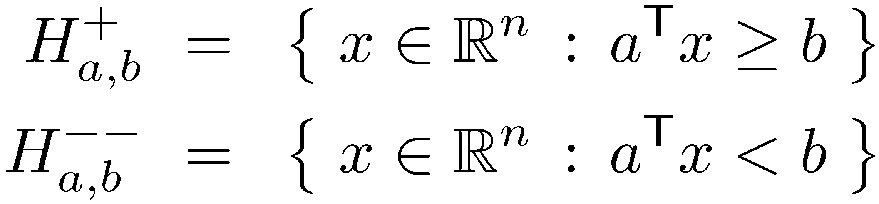
Systems of Inequalities
Lemma: Exactly one of the following holds:
  There exists x¸0 satisfying Ax=b (b is in cone(A₁,…,A_{n}))
  There exists y satisfying y^{T}A¸0 and y^{T}b<0
Geometrically…
(y gives a separating hyperplane)
+
--
cone(A₁,…,A_{n})2H_{y,0} but b2H_{y,0}
Positive closed halfspace
Negative open halfspace
x₂
y
cone(A₁,…,A_{n})
A₂
A₃
A₁
H_{y,0}
b
x₁
x₃

Slide 32
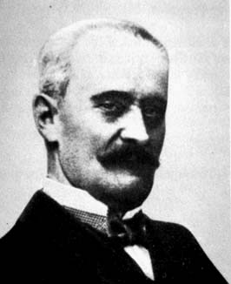
Systems of Inequalities
Lemma: Exactly one of the following holds:
  There exists x¸0 satisfying Ax=b (b is in cone(A₁,…,A_{n}))
  There exists y satisfying y^{T}A¸0 and y^{T}b<0 (y gives a “separating hyperplane”)
This is called “Farkas’ Lemma”
  It has many interesting proofs.
  It is “equivalent” to strong duality for LP.
  There are several “equivalent” versions of it.
Gyula Farkas

Slide 33
Variants of Farkas’ Lemma
Gyula Farkas
The System | Ax · b | Ax = b
has no solution x¸0 iff | 9y¸0, A^{T}y¸0, b^{T}y<0 | 9y2R^{n}, A^{T}y¸0, b^{T}y<0
has no solution x2R^{n} iff | 9y¸0, A^{T}y=0, b^{T}y<0 | 9y2R^{n}, A^{T}y=0, b^{T}y<0
These are all “equivalent”
(each can be proved using another)
This is the simple lemma on systems of equalities
Notes:
See p92 in Matousek-Gartner.
The bottom-left statement is Theorem 2.7 in Cunningham-Lewis

