Slide 1
Whose Cache Line
Is It Anyway?
Operating System Support for Live
Detection and Repair of False Sharing
Mihir Nanavati, Mark Spear, Nathan Taylor, Shriram Rajagopalan, Dutch T. Meyer, William Aiello, and Andrew Warfield
University of British Columbia

Slide 2


Slide 3


Slide 4

Mondriaan Memory Protection [ASPLOS ’02, SOSP ’05]

Slide 5

Byte-granularity, software-only remapping

Slide 6
False Sharing

Slide 8
+
Control VM (Dom0)
Target System
Xen
Hardware
Memory

Slide 9
Dynamic Detection
and
Mitigation
of
False Sharing

Slide 10
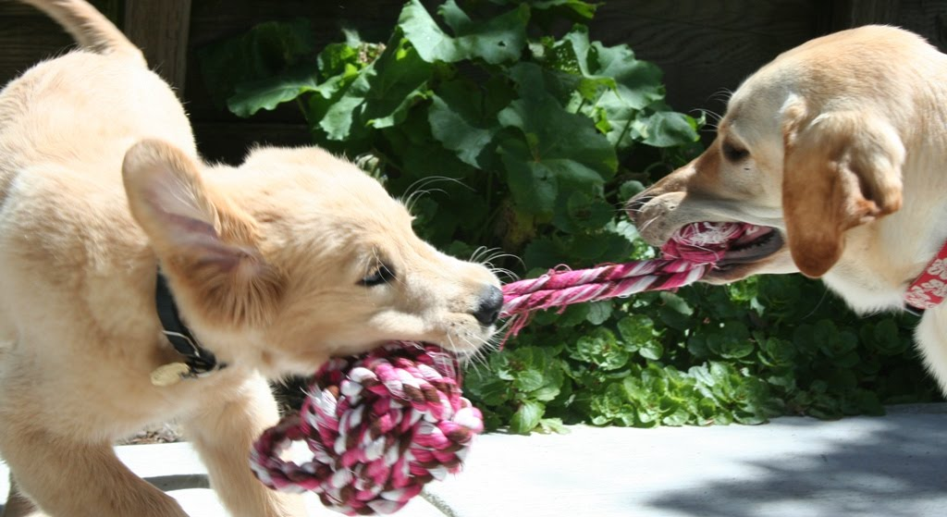

Slide 11
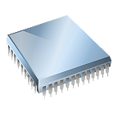
T1
T2
Write 0x300
Write 0x308
Read 0x300
Cache
0x300
0x340
Main Memory

Slide 12
Cache Line
C Structure
With Padding
With Allocator
Metadata

Slide 13
Time (s)
No. of Cores

Slide 14
Time (s)
No. of Cores

Slide 15
Time (s)
No. of Cores

Slide 16
Time (s)
No. of Cores

Slide 17
Time (s)
7.5x
No. of Cores
Linux Kernel [OSDI ’10], JVM [Dice, 2012],
Software Transactional Memory [HPCA ’06]

Slide 18
Dynamic Detection
and
Mitigation
of
False Sharing

Slide 19
Modify access locations
Modify access frequency
Sheriff [OOPSLA ’11]

Slide 20




Slide 21
T1
T2
Isolated Page
Underlay Page

Slide 22
Dynamic Detection
and
Mitigation
of
False Sharing

Slide 23
Persistent, high-frequency
false sharing

Slide 24
Very Fast and Imprecise
Fast and Somewhat Precise
Slow and Precise

Slide 25
Performance Counters
Log Page Reads
Instruction Emulation
Log-Analysis
Rules for
remapper
What are the byte ranges
being accessed?
What pages are involved
in the contention?
Does contention exist?
Does this signify
false sharing?

Slide 26
Dynamic Detection
and
Mitigation
of
False Sharing

Slide 27
T1
T2
Isolated Page
Underlay Page

Slide 28
Don’t be Evil
Harmful

Slide 29
Fault Driven Redirection

Slide 30


?!
It’s a Fault?!
Original Code
Code Cache

Slide 31
Original Code
Code Cache

Slide 32
Catch all accesses via data path
Avoid code trampolines
Amortize page fault cost

Slide 33

“Know When You are Beaten”

Slide 34
T1
T2
Isolated Page
Underlay Page

Slide 35
Evaluation

Slide 36
Remappings
Established
Progress (million records)
160 M/sec
110 M/sec
Time (ms)
Version with false sharing under Plastic
Coherence Invalidations
Source-fixed Version

Slide 37
CCBench
Phoenix
Parsec
Normalized Performance
5.4x
3.6x
1.4x

Slide 38
Low overhead runtime detection
Byte-granularity remapping
Speedup of up to 5.4x

Slide 39
Performance Optimizations
Security Enhancements

Slide 40


