Slide 1
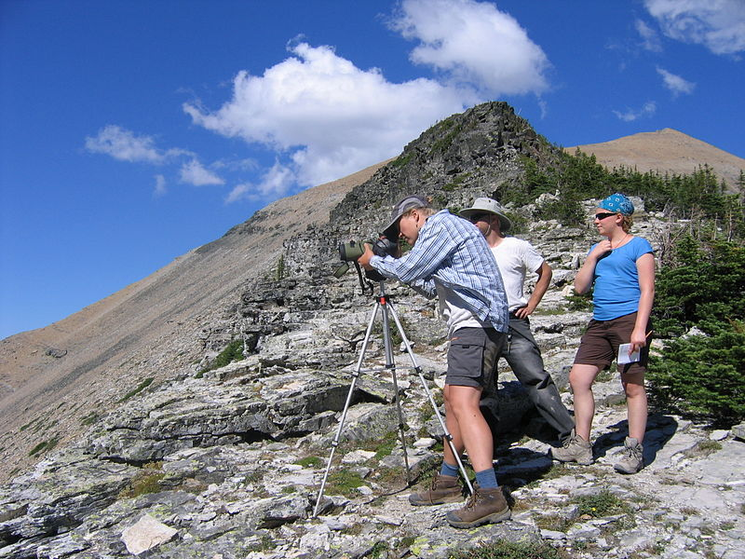





Citizen Science: People, Information, and Technology
Jennifer Preece, Professor & Dean, iSchool @ Maryland
biotracker.umd.edu
Notes:
From Abstract: Citizens have been informally contributing to science for hundreds of years. One of the best known modern examples is of sightings by bird watchers. The Christmas Bird Count, an annual national count in the USA, is one hundred years old and birdwatching activities date back to even earlier times in the UK and parts of Europe. This data informs scientific studies of bird migration and behavior, which in turn provide evidence of habitat loss, and changes in weather patterns.
Citizens contribute to many branches of science from astronomy, to biochemistry, hydrology, biodiversity, personalized medicine, and more. Increasingly digital devices including cell phones, sensors, cameras, databases and associated techniques for storing, retrieving, and communicating data, and many types of social media have been integrated into citizen science and other volunteer practices.

Slide 2
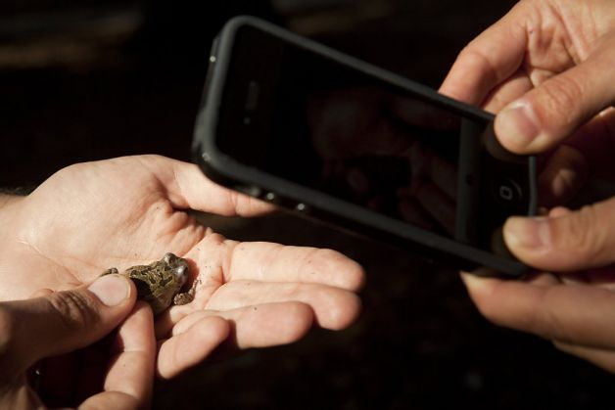
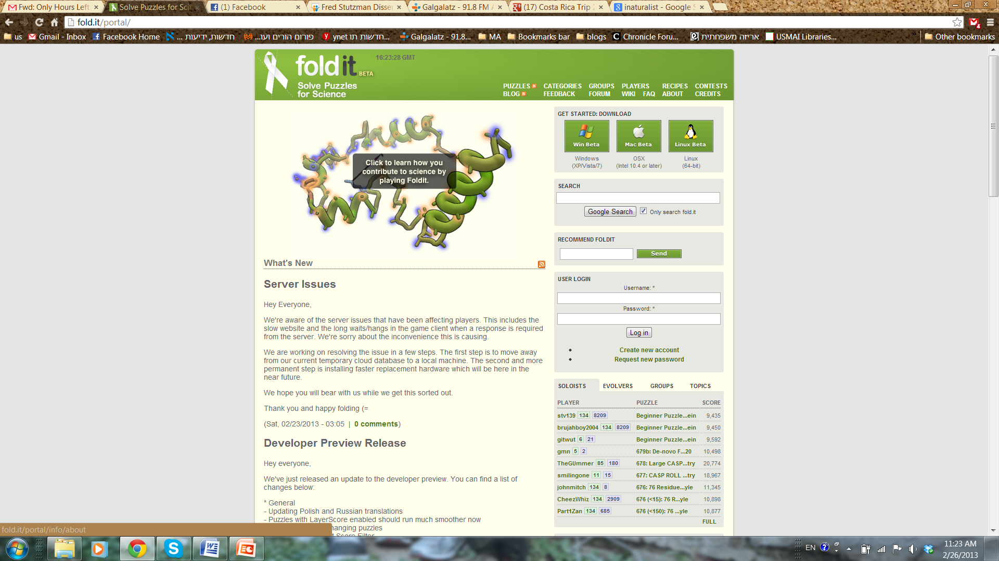
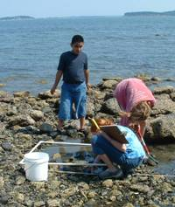
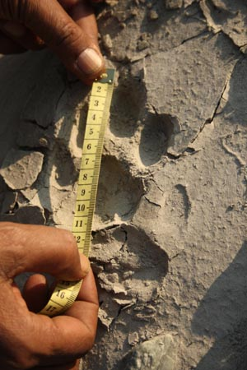
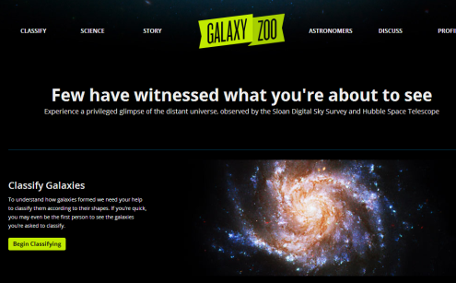
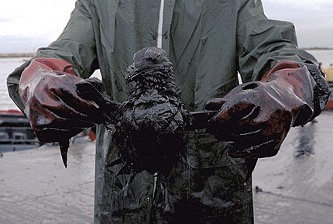
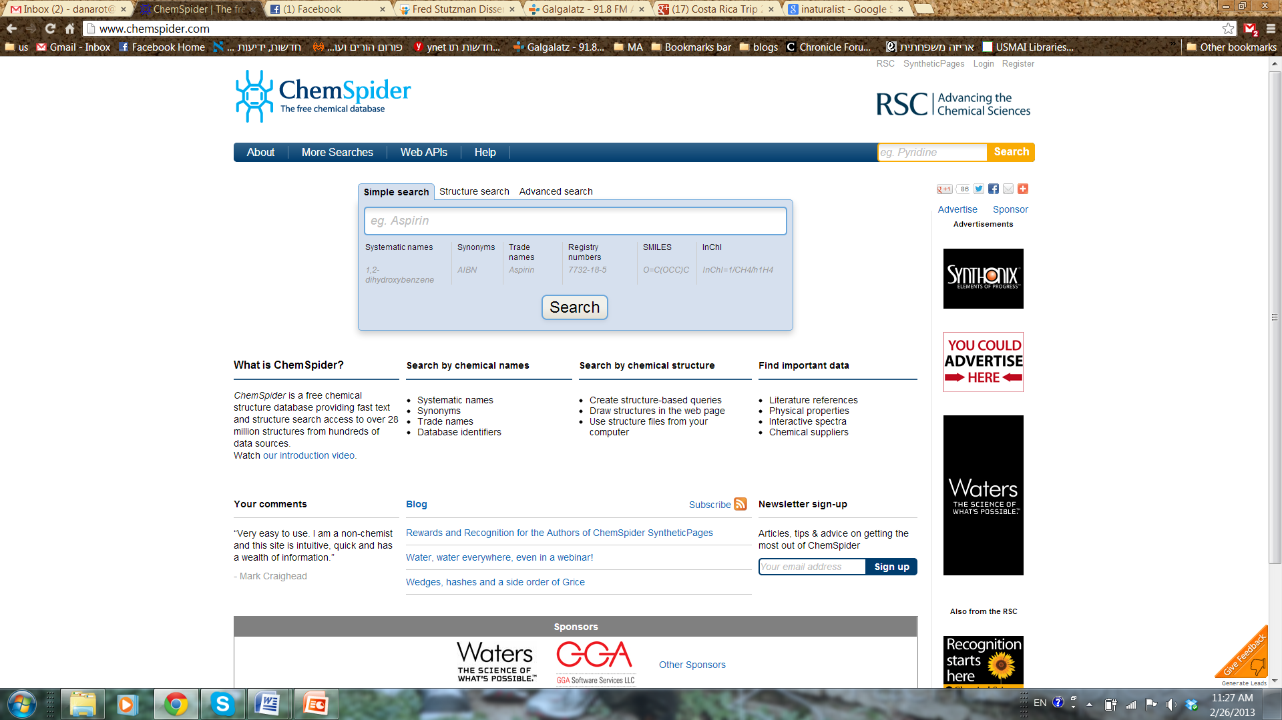
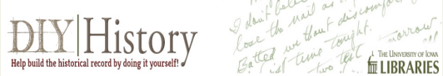
Citizen science
Notes:
Key points to address:
Citizen science includes projects in really diverse fields. Biodiversity, public health, chemistry, even archeology. These projects range from from those that can be done at home or in the backyard, such as sorting photographs of animals in order to document migration habits or counting the number and species of birds feeding from a birdfeeder, to remote and more complex fieldwork, including field observations, specimen collection, and long-term monitoring (see www.citizenscience.org and www.scistarter.org for a list of citizen science projects in the United States).
people of all ages, professions, occupations, and locations, take part in citizen science. Some times they just contribute data. Other times they engage in analysis or interpretation.
Projects can be place-based, virtual, or blended

Slide 3
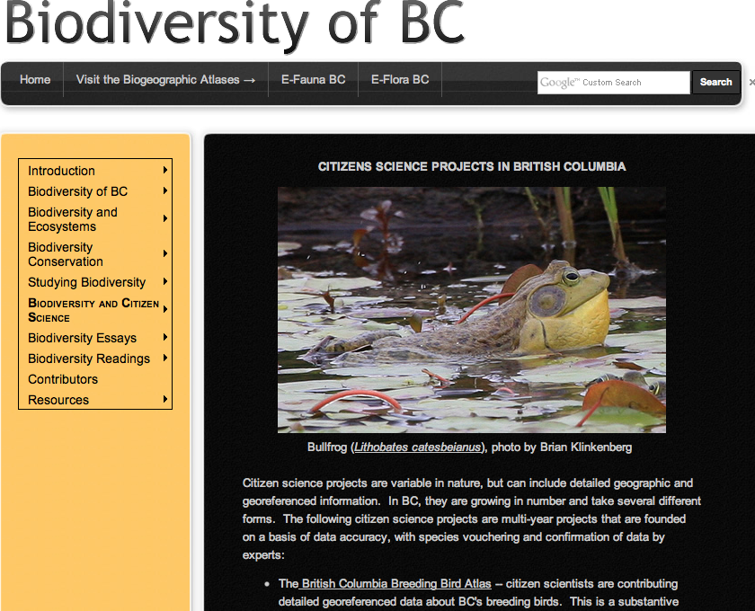

Slide 4
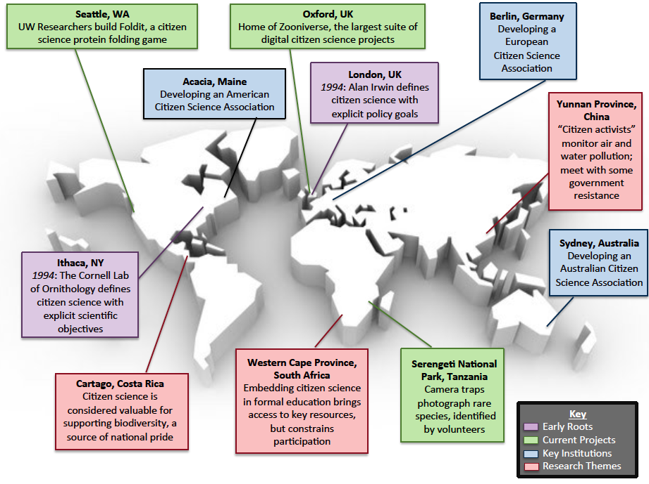
Notes:
Key points:
-Citizen Science has been practiced for hundreds of years, but the way it’s currently understood can be traced back to two places in the 1990s. The Cornell Lab of Ornithology started citizen science to help scientists with different problems about birds. Alan Irwin in the UK saw citizen science as a method for supporting citizen engagement in public policy.
- Right now a lot of really exciting things are happening. Projects increasingly take advantage of new technologies to scale up. The field is coming together as a whole. New associations are emerging across the world.

Slide 5

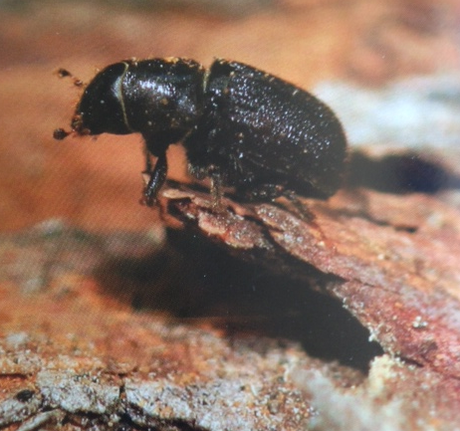
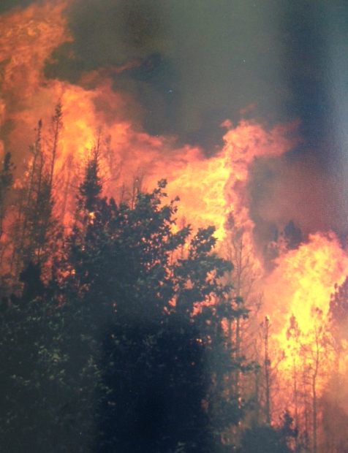
Issue 1
Citizen science addresses:
Biodiversity recorded before loss due to habitat destruction, climate change, etc.
e.g., Encyclopedia of Life (EOL)
  Large volume of data: camera, sound, sensor monitoring
  Field observations: vast geographic & temporal scales

Slide 6
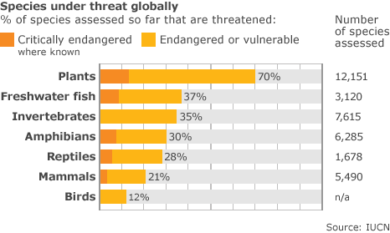
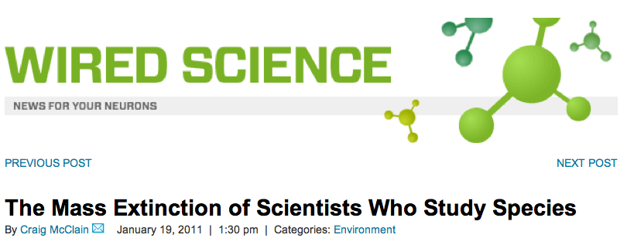
Notes:
2011 Wired article by Craig McClain
As you can see, many species are endangered, some of them critically so. At the same time that these species are getting scarcer, so are the scientists who study them, for various reasons, ranging from funding to popularity of the work. If we, as a society, think that it is important to document existing and vanishing species, relying on professional scientists to do so is just not enough anymore.

Slide 7
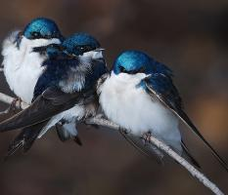
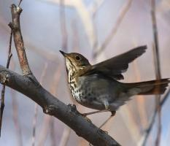
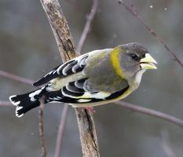
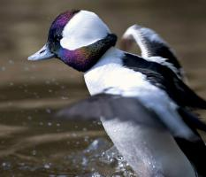
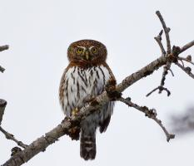
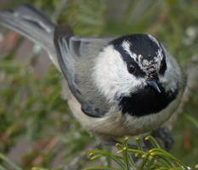
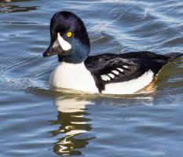

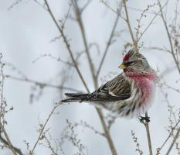
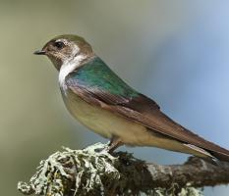
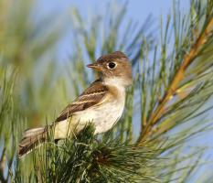
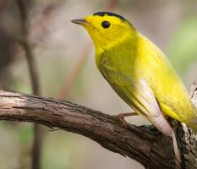
Birds at risk due to climate change
According to Audubon’s Birds & Climate Change report, more than half of the 588 North American bird species studied are expected to lose 50+% of their climatic range by 2080.
50 species in B.C.
http://climate.audubon.org/
Notes:
The recently released Audubon Birds and Climate Change report indicates that of 588 North American bird species, more than half are at risk from global warming and are expected to lose more than 50% of their current climactic range by 2080. 50 species in BC, Canada.
Of these, 126 species are considered “climate endangered” because they are projected to lose more than 50% of their current range by 2050.

Slide 8
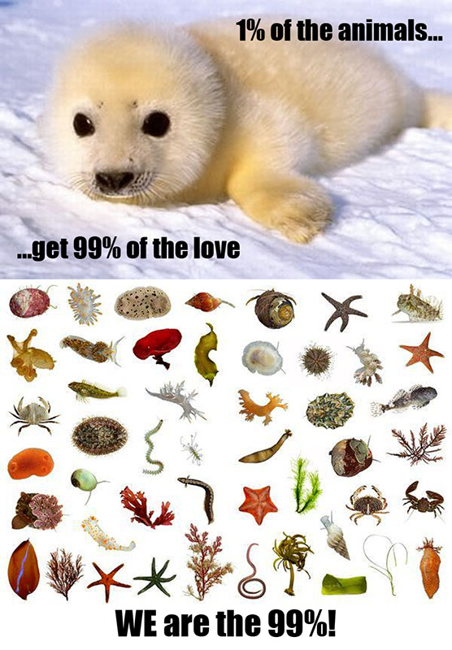
http://deepseanews.com/2011/10/we-are-the-99/

Slide 9
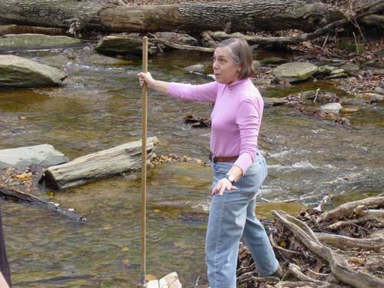
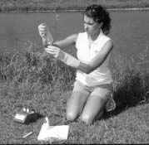
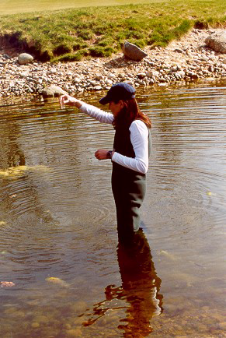
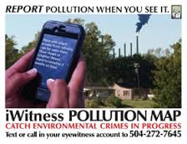
Issue 2
Citizen science can address:
Pollution – especially air & water quality
Climate change
Data is collected to monitor,
& mobilize support
  Effective grassroots activity
  Official intervention is often
    a second step
Notes:
E.g. Clean Air Coalition of Western New York

Slide 10
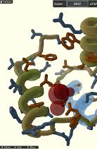
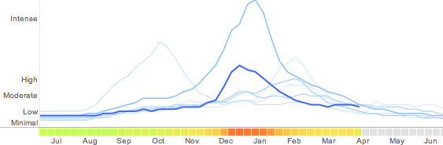
Issue 3
Citizen science can address:
Public health – Understanding threats to public health; supporting personal health; studying the spread/evolution of disease
  Many projects have significant personal value
  Clever ideas for involving public (e.g., Foldit and Nathan Eagle’s company Jana.com)

Slide 11
Citizen science brings together people,
information, and technology (Andrea Wiggins, 2014)
Notes:
Venn diagram by one researcher who studies citizen science and IS at the University of Maryland—Andrea Wiggins

Slide 12


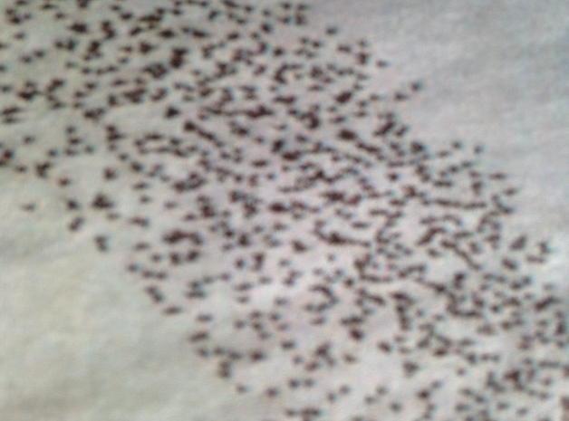
Key topics
Two key topics:
Community engagement & motivation
  How to motivate for short & long-term engagement
Data quality
  How to measure and ensure quality data

Slide 13



  Foundational Research
Motivation 1
Three independent cases:
United States, India, and Costa Rica
Country | Size and population (compared to other countries) | History of collaborative scientific projects | Institutional support and funding
United States | 3rd largest in size, 3rd in population | Since the 19th century | Government, NGOs, educational institutions (142 surveys, 13 interviews)
India | 7th largest in size, 2nd in population | Since the 1990s | NGOs, few educational institutions (156 surveys, 22 interviews)
Costa Rica | 127th largest in size, 121st in populations | Since 1970 | Government, local and global NGOs, local communities, educational institutions (9 interviews)
Notes:
Rotman (2013) conducted an exploratory study examining what draws volunteers to contribute initially to ecology-based citizen science projects, how their motivations change over time, and how culture might affect motivation. She collected survey and interview data from both professional scientists and volunteers in the USA, India, and Costa Rica. (142 surveys in USA; 156 in India; 13 interviews in USA; 22 India; 9 Costa Rica).
The cases differ in the dominant demographics and in the professions, backgrounds, and education of their participants. The countries, which differ in their placement on various cultural dimensions proposed by Hofstede (1980, 2001), were chosen primarily because they offer different histories of citizen science, variation in the ways in which citizen science is practiced, and differing levels of formal and institutional support for citizen science projects Sampling the different countries provided an opportunity to better understand the range of motivations and gain a more global perspective.
While the definition of “culture” is a matter for ongoing debate in various domains (Geertz, 1973; Kroeber & Kluckhohn, 1952; Malinowski, 1939), we consider “national culture” to be the structures, values, and relationships among members of a group situated in a specific geographic area during a certain period. In addition to national culture, there is a scientific culture that reflects the knowledge of science and attitudes toward science and technology, and a collaborative culture that encourages individuals to contribute towards a common good.
A national ethos is easier to construct in small and relatively homogenous countries like Costa Rica (which also has institutional supported and funded ecology projects), and is harder in a large and diverse country like India. The dozens of states and richness and diversity of social backgrounds contributed to alternative local ethos varying by geography and heritage in India. Highly individualistic cultures like the USA and parts of India favor individual initiatives and actions over collaborative ones and emphasize formal knowledge and professionalism. Collectivism is highly regarded and supported in Costa Rica.

Slide 14
Key Findings
Long-term Participation
Initial Participation
Within-project relationships
  Trust
  Common goals
  Acknowledgement
  Membership
External-project relationships
  Education and outreach
  Policy and activism
Demotivating factors
Time
Technology
Important:
Relationships & interaction between volunteers and scientists
Personal interest
Self-promotion
Self-efficacy
Social responsibility
Notes:
Rotman found that among volunteers, the motivation for initial participation was largely self-related. They wanted to participate in projects addressing their interests and offering opportunities for self-advancement and enjoyment. The exception to this was Costa Rica, where there was a collectivist motivation associated with a national expectation for individuals to be involved in conservation as an expected social commitment.
QUOTE:
“I think if you visit Costa Rica and you talk to a cop, driver, or maybe a bus driver or people that work in a restaurant, they will make you a conversation about the topics of environment and their importance, there’s a true moral thing.” (Jose, Costa Rica)
Attrition rates among volunteers studied by Rotman were estimated to range between 80-95 percent. A key factor that determined volunteers’ inclination to continue to participate was relationships within the project, especially between volunteers and scientists. Goal setting, clear communication, and acknowledgement of contributions also supported continuous participation.
QUOTE:
“Just a name and this X and that Y was contributed by this or that person. Something simple… is like a big thing for a normal person, this kind of thing make it very personal thing, and that way we encourage all to do it more …” (Suzan, USA)
The biggest demotivating factors for volunteers was an expectation that they spend “too much time” on a project (a subjective term). Projects that broke down tasks, focused on the volunteer’s immediate environment, and required an incremental time commitment were considered more manageable and fun. Technology that failed or was erratic was also a source of frustration to volunteers (noticed more in India and Costa Rica, where mobile and web connectivity could be poor in rural areas). In the United States, many volunteers found complex online reporting systems too burdensome and taxing to learn or use, and preferred simple interfaces or offline reporting tools.

Slide 15
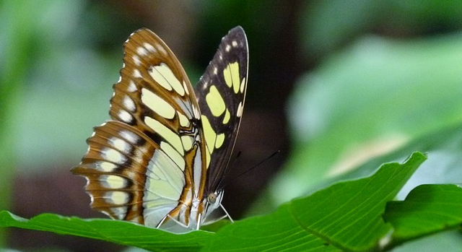
Summary—Motivation Study 1
People: Most volunteers have self-related motivations initially; continuing involvement requires feedback, especially from scientists who may lack time or interest in providing feedback.
Information: Scientists may not trust the data collected by volunteers; volunteers asked for open access to data, opportunities beyond data collection, and attribution.
Technology: Lack of access to technology and poor-performing technology can be demotivators. Paper and pencil may be best in some areas!
Notes:
From Dana’s diss: “And, in some cases, [projects] synthesize formal knowledge (which is highly respected and trusted) with indigenous knowledge (local traditions generated in the field and passed on from one generation to the next), to create a deeper body of resources that can be used by locals and professionals alike, with the needed adjustments for either population.
Data – scientists did not trust the data collected by volunteers
People – motivation of participants relies heavily on feedback especially from scientists who often regard volunteers as cheap labor
Technology – has to work and in some parts of the world paper may still be best

Slide 16
Suggested References
Rotman, D., et al. (2014). Does motivation in citizen science change with time and culture? In Proceedings of the Companion Publication of the 17th ACM Conference on Computer Supported Cooperative Work & Social Computing (pp. 229-232). New York: ACM.
Rotman, D., et al. (2014). Motivations affecting initial and long-term participation in citizen science projects in three countries. In iConference 2014 Proceedings (pp. 110-124). https://www.ideals.illinois.edu/bitstream/handle/2142/47301/054_ready.pdf?sequence=2
Rotman, D. (2013). Collaborative Science Across the Globe: The Influence of Motivation and Culture on Volunteers in the United States, India and Costa Rica. Ph.D. Dissertation, University of Maryland. http://drum.lib.umd.edu//handle/1903/14163

Slide 17
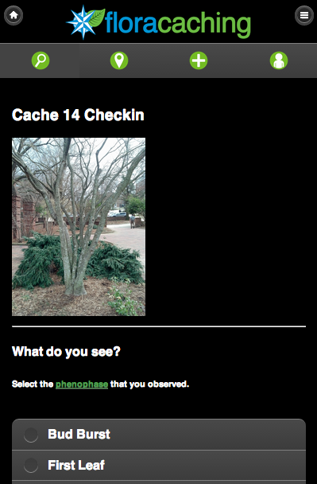






Gamification as a Motivational Strategy:
Case study of the Floracaching App
Motivation 2
Notes:
Research Question: How do the motivations of traditional citizen science volunteers differ from the motivations of millennial college students?
Social, location-based gamified app
Like geocaching, but plants are virtual caches
Designed to gather plant phenology data for Project Budburst
Users check in by reporting on plant’s state (e.g., flowering, fruiting) and may submit photos or leave comments
Points for all forms of participation
Two Leaderboards: one for activities requiring knowledge of plants, one for all forms of participation
Badges are unanticipated rewards. These include ”Invasive Patroller” and others in response to changing scientific rewards
Missions are directed, anticipated quests. These are sequential and require significant effort.

Slide 18
  Key Findings
  (186 volunteers)
Both Groups
Millenials
Motivated by sense of discovery or “treasure hunt feel”
Enjoy learning about plants but have different base knowledge
View Floracaching as a social activity
Are interested in gamification Millennials more so
Citizen Science Volunteers
Prefer autonomy
Will integrate app into their hobbies
Want scientifically useful challenges that take advantage of their unique expertise
Want guidance and specific tasks
App must fit into everyday routines
Like challenge and competition
Notes:
Findings come from three rounds of evaluation conducted between Spring 2012 and Fall 2013 and involving nearly 200 (186) citizen science volunteers, both traditional and millennial college students.

Slide 19
Summary—Motivation Study 2
People: Age, experience with technology, and experience with the natural world all influence reactions to gamification.
Information: Structured tasks can benefit those with less expertise, those with more background knowledge look up information as needed to assist with tasks they wish to pursue.
Technology: Features such as points, leaderboards, and badges are appealing to both millennials and more traditional citizen science volunteers; users have high expectations for speed and functionality based on previous experience with mobile apps.

Slide 20
Suggested References
Bowser, A., et al. Gamifying citizen science: A study of two user groups. In Proceedings of the Companion Publication of the 17th ACM Conference on Computer Supported Cooperative Work & Social Computing (pp. 137-140). New York: ACM.
Bowser, A., et al. (2014). Motivating participation in citizen science. In European Conference on Social Media Proceedings, (pp. 64-71). http://www.scribd.com/doc/233761856/ECSM2014-Proceedings-Dropbox
Bowser, A., et al. (2013). Using gamification to inspire new citizen science volunteers. Paper presented at Gamification 2013, October 2-4. Waterloo, Canada.

Slide 21
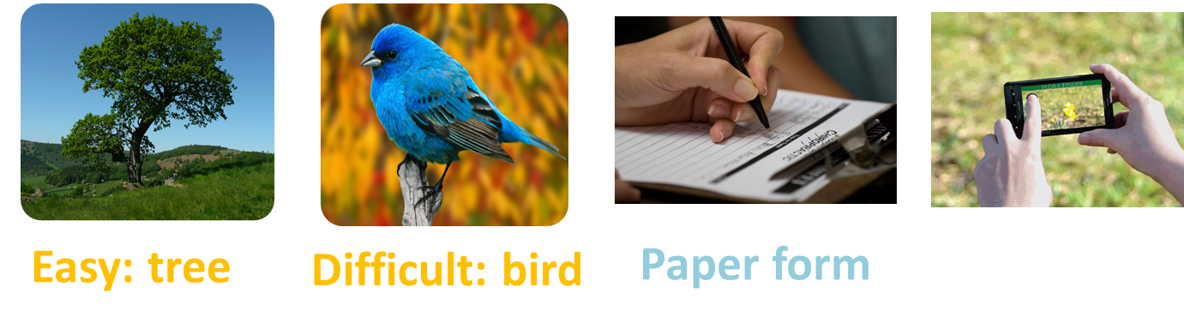
Feedback as a Motivational Strategy:
How do different types of feedback affect motivation and effort?
Motivation 3
Digital photo
Notes:
Used Zhu et al. (2013) research on the type of feedback that motivated Wikipedia contributors. Zhu et al. found that positive and social feedback worked best to increase motivation, while negative and directive feedback worked best to increase contributors’ effort. These effects were only significant for novice Wikipedians, not for experienced contributors.
We therefore recruited participants unfamiliar with citizen science AND had them participate in a simulated citizen science project to record biological information about plants and birds on campus. (We did not wish to disrupt a genuine citizen science campaign by controlling feedback; hence, the simulation.)

Slide 22
  Method: A field experiment
Participants:
  70 undergraduate students new to citizen science
Independent variables:
  Type of feedback (Positive only vs. Positive corrective)
  Working alone or together in a pair
  Task difficulty (Easy vs. Difficult)
Dependent variables:
  Situational motivation (Vallerand, 1997; Guay et al., 2000)
  Data quantity
  Data quality
Notes:
Feedback was either positive only (appreciation) or positive corrective guidance (appreciation + polite suggestions about improving future contributions)
Situational motivation was measured by the Situational Motivation Scale (SIMS) developed by Guay et al. (2000). Compared with Global and Contextual motivation, the situational motivation is the most
unstable level of motivation, and refers to the influence of an individual’s experiences when engaging in a specific activity at a given moment in time (Vallerand, 1997; Vallerand & Ratelle, 2002).
Data quantity: (1) the number of words written on observation paper form, and (2) the number of photos.
Data quality: (1) For the observation paper form, two raters compared the data collected in the 2nd round with that collected in the 1st round to see whether the participants write down more, same, or less meaningful details about tree and bird in the 2nd round observation; (2) for the photo, two raters compared the photo taken in the 2nd round with that collected in the 1st round and decided whether the photo quality had increased, not change, or decreased in the 2nd round observation.

Slide 23
Key Findings
Best type of feedback:
Positive corrective feedback most effective for increasing situational motivation and contribution quantity and quality.
Polite guidance with appreciation is more effective than simple thank-you notes.
Increased the quality of a contribution for those working alone more than in pairs.
Notes:
While Dana Rotman’s dissertation work identified the motivating effect of acknowledgement and interactions with scientists on the continued participation of citizen science volunteers, this study delves into specifics about the what type of feedback increases motivation and contributions.

Slide 24
Summary—Motivation Study 3
People: Participants need feedback; directive feedback, encourages better performance in later contributions.
Information: Different types of data create different collection challenges (e.g., bird photographs are tricky) and may require different support (e.g., bird dictionary to aid identification).
Technology: Individual email was useful for sharing feedback.

Slide 25
Suggested Reference
He, Y., et al. (2014). The effects of individualized feedback on college students' contributions to citizen science. In Proceedings of the Companion Publication of the 17th ACM Conference on Computer Supported Cooperative Work & Social Computing (pp. 165-168). New York: ACM.

Slide 26
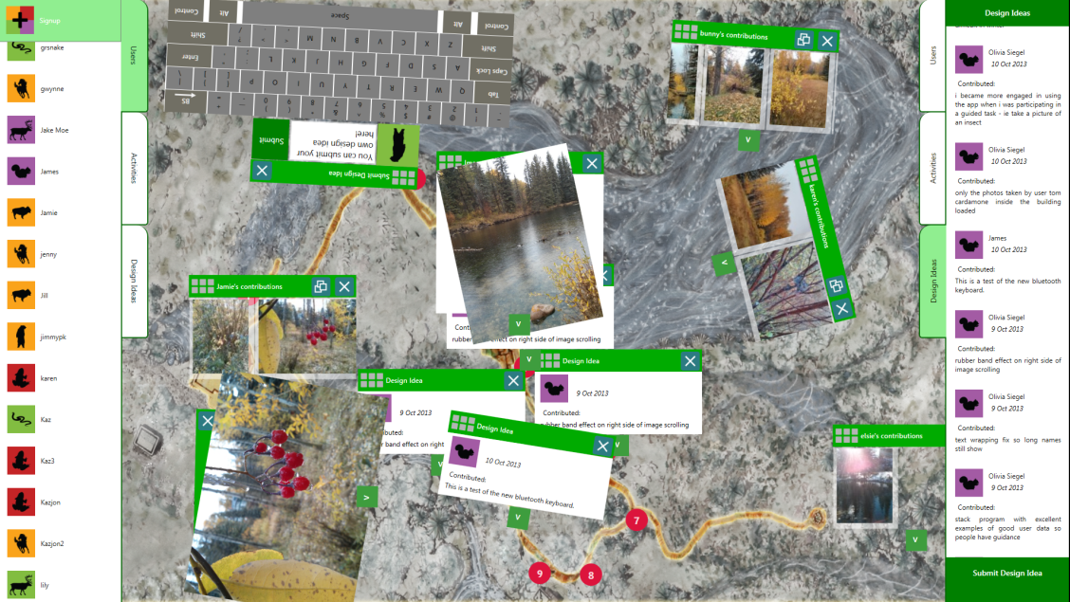
Motivation
4
NatureNet: Crowdsourcing
Data Collection & Design
Digital photo

Slide 27
  Early Results
Research Questions
What We’ve Learned
What’s Next
Visitors are drawn to the tabletop.
Casual users want to view their own photos rather than commenting.
Engaged stakeholders (e.g., naturalists and visitors who have spent some guided, extended time with NatureNet ) provide rich and thought-ful nature content and design ideas.
Offering structured and guided scientific activities & challenges
Enabling naturalists to provide immediate feedback on visitor queries & observations
Notifying on-site participants about further opportunities for interaction on the website
What are the roles and tasks of the crowd in a design process that engages the public in the interaction design for a virtual organization?
Does crowdsourcing the design of interactive social technology for a citizen science organization motivate participation in collecting and sharing biodiversity data?
Notes:
Findings come from three rounds of evaluation conducted between Spring 2012 and Fall 2013 and involving nearly 200 (186) citizen science volunteers, both traditional and millennial college students.
The hypothesis is that users who have more of an active stake in shaping their involvement with the platform and the community will be motivated to participate more, and additionally that a social media platform that is iteratively re-designed by its users will improve in quality over the course of its development. Two preliminary studies show that this integration of technology with the visit to the preserve is compelling, and appears to assist visitors to see and observe nature more closely. Initial participatory design sessions suggest that using the phone app. encourages visitors to notice details about nature that they would probably otherwise have overlooked, with even the naturalists in the park commenting that with it they observe things that they did not expect to see. On one occasion, a naturalist spotted an unusual insect in a photograph of a plant that he did not know was there at the time he took the photograph.
Visitors also exhibited excitement about seeing their data on the tabletop and comparing it with the data of others. They liked the communal aspect of viewing data with others around the tabletop, and hearing comments from others. The suggestions about how to modify the design of NN included requests to add some specific questions to direct visitors’ activities, encouraging the visitors to identify meaningful science-like challenges.

Slide 28
Summary—Motivation Study 4
People: Visitors have high expectations that technology should function in a familiar way; find it challenging to provide design ideas for improvement without knowing what kinds of recommendations are appropriate.
Information: Data types included nature pictures and design ideas; both require some scaffolding to elicit useful responses.
Technology: Large, interactive, touch-based displays are engaging to visitors; technology must be stable, robust, fast & familiar to avoid alienating users.
Notes:
Data – two types nature pix and design ideas
People – hard to give design ideas with out knowing the kinds of things that are appropriate
Technology – again it has to be stable and work

Slide 29
Suggested References
Grace, K., et al. (2014). A process model for crowd-sourcing design: A case study in citizen science. In Gero, J.S. and Hanna, S. (Eds.), Proceedings of Design Computing and Cognition 2014, University College London.
Maher, M.L., et al. (2014). NatureNet: A model for crowdsourcing the design of citizen science systems, In Proceedings of the Companion Publication of the 17th ACM Conference on Computer Supported Cooperative Work & Social Computing (pp. 201-204). New York: ACM.
Preece, J., et al. (2014). Crowdsourcing design and citizen science data using a tabletop in a nature preserve, In European Conference on Social Media Proceedings, (pp. 413-420). http://www.scribd.com/doc/233761856/ECSM2014-Proceedings-Dropbox

Slide 30

Guidelines for Research and Practice
Technology needs to be:
Easy to use, fast, in line with state-of-the-art UX, capable of evolving
Designed in consultation with stakeholders and with awareness that user needs and experiences vary
Robust and rugged enough to respond to field conditions
Scaffolded to provide clear guidance for novice users and to support collection of high-quality data

Slide 31
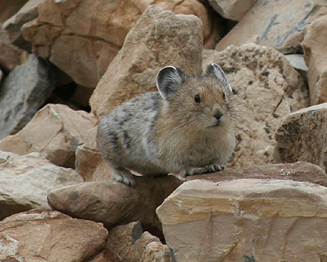
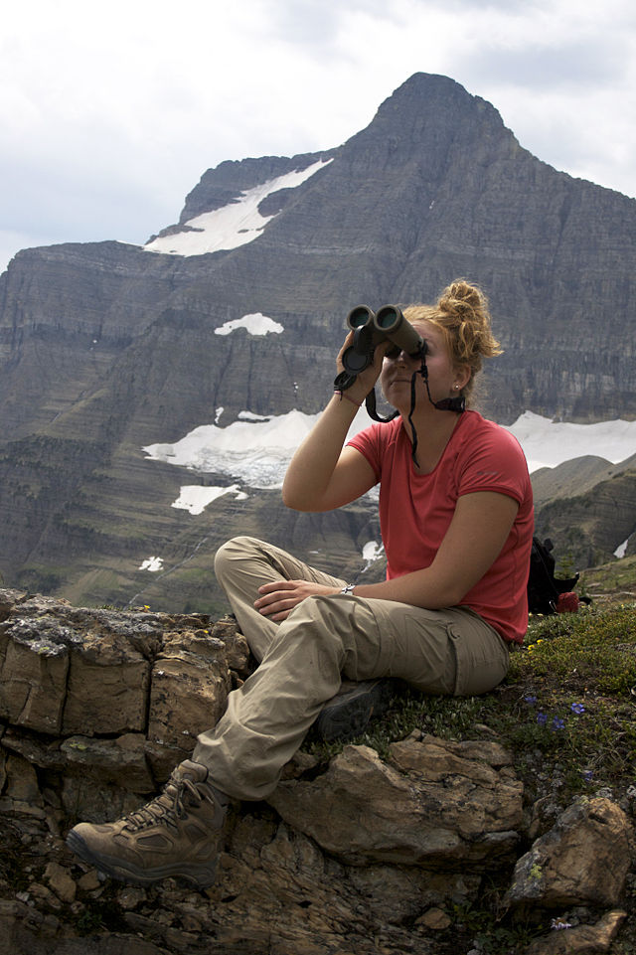

Thank you!
NSF grants: SES 0968546, VOSS 357948-1, EAGER 1450942
Notes:
Surveys are conducted every summer at Glacier National Park to determine the location and health of the park's American pika population.

Slide 32


