Slide 1

Interactive Visual Discovery in Temporal Event Sequences:
Electronic Health Records &
Other Applications
Ben Shneiderman ben@cs.umd.edu
Founding Director (1983-2000), Human-Computer Interaction Lab
Professor, Department of Computer Science
Member, Institute for Advanced Computer Studies

Slide 2


Interdisciplinary research community
- Computer Science & Info Studies
- Psych, Socio, Educ, Jour & MITH
www.cs.umd.edu/hcil
vimeo.com/72440805

Slide 3
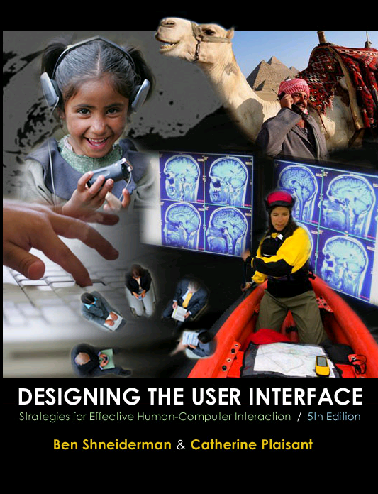
Design Issues
Input devices & strategies
  Keyboards, pointing devices, voice
  Direct manipulation
  Menus, forms, commands
Output devices & formats
  Screens, windows, color, sound
  Text, tables, graphics
  Instructions, messages, help
Collaboration & Social Media
Help, tutorials, training
Search
www.awl.com/DTUI
Fifth Edition: 2010
Visualization

Slide 4
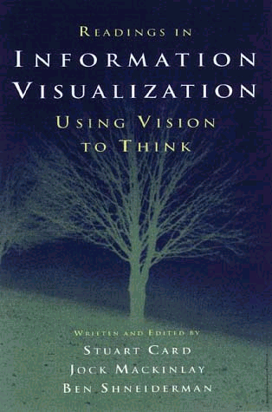
Information Visualization & Visual Analytics
Visual bands
  Human percle
    Trend, clus..
    Color, size,..
Three challe
  Meaningful vi
  Interaction: w
  Process mo
  1999

Slide 5
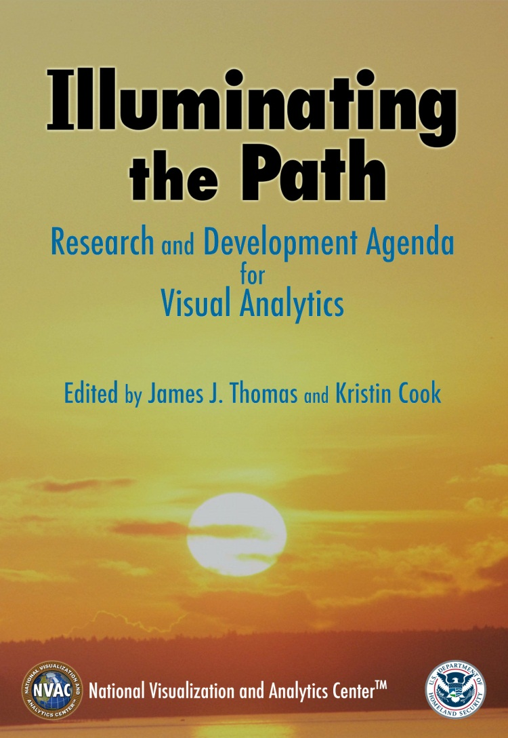
Information Visualization & Visual Analytics
Visual bandwidth is enormous
  Human perceptual skills are remarkable
    Trend, cluster, gap, outlier...
    Color, size, shape, proximity...
Three challenges
  Meaningful visual displays of massive da
  Interaction: widgets & window coordinati
  Process models for discovery
  1999 2004

Slide 6
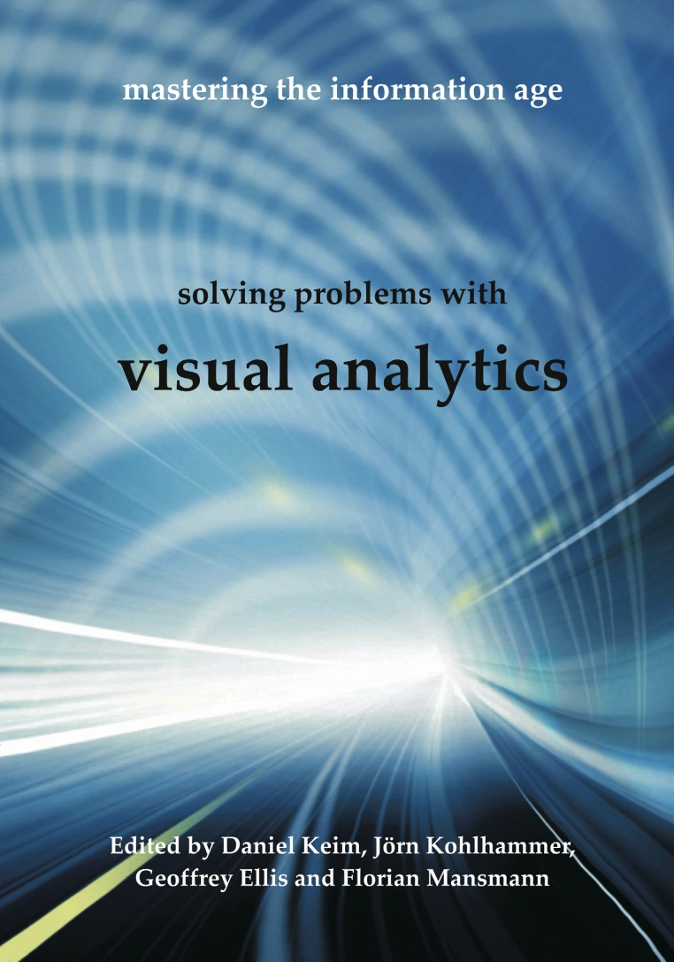
Information Visualization & Visual Analytics
Visual bandwidth is enormous
  Human perceptual skills are remarkable
    Trend, cluster, gap, outlier...
    Color, size, shape, proximity...
Three challenges
  Meaningful visual displays of massive data
  Interaction: widgets & window coordination
  Process models for discovery
  1999 2004 2010

Slide 7
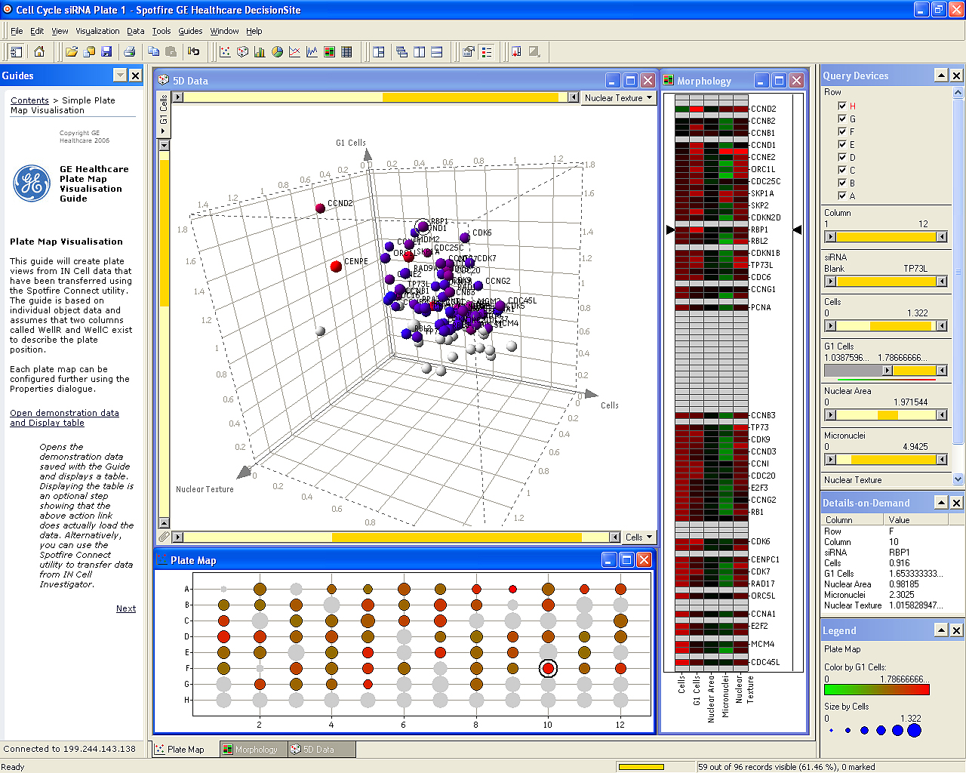
Spotfire: Retinol’s role in embryos & vision
Notes:
"The IN Cell Analyzer automated microscope was used to identify proteins influencing the division of human cells. After the images were analyzed, quantitative results were transferred to Spotfire DecisionSite. This screen revealed the previously unknown involvement of the retinol binding protein RBP1 in cell cycle control.(Stubbs S, & Thomas N. 2006 Methods in Enzymology; 414:1-21.) Retinol a form of Vitamin A plays a crucial role in vision and during embryonic development"

Slide 8
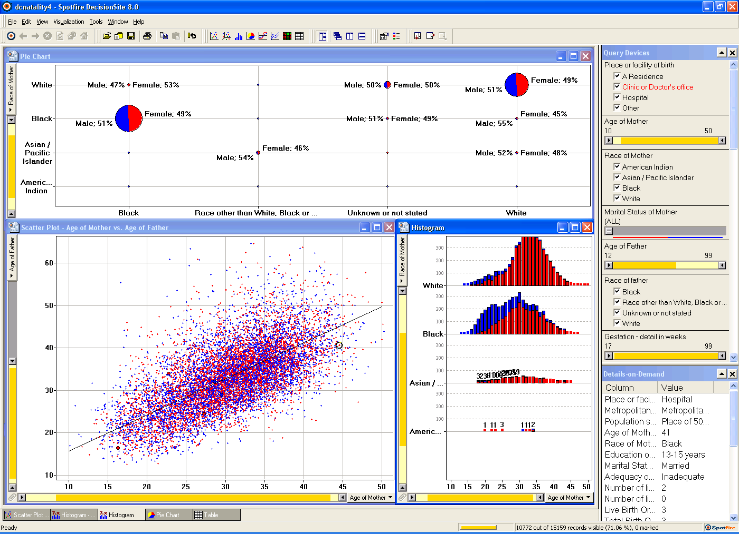
Spotfire: DC natality data

Slide 9

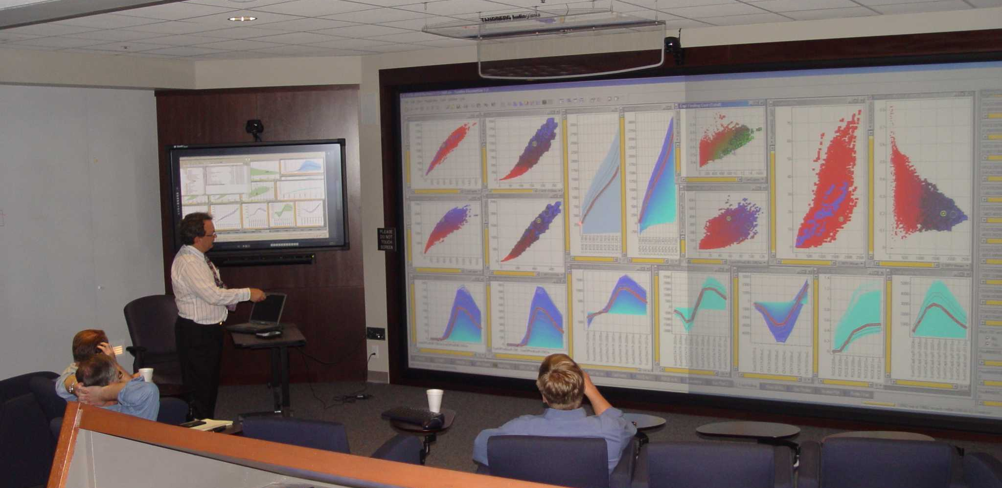
http://registration.spotfire.com/eval/default_edu.asp

Slide 10
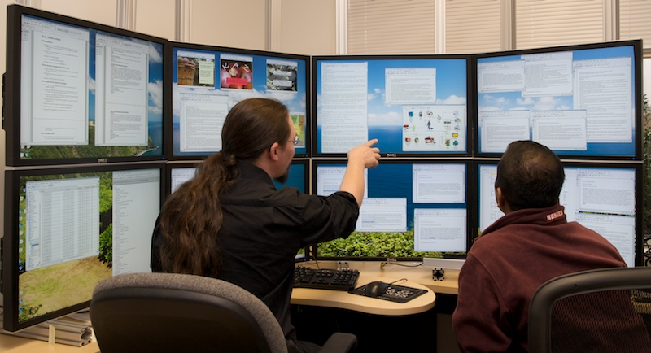
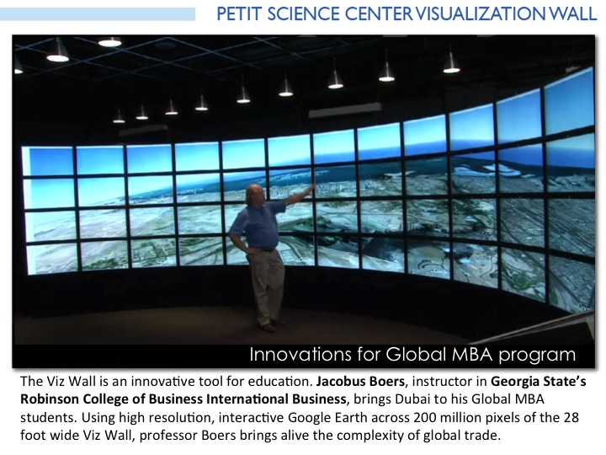
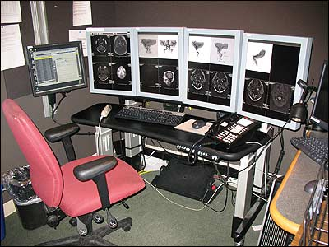
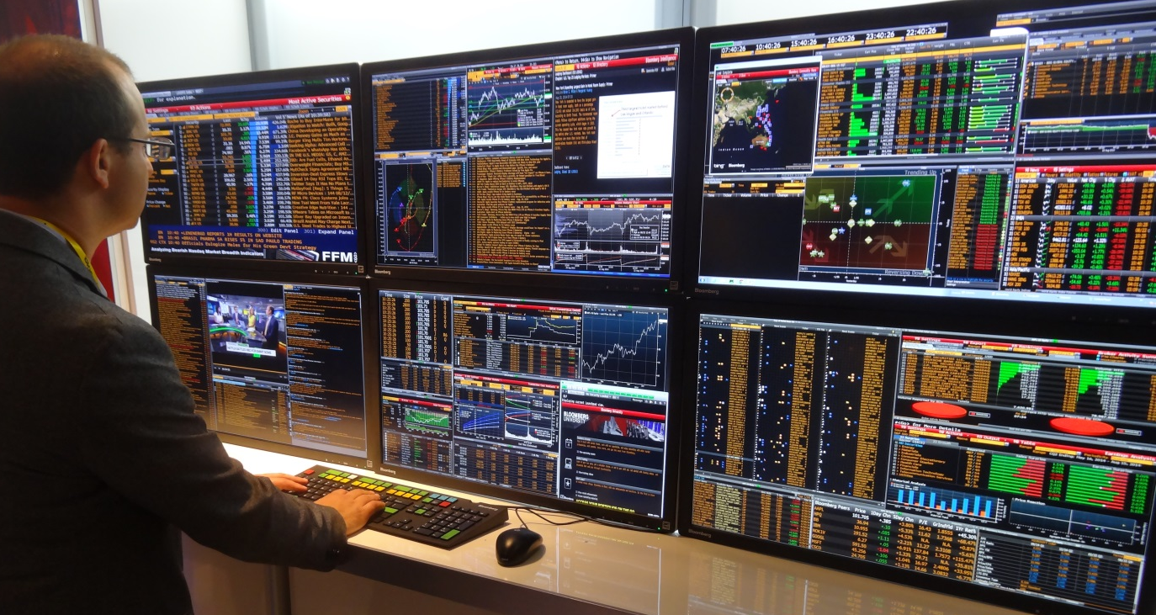
10M - 100M pixels: Large displays

Slide 11
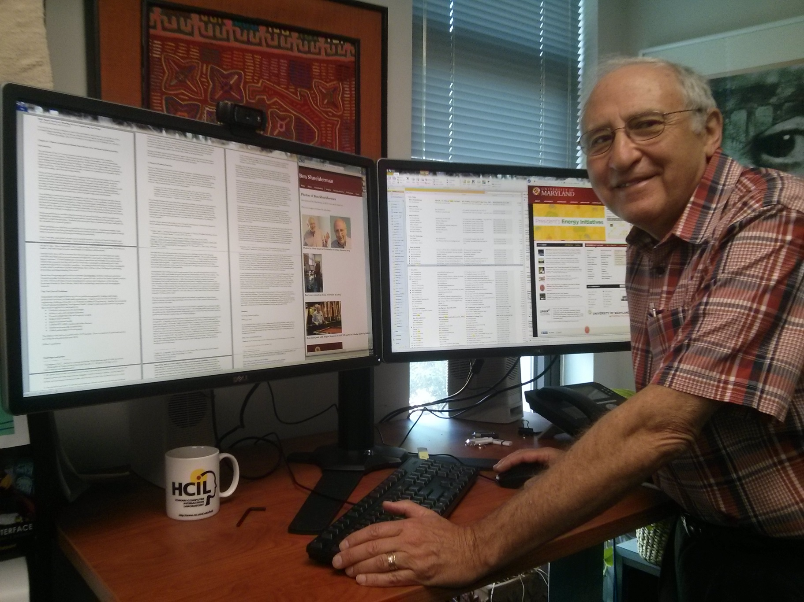
16M pixels: My New Workstation

Slide 12
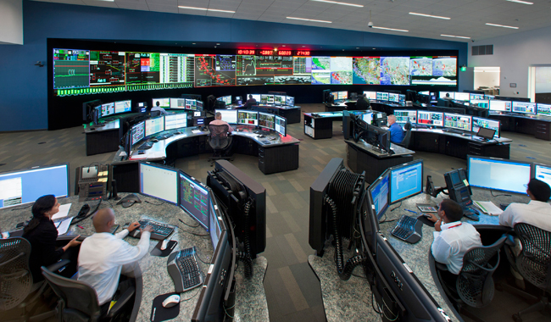
100M-pixels & more

Slide 13
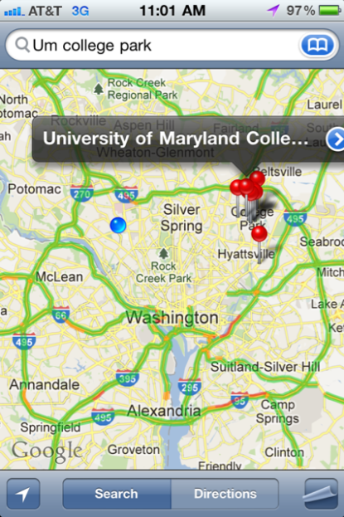
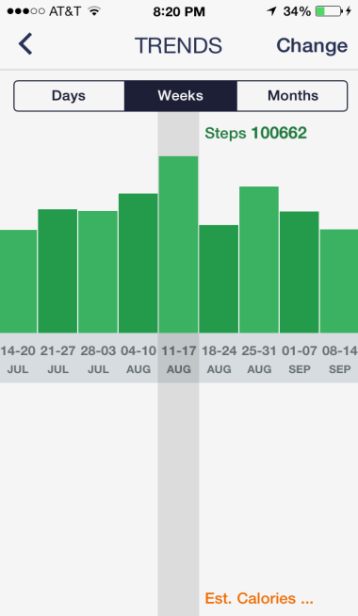
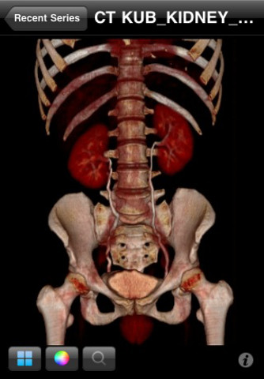
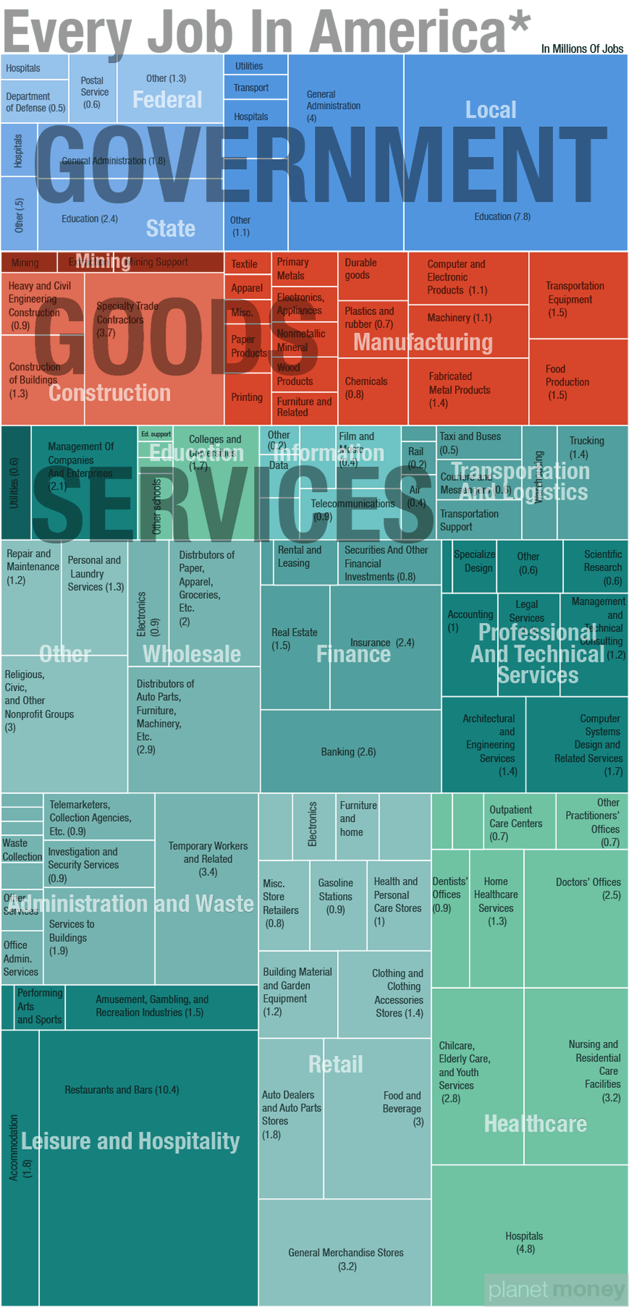
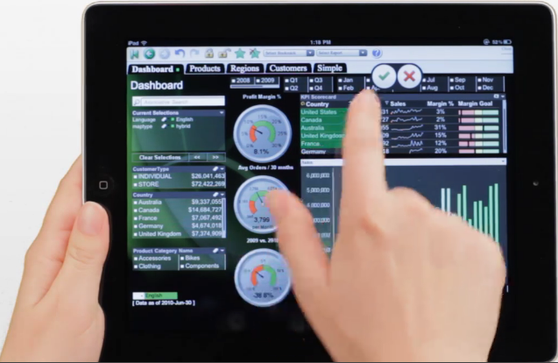
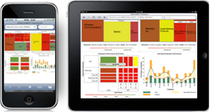
1M-pixels & less
Small mobile devices

Slide 14
Information Visualization: Mantra
Overview, zoom & filter, details-on-demand
Overview, zoom & filter, details-on-demand
Overview, zoom & filter, details-on-demand
Overview, zoom & filter, details-on-demand
Overview, zoom & filter, details-on-demand
Overview, zoom & filter, details-on-demand
Overview, zoom & filter, details-on-demand
Overview, zoom & filter, details-on-demand
Overview, zoom & filter, details-on-demand
Overview, zoom & filter, details-on-demand
(The Eyes Have It, IEEE VL, 1996)

Slide 15
Information Visualization: Data Types
InfoViz SciViz .
1-D Linear Document Lens, SeeSoft, Info Mural
2-D Map GIS, ArcView, PageMaker, Medical imagery
3-D World CAD, Medical, Molecules, Architecture
Multi-Var Spotfire, Tableau, Qliktech, Visual Insight
Temporal EventFlow, TimeSearcher, Palantir, RecordedFuture
Tree Windows Explorer, SpaceTree, Treemap
Network Pajek, UCINet, NodeXL, Gephi, Tom Sawyer
flowingdata.com visualcomplexity.com eagereyes.org
infosthetics.com perceptualedge.com datakind.org
visual.ly visualizing.org infovis.org

Slide 16
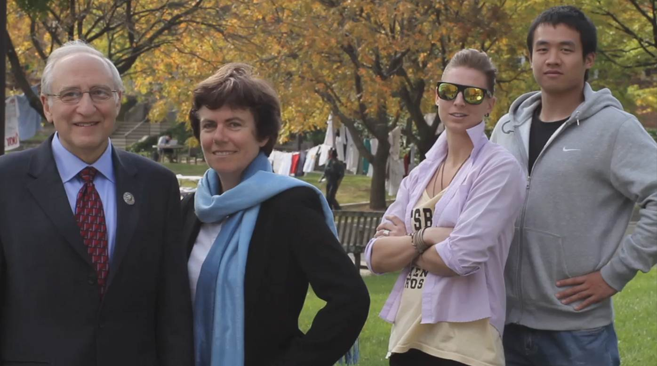
EventFlow Team: Oracle support
www.cs.umd.edu/hcil/eventflow
www.umdrightnow.umd.edu/news/umd-research-team-developing-powerful-data-visualization-tool-support-oracle

Slide 17
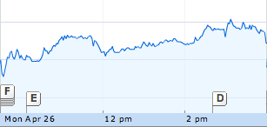
EHRs: Temporal data
Numerical Events
Categorical Events
Stock: Microsoft
Patient ID: 45851737
04/26/2010 10:00 31.03
04/26/2010 10:15 31.01
04/26/2010 10:30 31.02
04/26/2010 10:45 31.08
04/26/2010 11:00 31.16
12/02/2008 14:26 Arrival
12/02/2008 14:36 Emergency
12/02/2008 22:44 ICU
12/05/2008 05:07 Floor
12/14/2008 06:19 Exit
Time
Arrival
Emergency
ICU
Floor
Exit
Notes:
Numerical time series, for example stock price over time, is a series of time and numerical value, in this case, the stock price.
Temporal categorical data, for example the patients transfer data, a series of time and categorical value.
Explain patient transfer
A valued pair of time and category is called an event.
Throughout this presentation, triangles are used to represent events while colors are used to show the category

Slide 18
Patient Histories: Our Research
Tool | Event Types | Records | Display
LifeLines | Points, Intervals | One | Individual
LifeLines2 | Points | Many | Individual, Summary
Similan | Points | Many | Individual
LifeFlow | Points | Many | Individual, Aggregate
EventFlow | Points, Intervals | Many | Individual, Aggregate
www.cs.umd.edu/hcil/toolname

Slide 19
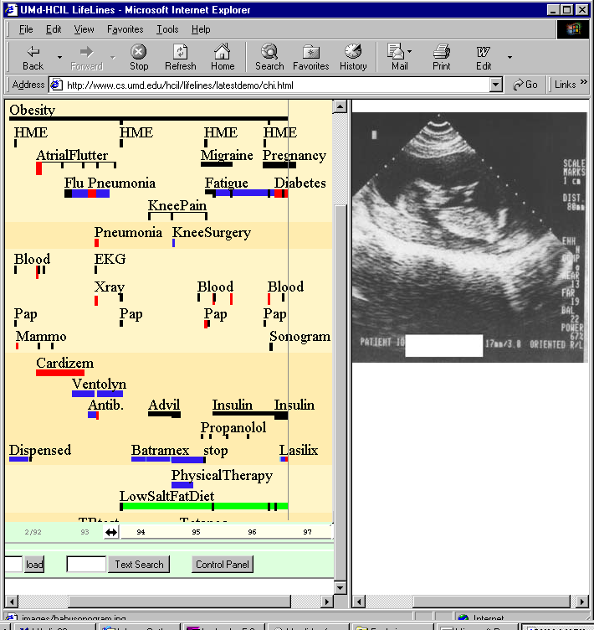
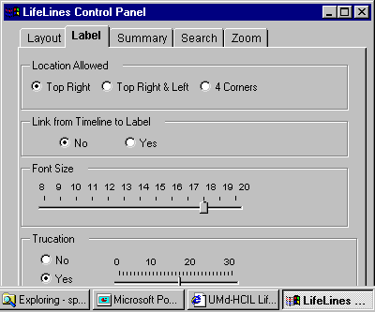
LifeLines: Patient Histories
www.cs.umd.edu/hcil/lifelines

Slide 20
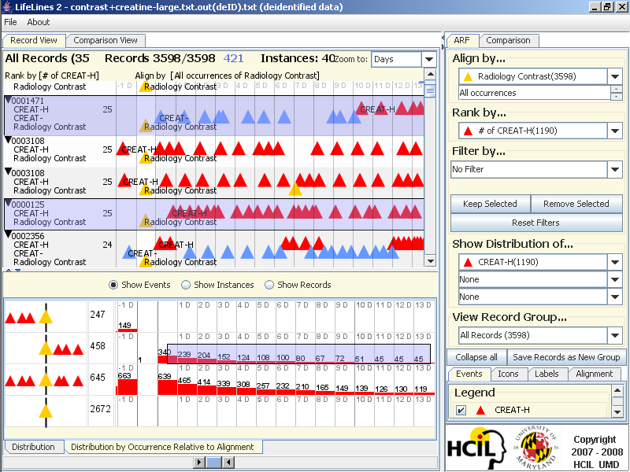
LifeLines2: Align-Rank-Filter & Summarize
www.cs.umd.edu/hcil/lifelines2

Slide 21
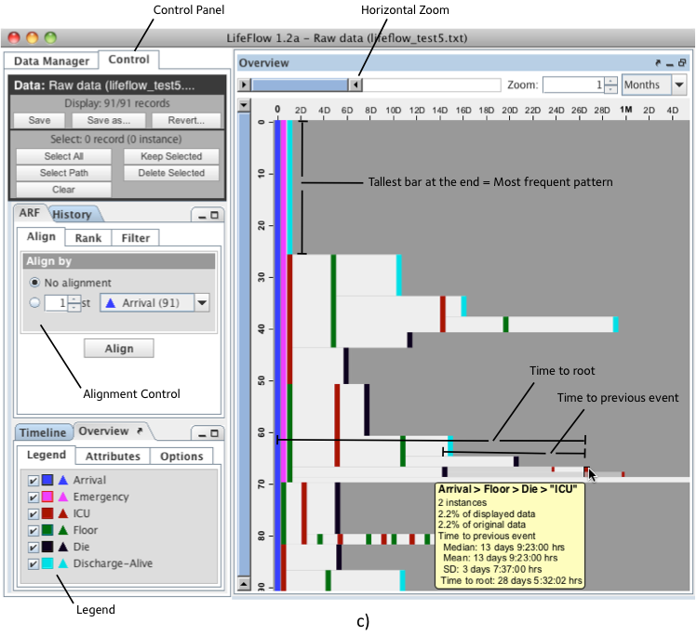
LifeFlow: Interface with User Controls

Slide 22
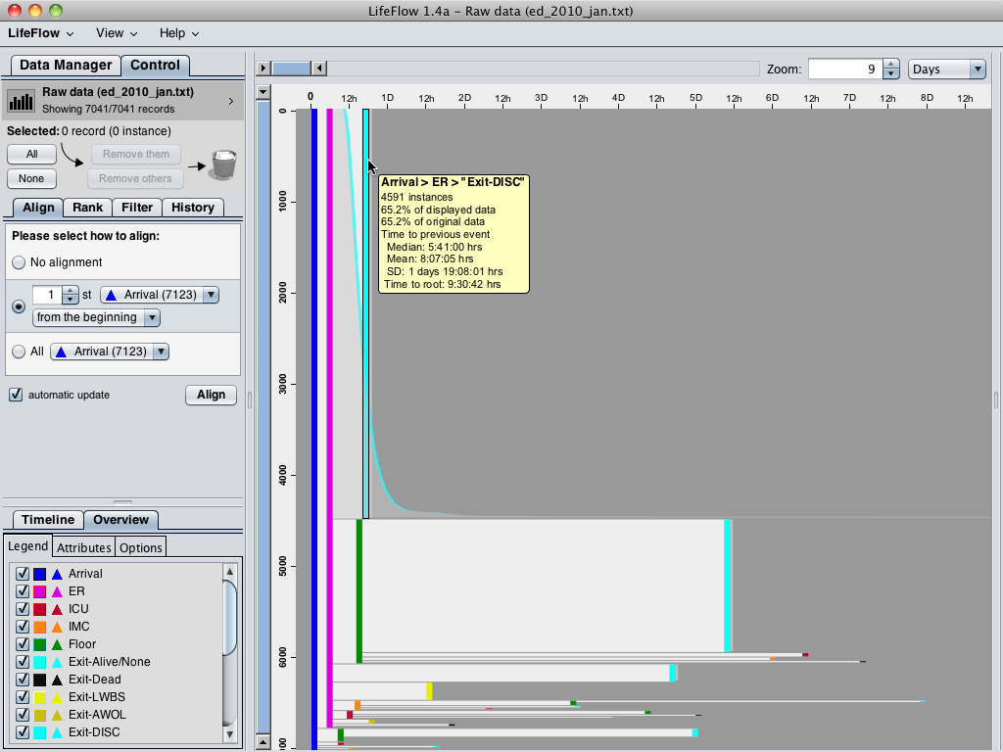
Notes:
Using LifeFlow, 7,041 patients are aggregated into this visualization and LifeFlow immediately reveal the most common pattern, which you could not do easily in SQL.
You could easily notice this huge pattern “Arrival -> ER -> Exit”, meaning patients who visited with minor injuries or simple conditions and left the hospital immediately after receiving their treatment.
When hovering the mouse over, LifeFlow displays a tooltip that gives more information, such as number of patients and other statistics, and also shows the distribution of the patients.
As the horizontal gap represents time, you can see from the distribution that some patients left the hospital very quickly after visiting the emergency room while some of them stayed longer.
*optional
The second most common pattern is “Arrival (Blue) -> ER (Pink) -> Floor (Green) -> Exit (Cyan)”, meaning patients who were admitted to observe the conditions and then everything went well so they left the hospital.
You can also use the horizontal gap to compare these patients with the patients who exit from the emergency room.
Comparing the gap from pink to cyan and pink to green, you can see that the gap from pink to green is smaller than pink to cyan, so the patients were transferred to Floor faster than exit the hospital in average.
You have seen the two most common cases, now I will remove the common patterns so we can analyze the less frequent patterns.

Slide 23
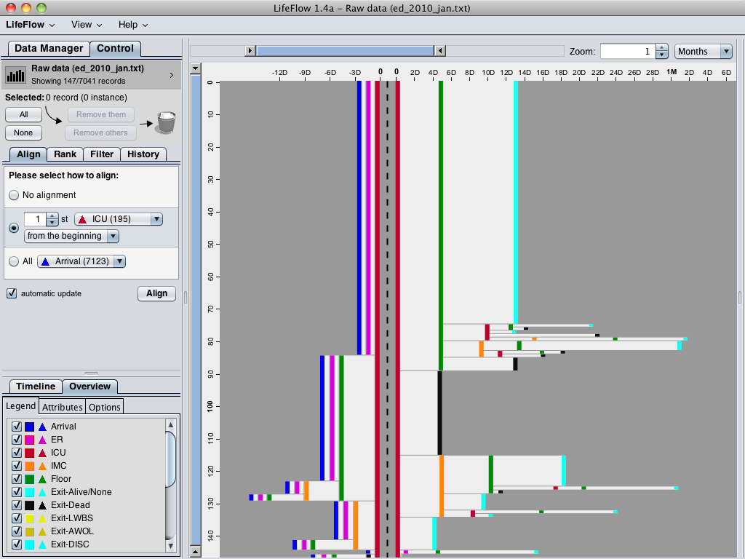
Notes:
Another interesting feature is you can align by a particular event.
For example, if you want to know what happened before and after the patients went to the ICU, you can align by ICU.
The dash line separate between what happened before and what happened after.
You can see that the ICU patients mostly came from the ER (pink), and most of them were transferred to Floor (green) after that.
Unfortunately, some of them died after they were transferred to the ICU (black).
From this visualization, you may notice a small pattern in the bottom.
Let me zoom in.

Slide 24
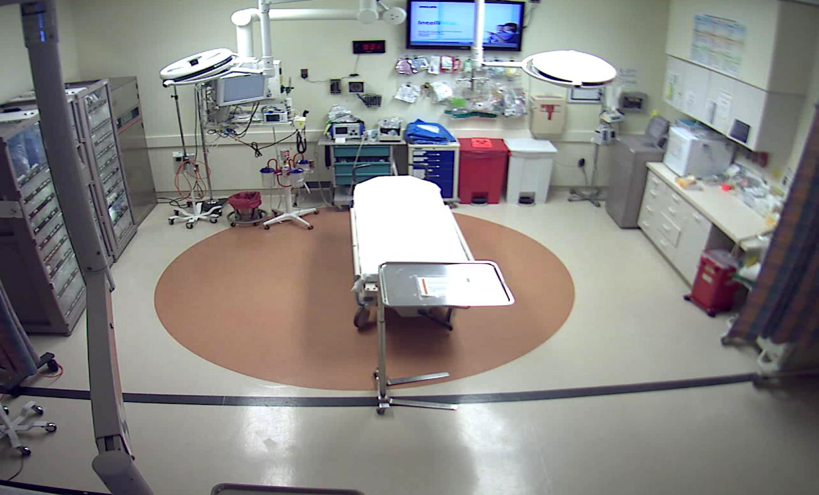
Children’s Hospital in DC: Trauma Bay

Slide 25

EventFlow
Airway
Breathing
Circulation
Secondary Survey
Disability
www.cs.umd.edu/hcil/eventflow

Slide 26
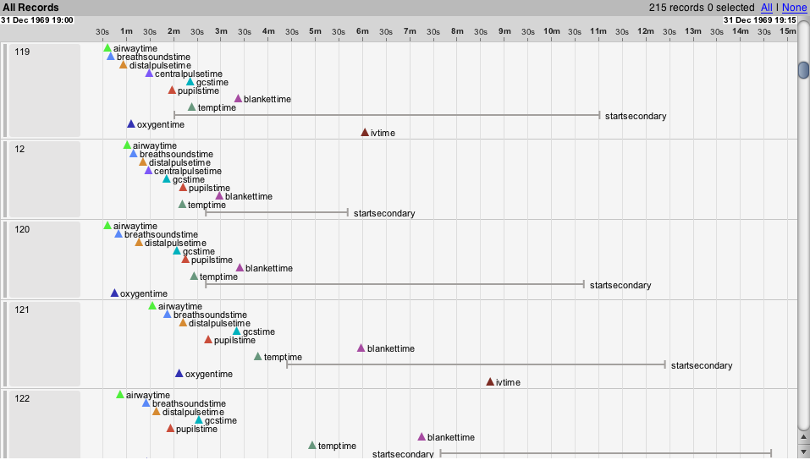
EventFlow: Temporal Events
http://youtu.be/dz86_nSXt-M

Slide 36
Time
Number of Records

Slide 37
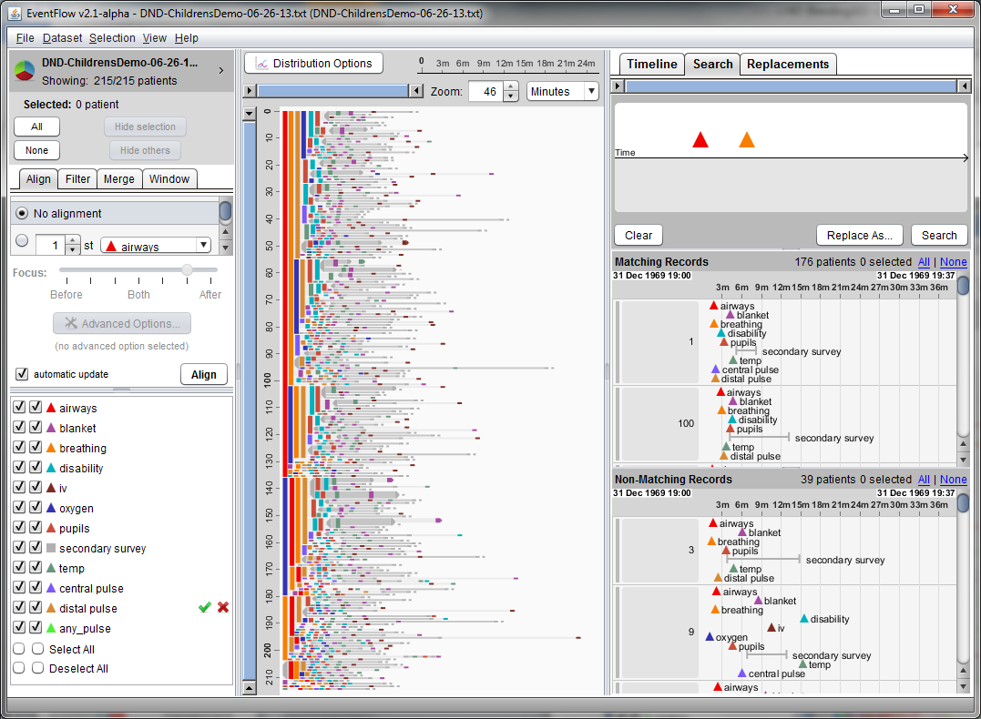
Children’s Hospital Trauma Care: EventFlow

Slide 38
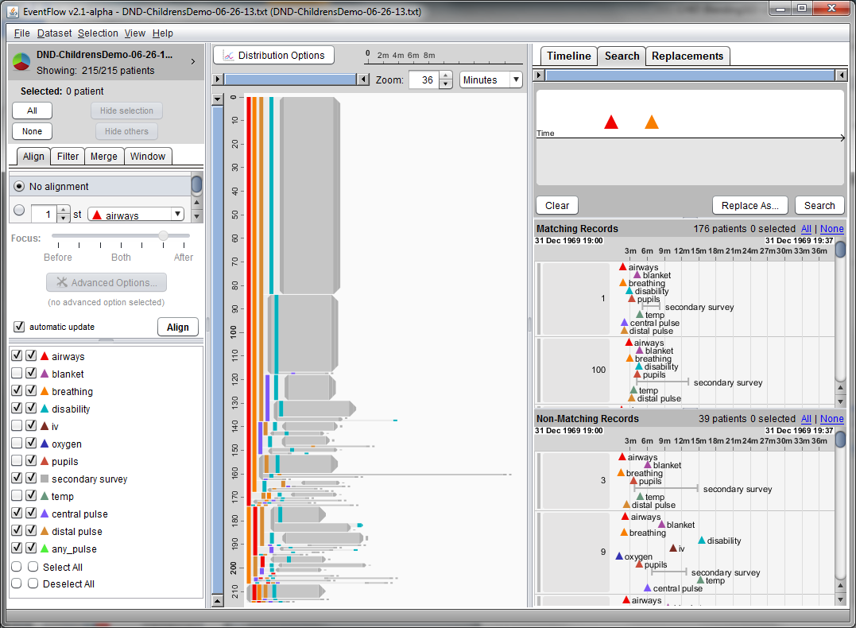
Children’s Hospital Trauma Care: EventFlow

Slide 39
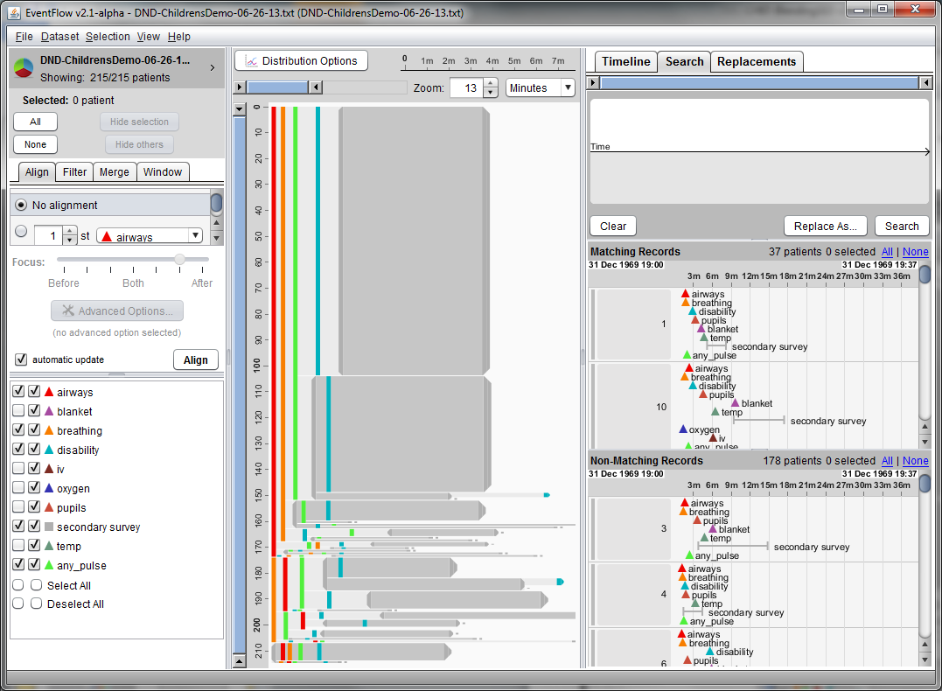
Children’s Hospital Trauma Care: EventFlow

Slide 40
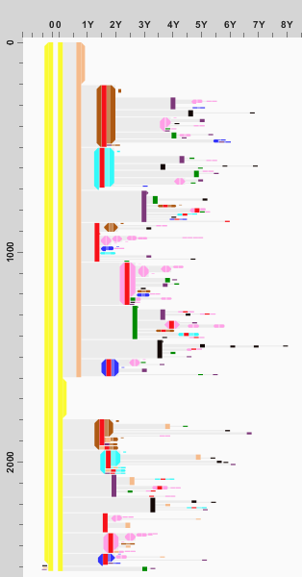
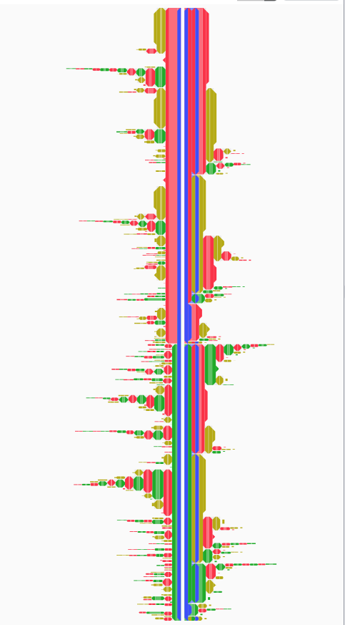
UM-Baltimore: CHIB Projects
Radiation Therapy:
Metastatic Prostate Cancer
Warfarin Usage in Patients with Traumatic Brain Injury

Slide 41
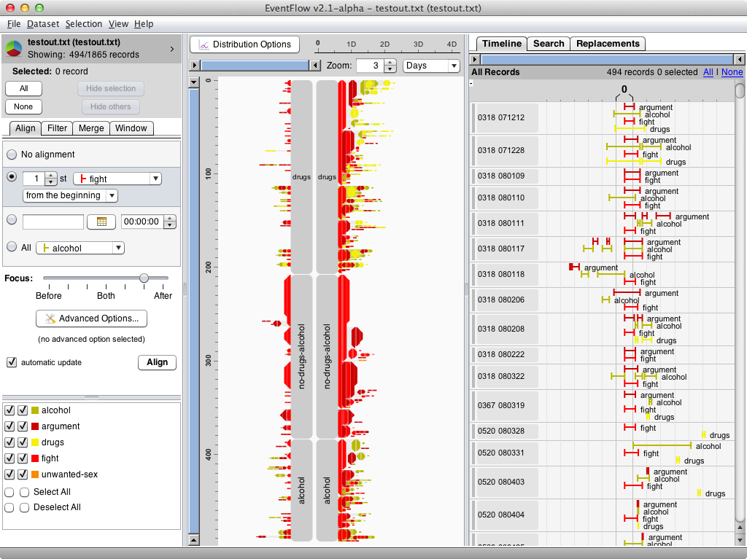
Yale Medical: Seth Powsner & Tami Sullivan

Slide 42
Future Directions: EventFlow
Refine software to add business features
Make backend database
Scalability of many kinds
Validation across usage domains
Build community
Launch startup company?

Slide 43
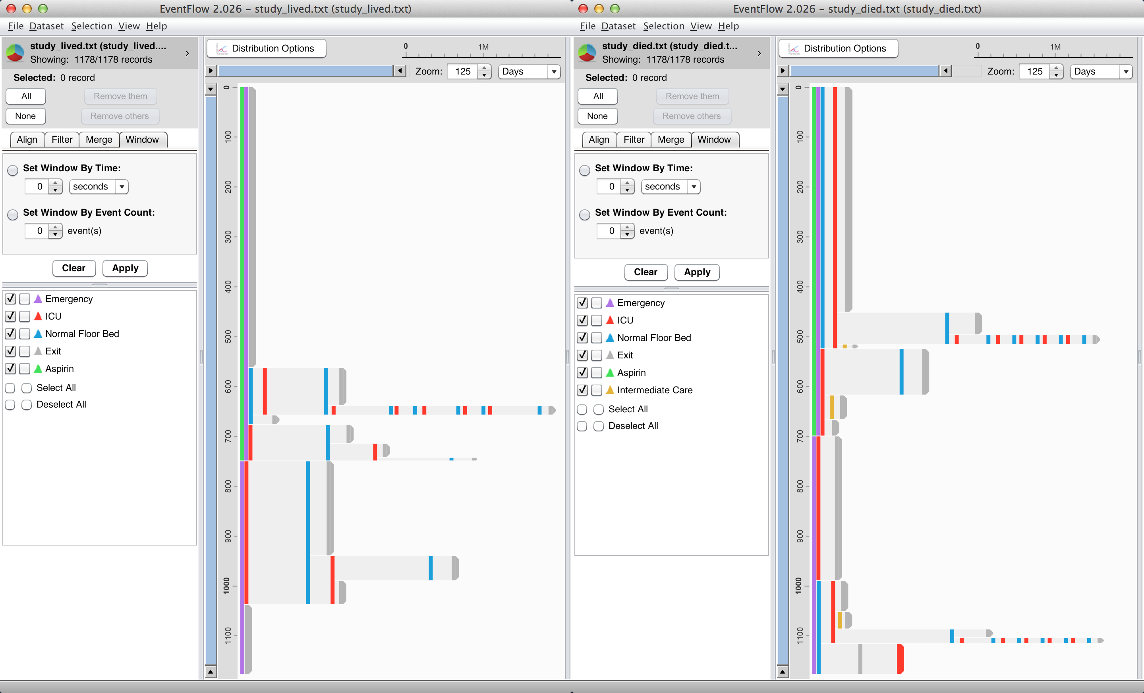
Cohort Comparison: Dual EventFlow

Slide 44
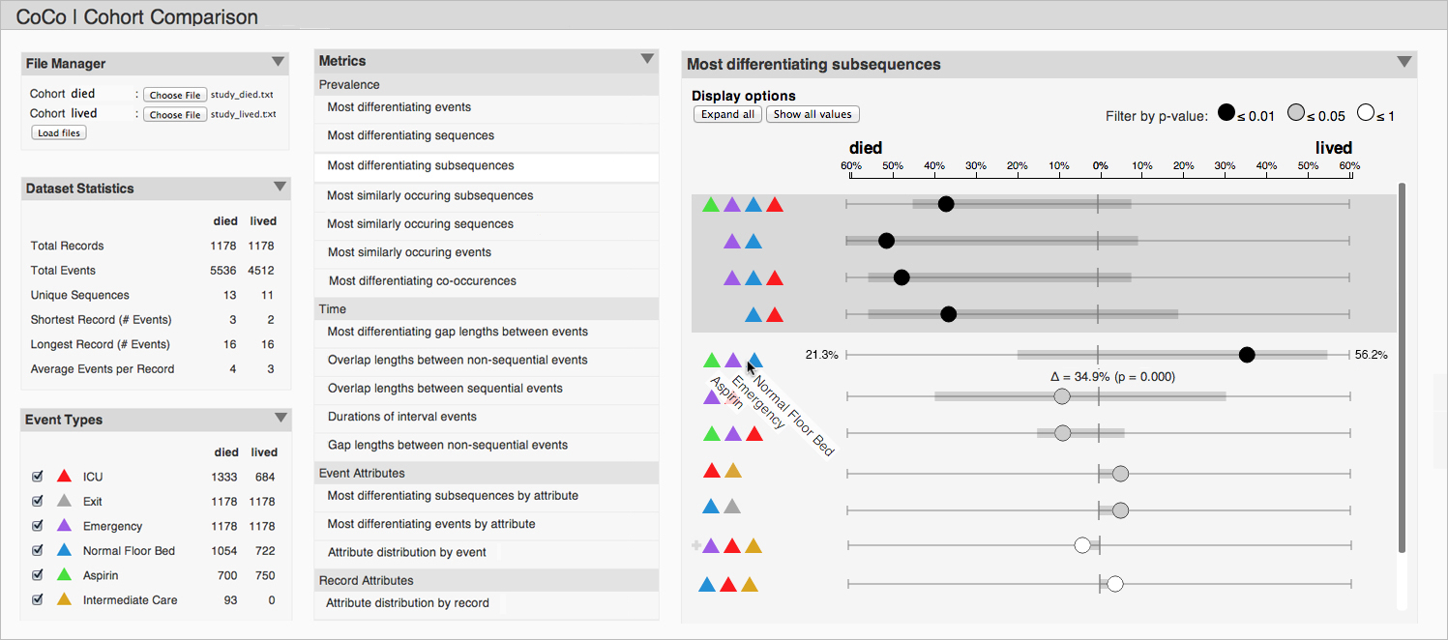
Cohort Comparison: CoCo

Slide 45
Thanks for getting us to this stage
Catherine Plaisant
LifeLines
LifeLines2 (David Wang)
LifeFlow (Krist Wongsuphasawat)
EventFlow team
  → Megan Monroe, Chris Imbriano →
  Sana Malik, Fan Du, Chris Musialek, Christi Capati, Duke Chan
THANKS! Sponsors: NIH, Oracle, CHIB

Slide 46
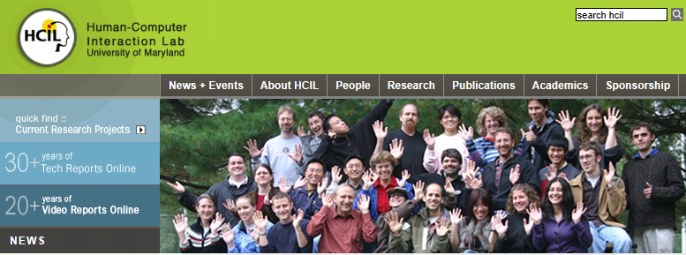
@benbendc
Workshop Website
www.cs.umd.edu/hcil/eventflow/workshop2014/

