Slide 1
Common knowledge of rationality and backward induction
Lauren Fratamico

Slide 2
Fun Game!
Notes:
For those of you who were player 1, did any of you choose the action D?
Why not? “much higher payoffs to the right if chose action A”
This is what we’ll be discussing today.

Slide 3
“In perfect information games, common knowledge of rationality implies backward induction.”
- Robert Aumann, 1995
Notes:
Image: http://www.cuhk.edu.hk/cpr/images/060503aumann.jpg

Slide 4
Outline
Backward induction
Review
Implications
Common knowledge of rationality
Criticism of the implications
Summary

Slide 5
Backward Induction
It is beneficial to you to guess how others will play
Goal: Prune game tree so that at each node, the player is choosing the action to maximize utility
Notes:
Backward Induction is a common way to compute Subgame perfect equilibria

Slide 6
Backward Induction Steps
Step 1: Locate node where all children are terminal nodes
Step 2: Choose action for player at that node assuming player wants to maximize his payoff
Step 3: Prune off path not taken
Repeat above until one node remains
Notes:
Work through toy example

Slide 7
Backward Induction Steps
Solution is unique if at every choice node, player is not indifferent
Will result in a Nash Equilibrium, but there could be more
Notes:
Same as minmax in zero-sum games

Slide 8
What is common knowledge of rationality?
All players know each others payoffs
Know that all other they know other players’
Know that other players know that they know
…
All players know that they are thought of as being rational

Slide 9
What is common knowledge of rationality?
All players know each others payoffs
Know that all other they know other players’
Know that other players know that they know
…
All players know that they are thought of as being rational
Knowledge refers to start of play – for a player to know something means that he knew it before the start of the game
Rational – player is a habitual payoff maximizer

Slide 10
Proof that common knowledge of rationality implies backward induction
Full proof in Aumann’s 1995 paper: Backward induction and common knowledge of rationality.
Notes:
Not appropriate to go into the depth of this proof in this lecture. It relies on quite a few lemmas of knowledge theory.

Slide 11
Important results and interpretations
Rationality:
Critical to define rationality at all nodes
Players pick an action at each node
They do not pick actions with the assumption that that node will be reached

Slide 12
Breakdown of rationality and backwards induction
Notes:
Have class walk backwards through centipede game, see that all will go down at last node, then see how many would go down at second to last node. Have them understand that it was irrational to not go down at second to last node since they see all will go down at last node. Somewhere the backwards induction and idea of rationality breaks down.

Slide 13
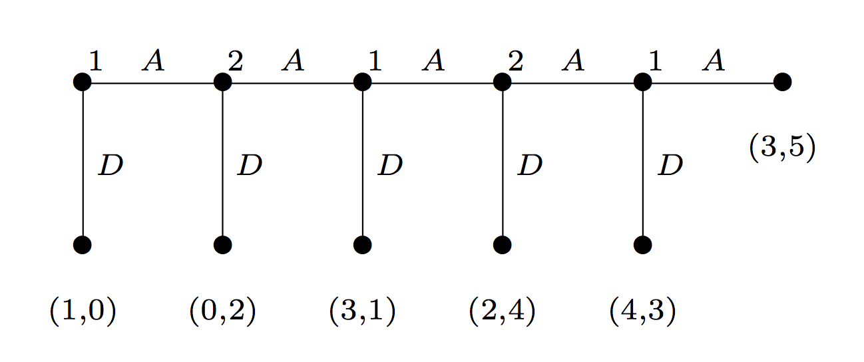
Backward Induction Paradox
What if player 1 doesn’t go down? What should you do as player 2?
If they played irrationally once, are they likely to do it again?
It seems that “rational” players should hold out for a better payoff
Notes:
What if player 1 doesn’t go down? What should you do as player 2?
Your knowledge was that players would act rationally
You have no idea what the next move of p1 will be. Maybe he will act irrationally again?

Slide 14
Counter-arguments to Aumann
The Backwards Induction Paradox
Taking into account past play
Does this change what it means to be rational?
“Co-operation theory”
Eg, tit for tat
=> Other (irrational) strategies often result in higher payoffs.
Notes:
Called cooperation theory by Reinhard Selten (Economist, 1994 Nobel Prize winner)

Slide 15
Summary
Backward Induction
Results in Subgame perfect equilibria
Is the “rational” solution to end up in
Common knowledge of rationality
Logically implies backward induction
Common knowledge of rationality implies backward induction
Unsatisfactory results in gameplay

Slide 16
References
Aumann, R. (1995). Backward induction and common knowledge of rationality. GEB: Games and Economic Behavior, 8(1), 6–19.
Jackson, Matthew O. “Backwards Induction.” YouTube. OpenCourseOnline. http://www.youtube.com/watch?v=ugAZqdYHQz8
Lecture Notes (2012). Rationalizability. http://ocw.mit.edu/courses/economics/14-12-economic-applications-of-game-theory-fall-2012/lecture-notes/MIT14_12F12_chapter5.pdf
Lecture Slides (2008). Backward Induction. http://www.cs.ubc.ca/~kevinlb/teaching/cs532l%20-%202008-9/lectures/lect8.pdf
Pettit, P. and R. Sugden. (1989). The Backwards Induction Paradox. J. Philos., 4 (1989), pp. 1–14
Y. Shoham and K. Leyton-Brown, Multiagent Systems: Algorithmic, Game-Theoretic, and Logical Foundations, Cambridge University Press, 2009.

Slide 17
Thank You!

