Slide 1
Equilibrium Refinements
Lifei Sheng
2014/01/23

Slide 2
Outline
Motivation of equilibrium refinements
Introduce different ways to refine Nash equilibrium
▪ definition
▪ why useful/reasonable
▪ toy example

Slide 3
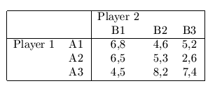
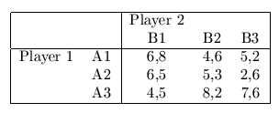
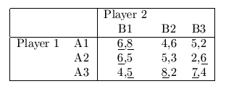
Why Equilibrium Refinements?
Nash Equilibrium: intersection of best responses
A little exercise:
Equilibrium refinements:
▪ games with multiple equilibria
▪ consider additional criteria and select a subset of NEs in order to
make better prediction
Pure-strategy NE?

Slide 4
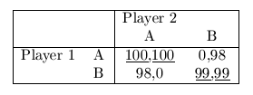
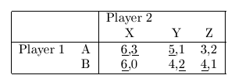
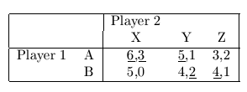
Refinements with Simple Features
Disadvantage:
May Not Exist!
Symmetric Nash Equilibrium
▪ symmetric game
Pareto optimal Nash Equilibrium
▪ pre-game communication
Strict Nash Equilibrium
▪ Definition: A strategy profile is a strict NE if every player’s strategy is a unique best
response to the other players’ strategies
▪ mixed-strategy NE is not strict; pure-strategy NE may or may not be strict

Slide 5
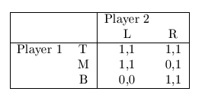
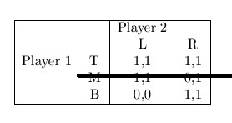
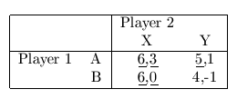
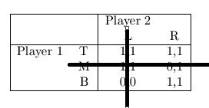
Equilibrium Refinements
Admissibility and Iterated Admissibility:
▪ Definition (Admissibility): A NE is admissible if no player plays a weakly dominated strategy.
▪ Definition (weakly dominated): Strategy $s_{i}$ weakly dominates $s_{i}′$ if $u_{i}(s_{i},s_{−i})≥u_{i}(s_{i}′,s_{−i})$for all
$s_{−i}$ with strict inequality for some $s_{−i}$.
▪ Defintion (Iterated Admissibility): A NE is iterated admissible if it survives the iterated elimination
of weakly dominated strategies.
▪ Iterated Elimination of Weakly Dominated Strategy: the iterated removal of weakly dominated
strategies

Slide 6
Equilibrium Refinements: Perfect Equilibrium
Trembling Hand Perfect Equilibrium (aka, Perfect Equilibrium)
▪ each player’s strategy $s_{i}$ is not only a best response to other players’ strategy $s_{−i}$,
but also a best response even when other players deviate from $s_{−i}$ with infinitely small
probability.
▪ more stable and robust

Slide 7
Perfect Equilibrium Example
when n is large enough

Slide 8
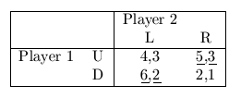
Perfect Equilibrium Example

Slide 9
Equilibrium Refinements: Proper Equilibrium
Proper Equilibrium
▪ motivated by perfect equilibrium
▪ a player is more likely to tremble in directions that are least
harmful to him
▪ difficult to verify

Slide 10
Conclusion
This talk introduced several equilibrium refinements
▪ symmetric NE, Pareto optimal NE, strict NE
▪ admissibility and iterated admissibility
▪ perfect equilibrium and proper equilibrium
Additional Comments
▪ no ideal refinements
▪ relationship between these refinements is complicated
▪ other equilibrium refinements in extensive-form game

Slide 11
Reference
Govindan, Srihari and Wilson, Robert, Refinements of Nash Equilibrium (2005). Available at SSRN: http://ssrn.com/abstract=772081 or http://dx.doi.org/10.2139/ssrn.772081
Refinements of Nash Equilibrium, John Nachbar (2011), lecture note
Refinements of the Nash Equilibrium Concept, R. Myerson, in Y. Varoufakis: Game Theory: Critical Concepts in the Social Sciences. London and New York: Routledge, 2001, pp. 159-66
"Nash Equilibrium", "Trembling Hand Perfect Equilibrium", "Proper Equilibrium", Wikipedia, http://en.wikipedia.org/wiki/Nash_equilibrium (/Trembling_hand_perfect_equilibrium/ Proper_equilibrium)
Admissibility in Games, Adam Brandenburger, Amanda Friedenberg, H.Jerome Keisler, (2007)
Iterated Admissibility as Solution Concept in Game Theory, Mario Gilli, Journal of Economic Literature
A Relation bewteen Perfect Equilibria in Extensive Form Games and Proper Equilibria in Normal Form Games, E.van Demme, Delft, International Journal of Game Theory, Vol 13, Issue 1, Page 1-13
Trembling Hand Prefect Equilibrium, lecture note http://dept.econ.yorku.ca/~sam/6100/slides/8c.pdf

Slide 12
Thank You

