Slide 1
Tolerating Business Failures in Hosted Applications
Jean-Sébastien Légaré
Dutch T. Meyer, Mark Spear, Alexandru Totolici, Sara Bainbridge, Kalan MacRow, Robert Sumi, Quinlan Jung, Dennis Tjandra, David Williams-King, William Aiello, Andrew Warfield
NSS Lab. UBC
SoCC 2013

Slide 2
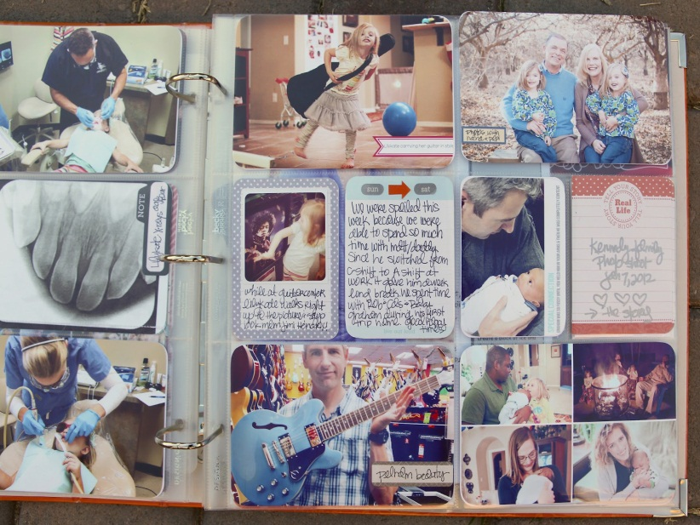
photo album
Notes:
You trust that it will be there in the future
Extremely Durable
No need for formats. You’ll always be able to see it the way it is built.

Slide 3
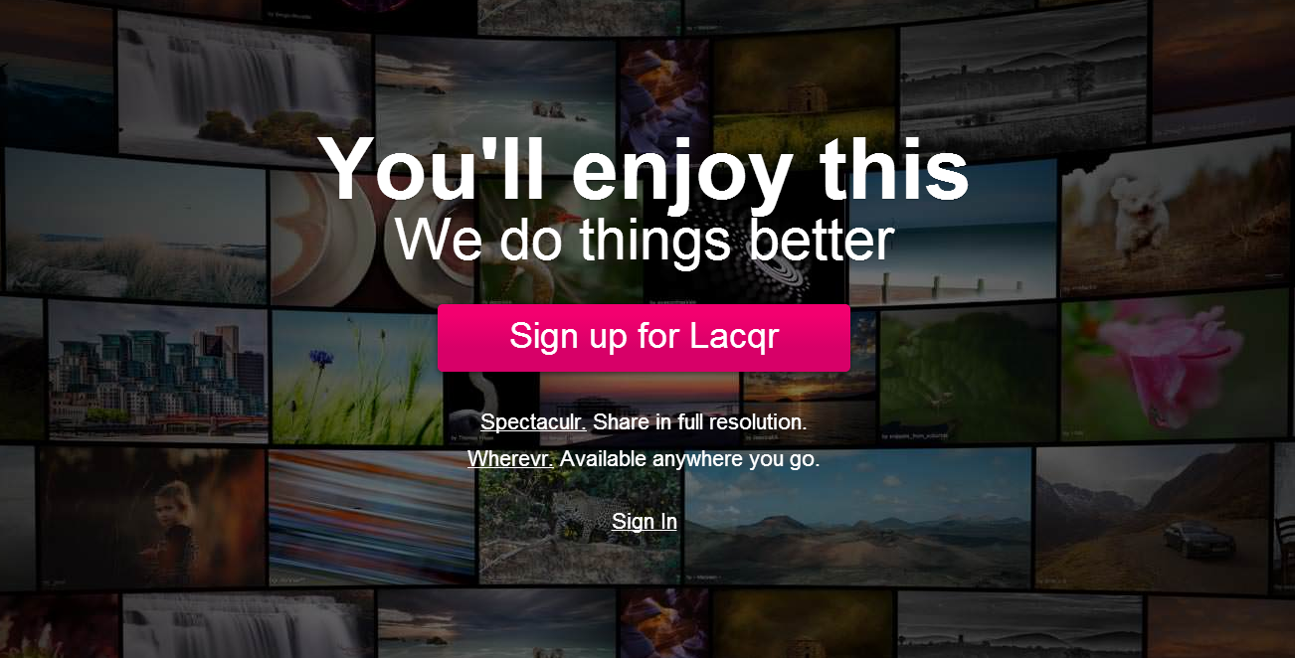
Notes:
Imagine for a moment that you would like to start a new online photo service called Lacqr.
You believe you have good ideas, and the right motivation for having this new service, and you want to gather a big customer base, but there are existing big services doing the same thing as you.
As a user, You like the features and UI much better than Flickr's. But you're really worried that if you start using it and spend a bunch of time uploading photos, annotating your photos, making comments on other people's photos, customizing the layouts of some of your albums, that all the time and effort will be wasted if the company goes out of business in a year or two. And you might lose all of my content as well.
For devs. It’s difficult to attract a user base.

Slide 4




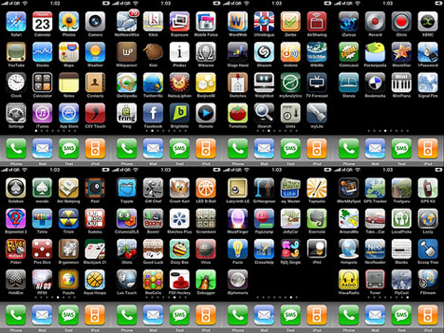



Apps are great. But they fail.
GeoCities
Piknik
Google Reader
Friendster
And more!
Notes:
and you know you're not just being paranoid. Apps do go out of business.
Markets are competitive
Application services are expensive to operate
Business models not always sustainable.
It’s not under your control.

Slide 5

Export is not enough
all_my_data_in_xml.tgz
Notes:
Laqr does have a way to export my data. But you're still super wary. Data is not enough. You don't know where the code will come from to easily navigate your content. And, even if you can do that in some halfway decent manner,
all that investment of time in customizing your albums will be lost.
So, You think you pretty much have to choose flickr.
Unless…. Laqr could give you really strong assurances that you wouldn't waist your investment of time and data, that your ability to navigate your content and your friends' content, to customize, to post messages and annotation, would remain even if Laqr went out of business.

Slide 6

Notes:
Now we believe that users would be more inclined to use a service if they had the reassurance that their data and the functionality they have learned to enjoy will stay there, just like a real photo album.
We've built a development platform called Micasa that can do exactly that. (walk through next slide)

Slide 7

Contributions
The Micasa platform that allows developers:
To build apps that tolerate EOL
To assert auditable guarantees about EOL behavior
Notes:
Micasa is a development platform that allows developers
* to build apps that tolerate EOL
* to assert audit able warranties about EOL behavior
we'll discuss the first bullet point first: how to build apps that tolerate EOL. Then we'll cover the second point: how to convince users that your app actually does have good functionality at EOL.

Slide 8
Hosted Apps Are great.
But… failures are catastrophic
ROLLING UPGRADES
SPEED
SHARING/AC
User Data
SEARCH
Server Data
VALIDATION
Notes:
Hosted application make it easy to do a lot of things:
Try application by browsing
Refresh / Rolling upgrade
Scalability (e.g. caching)
Global Search / Recommendations
Authentication
Access control / sharing
Animation: X appears, and title changes.
Risk of failure:
- Lose your data
- Lose other user’s data you had access to
- Lose logic to understand it. (export not enough)

Slide 9
We can build differently
Cloud storage is available to users (Move data)
Browsers are more powerful (Cache logic)
ROLLING UPGRADES
SEARCH
SHARING/AC
SPEED
VALIDATION
User Data
Server data
Notes:
This slide comes back 3 times, each time having moved another component to the RHS.
The fact that hosted application services are server-heavy is not a technical necessity. It is this way because it is a very convenient way of building applications. Namely, most web application frameworks encourage that form of construction.
Nowadays cloud storage is no longer something reserved for enterprises. It is at the users’ reach. So this lets us consider moving the user data out of the application provider. We’ll need to find a way to keep access control working.
Animation: user data and sharing/ac moves to RHS
The sound track can give additional characteristics of that type of data: global, private, proprietary.

Slide 10


Sharing And Access CTL
A [URLs]
Nice Photo!
B [URL]
B [URL]
Append
User A’s Store
User B’s Store
Notes:
Walk through example of user posting a comment in this model.

Slide 11
DaTA STORE DEsIGN GOALS
Allow multiple-SP ecosystem. All support API.
Sharing: capability URLs to objects
  No registr. to friend store.
  Files and folders
Revocation: undo share
Limit writes: No RW to other stores. Append only.
  Inbox-style communication
Migrate between storage providers
Notes:
Only cover important points. Too long. Refer to paper for rest.
May be cut. Explanation included in example walkthrough.
Move this closer to example flow slide.

Slide 12
We can build differently
Cloud storage is available to users (Move data)
Browsers are more powerful (Cache logic)
ROLLING UPGRADES
SEARCH
SPEED
VALIDATION
SHARING/AC
Server Data
User Data
Notes:
Sharing/AC and user data already moved.
Now because browsers are great, we can cache some of the application logic to the client.

Slide 13
Client Side Design Goals
Code cached using HTML5 Application Cache
Durable storage of client side code--can use storage provider
  After (manual or automatic) trigger that server is gone, need to switch to "unplugged" code paths
Library support/extension for redirecting app.com requests when unplugged

Slide 14
Libeol extension
Application
Provider
User A
CAPSI
Browser
+ libeol
.htm
.js
.css
User A’s Store
Client Code
User B
{rpc}
Server
Code/Data
CAPSI
{rpc}
Browser
+ libeol
-User List
-Cache
-Indexes
User B’s Store
Static Requests + RPC
“Peer-to-Store”
Notes:
Putting together user data, client side code caching and access control looks like this.

Slide 15
We can build differently
Cloud storage is available to users (Move data)
Browsers are more powerful (Cache logic)
SEARCH
SEARCH
ROLLING UPGRADES
SPEED
VALIDATION
SHARING/AC
Server Data
User Data
Notes:
Sharing/userdata/gear moved to client side
We can now use this client side code to implement needed features that don’t depend on the provider.
Animation: Validation and search moves to the right

Slide 16
Validation
Users have RW/Del over their store
Extra precautions when displaying user data
  content integrity filters (object len, checksums)
  routines to digitally sign and verify messages
Notes:
For centralized apps:
* message authentication/integrity: If a message has a username of TomH, other users can be pretty sure that it was TomH who uploaded exactly that message over an authenticated channel.
* specification conformance/sanity checking: The central app can sanity check data when users upload it. When a friend downloads that data, the browser can just render it.

Slide 17
Contributions
The Micasa platform that allows developers:
To build apps that tolerate EOL
To assert auditable guarantees about EOL behavior
Notes:
we'll now cover the second point: how to convince users that your app actually does have good functionality at EOL.

Slide 18
Auditable provider guarantees
Monitor
IDL
POLICY
PLUGGED
UNPLUGGED
CAPSI
User Store
Server RPC
Data RPC
Audit Log
3rd Party
Notes:
Extraordinary claims require extraordinary proofs
Providers can be explicit about which portions keep going
Monitor allows users to “test drive” unplugged func.
When launched in “unplugged mode”
Extension intercepts network requests
Requests are written to an audit log
Warranty claims can be validated
E.g. trigger local search feature and expect no external requests

Slide 19
Evaluation
Ease of development
Satisfactory performance
Good user experience
Notes:
Third piece of outline.

Slide 20
Applications Built
App Name | SLOC | Description
TwoCans | 1500 | IM System
HotCRP-P | 10K | Permanent HotCRP
Lenscapes | 2200 | Photo album sharing
Data Viewer | 650 | Namespace file explorer
Python Server prototype implementing CAPSI API (X lines of code).
Supports three underlying storage backends, FS, Azure, S3.

Slide 21
TWOCANS
Chat owner keeps list of message capabilities
Message authors can revoke their messages
Uses client-side crypto to sign and verify messages
Very simple hosted service
  Messages don’t go through server: p2store
  Only user registry and public chat URLs
Notes:
Chat owner can keep history of all messages
Message authors can revoke their messages
Emphasis: chat owner keeps list of message caps. Users place messages in their own store.

Slide 22
HOTCRP-P (Permanent)
Refitted php app to DHTML view logic
Client-side archiving of papers/reviews (copy)
Local index is built using applet port of Apache Lucene
Unplugged mode allows local archive search
(regardless of conference website availability)
Notes:
The way hotcrp is a php application, generally installed for a conference for the chairs.
It’s generally undefined how long the chair will keep hosting a conference website.
The PHP application stores all papers and reviews in a server database, and this gets lost when the site is taken down.
We refitted HotCRP to work in micasa, allow those reviews and papers to persist, and remain searchable locally… Not just your own comments, but everything you’ve crawled in the past goes in that index.

Slide 23



performance
Application benchmark for caching, sampling Flickr pages.
Compare loading pages statically with content-identical Micasa impl.
Evaluation server keeps flattened capability structure.
Compare cached vs non-cached load times and BW.
Birdi@:
Nice!
Chex:
great comp.
Accessing an item: $root/Comments/0/{icon, author, text}
Notes:
Make this shorter with earlier usage example. Say that comment and images come from various user stores in the micasa case.

Slide 24
Overheads
Fetching Micasa blobs slower than apache static fetch
Content integrity overhead (checksum + signatures)
Additional data dependencies
Notes:
More details in paper

Slide 25
Load times and BW Over STATIC
Page Load times:
  80% of pages have <100% overhead over static (2sec vs 1sec avg)
  With caching, all pages have <40% load times overhead
BW Consumption
  23% overhead, 6% when cached hierarchies are available
Notes:
Remember: wanted to characterize what portion of the overheads was caused by the additional data dependencies introduced, so included a third version with flattened…

Slide 26
Future Work
Improve user data privacy
  Confidentiality via crypto in user-defined groups
  Monitor exfiltration of capabilities
Ease adoption of data store API (see paper)
  Client-side abstraction layer to support backend diversity
Explore advertising avenues (see paper)
Notes:
Only talk about the first bullet. Refer to paper for more.

Slide 27
Allow testing Guarantees
Raise level of trust between users and application providers
Unplug to test out features present after End-of-Life (EOL)
Provide audit mechanism
Verify provider’s claims wrt to functionality
Notes:
Later in presentation

Slide 28
APPLICATION CLASSES SupportED
Data View based Applications: Blogs, Photo Galleries are best suited
  Peer-to-store connections allow sharing and commenting
Local archives of previously viewed content
  Preserve search with client-side indexing
  Access to “friends” data can be kept
Notifications via polling (fallback for live pub-sub)
Server-side caching of user objects
Server protocols (e.g. SMTP for webmail)
Notes:
Backup. Refer to paper for list of apps we support(or not)

Slide 29
Conclusion
Platform to handle service provider EOL
Lose no benefits from central hosting
Application can go in unplugged mode
App`s dependence on the provider can be audited
Demonstrated feasibility with several useful applications
Performance of proto well within the bounds of usability
Notes:
Backup.

