Slide 1




Fine Grain MPI
Earl J. Dodd
Humaira Kamal, Alan Wagner
@ University of British Columbia

Slide 2
Agenda
Motivation
Fine-Grain MPI
Key System Features
Novel Program Design.

Slide 3
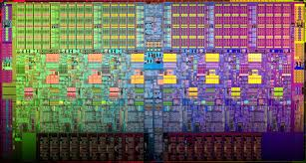
Introduction of multicore has changed the architecture of modern processors dramatically.
Plethora of languages and frameworks have emerged to express fine-grain concurrency on multicore systems.

Slide 4




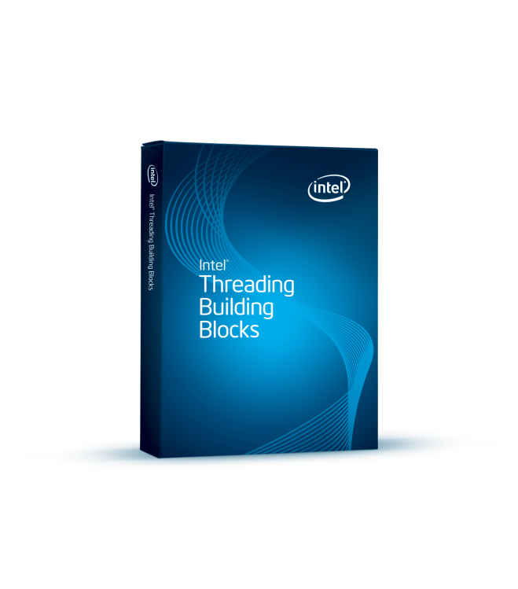

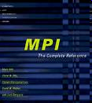










concurrency
threads/processes
parallel
New Languages
and
Frameworks
golang
multicore
cluster

Slide 5

multicore
cluster
computing
How to take advantage of multicore with seamless execution across a cluster?

Slide 6
OpenMP
MPI + X
PGAS
UPC
?
Let X = MPI

Slide 7
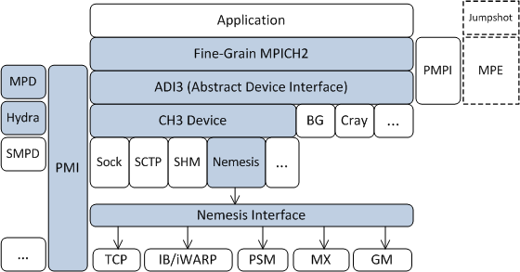
FG-MPI: FINE-GRAIN MPI
FG-MPI extends the execution model of the Message Passing Interface (MPI) to expose large-scale, fine-grain concurrency.

Slide 8
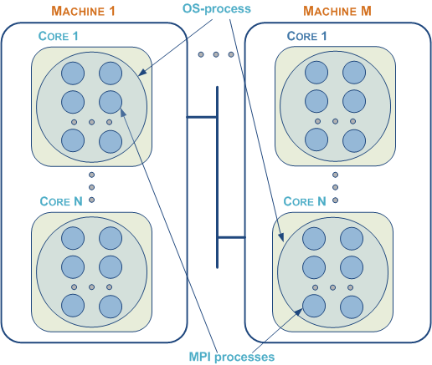
Decoupling an MPI process from an OS-level process.

Slide 9
FG-MPI System
Has light-weight, scalable design integrated into MPICH middleware which leverages its architecture.
Implements location-aware communication inside OS-processes and nodes.
Allows the user to scale to millions of MPI processes without needing the corresponding number of processor cores.
Allows granularity of MPI programs to be adjusted through the command-line to better fit the cache leading to improved performance.
Enables design of novel algorithms and vary the number of MPI processes to match the problem rather than the hardware.
Enables task oriented program design due to decoupling from hardware and support for function-level concurrency.

Slide 10
Executing FG-MPI Programs
mpiexec –nfg 2 –n 8 myprog
Example of SPMD MPI program
  with 16 MPI processes,
  assuming two nodes with quad-core.
8 pairs of processes executing in parallel,
where each pair interleaves execution.

Slide 11
Decoupled from Hardware
mpiexec –nfg 250 –n 4 myprog
Fit the number of processes to the problem rather than the number of cores.

Slide 12
Flexible Process Mapping
mpiexec –nfg 1000 –n 4 myprog
mpiexec –nfg 500 –n 8 myprog
mpiexec –nfg 750 –n 4 myprog: -nfg 250 –n 4 myprog
Flexibly move the boundary of MPI processes
mapped to OS-processes, cores and machines.

Slide 13
Scalability
mpiexec –nfg 30000 –n 8 myprog
Can have hundreds and thousands of MPI processes on a laptop or cluster.
100 Million processes on 6500 cores.
mpiexec –nfg 16000 –n 6500 myprog

Slide 14
Novel Program Design
Modelling of emergent systems
  Bird flocking.
Distributed data structures
  Every data item is an MPI process.

Slide 15

Dynamic Graph Applications
How to query large amounts of real-time data to extract relationship information?
Twitter feeds
Sensor data feeds
Financial data
Companies with an Executive in common: Every dot represents a executive/director from a publicly listed company; People are connected to one another if they served the company at the same time.
FG-MPI Distributed Skip-list with support for Range-querying
Scalable, using thousands of processors executing on over 200 cores

Slide 16
Technical Deep-Dive Webinar
FG-MPI: A Finer Grain Concurrency Model for MPI
March 19, 2014 at 3:00 PM - 4:00 PM CT
Society of HPC Professionals (SHPCP)
http://hpcsociety.org/events?eventId=849789&EventViewMode=EventDetails

Slide 17
Acknowledgements
We acknowledge the support of the on-going FG-MPI project by:
Intel Corporation, Inc.
Mitacs Canada.
NSERC (Natural Sciences and Engineering Research Council of Canada)

Slide 18
Thank You …
http://www.cs.ubc.ca/~humaira/fgmpi.html
or google “FG-MPI”
Dr. Alan Wagner UBC +1-604-822-6450 wagner@cs.ubc.ca | Dr. Humaira Kamal UBC +1-604-822-6450 kamal@cs.ubc.ca | Sarwar Alam UBC +1-604-827-3985 sarwar@cs.ubc.ca | Earl J. Dodd Scalable Analytics Inc. +1-713-446-4963 Earl.Dodd@scalableanalytics.com

Slide 19
Publications
H. Kamal and A. Wagner. An integrated fine-grain runtime system for MPI. Journal of Computing, Springer, May 2013, 17 pages.
Sarwar Alam, Humaira Kamal and Alan Wagner. Service Oriented Programming in MPI. In Communicating Process Architectures 2013. pp 93-112. ISBN: 978-0-9565409-7-3. Open Channel Publishing Ltd., England., August 2013.
H. Kamal and A. Wagner. Added concurrency to improve MPI performance on multicore. In 41st International Conference on Parallel Processing (ICPP), pages 229-238, 2012.
H. Kamal and A. Wagner. An integrated runtime scheduler for MPI. In J. Traff, S. Benkner, and J. Dongarra, editors, Recent Advances in the Message Passing Interface, volume 7490 of Lecture Notes in Computer Science, pages 173-182. Springer Berlin Heidelberg, 2012.
H. Kamal, S.M. Mirtaheri, and A. Wagner. Scalability of communicators and groups in MPI. In Proceedings of the 19th ACM International Symposium on High Performance Distributed Computing, HPDC 2010, pages 264-275, New York, NY, USA, 2010.
H. Kamal and A. Wagner. FG-MPI: Fine-Grain MPI for multicore and clusters. In 11th IEEE Intl. Workshop on Parallel and Distributed Scientific and Engineering Computing (PDSEC) held in conjunction with IPDPS-24, pages 1-8, April 2010.

