Slide 1
CMPT 120 Lists and Strings
Summer 2012
Instructor: Hassan Khosravi

Slide 2
All of the variables that we have used have held a single item
One integer, ﬂoating point value, or string
often you find that you want to store a collection of values in your programs.
a list of values that have been entered by the user or a collection of values that are needed to draw a graph.
In Python, lists can be used to store a collection of values.
Python can hold values of any type; they are written as a comma-separated list enclosed in square brackets:
numlist = [23, 10, -100, 2]
words = [’zero’, ’one’, ’two’]
junk = [0, 1, ’two’, [1,1,1], 4.0]

Slide 3
To get a particular value out of a list, it can be subscripted
testlist = [0, 10, 20, 30, 40, 50]
print testlist[2]
20
print testlist[0]
0
print testlist[10]
IndexError: list index out of range
Like strings, the first element in a list is element 0

Slide 4
You can determine the length of a list with the len function:
print len(testlist)
6
for i in range(len(testlist)):
print testlist[i],
0 10 20 30 40 50

Slide 5
Lists can be joined (concatenated) with the + operator:
testlist + [60, 70, 80]
[0, 10, 20, 30, 40, 50, 60, 70, 80]
[’one’, ’two’, ’three’] + [1, 2, 3]
[’one’, ’two’, ’three’, 1, 2, 3]
It is also possible to delete an element from a list
colours = [’red’, ’yellow’, ’blue’]
del colours[1]
print colours
[’red’, ’blue’]
del colours[1]
print colours
[’red’]

Slide 6
You can also add a new element to the end of a list with the append
colours = [’red’, ’yellow’, ’blue’]
colours.append(’orange’)
colours.append(’green’)
print colours
[’red’, ’yellow’, ’blue’, ’orange’, ’green’]
In order to do something similar with a string, a new string must be built with the + operator:
letters = ’abc’
letters = letters + ’d’
letters = letters + ’e’
print letters
abcde

Slide 7
print "Enter some numbers, 0 to stop:"
numbers = []
x=1
while x!=0:
x = int(raw_input())
if x!=0:
numbers.append(x)
print "The numbers you entered are:"
print numbers

Slide 8
Lists and for loops
range(10)
[0, 1, 2, 3, 4, 5, 6, 7, 8, 9]
range(1,17,3)
[1, 4, 7, 10, 13, 16]
Range(13,1,2)
[]
Range(13,1,-2)
[13, 11, 9, 7, 5, 3]
for i in range(10):
# do something with I
For loop in Python can iterate over any list
not just those produced by the range function.

Slide 9
There, the for loop iterates over each element in the list words.
words = ["up", "down", "green", "cabbage"]
for word in words:
print "Here’s a word: " + word
Here’s a word: up
Here’s a word: down
Here’s a word: green
Here’s a word: cabbage

Slide 10
Slicing and Dicing
colours = [’red’, ’yellow’, ’blue’]
colours[1] = ’green’ # set an element with indexing
Print colours[1]
green
print colours[2] # index to retrieve an element
’blue’
colours = [’red’, ’yellow’, ’green’, ’blue’]
print colours[1:3]
[’yellow’, ’green’]
In general, the slice [a:b] extracts elements a to b-1
Same as range

Slide 11
Special Slice Positions
Negative values count from the end of a list.
-1 refers to the last item in the list
-2 to the second-last, and so on
colours = [’red’, ’yellow’, ’green’, ’blue’]
print colours[0:-1]
[’red’, ’yellow’, ’green’]
If you leave out one of the values in the slice, it will default to the start or end of the list.
[:num] refers to elements 0 to num-1.
[2:] gives elements from 2 to the end of the list.

Slide 12
Examples
colours = [’red’, ’yellow’, ’green’, ’blue’, ’orange’]
print colours[2:]
[’green’, ’blue’, ’orange’]
print colours[:3]
[’red’, ’yellow’, ’green’]
print colours[:-1]
[’red’, ’yellow’, ’green’, ’blue’]
e [:-1] will always give you everything except the last element;
[1:] will give everything but the ﬁrst element.

Slide 13
Examples Fibonacci
Store the first 20 values in the Fibonacci series in a list such that the index i of the list stores the ith element.
● Fibonacci series are the numbers in the following integer
sequence:
 0,1,1,2,3,5,…
 F_{n} = F_{n-1} + F_{n-2}
 F₀ = 0, F₁ =1

Slide 14
Example Fibonacci
fib = []
fib.append('garbage')
fib.append(0)
fib.append(1)
for i in range(3,20):
new = fib[i-1] + fib[i-2]
fib.append(new)
print fib

Slide 15
Example Fibonacci
Store the first 20 values in the Fibonacci series in a list such that the index i of the list stores the ith element.
● Fibonacci series are the numbers in the following integer
sequence:
 0,1,1,2,3,5,…
 F_{n} = F_{n-1} + F_{n-2}
 F₀ = 0, F₁ =1
For the odd elements of the series calculate their average
For even elements of the series calcuate their sum

Slide 16
Example Fibonacci
def average(list):
length = len(list)
j=0
sum=0
for i in range(1,length,2):
j=j+1
sum = sum+list[i]
print list[i]
average = float(sum)/j
return average
def sumforfib(list):
length = len(list)
sum=0
for i in range(length,2):
sum = sum+list[i]
print list[i]
return sum

Slide 17
Example Duplicate
Store a list of 10 words and determine whether any word has been entered more than once.
words= []
for i in range(10):
words.append( raw_input("enter word please: "))
flag = False
for i in range(10):
for j in range(i+1,10):
if words[i] == words[j]:
print "duplicated"
flag = True
if flag == False:
print "No duplicates"

Slide 18
Words containing ‘s’
Store a list of 10 words and determine whether each contains the letter s or not.
words= []
for i in range(10):
words.append( raw_input("enter word please: "))
for w in words:
flag = False
for let in w:
if let == 's':
print w, "contains s"
flag = True
if flag == False:
print w, "does not contain s"

Slide 19
Store a list of 10 words and determine whether each contains the letter s or not. Remove all occurrences of letter s from all words
words= []
for i in range(4):
words.append( raw_input("enter word please: "))
length = len(words)
for i in range(length):
temp = ""
for let in words[i]:
if let != 's':
temp = temp + let
words[i]= temp
print words

Slide 20
Manipulating Slices
You can actually do almost anything with list slices
colours = [’red’, ’yellow’, ’green’, ’blue’]
colours[1:3] = [’yellowish’, ’greenish’]
print colours
[’red’, ’yellowish’, ’greenish’, ’blue’]
colours[1:3] = [’pink’, ’purple’, ’ecru’]
print colours
[’red’, ’pink’, ’purple’, ’ecru’, ’blue’]
we assigned a list of three elements to a slice of length two
The list expands to make room or the new elements
[’yellowish’, ’greenish] is replaced with [’pink’, ’purple’, ’ecru’].

Slide 21
Manipulating Slices
If the list assigned is shorter than the slice, the list would shrink
colours = ['red', 'yellow', 'green', 'blue']
colours[1:3] = "red"
print colours
['red', 'r', 'e', 'd', 'blue']
colours = ['red', 'yellow', 'green', 'blue']
colours[1:3] = ['red']
print colours
['red', 'red', 'blue']

Slide 22
Deleting Slices
You can also remove any slice from a list:
colours = [’red’, ’yellow’, ’green’, ’blue’]
del colours[1:3]
print colours
[’red’, ’blue’]

Slide 23
Strings
Strings are a sequence of characters; lists are a sequence of any combination of types.
Any type that represents a collection of values can be used as the “list” in a for loop.
Since a string represents a sequence of characters, it can be used.
for char in "abc":
print "A character:", char
A character: a
A character: b
A character: c

Slide 24
Slicing Strings
Slices in strings are read only
sentence = "Look, I’m a string!“
print sentence[:5]
Look
print sentence[6:11]
I’m a
print sentence[-7:]
string!

Slide 25
But, you can’t modify a string slice
sentence = "Look, I’m a string!“
sentence[:5] = "Wow"
TypeError: object doesn’t support slice assignment
del sentence[6:10]
TypeError: object doesn’t support slice assignment

Slide 26
Mutability
dots = dots + "." # statement #1
The right side of = is evaluated and put into dots. The old value of dots is lost in the assignment
values = values + [n] # statement #2
Same with this method of modifying lists
values.append(n) # statement #3
The output of this statement is the same as statement 2.
Statement 3 requires a lot less work.
The whole list in not rebuilt.
Data structures that can be changed in-place like lists are called mutable.
Strings and numbers are not mutable: they are immutable.
Objects depends how they are written, but they have the capability to be mutable

Slide 27
References
There are several cases where the contents of one variable are copied to another.
# x copied into y:
y = x
You probably don’t think of copying the contents of a variable as a difficult operation, but consider the case where x is a list with millions of elements.
Python avoids making copies where possible
To understand this, we need to understand references.

Slide 28
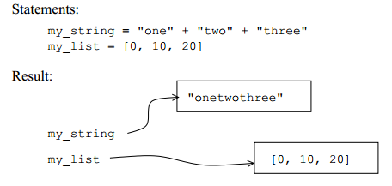
Every variable in Python is actually a reference to the place in memory where its contents are stored.
Conceptually, you should think of a variable referencing its contents like an arrow pointing to the contents in memory.

Slide 29
When you use a variable in an expression, Python follows the reference to find its contents.
Usually, the expression on the right side of an assignment creates a new object in memory.
Total = a+b calculates a+b, stores this in memory, and sets total to reference that value.
The exception to this is when the right side of an assignment is simply a variable reference
(like total=a).
In this case, the result is already in memory and the variable can just reference the existing contents

Slide 30
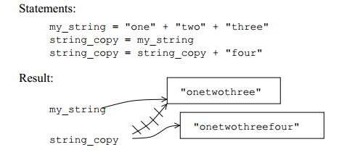
Aliases
When two variables refer to the same contents, they are aliases of each other.
it’s generally good since it doesn’t require copying the contents to another location in memory.
When you assign to a variable, you are changing it so the variable now references different contents.
(The old contents are thrown away since they are no longer being referenced.)

Slide 31
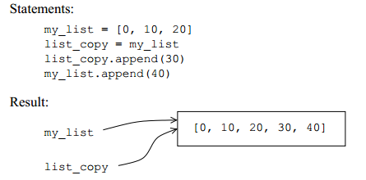
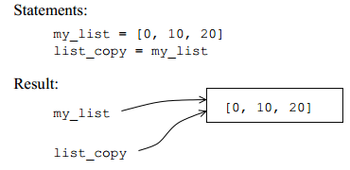
Mutable data structures and aliases
Mutable data structures (lists and some objects), aliases complicate things.
Mutable data structures can be changed without totally rebuilding them, we can change the contents without moving the reference to a new object in memory
It’s possible to change a variable, and the changes will affect any other variables that reference the same contents.
my_list and list_copy are aliases of the same contents. When either one is changed, both are affected. I

Slide 32
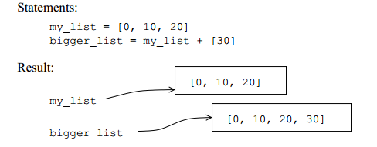
Any expression (that’s more complicated than a variable reference) will result in a new reference being created. If this is assigned to a variable, then there is no aliasing.

Slide 33
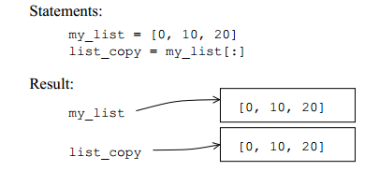
Really Copying
If you want to make a copy of a variable that isn’t a reference, it’s necessary to force Python to actually copy its contents to a new place in memory. This is called cloning. Cloning is more expensive than aliasing,
There are three methods for this
The slice operator can be used to create a clone.
You could also make a copy of a list with the list function that creates a new list (out of the old one). So, list(my_list) would give the same result as my_list[:].
the copy module contains a copy function. This function will take any Python object and clone its contents
import copy
new_obj = copy.copy(obj)

