Slide 1
CMPT 120 How computers run programs
Summer 2012
Instructor: Hassan Khosravi

Slide 2
How Computers Represent Information
All information that is stored and manipulated with a computer is represented in binary
with zeros and ones.
Why just zeros and ones?
Computer’s memory is a whole bunch of tiny rechargeable batteries (capacitors).
discharged (0) or charged (1).
It’s easy for the computer to look at one of these capacitors and decide if it’s charged or not.
This could be done to represent digits from 0 to 9
diﬃcult to distinguish ten diﬀerent levels of charge in a capacitor
hard to make sure a capacitor doesn’t discharge a little to drop from a 7 to a 6

Slide 3
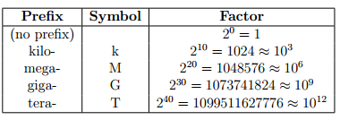
How Computers Represent Information
A single piece of storage that can store a zero or one is called a bit.
Bits are often grouped. It’s common to divide a computer’s memory into eight-bit groups called bytes
00100111 and 11110110
Number of bits or bytes quickly becomes large
For example, “12 megabytes” is
12 × 2²⁰ bytes = 12,582,912 bytes = 12582912 × 8 bits = 100,663,296 bits
Note that values are approximations
Kilo is 1000 here it is 1024

Slide 4
Unsigned Integers
Consider the number 157
157 = (1 × 10² ) + (5 × 10¹) + (7 × 10⁰).
Applying the same logic, there is a counting system with bits, binary or base 2 arithmetic
The rightmost bit will be the number of 1s(2⁰ ), the next will be the number of 2s (2¹ ), then 4s (2²), 8s (2³), 16s (2⁴), and so on.
1001₂ = (1 × 2³) + (0 × 2²) + (0 × 2¹) + (1 × 2⁰) = 8 + 1
10011101₂ = (1 × 2⁷) + (0 × 2⁶) + (0 × 2⁵) + (1 × 2⁴) + (1 × 2³) + (1 × 2²) + (0 × 2¹) + (1 × 2⁰) = 128 + 16 + 8 + 4 + 1 = 157₁₀.

Slide 5
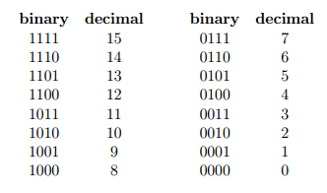

Slide 6
The computer can do operations like addition and subtraction on binary integers the same way you do with decimal numbers
Keep in mind that 1 + 1 = 2₁₀ = 10₂

Slide 7
Positive and Negative Integers
One easy way to think of this is to have the left most bit as the sign
(0 = positive, 1 = negative)
With four bits
0 111 would 7
1111 would be -7
Pros:
Its easy for the human eye to understand
It’s easy to tell if the value is negative: if the ﬁrst bit is 1, it’s negative.
For positive numbers the values are the same as the unsigned representation.
Cons
Addition and subtraction does not work as before
The value 0 has two representations 1000 and 0000.

Slide 8
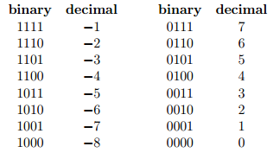
two’s complement notation
To convert a positive value to a negative value in two’s complement, you ﬁrst ﬂip all of the bits (convert 0s to 1s and 1s to 0s) and then add one.
For example to show -5
Start with the positive version: 0101
Flip all of the bits: 1010
Add one: 1011
With 4bits using two’s complement we can show -8, 7

Slide 9
Pros and cons of two’s complement
Pros
It’s easy to tell if the value is negative: if the ﬁrst bit is 1, it’s negative.
For positive numbers the values are the same as the unsigned representation.
Addition and subtraction works the same unsigned method
The value 0 now has 1 representations 0000
Cons
Not as easy for humans to see

Slide 10
Examples of two’s complement
-6 +4 with 4 digits
Start with 6 → 0110
Complement → 1001
Add 1 → 1010
What value is 1110?
Take one away → 1101
Complement →0010 → which is 2
+
1 0 1 0
0 1 0 0
----------
1 1 1 0

Slide 11
Examples of two’s complement
−3 + 5 = 2
Start with 3 → 0011
Complement → 1100
Add 1 → 1101
We only have 4 bits of memory for values -8 to 7 so we ignore last carried one
+
1 1 0 1
0 1 0 1
----------
1 0 0 1 0

Slide 12
3 – 4
What is 1111
Take one away → 1110
Complement → 0001
-
1 0 0 1 1
0 1 0 0
----------
1 1 1 1

Slide 13
I-clicker
A: I feel comfortable with binary values and mathematical operations on them
B: I was following the class and got the basics, I need to practice some more to be comfortable with it
I had difficulty in understanding binary values. I need to go over the theory again.
D: I didn’t understand binary values and operators on them at all

Slide 14
Characters
A character is a single letter, digit or punctuation
Storing characters is as easy as storing unsigned integers. For a byte (8 bits) in the computer’s memory, there are 2⁸ = 256 diﬀerent unsigned numbers
Assign each possible character a number and translate the numbers to characters.
The character set used by almost all modern computers, when dealing with English and other western languages, is called ASCII
T =84
$= 36
Number 4 as a string = 52
Why not give numbers their own value?

Slide 15
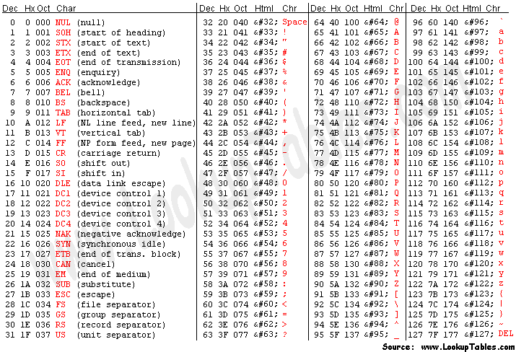
ASCII code

Slide 16
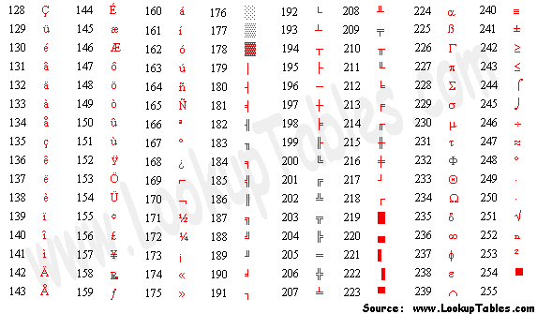
Extended ASCII codes

Slide 17
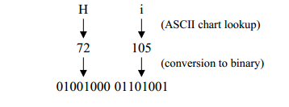
Strings
A string is a collection of several characters.
Some strings are "Jasper", "742", and "bhay-gn-flay-vn".
The particular character set that is used by almost all modern computers, when dealing with English and other western languages, is called ASCII
The binary is the same as 18537 how does the computer know whether this is “hi” or 18537?
The programming language should take care of that.

Slide 18
Unicode
With only one byte per character, we can only store 256 diﬀerent characters in our strings
But gets quite hard with languages like Chinese and Japanese
The Unicode character set was created to overcome this limitation. Unicode can represent up to 2 ³² characters.
Read topic 2.6 from introduction to computing science and programming

Slide 19
The Python programming language
The programming language we will use in this course is Python.
Python is an example of a high-level language;
Other high-level languages are C, C++, Perl, and Java.
Much easier to program
Less time to read and write
More likely to be correct
Portable
Low-level languages, sometimes referred to as “machine languages" or “assembly languages”
Only used for a few specialized applications.
Computers can only execute programs written in low level . Programs written in high level have to be processed before then can be run.
Two kinds of programs process high-level languages into low-level languages:

Slide 20
Interpreters
An interpreter reads a high-level program and executes it,
It processes the program a little at a time, alternately reading lines and performing computations.
Python is interpreted

Slide 21
Compiler
A compiler reads the program and translates it completely before the program starts running.
In this case, the high-level program is called the source code, and the translated program is called the object code or the executable
Read chapter 1 from how to think like a computer scientist

