Slide 1
CMPT 120 Introduction To Computing Science And Programming I
Summer 2012
Instructor: Hassan Khosravi

Slide 2
Admin
See website http://www.cs.sfu.ca/~hkhosrav/personal/py/120-2012.html

Slide 3
Textbook
Introduction to Computing Science and Programming I by Greg Baker
One page per sheet
Two page per sheet
Four page sheet
How to Think Like a Computer Scientist -- Learning with Python
PDF format
HTML format
HTML zip format
Lecture slides
Reference Books
Learn Python The Hard Way, Zed Shaw
by downloading it or buying it from its home site

Slide 4
Course Grading
Lab assignments/quizzes 13%
Assignments 25%
4 assignments
Midterm 29th of June in class (20%)
AEP 2%
Final (40%)
You must be able to attend the final exam to pass the course!

Slide 5
Teaching Style
Motivate the students. I feel it is the duty of the instructor to present the subject in a motivating and engaging manner.
Ask a lot of questions
Get the students involved.
Use I-clickers
Go Over Many Examples
Set clear and realistic goals. Students respond best to goals that are both challenging and achievable.
I would like all of you to be successful
You are all competing with yourselves to do your personal best and I am here to help you with that
Final grade: Normal distribution
Always respect the students.

Slide 6
Questions and policies
http://www.cs.sfu.ca/~hkhosrav/personal/py/120-2012.html

Slide 7
I-clickers
http://www.iclicker.com/
Enter your last name, first name, student ID (your
email ID), and the clicker ID and click “submit.”

Slide 8
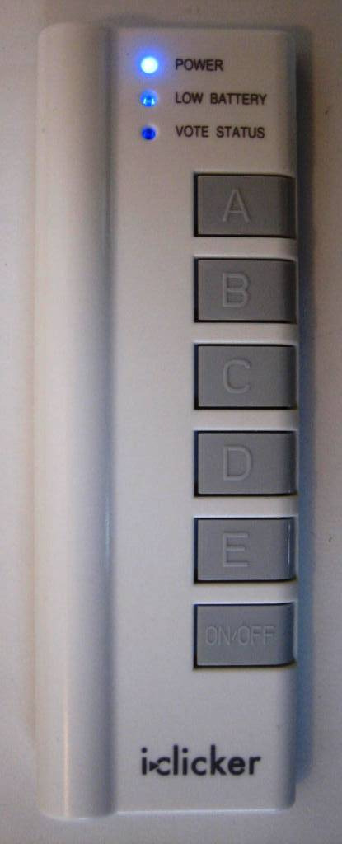
How do you vote?
Turn on the clicker by pressing the “On/Off” button.
A blue “Power” light will appear at the top of the remote.
When I ask a question in class (and start the timer), select A, B, C, D, or E as your vote.
Check your “Vote Status” Light:
Green light = your vote was sent AND received.
Red flashing light = you need to vote again.
**Not sure you saw the light? Just vote again.
**Want to change your vote? You can vote again as long as the timer is still going.

Slide 9
I-clicker Question
You are
A: First year student
B:second year student
C:Third year student
D: fourth year student
E: Other

Slide 10
I-clicker Question
What is your major?
A: Computer Science
B: math or statistics
C: Physics or Chemistry
D: Business or engineering
E: Other

Slide 11
I-clicker Question
Which of the following best describes your experience with computers?
A: I have seen computers and know how to turn them on
B: I mostly use them for browsing internet and Google is my best friend. I have no programming experience.
C: I have done some programming before, but not much.
D: I think I’m a decent programmer.

Slide 12
I-clicker Question
Which of the following best describes your expectations from the course
A: I’m here to get the credits
B: I’m here to see how I like programming. I may consider programming as a future career
C:I want to learn programming professionally. I know that programming is my future career.
D: I am all set to become the next Bill gates or Steve jobs

Slide 13
Content of CMPT 120
Course Website is http://www.cs.sfu.ca/~hkhosrav/personal/py/120-2012.html
About CMPT 120
Computer Science and Pseudocode
Programming Basics
Data types, User inputs
Control Structures
If statements, loops
Problem Solving
Data structures
Lists, strings, references
Algorithms
Searching, sorting, recursion
Working with Files
File input, file outputs

Slide 14
What is an Algorithm?
The concept of an “algorithm” is fundamental to all of computing science and programming
An algorithm is a set of instructions that can be used to solve a problem.

Slide 15
An everyday algorithm
A baking recipe
Combine the room-temperature butter and the sugar. Mix until light and ﬂuﬀy.
Add the eggs to the creamed butter and mix to combine.
In another bowl, combine the liquid ingredients and mix to combine.
Sift together the ﬂour and other dry ingredients.
Alternately add the dry and liquid ingredients to the butter-egg mixture.
Mix just enough to combine.

Slide 16
What is an Algorithm?
We are more interested in the kinds of algorithms that can be completed by computers.
An algorithm definition accepted by most Computer Scientists
“An algorithm is a sequence of unambiguous instructions for solving a problem, i.e., for obtaining a required output for any legitimate input in a ﬁnite amount of time”

Slide 17
What is an Algorithm?
“An algorithm is a sequence of unambiguous instructions for solving a problem, i.e., for obtaining a required output for any legitimate input in a ﬁnite amount of time”
Unambiguous: When you read an algorithm, there should be no question about what should be done.
Combine the room-temperature butter and the sugar. Mix until light and ﬂuﬀy.
Add the eggs to the creamed butter and mix to combine.
In another bowl, combine the liquid ingredients and mix to combine.
Sift together the ﬂour and other dry ingredients.
Alternately add the dry and liquid ingredients to the butter-egg mixture.
Mix just enough to combine.

Slide 18
What is an Algorithm?
“An algorithm is a sequence of unambiguous instructions for solving a problem, i.e., for obtaining a required output for any legitimate input in a ﬁnite amount of time”
Solving a Problem: An algorithm should always present a solution to a particular problem.
Our example: Using these ingredients, make muﬃns.”
Legitimate input:
An algorithm might need some kind of input to do its job.
In addition to having the inputs, they have to be “legitimate”
1 can of baby corn, 1 cup orange juice; 1 telephone. We aren’t going to get very far.
“legitimate” ingredients include sugar, eggs, ﬂour and butter.

Slide 19
What is an Algorithm?
“An algorithm is a sequence of unambiguous instructions for solving a problem, i.e., for obtaining a required output for any legitimate input in a ﬁnite amount of time”
Finite amount of time: The algorithm should finish eventually
A recipe that leaves us in the kitchen until the end of time isn’t much good.
Stir with a fork until the mixture turns into Beef Wellington.

Slide 20
Data Structures
A data structure describes how a program stores the data it’s working with
To carry on with the cooking example
Most people have their recipes in cookbooks on a shelf
Recipes on index cards in a box (you might have to shuﬄe through the whole pile to ﬁnd the one you want)
If pile is in some kind of order, e.g. alphabetical by the name of the dish it makes, you might be able to ﬁnd the recipe much faster.
The way you choose to store information can have a big eﬀect on the algorithm you need to work with it

Slide 21
What is Computing Science?
Computing science is often deﬁned as the study of algorithms, including
1. Their formal and mathematical properties.
2. Their hardware realizations.
3. Their linguistic realizations.
4. Their applications.

Slide 22
What is Computing Science?
Their formal and mathematical properties:
What problems can be solved with algorithms
For what problems can we ﬁnd solutions in a reasonable amount of time
Is it possible to build computers with diﬀerent properties that would be able to solve more problems?”
Their hardware realizations:
One of the goals when building computers is to make them fast.
Able to execute algorithms speciﬁed by the programmer quickly.
Make good use of their memory and be able to access other systems (disks, networks, printers, and so on).

Slide 23
What is Computing Science?
Their linguistic realizations:
There are many ways to express algorithms so a computer can understand them.
Finding languages that are written by people and followed by computers.
Some “language” that can be understood by both people and computers.
Their applications:
what actual useful things can be done algorithmically.
Is it possible for a computer to understand a conversation?
Can it drive a car?
Can the small computers in cell phones be made more useful?

