Slide 1
Scalable Multi-stage Preconditioners for Numerical Simulations of Multi-Phase Flow in Porous Media
Hui Liu
University of Calgary
Email: hui.j.liu@ucalgary.ca
Joint work with Kun Wang and Zhangxin Chen

Slide 2
Outline
Introduction
Multi-Stage Preconditioners
Results and Discussions
Conclusions

Slide 3
Introduction

Slide 4
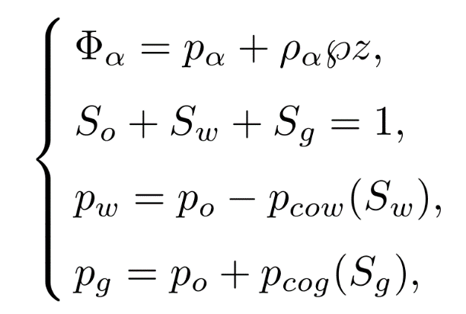
Black Oil Model
Conservation laws:
Constraints:

Slide 5
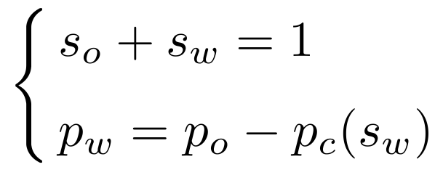
Oil-Water Model
Conservation laws:
Constraints:

Slide 6
Traditional Simulators
Designed for desktop/workstation
Multi-cores, OpenMP
Efficient for small/medium cases
Long simulation time for large-scale cases with tens of millions of grid cells
Notes:
Most applications are using the shared-memory programming models – based on OpenMP.
The simulation speed is very slow.

Slide 7
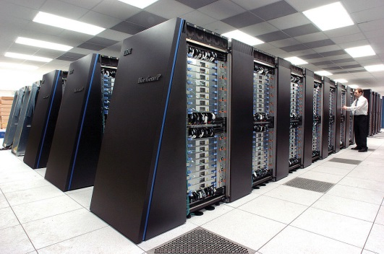
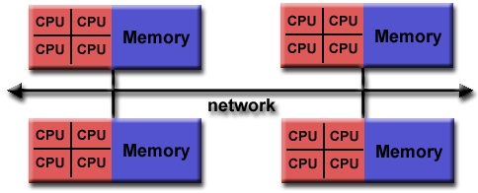
New Generration Reservoir Simulators
Clusters/supercomputers
OpenMP for shared memory
- multi-cores, easy to use
MPI among computation nodes
- communication
- MPI-IO, read input and write output
Large-scale simulations
General Purpose Cluster (GPC)
IBM Blue Gene/Q

Slide 8
Challenges for Linear Solvers
Reservoir models are highly coupled nonlinear systems
Heterogeneous permeability and porosity
Linear systems are ill-conditioned and hard to solve
Preconditioners:
-- ILU(k), ILUT, ILUC, and block ILU(k)
-- CPR (Constrained Pressure Residual)
CPR is the most effective method, and it is serial
Parallel preconditioners:
-- Effective
-- Scalable

Slide 9
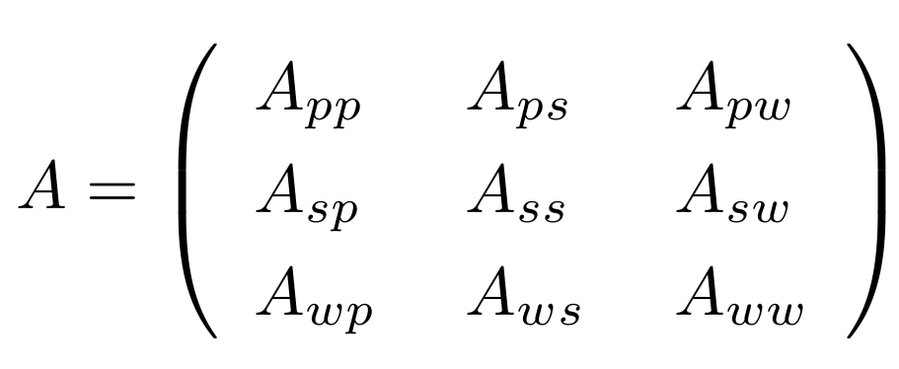
Multi-Stage Preconditioners
Highly nonlinear system, F(x) = 0
Linearization by Newton methods: A x = b
Pressure block $A_{pp}$, positive definite
Saturation (bubble point) block $A_{ss}$
Well block $A_{ww}$
Coupled matrices

Slide 10
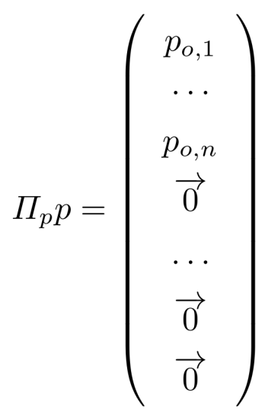
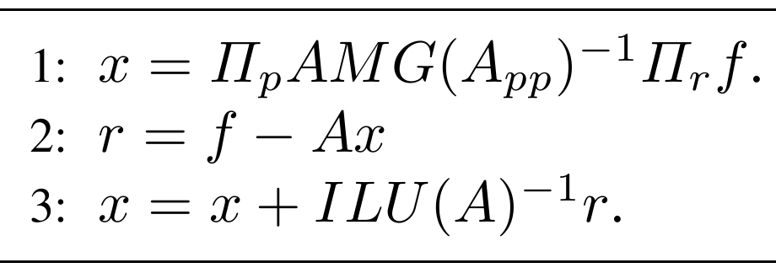
Constrained Pressure Residual Method
Preconditioning system: M x = f

Slide 11
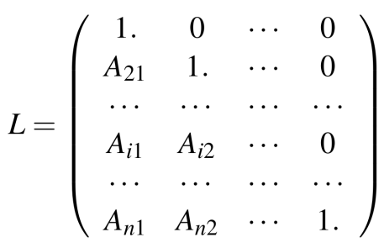
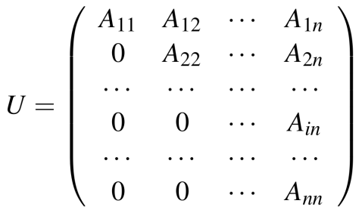
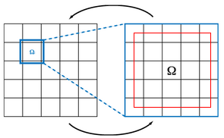
Constrained Pressure Residual Method
AMG methods: scalable for parallel computing.
ILU: LU x = f (Ly = f, Ux = y); triangular solvers introduce global data dependence; not scalable.
Restricted Additive Schwarz method (RAS): scalable; less communication and better convergence than other domain decomposition preconditioners.

Slide 12
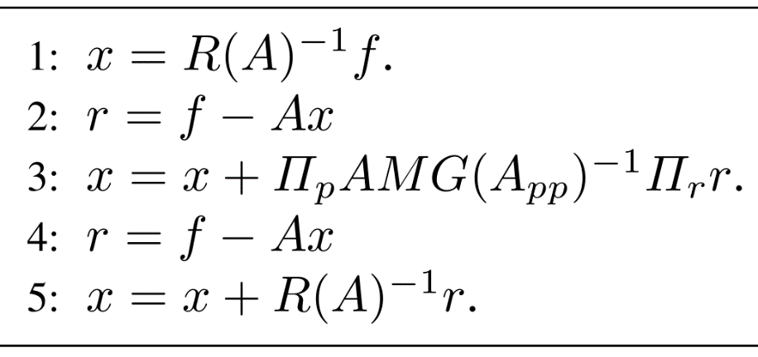
CPR-like Preconditioners
CPR-PF method
CPR-FPF method

Slide 13
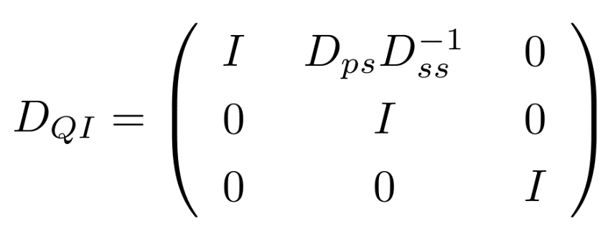
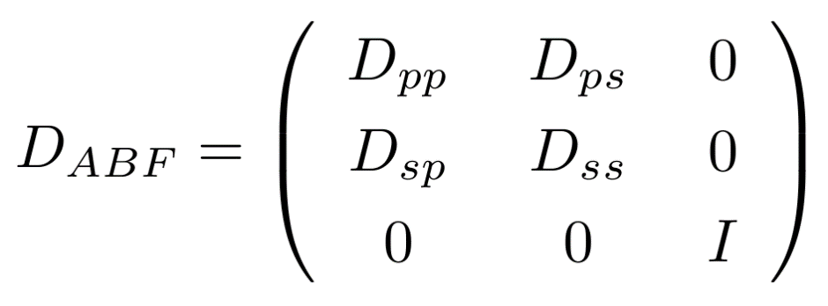
Matrix Decoupling
Quasi-IMPES
Alternative Block Factorization (ABF)

Slide 14
Results and Discussions
PRSI
-- parallel reservoir simulation platform
-- distributed systems, MPI, OpenMP
-- arbitrary grid size and MPI procs
-- grids, DOF
-- distributed matrix and vector
-- linear solvers (Krylov and AMG)
-- AMG is BoomerAMG
-- preconditioners
-- parallel IO, key words parsing
-- well modelling
-- visualization
-- in-house parallel simulators
-- highly scalable, 8192 CPU cores
Blue Gene/Q, IBM
-- 2 racks (4 midplanes)
-- one midplance:16 node
-- one node: 32 cards
-- one card: PowerPC A2
-- 16+1 cores, 16 GB mem, per card
-- A2: low performance (1/10)
-- system: strong network, scalable

Slide 15
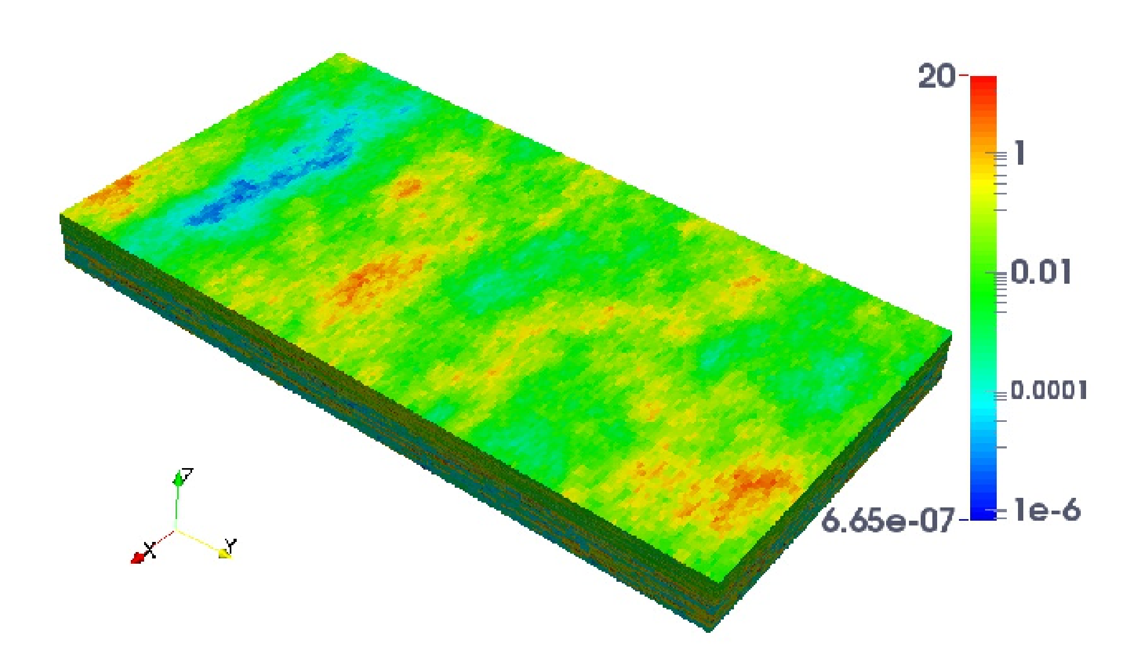
Case 1: Matrices from SPE10 Project
Oil-water model
Grid: 60 x 110 x 85, 1.12 million
Highly heterogeneous permeability
2000 days
One injection well, four producers
RAS, ILU(0)
AMG: 6 levels
-- Falgout coarsening
-- One V-cycle
-- Symmetric Gauss-Seidel smoother
-- 2 smoothing iteration
-- CMI interpolation

Slide 16
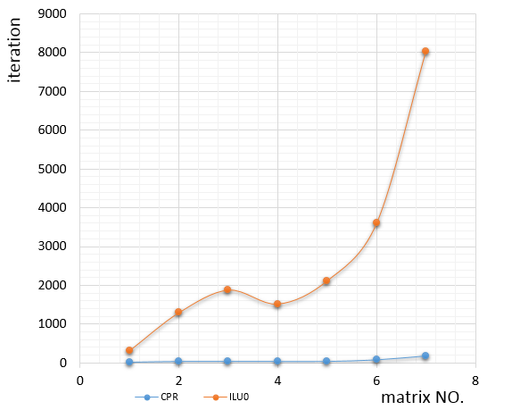
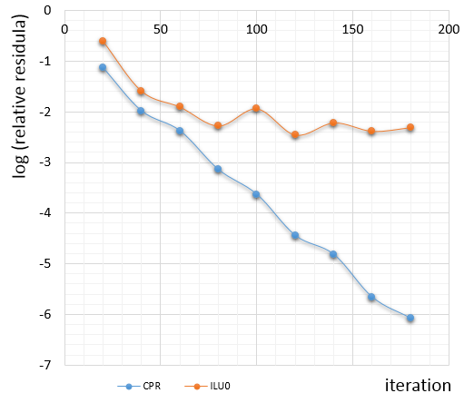
Case 1: convergence

Slide 17
Case 2: refined SPE10, oil-water
Grid: 180 x 660 x 255, 30 million
10 days, max step: 5 days
Inexact Newton: 1e-2
BiCGSTAB, max: 100
CPR-FPF, Quasi-IMPES
RAS, overlap 1, ILU(0)
AMG, one V-cycle, 6 levels
IBM Blue Gene/Q

Slide 18
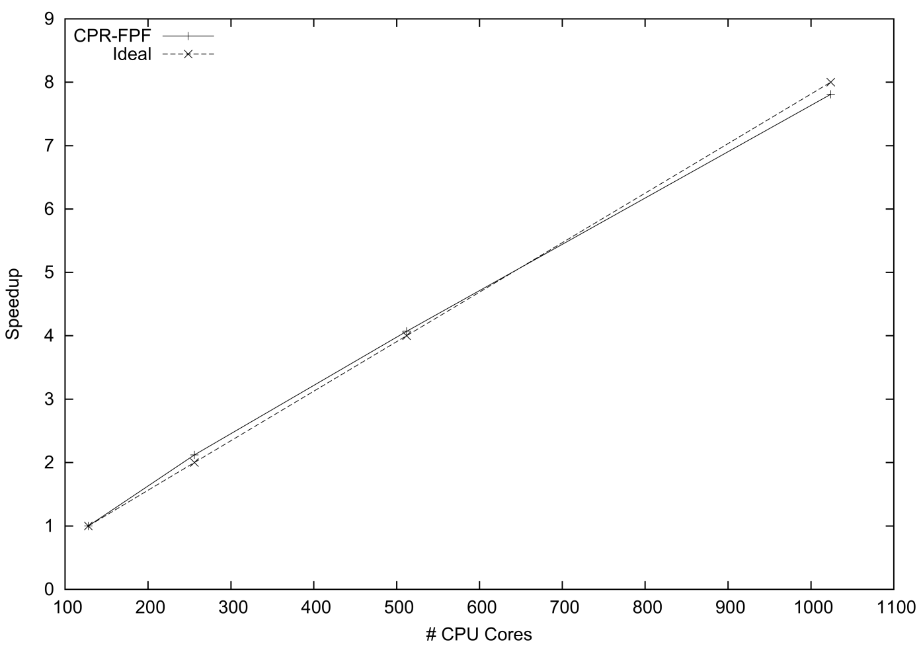
Case 2: scalability

Slide 19
Case 3: refined SPE10, black oil
Grid: 180 x 660 x 255, 30 million
10 days, max: 5 days
Inexact Newton: 1e-2
BiCGSTAB, max: 100
CPR-FPF, ABF decoupling
RAS, overlap 1, ILU(0)
AMG, one V-cycle, 6 levels
IBM Blue Gene/Q

Slide 20
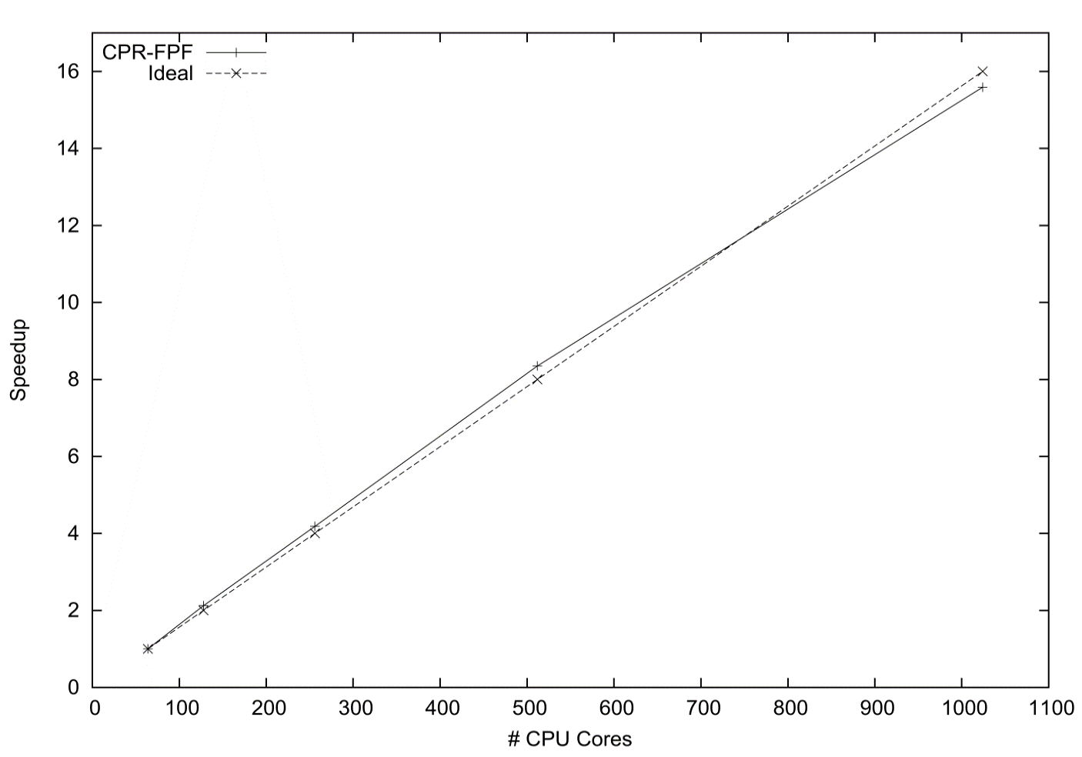
Case 3: scalability

Slide 21
Case 4: a giant oil-water model
Homogeneous model
Grid: 140 million
BiCGSTAB solver
CPR-FPF preconditioner
10 days
Quasi-IMPES decoupling
Inexact Newton method, tol: 1e-2
IBM Blue Gene/Q supercomputer
MPI | Steps | Newton | Solver | Time (s)
256 | 27 | 102 | 119 | 21056.59
512 | 26 | 99 | 114 | 9321.31
1024 | 25 | 90 | 104 | 4235.68
2048 | 25 | 90 | 104 | 2110.16
4096 | 26 | 98 | 124 | 1265.42

Slide 22
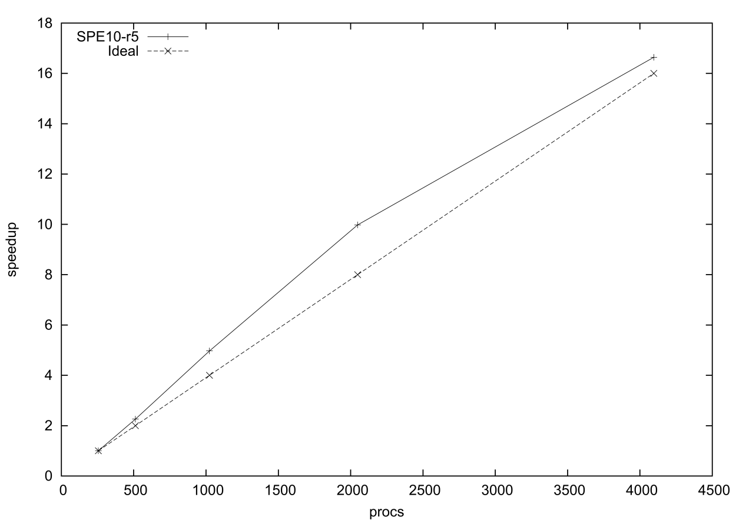
Case 4: scalability

Slide 23
Case 5: refined SPE1
Black oil model
Grid: 100 million
Inexact Newton method
tol: 1e-3
Solver: BiCGSTAB
Preconditioner: CPR-FPF
ABF decoupling
10 days

Slide 24
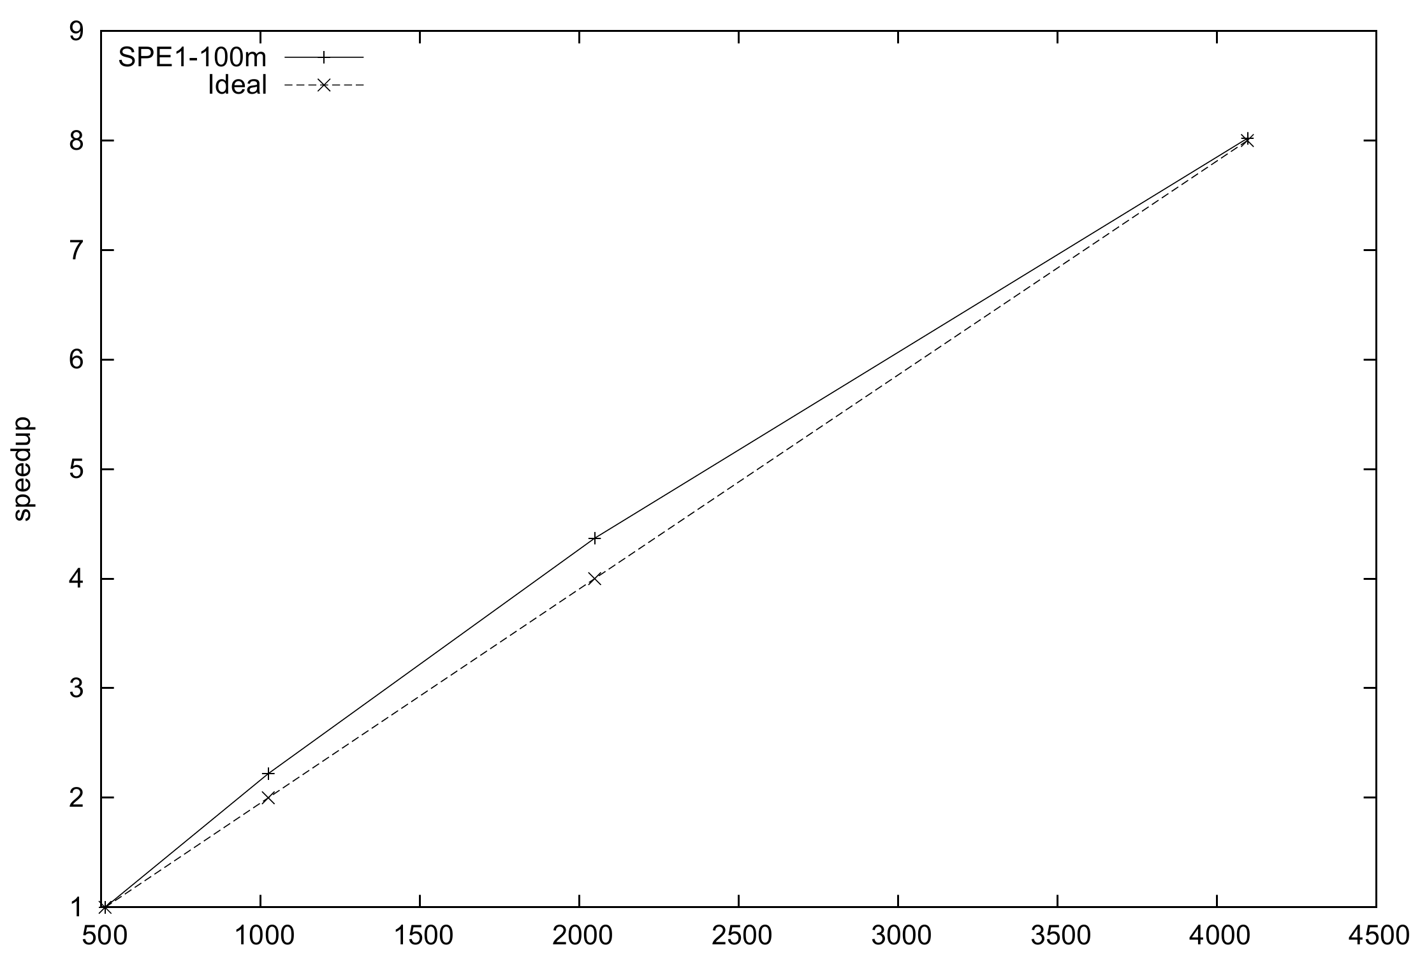
Case 5: scalability

Slide 25
Conclusions
Study CPR-like preconditioners for parallel systems
Apply Restricted Additive Schwarz method instead of ILU methods
Propose multi-stage CPR-like preconditioners
These methods are effective to heterogeneous models
Good convergence
Highly scalable, thousands of CPUs
They work for black oil model and derived models, such as polymer flooding and extended model.
They also work for compositional model.

Slide 26
Future Work
CPR-like methods do not work with thermal models, which consider multiple components and temperature change.
To study and develop multi-level methods for thermal models

Slide 27
Thank you.

