Slide 1
Probabilistic Programming
Frank Wood
fwood@robots.ox.ac.uk

Slide 2
What Is It?

Slide 3
The Way Machine Learning Is

Slide 4
The Way Machine Learning Will Be

Slide 5
Larger Goal: Expressive Compact Models (AI)

Slide 6
(Streaming) Sequence Memoizer
Model
World state = (infinite) history of emissions
Per-state emissions learned
  Requires careful smoothing
Deterministic transitions fixed
Wikipedia next-byte predictive performance in range of Shannon’s human-estimate of the entropy of written English
Problem
~2500 lines of Java code
New student re-implementation
  6-12 months
High-arity state space brings out statistical inefficiencies
Wood, Archambeau, Gasthaus, James, and Teh A Stochastic Memoizer for Sequence Data, ICML 2009
Bartlett and Wood Deplump for Streaming Data, DCC 2011

Slide 7
Probabilistic Deterministic Infinite Automata
Model
World state ≈ sufficient statistic of emissions
Per-state emissions learned
Per-state deterministic transition functions learned
Unsupervised PDFA structure learning biases towards compact (few states) world models that are fast approximate predictors
Problem
~4000 lines of Java code
New student re-implementation
  6-12 months
Pfau, Bartlett, and Wood Probabilistic Deterministic Infinite Automata, NIPS, 2011
Doshi-Velez, Pfau, Wood, and Roy Bayesian Nonparametric Methods for Partially-Observable Reinforcement Learning, TPAMI, 2013

Slide 8
Mixture of Objects Markov Model
Model
World state ≈ infinite mixture of objects
Per-state, per-object emissions learned
Per-state, per-object complex transition functions learned
Problem
~5000 lines of Matlab code
Implementation
  ~ 1 year
Generative model
  ~1 page latex math
Inference algorithm
  ~3 pages latex math
Neiswanger, Wood, and Xing The Dependent Dirichlet Process Mixture of Objects for Detection-free Tracking and Object Modeling, AISTATS, 2014

Slide 9
Motivation, Proposal, Honesty
Existing tools for modeling are cumbersome
  Akin to writing code in assembly language
  Model specification and forward sampling “easy”
  Inference hard
Probabilistic programming systems
  Efficient model development and testing
  Decoupling of modeling and inference
  More compact notation
  Bigger more expressive models
  Automated inference
Problem
  Existing probabilistic programming systems not quite there yet

Slide 10
Probabilistic Programming
Inverse Computing
Automated Inference For Generative Modeling
Stochastic Black-box Simulator Inversion
“Probabilistic programs are usual functional or imperative programs with two added constructs: (1) the ability to draw values at random from distributions, and (2) the ability to condition values of variables in a program via observations. Models from diverse application areas such as computer vision, coding theory, cryptographic protocols, biology and reliability analysis can be written as probabilistic programs.”
Gordon et al, “Probabilistic Programming”, ICSE 2014

Slide 11


Teaching and Research Language
Anglican
A “Church” of England “Venture”
http://www.robots.ox.ac.uk/~fwood/anglican/
Please report bugs to
https://bitbucket.org/fwood/anglican/issues
Perov
van de Meent
Wood, van de Meent, Mansinghka “A New Approach to Probabilistic Programming Inference” AISTATS 2014

Slide 12
Modeling Language Syntax
Outer Directives
  [assume symbol expr]
  [observe expr value]
  [predict expr]
Inner Expressions - Scheme/Lisp/Clojure
Functional except stochastic procedures
Pure (no side-effects) except mem
Higher order

Slide 13
Ugh, Why Lisp?
Redefinition prohibited (“pure functional”)
  [assume a (normal 5 10)]
  [assume b (normal a 2 )]
  [assume a (normal b 7 )]
  => Error
Imperative languages (i.e. Probabilistic-C) allow (!?!!)
  int a = normal(5,10);
  int b = normal(a,2 );
  int a = normal(b,7 );
Paige and Wood “A Compilation Target for Probabilistic Programming Languages” ICML 2014

Slide 14
Anglican Stochastic Procedures
(flip p) sample a single binomial trial. Returns true with probability p and false with probability 1-p.
(gamma a b) samples from a Gamma distribution with shape a and rate b. Returns a double on the domain (0, Inf).
(invgamma a b) samples from an inverse Gamma distribution with shape a and rate b. Returns a double on the domain (0, Inf).
(normal m s) samples from a univariate normal distribution with mean m and stdev s. Returns a double on the domain (-Inf, Inf)
http://www.robots.ox.ac.uk/~fwood/anglican/language/

Slide 15
Higher Order
(lambda (& symbols) body) => compound procedure
(lambda symbol body) => compound procedure
Constructs a compound procedure.
Example
  ((lambda (n m)
  (* (+ n 1) m))
  1 2)
  => 4
http://www.robots.ox.ac.uk/~fwood/anglican/language/

Slide 16
Memoization
(mem proc)
  Constructs a memoized procedure instance from an expression proc that must evaluate to a procedure. If a memoized procedure call is made with a previously used set of arguments, a cached value is returned instead of re-doing computation. This is typically used both to get dynamic programming for free and to incrementally construct complex datastructures.
Example
[assume H (mem (lambda (k) (list (normal 3 4) (gamma 1 1))))]
[assume theta_1 (H 1)]
[assume theta_2 (H 2)]
[assume theta_3 (H 1)]
[predict (= theta_1 theta_3 )] => always true
http://www.robots.ox.ac.uk/~fwood/anglican/language/

Slide 17
Complex Control Flow
(if bool-expr cons-expr alt-expr)
Example
  (if (= 1 (poisson 2))
  "the predicate is true"
  (normal 18 (/ 45 3.98)))
  => "the predicate is true” w.p. 0.2707
http://www.robots.ox.ac.uk/~fwood/anglican/language/

Slide 18
Birthday Coincidence
Approximately, what’s the probability that in a room filled with 23 people at least one pair of people have the same birthday?

Slide 19
Solution
[assume birthday (mem (lambda (i) (uniform-discrete 1 366)))]
[assume N 23]
[assume pair-equal
(lambda (i j)
(if (> i N)
false
(if (> j N)
(pair-equal (+ i 1) (+ i 2))
(if (= (birthday i) (birthday j))
true
(pair-equal i (+ j 1))))))]
[predict (pair-equal 1 2)]

Slide 20
Invoking Anglican
anglican -s *yoursourcefile*
or –
cat *yoursourcefile* | anglican
Some command line switches
  Switches Default Desc
  -------- ------- ----
  -h, --no-help, --help false Show help
  -s, --source-file *in* Anglican source file to interpret
  -p, --predict-file *out* File into which to print predicts
  -n, --num-samples Infinity Number of samples

Slide 21
Anglican Semantics Lite
Applying a (random) procedure generates a sample.
Running an Anglican program yields a stream of predict expression samples generated from a sequence of program execution paths sampled via a Markov chain Monte Carlo exploration of the space of execution paths.

Slide 22
Inference

Slide 23
Solution
[assume sigma (sqrt 2)]
[assume mu (normal 1 (sqrt 5))]
[observe (normal mu sigma) 9]
[observe (normal mu sigma) 8]
[predict mu]

Slide 24
Addition
What numbers added together equal seven?

Slide 25
Solution
[assume a (- (poisson 100) 100)]
[assume b (- (poisson 100) 100)]
[observe (normal (+ a b) .00001) 7]
[predict (list a b)]

Slide 26
Anglican Semantics
Running an Anglican program yields a stream of predict expression samples generated from a dependent sequence of program execution paths sampled via a Markov chain Monte Carlo exploration of the posterior of execution paths conditioned on observed data.
Test function averages converge in the usual sense.

Slide 27
Leaving The Beaten Path

Slide 28
Solution
[assume sigma (sqrt 2)]
[assume mu (poisson 1)]
[observe (normal mu sigma) 9]
[observe (normal mu sigma) 8]
[predict mu]

Slide 29
Multivariate Logistic Regression

Slide 30
Solution
[assume dot-product (lambda (u v)
(if (= (count u) 0)
0
(+ (* (first u) (first v))
(dot-product (rest u) (rest v)))))]
[assume sigma (sqrt (gamma 1 1))]
[assume beta (list (normal 0 sigma) (normal 0 sigma) (normal 0 sigma) (normal 0 sigma) (normal 0 sigma))]
[assume z (lambda (x)
(/ 1 (+ 1 (exp (* -1 (dot-product beta x))))))]
[observe-csv
"http://www.robots.ox.ac.uk/~fwood/anglican/examples/logistic_regression/iris.csv"
(flip (z (list 1 $1 $2 $3 $4))) (= $5 "Iris-setosa")]
[predict beta]
; should be Iris-setosa, i.e. 1 (from training data)
[predict (z (list 1 5.1 3.5 1.4 0.2 ))]
; should be Iris-virginica, i.e. 0 (from training data)
[predict (z (list 1 7.7 2.6 6.9 2.3 ))]

Slide 31
Hidden Markov Model
[assume initial-state-dist (list (/ 1 3) (/ 1 3) (/ 1 3))]
[assume get-state-transition-dist
(lambda (s) (cond ((= s 0) (list .1 .5 .4))
((= s 1) (list .2 .2 .6))
((= s 2) (list .15 .15 .7))))]
[assume transition (lambda (prev-state)
(discrete (get-state-transition-dist prev-state)))]
[assume get-state (mem (lambda (index)
(if (<= index 0) (discrete initial-state-dist)
(transition (get-state (- index 1))))))]
[assume get-state-observation-mean
(lambda (s) (cond ((= s 0) -1)
((= s 1) 1)
((= s 2) 0)))]
[observe (normal (get-state-obs-mean (get-state 1 )) 1) .9]
[observe (normal (get-state-obs-mean (get-state 2 )) 1) .8]
…
[observe (normal (get-state-obs-mean (get-state 16)) 1) -1]
[predict (get-state 0)]
[predict (get-state 1)]
…
[predict (get-state 16)]

Slide 32
Bayesian Nonparametrics
One way : lazy stick sampling
; sample-stick-index is a procedure that samples an index from
; a potentially infinite dimensional discrete distribution
; lazily constructed using a stick breaking rule
[assume sample-stick-index (lambda (breaking-rule index)
(if (flip (breaking-rule index))
index
(sample-stick-index breaking-rule (+ index 1))))]

Slide 33
Sethuraman Stick Breaking
; sethuraman-stick-picking-procedure returns a procedure
; that picks a stick each time its called from the set of sticks
; lazily constructed via a closed-over one-parameter stick
; breaking rule
[assume make-sethuraman-stick-picking-procedure
(lambda (concentration)
(begin (define V
(mem (lambda (x) (beta 1.0 concentration))))
(lambda () (sample-stick-index V 1))))]

Slide 34
DPMem
; DPmem is a procedure that takes two arguments -- the concentration
; to a Dirichlet process and a base sampling procedure
; DPmem returns a procedure
[assume DPmem (lambda (concentration base)
(begin
(define get-value-from-cache-or-sample
(mem (lambda (args stick-index)
(apply base args))))
(define get-stick-picking-procedure-from-cache
(mem (lambda (args)
(make-sethuraman-stick-picking-procedure concentration))))
(lambda varargs
; when the returned function is called , the first thing
; it does is get the cached stick breaking
; procedure for the passed in arguments
; and _calls_ it to get an index
(begin
(define index ((get-stick-picking-procedure-from-cache varargs)))
; if , for the given set of arguments and
; just sampled index a return value has already
; been computed , get it from the cache
; and return it , otherwise sample a new value
(get-value-from-cache-or-sample varargs index)))))]

Slide 35
Dirichlet Process Mixture
[assume H (lambda ()
(begin
(define v (/ 1.0 (gamma 1 10)))
(list (normal 0 (sqrt (* 10 v))) (sqrt v))))]
[assume gaussian-mixture-model-parameters (DPmem 1.72 H)]
[observe-csv "http:// ... "
(apply normal (gaussian-mixture-model-parameters)) $2]
[predict (apply normal (gaussian-mixture-model-parameters))]
Example:
curl -s http://www.robots.ox.ac.uk/~fwood/anglican/examples/dp_mixture_model/dp-church.anglican | anglican | grep 'normal' | awk -F',' '{print $2}' | feedgnuplot --stream --histogram 0 --with boxes --xlabel 'x' --ylabel Frequency --binwidth 1

Slide 36
Expressivity
Easily implement modern machine learning methods
  10’s of lines of code
Higher-order functionality

Slide 37
Symbolic Function Induction
What’s the next value? And the function?
Input | Output
1 | 5
2 | 3
3 | 1
4 | ?

Slide 38
Solution
[assume get-int-constant
(lambda () (uniform-discrete 0 10))]
[assume safe-div
(lambda (x y) (if (= y 0) 0 (/ x y)))]
[assume pcfg
(lambda ()
(define expression-type (discrete (list 0.40 0.30 0.30)))
(cond
((= expression-type 0) (get-int-constant))
((= expression-type 1) 'x)
(else
(list
(nth (list (quote +) (quote -) (quote *) (quote safe-div))
(discrete (list 0.25 0.25 0.25 0.25)))
(pcfg) (pcfg)))))]
[assume induced-procedure-code (list 'lambda (list 'x) (pcfg))]
[assume induced-procedure (eval induced-procedure-code)]
[assume noise 0.00001]
[observe (normal (induced-procedure 1) noise) 5]
[observe (normal (induced-procedure 2) noise) 3]
[observe (normal (induced-procedure 3) noise) 1]
[predict induced-procedure-code]
[predict (induced-procedure 4)]

Slide 39
Goals and Aims
Accelerate iteration over models
  Inference is automatic
  Writing generative code is easier than deriving model inverses
  Lower technical barrier of entry to development of new models
Accelerate iteration over inference procedures
  Computer language is an abstraction barrier
    Inference procedures can be tested against a library of models
    Inference procedures become “compiler optimizations”
Enable development of more expressive models
  Probabilistic programs can express a superset of graphical models
  Modern machine learning models are tens of lines of code

Slide 40
How Does it Work?

Slide 41
Probabilistic Programming Concepts
First half
  Procedures “sample”
  Programs are generative models
This half
  “Sampling” execution traces = inference
  Different traces arise from stochastic procedure outputs
    Elementary
      flip, normal, discrete, poisson, gamma, …
    Compound
      (lambda (a b) (if (flip a)
      (+ (poisson b) 7)
      (normal a b)))
  Various sampling algorithms apply
    Rejection sampling
    Metropolis Hastings
    Sequential Monte Carlo
    Particle Markov Chain Monte Carlo

Slide 42
Outline
Trace Probability
Probabilistic Program Interpretation
Monte Carlo-based probabilistic inference
  Rejection Sampling
  MCMC
  SMC
  PMCMC

Slide 43
Probabilistic Inference

Slide 44
Monte Carlo Integration

Slide 45
How To Sample Execution Traces
What is an execution trace?
What is its probability?

Slide 46
Execution Trace Probability
Forward interpretation generates sequences of stochastic procedure applications
Observed value
Posterior Distribution of Trace Given
Observations
Parameter of observation distribution
Joint Distribution of Trace And
Observations
Type of observation
distribution
Interpreter memory state
Parameter of stochastic procedure
Type of stochastic procedure

Slide 47
Suggests Relationship To State Space Modeling
Program generates all random variables
State is interpreter memory state
Transition is stochastic procedure application
Only observes need be indexed
f = execute forward
g = observe

Slide 48
Program Interpretation
eval
apply
(define (eval exp env)
(cond
((self-evaluating? exp) exp)
((variable? exp) (lookup-variable-value exp env))
((quoted? exp) (text-of-quotation exp))
((assignment? exp) (eval-assignment exp env))
((definition? exp) (eval-definition exp env))
((if? exp) (eval-if exp env))
((lambda? exp)
(make-procedure (lambda-parameters exp)
(lambda-body exp) env))
((begin? exp)
(eval-sequence (begin-actions exp) env))
((cond? exp) (eval (cond->if exp) env))
((application? exp)
(apply (eval (operator exp) env)
(list-of-values (operands exp) env)))
(else
(error
"Unknown expression type -- EVAL" exp))))
(define (apply procedure arguments)
(cond
((primitive-procedure? procedure)
(apply-primitive-procedure procedure arguments))
((compound-procedure? procedure)
(eval-sequence
(procedure-body procedure)
(extend-environment
(procedure-parameters procedure)
arguments
(procedure-environment procedure)
)
)
)
(else
(error
"Unknown procedure type – APPLY” procedure))))
Copied from Abelson, Sussman and Sussman “Structure and Interpretation of Computer Programs”

Slide 49
What is ?

Slide 50
What is ?

Slide 51
Observe Statements

Slide 52
Original Church : Rejection Sampling
Run program forward and condition on all observations exactly matching the observed output
Goodman, Mansinghka, Roy, Bonawitz, and. Tenenbaum Church: A language for generative models, UAI, 2008
Copied from Goodman “The Principles and Practice of Probabilistic Programming”

Slide 53
Review: Rejection Sampling

Slide 54
Rejection Sampling
Figure from Bishop “Pattern Recognition and Machine Learning”

Slide 55
Rejection Sampling

Slide 56
Rejection Sampling

Slide 57
Original Church : Rejection Sampling
Run program forward and condition on all observations exactly matching the observed output
Goodman, Mansinghka, Roy, Bonawitz, and. Tenenbaum Church: A language for generative models, UAI, 2008
Copied from Goodman “The Principles and Practice of Probabilistic Programming”

Slide 58
New Church : Single-Site Independent MH
Sample posterior distribution of execution traces using joint with observed values plugged in
Metropolis-Hastings acceptance rule
Need
  Proposal
Have
  Likelihoods (via observe statement restrictions)
  Prior (sequence of ERP returns; scored in interpreter)
Wingate, Stuhlmüller et al Lightweight Implementations of Probabilistic Programming Languages Via Transformational Compilation, 2011
Wood, van de Meent, and Mansinghka “A New Approach to Probabilistic Programming Inference” AISTATS 2014
Mansinghka, Selsam, and Perov “Venture: an interactive, Turing-complete probabilistic programming platform” arXiv 2014

Slide 59
Review : Metropolis Hastings

Slide 60
Random Database (RDB) MH Proposal
Probability of new part of
proposed execution trace
Single stochastic
procedure (SP) output
Number of SP’s in
original trace
Probability of new SP return value (sample) given trace prefix

Slide 61
RDB Implementation
Single site update = sample from the prior = run program forward
MH acceptance ratio simplifies
Number of SP applications
in original trace
Probability of regenerating current trace
continuation given proposal trace beginning
Number of SP applications
in new trace
Probability of generating proposal trace
continuation given current trace beginning

Slide 62
RDB Implementation Sketch

Slide 63
SMC for Prob. Prog. Inference
State-space-model-like decomposition
Suggests Sequential Importance Resampling (SIR)
Proposal
Run program forward
until next observe directive
Weight of particle
Is observation likelihood
Fischer, Kiselyov, and Shan “Purely functional lazy non-deterministic programming” ACM Sigplan 2009
Wood, van de Meent, and Mansinghka “A New Approach to Probabilistic Programming Inference” AISTATS 2014
Paige and Wood “A Compilation Target for Probabilistic Programming Languages” ICML 2014

Slide 64
Review : Sequential Importance Resampling
SIR Targets
With a weighted set of particles
Noting the identity
We can use importance sampling to generate samples from
Given our sample-based approximation to

Slide 65
Review : Importance Sampling

Slide 66
Review: Sequential Importance Resampling

Slide 67
SMC Methods Discussed Require Only
Initialization
        can be sampled
Forward Simulation
        can be sampled (blackbox)
Observation Likelihood Weight Computation
        can be point-wise evaluated up to constant multiple

Slide 68
Sequential Monte Carlo for Prob. Prog.
Paige and W. “A Compilation Target for Probabilistic Programming Languages.” ICML, 2014

Slide 69
Probabilistic-C
Paige and Wood “A Compilation Target for Probabilistic Programming Languages” ICML 2014

Slide 70
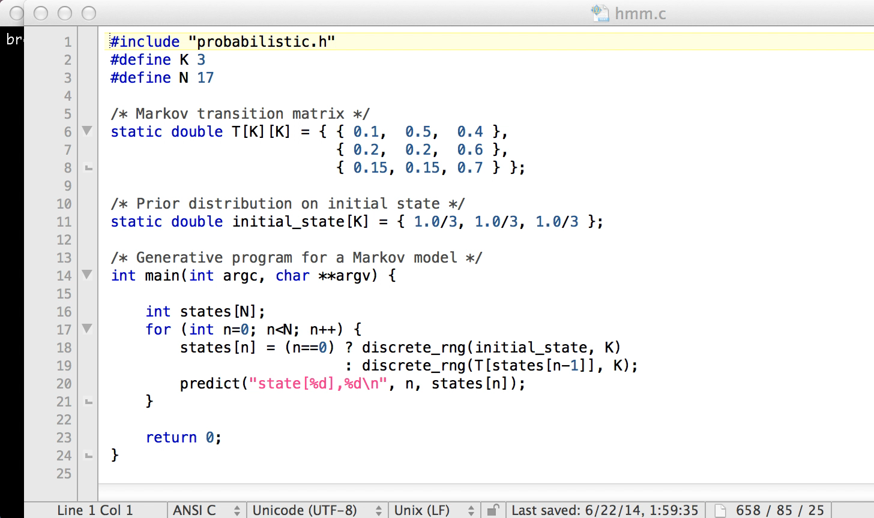
Markov Model

Slide 71
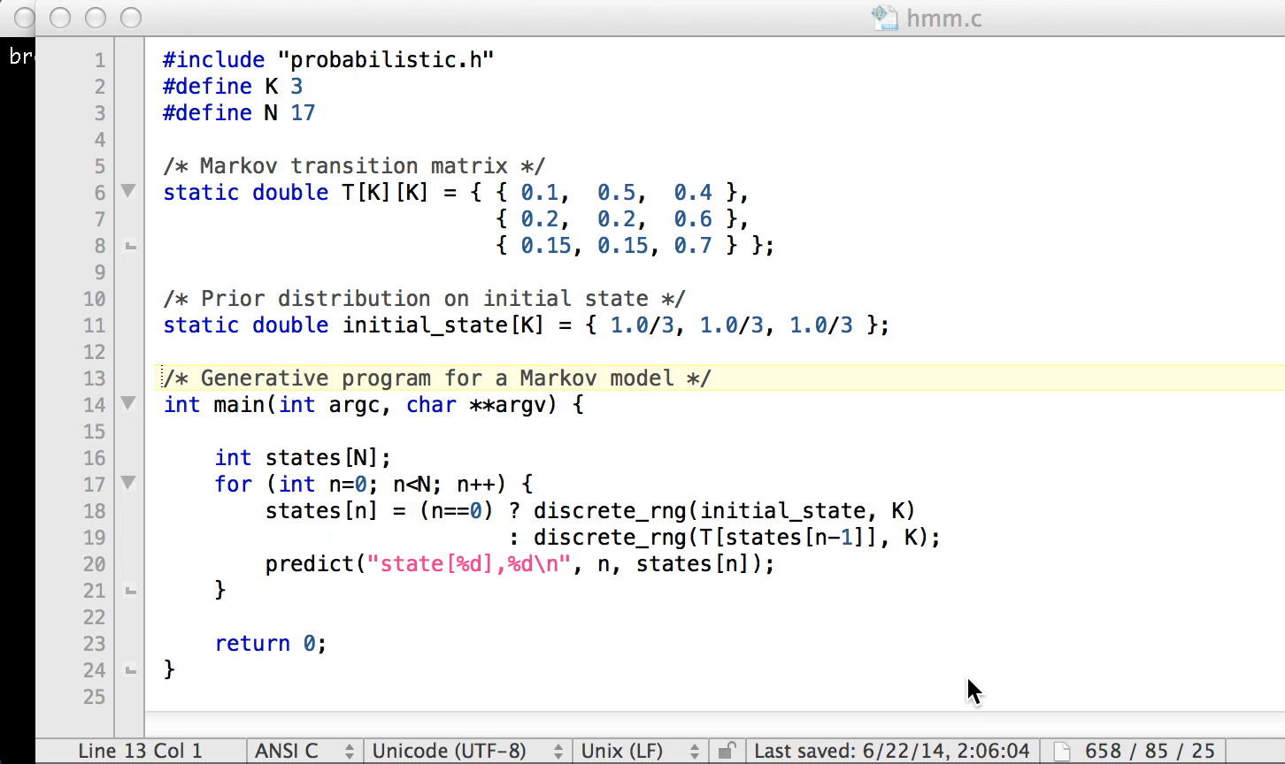
HMM

Slide 72
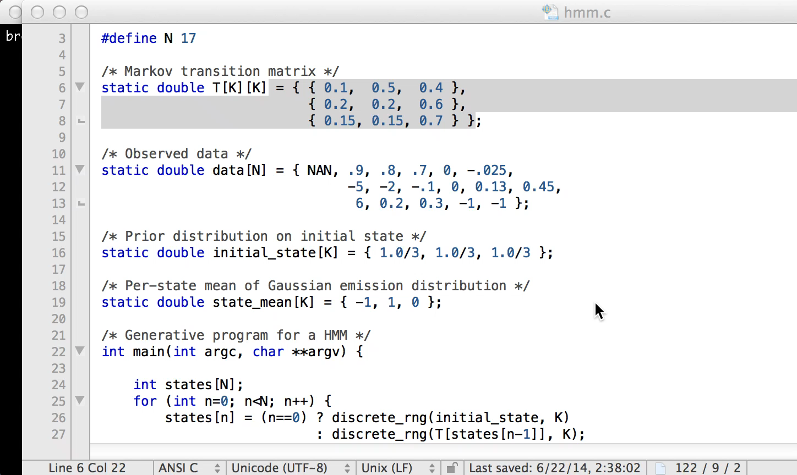
Bayesian HMM

Slide 73
Inverse Stochastic Simulation
Deterministic simulator exists as code
Parameter uncertainties exist
  Varying parameters to simulator = stochastic simulator
What to do with observations?
  Update estimates of parameters
  Posterior predictions

Slide 74
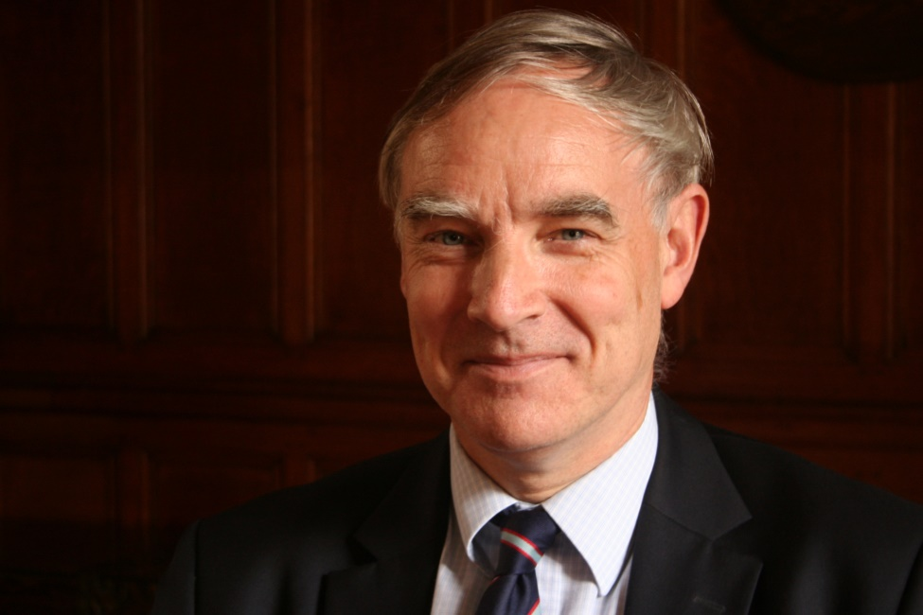
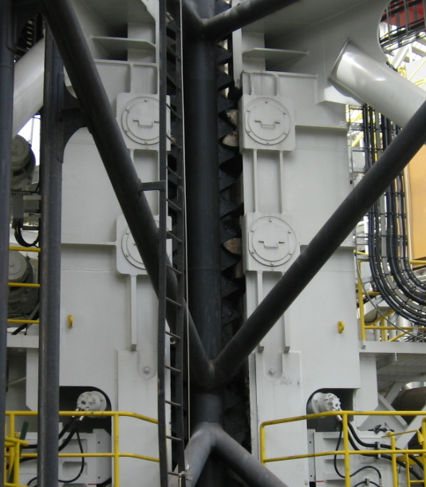
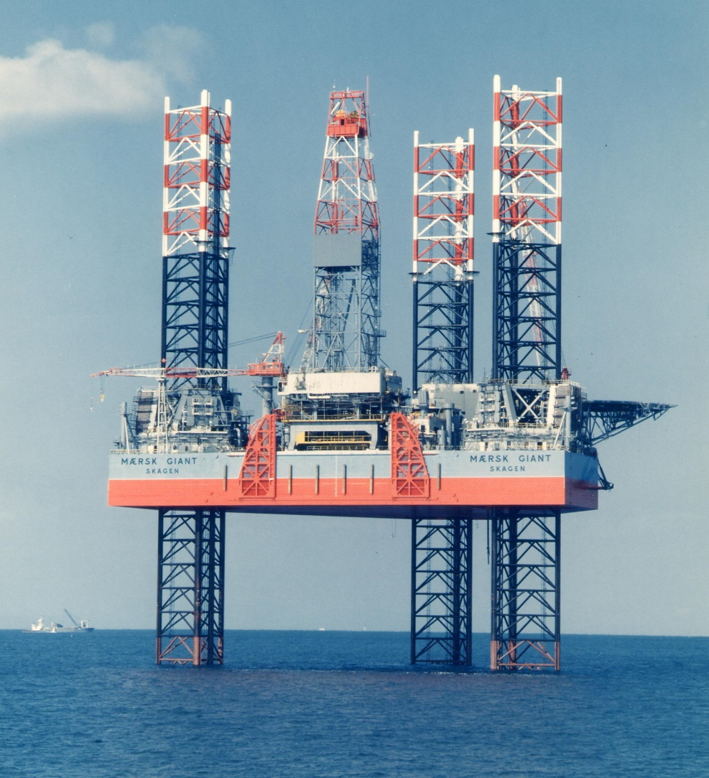
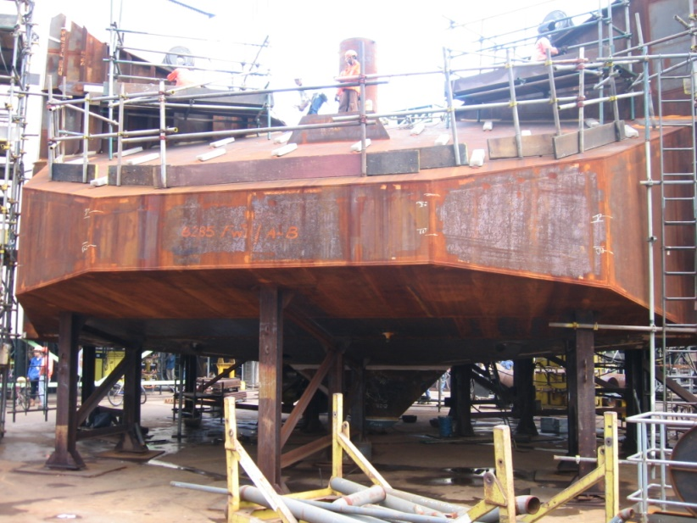
Example : Jack-Up Units
Houlsby
60m
Keppel FELS
Maersk
Keppel FELS
Slide from Houlsby

Slide 75
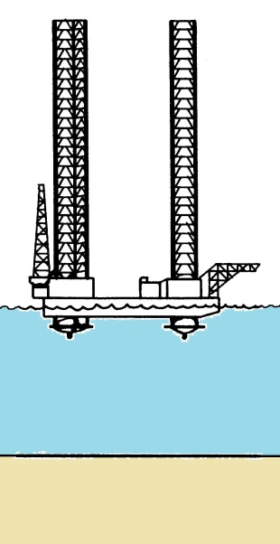
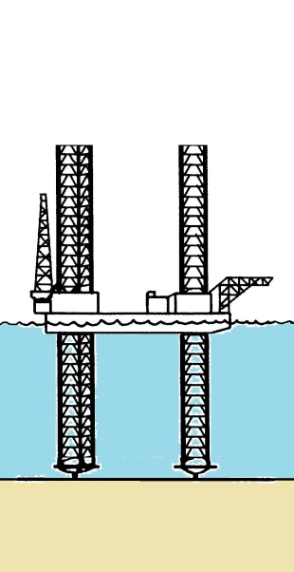



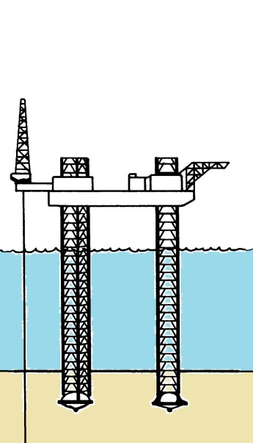
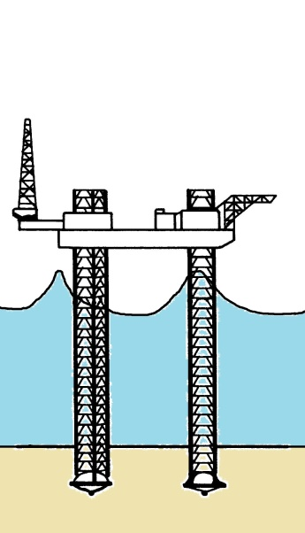
Jack-up operations
Float to site
Lower legs
Light ship load
Preload
Dump preload
Climb to air-gap and operate
Storm
sketches after Poulos (1988)
Slide from Houlsby

Slide 76
Spudcan Simulator + Probabilistic-C -> Inference
Deterministic simulator
  ~750 lines of C code
  10-100’s of parameters
  Black-box
  Not differentiable
Stochastic simulator
  +150 lines of C code
  Priors on parameters
Automatic inference
  +15 lines of Probabilistic-C
~1000 samples / second

Slide 77
Review : Inference In State Space Models
Consider inference in a state space model that depends on fixed parameters
can’t use SMC
single-site updates won’t mix

Slide 78
“Ideal” Inference
Ideal MH
intractable.
SMC provides unbiased estimate
Del Moral “Feynman-Kac Formulae: Genealogical and Interacting Particle Systems with Applications”

Slide 79
Particle Marginal Metropolis Hastings
MH with unbiased likelihood estimates
computed via SMC proposal
targets correct distribution!
C. Andrieu, A. Doucet, R. Holenstein Particle Markov Chain Monte Carlo methods

Slide 80
Conditional SMC for Prob. Prog. Inference
No fixed parameter
Program generates all random variables
State is interpreter memory state
Transition is stochastic procedure application
Only observes need be indexed
Eager parameter
generation
Lazy parameter
generation

Slide 81
PIMH For Probabilistic Programming
Run SMC Once
Compute marginal likelihood estimate
Do forever
  Re-run SMC
  Compute new marginal likelihood estimate
  Accept particle set with probability
  Emit predictions from all particles in next set (new and/or old)
No theta!

Slide 82
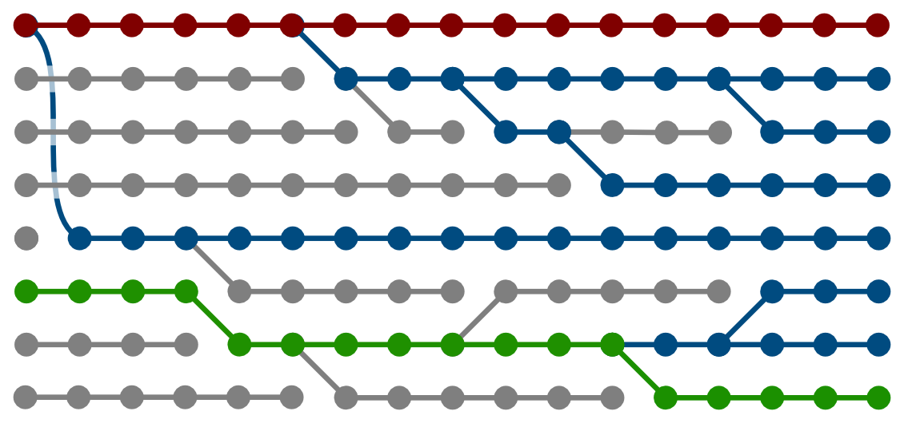
Particle Gibbs for Prob. Prog.
MH w/ accept prob. = 1
SMC “inner-loop” proposal
“Retained particle”
Non-local
  Single “sweep” can propose changes to many variable values at once
[Holenstein 2009; Andrieu, Doucet, Holenstein 2010; etc]
Wood, van de Meent, Mansinghka “A New Approach to Probabilistic Programming Inference” AISTATS 2014
Paige and Wood “A Compilation Target for Probabilistic Programming Languages” ICML 2014

Slide 83
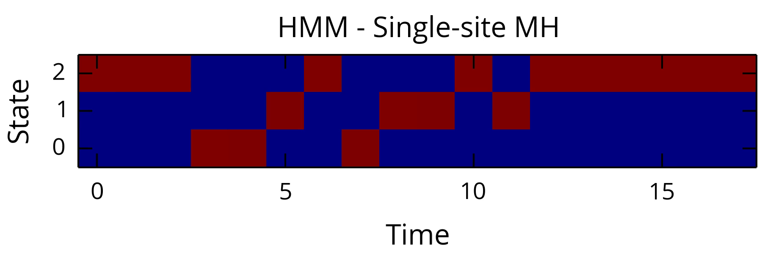
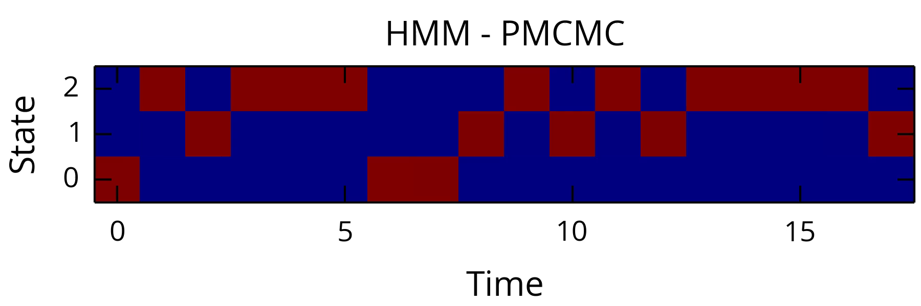


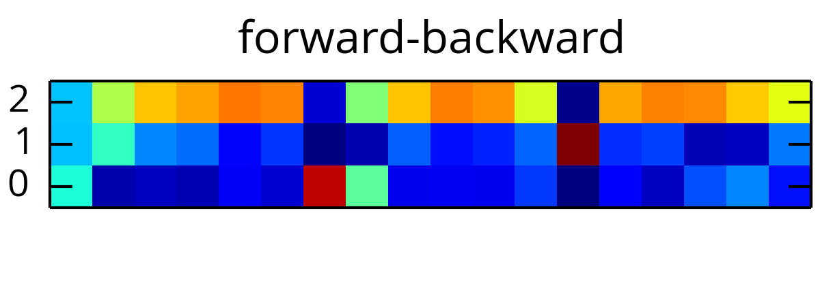
PMCMC Prob. Prog. Example

Slide 84
Goals and Aims
Accelerate iteration over models
  Inference is automatic
  Writing generative code is easier than deriving model inverses
  Lower technical barrier of entry to development of new models
Accelerate iteration over inference procedures
  Computer language is an abstraction barrier
    Inference procedures can be tested against a library of models
    Inference procedures become “compiler optimizations”
Enable development of more expressive models
  Probabilistic programs can express a superset of graphical models
  Modern machine learning models are tens of lines of code

Slide 85
Wrap-Up
Research
  New paths to efficient, scalable probabilistic programming inference
  True hope for general purpose automatic inference
  New models (soon)
Resources
  http://www.robots.ox.ac.uk/~fwood/anglican/
  http://www.robots.ox.ac.uk/~brooks/probabilistic-c/
  http://probabilistic-programming.org/wiki/Home
  http://forestdb.org/

Slide 86
Parameter Posterior vs. Expert

Slide 87
Compiled PMCMC Algorithm Performance

Slide 88
What if dirac Observes?
Show up as constraints in joint
dirac observes are constraints
=> SMC / PMCMC reduce to rejection / repeated rejection sampling if all observes are constraints

Slide 89
Opportunity : Optimizing Inference by Program Line Reordering

Slide 90
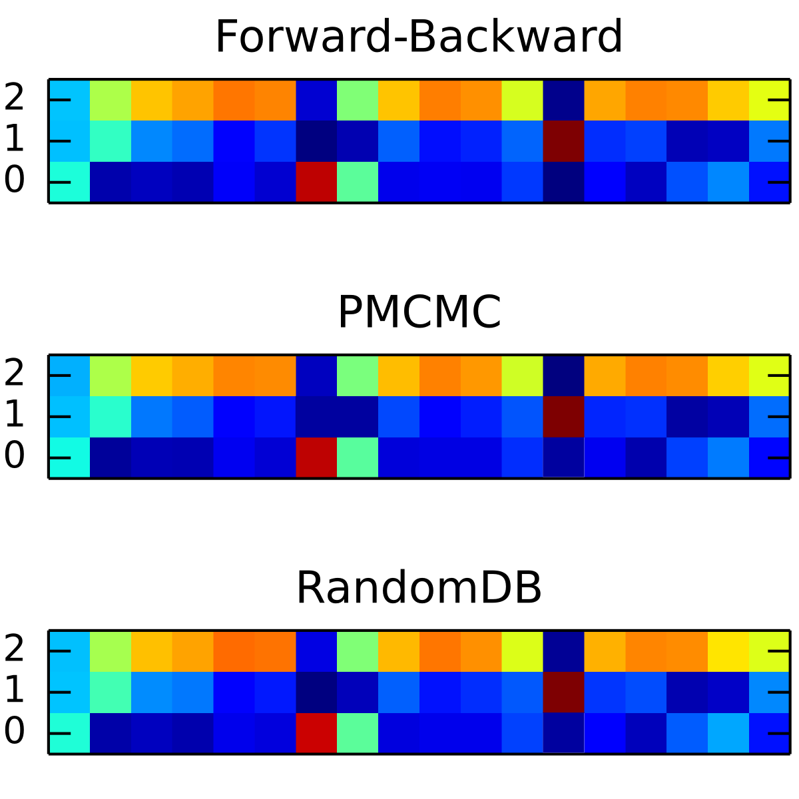
Anglican : Particle MCMC Inference
Wood, van de Meent, Mansinghka “A new approach to probabilistic programming inference.” AISTATS, 2014
Wingate et al “Lightweight implementations of probabilistic programming languages via transformational compilation” AISTATS, 2011

