Slide 1
Taking over routine tasks: PAL
(Personalized Assistants that Learn)
RADAR is part of a large research initiative sponsored by USA – DARPA to devise all-encompassing personalized assistance
Ptime System for Scheduling Assistance (Berry et al, Knowl. Inf. Syst. 52(2): 379-409 (2017)
PAL generated several commercial applications, including SIRI

Slide 2
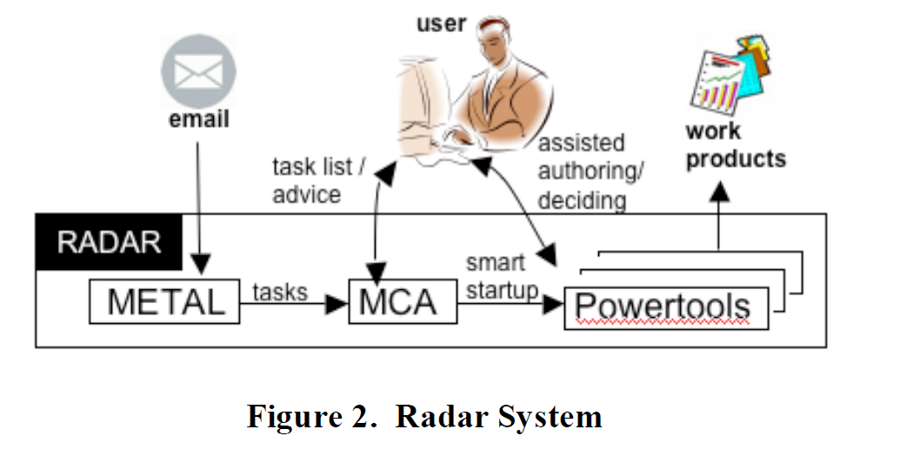

Slide 3
Horvitz Mixed-Initiative principles
Significant value-added automation
Consider uncertainty about user goals
Consider status of user attention in timing services
Infer ideal action in light of costs, benefits and uncertainties
Use dialogue to resolve uncertainty
Allow direct invocation and termination
Minimize cost of poor guesses
Match precision of services with goal uncertainty
Mechanisms for user-system collaboration to refine results
Socially appropriate behaviors for agent-user interaction
Maintaining working memory of recent interactions
Continuous learning via observation

Slide 4
Minimize the cost of Poor Guesses
“Note that in VIO, high precision is favored over high recall, because”
the cost to the user of repairing an incorrect prediction is much higher than the cost of approving a correct prediction
the cost of handling a missed prediction is exactly the cost that the user would incur without assistance.
We will see more in the paper for Th.

Slide 5


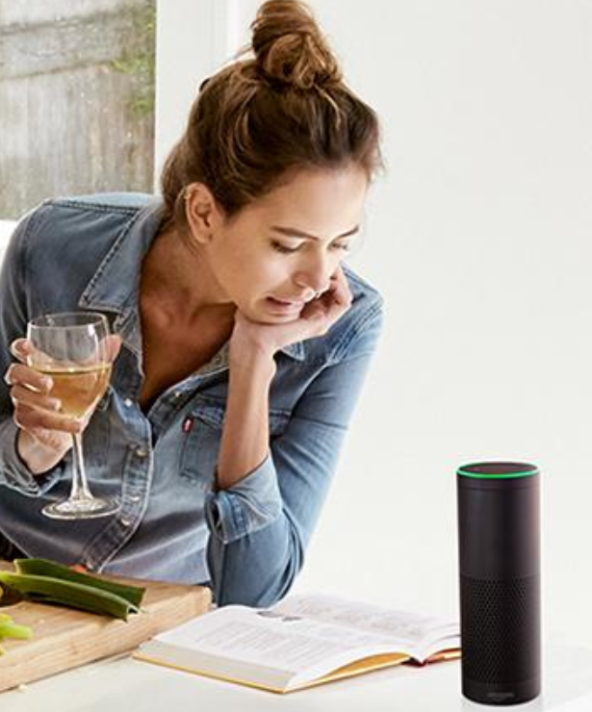
Adaptation Cycle
Adapt behavior to user U on the basis of nontrivial inferences from information about U
Forms of adaptation
Inference/Learning:
how to adapt
User Model
Inference/Learning:
Relevant user properties/states
Input sources
Notes:
1:30

Slide 6
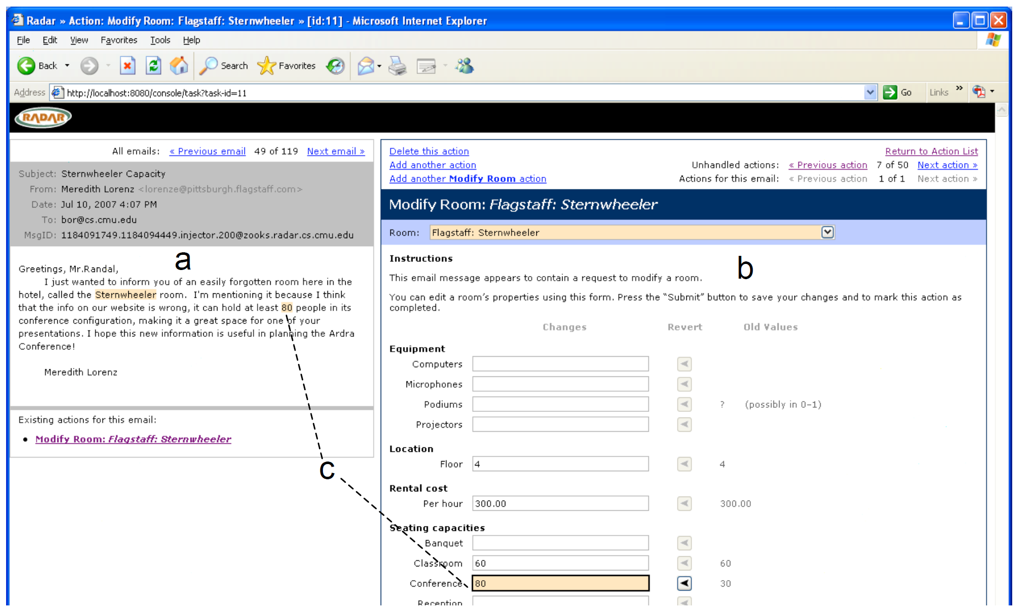
Take over tasks (e.g. form filling)
Advice on task (how to prioritize, what to drop)
Techniques to match email terms to task fields
Detection of task boundaries
Constraint satisfaction on tasks
User Model
Role
tasks a user performs,
user experience in performing these tasks,
preferences,
expected workload
=================
User affective state (e.g. frustration, confusion)
Emails
Previous Behaviors on tasks
Feedback on system actions (e.g. behavior correctio)
--------------------------
Facial expressions
regularized logistic regression (task classification)

Slide 7
Domain Model?
Closed World (e.g. domain to be taught in educational application)
  Usually well defined
  Rich representations are possible
Here
  “explicit representation of user/system tasks. The representation provides a basic accounting of all currently known tasks including their constraints (deadlines, dependencies with other tasks), associations to other media (email) and execution state.”
  “these representations provide a basis for anticipating resource requirements (e.g. necessary data inputs) and for inferring task execution profiles (expected durations, likely follow-on tasks).”
  Model of ordering preferences learned from experts executing tasks

