Slide 1
Gajos et al.
Functions
Support
Info Acquisition/
Decision Making
Support
System
Usage
Support
Learning
Support
Collaboration
Support
Entertainment
Advice
on
System
Usage
Advice
on
task
Take Over
Routine
Tasks
Adapt
the
Interface
Tailor
Info
Presentation
Retrieve Info/
Recommend Objects
Forms of Adaptation

Slide 2
Contributions (aka What’s New?)
Look at subjective benefits and costs of adaptation as perceived by the user and try to identify the design choices that influence these perceptions.
Split-interface: no previous work on evaluating the effects of replicating rather than moving content into the extra toolbar
Karyn
... inconsistencies in previous literature. To some extent, the inconsistency is expected because the design and evaluation process is likely to be heavily interface dependent….So I am wondering, to what extent, should we trust the GUI research.

Slide 3
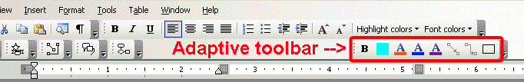
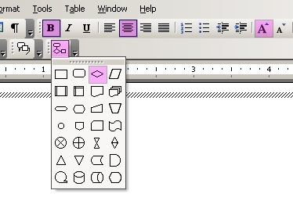
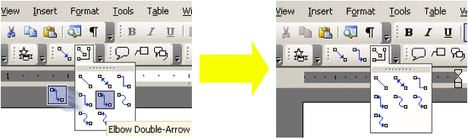
Interfaces and Expectation
The Split Interface
The Visual Popout Interface
The Moving Interface
 |  | Potential Disorientation
Split | Medium | Low
Moving | High | Medium
Visual Popout | Low | Low

Slide 4
User studies
First study with high ecological validity to evaluate user subjective experience
  They say it is expected that these tasks would not be suitable to capture changes in task performance
  Interviews confirmed that users found these tasks realistic
Second study uses less realistic tasks, but suitable to ascertain impact on performance

Slide 5
First Study Outcome
Subjective Benefit
Performance
Efficiency due to adaptation
Subjective Cost
Mental Demand
Physical Demand
Frustration
Confusion due to adaptation
Visual Popout found very distracting: surprising? (Rohit, Harshinee)
  Dropped from study 2
No effect of adaptation algorithm
  They keep only recency based for study 2
Does it make sense to drop these tasks from study 2 (Jocelyn)

Slide 6
Second Study outcome
Split interface: significantly faster
Moving interface: marginally faster
Users performed much faster with both adaptive interfaces at the higher accuracy level (70%).

Slide 7
Parnia:
I think the work they have done to investigate the reasons for the failure of some UIs can not be generalised to all existing UIs.
In their second experiment, …I am not sure how much the results can be reliable if these tasks will never occur in the real world.
Felipe
It seems that the locality of the adaptations plays an important role. When adaptation occurs close to the user's point of focus, they might discover those changes quickly. How can we identify those localities? For example, by conducting Eye-tracking user studies? It seems crucial to determine how to get user attention.
Lucie, Karyn
paper is 16 years old. Are the results still revelant?
Users might be more adaptive now
Can we use anything more sophisticated than frequency and recency?

Slide 8
Interfaces and Expectation
The Split Interface
The Visual Popout Interface
The Moving Interface
 | Potential Benefit | Potential Disorientation
Split | Medium | Low
Moving | High | Medium
Visual Popout | Low | Low
Moving interface only moves items that are within pull down menus, Split also moves items in the tool bar
  They say this makes Moving potentially more beneficial
  Possible confound?

Slide 9
Horvitz Mixed-Initiative principles
Significant value-added automation
Consider uncertainty about user goals
Consider status of user attention in timing services
Infer ideal action in light of costs, benefits and uncertainties
Use dialogue to resolve uncertainty
Allow direct invocation and termination
Minimize cost of poor guesses
Match precision of services with goal uncertainty
Mechanisms for user-system collaboration to refine results
Socially appropriate behaviors for agent-user interaction
Maintaining working memory of recent interactions
Continuous learning via observation

Slide 10
Horvitz Mixed-Initiative principles
Significant value-added automation
Consider uncertainty about user goals
Consider status of user attention in timing services
Infer ideal action in light of costs, benefits and uncertainties
Use dialogue to resolve uncertainty
Allow direct invocation and termination
Minimize cost of poor guesses
Match precision of services with goal uncertainty
Mechanisms for user-system collaboration to refine results
Socially appropriate behaviors for agent-user interaction
Maintaining working memory of recent interactions
Continuous learning via observation

Slide 11
Overview
Functions and Forms of Adaptive IUIs
Components
Usability and Evaluation

Slide 12


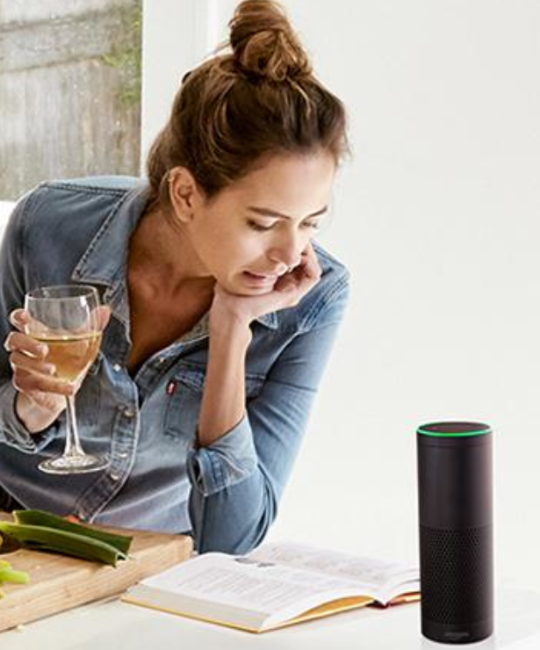
Adaptation Cycle
Adapt behavior to user U on the basis of nontrivial inferences from information about U
Forms of adaptation
Inference/Learning:
how to adapt
User Model
Inference/Learning:
Relevant user properties/states
Input sources
Notes:
1:30

Slide 13
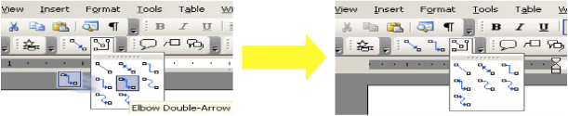
Gajos, K. et al (2006) . Exploring the design space for adaptive graphical user interfaces. In Proceedings of AVI ’06, Advanced Visual Interfaces
Select the top N (eight)
Promote the top 8 based on the specific interface adaptation strategy
User Model
Most frequent/recent commands
User activity with menu selection
Computation of frequency and recency

