Slide 1
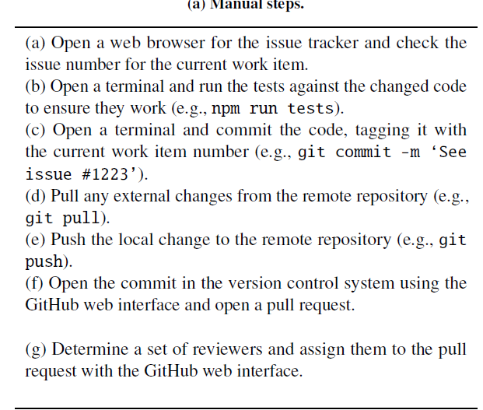
Devy

Slide 2
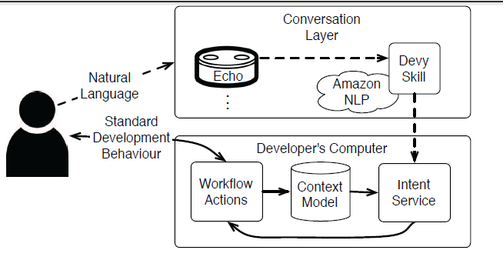
Is this system adaptive? (Naomi)
Notes:
What exactly makes Devy an Intelligent Agent? [did was in the slide from 2019

Slide 3
Horvitz Mixed-Initiative principles
Significant value-added automation
Consider uncertainty about user goals
Consider status of user attention in timing services
Infer ideal action in light of costs, benefits and uncertainties
Use dialogue to resolve uncertainty
Allow direct invocation and termination
Minimize cost of poor guesses
Match precision of services with goal uncertainty
Mechanisms for user-system collaboration to refine results
Socially appropriate behaviors for agent-user interaction
Maintaining working memory of recent interactions
Continuous learning via observation

Slide 4
Horvitz Mixed-Initiative principles
Significant value-added automation
Consider uncertainty about user goals
Consider status of user attention in timing services
Infer ideal action in light of costs, benefits and uncertainties
Use dialogue to resolve uncertainty
Allow direct invocation and termination
Minimize cost of poor guesses
Match precision of services with goal uncertainty
Mechanisms for user-system collaboration to refine results
Socially appropriate behaviors for agent-user interaction
Maintaining working memory of recent interactions
Continuous learning via observation

Slide 5
How was the system evaluate?
Exploratory study with system with reduced functionalities
Key analysis: qualitative coding of user answers to interviews
Very rich information on the need for adaptation, what to focus on etc.
VERY TIME CONSUMING!
Need for multiple coders
Interesting feedback
Lack of transparency
how would one know if Devy is doing something wrong (Liam)
Potential users might be afraid that the system will perform unexpected actions (Felipe)
Need for customization tools

Slide 6
Questions on Evaluation
Issues with having only used experts (Naomi, Mary)
Difficulty of learning GIT/Dewy words
Should this ne a concern?
Conduct study earlier and use more quantitative measures (time on task) (Arash)
Functionalities are too simple for good added value, why no control?
(Aziz)
Do not remove users for which there was a system failure (Parnia, Felipe)
Rohit has suggestions on how failures could be leveraged

Slide 7
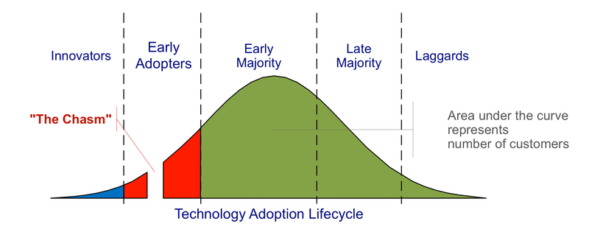
Questions on Added Value
Can a voice-based system work well in an open space setting?
Before spending time building sophisticated tools, how can we check if our solution will be used in real-world scenarios? Something such as "market research"? I believe that only a tiny percent of developers would be interested in using it in real life (felipe)

Slide 8
Questions Limitations
Missing feedback and error prevention mechanisms, which can be detrimental. How to deal with erroneous verbal instructions [Karyn]

Slide 9
Questions Limitations
Missing feedback and error prevention mechanisms, which can be detrimental. One of the reasons to use the conversational interface is that the verbal instruction would not require developers to leave their development context. However, we know that people have limited attention, so when developers’ attention is on the “high-level” tasks, it is likely that they may give erroneous verbal instructions, the issue of which can be leveraged especially when the developer is unaware of the mistake. I am thinking that the CDA can verbally confirm its actions with the developer, however, it can be challenging and annoying for developers to pay attention to the details (e.g., which branches, which issues) of the confirmation when they are busy with other work. So perhaps a better practice is to have a pop-up window on developers with confirmation information in text. I am wondering, in this context, what is the best practice to avoid and recover from potential human errors?

Slide 10
Overview
Functions and Forms of Adaptive IUIs
Components
Usability and Evaluation

Slide 11
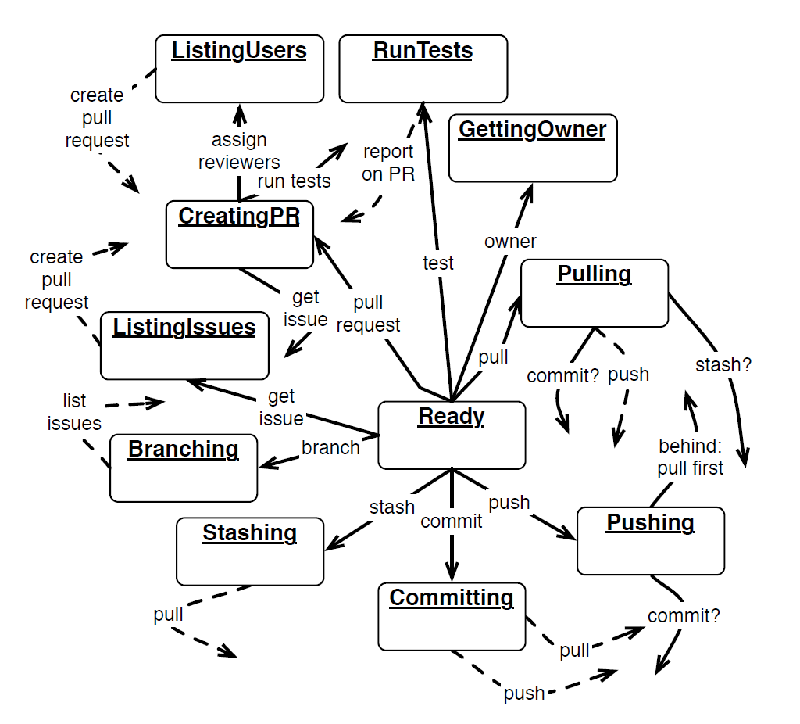
Domain Model?
Closed World (e.g. domain to be taught in an ITS)
Usually well defined
Rich representations are possible
Here
Simple final state machine for now
How to scale?

Slide 12
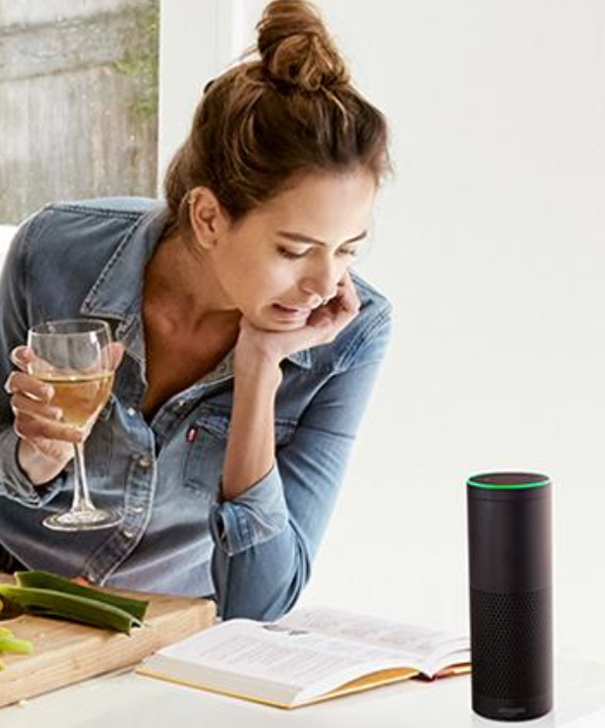
Adaptation Cycle
Adapt behavior to user U on the basis of nontrivial inferences from information about U
Forms of adaptation
Inference/Learning:
how to adapt
User Model
Inference/Learning:
Relevant user properties/states
Input sources
Notes:
1:30

Slide 13
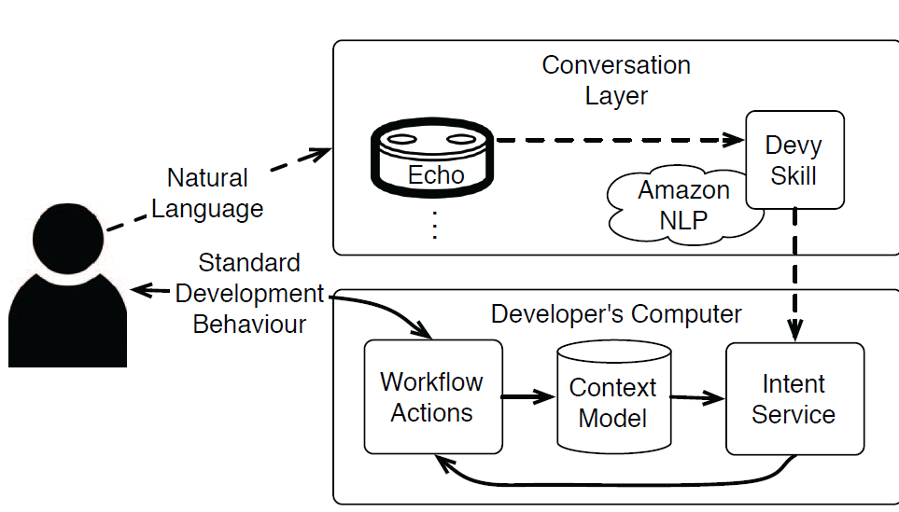
User Model

Slide 14
Leverages FSM to infer which low-level actions to perform
Take over tasks – perform low-levels actions
User Model
User Intent
Current context
Voice commands
Actions/activities
Alexa NLP to parse speech into commands
Leverages context model to infer where the user is at
Leverages FSM to infer intent

