Slide 1
Preamble
2 sigma effect (Bloom, 1984):
Average student’s achievement with a personal human tutor
better than 98% of classroom students
Bloom, B. "The 2 Sigma Problem: The Search for Methods of Group Instruction as Effective
as One-to-One Tutoring." Educational Researcher 13 (6):4–16.
2σ
Students with
Human Tutor
Classroom
Students
# Students
Learning gains
Notes:
In developing an Intelligent Tutor, or ITS, the goal has been to capture at least some of the impressive increase in learning -- an average of 2 sigma in the studies by Bloom (1984) -- that tends to result from one-on-one tutoring as compared to group instruction. The much quoted "2-sigma effect" of having an individual tutor meant that the average student who had been tutored performed better than 98% of the students who had been taught in the classroom. In comparing the effect of one-on-one tutoring with the effect of a number of other variables and treatments, Bloom found that none of the others produced an effect as large as 2 sigma.
We know that substantial improvements in instructional effectiveness may be obtained by tailoring instruction to the needs and capabilities of individual learners. One widely cited discussion was based on studies performed by Benjamin Bloom and his students (Bloom, 1984), who compared the achievement of individually tutored students (one instructor for each student) with that of classroom students (one instructor for every 28-32 students). It is not surprising to find that individual tutoring in these studies increased the achievement of students. What is surprising is the magnitude of the increase. Bloom reported that the overall difference in achievement across three studies was about two standard deviations, which means, roughly, that tutoring improved the achievement of 50th percentile students to that of 98th percentile students. Two standard deviations is a large difference. Bloom posed it to educators as a 2-sigma challenge.

Slide 2
Precursors of ITS
Computer-Assisted Instruction (CAI) systems
Curriculum
Curriculum
Present Problem
Present Problem
Computer Answer
Get Student Answer
Remediation
Computer Answer
Get Student Answer
Remediation
Compare Answers
Compare Answers
Present Feedback
Present Feedback
If correct
If correct
If incorrect
If incorrect
Shute and Potska 1996, Handbook of Research on Educational Communications and Technology
Notes:
Example: student learning solving equations
first simple equations Nx + Mx = K
Then equations with Nx = K
Then Nx + Mx = K
Alternative example
(A) (B) (C) (D)
22+ 39 = 61 51 161 61
46 + 37 = 83 73 203 85

Slide 3
CAI systems (cont.)
All branching in the program to be pre-defined
Sequencing of topics and exercises
All relevant student answers
All feedback actions
Student’s solution process is not taken into account, only final answers
No information on the reasons for the student behavior
Fine for drill-and-practice in simple domains such as basic math operations
Unmanageable for more complex domains and pedagogy (e.g., support problem solving in physics)
Notes:
(www.aplusmath.com/Flashcards/subtraction.html)

Slide 4
Good Human Tutors..
Can provide more flexible and comprehensive support to learning
Recognize a large variety of student’s behaviors
Diagnose student’s understanding (and other relevant states)
Provide adequate tailored interventions at different stages of the interaction
Notes:
GIUSEPPE SAYS TO PUT THINGS IN BOLD (recognize diagnose ect), but I am not sure

Slide 5
Ideal ITS
Pedagogical model
Teaching strategies
Remediation
curriculum
Pedagogical model
Teaching strategies
Remediation
curriculum
Tutor
Tutor
Domain Model
Concepts
Principles..
Domain Model
Concepts
Principles..
Tutorial
Action
Communication
model
Communication
model
Select activity
Solution Generator
Hints
Feedback
Corrections
Etc.
Solution Generator
Interface
Interface
computer solution
(solution step)
computer solution
(solution step)
Student solution
(solution step)
Student solution
(solution step)
Student Modeler
Student Modeler
Student model
-knowledge, Goals, Beliefs…
Student model
-knowledge, Goals, Beliefs…
Notes:
Example: student learning solving equations
first simple equations Nx + Mx = K
Then equations with Nx = K
Then Nx + Mx = K

Slide 6
ITS Evolution
70s | 80s | 90s | 2000s
Problem Generation | Model-tracing | Learner Control | Pedagogical Agents
Simple Student Modeling | More buggy-based systems | Collaborative Learning | Educational games
Knowledge Representation | Case-based reasoning | Situated Learning | Meta-cognitive skills
Skills and Strategic Knowledge | Discovery Worlds | Virtual Reality | More Natural Language Processing
Reactive learning environments | Progression of Mental Models | Probabilistic Student modeling | Comprehensive Student modeling
Expert Systems and tutors | Simulations | Web-based learning | More Machine Learning Educational Data Mining
Buggy Library | Natural Language Processing | Machine learning for ILE | Decision-theoretic tutors
OverlayModels/ Genetic Graphs | Authoring Systems
Notes:
Problems in the 70s
Feedback specificity
Non-adaptability
Atheoretical foundations
Restrictive environments

Slide 7
How much learning improvement?
2σ
Human Tutor
~1σ
Classroom
Students
# Students
ITS
Learning Improvements
Most sophisticated CAI: 0.5 σ (Dodds & Fletcher, 2004)

Slide 8
Achievements
In the last 20 years, there have been many successful initiatives in devising Intelligent Tutoring Systems
(Woolf 2009, Building Intelligent Interactive Tutors, Morgan Kaufman)
Including CanergieLearning, a company that commercializes ITS for Math in hundreds of high schools in the USA
But most of this success has been in supporting problem solving activities (e.g. CT and CMT Tutor)
Notes:
The research that I will discuss today is in the field of Intelligent tutoring systems, a strongly interdisciplinary field that combines research in Psychology, Education and computer science to develop computer based turors that can improve classroom instruction with the benefits of individualized tutoring.
In particular, applying AI techniques to improve the effectiveness of computer based instruction needs to devote a good amount of time to understanded the cognitive processes underslying learning and teaching to be able to build tutors that rely on these processes to enhance learning.

Slide 9
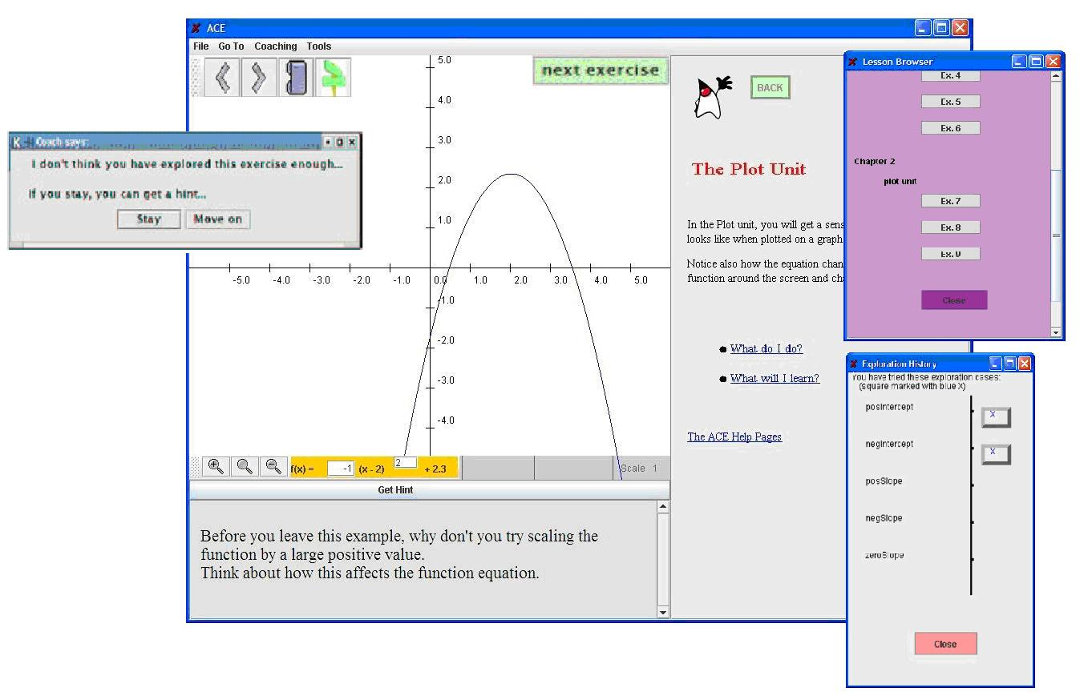
Adaptive Coach for Exploration
Example of tutoring agent that generates tailored suggestions to improve student exploration/learning when necessary
Before you leave this exercise, why don’t you try scaling the function by a large negative value?
Think about how this will affect the plot

Slide 10
Learning from Exploration: Challenges
Activities more open-ended and less well-defined than pure problem solving
No clear definition of correct/successful behavior
A variety of learner states should be modeled to provide effective instructional support
Meta-cognitive skills important for succeeding in these activities
E.g., self-explanation, self-reflection, analogical reasoning)
Affective states that can affect student initiative
(e.g.. frustration, confusion, resentment in receiving tutorial guidance)
difficult to assess unobtrusively from interaction events
Notes:
The research that I will discuss today is in the field of Intelligent tutoring systems, a strongly interdisciplinary field that combines research in Psychology, Education and computer science to develop computer based turors that can improve classroom instruction with the benefits of individualized tutoring.
In particular, applying AI techniques to improve the effectiveness of computer based instruction needs to devote a good amount of time to understanded the cognitive processes underslying learning and teaching to be able to build tutors that rely on these processes to enhance learning.

Slide 11
Challenges
How to model
what the student should do
the underlying cognitive, meta-cognitive and affective states
How to provide feedback that
fosters learning
Maintains student initiative and engagement
Notes:
The research that I will discuss today is in the field of Intelligent tutoring systems, a strongly interdisciplinary field that combines research in Psychology, Education and computer science to develop computer based turors that can improve classroom instruction with the benefits of individualized tutoring.
In particular, applying AI techniques to improve the effectiveness of computer based instruction needs to devote a good amount of time to understanded the cognitive processes underslying learning and teaching to be able to build tutors that rely on these processes to enhance learning.

Slide 12
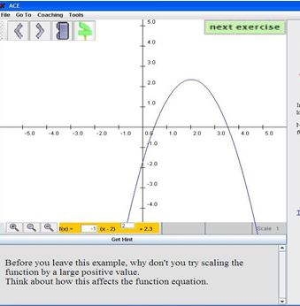
Adaptive Coach for Exploration
Activities organized into units to explore mathematical functions (e.g. input/output, equation/plot)
Probabilistic learner model:
captures student exploratory behavior and other relevant traits

Slide 13
ACE Initial Learner model (Bunt and Conati, UMUAI 2002)
Uses Bayesian networks to assess exploratory behaviour at different levels of granularity
Categories
Exploration
Positive
Intercept
Negative
Intercept
Positive
Slope
Negative
Slope
……..
Correct
Behaviour
Cases
Exploration
e₁Case₁
e₁Case₂
e₁Case₃
……..
Knowledge
Knowledge
Exercises Exploration
e₁
e₂
……..
Unit exploration
……..
PlotUnitExploration

Slide 14
Lucie Polakova
It is noted that in the original version of the ACE student model, the links between knowledge and exploration nodes depend on how much knowledge a learner already has, however, they are updated only through actions for which there is a clear definition of correctness. I was wondering whether we could track the multiple levels of correctness and update the model accordingly. It would certainly add to the complexity of the model. Would this “more detailed” assessment of correctness lead to different results? Would it be even possible from the algorithmic point of view? And would it be worth it?
Categories
Exploration
Positive
Intercept
Negative
Intercept
Positive
Slope
Negative
Slope
……..
Correct
Behaviour
Cases
Exploration
e₁Case₁
e₁Case₂
e₁Case₃
……..
Knowledge
Knowledge
Exercises Exploration
e₁
e₂
……..
Unit exploration
……..
PlotUnitExploration

Slide 15
Modeling Student Exploration
Bayesian network representing
how individual exploratory actions influence understanding of exercises and concepts (Bunt and Conati, 2002)
Interface Actions
Learner Model
Number and Coverage of Exploratory Actions, e.g.
Positive/negative Y-Intercept
Odd/Even, Positive Negative Exponent....
Learning

Slide 16
Evaluation
Quasi-experimental design with 13 participants using ACE (Bunt and Conati 2002)
Good results on the effectiveness of the adaptive interventions based on the initial model
The model can overestimate student exploration, because it only considers action coverage
Need to consider whether the student is reasoning about the effects of his/her actions
Self-explanation meta-cognitive skill (Chi 1989)

Slide 17
Revised Learner Model (Merten and Conati, KBS 2007)
Interface Actions
Input from eye-tracker
Learner Model
Number and coverage of student actions
Self-explanation of action outcomes
Time between actions
Gaze Shifts in Plot Unit
Learning

Slide 18
Not relevant in this paper
Not relevant in this paper
User Model
Self-explanation of a specific base
Tendency to self-explain
Leaning
Evidence propagation I the Bayesian network
Interface actions
Eye-tracking data
SE Tendency
Positive
Intercept
Negative
Intercept
Positive
Slope
Negative
Slope
SE
e₁Case₁
e₁Case₂
e₁Case₃
Gaze Shift
Time > T
e₁

Slide 19
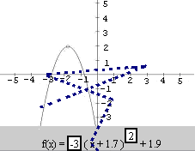
Sample Gaze Shift

Slide 20
Capturing SE in the Student Model
SE Tendency
Positive
Intercept
Negative
Intercept
Positive
Slope
Negative
Slope
SE
e₁Case₁
e₁Case₂
e₁Case₃
SE-Related
Behavior
e₁
The probability that a student explores a case effectively is now conditional to the probability that the student self-explained that case

Slide 21
Which Behaviors Can We Use to Capture SE?
Use time: the higher the latency between actions, the more likely self-explanation is => not very reliable
Use eye-tracking (ET): presence of gaze shifts between plot and equation area, after changing one of the two, as indicator of SE

Slide 22
Adding SE Assessment to the Model
Need data to add to the model probabilistic relations on:
Presence/Absence of gaze shifts and self-explanation
Time between action and self-explanation
Notes:
Mention here the parts of the network that are dynamic

Slide 23
User Study (Conati and Merten 2007)
36 students using ACE while gaze is tracked via an Eyelink 1 eye tracker
Encouraged to “think aloud” during interaction
Pre-test and post-test on concepts targeted by ACE
Software for on-line detection of relevant attention patterns
gaze shifts between plot and equation area
Synchronized log files including
All interface actions
Gaze shifts
Video/Audio recordings of each interaction

Slide 24
Coding Student SE behavior
Two coders labelled students’ speech for clear cases of presence or lack of SE (silence did not count as such)
When students did not think aloud, no data points
149 data points <exploratory action, SE/no SE>
Sincronized with log files to derive information on
Presence/absence of Gaze shifts and self-explanation
self-explanation and time between actions
High (low) tendency to self-explain if a student explains at least (less than) 20% of their actions
Notes:
Positive Self-explanation episodes
Conclusions on domain specific principle related to exploration process (regardless of correctness)
Attempted predictions on action outcome
Negative
Simple narration of action outcome
Isolated expressions of confusion
Schema applied to code the rest of the data: 93% intercoder reliability

Slide 25
Coding Schema
Positive Self-explanation episodes
Conclusions on domain specific principles related to exploration process (regardless of correctness)
Attempted predictions on action outcome
Negative (i.e. absence of SE)
Simple narration of action outcome
Isolated expressions of confusion
It is not fully clear to me how they obtain the CPT values in Table 1. It is mentioned that they divide users into two groups, self-explainers and non-self-explainers based on the amount of time they spent self-explaining. Here, I am assuming this is done based on the measurement of explicit self-explanation during the interaction, ie.. if the user is self-explaining using the interface. However, they use this to define the conditional probabilities for implicit self-explanation. Since we can not measure implicit self-explanation with any validity, I am not sure of how else we might model these probabilities, but the authors should probably have justified why they are using explicit self-explanations to calculate these values.
Notes:
10??? Must double check
Next time I tried it was 13

Slide 26
Coding Schema
Positive Self-explanation episodes
Conclusions on domain specific principles related to exploration process (regardless of correctness)
Attempted predictions on action outcome
Negative (i.e. absence of SE)
Simple narration of action outcome
Isolated expressions of confusion
Notes:
10??? Must double check
Next time I tried it was 13

Slide 27
Adding SE Assessment to the Model
Need data to define
SE Tendency
Positive
Intercept
Negative
Intercept
Positive
Slope
Negative
Slope
P(SE|SE Tendency)
SE
e₁Case₁
e₁Case₂
e₁Case₃
P(Gaze Shift | SE)
Gaze Shift
e₁
Time > T
P(Time > T | SE)
T is an empirically established threshold (16 sec.) found to be a good predictor of presence/absence of SE (Conati et al 2005)
Notes:
Mention here the parts of the network that are dynamic

Slide 28
Adding SE Assessment to the Model
Need data to define
SE Tendency
Positive
Intercept
Negative
Intercept
Positive
Slope
Negative
Slope
P(SE|SE Tendency)
SE
e₁Case₁
e₁Case₂
e₁Case₃
P(Gaze Shift | SE)
Gaze Shift
e₁
Time > T
P(Time > T | SE)
Arash. I expect this optimal threshold is very dependent on the age of the students, i.e younger students may require a longer time than their older counterparts.I wonder how age and gender of the students can affect the user model to effectively assess implicit explanation and whether these traits would be significant enough to be included in the user model.
Notes:
Mention here the parts of the network that are dynamic

Slide 29
Adding SE Assessment to the Model
Need data to define
SE Tendency
Positive
Intercept
Negative
Intercept
Positive
Slope
Negative
Slope
SE
e₁Case₁
e₁Case₂
e₁Case₃
Gaze Shift
Time > T
e₁
The paper … don't consider the correlation between time spent and the gaze=shift, and they say such assumptions in naïve Bayesian classifiers does not affect much on the final results. However, I wonder how hard it was to add this correlation to the model and compare the results. Even if this consideration makes 2-3 percentages to final results I think it is beneficial to create a model that sees the correlation.
Notes:
Mention here the parts of the network that are dynamic

Slide 30
Results on Accuracy
Evaluated the complete model against
The original model with no self-explanation
A model that uses only time in between actions as evidence of self-explanation

Slide 31
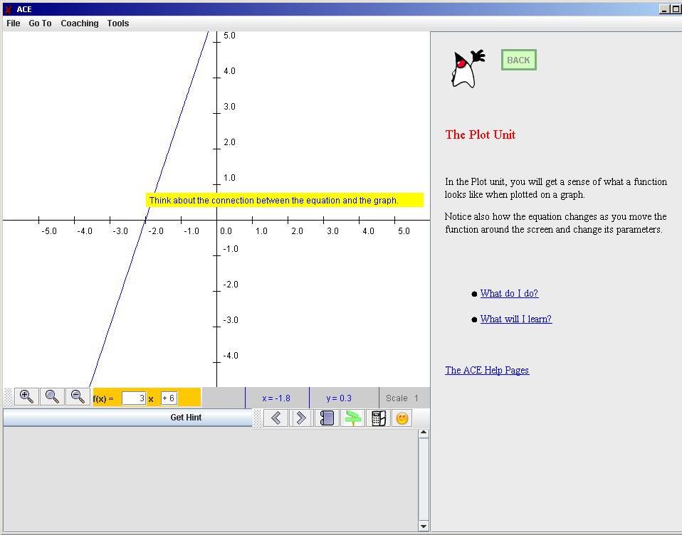
Interface to Generate Explanations Explicitly
Test adaptive interventions to trigger self-explanation (Conati 2011)
Notes:
14 from outilne (~26 from beginning)

Slide 32
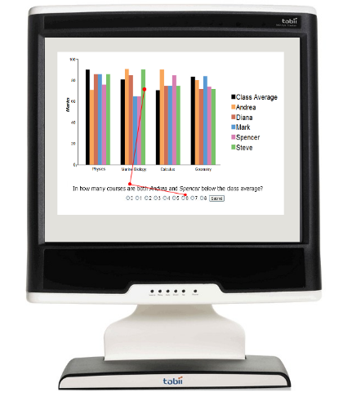
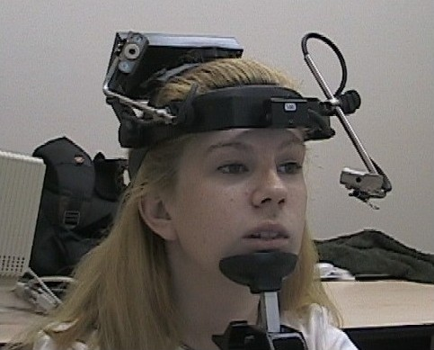
And even better
First Eye-Tracker I used
Getting much better now
I wonder about the practicality of implementing eye-tracking for learning environments. This is one of the first examples we've seen in this course of user input that is observed with video, rather than say keyboard inputs. However, that can cause issues with privacy if students are required to have a camera on them while using the system. Especially if students are children, then getting permission to use a camera may just not be possible. While the paper does mainly focus on showing the improvement to the student modelling, I wonder if the practicality of the solution was properly considered.
Can we truly relate eye-tracking to user focus?
Notes:
5

