Slide 1
Decision Theoretic Planning

Slide 2
Decisions Under Uncertainty
Some areas of AI (e.g., planning) focus on decision making in domains where the environment is understood with certainty
What if an agent has to make decisions in a domain that involves uncertainty?
An agent’s decision will depend on:
what actions are available. They often don’t have deterministic outcome
what beliefs the agent has over the world
the agent’s goals and preferences

Slide 3
Decisions Under Uncertainty
In CPSC 322, you have covered
How to express agent’s preferences in terms of utility functions
One-off decisions
Started looking at sequential decision problems
In this section of the course we will look in more detail at sequential decision problems

Slide 4
Overview
Decision processes and Markov Decision Processes (MDP)
Rewards and Optimal Policies
Defining features of Markov Decision Process
Solving MDPs
Value Iteration
Policy Iteration
POMDPs

Slide 5
Decision Processes
Often an agent needs to decide how to act in situations that involve sequences of decisions
The agent’s utility depends upon the final state reached, and the sequence of actions taken to get there
Would like to have an ongoing decision process. At any stage of the process
The agent decides which action to perform
The new state of the world depends probabilistically upon the previous state as well as the action performed
The agent receives rewards or punishments at various points in the process
Aim: maximize the reward received

Slide 6
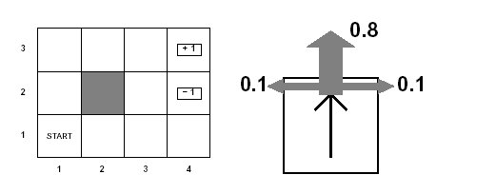
Example
Agent moves in the above grid via actions Up, Down, Left, Right
Each action has
0.8 probability to reach its intended effect
0.1 probability to move at right angles of the intended direction
If the agents bumps into a wall, it says there

Slide 7
Example

Slide 8
Example
Can the sequence [Up, Up, Right, Right, Right] take the agent in terminal state (4,3)?
Can the sequence reach the goal in any other way?

Slide 9
Example
Can the sequence [Up, Up, Right, Right, Right] take the agent in terminal state (4,3)?
Yes, with probability 0.8⁵=0.3278
Can the sequence reach the goal in any other way?
yes, going the other way around with prob. 0.1⁴x0.8

Slide 10
Markov Decision Processes (MDP)
We will focus on decision processes that can be represented as Markovian (as in Markov models)
Actions have probabilistic outcomes that depend only on the current state
Let s_{t} be the state at time t
P(s_{t+1}|s₀ , a₀ ,... ,s_{t} , a_{t}) = P(s_{t+1}|s_{t} , a_{t})
The process is stationary if P(s_{t+1}|s_{t} , a_{t}) is the same for every t
P(s’ |s , a) is the probability that the agent will be in state s’ after doing action a in state s
We also need to specify the utility function for the agent
depends on the sequence of states involved in a decision (environment history), rather than a single final state
Defined based on a reward R(s) that the agent receives in each state s
can be negative (punishment)

Slide 11
MDP specification
For an MDP you specify:
set S of states, set A of actions
Initial state s₀
the process’ dynamics (or transition model)
P(s'|s,a)
The reward function
R(s, a,, s’)
describing the reward that the agent receives when it performs action a in state s and ends up in state s’
We will use R(s) when the reward depends only on the state s and not on how the agent got there

Slide 12
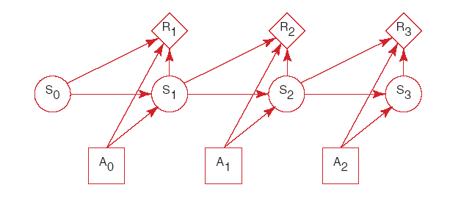
MDP specification
An MDP augments a Markov chain with actions and values

Slide 13
Overview
Decision processes and Markov Decision Processes (MDP)
Rewards and Optimal Policies
Defining features of Markov Decision Process
Solving MDPs
Value Iteration
Policy Iteration
POMDPs

Slide 14
Solving MDPs
In search problems, aim is to find an optimal state sequence
In MDPs, aim is to find an optimal policy π(s)
A policy π(s) specifies what the agent should do for each state s
Because of the stochastic nature of the environment, a policy can generate a set of environment histories (sequences of states) with different probabilities
Optimal policy maximizes the expected total reward, where the expectation is take over the set of possible state sequences generated by the policy
Each state sequence associated with that policy has a given amount of total reward
Total reward is a function of the rewards of its individual states (we’ll see how)

Slide 15
Optimal Policy in our Example
Let’s suppose that, in our example, the total reward of an environment history is simply the sum of the individual rewards
For instance, with a penalty of -0.04 in not terminal states, reaching (3,4) in 10 steps gives a total reward of 0.6
Penalty designed to make the agent go for shorter solution paths

Slide 16
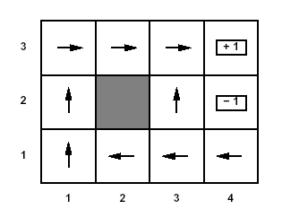
Rewards and Optimal Policy
Optimal Policy when penalty in non-terminal states is -0.04
Note that here the cost of taking steps is small compared to the cost of ending into (4,2)
Thus, the optimal policy for state (3,1) is to take the long way around the obstacle rather then risking to fall into (4,2) by taking the shorter way that passes next to it
But the optimal policy may change if the reward in the non-terminal states (let’s call it r) changes

Slide 17
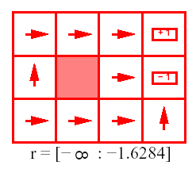
Rewards and Optimal Policy
Optimal Policy when r < -1.6284
1 2 3 4
3
2
1
Why is the agent heading straight into (4,2) from it surrounding states?

Slide 18
Rewards and Optimal Policy
Optimal Policy when r < -1.6284
1 2 3 4
3
2
1
The cost of taking a step is so high that the agent heads straight into the nearest terminal state, even if this is (4,2) (reward -1)

Slide 19
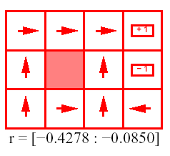
Rewards and Optimal Policy
Optimal Policy when -0.427 < r < -0.085
1 2 3 4
3
2
1
The cost of taking a step is high enough to make the agent take the shortcut to (4,3) from (3,1)

Slide 20
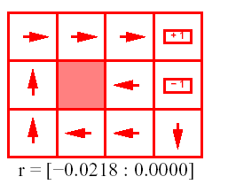
Rewards and Optimal Policy
Optimal Policy when -0.0218 < r < 0
1 2 3 4
3
2
1
Why is the agent heading straight into the obstacle from (3,2)?

Slide 21
Rewards and Optimal Policy
Optimal Policy when -0.0218 < r < 0
1 2 3 4
3
2
1
Stay longer in the grid is not penalized as much as before. The agent is willing to take longer routes to avoid (4,2)
This is true even when it means banging against the obstacle a few times when moving from (3,2)

Slide 22
Rewards and Optimal Policy
Optimal Policy when r > 0
1 2 3 4
3
2
1
state where every action belongs to an optimal policy
What happens when the agent is rewarded for every step it takes?

Slide 23
Rewards and Optimal Policy
Optimal Policy when r > 0
1 2 3 4
3
2
1
state where every action belong to an optimal policy
What happens when the agent is rewarded for every step it takes?
it is basically rewarded for sticking around
The only actions that need to be specified are the ones in states that are adjacent to the terminal states: take the agent away from them

Slide 24
Overview
Decision processes and Markov Decision Processes (MDP)
Rewards and Optimal Policies
Defining features of Markov Decision Process
Solving MDPs
Value Iteration
Policy Iteration
POMDPs

Slide 25
Planning Horizons
The planning horizon defines the timing for decision making
Indefinite horizons: the decision process ends but it is unknown when
In the previous example, the process ends when the agent enters one of the two terminal (absorbing) states
Infinite horizons: the process never halts
e.g. if we change the previous example so that, when the agent enters one of the terminal states, it is flung back to one of the two left corners of the grid
Finite horizons: the process must end at a specific time N

Slide 26
Finite Planning Horizons
Decision processes with a finite planning horizon are especially tricky to handle
Assume that, in the previous example with r = -.004, the agent starts at (3,1)
If it has a limit of 3 steps that it can take, it can only reach the high reward state (4,3) if it goes straight to it: UP is the optimal action here
If it has a limit of 100, there is plenty of time to take the safe action of going left, as it did in our initial example
start

Slide 27
Finite Planning Horizons
So the optimal action in a given state can change overtime: the optimal policy is non-stationary
If there is no time limit, there is no reason to behave differently in the same state at different times: optimal policy is stationary
we will only consider processes with stationary policies here

Slide 28
Information Availability
What information is available when the agent decides what to do?
Fully-observable MDP (FOMDP):
the agent gets to observe current state s_{t} when deciding on action a_{t} .
Partially-observable MDP (POMDP)
the agent can’t observe s_{t} directly, can only use sensors to get information about the state
Similar to Hidden Markov Models
We will first look at FOMDP (but we will call them simply MDPs)

Slide 29
Types of Reward Functions
Suppose the agent goes through states s₁, s₂,...,s_{k} and receives rewards r₁, r₂,...,r_{k}
We will look at two ways to define the reward for this sequence, i.e. its utility for the agent

Slide 30
Discounted Reward
If we are dealing with infinite horizon, the environment histories can be infinitely long
their values will generally be infinite if we use additive rewards -> hard to compare
The problem disappears if we use a discounted reward with γ < 1 and reward for each state bounded by R_{max}
using the standard formula for an infinite geometric series
Thus, with discounted reward, the utility of an infinite sequence is finite

Slide 31
Discounted Reward
The discount factor γ determines the preference of the agent for current rewards vs. future rewards
The closer γ is to 0, the less importance is given to future rewards
We could see the resulting policies as being “short sighted”, i.e. not taking much into account the consequences of the agent’s action in the distant future
For γ = 1, discounted rewards are equivalent to additive rewards

Slide 32
Total (additive) Reward
If the environment includes terminal states and the agent is guaranteed to reach one, the environment histories are guaranteed to be finite, and so their values
Fine to use an additive reward function
Allows for “far sighted” policies that value rewards in the future as much as rewards in the present
A policy guaranteed to reach a terminal state is a proper policy
In environments with terminal states but improper policies (i.e. policies that never reach them), can’t use additive reward function
the improper policy gains infinite rewards just by staying away from the terminal states
Generally safer to use discounted reward unless finite horizon is guaranteed

Slide 33
Example of Improper Policy
1 2 3 4
3
2
1

Slide 34
A Few More Definitions
A stationary policy is a function:
For every state s, л(s) specifies which action should be taken in that state.
Utility of a state
Defined as the expected utility of the state sequences that may follow it
These sequences depend on the policy л being followed, so we define the utility of a state s with respected to л (a.k.a value of л for that state) as
Where S_{i} is the random variable representing the state the agent reaches after executing л for i steps starting from s

Slide 35
A Few More Definitions
An optimal policy is one with maximum expected discounted reward for every state.
A policy л* is optimal if there is no other policy л’ and state s such as
U^{п’}(s) > U^{п*}(s)
That is an optimal policy gives the Maximum Expected Utility (MEU)
For a fully-observable MDP with stationary dynamics and rewards with infinite or indefinite horizon, there is always an optimal stationary policy.

