Slide 1
Overview
Modelling Evolving Worlds with DBNs
Simplifying Assumptions
Stationary Processes, Markov Assumption
Inference Tasks in Temporal Models
Filtering (posterior distribution over the current state given evidence to date)
Prediction (posterior distribution over a future state given evidence to date
Smoothing (posterior distribution over a past state given all evidence to date)
Most Likely Sequence (given the evidence seen so far)
Hidden Markov Models (HMM)
Application to Part-of-Speech Tagging
HMM and DBN

Slide 2
Hidden Markov Models (HMM)‏
Temporal probabilistic models in which the state of the temporal process is described by a single discrete random variable
Variable’s values are all the possible states of the world.
The Rain example is a HMM
Simplified matrix-based representation for the transition and sensor models, as well as simplified algorithms
Notes:
2

Slide 3
Overview
Modelling Evolving Worlds with DBNs
Simplifying Assumptions
Stationary Processes, Markov Assumption
Inference Tasks in Temporal Models
Filtering (posterior distribution over the current state given evidence to date)
Prediction (posterior distribution over a future state given evidence to date
Smoothing (posterior distribution over a past state given all evidence to date)
Most Likely Sequence (given the evidence seen so far)
Hidden Markov Models (HMM)
Application to Part-of-Speech Tagging
HMM and DBN

Slide 4
Part-of-Speech (PoS) Tagging
Given a text in natural language, label (tag) each word with its syntactic category
E.g, Noun, verb, pronoun, preposition, adjective, adverb, article, conjunction
Input
Brainpower, not physical plant, is now a firm's chief asset.
Output
Brainpower_NN ,_, not_RB physical_JJ plant_NN ,_, is_VBZ now_RB a_DT firm_NN 's_POS chief_JJ asset_NN ._.
Tag meanings
NNP (Proper Noun singular), RB (Adverb), JJ (Adjective), NN (Noun sing. or mass), VBZ (Verb, 3 person singular present), DT (Determiner), POS (Possessive ending), . (sentence-final punctuation)

Slide 5
Why?
Part-of-speech (also known as word syntactic category, word class, morphology class,) gives a significant amount of information about the word and its neighbors
Useful for many tasks in Natural Language Processing (NLP)
As a basis for parsing in NL understanding
Information Retrieval
Quickly finding names or other phrases for information extraction
Select important words from documents (e.g., nouns)
Word-sense disambiguation
I made her duck (how many meanings does this sentence have)?
Speech synthesis: Knowing PoS produce more natural pronunciations
E.g,. Content (noun) vs. content (adjective); object (noun) vs. object (verb)

Slide 6
Problem
Ambiguity
Most words have only one PoS. Of the rest,
about half have two PoS (like many of the nouns that can be used as verbs)
The other half have more than 2
Unfortunately, the words with several parts of speech occur with high frequency
Very likely to find them in a document
> 2 PoS
Unfortunately frequent!
Words
~4k
1 PoS
~35k
2 PoS
~4k
Luckily, different tags associated with a word are not equally likely!

Slide 7
Example Word with Several PoS
Back
The back door = JJ
On my back = NN
Win the voters back = RB
Promised to back the bill = VB
The POS tagging problem is to determine the POS tag for a particular instance of a word.

Slide 8
PoS Tagging
Obviously extremely laborious to do PoS by hand
Although some amount of hand-tagging has been done (we will see why).
There are many “corpora” including hand tagged documents on many different topics
We want automatic taggers
Given a document and a “dictionary” that gives all possible PoS (tags) for each word
Return a tagged document with the most likely tag for each word
There are various dictionaries available, that use different sets of tags (tagsets)

Slide 9
Sets of Parts of Speech: Tagsets
Most commonly used:
45-tag Penn Treebank,
61-tag C5,
146-tag C7
The choice of tagset is based on the application (do you care about distinguishing between “to” as a prep and “to” as a infinitive marker?)
The fewer the tags, the easier to get the tagging right.
However, accurate tagging can be done even with even large tagsets

Slide 10
PoS Tagging
Input text
Brainpower, not physical plant, is now a firm's chief asset. …………
Dictionary
word_{i} -> set of tags from Tagset
Tagger
Output
Brainpower_NN ,_, not_RB physical_JJ plant_NN ,_, is_VBZ now_RB a_DT firm_NN 's_POS chief_JJ asset_NN ._. ……….

Slide 11
Tagger Types
Rule-based (1995)
Stochastic
HMM tagger ~ 1992
Maximum Entropy Models ~ 1997

Slide 12
HMM Stochastic Tagging
Tags correspond to the HMM states
The state variable has as many values as the number of tags in the tagset (45, 61, 146,…)
The transition model P(Tag_{j}|Tag_{j-1}) leverages information from context
PoS of a word influences what other words can occur nearby
An Adjective is a word that can fill the blank in: “It’s so __________.”
A Noun is a word that can fill the blank in: “the __________ is”
What is green?
It’s so green.
Both greens could work for the walls.
The green is a little much given the red rug.
The transition model partially accounts for context by modeling which PoS can follow a given PoS

Slide 13
HMM Stochastic Tagging
Tag transition probabilities p(tag_{i}|tag_{i-1})
Determiners likely to precede adjs and nouns
That/DT flight/NN
The/DT yellow/JJ hat/NN
So we expect P(NN|DT) and P(JJ|DT) to be high
But P(DT|JJ) to be not so high

Slide 14
HMM Stochastic Tagging
Words correspond to the HMM observations
The observation model P(Word|Tag) describes the probability that, given a specific tag, each word in the dictionary can be in that position.
P(Word = house | tag = noun),
P(Word = hemophiliac | tag = noun),
P(Word = to | tag = noun)
Each evidence node has as many values as the number of words in the dictionary (~44,000 for English)

Slide 15
HMM Stochastic Tagging
Tagging: given a sequence of words (observations), find the most likely sequence of tags (states)
But this is….?
Major issue: how to get the transition and observation models?
From frequencies in hand-tagged corpora (that’s why some hand-tagging was done!)
Using unsupervised machine learning techniques on non-tagged corpora

Slide 16
Example 1
Tag transition probabilities p(tag_{i}|tag_{i-1})
Determiners likely to precede adjs and nouns
That/DT flight/NN
The/DT yellow/JJ hat/NN
So we expect P(NN|DT) and P(JJ|DT) to be high
But P(DT|JJ) to be:
Compute P(NN|DT) by counting in a labeled corpus:

Slide 17
Example 2
Word likelihood probabilities p(word_{i}|tag_{i})
VBZ (3 person, sing. present verb) likely to be “is”
Compute P(is|VBZ) by counting in a labeled corpus:

Slide 18
Evaluating Taggers
Accuracy: percent correct (most current taggers 96-7%)
Test on unseen data!
Get hand-tagged document, feed its un-tagged version to the automatic tagger, and compare the output with the original tags
Human Ceiling: agreement rate of humans on classification (96-7%)
This is the agreement that two or more human taggers would get on a document

Slide 19
Overview
Modelling Evolving Worlds with DBNs
Simplifying Assumptions
Stationary Processes, Markov Assumption
Inference Tasks in Temporal Models
Filtering (posterior distribution over the current state given evidence to date)
Prediction (posterior distribution over a future state given evidence to date
Smoothing (posterior distribution over a past state given all evidence to date)
Most Likely Sequence (given the evidence seen so far)
Hidden Markov Models (HMM)
Application to Part-of-Speech Tagging
HMM and DBN

Slide 20
DBN and HMM
Every HMM is a DBN with only one state variable
Every DBN can be turned into a HMM
Just create a mega-variable with values that represent all possible combinations of values for the variables in the DBN

Slide 21
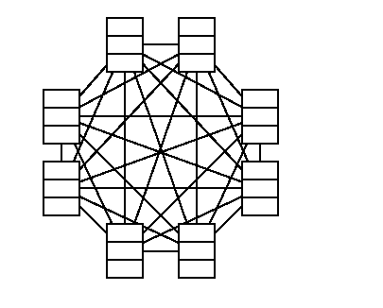
DBN and HMM
Student learning example in DBN format
Knows-Add (boolean), Knows-Sub (boolean), Morale {low, high}
Knows-Sub_{t-1}
Knows-Sub_{t}
Knows-Add_{t-1}
Knows-Add_{t}
Morale_{t-1}
Morale_{t}
Equivalent HMM: only one variable
StudentState with 8 possible states
representing all possible combinations of knowing/not knowing addition and subtraction and having a high/low morale

Slide 22
DBN and HMM
If they are equivalent, why bother making a distinction?
Main difference is that decomposing the state into variables allows one to explicitly represent dependencies among them
Sparse dependencies => Exponentially fewer parameters
Suppose we have Bnet with
20 Boolean state variables
Each with 3 parents in previous time slice
Transition model has …………….
Equivalent HMM
1 state variable with ……. states
……………. entries in the transition matrix
Really bad space and time complexity
Really bad having to specify so many parameters

Slide 23
DBN and HMM
If they are equivalent, why bother making a distinction?
Main difference is that decomposing the state into variables allows one to explicitly represent dependencies among them
Sparse dependencies => Exponentially fewer parameters
Suppose we have Bnet with
20 Boolean state variables
Each with 3 parents in previous time slice
Transition model has 20 x 2³ = 160 probabilities
Equivalent HMM
1 state variable with 2²⁰ states
2²⁰ x 2²⁰ = 2⁴⁰ ~ 10 ¹² entries in the transition matrix
Really bad space and time complexity
Really bad having to specify so many parameters

Slide 24
DBN and HMM
Even when the number of states in the equivalent HMM is not that large (e.g. student learning model)…
…specifying the numbers in the transition matrix can be less intuitive than specifying the more modular conditional probabilities in the Bnets
What is the probability that the student goes
From knowing addition, not knowing subtraction, having low morale
To knowing addition, not knowing subtraction and having high morale?

Slide 25
Exact Inference in DBN
Since DBN are Bayesian networks, we can use any of the existing algorithms for exact inference
Given a sequence of observations
Construct the full Bayesian networks by creating as many time slices as they are needed to fit the whole sequence
This technique is called unrolling
But this is not such a great idea, as it would requite O(t) space to unroll the network
Besides if we update the network anew for each new piece of evidence, time complexity would also be O(t)

Slide 26
Exact Inference in DBN
Better to use the recursive definition of filtering that we have seen earlier
P(X_{t} | e_{0:t}) = α P(e_{t} | X_{t}) ∑_{xt-1} P(X_{t} | x_{t-1} ) P( x_{t-1} | e_{0:t-1} )
Filtering at time t-1
Inclusion of new evidence
(sensor model)‏
Propagation to time t
Filtering step: basically sums out the state variables in the previous time slice to get the distribution in the current time slice
This is exactly variable elimination run with the variables in temporal order

Slide 27
Rollup Filtering
This algorithm (rollup filtering) keeps only two time slices in memory at any given time
Start with Slice 0
Add slice 1 and sum out slice 0
Add slice 2 and sum out slice 1
Add slice n and sum out slice n -1
0.5
0.5
0.627
0.373
TRUE 0.5
FALSE 0.5
0.818
0.182
0.883
0.117
Rain₀
Rain₁
Rain₂
Umbrella₁
Umbrella₂

Slide 28
Rollup Filtering
Rollup filtering requires constant (independent of t) space and time for each update
Unfortunately the “constant” is, in most cases, exponential in the number of state variables
As variable elimination proceeds, the factors grow to include all state variables that have parents in the previous time slice
This result in an update cost of O(d^{n+2}), where d is the size of the largest variable domain
Thus, while in principle DBN allow to represent temporal processes with many sparsely connected variables, in practice we cannot reason efficiently and exactly about those processes
Need to use sampling algorithms!
The most promising is particle filtering

Slide 29
Why not Likelihood Weighting ?
LW Avoids the inefficiency of rejection sampling by generating only events that are consistent with evidence e
Fixes the values for the evidence variables E
Samples only the remaining variables Z, i.e. the query X and hidden variables Y
Still needs to account for the influence of the given evidence on the probability of the samples
LW approximates the posterior distribution by weighing the samples by the probability they afford to the evidence

Slide 30
Example: P(Rain|sprinkler, wet-grass)‏
Random => 0.4
Sample=> cloudy
P(C)‏
Cloudy
w₁ = 1
0.5
w₂ = w_{1*} 0.1 = 0.1
w₃ = w_{2*} 0.99 = 0.099
C
P(S|C)‏
T
F
0.1
0.5
Rain
Sprinkler
C
P(R|C)‏
Sprinkler is fixed
No sampling, but adjust weight w₂ = w₁ * P(sprinkler|cloudy)‏
T
F
0.8
0.2
Wet Grass
Random => 0.4
Sample=> rain
S
R
P(W|S,R)‏
T
T
0.99
T
F
0.9
Wet Grass is fixed
No sampling, but adjust weight
w₃ = w₂ * P(wet-grass|sprinkler, rain)‏
F
T
0.9
F
F
0.1

Slide 31
Why not Likelihood Weighting
Two problems
Standard algorithm runs each sample in turn, all the way through the network
time and space requirements grow with t!

Slide 32
Why not Likelihood Weighting
Does not work well when evidence comes “late” in the network topology
Samples are largely independent on the evidence
True in a DBN, where state variables never have evidence as parents
In the Rain network, I could observe umbrella every day, and still get samples that are sequences of sunny days
Number of samples necessary to get good approximations increases exponentially with t!

Slide 33
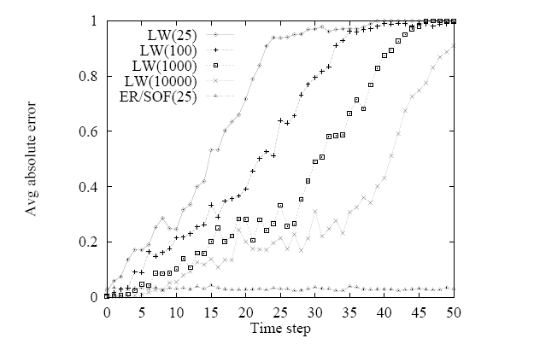
Why not Likelihood Weighting

Slide 34
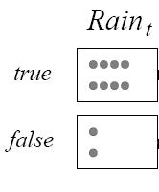
Particle Filtering
Designed to fix both problems
Run all N samples together through the network, one slice at a time
Form of filtering, where the N samples are the forward message
Essentially use the sample themselves as an approximation of the current state distribution
No need to unroll the network, all needed is current and next slice => “constant” update per time step
STEP 0: Generate a population on N initial-state samples by sampling
from initial state P(X_{t})
N = 10

Slide 35
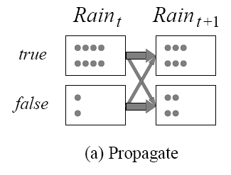
Particle Filtering
STEP 1: Propagate each sample for x_{t} forward by sampling the next state value x_{t+1} based on P(X_{t+1} |x_{t+1} )
R_{t-1} | P(R_{t})
t f | 0.7 0.3

Slide 36
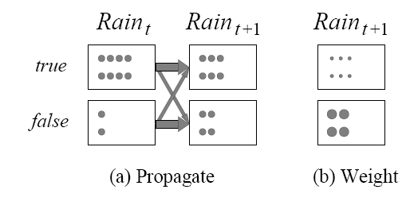
Particle Filtering
STEP 2: Weight each sample by the likelihood it assigns to the evidence
E.g. assume we observe not umbrella at t+1
R_{t} | P(U_{t})
t f | 0.9 0.2

Slide 37
Particle Filtering
Now we need to take care of problem #2: generate samples that are a better simulation of reality
IDEA: Focus the set of samples on the high probability regions of the state space
Throw away samples with very low weight according to evidence
Replicate those with high weight, to obtain a sample closer to reality
STEP 3: Create a new sample from the population at X_{t+1,} i.e.
resample the population so that the probability that each sample is selected is proportional to its weight

Slide 38
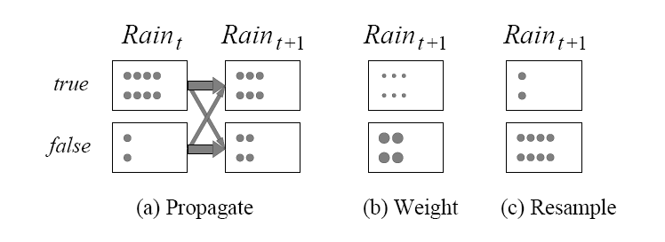
Particle Filtering
STEP 3: Create a new sample from the population at X_{t+1,} i.e.
resample the population so that the probability that each sample is selected is proportional to its weight
Start the Particle Filtering cycle again from the new sample

Slide 39
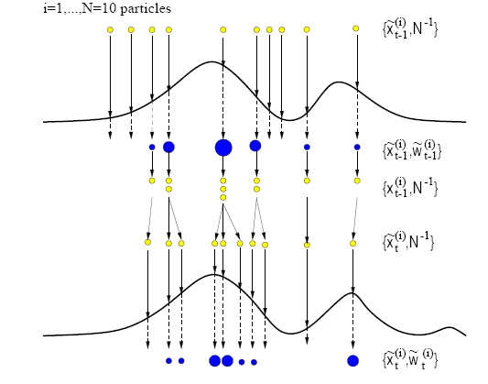
Particle Filtering

Slide 40
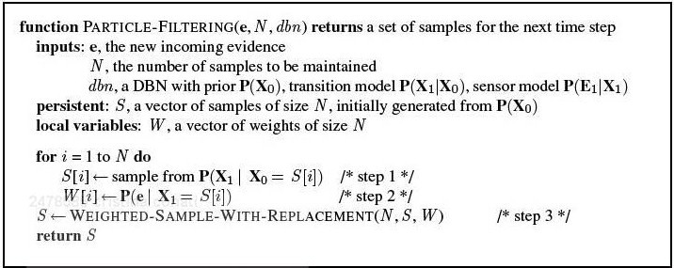
Particle Filtering
N = 10

Slide 41
Particle Filtering

Slide 42
Particle Filtering

Slide 43
Particle Filtering

Slide 44
Is Particle Filtering Consistent?
Let’s assume that the sample population starts with a correct representation of f_{1:t}= P(X_{t}|e_{1:t})
If N(x_{t}|e_{1:t}) is the number of samples in x_{t} after observations e_{1:t}
P(x_{t}|e_{1:t}) = N(x_{t}|e_{1:t})/N for large N

Slide 45
Is Particle Filtering Consistent?
Now we propagate each sample forward by sampling the state variables at t+1 given the values of the samples in t
Number of samples reaching x_{t+1} from each x_{t} is the transition probability times the population of x_{t} .
Thus, total samples in x_{t+1}
N(x_{t+1}|e_{1:t+1}) = ∑ _{xt} P(x_{t+1}|x_{t}) N(x_{t}|e_{1:t})

Slide 46
Is Particle Filtering Consistent?
A sample in state x_{t+1} receives weight P(e_{t+1}|x_{t+1})
Thus, total weight of samples in x_{t+1} after seeing e_{t+1} is
W(x_{t+1}|e_{1:t+1}) = P(e_{t+1}|x_{t+1}) N(x_{t+1}|e_{1:t})

Slide 47
Is Particle Filtering Consistent?
Now for resampling

Slide 48
Is Particle Filtering Consistent?
For resampling, each sample is replicated with probability proportional to its weight.
Thus, number of samples in x_{t+1} after resampling is proportional to the total weight in x_{t+1} before resampling
N(x_{t+1}|e_{1:t+1})/N = α W(x_{t+1}|e_{1:t+1})
= α P(e_{t+1}|x_{t+1}) N(x_{t+1}|e_{1:t})
= α P(e_{t+1}|x_{t+1}) ∑ _{xt} P(x_{t+1}|x_{t}) N(x_{t}|e_{1:t})
= αN P(e_{t+1}|x_{t+1}) ∑ _{xt} P(x_{t+1}|x_{t}) P(x_{t}|e_{1:t})
= α’P(e_{t+1}|x_{t+1}) ∑ _{xt} P(x_{t+1}|x_{t}) P(x_{t}|e_{1:t})
= P(x_{t+1}|e_{1:t+1})
Sample population after one cycle correctly represents the forward message at t+1

Slide 49
Is Particle Filtering Consistent?
For resampling, each sample is replicated with probability proportional to its weight.
Thus, number of samples in x_{t+1} after resampling is proportional to the total weight in x_{t+1} before resampling
N(x_{t+1}|e_{1:t+1})/N = α W(x_{t+1}|e_{1:t+1})
= α P(e_{t+1}|x_{t+1}) N(x_{t+1}|e_{1:t})
= α P(e_{t+1}|x_{t+1}) ∑ _{xt} P(x_{t+1}|x_{t}) N(x_{t}|e_{1:t})
= αN P(e_{t+1}|x_{t+1}) ∑ _{xt} P(x_{t+1}|x_{t}) P(x_{t}|e_{1:t})
= α’P(e_{t+1}|x_{t+1}) ∑ _{xt} P(x_{t+1}|x_{t}) P(x_{t}|e_{1:t})
= P(x_{t+1}|e_{1:t+1})
Sample population after one cycle correctly represents the forward message at t+1

Slide 50
Is PF Efficient?
In practice, approximation error of particle filtering remains bounded overtime
It is also possible to prove that the approximation maintains bounded error with high probability (with specific assumptions)

