Slide 1
Probability and Time

Slide 2
Overview
Modelling Evolving Worlds with Dynamic Baysian Networks
Simplifying Assumptions
Stationary Processes, Markov Assumption
Inference Tasks in Temporal Models
Filtering (posterior distribution over the current state given evidence to date)
Prediction (posterior distribution over a future state given evidence to date
Smoothing (posterior distribution over a past state given all evidence to date)
Most Likely Sequence (given the evidence seen so far)
Hidden Markov Models (HMM)
Application to Part-of-Speech Tagging
HMM and DBN

Slide 3
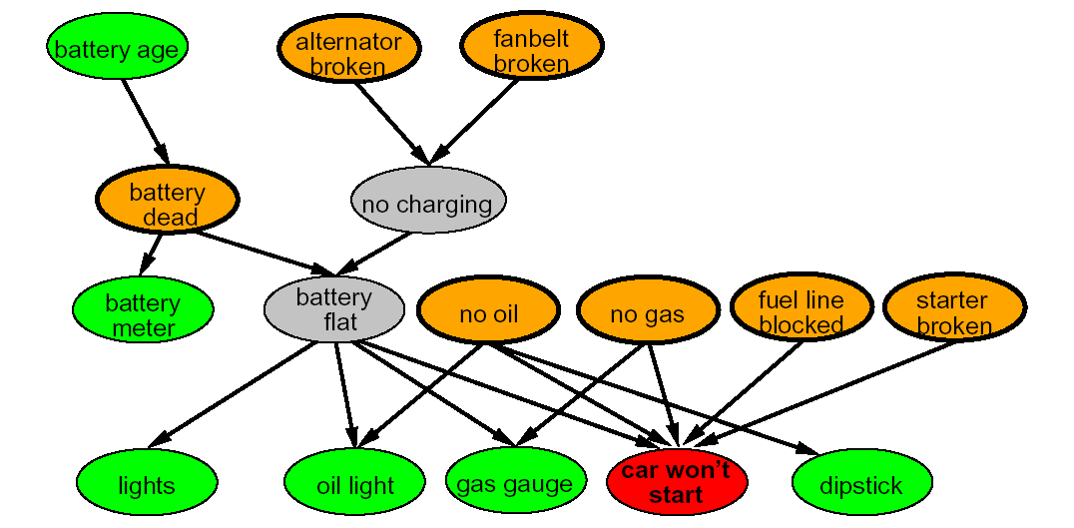
Modeling Evolving Worlds
So far we have looked at techniques for probabilistic reasoning in a static world
E.g., keep collecting evidence to diagnose the cause of a fault in a system.
The true cause does not change as one gathers new evidence, what changes the belief over the possible causes.
Notes:
For example, while a casino may lose money in a single spin of the American Roulette wheel, it will almost certainly gain very close to 5.3% of all gambled money over thousands of spins. Any winning streak by a player will eventually be overcome by the parameters of the game.

Slide 4
Dynamic Bayesian Networks (DBN)‏
DBN are an extension of Bayesian networks devised for reasoning under uncertainty in dynamic environments
Knows-Sub₁
Knows-Sub₂
Knows-Sub₃
Knows-Add₁
Knows-Add₂
Knows-Add₃
Morale₁
Morale₂
Morale₃
Face
Obs₁
Face
Obs₂
Face
Obs₃
Add-Test₁
Add-Test₂
Add-Test₃
Sub-Test₁
Add-Test₂
Sub-Test₃
Notes:
4

Slide 5
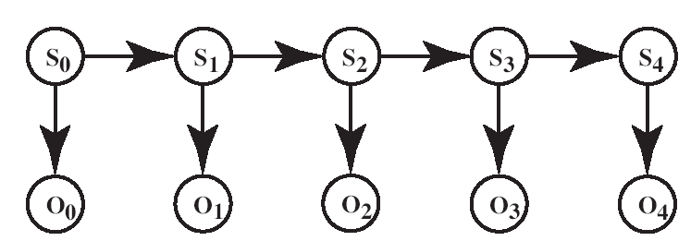
Assumptions
X_{o}
X₁
X₂
X₃
X₄
E_{o}
E₁
E₂
E₃
E₄
Assumption of stationary process: the mechanism that regulates how state variables change overtime is stationary, that is it can be described by a single transition model P(X_{t}|X_{t-1})
Markov assumption: current state X_{t} depends on bounded subset of previous states X_{0:t-1}
Markov Assumption on Evidence: Typically, we will assume that the value of an observation at time t depends only on the current state
P(E_{t} |X_{0:t} , E_{0:t-1}) = P(E_{t} | X_{t})
Thus
P(X₀, X₁,.., X_{t}, E₀,.., E_{t} ) = ∏_{i=}^{t} ₁ P(X_{i} | X_{i-1}) P(E_{i-1} | X_{i-1})
Notes:
5

Slide 6
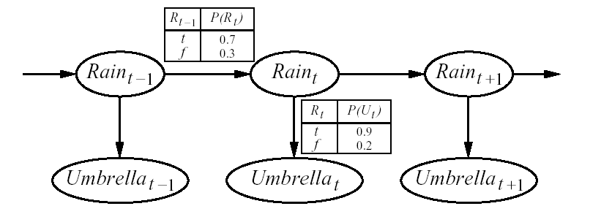
Simpler Example
(We’ll use this as a running example)
Guard stuck in a high-security bunker
Would like to know if it is raining outside
Can only tell by looking at whether his boss comes into the bunker with an umbrella every day
Transition model
State
variables
Observation model
Observable variables
Notes:
6

Slide 7
Inference Tasks in Temporal Models
Filtering (or monitoring): P(X_{t} |e_{0:t} )
Compute the posterior distribution over the current state given all evidence to date
Recursive approach
Compute filtering up to time t-1, and then include the evidence for time t (recursive estimation)‏
P(X_{t} | e_{0:t}) = α P(e_{t} | X_{t}) ∑_{xt-1} P(X_{t} | x_{t-1} ) P( x_{t-1} | e_{0:t-1} )
Filtering at time t-1
Inclusion of new evidence
(sensor model)‏
Propagation to time t
P( X_{t-1} | e_{0:t-1} ) can be seen as a message f_{0:t-1} that is propagated forward along the sequence, modified by each transition and updated by each observation
Thus, the recursive definition of filtering at time t in terms of filtering at time t-1 can be expressed as a FORWARD procedure
f_{0:t} = α FORWARD (f_{0:t-1}, e_{t})
Notes:
7

Slide 8
Rain Example
P(R₂| u₁ , u₂)
0.5
0.5
0.627
0.373
TRUE 0.5
FALSE 0.5
0.818
0.182
0.883
0.117
Rain₀
Rain₁
Rain₂
Umbrella₁
Umbrella₂
Notes:
8

Slide 9
Overview
Modelling Evolving Worlds with DBNs
Simplifying Assumptions
Stationary Processes, Markov Assumption
Inference Tasks in Temporal Models
Filtering (posterior distribution over the current state given evidence to date)
Prediction (posterior distribution over a future state given evidence to date
Smoothing (posterior distribution over a past state given all evidence to date)
Most Likely Sequence (given the evidence seen so far)
Hidden Markov Models (HMM)
Application to Part-of-Speech Tagging
HMM and DBN

Slide 10
Prediction (P(X_{t+k+1} | e_{0:t} ))
Can be seen as filtering without addition of new evidence
0.5
0.5
0.627
0.373
0.653
0.347
0.561
0.439
0.5
0.5
0.818
0.182
0.883
0.117
Rain₀
Rain₁
Rain₂
Rain₃
Rain₃
R_{t} | P(U_{t})
t f | 0.9 0.2
R_{t-1} | P(R_{t})
t f | 0.7 0.3
Umbrella₁
Umbrella₂
Umbrella₃
Umbrella₃
Notes:
10

Slide 11
Overview
Modelling Evolving Worlds with DBNs
Simplifying Assumptions
Stationary Processes, Markov Assumption
Inference Tasks in Temporal Models
Filtering (posterior distribution over the current state given evidence to date)
Prediction (posterior distribution over a future state given evidence to date
Smoothing (posterior distribution over a past state given all evidence to date)
Most Likely Sequence (given the evidence seen so far)
Hidden Markov Models (HMM)
Application to Part-of-Speech Tagging
HMM and DBN

Slide 12
Smoothing
Smoothing: Compute the posterior distribution over a past state given all evidence to date
P(X_{k} | e_{0:t} ) for 1 ≤ k < t
E₀
Notes:
12

Slide 13
Smoothing
P(X_{k} | e_{0:t}) = P(X_{k} | e_{0:k},e_{k+1:t} ) dividing up the evidence
= α P(X_{k} | e_{0:k} ) P(e_{k+1:t} | X_{k}, e_{0:k} ) using…
= α P(X_{k} | e_{0:k} ) P(e_{k+1:t} | X_{k}) using…
forward message from filtering up to state k,
f _{0:k}
backward message,
b _{k+1:t}
computed by a recursive process that runs backwards from t
Notes:
13

Slide 14
Smoothing
P(X_{k} | e_{0:t}) = P(X_{k} | e_{0:k},e_{k+1:t} ) dividing up the evidence
= α P(X_{k} | e_{0:k} ) P(e_{k+1:t} | X_{k}, e_{0:k} ) using Bayes Rule
= α P(X_{k} | e_{0:k} ) P(e_{k+1:t} | X_{k}) By Markov assumption on evidence
forward message from filtering up to state k,
f _{0:k}
backward message,
b _{k+1:t}
computed by a recursive process that runs backwards from t
Notes:
14

Slide 15
Backward Message
Product Rule
P(e_{k+1:t} | X_{k}) = ∑_{xk+1} P(e_{k+1:t} , x_{k+1} | X_{k}) = ∑_{xk+1} P(e_{k+1:t} |x_{k+1} , X_{k}) P( x_{k+1} | X_{k}) =
= ∑_{xk+1} P(e_{k+1:t} |x_{k+1} ) P( x_{k+1} | X_{k}) by Markov assumption on evidence
= ∑_{xk+1} P(e_{k+1},e_{k+2:t} |x_{k+1} ) P( x_{k+1} | X_{k})
= ∑_{xk+1} P(e_{k+1}|x_{k+1} ) P(e_{k+2:t} |x_{k+1} ) P( x_{k+1} | X_{k})
because e_{k+1} and e_{k+2:t}, are conditionally independent given x_{k+1}
recursive call
transition model
sensor model
In message notation
b_{k+1:t} = BACKWARD (b_{k+2:t}, e_{k+1})
As with the forward recursion, the time and space for each backward update is independent of t
Notes:
15

Slide 16
Smoothing: putting it all together
P(X_{k} | e_{0:t})
= α P(X_{k} | e_{0:k} ) P(e_{k+1:t} | X_{k}) By Markov assumption on evidence
backward message,
b _{k+1:t}
computed by a recursive process that runs backwards from t
forward message from filtering up to state k, f _{0:k}
P(e_{k+1:t} | X_{k}) =
= ∑_{xk+1} P(e_{k+1}|x_{k+1} ) P(e_{k+2:t} |x_{k+1} ) P( x_{k+1} | X_{k})
recursive call
transition model
sensor model
Notes:
16

Slide 17
Forward-Backward Procedure
Thus,
P(X_{k} | e_{0:t}) = α f_{1:k} b_{k+1:t}
and this value can be computed by recursion through time, running forward from 0 to k and backwards from t to k+1
The backwards phase is initialized with an empty observation sequence from t to t+ 1, e_{t+1:t} which has probability of 1 to be observed
b_{t+1:t} = P(e_{t+1:t}| X_{t} ) = P(| X_{t} ) = 1
Notes:
17

Slide 18
Rain Example
Let’s compute the probability of rain at t = 1, given umbrella observations at t=1 and t =2
From P(X_{k} | e_{0:t}) = α P(X_{k} | e_{0:k} ) P(e_{k+1:t} | X_{k}) we have
P(R₁| e_{1:2}) = P(R₁| u_{1:}u₂) = α P(R₁| u₁) P(u₂ | R₁)
P(R₁| u₁) = <0.818, 0.182> as it is the filtering to t =1 that we did earlier
forward message from filtering up to state 1
backward message for propagating evidence backward from time 2
0.5
0.5
TRUE 0.5
FALSE 0.5
0.818
0.182
Rain₀
Rain₁
Rain₂
Umbrella₁
Umbrella₂
Notes:
18

Slide 19
Rain Example
From P(e_{k+1:t} | X_{k}) = ∑_{xk+1} P(e_{k+1}|x_{k+1} ) P(e_{k+2:t} |x_{k+1} ) P( x_{k+1} | X_{k})
P(u₂ | R₁) = ∑_{r2} P(u₂|r₂ ) P(|r₂ ) P( r₂ | R₁) =
P(u₂|r₂ ) P(|r₂ ) <P( r₂ | r₁), P( r₂ | ⌐r₁) >+
P(u₂| ⌐ r₂ ) P(| ⌐ r₂ ) <P(⌐ r₂ | r₁), P(⌐ r₂ | ⌐r₁)>
= (0.9 * 1 * <0.7,0.3>) + (0.2 * 1 * <0.3, 0.7>) = <0.69,0.41>
Thus
α P(R₁| u₁) P(u₂ | R₁) = α<0.818, 0.182> * <0.69, 0.41> ~ <0.883, 0.117>
Term corresponding to the Fictitious empty observation sequence e_{3:2}
0.5
0.5
0.818
0.182
0.69
0.41
TRUE 0.5
FALSE 0.5
0.883
0.117
Rain₀
Rain₁
Rain₂
Umbrella₁
Umbrella₂
Notes:
19

Slide 20
Forward-Backward Algorithm
Simple smoothing estimates the posterior of a single state given past and future evidence
But the procedure can be used to estimate the posterior distribution of the complete sequence of states.
One way to do this efficiently is to
compute and store the results of forward filtering over the whole sequence.
run the back recursion from t down to 1, computing the smoothed estimate for step k from b_{k+1:t} and the stored forward message f_{1:k} (as we did in the previous example)
this can be done in O(t)
Notes:
20

Slide 21
Overview
Modelling Evolving Worlds with DBNs
Simplifying Assumptions
Stationary Processes, Markov Assumption
Inference Tasks in Temporal Models
Filtering (posterior distribution over the current state given evidence to date)
Prediction (posterior distribution over a future state given evidence to date
Smoothing (posterior distribution over a past state given all evidence to date)
Most Likely Sequence (given the evidence seen so far)
Hidden Markov Models (HMM)
Application to Part-of-Speech Tagging
HMM and DBN

Slide 22
Most Likely Sequence
Suppose that in the rain example we have the following umbrella observation sequence
[true, true, false, true, true]
Is it the perfect reflection on the rain situation?
[rain, rain, no-rain, rain, rain]
Or perhaps it did rain on the third day but the boss forgot to bring the umbrella?
If it did not rain on day 3, perhaps it also did not rain on day 4, but the boss brought the umbrella just in case
2⁵ possible sequences of states
Notes:
22

Slide 23
Most Likely Sequence (Explanation)
Most Likely Sequence: argmax_{x0:t} P(X_{0:t} | e_{0:t} )
Different than sequence of most likely states
Idea:
find the most likely path to each state in X_{t+1}
i.e., search in a graph whose nodes are the possible states at each time step
Notes:
23

Slide 24
Most Likely Sequence
Suppose we want to find the most likely path to state X_{t+1}.
Because of the Markov assumption, this can be found by finding
The most likely path to each state x_{t} at step t
the state x_{t}, at step t that maximizes the path to X_{t+1}.
Recursive relationship between most likely path to state X_{t+1} and most likely path to state X_{t,} which we can express as
max _{x1,...xt} P(x₁,.... x_{t} ,X_{t+1}|e_{1:t+1})
= P(e_{t+1} |X_{t+1}) max _{xt}[(P(X_{t+1}|x_{t}) max _{x1,...xt-1} P(x₁,.... x_{t-1} ,x_{t}|e_{1:t})]
Notes:
24

Slide 25
Most Likely Sequence
Suppose we want to find the most likely path to state X_{t+1}.
Because of the Markov assumption, this is
The most likely path to state X_{t} at step t
the state x_{t}, at step t that maximizes the path to X_{t+1}.
Recursive relationship between most likely path to state X_{t+1} and most likely path to state X_{t,} which we can express as
max _{x1,...xt} P(x₁,.... x_{t} ,X_{t+1}|e_{1:t+1})= max _{x1,...xt} P(x₁,.... x_{t} ,X_{t+1}|e_{1:t,} e_{t+1})=
= max _{x1,...xt} αP(e_{t+1}|e_{1:t,} x₁,.... x_{t} ,X_{t+1}) P(x₁,.... x_{t} ,X_{t+1}|e_{1:t})=
= max _{x1,...xt} αP(e_{t+1}|X_{t+1}) P(x₁,.... x_{t} ,X_{t+1}|e_{1:t})=
= max _{x1,...xt} αP(e_{t+1}|X_{t+1}) P(X_{t+1}| x₁,.... x_{t} , e_{1:t})P(x₁,.... x_{t} , |e_{1:t})=
= max _{x1,...xt} P(e_{t+1} |X_{t+1}) P(X_{t+1}|x_{t}) P(x₁,.... x_{t-1} ,x_{t}|e_{1:t})
P(e_{t+1} |X_{t+1}) max _{xt} (P(X_{t+1}|x_{t}) max _{x1,...xt-1} P(x₁,.... x_{t-1} ,x_{t}|e_{1:t})
Bayes Rule
Markov Assumption
Product Rule
Markov Assumption
Notes:
25
It is the backbone for applications that deal with sequences of noisy observations
Predict the probability of a sequence of actual words from captured speech signals
two main problems: high space complexity if states are large and sequences arelong, as I have to store the forward message for t steps
In on-line applications, one needs to recomputed the sequence everytime new evidence comes. usually one does not recompute the whole sequence but just a predefined lag of d steps before t

Slide 26
Most Likely Sequence
Identical to filtering,
P(X_{t} | e_{0:t}) = α P(e_{t} | X_{t}) ∑_{xt-1} P(X_{t} | x_{t-1} ) P( x_{t-1} | e_{0:t-1} )‏
max _{x1,...xt} P(x₁,.... x_{t} ,X_{t+1}|e_{1:t+1})
= P(e_{t+1} |X_{t+1}) max _{xt} (P(X_{t+1}|x_{t}) max _{x1,...xt-1} P(x₁,.... x_{t-1} ,x_{t}|e_{1:t})
f_{0:t-1} = P(X_{t-1}|e_{0:t-1}) is replaced by
m_{1:t} = max _{x1,...xt-1} P(x₁,.... x_{t-1} ,X_{t}|e_{1:t}) (*)‏
the summation in the filtering equations is replaced by maximization in the maximization equations
Recursive call
Notes:
26

Slide 27
Viterbi Algorithm
Computes the most likely sequence to X_{t+1} by
running forward along the sequence
computing the m message at each time step, using (*) in the previous slide
in the end it has the most likely sequence to each of the final states, and we can pick the most likely
Notes:
27

Slide 28
Rain Example
max _{x1,...xt} P(x₁,.... x_{t} ,X_{t+1}|e_{1:t+1}) = P(e_{t+1} |X_{t+1}) max _{xt} [(P(X_{t+1}|x_{t}) m _{1:t}]
m _{1:t} = max_{x1,...xt-1} P(x₁,.... x_{t-1} ,X_{t}|e_{1:t})
0.818
0.515
0.182
0.049
m _{1:1} is just P(R₁|u) = <0.818,0.182>
m _{1:2} =
P(u₂|R₂) <max [P(r₂|r₁) * 0.818, P(r₂| ⌐ r₁) 0.182], max [P(⌐ r₂|r₁) * 0.818, P(⌐ r₂| ⌐ r₁) 0.182)=
= <0.9,0.2><max(0.7*0.818, 0.3*0.182), max(0.3*0.818, 0.7*0.182)=
=<0.9,0.2>*<0.573, 0.245>= <0.515, 0.049>
Notes:
28

Slide 29
Rain Example
0.818
0.515
0.0036
0.182
0.049
0.124
m _{1:3} =
P(⌐ u₃|R₃) <max [P(r₃|r₂) * 0.515, P(r₃| ⌐ r₂) *0.049], max [P(⌐ r₃|r₂) * 0.515, P(⌐ r₃| ⌐ r₂) 0.049)=
= <0.1,0.8><max(0.7* 0.515, 0.3* 0.049), max(0.3* 0.515, 0.7* 0.049)=
=<0.1,0.8>*<0.036, 0.155>= <0.0036, 0.124>
Notes:
29

Slide 30
Viterbi Algorithm
Time complexity, O(t)
The space is also linear in t, because the algorithm needs to save the pointers indicating the best sequence to each state
Notes:
30

Slide 31
Overview
Modelling Evolving Worlds with DBNs
Simplifying Assumptions
Stationary Processes, Markov Assumption
Inference Tasks in Temporal Models
Filtering (posterior distribution over the current state given evidence to date)
Prediction (posterior distribution over a future state given evidence to date
Smoothing (posterior distribution over a past state given all evidence to date)
Most Likely Sequence (given the evidence seen so far)
Hidden Markov Models (HMM)
Application to Part-of-Speech Tagging
HMM and DBN

Slide 32
Hidden Markov Models (HMM)‏
Temporal probabilistic models in which the state of the temporal process is described by a single discrete random variable
Variable’s values are all the possible states of the world.
The Rain example is a HMM
Can always turn a model with more than one state variable into a HMM by merging them in a single “mega-variable”
Its values must cover all the possible combinations of values of the original variables
Simplified representation for the transition and sensor models, as well as simplified algorithms
Notes:
32

Slide 33
Hidden Markov Models (HMM)
X_{t} is a single, discrete variable (usually E_{t} is too)
Domain of X_{t} is {1,…,S}; S is number of possible states
The transition model P(X_{t+1}|X_{t}) becomes an S x S matrix T
T_{i,j} = P(X_{t+1}= j | X_{t}= i )
That is, T_{i,j} is the probability of a transition from state i to state j

Slide 34
Transition Model for Rain Example
Domain of Rain_{t} is {1,2};
1 = rain; 2 = ⌐ rain
The transition model P(Rain_{t+1}|Rain_{t}) becomes a 2 x 2 matrix T
T_{1,1} = P(rain_{t+1}| rain_{t} )
T_{1,2} = P(⌐rain_{t+1}| rain_{t} )
T_{2,1} = P(rain_{t+1}| ⌐ rain_{t} )
T_{2,2} = P(⌐ rain_{t+1}| ⌐ rain_{t} )
P(rain_{t+1}| rain_{t} )
P(⌐ rain_{t+1} | rain_{t})
T = P(X_{t+1} | X_{t} ) =
P(rain_{t+1} | ⌐ rain_{t})
P(⌐ rain_{t+1} | ⌐ rain_{t})

Slide 35
Sensor Model in HMM
We can also express the sensor model P(E_{t}|X_{t}) in matrix form
For every step t at which we have observed an evidence value e_{t},
We define a matrix O_{t} with 0 everywhere except on the diagonal (diagonal matrix)
O_{i,j} = 0 if i ≠ j
= P(e_{t}| X= x_{i}) if i=j (from the original sensor model)
In the rain example, if we observe the umbrella at day 1, and no umbrella at day 2, we define
P(u | rain )
P(⌐ u | rain )
0.1
O₁ =
O₂ =
0.8
P(u | ⌐ rain )
P(⌐ u | ⌐ rain)

Slide 36
Transpose Matrix
In HMM, inference tasks based on forward and backward messages become simple matrix-vector operations
Remember the forward and backwards messages
f_{0:t} = P(X_{t} | e_{0:t}) = α P(e_{t} | X_{t}) ∑x_{t-1} P(X_{t} | x_{t-1} ) P( x_{t-1} | e_{0:t-1} )
b_{k+1:t} = P(e_{k+1:t} | X_{t}) = ∑x_{k+1} P(e_{k+1}|x_{k+1} ) P(e_{k+2}:t |x_{k+1} ) P( x_{k+1} | X_{k})
They can now be expressed as column vectors
f_{0:t} = α O_{t} T^{T} f_{0:t-1}
b_{k+1:t} = T O_{k+1} b_{k+2:t}
Where T^{T} is the transpose of matrix T

Slide 37
Inference in HMM
The transpose of a matrix A is another matrix A^{T} created by any one of the following equivalent actions:
write the rows of A as the columns of A^{T}
write the columns of A as the rows of A^{T}

Slide 38
Rain Example: filtering
Day 2: umbrella appears (u₂), after having observed u_{1.} We need f_{0:1}, T^{T} and O₂
0.5
0.5
f_{0:t-1 =} P(rain₁|u₁)
P(⌐ rain₁|u₁)
TRUE 0.5
FALSE 0.5
0.818
0.182
Rain₀
Rain₁
Rain₂
Umbrella₁
Umbrella₂
P(rain_{t+1} | rain_{t})
P(rain_{t+1} | ⌐ rain_{t})
P(u₂ | rain₂)
T^{T} =
O₂ =
P(⌐ rain_{t+1} | rain_{t})
P(u₂ | ⌐ rain₂ )
P(⌐ rain_{t+1} | ⌐ rain_{t})
Notes:
38

Slide 39
Rain Example: filtering
Day 2: umbella appears (u₂). Thus
P(R₂ | e_{0:t-1} ) = P(R₂ | u₁ ) = ∑_{r1} P(R₂ | r₁ ) P(r₁ | u₁) =
= <0.7, 0.3> * 0.818 + <0.3,0.7> * 0.182 ~ <0.627,0.373>
This is exactly T^{T *} f_{0:1} =
= <P(rain₂ | rain₁ )* P(rain₁ | u₁ ) + P(rain₂ | ⌐ rain₁ )* P(⌐ rain₁ | u₁ ) ,
<P(⌐ rain₂ | rain₁ )* P(rain₁ | u₁ ) + P(⌐ rain₂ | ⌐ rain₁ )* P(⌐ rain₁ | u₁ ) >
0.5
0.5
0.627
0.373
TRUE 0.5
FALSE 0.5
0.818
0.182
Rain₀
Rain₁
Rain₂
Umbrella₁
Umbrella₂
Notes:
39

Slide 40
Rain Example
Updating this with evidence for t =2 (umbrella appeared) gives
P(R₂| u₁ , u₂) = α P(u₂ | R₂) P(R₂| u₁) =
α<0.9, 0.2><0.627,0.373> = α<0.565, 0.075> ~ <0.883, 0.117>
This is exactly αO₂*[T^{T} * f_{0:1} ] = You do it as an excercise
0.5
0.5
0.627
0.373
TRUE 0.5
FALSE 0.5
0.818
0.182
0.883
0.117
Rain₀
Rain₁
Rain₂
Umbrella₁
Umbrella₂
Notes:
40

Slide 41
Inference in HMM
There are algorithms to perform the required matrix-vector operations efficiently
E.g., Constant space and time for smoothing over a fixed time lag k (you won’t need to know the details provided on p. 579 of textbook)
Important because HMM can be used to represent and reason about many dynamic processes of interest for an intelligent agent, e.g.
Speech recognition (infer word sequence from sequence of sounds)
Robot localization (should have seen this in 322, see textbook and robot locatization demo, http://www.cs.ubc.ca/spider/poole/demos/localization/localization.html)
Part-of-speech tagging

Slide 42
Overview
Modelling Evolving Worlds with DBNs
Simplifying Assumptions
Stationary Processes, Markov Assumption
Inference Tasks in Temporal Models
Filtering (posterior distribution over the current state given evidence to date)
Prediction (posterior distribution over a future state given evidence to date
Smoothing (posterior distribution over a past state given all evidence to date)
Most Likely Sequence (given the evidence seen so far)
Hidden Markov Models (HMM)
Application to Part-of-Speech Tagging
HMM and DBN

Slide 43
Part-of-Speech (PoS) Tagging
Given a text in natural language, label (tag) each word with its syntactic category
E.g, Noun, verb, pronoun, preposition, adjective, adverb, article, conjunction
Input
Brainpower, not physical plant, is now a firm's chief asset.
Output
Brainpower_NN ,_, not_RB physical_JJ plant_NN ,_, is_VBZ now_RB a_DT firm_NN 's_POS chief_JJ asset_NN ._.
Tag meanings
NNP (Proper Noun singular), RB (Adverb), JJ (Adjective), NN (Noun sing. or mass), VBZ (Verb, 3 person singular present), DT (Determiner), POS (Possessive ending), . (sentence-final punctuation)

Slide 44
Why?
Part-of-speech (also known as word syntactic category, word class, morphology class,) gives a significant amount of information about the word and its neighbors
Useful for many tasks in Natural Language Processing (NLP)
As a basis for parsing in NL understanding
Information Retrieval
Quickly finding names or other phrases for information extraction
Select important words from documents (e.g., nouns)
Word-sense disambiguation
I made her duck (how many meanings does this sentence have)?
Speech synthesis: Knowing PoS produce more natural pronunciations
E.g,. Content (noun) vs. content (adjective); object (noun) vs. object (verb)

