Slide 1
Probability and Time

Slide 2
Overview
Modelling Evolving Worlds with Dynamic Baysian Networks
Simplifying Assumptions
  Stationary Processes, Markov Assumption
Inference Tasks in Temporal Models
  Filtering (posterior distribution over the current state given evidence to date)
  Prediction (posterior distribution over a future state given evidence to date
  Smoothing (posterior distribution over a past state given all evidence to date)
  Most Likely Sequence (given the evidence seen so far)
Hidden Markov Models (HMM)
Application to Part-of-Speech Tagging
HMM and DBN

Slide 3
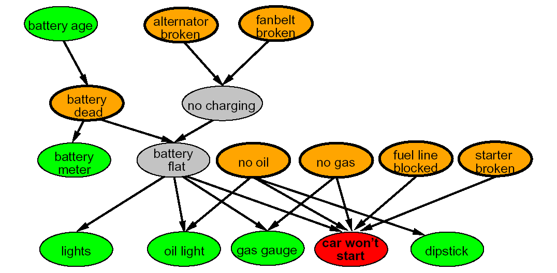
Modeling Evolving Worlds
So far we have looked at techniques for probabilistic reasoning in a static world
  E.g., keep collecting evidence to diagnose the cause of a fault in a system.
  The true cause does not change as one gathers new evidence, what changes the belief over the possible causes.
Notes:
For example, while a casino may lose money in a single spin of the American Roulette wheel, it will almost certainly gain very close to 5.3% of all gambled money over thousands of spins. Any winning streak by a player will eventually be overcome by the parameters of the game.

Slide 4
Dynamic Bayesian Networks (DBN)‏
DBN are an extension of Bayesian networks devised for reasoning under uncertainty in dynamic environments
Basic approach
  World’s dynamics captured via series of snapshots, or time slices, each representing the state of the world at a specific point in time
  Each time slice contains a set of random variables.
  Some represent the state of the world at time t: state variables X_{t}
    E.g., student’s knowledge over a set of topics; patient’s blood sugar level and insulin levels, robot location
  Some represent observations over the state variables at time t: evidence (observable) variables E_{t}
    E.g., student test answers, blood test results, robot sensing of its location
This assumes discrete time; step size depends on problem
  Notation: X_{a:b} = X_{a} , X_{a+1},…, X_{b-1} , X_{b}
Notes:
4

Slide 5
Stationary Processes
How do we build a Bnet from these times slices and their variables?
Could use the procedure we defined in lecture 2:
  order variables (temporally),
  insert them in the networks one at time,
  find suitable parents by checking conditional dependencies given predecessors
First Problem – we could have a very long sequence of time slices: how to specify CPTs for all of them?
  Assumption of stationary process: the mechanism that regulates how state variables change overtime is stationary, that is it can be described by a single transition model P(X_{t}|X_{t-1})
  Note that X_{t} is a vector representing a set of state variables
Notes:
5

Slide 6
Student Learning Example
Suppose we want to monitor
  the progress of a student who is learning addition and subtraction
  her morale during the process
Sample state variables:
  X_{t} = {Knows-Add, Knows-Sub, Morale}
We periodically administer addition and subtraction tests, and we look at the student’s facial expressions to gauge morale
  Sample Evidence variables:
    E_{t} = {Add-test, Sub-test, Face-Obs}
Notes:
6
It is the backbone for applications that deal with sequences of noisy observations
Predict the probability of a sequence of actual words from captured speech signals
two main problems: high space complexity if states are large and sequences arelong, as I have to store the forward message for t steps
In on-line applications, one needs to recomputed the sequence everytime new evidence comes. usually one does not recompute the whole sequence but just a predefined lag of d steps before t

Slide 7
Transition Model
Need to decide if/how the current level of knowledge and morale influence knowledge and morale in the next time slice.
For instance, one can decide that student’s knowledge of addition at time t is influenced only by knowledge at time t-1, not by morale at that time
  P(Knows-Add_{t}|Knows-Add_{t-1}), ……..
And that morale at time t is influence by both morale and knowledge at t-1
  P(Morale_{t}|Knows-Add_{t-1}, Knows-Sub_{t-1}, Morale_{t-1})
Does the stationary
assumption make sense in this example?
Knows-Sub_{t}
Knows-Sub_{t-1}
Knows-Add_{t}
Knows-Add_{t-1}
Morale_{t-1}
Morale_{t}
Notes:
7
It is the backbone for applications that deal with sequences of noisy observations
Predict the probability of a sequence of actual words from captured speech signals
two main problems: high space complexity if states are large and sequences arelong, as I have to store the forward message for t steps
In on-line applications, one needs to recomputed the sequence everytime new evidence comes. usually one does not recompute the whole sequence but just a predefined lag of d steps before t

Slide 8
Markov Assumption
Second Problem: there could be an infinite number of parents for each node, coming from all previous time-slices
  Markov assumption: current state X_{t} depends on bounded subset of previous states X_{0:t-1}
Processes satisfying this assumption are called Markov Processes or Markov Chains
Notes:
8

Slide 9
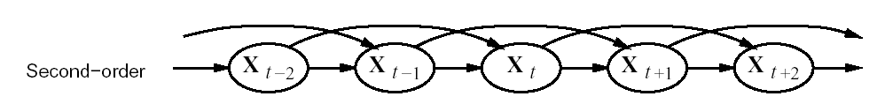
Markov Processes
First order Markov process: P(X_{t} | X_{0:t-1}) = P(X_{t} | X_{t-1})
  Probability of state X_{t} depends only on the probability of its previous state
Second order Markov process: P(X_{t} | X_{0:t-1}) = P(X_{t} | X_{t-2} , X_{t-1})
  Probability of state X_{t} depends only on the probability of its two previous states
For the purposes of this course, we will refer by default to first-order markov processes
Notes:
9

Slide 10
Student Learning Example
Does the Markov
assumption make sense in the student learning example?
Knows-Sub_{t-1}
Knows-Sub_{t}
Knows-Add_{t}
Knows-Add_{t-1}
Morale_{t-1}
Morale_{t}
Notes:
10
It is the backbone for applications that deal with sequences of noisy observations
Predict the probability of a sequence of actual words from captured speech signals
two main problems: high space complexity if states are large and sequences arelong, as I have to store the forward message for t steps
In on-line applications, one needs to recomputed the sequence everytime new evidence comes. usually one does not recompute the whole sequence but just a predefined lag of d steps before t

Slide 11
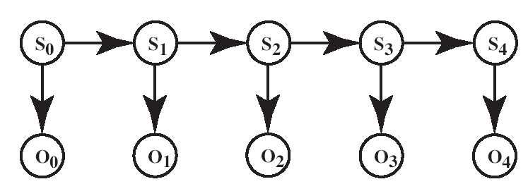
Sensor (Observation) Model
X_{o}
X₁
X₂
X₃
X₄
E_{o}
E₁
E₂
E₃
E₄
In addition to the transition model P(X_{t}|X_{t-1}), one needs to specify the sensor (or observation) model
  P(E_{t}|X_{t})
Typically, we will assume that the value of an observation at time t depends only on the current state (Markov Assumption on Evidence)
  P(E_{t} |X_{0:t} , E_{0:t-1}) = P(E_{t} | X_{t})
Notes:
11

Slide 12
Student Learning Example
Here I need to decide what is the reliability of each of my “observations tools”, e.g. the probability that
  the addition test is correct/incorrect if the student knows/does not know addition,
  the student has a smiling/neutral/sad facial expression when her morale is high/neutral/low
Knows-Sub_{t}
Knows-Add_{t}
Morale_{t}
Add-Test_{t}
Face
Obs_{t}
Sub-Test_{t}
Notes:
12
It is the backbone for applications that deal with sequences of noisy observations
Predict the probability of a sequence of actual words from captured speech signals
two main problems: high space complexity if states are large and sequences arelong, as I have to store the forward message for t steps
In on-line applications, one needs to recomputed the sequence everytime new evidence comes. usually one does not recompute the whole sequence but just a predefined lag of d steps before t

Slide 13
Complete Process Specification
If, in addition to the transition and sensor models we specify the prior probability of the state at time P (X₀), then we have a complete specification of the joint distribution over all variables of interest
  P(X₀, X₁,.., X_{t}, E₀,.., E_{t} ) = ∏_{i=}^{t} ₁ P(X_{i} | X_{i-1}) P(E_{i-1} | X_{i-1})
Notes:
13

Slide 14
Student Learning Example
Knows-Sub₁
Knows-Sub₂
Knows-Sub₃
Knows-Add₁
Knows-Add₂
Knows-Add₃
Morale₁
Morale₂
Morale₃
Face
Obs₁
Face
Obs₂
Face
Obs₃
Add-Test₁
Add-Test₂
Add-Test₃
Sub-Test₁
Add-Test₂
Sub-Test₃
Notes:
14
It is the backbone for applications that deal with sequences of noisy observations
Predict the probability of a sequence of actual words from captured speech signals
two main problems: high space complexity if states are large and sequences arelong, as I have to store the forward message for t steps
In on-line applications, one needs to recomputed the sequence everytime new evidence comes. usually one does not recompute the whole sequence but just a predefined lag of d steps before t

Slide 15
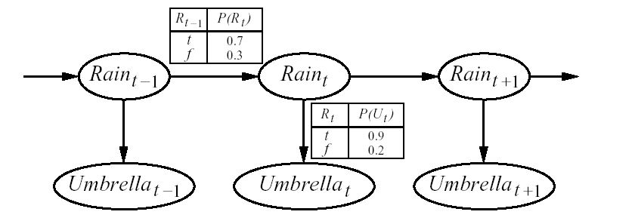
Simpler Example
(We’ll use this as a running example)
Guard stuck in a high-security bunker
Would like to know if it is raining outside
Can only tell by looking at whether his boss comes into the bunker with an umbrella every day
Transition model
State
variables
Temporal step size?
Observation model
Observable variables
Notes:
15

Slide 16
Discussion
Note that the first-order Markov assumption implies that the state variables contain all the information necessary to characterize the probability distribution over the next time slice
Sometime this assumption is only an approximation of reality
  The student’s morale today may be influenced by her learning progress over the course of a few days (more likely to be upset if she has been repeatedly failing to learn)
  Whether it rains or not today may depend on the weather on more days than just the previous one
Possible fixes
  Increase the order of the Markov Chain (e.g., add Rain_{t-2} as a parent of Rain_{t})
  Add state variables that can compensate for the missing temporal information
Such as?
Notes:
16

Slide 17
Rain Network
We could add Month to each time slice to include season statistics
Month_{t}
Month_{t+1}
Month_{t-1}
Rain_{t-1}
Rain_{t}
Rain_{t+1}
Umbrella_{t-1}
Umbrella_{t}
Umbrella_{t+1}
Notes:
17

Slide 18
Rain Network
Or we could add Temperature, Humidity and Pressure to include meteorological knowledge in the network
Pressure_{t-1}
Pressure_{t}
Pressure_{t+1}
Humidity_{t-1}
Humidity_{t}
Humidity_{t+1}
Temperature_{t-1}
Temperature_{t}
Temperature_{t+1}
Rain_{t-1}
Rain_{t}
Rain_{t+1}
Umbrella_{t-1}
Umbrella_{t}
Umbrella_{t+1}
Notes:
18

Slide 19
Rain Network
However, adding more state variables may require modelling their temporal dynamics in the network
Trick to get away with it
  Add sensors that can tell me the value of each new variable at each specific point in time
  The more reliable a sensor, the less important to include temporal dynamics to get accurate estimates of the corresponding variable
Humidity_{t-1}
Humidity_{t}
Pressure_{t-1}
Pressure_{t}
Temperature_{t-1}
Temperature_{t}
Rain_{t-1}
Rain_{t}
Thermometer_{t}
Thermometer_{t-1}
Barometer_{t-1}
Barometer_{t}
Umbrella_{t-1}
Umbrella_{t}
Notes:
19

Slide 20
Overview
Modelling Evolving Worlds with DBNs
Simplifying Assumptions
  Stationary Processes, Markov Assumption
Inference Tasks in Temporal Models
  Filtering (posterior distribution over the current state given evidence to date)
  Prediction (posterior distribution over a future state given evidence to date
  Smoothing (posterior distribution over a past state given all evidence to date)
  Most Likely Sequence (given the evidence seen so far)
Hidden Markov Models (HMM)
Application to Part-of-Speech Tagging
HMM and DBN

Slide 21
Inference Tasks in Temporal Models
Filtering (or monitoring): P(X_{t} |e_{0:t} )
  Compute the posterior distribution over the current state given all evidence to date
  In the rain example, this would mean computing the probability that it rains today given all the observations on umbrella made so far
  Important if a rational agent needs to make a decision in the current situation
Prediction: P(X_{t+k} | e_{0:t} )
  Compute the posterior distribution over a future state given all evidence to date
  In the rain example, this would mean computing the probability that it rains in two days given all the observations on umbrella made so far
  Useful for an agent to evaluate possible courses of actions
Notes:
21

Slide 22
Inference Tasks in Temporal Models
Smoothing: P(X_{t-k} | e_{0:t} )
  Compute the posterior distribution over a past state given all evidence to date
  In the rain example, this would mean computing the probability that it rained five days ago given all the observations on umbrella made so far
  Useful to better estimate what happened by incorporating additional evidence to the evidence available at that time
Most Likely Explanation: argmax_{X0:t} P(X_{0:t} | e_{0:t} )
  Given a sequence of observations, find the sequence of states that is most likely to have generated them
  Useful in many applications, e.g., speech recognition: find the most likely sequence of words given a sequence of sounds
Notes:
22

Slide 23
Filtering
Idea: recursive approach
  Compute filtering up to time t-1, and then include the evidence for time t (recursive estimation)‏
TRUE 0.5
FALSE 0.5
Rain₀
Rain₁
Rain₂
Umbrella₁
Umbrella₂
Notes:
23

Slide 24
Filtering
Idea: recursive approach
  Compute filtering up to time t-1, and then include the evidence for time t (recursive estimation)‏
P(X_{t} | e_{0:t}) = P(X_{t} | e_{0:t-1},e_{t} ) dividing up the evidence
= α P(e_{t} | X_{t}, e_{0:t-1} ) P(X_{t} | e_{0:t-1} ) WHY?
= α P(e_{t} | X_{t}) P(X_{t} | e_{0:t-1} ) WHY?
One step prediction of current state given evidence up to t-1
Inclusion of new evidence: this is available from..
So we only need to compute P(X_{t} | e_{0:t-1} )
Notes:
24

Slide 25
Filtering
why?
Product Rule P(A,B) = P(A|B)P(B)
Compute P(X_{t} | e_{0:t-1} )
  P(X_{t} | e_{0:t-1} ) = ∑_{xt-1} P(X_{t}, x_{t-1} |e_{0:t-1} ) = ∑_{xt-1} P(X_{t} | x_{t-1} , e_{0:t-1} ) P( x_{t-1} | e_{0:t-1} ) =
  = ∑_{xt-1} P(X_{t} | x_{t-1} ) P( x_{t-1} | e_{0:t-1} ) because of..
Transition model!
Filtering at time t-1
Putting it all together, we have the desired recursive formulation
  P(X_{t} | e_{0:t}) = α P(e_{t} | X_{t}) ∑_{xt-1} P(X_{t} | x_{t-1} ) P( x_{t-1} | e_{0:t-1} )
Filtering at time t-1
Inclusion of new evidence
(sensor model)‏
Propagation to time t
P( X_{t-1} | e_{0:t-1} ) can be seen as a message f_{0:t-1} that is propagated forward along the sequence, modified by each transition and updated by each observation
Notes:
25

Slide 26
Filtering
Thus, the recursive definition of filtering at time t in terms of filtering at time t-1 can be expressed as a FORWARD procedure
  f_{0:t} = α FORWARD (f_{0:t-1}, e_{t})
which implements the update described in
P(X_{t} | e_{0:t}) = α P(e_{t} | X_{t}) ∑_{xt-1} P(X_{t} | x_{t-1} ) P( x_{t-1} | e_{0:t-1} )
Filtering at time t-1
Inclusion of new evidence
(sensor model)
Propagation to time t
Notes:
26

Slide 27
Analysis of Filtering
Because of the recursive definition in terms for the forward message, when all variables are discrete the time for each update is constant (i.e. independent of t)
The constant depends of course on the size of the state space and the type of temporal model
Notes:
27

Slide 28
Rain Example
Suppose our security guard came with a prior belief of 0.5 that it rained on day 0, just before the observation sequence started.
Without loss of generality, this can be modeled with a fictitious state R₀ with no associated observation and P(R₀) = <0.5, 0.5>
Day 1: umbella appears (u₁). Thus
  P(R₁ | e_{0:t-1} ) = P(R₁) = ∑_{r0} P(R₁ | r₀ ) P(r₀ )
  = <0.7, 0.3> * 0.5 + <0.3,0.7> * 0.5 = <0.5,0.5>
0.5
0.5
TRUE 0.5
FALSE 0.5
Rain₀
Rain₁
Rain₂
R_{t-1} | P(R_{t})
t f | 0.7 0.3
R_{t} | P(U_{t})
t f | 0.9 0.2
Umbrella₁
Umbrella₂
Notes:
28

Slide 29
Rain Example
Updating this with evidence from for t =1 (umbrella appeared) gives
  P(R₁| u₁) = α P(u₁ | R₁) P(R₁) =
  α<0.9, 0.2><0.5,0.5> = α<0.45, 0.1> ~ <0.818, 0.182>
Day 2: umbella appears (u₂). Thus
  P(R₂ | e_{0:t-1} ) = P(R₂ | u₁ ) = ∑_{r1} P(R₂ | r₁ ) P(r₁ | u₁) =
  = <0.7, 0.3> * 0.818 + <0.3,0.7> * 0.182 ~ <0.627,0.373>
0.5
0.5
0.627
0.373
TRUE 0.5
FALSE 0.5
0.818
0.182
Rain₀
Rain₁
Rain₂
R_{t-1} | P(R_{t})
t f | 0.7 0.3
R_{t} | P(U_{t})
t f | 0.9 0.2
Umbrella₁
Umbrella₂
Notes:
29

Slide 30
Rain Example
Updating this with evidence from for t =2 (umbrella appeared) gives
  P(R₂| u₁ , u₂) = α P(u₂ | R₂) P(R₂| u₁) =
  α<0.9, 0.2><0.627,0.373> = α<0.565, 0.075> ~ <0.883, 0.117>
Intuitively, the probability of rain increases, because the umbrella appears twice in a row
0.5
0.5
0.627
0.373
TRUE 0.5
FALSE 0.5
0.818
0.182
0.883
0.117
Rain₀
Rain₁
Rain₂
Umbrella₁
Umbrella₂
Notes:
30

Slide 31
Overview
Modelling Evolving Worlds with DBNs
Simplifying Assumptions
  Stationary Processes, Markov Assumption
Inference Tasks in Temporal Models
  Filtering (posterior distribution over the current state given evidence to date)
  Prediction (posterior distribution over a future state given evidence to date
  Smoothing (posterior distribution over a past state given all evidence to date)
  Most Likely Sequence (given the evidence seen so far)
Hidden Markov Models (HMM)
Application to Part-of-Speech Tagging
HMM and DBN

Slide 32
Review
Stationary Process:
  the mechanism that regulates how state variables change overtime is stationary, that is it can be described by a single transition model P(Xt|Xt-1)
Markov Assumption: current state X_{t} depends on bounded subset of previous states X_{0:t-1} (one previous state for our purposes)
Transition model
State
variables
Observation model
Observable variables
Notes:
32

Slide 33
Prediction (P(X_{t+k+1} | e_{0:t} ))
Can be seen as filtering without addition of new evidence
In fact, filtering already contains a one-step prediction
  P(X_{t} | e_{0:t}) = α P(e_{t} | X_{t}) ∑_{xt-1} P(X_{t} | x_{t-1} ) P( x_{t-1} | e_{0:t-1} )
Filtering at time t-1
Inclusion of new evidence
(sensor model)‏
Propagation to time t
We just need to show how to recursively predict the state at time t+k +1 from a prediction for state t + k
  P(X_{t+k+1} | e_{0:t} ) = ∑_{xt+k} P(X_{t+k+1}, x_{t+k} |e_{0:t} ) = ∑_{xt+k} P(X_{t+k+1} | x_{t+k} , e_{0:t} ) P( x_{t+k} | e_{0:t} ) =
  = ∑_{xt+k} P(X_{t+k+1} | x_{t+k} ) P( x_{t+k} | e_{0:t} )
Let‘s continue wih the rain example and compute the probability of Rain on day four after having seen the umbrella in day one and two: P(R₄| u₁ , u₂)
Prediction for state t+ k
Transition model
Notes:
33

Slide 34
Rain Example
Prediction from day 2 to day 3
  P(X₃ | e_{1:2} ) = ∑_{x2} P(X₃ | x₂ ) P( x₂ | e_{1:2} ) = ∑_{r2} P(R₃ | r₂ ) P( r₂ | u₁ u₂ ) =
  = <0.7,0.3>*0.883 + <0.3,0.7>*0.117 = <0.618,0.265> + <0.035, 0.082>
  = <0.653, 0.347>
Prediction from day 3 to day 4
  P(X₄ | e_{1:2} ) = ∑_{x3} P(X₄ | x₃ ) P( x₃ | e_{1:2} ) = ∑_{r3} P(R₄ | r₃ ) P( r₃ | u₁ u₂ ) =
  = <0.7,0.3>*0.653 + <0.3,0.7>*0.347= <0.457,0.196> + <0.104, 0.243>
  = <0.561, 0.439>
0.5
0.5
0.627
0.373
0.653
0.347
0.561
0.439
0.5
0.5
0.818
0.182
0.883
0.117
Rain₀
Rain₁
Rain₂
Rain₃
Rain₃
R_{t} | P(U_{t})
t f | 0.9 0.2
R_{t-1} | P(R_{t})
t f | 0.7 0.3
Umbrella₁
Umbrella₂
Umbrella₃
Umbrella₃
Notes:
34

Slide 35
Rain Example
Intuitively, the probability that it will rain decreases for each successive day, as the inflence of the observations from the first two days decays
What happens if I try to predict further and further into the future?
  It can be shown that the predicted distribution converges to the stationary distribution of the Markov process defined by the transition model (<0.5,0.5> for the rain example)‏
  When the convergence happens, I have basically lost all the information provided by the existing observations, and I can’t generate any meaningful prediction on states from this point on
  The time necessary to reach this point is called mixing time.
  The more uncertainty there is in the transition model, the shorter the mixing time will be
  Basically, the more uncertainty there is in what happens at t+1 given that I know what happens in t, the faster the information that I gain from evidence on the state at t dissipates with time
Notes:
35

Slide 36
Rain Example
Suppose our security guard came with a prior belief of 0.5 that it rained on day 0, just before the observation sequence started.
Without loss of generality, this can be modeled with a fictitious state R₀ with no associated observation and P(R₀) = <0.5, 0.5>
Day 1: umbella appears (u₁). Thus
  P(R₁ | e_{0:t-1} ) = P(R₁) = ∑_{r0} P(R₁ | r₀ ) P(r₀ )
  = <0.7, 0.3> * 0.5 + <0.3,0.7> * 0.5 = <0.5,0.5>
0.5
0.5
TRUE 0.5
FALSE 0.5
Rain₀
Rain₁
Rain₂
R_{t-1} | P(R_{t})
t f | 0.7 0.3
R_{t} | P(U_{t})
t f | 0.9 0.2
Umbrella₁
Umbrella₂
Notes:
36

