Slide 1
Bayesian Networks: Sampling Algorithms for Approximate Inference

Slide 2
Recap from Last class
Sampling algorithms: background
What is sampling
How to do it: generating samples from a distribution
Sampling in Bayesian networks
Forward sampling
Why does sampling work
Two more sampling algorithms
Rejection Sampling
Likelihood Weighting
Case study from the Andes project

Slide 3
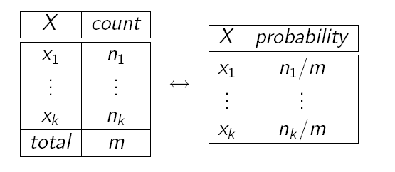
Recap - Sampling: What is it?
Problem: how to estimate probability distributions that are hard to compute via exact methods.
Idea: Estimate probabilities from sample data (samples) of the (unknown) probabilities distribution
Use frequency of each event in the sample data to approximate its probability
Frequencies are good approximations only if based on large samples
But these samples are often not easy to obtain from real-world observations
How do we get the samples?

Slide 4
Recap - We use Sampling
Sampling is a process to obtain samples adequate to estimate an unknown probability
The samples are generated from a known probability distribution
P(x₁)
P(x_{n})

Slide 5
Recap
Sampling algorithms: background
What is sampling
How to do it: generating samples from a distribution
Sampling in Bayesian networks
Forward sampling
Why does sampling work
Two more sampling algorithms
Rejection Sampling
Likelihood Weighting
Case study from the Andes project

Slide 6
Generating Samples from a Distribution
For a random variable X with
values {x₁,…,x_{k}}
Probability distribution P(X) = {P(x₁),…,P(x_{k})}
Partition the interval (0, 1] into k intervals p_{i} , one for each x_{i} , with length P(x_{i} )
To generate one sample
Randomly generate a value y in (0, 1] (i.e. generate a value from a uniform distribution over (0, 1]).
Select the value of the sample based on the interval p_{i} that includes y
From probability theory:

Slide 7
Recap: Example
Consider a random variable Lecture with
3 values <good, bad, soso>
with probabilities 0.7, 0.1 and 0.2 respectively.
We can have a sampler for this distribution by:
Using a random number generator that outputs numbers over (0, 1]
Partition (0,1] into 3 intervals corresponding to the probabilities of the three Lecture values: (0, 0.7], (0.7, 0.8] and (0.8, 1]):
To obtain a sample, generate a random number n and pick the value for Lecture based on which interval n falls into:
P (0 < n ≤ 0.7) = 0.7 = P(Lecture = good)
P (0.7 < n ≤ 0.8) = 0.1 = P(Lecture = bad)
P (0.8 < n ≤ 1) = 0.2 = P(Lecture = soso)

Slide 8
Recap: Example
Random n‏
sample
0.3
good
0.1
good
0.73
bad
0.87
soso
0.2
good
0.5
good
0.9
soso
If we generate enough samples, the frequencies of the three values will get close to their probability

Slide 9
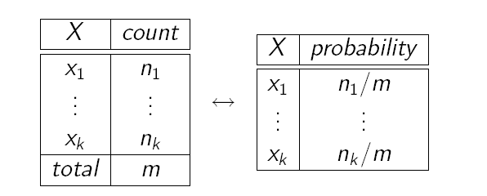
Recap: Samples as Probabilities
Count total number of samples m
Count the number n_{i} of samples x_{i}
Generate the frequency of sample x_{i} as n_{i} / m
This frequency is your estimated probability of x_{i}

Slide 10
Overview
Sampling algorithms: background
What is sampling
How to do it: generating samples from a distribution
Sampling in Bayesian networks
Forward sampling
Why does sampling work
Two more sampling algorithms
Rejection Sampling
Likelihood Weighting
Case study from the Andes project

Slide 11
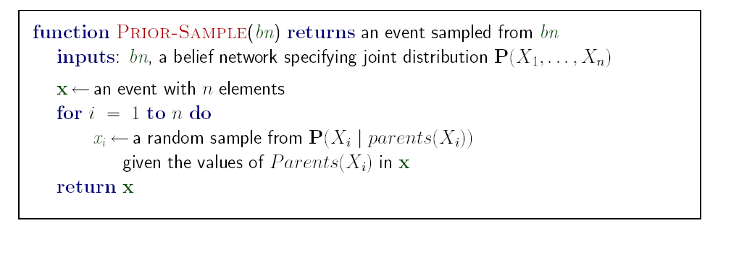
Recap: Forward Sampling
In a BN
we can order parents before children (topological order) and
we have CPTs available.
If no variables are instantiated (i.e., there is no evidence), this allows a simple algorithm: forward sampling.
Just sample variables in some fixed topological order, using the previously sampled values of the parents to select the correct distribution to sample from.

Slide 12
Recap: Forward Sampling
We showed that we can obtain an estimate for the probability of any event P(x₁,….,x_{m}) with m ≤ n as
Because for the Law of Large Numbers, we have

Slide 13
Overview
Sampling algorithms: background
What is sampling
How to do it: generating samples from a distribution
Sampling in Bayesian networks
Forward sampling
Why does sampling work
Two more sampling algorithms
Rejection Sampling
Likelihood Weighting
Case study from the Andes project

Slide 14
Sampling: why does it work?
Because of the Law of Large Numbers (LLN)
Theorem in probability that describes the long-term stability of a random variable.
Given repeated, independent trials with the same probability p of success in each trial,
the percentage of successes approaches p as the number of trials approaches ∞
Example: tossing a coin a large number of times, where the probability of heads on any toss is p.
Let S_{n} be the number of heads that come up after n tosses.

Slide 15
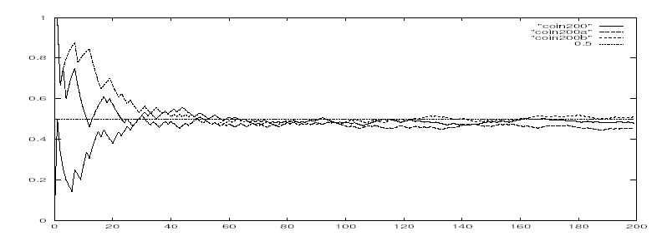
Simulating Coin Tosses
Here’s a graph of S_{n}/n against p for three different sequences of simulated coin tosses, each of length 200.
Remember that P(head) = 0.5

Slide 16
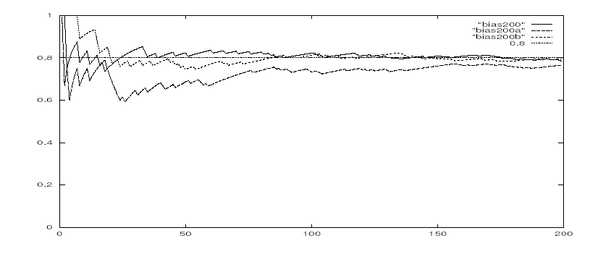
Simulating Tosses with a Bias Coin
Let's change P(head) = 0.8
http://socr.ucla.edu/htmls/SOCR_Experiments.html

Slide 17
Simulating Coin Tosses
http://socr.ucla.edu/htmls/SOCR_Experiments.html
You can run simulations with different values of P(head) and number of samples, and see the graph of of S_{n}/n against p
Select “Coin Toss LLN Experiment” under “Simulations and Experiments”

Slide 18
Sampling: why does it work?
The LLN is important because it "guarantees" stable long-term results for random events.
However, it is important to remember that the LLN only applies (as the name indicates) when a large number of observations are considered.
There is no principle ensuring that a small number of observations will converge to the expected value or that a streak of one value will immediately be "balanced" by the others.
But how many samples are enough?

Slide 19
Hoeffding’s inequality
Suppose p is the true probability and s is the sample average from n independent samples.
p above can be the probability of any event for random variable X = {X₁,…X_{n}} described by a Bayesian network
If you want an infinitely small probability of having an error greater than ε, you need infinitely many samples
But if you settle on something less than infinitely small, let’s say δ, then you just need to set
So you pick
the error ε you can tolerate,
the frequency δ with which you can tolerate it
And solve for n, i.e., the number of samples that can ensure this performance
(1)‏

Slide 20
Hoeffding’s inequality
Examples:
You can tolerate an error greater than 0.1 only in 5% of your cases
Set ε =0.1, δ = 0.05
Equation (1) gives you n > 184
If you can tolerate the same error (0.1) only in 1% of the cases, then you need 265 samples
If you want an error of 0.01 in no more than 5% of the cases, you need 18,445 samples

Slide 21
Overview
Sampling algorithms: background
What is sampling
How to do it: generating samples from a distribution
Sampling in Bayesian networks
Forward sampling
Why does sampling work
Two more sampling algorithms
Rejection Sampling
Likelihood Weighting
Case study from the Andes project

Slide 22
Rejection Sampling
Used specifically to compute conditional probabilities P(X|e) given some evidence e
It generates samples from the prior distribution specified by the Bnet (e.g., by using the Prior-Sample algorithm we saw earlier)‏
It rejects all those samples that do not match the evidence e
Then, for every value x of X, it estimates P (X = x | e) by looking at the frequency with which X = x occurs in the remaining samples (i.e. those consistent with e)

Slide 23
Example
Estimate P(Rain|sprinkler) using 100 samples
27 samples have sprinkler
Of these, 8 have rain and 19 have ⌐rain.
Estimated P(Rain|sprinkler) =
= P*(Rain|sprinkler) = <8/27, 19/27>

Slide 24
Analysis of Rejection Sampling
Let P_{e}(X|e) be the estimate of P(X|e) produced by Rejection Sampling
P_{e}(X|e) = N_{PS}(X,e)/ N_{PS}(e) (From algorithm definition)‏
But,
N_{PS}(X,e) / N ~ P(X,e)
N_{PS}(e) / N ~ P(e)
Because of how Prior-Sample works
Thus, N_{PS}(X,e)/ N_{PS}(e) ~ P(X,e)/ P(e) = P(X/e)‏
Rejection sampling provides a consistent estimate of the true probabilities
the estimated probabilities becomes exact as the sample size goes to infinity

Slide 25
Analysis of Rejection Sampling
Main Problem: it rejects too many samples when the evidence is not very likely.
Consider our previous example
A
P(A=T)‏
0.3
A
P(=T|A)‏
B
T
F
0.7
0.1
If we are interested in P(B|A=T),
we can only use samples with A = T,
but I only have 0.3 probability of getting A = T from Prior-Sample,
so I likely have to reject 70% of my samples
Things get exponentially worse as the number of evidence variables grow

Slide 26
Analysis of Rejection Sampling
P(A)‏
P(C)‏
0.3
A
0.1
C
B
If we are interested in P(B|A=T, C = T),
can only use samples (A=T, B, C=T), but the probability of getting them is
P(A=T)P(C=T) = 0.03
I should expect to reject in the order of 97% of my samples!

Slide 27
Analysis of Rejection Sampling
Note that rejection sampling resembles how probabilities are estimated from observations in the real world.
You need the right type of event to happen in order to have a valid observation
e.g. P(rains tomorrow|redSky tonight))
If the event is not common, I have to wait a long time to gather enough relevant events
e.g, nights with red sky

Slide 28
Overview
Sampling algorithms: background
What is sampling
How to do it: generating samples from a distribution
Sampling in Bayesian networks
Forward sampling
Why does sampling work
Two more sampling algorithms
Rejection Sampling
Likelihood Weighting
Case study from the Andes project

Slide 29
Likelihood Weighting (LW)‏
Avoids the inefficiency of rejection sampling by generating only events that are consistent with evidence e
Fixes the values for the evidence variables E
Samples only the remaining variables Z, i.e. the query X and hidden variables Y
But it still needs to account for the influence of the given evidence on the probability of the samples, otherwise it would not be sampling the correct distribution

Slide 30
Likelihood Weighting (LW)‏
If the sample comes from the correct distribution (e.g., the priory distribution for my Bnet in forward sampling or rejection sampling)
simply count the number of samples with the desired values for the query variable X
In LW, before counting, each sample is weighted to account for the actual likelihood of the corresponding event given the original probability distribution and the evidence
Basically, the point is to make events which are unlikely given the actual evidence have less weight than others

Slide 31
Example: P(Rain|sprinkler, wet-grass)‏
Random => 0.4
Sample=> cloudy
P(C)‏
Cloudy
w₁ = 1
0.5
w₂ = w_{1*} 0.1 = 0.1
w₃ = w_{2*} 0.99 = 0.099
C
P(S|C)‏
T
F
0.1
0.5
Rain
Sprinkler
C
P(R|C)‏
Sprinkler is fixed
No sampling, but adjust weight w₂ = w₁ * P(sprinkler|cloudy)‏
T
F
0.8
0.2
Wet Grass
Random => 0.4
Sample=> rain
S
R
P(W|S,R)‏
T
T
0.99
T
F
0.9
Wet Grass is fixed
No sampling, but adjust weight
w₃ = w₂ * P(wet-grass|sprinkler, rain)‏
F
T
0.9
F
F
0.1

Slide 32
Example: P(Rain|sprinkler, wet-grass)‏
Basically, LW generated the sample
<cloudy, sprinkler, rain, wet-grass>
by cheating, because we did not sample the evidence variables, we just set their values to what we wanted
But LW makes up for the cheating by giving a relative low weight to this sample (0.099), reflecting the fact that it is not very likely
LW uses the weighted value when counting through all generated samples to compute the frequencies of the events of interest

Slide 33
Likelihood Weighting (LW)‏
Fix evidence variables, sample only non-evidence variables,
and weight each sample by the likelihood it accords the evidence

Slide 34
Likelihood Weighting: why does it work?
Remember that we have fixed evidence variables E, and we are sampling only all the other variables Z = X U Y
The “right” distribution to sample from would be P(Z|e) but we have seen with rejection sampling that this is really inefficient
So which distribution is Weighted-Sample using?
By looking at the algorithm, we see that to get an event (z,e) the algorithm samples each variable in Z given its parents
S_{WS}(z , e) = ∏_{i} P(z_{i}|parent(Z_{i}))‏

Slide 35
Likelihood Weighting: why does it work?
P(z_{i}|parent(Z_{i})) can include both hidden variables Y and evidence variables E, so S_{WS} does pay some attention to evidence
The sampled values for each Z_{i} will be influenced by evidence among Z_{i} ancestors.
Better than sampling from P(z) in this respect (i.e. by completely ignoring E)
However, they won’t be influenced by any evidence that is not an ancestor of Z_{i}.
S_{WS}(z , e) pays less attention to evidence than the true distribution P(z|e)‏
The weights are there to make up for the difference

Slide 36
Example: P(Rain|sprinkler, wet-grass)‏
Random => 0.4
Sample=> cloudy
P(C)‏
Cloudy
w₁ = 1
0.5
w₂ = w_{1*} 0.1 = 0.1
w₃ = w_{2*} 0.99 = 0.099
C
P(S|C)‏
T
F
0.1
0.5
Rain
Sprinkler
C
P(R|C)‏
Sprinkler is fixed
No sampling, but adjust weight w₂ = w₁ * P(sprinkler|cloudy)‏
T
F
0.8
0.2
Wet Grass
Random => 0.4
Sample=> rain
S
R
P(W|S,R)‏
T
T
0.99
T
F
0.9
Wet Grass is fixed
No sampling, but adjust weight
w₃ = w₂ * P(wet-grass|sprinkler, rain)‏
F
T
0.9
F
F
0.1

Slide 37
How?
The weight for sample x = (z, e) is the product of the likelihood of each evidence variable given its parents
w(z , e) = ∏_{j} P(e_{j} |parent(E_{j} ))‏
So, the weighted probability of a sample (used by Likelihood Weighting instead of simple counts) can be expresses as
S_{WS}(z, e) w(z, e) = ∏_{i} P(z_{i} |parent(Z_{i} ))*∏_{j} P(e_{j} |parent(E_{j} )) = P(z, e) (2)‏
By definition of Bayesian networks, because the two products cover all the variables in the network
But we still need to show that Likelihood weighting generates consistent estimates P_{e} (X|e) for P(X|e)‏

Slide 38
How?
LW generates consistent estimates P_{e}(X|e) for P(X|e)‏
P_{e}(x|e) = α∑_{y}N_{WS} (x,y,e)w(x,y,e)
from Likelyhood-Weighting, where α is the normalization constant needed to make the numbers in the returned vector sum to 1)‏
α∑_{y}N_{WS} (x,y,e)w(x,y,e) ~ α’ ∑_{y}S_{WS} (x,y,e)w(x,y,e) for large N
That is, for large N, the frequency of samples with values (x,y,e) reaches the sampling probability for that event S_{WS} (x,y,e)‏
α’ ∑_{y}S_{WS} (x,y,e)w(x,y,e) = α’ ∑_{y}P(x,y,e) because of equation (2) in previous slide
P_{e}(x|e) ~ α’ P(x,e) = P(x|e)

Slide 39
Analysis of LW
Contrary to Rejection Sampling, LW uses all the samples that it generates.
It simulates the effect of many rejections via weighting
Example:
A
P(A)‏
0.3
A
P(B|A)‏
T
F
0.003
0.63
B

Slide 40
Analysis of LW
A
P(A)‏
0.3
A
P(B|A)‏
T
F
0.003
0.63
B
Suppose B = true, and we are looking for samples with A = true.
If there are 1000 of them, likely only 3 will have B = true,
Only ones that would not be rejected by Rejection Sampling.
With LW, we fix B = true, and give the very first sample with A = true a weight of
Thus LW simulates the effect of many rejections with only one sample

Slide 41
Efficiency of LW
Because LW keeps using all the samples that it generates, it is much more efficient that Rejection Sampling
But performance still degrades when number of evidence variables increase
The more evidence variables, the more samples will have small weight
If one does not generate enough samples, the weighted estimate will be dominated by the small fraction of sample with substantial weight
One possible approach is to sample some of the variables, while using exact inference to generate the posterior probability for others

Slide 42
Overview
Inference in Bayesian networks: need for approximate algorithms
Sampling algorithms: background
What is sampling and how to do it
Review of concepts from probability theory: cumulative distribution and probability density functions
Generating samples from a distribution
Why does sampling work
Sampling in Bayesian networks
Forward sampling
Rejection Sampling
Likelihood Weighting
Case study from the Andes project

Slide 43
Intelligent Learning Environments
Cognitive Science
Computer Science
(AI, HCI)
ILE
Education

Slide 44
ANDES: an ITS for Coached problem solving
The tutor monitors the student’s solution and intervenes when the student needs help.
Gives feedback on correctness of student solution entries
Provides hints when student is stuck
N
Fw = mc*g
Think about the direction of N…

Slide 45
Student Model for Coached Problem Solving
Three main functions
Assess from the student’s actions her domain knowledge, to decide which concepts the student needs help on
Infer from student’s actions the solution being followed, to understand what the student is trying to do
Predict what further actions should be suggested to the student, to provide meaningful suggestions

Slide 46
Several sources of uncertainty
Same action can belong to different solutions
Often much of the reasoning behind the student’s actions is hidden from the tutor
Correct answers can be achieved through guessing
Errors can be due to slips
System’s help affects learning
In many domains, there is flexible solution step order
Andes deals with this uncertainty by using Bayesian networks

Slide 47
Case Study: LW on Andes
Conati C., Gertner A., VanLehn K., Druzdzel M. (1997). On-Line Student Modeling for
Coached Problem Solving Using Bayesian Networks . In Jameson A., Paris C., Tasso C.,
(eds.) User Modeling; Proceedings of the sixth International Conference UM97.
Andes’ networks include anywhere between 100 and 1000 nodes
(You’ll know more about it after reading the paper for next class)
Update needs to happen in real time
Starts each time a student performs a new action
Needs to be done when the student asks for help
Exact algorithms would often not be done when needed.
Everything would stop until the algorithm was done
Very intrusive for the student
Sampling algorithms have the advantage of being anytime algorithms
They can give you an answer anytime
The answer gets better the longer you wait
So they seemed a good alternative for Andes

Slide 48
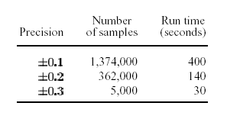
Case Study: LW on Andes
Tested on a network with 110 nodes
Run exact algorithm to get “true” probabilities
Checked the number of samples and running times to get all nodes in the network within 0.1, 0.2, and 0.3 of the exact probability with all actions in the solution as evidence
Many networks in Andes have 5 to 10 times the nodes of our test network, and running time of LW increases linearly with the number of nodes
It may take several minutes to update nodes in larger networks to a high precision

Slide 49
Case Study: LW on Andes
Can still be OK when students think before asking for help after an action.
Also, LW reaches
0.3 precision for all nodes when 98% of the nodes where already at 0.2 precision, and 66% of the nodes where at 0.1 precision
0.2 precision for all nodes when 98% of the nodes where already at 0.1 precision
Could have still been acceptable in most cases – we were planning to run studies to compute the average waiting time
But then we found an exact algorithm that works well for most of our networks…
Notes:
0.296, 0.704

Slide 50
Next Tuesday
First discussion-based class
Paper (available on-line from class schedule):
Conati C., Gertner A., VanLehn K., 2002. Using Bayesian Networks to Manage Uncertainty in Student Modeling. User Modeling and User-Adapted Interaction. 12(4) p. 371-417.
Make sure to have at least two questions on this reading to discuss in class.
- See syllabus for more details on what questions should look like
Send your questions to *both* conati@cs.ubc.ca and ssuther@cs.ubc.ca by 9am on Tuesday.
Please use “questions for 422” as subject
Bring printed copy of questions to class, hand them in at the end
You can also try the Andes system by following the posted instructions

